Slide 1
Powerful Presentations
Kellen Reid (ECTA, DaSy)
Cesar D’Agord (NCSI)
Sandy Grummick (WA Part B/619)
Valerie Arnold (WA Part B/619)
June 28, 2017
Notes:
Hello and welcome to today’s webinar. My name is Kellen Reid with the DaSy and ECTA centers and am joined today by my colleagues Cesar with NCSI. I am also happy to have Sandy and Valerie here today as presenters and they are joining us from Washington state’s Part B section 619 program. Before we begin, I would like to go over some logistics for the call today. First, you may have noticed that we are not using a conference line to broadcast the audio. So if you are hearing me now then everything is working correctly. The one thing to know about this is that unless you have a headset or microphone, then we will not be able to hear you when it comes time for questions. For those with a microphone or headset, you can enable, mute, or disable your microphone by clicking on the image of the microphone in the toolbar of the adobe connect interface. Since this webinar is 30 minutes, there will not be a lot of extra time for questions but we will keep the room going for a few minutes after the presentation or until all questions are answered at the end. Those with microphones should feel free to unmute or enable them at that time. That being said, we do have a couple members of our team monitoring the chat for questions and they will address any questions you have as we go. We will also be recording this webinar and will make it available very soon after our presentation today. The last logistical item is about evaluations. We would love to hear your feedback about how we did today. In fact, we used feedback from other webinars to reduce the time of today’s webinar to 30 minutes. We will send out an evaluation to the email address you used during registration and we will also have a link at the end for you to access the evaluation. Now, I would like to set the groundwork for what I hope to convey or rather what I hope you will gain from this presentation…

Slide 2
As a result of participating in today’s webinar, you will…
Gain knowledge on ways to present and share information to stakeholders in line with the principles of effective design
Be better able to access and select appropriate tools and resources for presenting data effectively
Notes:
By the end, I hope that you would have gained knowledge about how to present and share information more effectively and be better equipped, through knowledge or tools, to do so.

Slide 3



The Challenge
Effective Data Visualization
Notes:
There are lots of challenges when it comes to presenting effectively such as themes, imagery, data visualizations, the content itself, and of course the time needed to plan and create it. External factors such as organizational rules and compliance policies create challenges by restricting the flexibility of your presentations design but the biggest one and one that I hope to challenge today, is the overall status-quo. However, before considering any of these challenges or rocking the boat, lets articulate what the real challenge is and talk about how pre-thinking can set you on the right trajectory—a path that can make identifying and navigating other challenges much easier.
Image: https://www.flickr.com/photos/jamison/3410120723

Slide 4




The Articulated Challenge
Presenting data or complex information in an…
  efficient and meaningful way that is…
    appropriate for your audience.
Notes:
If you had to summarize the challenge of almost any presentation in one sentence, you might say that it is to present data or complex information in an… efficient and meaningful way that is… appropriate for your audience. The good news is that some up-front planning and decision making can maximize your return. I put these considerations into three areas. The audience, the purpose, and the message.

Slide 5


The Audience
Who are they? What is their role?
What keeps them up at night?
How much will they already know about your topic?
Do they have a particular point of view?
Notes:
The audience. The importance of knowing and tailoring your presentation to your audience cannot be understated. This may seem obvious but I see that this consideration is often addressed once presenters are preparing the content for a PPT slideshow. Maybe the audience question should shape more than just the content, perhaps it should help guide the means by which you share your content. How many of us automatically assumed that I was setting the stage to discuss effective PPT slide design, exclusively? Before we go there, though we still have a couple of other considerations to identify and the next one is…
Top Image: https://pixabay.com/en/photos/train/
Bottom Image: https://www.flickr.com/photos/14589121@N00/4005130530

Slide 6
The Purpose
Why are you sharing the information?
Why is this information important to the audience?
What do you want your audience to do with the information?
Notes:
… the purpose. Of course the purpose right? This is one of those considerations that you could think about at every point of presentation creation, from the presentation media to the font used. Being explicit up front about what you hope to accomplish then filtering your subsequent decisions through that lens will make your presentation much more effective as your message will be focused and intentional. Your message…
Image: https://pixabay.com/en/army-blade-compact-cut-equipment-2186/

Slide 7






The Message
Notes:
Or a kind of plot is often left off of the list of pre-thinking. The message, in this case, is the full account of the purpose, objectives, content, etc. you wish to convey to a particular audience. For instance my interpretation of the audience and purpose of Plat & Munk’s book, “The Little Engine that Could,” was to teach children the value of hard work. The message is more. That even when we may be stranded or facing a seemingly impossible task, we should not give up. Even though we may be at a disadvantage outside of our control, there are strategies that we can use. We can use optimism and hard work to overcome challenges.
Image: https://www.flickr.com/photos/swimfast/2178341175

Slide 8
Appropriate tools & level of information
Audience
Purpose
Message
Appropriate tools & level of information
Notes:
As I eluded earlier, these considerations, up-front, can be used at a step before you begin outlining your slideshow since your information might be best conveyed using something besides PPT. Of course there may be certain key aspects of your presentation’s audience and purpose that point you towards a number of presentation media types such as dashboards, learning modules, or slideshows, the crucial first step to maximizing your efforts is selecting the best tool to do it with. Given the wide array of options now, we only have time today to cover animations, slideshows, and similar slideshow alternatives. Still, acknowledging this step is a good start. The graphic on this slide represents the path you might consider. As you flesh out some of the details of these considerations, the options will begin to narrow. In one scenario, for instance, you might want to inform and garner some political will for an initiative in order to address a problem. Your purpose. The audience might be someone that has little knowledge or understanding of the initiative, the problem, or both. Does this information coalesce into a message that sounds like a storyline? A problem, a solution, and evidence? An animation (also called cartoons and include whiteboard animations) would certainly be on my list. Other factors that might point me to choosing an animation include complex information that must be shared that does not need to be fully understood by the audience. An audience I need to convince or persuade. Or a limited amount of time available to present. To illustrate how this may play out…

Slide 9
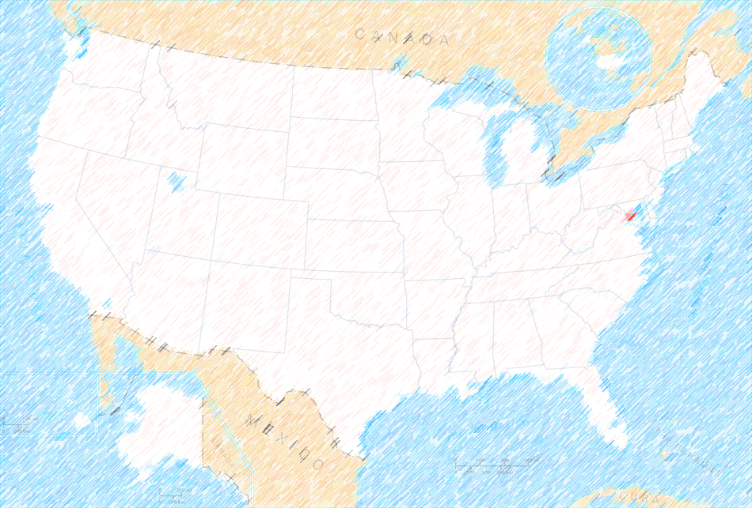

Washington Example
Notes:
We have Sandy and Valerie from Washington to share their experience and resulting products.
CC WA Image: https://www.google.com/url?sa=i&rct=j&q=&esrc=s&source=images&cd=&cad=rja&uact=8&ved=0ahUKEwiy2b_6xt3UAhWFOyYKHWRcBgMQjhwIBQ&url=https%3A%2F%2Fcommons.wikimedia.org%2Fwiki%2FFile%3AWashington-state-map_h.svg&psig=AFQjCNH80HlrUh8U_UqBUrIfIfqkiDGscA&ust=1498636701110793
Free US Image: http://www.deboomfotografie.nl/map-washington-dc.html

Slide 10

Washington’s Message
Challenge
Audience
Purpose
Message

Slide 11
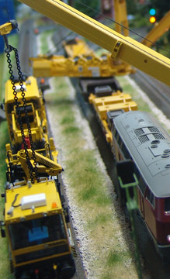
Presentation Tools
Notes:
Image:https://www.flickr.com/photos/ayalabotto1/14233471678/in/photostream/

Slide 12

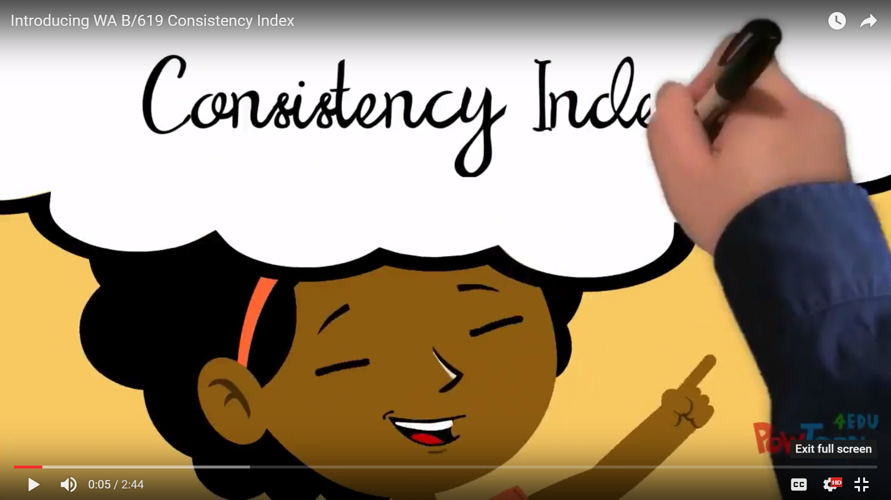
Powtoon
Notes:
With permission from PowToon—Logo Image: https://www.google.com/url?sa=i&rct=j&q=&esrc=s&source=images&cd=&cad=rja&uact=8&ved=0ahUKEwj-qb_Oxt3UAhUBNSYKHcGhA9EQjRwIBw&url=http%3A%2F%2Ficctlc.blogspot.com%2F2016%2F03%2Fpowtoon.html&psig=AFQjCNFshhu90BdjxXIyznTjJ0Ggd-F30g&ust=1498636620062900

Slide 13
Powtoon Pros Cons
Engaging
Disarming
Storytelling
Brief
Brief
Effort

Slide 14

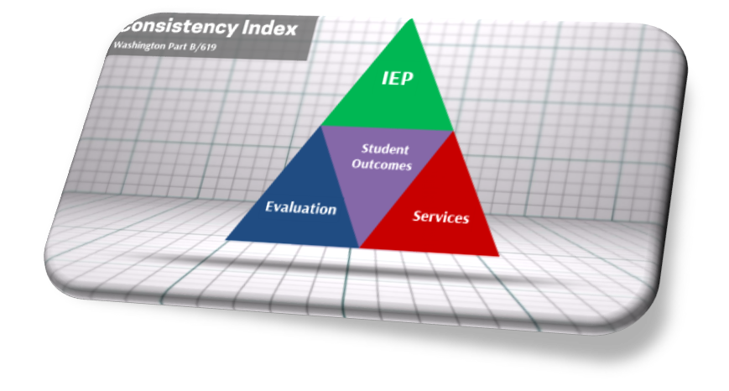
PREZI
Notes:
CC Image: https://www.google.com/url?sa=i&rct=j&q=&esrc=s&source=images&cd=&cad=rja&uact=8&ved=0ahUKEwiZlc-Ixd3UAhXLbz4KHX_dCLMQjhwIBQ&url=https%3A%2F%2Fcommons.wikimedia.org%2Fwiki%2FFile%3APrezi_logo.png&psig=AFQjCNHjPIxSzznWNHKbC1TD5sVov2q62A&ust=1498636197744422

Slide 15

PREZI Pros Cons
Interactive
Non-linear
Engaging
Distracting
Compliance

Slide 16

PowerPoint
Notes:
Simplify then emphasize
Image: https://www.google.com/url?sa=i&rct=j&q=&esrc=s&source=images&cd=&cad=rja&uact=8&ved=0ahUKEwjqr_6qxd3UAhWCaz4KHc2bA_QQjRwIBw&url=https%3A%2F%2Fcommons.wikimedia.org%2Fwiki%2FFile%3AAntu_wps-office-ppt.svg&psig=AFQjCNHY9xMJYJreVR9aIqj-DpXf3p1nFw&ust=1498636276916749

Slide 17
Table
Index Element | Previously Excluded | Insufficient Quality | Sufficient Quality | Total Children
Services | 20 | 7 | 21 | 28
IEP | 8 | 12 | 28 | 40
Evaluation | 0 | 8 | 40 | 48
Total Eligible | 0 | 0 | 48 | 48

Slide 18
Nested Chart for Example Program

Slide 19
Number of Students Receiving Sufficient Evaluations and Proper IEPs and SDI Services in Example Program (n=48)
Notes:
Title, row gap, no fill in “empty space”, remove tick marks, remove horizontal and vertical axes, remove legend and add labels, slide title is chart title

Slide 20
12 Students Did Not Receive Proper IEPs among those also receiving Sufficient Evaluations and SDI Services in Example Program (n=48)
Notes:
Focused title and chart design for specific purpose and/or audience

Slide 21

PowerPoint Pros Cons
Multi-purpose
Familiar
Run-of-the-mill
Effort

Slide 22
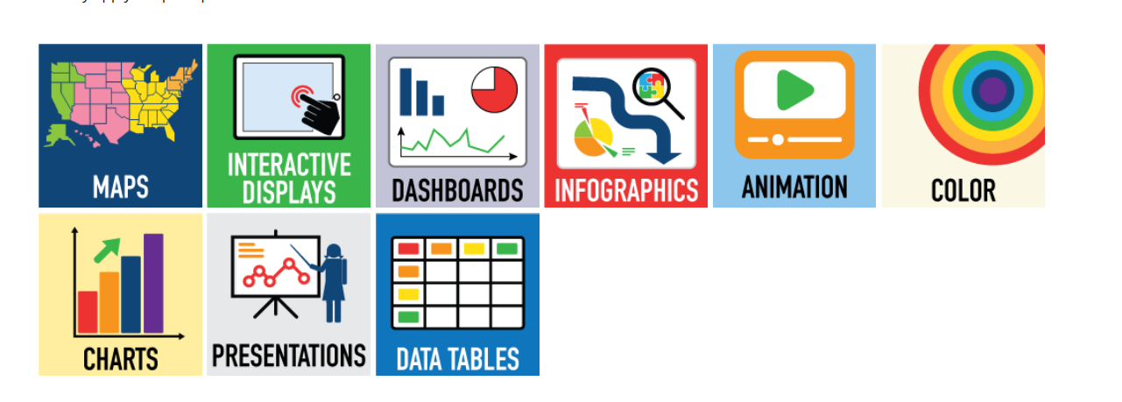
DaSy-NCSI Data Visualization Toolkit
http://dasycenter.org/data-visualization-toolkit/

Slide 23

Evaluation

Slide 24

Thank you
The contents of this presentation were developed under grants from the U.S. Department of Education, # H373Z120002 and H326R140006. However, those contents do not necessarily represent the policy of the U.S. Department of Education, and you should not assume endorsement by the Federal Government. DaSy Center Project Officers: Meredith Miceli and Richelle Davis. NCSI Project Officers: Perry Williams and Shedeh Hajghassemali.

