Slide 1
Data Governance Toolkit: Not as boring as you think, and twice as helpful
Bruce Bull
Tate Gould
Jeff Sellers
April 5, 2017

Slide 2
Big Data Factoids
Making it? Govern it.
Every 2 days we create 2.5 quintillion bytes of data—as much as we did from the beginning of time until 2003. (IBM)
Over 90% of all the data in the world was created in the past 2 years. (MS, IBM)
In 2015, 32 states introduced data/security breach bills. (www.ncsl.org/research/telecommunications-and-information-technology/2015-security-breach-legislation.aspx)

Slide 3
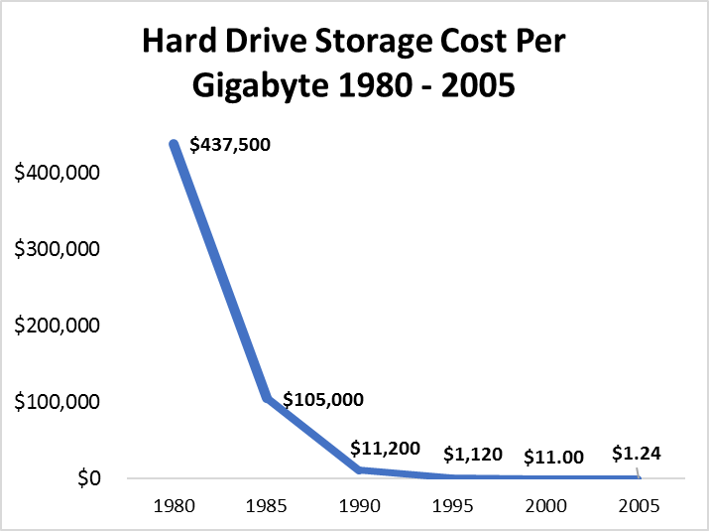
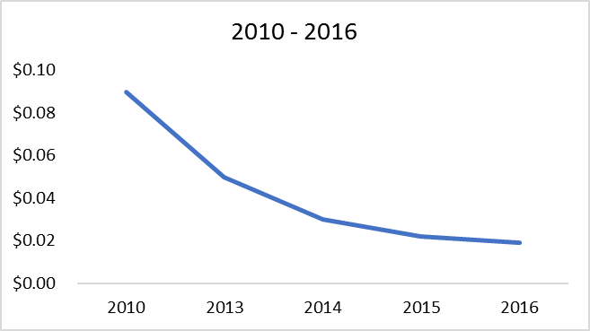
Data Storage is Cheap
Saving it? Govern it.
Source: www.statisticbrain.com

Slide 4
BIG Data Getting Bigger
Please govern it.
Unit | Value | Size
bit (b) | 0 or 1 | 1/8 of a byte
byte (B) | 8 bits | 1 byte
kilobyte (KB) | 1000¹ bytes | 1,000 bytes
megabyte (MB) | 1000² bytes | 1,000,000 bytes
gigabyte (GB) | 1000³ bytes | 1,000,000,000 bytes
terabyte (TB) | 1000⁴ bytes | 1,000,000,000,000 bytes
petabyte (PB) | 1000⁵ bytes | 1,000,000,000,000,000 bytes
exabyte (EB) | 1000⁶ bytes | 1,000,000,000,000,000,000 bytes
zettabyte (ZB) | 1000⁷ bytes | 1,000,000,000,000,000,000,000 bytes
yottabyte (YB) | 1000⁸ bytes | 1,000,000,000,000,000,000,000,000 bytes

Slide 5



Webinar Objectives
The importance of data governance policies and procedures to state agencies
How to utilize the DaSy Data Governance and Management Toolkit
How to access Technical Assistance for working on Data Governance and Management policies
Increase Understanding of

Slide 6

Data Governance Scenarios

Slide 7
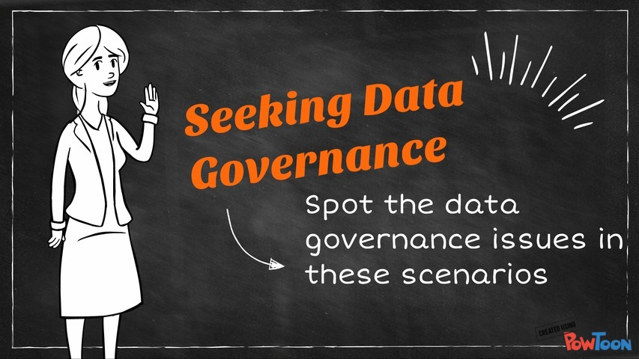

Slide 8
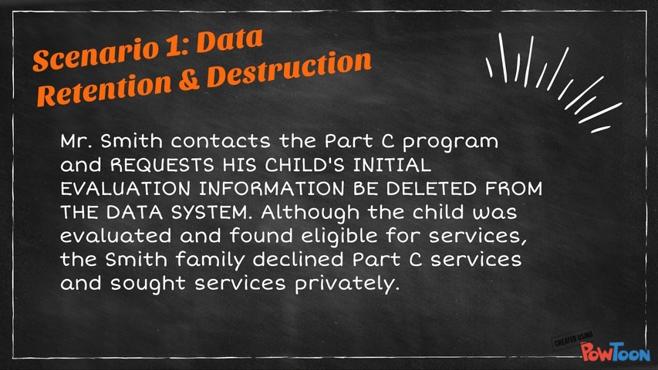

Slide 9
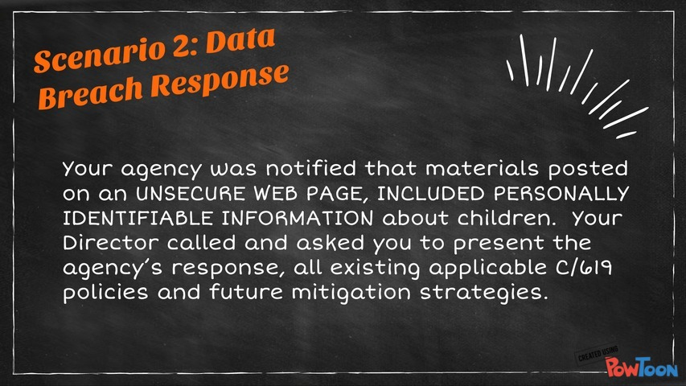

Slide 10
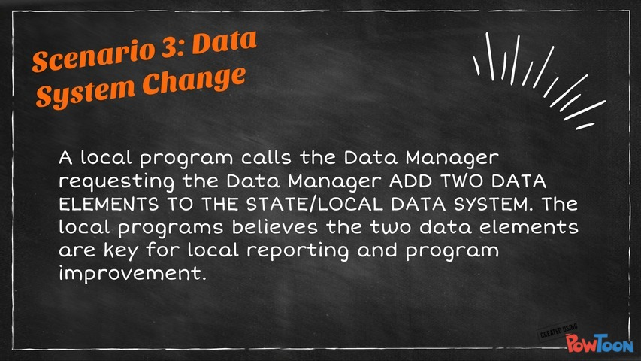

Slide 11
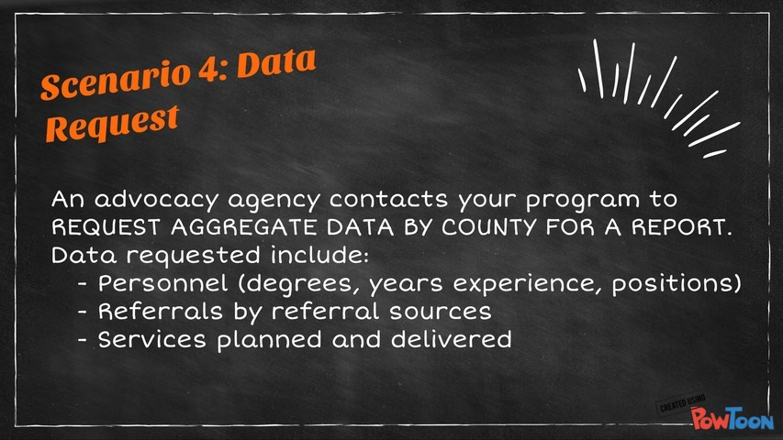

Slide 12
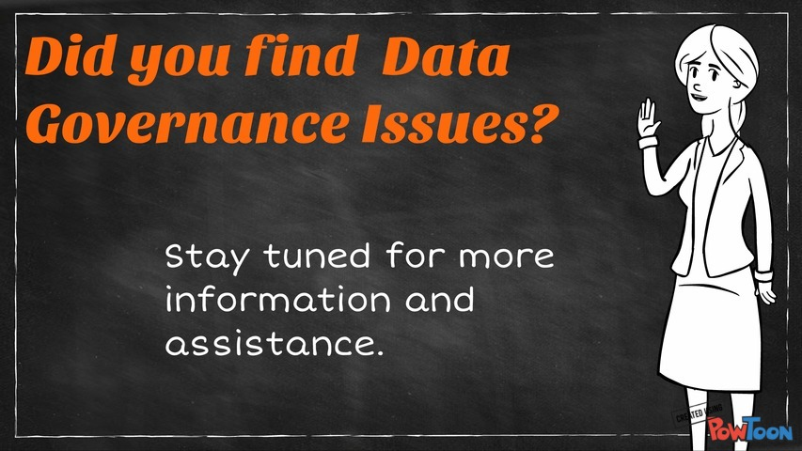

Slide 13
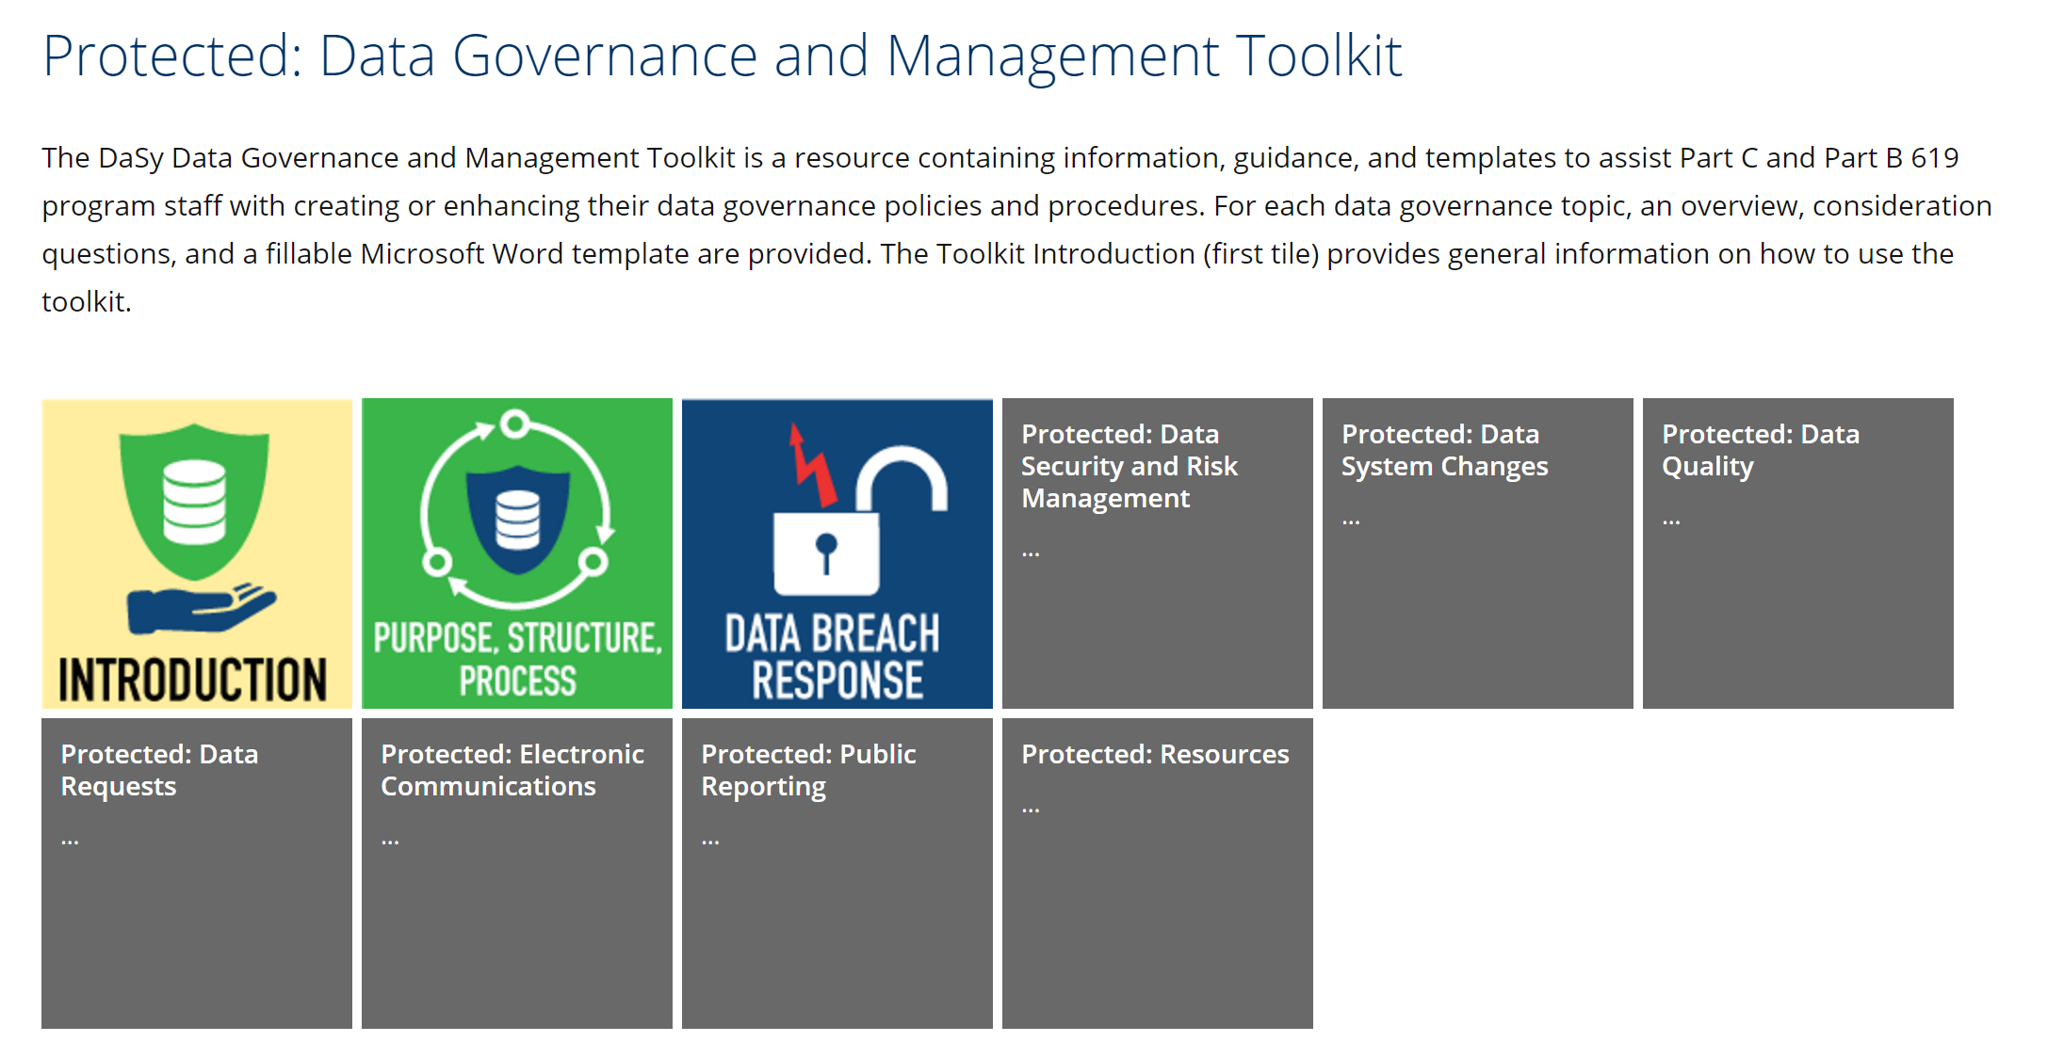
DATA GOVERNANCE TOOLKIT

Slide 14
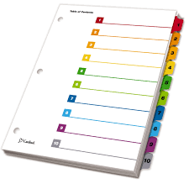
Table of Contents
Introduction
Purpose, Structure, Process Charter
Data Breach Response
Data Security and Access
Data System Changes
Data Quality
Data Requests
Electronic Communications
Public Reporting
Resources

Slide 15
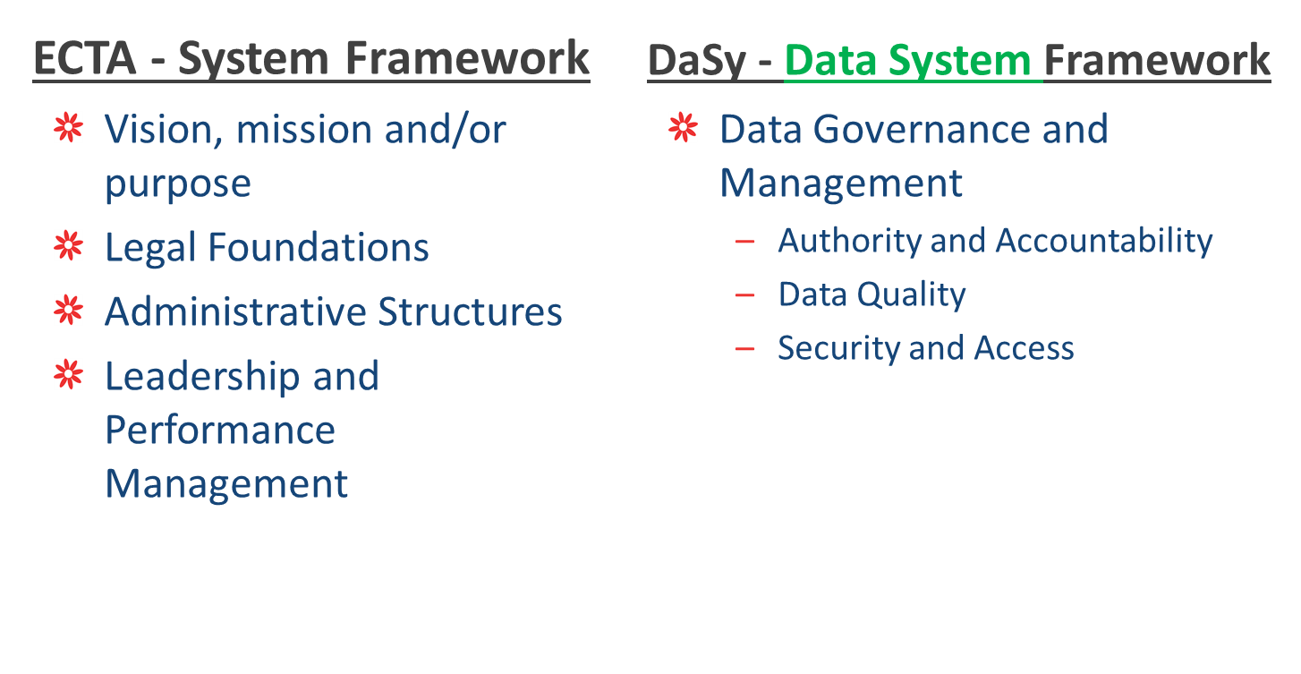
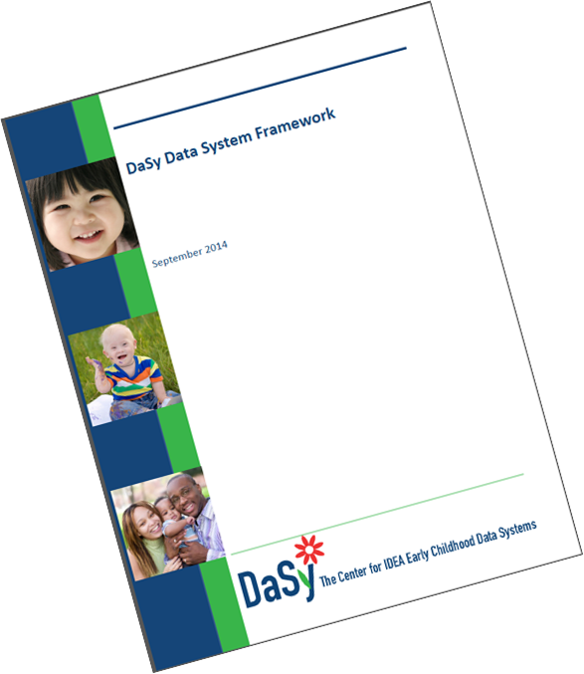

Overlap Between the Data Governance Toolkit and the Frameworks

Slide 16
Each Toolkit Section Contains
Overview
Considerations
Template

Slide 17
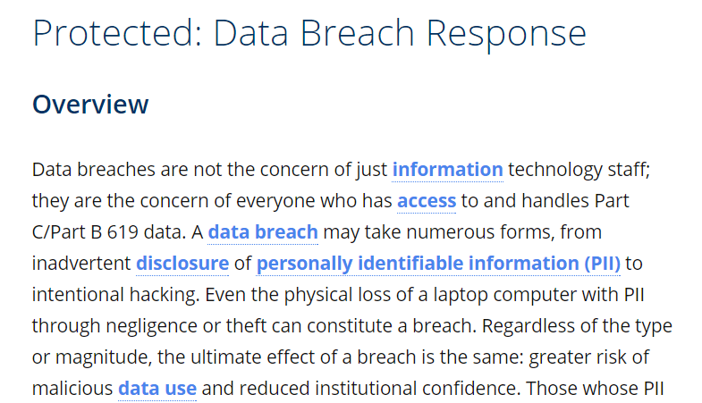

Overview
A short description of the data governance topic and how it applies to Part C and Part B 619 programs.

Slide 18
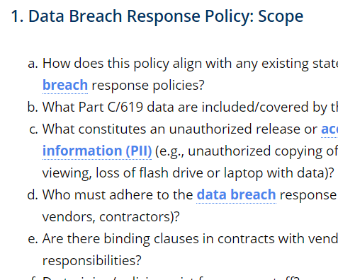
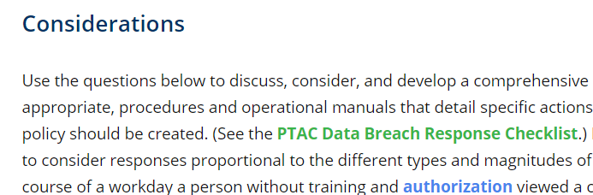
Considerations
Questions to help programs draft policies and procedures for the topic

Slide 19
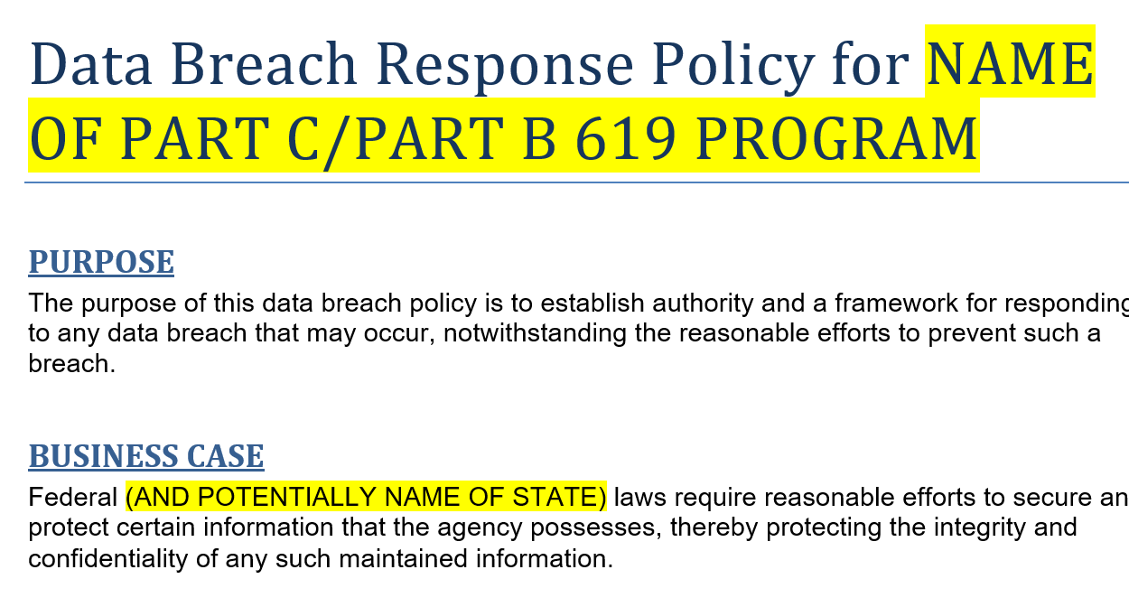
Template
An editable and prepopulated template with language to expedite writing topical policies and procedures.

Slide 20
What is Data Governance?
Management of availability, usability, integrity, quality, and security of data
Organizational process and a structure
Establishes responsibility
Creation and enforcement of policies, roles, responsibilities, and procedures
- DaSy Glossary

Slide 21
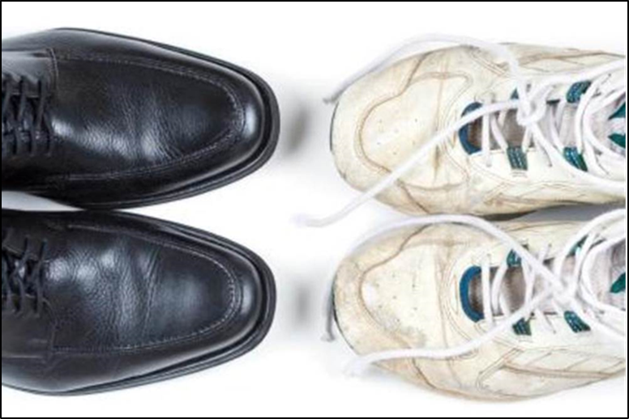
Why Focus on Formal Data Governance?

Slide 22
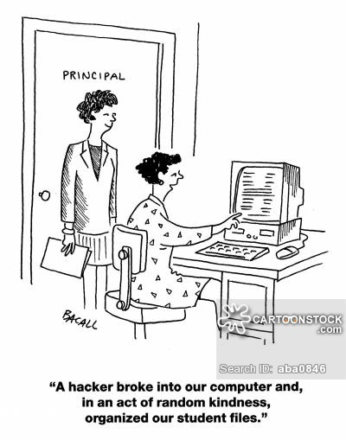
. . . because this won’t happen.

Slide 23
Formal Data Governance
Informal Data Governance
Data use consistent with purpose and vision
Increases
  probability of effective data practices
  data security
  confidence in data and associated processes
Supports
  Data integration
  Improved data efficiency
Questionable data quality, security, and usefulness
Difficulty managing data and processes
Unclear data roles and responsibilities of staff (internal and external)
Inappropriate data sharing
Unprepared for data integration opportunities
Increased risks with staff turnover

Slide 24
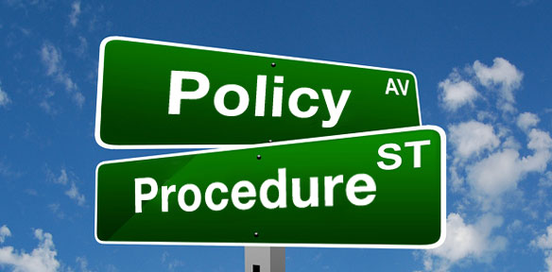
Toolkit Documents and Supports Formal Data Governance with Creation of Polices
Policies, and Procedures to support the policies, are at the center of data governance and management

Slide 25
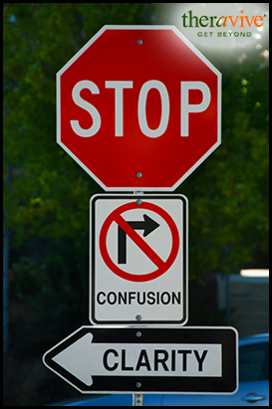
Data Governance P&Ps Support:
Common data understanding and consensus
Consistent practices
Record historical processes
Defined work
Increased productivity
A standard for evaluation
“The Lottery” scenario (staff turnover)

Slide 26

Data Governance Familiarity Poll

Slide 27



TOOLKIT ONLINE DEMO

Slide 28
DATA GOVERNANCE TOOLKIT

Slide 29

How YOU can Help US*
Your feedback on content—especially considerations and template
Your state policy examples we can share with other states
Especially if you are a “do it yourself” state. Let us know how it went, what to improve.

Slide 30

Continuum of Data Governance TA
Lots
Some
A Little
Nothing now
YOU DECIDE!

Slide 31

Discussion

Slide 32
Resources
DaSy Data Governance Toolkit
http://dasycenter.org/data-governance-management-toolkit/
< DaSy / DaSy Resources / Products / Toolkits >
DaSy Website: Broad Data Governance Resource Collection
http://dasycenter.org/tag/data-governance/

Slide 33
Thank you!
Visit the Toolkit at: http://dasycenter.org/data-governance-management-toolkit/
Visit the DaSy website at:
http://dasycenter.org/
Like us on Facebook:
https://www.facebook.com/dasycenter
Follow us on Twitter:
@DaSyCenter

Slide 34

The contents of this presentation were developed under a grant from the U.S. Department of Education, # H373Z120002. However, those contents do not necessarily represent the policy of the U.S. Department of Education, and you should not assume endorsement by the Federal Government. Project Officers, Meredith Miceli and Richelle Davis.

