Slide 1
Sharing is Good for Kids
Kathy Hebbeler
NERCC Part C Coordinators Meeting
April 24, 2013

Slide 2
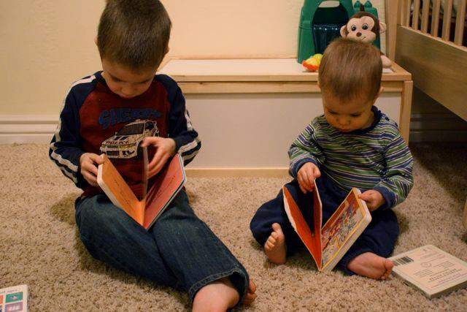
Some important questions
How are children and families doing when they leave your program?
How much have children changed from when they entered?

Slide 3
A really important question
Which children and families have the best outcomes? the worst?
Race/ethnicity?
Disability?
Parent education level?
Family income?
Language spoken in the home?
How many months of EI service received?
What kind of EI service was received?
Who provided the service?
How much service was received?
How much service was missed?
Notes:
Other examples of which?

Slide 4
IS THERE SOMETHING GOING ON IN YOUR PROGRAM THAT YOU DON’T KNOW ABOUT?
Is it hiding in your data somewhere?
Do you have enough data (the right data elements) to answer these questions?
Notes:
How you could improve your program if you had the right information?

Slide 5
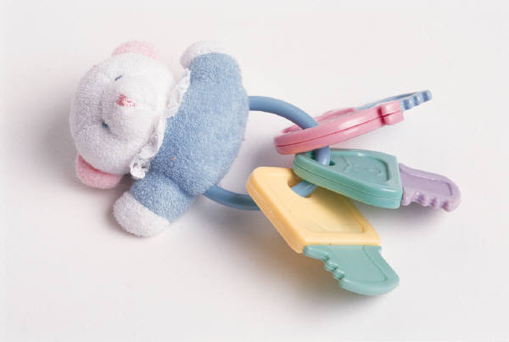
What are the major factors that influence development and learning (AKA outcomes)?
Think of a 6 month old girl with a visual impairment…..
Notes:
6 month old girl with a visual impairment – only child born to a two parent family with adequate financial resources, mom is a social worker, dad is a teacher, both are very committed to doing everything they can to help the child develop and learn, child attends a high quality family child care program where the child care provider is equally committed to the child’s development.
Same child – single mom, limited resources, 4 other children, one of whom has a physical disability, mom very devoted to her kids but very stressed out, the 6 month old is cared for by a neighbor while mom works in what would be considered a low quality child care situation.
Same child – in 5 different foster homes by the time she turns one.
Under each scenario, high quality early intervention was provided. Would you expect the same outcomes at age 3?

Slide 6
Part C Legislation
Part C State System
Lead Agency
Definition
Change Over Time
Part C Local System
Coordination
Family-centeredness
Other Services
Child care
Health Services
Preschool Special Education
Part C Services
Type
Intensity
Duration
Setting/Environment
Quality
Provider
Child Outcomes
Disabilities
Engagement
Functional abilities(cognitive,
communication,
motor)
Self-help skills
Family Outcomes
Family capacity to
meet needs
Services address
needs
Social Support
Quality of Life
Satisfaction with
services
Community
Demographics
Geography
Resources
Demographics
E.g., Age when identified
Family resources
Household Composition
Conceptual Framework for the National Early Intervention Longitudinal Study (NEILS)

Slide 7
If we want to understand outcomes, we have to be able to look at the major factors that are working for and against good outcomes.

Slide 8
4 or more
Notes:
Poor quality child care will wipe out high quality EI. So will a depressed mom. Or multiple foster care placement or abuse and neglect.
Risk Factors
Living at or below 200% of the federal poverty line
Single parent household
Young maternal age
Low maternal education
Large family size
Other special needs children in household
Fair or poor housing quality
Fair or poor transportation quality
Foster care
Minority group status

Slide 9
Do you know…
How many children in EI also are in Early Head Start?
How many children in EI are in child care?
What is the quality of that child care?
Notes:
Wouldn’t it be powerful to be able to show that a high quality Early Head Start program increases the impact of high quality EI for our little 6 month old?

Slide 10
Propositions
There is a collective impact of public investments on the development of children birth to age 3 with delays and disabilities – and EI is only a part of that impact.
The data needed to examine collective impact exists in your state.
But it might not exist in a way that it can be accessed to address critical questions.
Notes:
That is where data sharing and linking comes in. Shared accountability. Shared attribution. I am suggestion we put the focus on children with disabilities, not Part C. The question changes from: Is Part C effective? This is a relatively narrow question. The broader more important question for children and families is how effectively are we as a state supporting the development of infants and toddlers with disabilities?

Slide 11
Some more important questions..
What happens after children leave EI?
What do outcomes look like in kindergarten? 3rd grade? 8th grade?
Notes:
This is the longitudinal question.

Slide 12
Need for Special Education and Disability Status at Kindergarten of Former EI Participants (NEILS)
Notes:
Every state should have one of these.

Slide 13
Percentage of Children Rated by Kindergarten Teachers as Intermediate or Proficient in Language and Literacy Skills, By IEP Status Compared with General Kindergarten Population (ECLS-K data)
Outcomes at Kindergarten: Children without IEPs were performing comparably to peers
Notes:
And every state should be have data on how its EI graduates are doing.

Slide 14
The State Longitudinal Grant (SLDS)Program
Each of your states has received at least one SLDS grant from the Department of Education.
How many of you know your state has an SLDS grant?
How many of you can link Part C data to K-12 data?
How many of you have participated in discussions in your state related to linking Part C data to K-12 data?

Slide 15
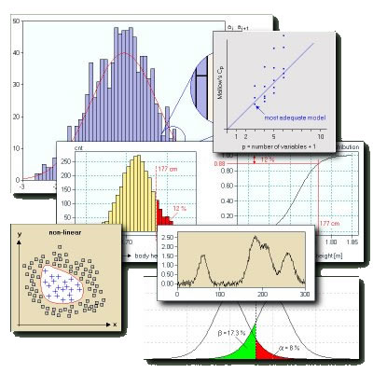
Does your state want to work on improving your EI data?

Slide 16
How DaSy can help you
Improving the quantity/quality of your EI data
Demographic data
Child descriptors
Services data
Work force data (linking??)
Program level data (model/philosophy, qualifications of the director, staff turnover, quality) (linking??)
Is your state collecting data that will allow you to answer really important questions about EI?
Using data to improve programs and practices

Slide 17
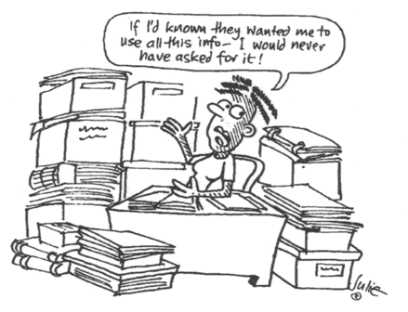

Slide 18
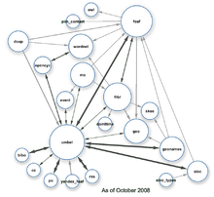
Does your state want to work on linking your EI data to data on other programs or to K-12?
l
Notes:
This is the next frontier. The Race to the Top Early Learning Challenge priority had a strong emphasis on building coordinated data systems. The last SLDS competition had a priority for early childhood and we hear the next one will as well.

Slide 19
How DaSy can help you
Linking data across programs serving children birth to 3
Unique IDs
Data sharing, confidentiality, FERPA
Data governance
Use of CEDS (Common Education Data Standards)
Stakeholder meetings
Linking to preschool and K-12 data.

Slide 20
More information about DaSy
dasycenter.org

Slide 21
How to request help
Send an email to any of the DaSy staff
We are all on the web site
Email dasycenter@sri.com
Phone: (650) 859-3881
Please complete the questionnaire
on your data system that will be coming to you soon.

Slide 22
…because sharing (and using) data is good for kids

