Slide 1
State Data Systems and Critical Questions about Personnel
Kathy Hebbeler
SRI International
ECPC Cross-Cohort Leadership Institute
September, 2017

Slide 2

The need to build a “data system”
The hardware, software, and other applications that enable Part C and Section 619 programs to collect data about children, families, workforce, and/or program characteristics (e.g., program quality), as well as the analysis, reporting, and data use practices associated with those data.
System for data
http://dasycenter.org/resources/dasy-framework/
Notes:
You have to build it all. The technology – yes – but also the data collection, capacity to analyze and share out, how to interpret and use. You can’t use what you don’t have. You can’t use what you can’t access.

Slide 3
Functions of a Data System/Uses of Data
Accountability
Program Improvement
Program Operations
Knowledge Development

Slide 4
Functions of a Data System/Uses of Data
Report to funders and other stakeholders to support wisdom of investment, e.g., federal and state reporting
Accountability
Program Improvement
Program Operations
Knowledge Development

Slide 5
Functions of a Data System/Uses of Data
Accountability
Program Improvement
Program Operations
Knowledge Development
Identify strengths and shortcomings; addressing shortcomings

Slide 6
Functions of a Data System/Uses of Data
Accountability
Program Improvement
Program Operations
Knowledge Development
Improve effectiveness and/or efficiency day-to- day management and implementation

Slide 7
Functions of a Data System/Uses of Data
Accountability
Program Improvement
Program Operations
Knowledge Development
Contribute to general understanding of service delivery and outcomes

Slide 8
Questions are the drivers
What data elements to collect
What analyses to run
What tables to produce
Need to design and build the data system based on questions
Notes:
Three of the 4 (all except program operations are driven by question) Here is what we have – what can we do with the data we have - starter approach….just not where you want to stay.
But of course, you are not starting from scratch. Most of you have some kind of a data system with some kind of personnel. So…

Slide 9
Questions are the drivers
What data elements to collect
What analyses to run
What tables to produce
Need to enhance the data system based on questions
Notes:
You will be enhancing your data system.

Slide 10
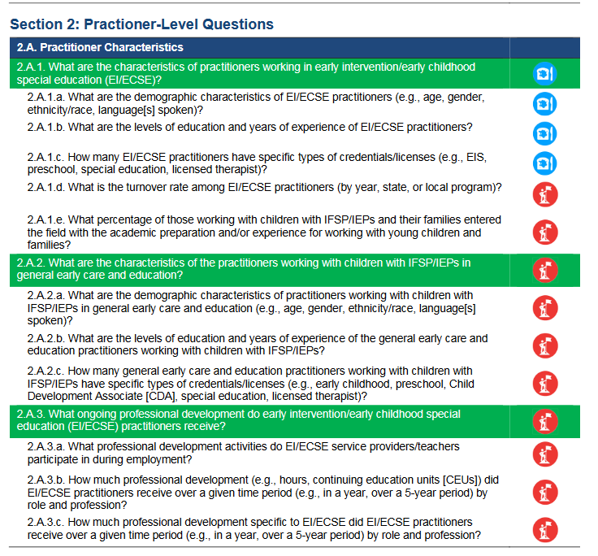

http://dasycenter.org/resources/critical-questions/
Notes:
Two kinds of questions: Bread and butter and aspirational

Slide 11

What are the characteristics of the work force?
Notes:
Let’s drive into a question to see how you might answer it.

Slide 12

National Early Intervention Longitudinal Study (NEILS)
Nationally representative sample of 3,338 children and families who received early intervention
Began EI in 1997 or 1998
Data on the professionals who worked with the family in the first 6 months of service
https://www.sri.com/work/publications/national-early-intervention-longitudinal-study-neils-final-report

Slide 13
Who works with EI families?
One professional had lots of titles: special educator, child development specialist, infant development specialist, early interventionist
How many providers?
  22% Two
  23% Three
  13% Six or more
Only 6% did not receive services from one or more of following: Special educator/child development specialist, SLP, OT, or PT
Notes:
Many titles for the early interventionist but families did not report having 2 within the category so same role – different role names

Slide 14
Characteristics of the professionals
Of all families who worked with this professional, X% had a provider who was…..
“Sphere of influence”
  61% of families worked with a child development specialist or special educator; 38% with a PT
  Implications for state data system: need to be able to link child data to personnel data

Slide 15
Characteristics of EI professionals
Female
  Child Development Specialists - 92%
  OTs - 98%
White
  SLPs – 90%;
  PTs – 89%;
  Nurses- 79%)
Any age
  Nurses, Special educators were older
  SLPs and Service coordinators were younger
Not likely to speak another language
  19% for nurses which was the highest

Slide 16
Characteristics of EI professionals
Highly educated
Children/families in EI served by professional with a masters degree or higher
  93% SLPs
  79% Social workers
  70% Special educators
  53% Child development specialists
  51% Service coordinators
  44% PTs/PT Assistants
  37% OTs/OT Assistants
  30% Nurses

Slide 17
The Profession of the Providers
SLP, PT, OT, Nursing, Social work – well defined field
  Had undergraduate, graduate degree or both in the field and a license
Service coordinators, child development specialists, special educators came from various backgrounds
Child development specialists:
  Psychology 16%
  Child development 13%
  Early childhood education 11%

Slide 18
Why would you want to know the characteristics of the work force?
What action could you take?
Age?
Race/Ethnicity?
Preparation?

Slide 19
Professionals have knowledge and skills to implement evidence-based practices
Professionals implement evidence-based practices
Good outcomes for children and families
Other factor
Other factor
Notes:
Professionals having the knowledge and skills is a necessary but not sufficient condition for good outcomes. Implementation science tells us about the multiple influences but professionals have to be knowledgeable. Other factors include leadership, caseloads, resources constraints. But having knowledgeable professionals is critical.

Slide 20

What kind of data are states collecting on personnel?

Slide 21
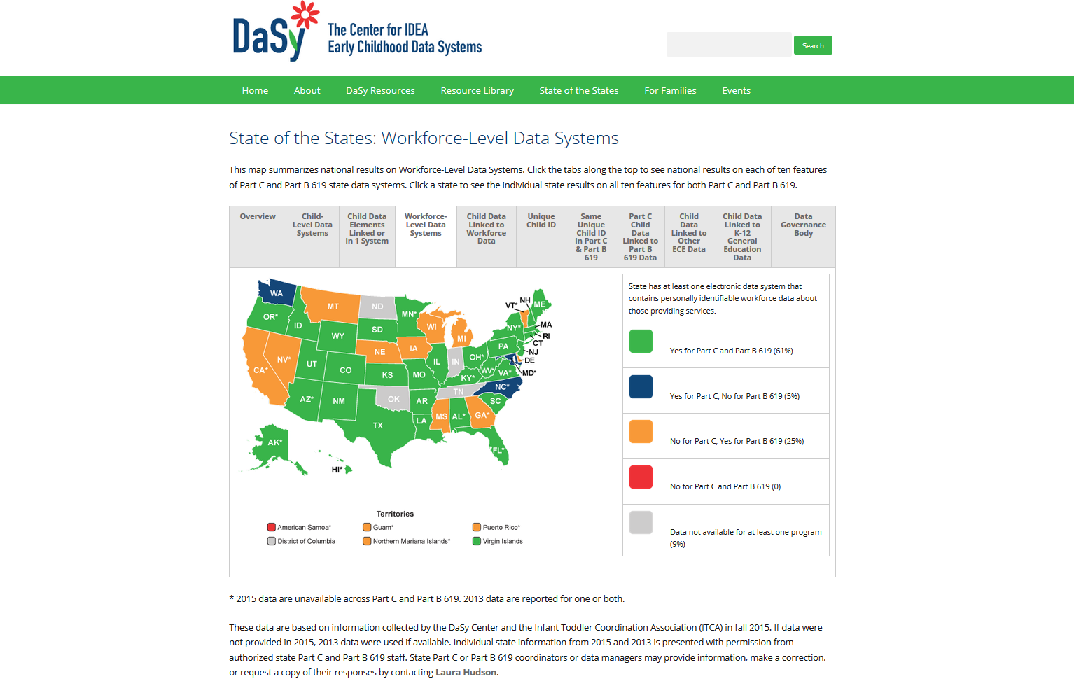
http://dasycenter.org/state-of-the-states-2016/workforce-level-data-systems/

Slide 22
Notes:
If you know what is up there for your state is incorrect, let me know or contact Laura Hudson. If you are gray, it means we are missing data or more likely do not have permission to share it. If you are will to share the data, let Laura or me know.

Slide 23
About the ITCA 2015 Data Survey
Data collected through online survey
Conducted survey in 2015
Sent to Part C Coordinators in all states and territories
47 states responded
Percents are percent of states

Slide 24
Early Intervention
At least one data system with data on work force member
Unique identifier for the work force member
Ever linked work force data to child level data
72%
31%
49%

Slide 25
Early Intervention
The majority of states have licensure date. Not many states have demographic data.

Slide 26
About the DaSy Part B 619 survey
Data collected through online survey
  Conducted survey in mid 2013 and fall 2015
  Sent to 619 coordinators in 56 states and jurisdictions, group effort encouraged
Response rates
  2013: 96% (54/56)
  2015: 93% (52/56)
  89% (51 states) answered the survey both years
Percents are percent of states.

Slide 27
Early Childhood Special Education
Majority of states have at least one data system with data on preschool special education teachers.
Little change over time.

Slide 28
Early Childhood Special Education
Majority of states have at least one data system with data on individual related services personnel

Slide 29
Early Childhood Special Education
The majority of states have at least one data system with data on individual general education teachers working with children with IEPs, and there has been little change over time.
Notes:
Doesn’t mean all the general education teachers. Early childhood special education is in Education, State Pre-K also there.

Slide 30
Early Childhood Special Education
Most states reported using a unique identifier for workforce members.
Seven states reported that they used the same unique workforce ID as Part C.

Slide 31
Early Childhood Special Education
More states have data on special education teachers than the other professions.
Licensure is the most common data across states.

Slide 32
Early Intervention
The majority of states have licensure date. Not many states have demographic data.

Slide 33


ECTA Frameworks
http://ectacenter.org/sysframe/
Notes:
What does quality look like in a state system?

Slide 34

“An effective system must coordinate and address state needs for both the number of personnel as well as the degree to which those personnel are supported and qualified for their roles in the service system”
ECTA System Framework
How does leadership build a state system that does that?
How does leadership know if the state system does that?
With
Data

Slide 35
PN2 (There is a plan..) e. The leadership team monitors both the implementation and effectiveness of the activities of the CSPD plan.
PN7 (…statewide system for inservice..) d. The inservice personnel development component of the CSPD plan is guided by updated needs assessment of the capability of the work force in relation to the desired knowledge and skill competencies.
PN9 (..recruitment and retention…) c. The effectiveness of strategies is tracked, reviewed annually, and updated as appropriate based on data, current research, and stakeholder input.
Notes:
Let’s look at some elements of quality in the personnel section

Slide 36
PN11. The evaluation plan for CSPD includes processes and mechanisms to collect, store, and analyze data across all subcomponents.
  c. The state has the capacity to support data collection, management, and analysis for personnel qualifications, needs assessment, preservice and inservice personnel development, and personnel supply and demand.
  d. Quality review processes for data collection, verification, storage and management, and analysis are defined and implemented regularly.
  e. Personnel data are linked to child and family outcomes.
Notes:
Remember knowledge development?

Slide 37
PN12 (…evaluation plan is implemented)
  c. Data are collected on personnel variables, such as personnel development participation, acquisition of content, and performance of competencies and those data are examined in relation to relevant child and family outcomes.
  d. Data are collected on personnel development variables, such as units of personnel development, type and amount of support (e.g., observational feedback, coaching, practica and content), and those data are examined in relationship to relevant child and family outcomes

Slide 38
Bottom line:
High quality data on personnel is essential to achieving a system with high quality personnel

Slide 39

To be useful, data must be
Current
Trustworthy
Accessible

Slide 40
How accurate/trustworthy do you data need to be?
There is always error in measurement.
As accurate as you need them to be for the kind of decisions you plan to make from them
What does it cost to get the data 100% accurate?
  $X to get to 95% accuracy (?)
  2 times $X to get to 99% accuracy (?)
Is it really worth it? Rarely.
Depends on the implications for the decision
Notes:
Depends on what you want to use the data for. What is the decision? How good it good enough?
Anticipating a shortage of 60 PTs next year – might be 65, might be 54 – but it is not 10 and it is not 110.

Slide 41
Building a culture of data use
CQs are starter list of questions.
Goal: Data conversations permeate your agency’s day to day work
DEC Recommended Practices
  L12. Leaders collaborate with stakeholders to collect and use data for program management and continuous program improvement and to examine the effectiveness of services and supports in improving child and family outcomes. https://divisionearlychildhood.egnyte.com/dl/tgv6GUXhVo

Slide 42
Examples of Simple Data Conversations
Let’s look at some 619 data reported to OSEP
States report on total number on personnel who are employed, highly qualified, not highly qualified.

Slide 43
Percent of Employed Teachers of 3-5 Year Olds Who Are Highly Qualified by State, 2014-15
Source: U.S. Department of Education, EDFacts Data Warehouse (EDW): “IDEA Part B Personnel Collection,” SY 2014-15.
Notes:
Anything I can create this kind of a graph for nationally, you can create the same graph by district within your state.

Slide 44
Number of 3 to 5 years olds per Number of 3 to 5 Teacher FTEs by State, 2014-15
Note: State with a ratio of 160 to 1 not shown.

Slide 45

Is there a relationship between percent served and the child to teacher ratio?
Notes:
3.6 to 13.2
High state – high resources, good ratios
High state – stretched thin, serving so many kids

Slide 46
Number of 3 to 5 years olds per Number of 3 to 5 Teacher FTEs for Each State, 2014-15
States serving the highest percentage of 3 to 5 population shown in yellow .
Correlation between percent served and ratio = .15
Correlation between number served and ratio = -.01

Slide 47
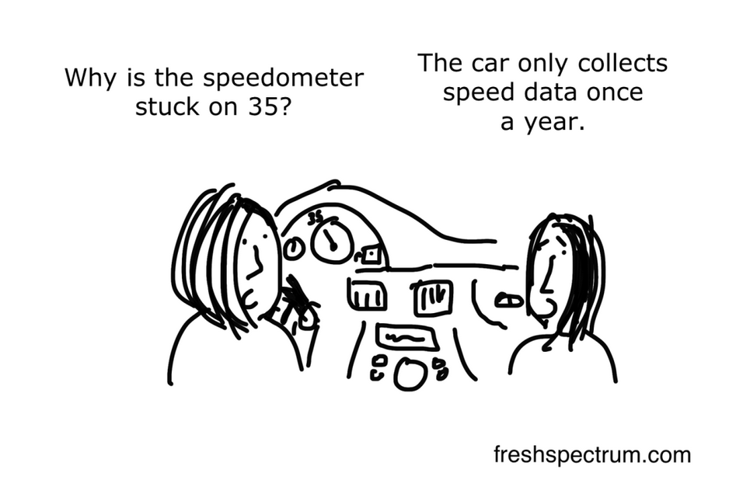
How often do you need data?
Notes:
Need to be current enough for the decisions you want to make from them

Slide 48
Not everything has to be in one of the big state data systems
Some things are time limited (e.g., an initiative).
Some things are spot checks.
  Implementing practice based coaching
Continuous quality improvement vs. a one time evaluation.
For the data elements you don’t have:
  How many of the data elements do you need regularly?
  How many do you need intermittently?

Slide 49
Personnel Data System:
Vision for Every State
Comprehensive set of data elements on personnel (demographics, education, employment start date, additional training, etc.).
All of the data are trustworthy.
All of the data are current.
Coordinator has reasonably easy access to the data and can get analysis completed when they are needed.

Slide 50
For more information
Visit the DaSy website at:
http://dasycenter.org/
Like us on Facebook:
https://www.facebook.com/dasycenter
Follow us on Twitter:
@DaSyCenter

Slide 51

Thank You
The contents of this presentation were developed under a grant from the U.S. Department of Education, # H373Z120002. However, those contents do not necessarily represent the policy of the U.S. Department of Education, and you should not assume endorsement by the Federal Government. Project Officers, Meredith Miceli and Richelle Davis.

