Slide 1


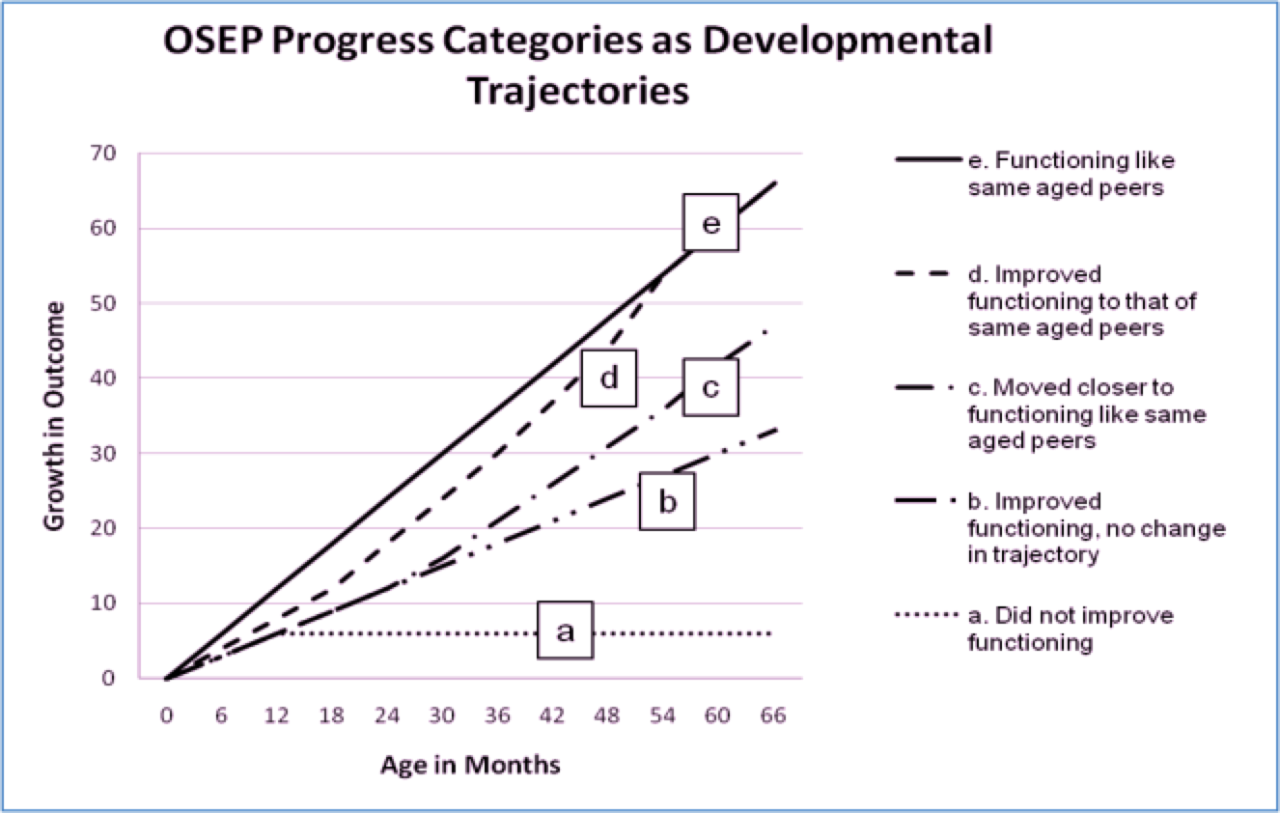




Child Outcomes Data: A Critical Lever for Systems Change
Kathleen Hebbeler, Christina Kasprzak, Megan Vinh, & Donna Spiker
OSEP Project Directors’ Conference 2016
Washington, DC August 2016
Background
Findings
Discussion and Implications
The Office of Special Education Programs (OSEP) requires state early intervention (EI) and early childhood special education (ECSE) programs to submit data on child outcomes annually.
OSEP does not require specific tools or methodologies, so states use a variety of approaches to collect the data. The table below shows information about approaches used by states and territories.
Data Quality: Some State Data Showed Unexpected Patterns
States varied considerably in the percentage of children showing greater than expected growth.
Most states showed the expected pattern of year-to-year stability, but some states showed dramatic differences.
Improving Data Quality
Although all states have been required to measure child outcomes for more than
10 years, producing consistently high-quality data continues to be challenging for states.
The national data have shown slight year-to-year fluctuations as states build their capacity to collect valid and reliable data.
Data quality must be addressed before, during, and after data collection.
OSEP TA Centers support states to improve data quality and use with:
  Individualized TA to states
  Online modules
  Communities of practice of states
  Other resources (briefs, data collection tools)
Policy Implications of Having High-Quality Data
The ongoing availability of data on child outcomes has assisted the U.S. Department of Education in making a case in the President’s budget for investing in EI and ECSE; some states have made similar use of the information with state policy makers.
High-quality data allows states to identify programs or sub-populations that need additional support in improving outcomes.
EI Trends Over Time: Greater Than Expected Growth – Social Emotional, 2014-2015, All States
Approach | EI (N = 56) | ECSE (N = 59)
Child Outcomes Summary (COS) | 43 (77%) | 42 (71%)
One tool statewide | 8 (14%) | 9 (15%)
Publisher’s online analysis | 2 (4%) | 6 (10%
Other approaches | 3 (5%) | 2 (3%)
Child Outcomes
States report 5 Progress Categories and
2 Summary Statements for each of 3 Child Outcomes:
Positive social-emotional skills (including social relationships);
Acquisition and use of knowledge and skills (including early language/communication);
Use of appropriate behaviors to meet their needs
Quality of State Data Has Improved
The national estimate uses the weighted average of states that meet minimum quality criteria.
Number of states that met criteria for inclusion in the national analysis has increased.
Number of States That Met Criteria for Inclusion in the National Analysis (N = 51)
States Have Consistently Reported That Large Percentages of Children Who Participated in Early Intervention or Preschool Special Education Experience Good Outcomes
Percentage of Children Exiting at Age Expectations
Two Summary Statements:
Of those children who entered or exited the program below age expectations in each outcome, the percentage who substantially increased their rate of growth by the time they turned 3 (for EI) or 6 (for ECSE) or exited.
The percentage of children who were functioning within age expectations in each outcome by the time they turned 3 (for EI) or 6 (for ECSE) or exited the program.
Early Intervention
Early Childhood Special Education
The contents of this tool and guidance were developed under grants from the U.S. Department of Education, #H326P120002 and #H373Z120002. However, those contents do not necessarily represent the policy of the U.S. Department of Education, and you should not assume endorsement by the Federal Government. Project Officers: Meredith Miceli, Richelle Davis, and Julia Martin Eile.
Stay connected with DaSy: http://dasycenter.org
Stay connected with ECTA: http://ECTAcenter.org

