Slide 1
A National Look at Statewide Data Systems from the Perspective of IDEA Early Childhood Programs
Donna Spiker and Lynne Kahn
The DaSy Center
Head Start Research Conference
Washington, DC
July 2014

Slide 2
What methods were used?
Online needs assessment developed by DaSy workgroup
Coordinated with ITCA and ECDC surveys
Sent to Part C (EI) and 619 (ECSE) coordinators
Completed with data managers and others identified by coordinators
Notes:
ITCA is the Part C (early intervention) Infant Toddlers Coordinators Association
Part C is early intervention (EI) and 619 is early childhood special education (ECSE)

Slide 3
What kinds of questions were asked?
Status of Part C and 619 data systems:
Data systems and data elements
Linkages between different state data systems
Data system administration and use of data
Note: Slightly different versions for Part C and 619
based on program differences

Slide 4
Who were the respondents?
Sent to all states and jurisdictions
Report of the information collected focuses on information reported by 50 states, DC, and Puerto Rico
We had an excellent response rate:
For Part C 94% (n = 49)
For 619 96% (n = 50)
Notes:
We focused the report on the 50 states, DC and Puerto Rico since they are included in IDEA data tables for how child count is reported.
But we do have information for other jurisdictions.
Need to address why territories not included in the report…Be clear on what response rate based on 52 (the report numbers) way child count data is reported…..

Slide 5
Results: Most Part C and 619 data systems have child-level and workforce data, fewer have local program-level data
 | Part C | 619
Child-level | 94% | 96%
Program-level | 29% | 40%
Workforce: EI providers | 65% | ----
Workforce: special education teachers | ---- | 83%
Workforce: related service providers | ---- | 71%
Workforce: general education teachers | ---- | 71%
Notes:
The percent's are the percent of states responding (and
For child-level – there are no “Nos”, only missing
There is a lot more detail and information in the report.

Slide 6
Most Part C and 619 data systems have a variety of data elements in their child-level data systems.
Some common data elements | Part C | 619
Child demographics | 94% | 96%
Disability category | 77% | 96%
Eligibility status | 98% | 90%
Child outcomes | 83% | 90%
Service setting | 89% | 87%
ID for program or school | 89% | 81%
Reason for exiting program | 98% | 79%

Slide 7
States vary in the kinds of workforce data they have in state data systems.
Workforce data element | Part C | 619 special ed teachers | 619 Therapists | 619 regular ed teachers
Demographics | 29% | 67% | 58% | 64%
Employment data | 54% | 77% | 60% | 67%
Education | 46% | 75% | 58% | 64%
Licenses/certifications | 56% | 83% | 69% | 71%
Professional development | 39% | 29% | 29% | 23%
Wages | 10% | 46% | 42% | 46%
Notes:
These are what we asked about:
a. Demographics (one or more of the following: race/ethnicity, age, language, gender, etc.)
b. Employment information (one or more of the following: employing agency/school, position title, years of experience, start date, etc.)
c. Education (one or more of the following: degree, field of study, etc.)
d. Licenses/certifications
e. Professional development completed (in-service or other training)
f. Wages

Slide 8
Linkages: Why is this important?
States can answer programmatic and policy questions about:
Children’s outcomes from EI and ECSE participation, e.g.,:
Do former EI recipients require special education in kindergarten?
How are ECSE graduates doing in third grade?
Factors associated with good child outcomes, e.g.,:
What workforce and program factors, such as personnel qualifications and program quality, have a substantial impact on child outcomes?
Do children served in inclusive programs have better outcomes?

Slide 9
Only about one-third of states have linked data across Part C and 619.
Notes:
Remember that there are 12 states with Education as the lead agency for Part C, so we would expect C and 619 data to be in same system or connected.
We combined data from the two surveys, and about one-fourth disagreed about the connections.

Slide 10
There is infrequent use of common identifiers across Part C and 619.
Common identifier for C & 619
Child-level | 21%
Program-level or school-level | 12%
Workforce-level | 6%

Slide 11
Linkages with K12 education data are more common for 619 than for Part C.
Types of education data in same system or have been linked | Part C | 619
K12 special education | 41% | 87%
K12 general education | 14% | 79%
Notes:
Not surprising that more states can link for 619

Slide 12
For Part C, few states have linkages with other EC data, and for 619,almost half have linkages with state preK.
Types of other EC data | Part C | 619
State pre-K | 12% | 46%
Head Start | 6% | 22%
Early Head Start | 2% | 10%
Child care | 6% | 8%
Home visiting | 8% | 8%

Slide 13
Linkages with health data are more common for Part C than for 619.
Types of health data | Part C | 619
Medicaid/SCHIP | 42% | 12%
EHDI | 37% | 8%
Vital records | 21% | 0%
Birth defects registry | 21% | 2%
All-payer claims (insurance) | 13% | 0%
WIC/SNAP | 8% | 6%
Hospital | 6% | 2%
Behavioral health | 4% | 2%
Notes:
Connections between c and health are strong in many states; health is lead agency in many states (N = )
Highest with Medicaid (42%); and newborn hearing screening (EDHI- Early Hearing Detection & Intervention Program)

Slide 14
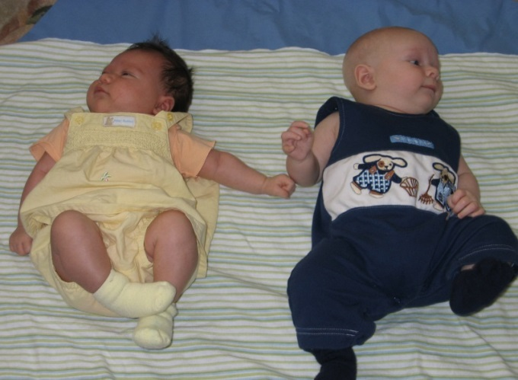
Only few states have linked Part C or 619 data to social services data.
Types of social services data | Part C | 619
Child welfare | 21% | 10%
Foster care | 12% | 8%
Temporary Assistance for Needy Families (TANF) | 10% | 14%
Homeless services | 6% | 14%

