Slide 1
SSIP Stakeholders: The Right People, The Right Purpose, The Right Plan
Improving Data, Improving Outcomes Conference
New Orleans, LA
August 16, 2016

Slide 2
Session Planning Team: State Staff
Arkansas
Tracy Turner, Part C Coordinator
Ravyn Hawkins, Part C Staff Development & Policy Coordinator
Yvonne Greene, 619 Coordinator
California
Sharon DeRego, Part C Coordinator
Marie Poulsen, SICC Chair (IHE/Personnel Prep. Representative) *tentative
Connecticut
Aileen McKenna, Manager, Part C Family & Community Supports
Kristen Williams, Parent Consultant, CT Parent Advocacy Center
Montana
Wendy Studt, Part C Coordinator & Data Manager
Laura McKee, SICC Co-Chair (Parent Representative)

Slide 3
Session Planning Team: SSIP TA Staff
Betsy Ayankoya, DaSy & ECTA
Patrice Linehan, NCSI
Amy Nicholas, DaSy
Virginia Reynolds, NCSI
Sharon Ringwalt, ECTA & IDC

Slide 4
Session Structure
Review of Key Topics: Presentations on State Experiences
Concurrent Roundtable Discussions
Source: Google image search

Slide 5
Review of Key Topics: State Experiences
Source: Google image search
Topics of interest to the conversation around SSIP stakeholder engagement
Engaging stakeholders in making connections between SSIP and other programs/initiatives
Refining core beliefs around stakeholder engagement
Maximizing engagement of SICC/SEAC stakeholders
Supporting stakeholders on local implementation teams
Engaging families in SSIP and making the work meaningful to them

Slide 6
Arkansas
SiMRs:
(C4C) Increase the percent of families participating in Part C who report that early intervention has helped them help their children develop and learn.
(B3C) Increase the percent of students with disabilities in grades 3- 5 who made gains towards reaching a proficient score or maintained a proficient score on the statewide literacy assessment.
Part C & 619:
Making Connections to Other Programs/ Initiatives
-and-
Refining Core Beliefs Around Stakeholder Engagement

Slide 7
Arkansas
Making Connections to Other Programs/ Initiatives
Making Connections to Other Programs/Initiatives:
Familiarizing ourselves with other initiatives and looking for the “common goal” or “common points”
“Marketing” our work form the “common” perspective
“Sharing” participating in their work (time/resources)
Leading by Convening -- going beyond “stakeholder” to “team member” and partner, giving team members “a voice,” more transparency

Slide 8
Arkansas
Outline of stakeholder engagement process:
PD identified as a target area using ECTA framework self-assessment
C & 619 form an Early Childhood Partnership and co-convene a joint “book study” of Leading by Convening via web-based meetings
NCSI facilitates a discussion call around Leading by Convening
C & 619 co-creates list of contacts from related initiatives and agencies/organizations also serving families of children 0-5 and jointly sends an invite/overview flier
ECTA facilitates call to provide overview of the purpose of the state-wide, cross-sector Professional Development Leadership Team
ECTA guiding C & 619 in process of “leading by convening” – facilitating meetings with PD Leadership Team

Slide 9
Arkansas
Refining Core Beliefs Around Stakeholder Engagement
A shift from “required input” to joining together:
“Stakeholder Input” | “Leading by Convening”
Lead agency controlled the content, agenda, etc. | Team members decide what’s on the agenda, identify who to invite, vote on meeting schedule
Lead agency “drove” the work in the direction and at the pace we wanted to go | Partners move the work sometimes in directions we had not expected. Shift from “start to finish” pace to viewing the work as “a process”
Stakeholders provided information with limited input | Partners contribute ideas and share the work
Lead agency shared only what we’re comfortable sharing and discussing (mutual lack of trust) | Team has difficult discussions around real issues (openness has built mutual trust)

Slide 10
Arkansas
Refining Core Beliefs Around Stakeholder Engagement
Part C: Letting go of control and being more transparent has built trust as we move beyond “stakeholder” to team member and partner.
619: The work helps us to communicate as partners and enables the entire team to help drive decisions rather than state agencies gathering a group after decisions are made.

Slide 11
Montana
SiMRs:
(C3A) Increase the percentage of infants and toddlers with IFSPs who demonstrate improved positive social-emotional skills, substantially increasing their rate of growth by the time they turn three years of age or exit the program.
(B1) Increase the number and percent of American Indian students with disabilities who successfully complete their secondary education.
Part C: Maximizing Engagement of SICC
Stakeholders

Slide 12
26 of Montana’s Best: SICC Representatives
5 Parents and Representatives from MT Parent Advocacy Group-PLUK
4 MT Milestones/Part C Early Intervention Program Providers
Higher Education Representatives from the University of Montana, Montana State University, University of Montana Rural Institute
State of Montana Legislative Representative
State Representatives from MT Office of Public Instruction 619/Part B, MT School for the Deaf and Blind, Ravalli County Early Head Start
MT DPHHS Representatives: Developmental Disabilities, Children’s Special Health, Child and Family Services, Child Protective Services, Children’s Mental Health, Health Resources, Quality Improvement, Auditor’s Office
MT Milestones/Part C Early Intervention Program Coordinator
FSSAC – Family Support Services Advisory Council

Slide 13
Teamwork is the ability to work together toward a common vision and the ability to direct individual accomplishments toward organizational objectives. It is the fuel that allows common people to attain uncommon results. ~ Andrew Carnegie
RBI and RBEI
Web-based online data management system
Common IFSP
Child Outcomes

Slide 14
plan /plan/ noun: plan; plural noun: plans 1. a detailed proposal for doing or achieving something.
If Montana implements specific improvement strategies, we will provide high quality early intervention programs for vulnerable infants and toddlers with disabilities and their families to improve social-emotional skills in an effort to reduce the incident of future problems in their learning, behavior, and health status.

Slide 15
Montana Milestones/Part C Early Intervention Program SSIP
Coaching Interaction Style
Social-emotional screenings, assessments, and evidence-based practices
MSU Extended University
Child Outcomes Summary Process Guidance and Train the Trainers
Family Involvement in Data Practices
Montana’s Comprehensive Monitoring Tool

Slide 16
California
SiMRs:
(C3A) Increase the percentage of infants and toddlers with disabilities in California who will substantially increase their rate of growth in positive social-emotional skills (including social relationships) by the time they exit the early intervention program.
(B3C) Increase assessment proficiency results for the subgroups of special education students who are also ELs, low-income (defined by student’s eligibility for FRPM), and foster youths.
Part C: Maximizing Engagement of SICC Stakeholders
-and-
Supporting Stakeholders on Local Implementation Teams

Slide 17
California’s Interagency Coordinating Council
Interagency Coordinating Council (ICC)
Members actively participated in the development of State Systemic Improvement Plan (SSIP) as members of the SSIP Task Force Workgroup
Dedicated ICC meeting time to develop and support SSIP resources and activities
Provided a forum for discussion and stakeholder engagement along the way

Slide 18
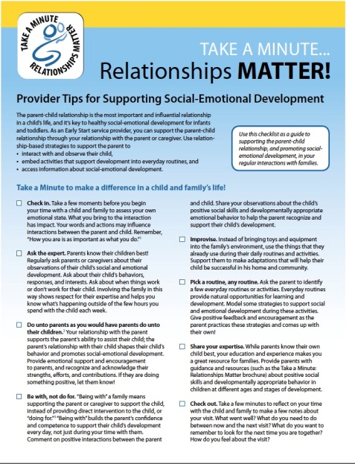
CA ICC’s Contribution to SSIP Implementation Resources
Parent/Provider Education
Supported development of “Take a Minute…Relationships Matter” campaign
Parent flyer
Video
Provider Checklist
Interagency Collaboration
Resource guide on initiatives
Develop Evidence Based Infant-Toddler Social-Emotional Assessment Guidelines

Slide 19
California Early Start SSIP Local Implementation Teams
Each regional center catchment area will have a Local Implementation Team, consisting of representatives from: Regional Center, Family Resource Center, Local Educational Agencies, and other community partners (ex: First 5, Early Head Start, County Office of Mental Health)
Implementation Cohorts
Regional Center
Local Implementation Team 2
Regional Center
Local Implementation Team 1
Regional Center
Local Implementation Team 3
Regional Center
Local Implementation Team 4
Regional Center
Local Implementation Team 7
Regional Center
Local Implementation Team 5
Regional Center
Local Implementation Team 6

Slide 20
California’s Early Start SSIP Implementation Stages
Three Stages of Implementation
July 2016 – Cohort #1 - four to seven Regional Centers and their local implementation partners
July 2017 – Cohort #2 - four to seven more Regional Centers and their local implementation partners
July 2018 – Cohort #3 - remaining Regional Centers and their local implementation partners
Ongoing one on one technical assistance (TA) from DDS and WestEd

Slide 21
California’s Support of Local Implementation Teams
Department of Developmental Services (DDS)
Governor designated Lead Agency for California
Liaisons assigned to Local Implementation Teams
DDS/WestEd liaisons
Monthly Conference Calls
In-person visits
Kick Off/Orientations
Local Implementation Team Plans
Support and Technical Assistance

Slide 22
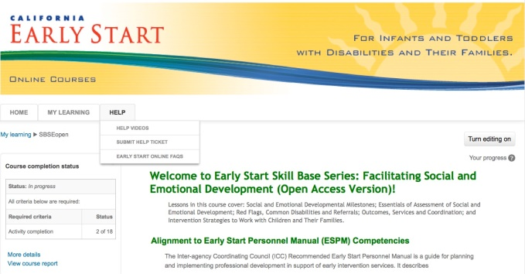
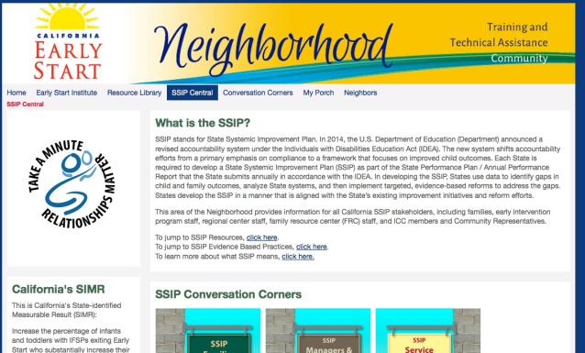
Continued Support of Local Implementation Teams
WestEd Center for Prevention and Early Intervention
Professional Development
Training through Comprehensive System of Personnel Development (CSPD)
Modify existing training on social-emotional development to make it shorter and available to additional participants
Online Community of Practice
Activate an online Community of Practice to support professional networking and sharing of resources focused on the SSIP
http://earlystartneighborhood.ning.com/

Slide 23
Continued Support of Local Implementation Teams
Interagency Coordinating Council (ICC)
Resource guide on initiatives
Evidence Based Infant-Toddler Social-Emotional Assessment Guidelines
Support Take a Minute Campaign
Fellow Local Implementation Teams
Peer Mentoring
Sharing best practices and lessons learned

Slide 24
Connecticut
SiMRs:
(C4B) Increase the percent of families participating in Part C who report that early intervention services have helped the family effectively communicate their children’s needs.
(B3C) Increase the reading performance of all 3rd grade students with disabilities, as measured by Connecticut’s Approved ESEA Flexibility Performance Index.
Part C:
Engaging Families in SSIP and Making the Work Meaningful to Them

Slide 25
Connecticut’s Family Engagement Efforts
Engaging Families in SSIP and Making the Work Meaningful to Them
Partner with our PTI, CT Parent Advocacy Center (CPAC), through a contractual agreement that allows CPAC parents to:
Participate in the development of the State Systemic Improvement Plan
Attend state and national meetings
Review drafts
Provide parent faculty and CPAC staff assistance in creating training modules, literature and presentations for Birth to Three providers and families

Slide 26
Connecticut’s Family Engagement Efforts
Engaging Families in SSIP and Making the Work Meaningful to Them
Results of using trained parent faculty at all trainings:
Sends the message that the parent perspective matters
Offers administration another way of looking at things
Keeps us grounded- we may be the professional but sometimes even research gets it wrong
Reminds providers to look to their families for possible parent leaders, mentors, SICC members

Slide 27
Connecticut’s Family Engagement Efforts
Engaging Families in SSIP and Making the Work Meaningful to Them
Through our contract with CPAC, we have the Family Connections program that connects Birth to Three parents with trained parent mentors for supportive services.
Question on the IFSP form asked at all meetings
Parents that have received supportive services often want to become parent mentors themselves.

Slide 28
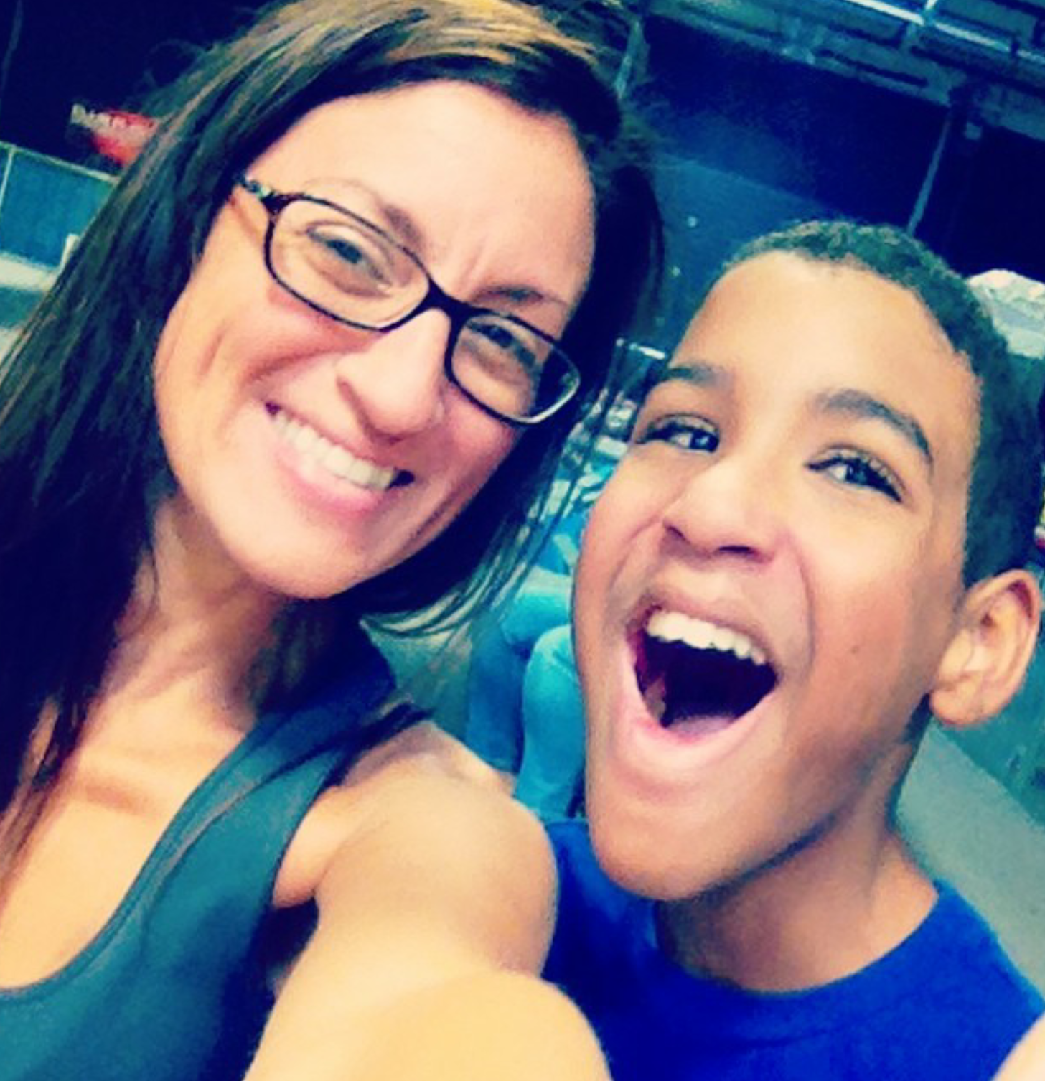
Family Stories on Our Website: Kristen and Noah’s Story
https://www.youtube.com/watch?v=Hv46nB-M_vI#t=11

Slide 29
Roundtable Discussions
Source: Google image search

Slide 30
Takeaways
Source: Google image search

Slide 31
Contact Information
Tracy Turner, AR Part C Coordinator: Tracy.Turner@dhs.arkansas.gov
Ravyn Hawkins, AR Part C Staff Development & Policy Coordinator: Ravyn.Hawkins@dhs.arkansas.gov
Yvonne Greene, AR 619 Coordinator: Yvonne.Greene@arkansas.gov
Sharon DeRego, CA Part C Coordinator: sharon.derego@dds.ca.gov
Marie Poulsen, SICC Chair: mpoulsen@chla.usc.edu
Aileen McKenna, Manager, Part C Family & Community Supports: Aileen.McKenna@ct.gov
Kristen Williams, Parent Consultant, CT Parent Advocacy Center: Kristenwilliamsadvocate@gmail.com
Wendy Studt, MT Part C Coordinator & Data Manager: wstudt@mt.gov
Laura McKee, MT SICC Co-Chair: lmckee@mt.gov
Betsy Ayankoya, DaSy/ECTA: betsy.ayankoya@unc.edu
Patrice Linehan, NCSI: patrice.linehan@nasdse.org
Amy Nicholas, DaSy: amy.nicholas@unc.edu
Virginia Reynolds, NCSI: vreynol@wested.org
Sharon Ringwalt, ECTA/IDC: sharon.ringwalt@unc.edu

Slide 32
Find Your TA Centers Online
DaSy : http://dasycenter.org/
ECTA: http://ectacenter.org/
IDC: https://ideadata.org/
NCSI: http://ncsi.wested.org/

Slide 33
The contents of this presentation were developed under a grant from the U.S. Department of Education, # H373Z120002. However, those contents do not necessarily represent the policy of the U.S. Department of Education, and you should not assume endorsement by the Federal Government. Project Officers, Meredith Miceli and Richelle Davis.

