Slide 1
Coaching Systems Change
Grace Kelley
Kim Hartsell
August 2016
New Orleans, LA

Slide 2
Topics Addressed in This Session
Part C/619 Systems
Systems Thinking and Change
Leaders Promoting Systems Change
Leaders as Systems Coaches
Notes:
What is the difference between coaching for practice and coaching for systems change
Coaching systems change is different than coaching practice or families. When coaching for practice you are most often coaching an individual. When coaching systems
Who – coaching individuals/ systems coaching large groups
What – coaching practice/ coaching infrastructure change of multiple components
When - coaching a EBP implementation/ coaching multiple levels and ongoing for longer periods of time
Where – where ever needed at the moment

Slide 3
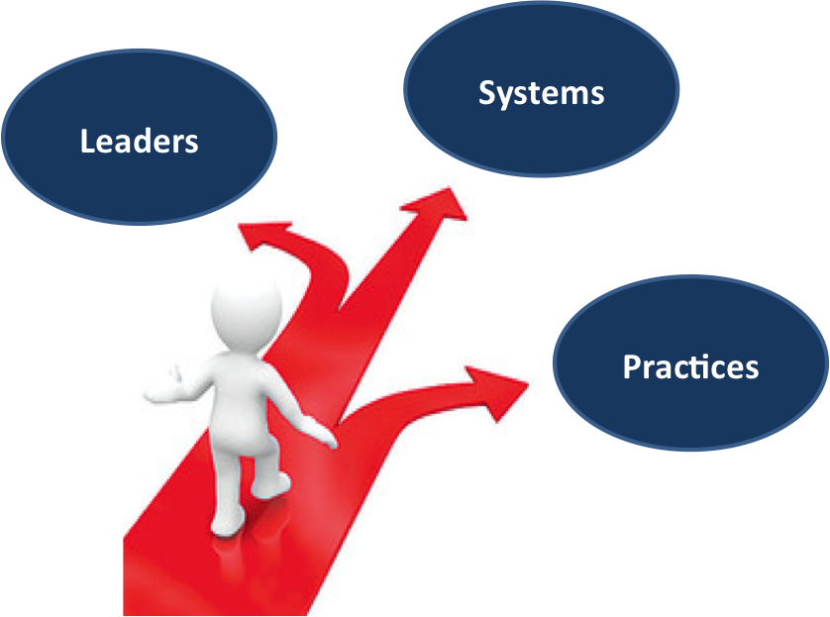
Systems change initiatives designed and implemented to improve outcomes for children with disabilities and their families, focus on:

Slide 4
Core Beliefs for Systems Change
Quality leaders drive quality systems.
Quality systems support quality practices.
Quality practices lead to quality outcomes for children with disabilities and their families.
If we want to achieve improved
outcomes, we must focus on all three!
Notes:
Complex problems require

Slide 5
Systems Thinking and Systems Change

Slide 7
Defining Systems
A system is a set of interacting or interdependent component parts forming a complex/intricate whole.
Early intervention/619 systems are Complex Adaptive Systems (CAS).
Complex- diverse and composed of multiple, interconnected elements
Adaptive- capacity to change and learn from experience
Notes:
group of related parts that move or work together

Slide 8
Systems Thinking
Systems thinking is a perspective of seeing and understanding systems as wholes rather than as collections of parts. A whole is a web of interconnections that creates emerging patterns.
Notes:
A systems thinker “steps back” to examine the dynamics of a system and the interrelationships among its parts. S/he sees the forest, rather than the details of any one tree.

Slide 9
Comprehensive ECE System

Slide 10
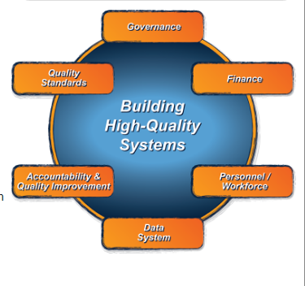
ECTA Framework for Part C and 619
Governance
Finance
Personnel/Workforce
Data System
Accountability and Quality Improvement
Quality Standards
More information available at: http://ectacenter.org/sysframe/

Slide 11
ECTA Framework for Part C and 619
The purpose of the ECTA System Framework is to guide state Part C and Section 619 Coordinators and their staff in:
evaluating their current systems;
identifying potential areas for improvement, and;
developing more effective, efficient systems that support implementation of evidence-based practices.

Slide 12
Systems Change
Systems change aims to bring about lasting change by altering underlying structures and supporting mechanisms which make the system operate in a particular way. These can include policies, routines, relationships, resources, power structures and values.
Source: http://www.thinknpc.org/publications/systems-change/
“Systems change is a journey.”
Esther Foreman, The Social Change Agency
Notes:
This should look familiar; Systems change brings about change through change in the infrastructure to support practice change.

Slide 13
Unfortunately systems change doesn’t just happen like magic

Slide 14
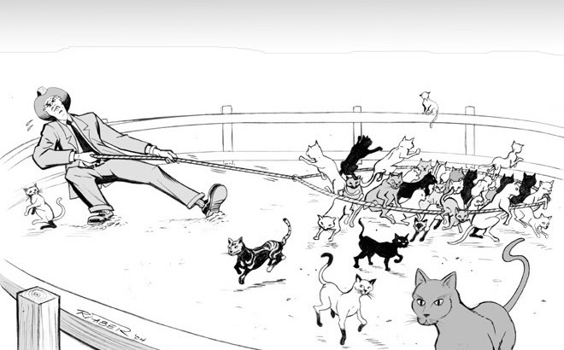
Systems Change is Like Herding Cats

Slide 15
Systems Change
It is the relationship between the components rather than the components themselves that is the primary driver of change.
“When we try to pick out anything by itself,
we find it hitched to everything else in the universe.”
-John Muir

Slide 16
Systems Thinking
Shifts in perception
From parts to the whole
Parts can only exist or be understood in relation to the whole
From individual components to relationships
Relationship between the parts may be more important than the individual parts
From quantity to quality
Some aspects of systems (i.e. relationships) cannot be measured, must be mapped
Notes:
If we want to change systems, we have to think systemically. We have to move from thinking about a single part to thinking about how the parts work together.

Slide 17
Systems Thinking (cont)
Shifts in perception (continued)
From structure to process
Move beyond evaluating and describing the components to processes within and across components
From content to patterns
Look for the configurations and patterns such as cycles and feedback loops that occur over and over again
Source: http://www.ecoliteracy.org/article/systems-thinking

Slide 18
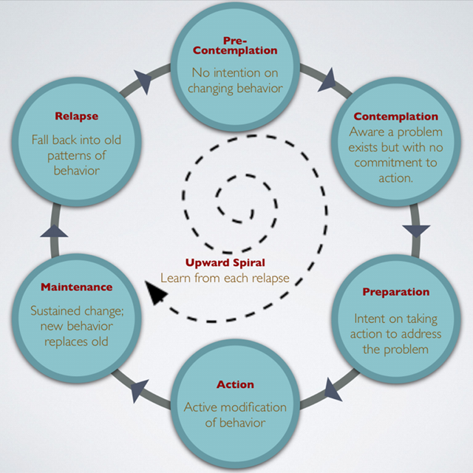
Systems Change

Slide 19
Quality Leaders Drive Quality Systems!
“Leaders become great, not because of their power, but because of their ability to empower others.”
John Maxwell
Notes:
Quality leaders drive quality systems; for systems change to be successful the leaders have provide adaptive leadership and coaching to address the complex issues. The leader has to keep the big picture in mind while coaching the individuals in the system to make small but significant change, at the same time keeping the vision in front of everyone. Each person had to know what role they play in the larger picture: what do I do that moves us forward. This applies to all “leaders” whether you are a provider, regional or district manager, program manager or state level staff.. Lead from where you are at

Slide 20
Seven Lessons for Leaders of Systems Change
Lesson 1: Foster community and cultivate networks
Lasting change requires a “critical mass or density of interrelationships within a community”
Constantly ask “who’s being left out?” and “Who should be in the room?”
“If nothing exists in isolation, then all problems are circumstantial; no problems resides, or can be solved, in anybody’s department.”
-Wendell Berry
Notes:
Systems change in field of equality; this is another way to think about systems change and aligns with SSIP, ECTA framework …

Slide 21
Seven Lessons for Leaders of Systems Change
Lesson 2: Work at multiple levels of scale
Changing a system affects the system within it and the systems within which it is nested
Challenge is choosing the right level or levels of scales for the desired changes
Often have to work at multiple levels (top, down, inside, outside, etc.)
Notes:
Start where you are at~ Often you can get stymied but trying to figure our where to start. Pick the most logical place and start. In your SSIP plan you have identified key strategies and activities

Slide 22
Seven Lessons for Leaders of Systems Change
Lesson 3: Make space for self-organization
Networks that can affect systems change will often self-organize if the right conditions are established
Teams rather than individuals are essential to systems change efforts
“Life constantly reaches out to novelty, and this is the origin of development, learning, and evolution.”
-Fritjof Capra
Notes:
It takes a team, if you have a problem that you are addressing – a group of people can organize and solve the problem if giving the flexibility and support to address the issues. This is hard to do for some of us who are Type A, but people who are a part of designing the solution are more likely to implement the solution…..
More heads are better than one, people who are experiencing the problem are the ones most invested in solving the problem.

Slide 23
Seven Lessons for Leaders of Systems Change
Lesson 4: Seize breakthrough opportunities when they arise
Stability of systems is a positive thing but can make change difficult
When systems encounter a point of instability (e.g. new information or circumstances that it can’t absorb without giving up old structures, behaviors, or beliefs), the instability can precipitate a breakdown or a breakthrough to new possibilities
“You never want a serious crisis to go to waste.”
- Rob Emmanuel

Slide 24
Seven Lessons for Leaders of Systems Change
Lesson 5: Facilitate – but give up the illusion that you can direct change
“We never succeed in directing or telling people how they must change. We don’t succeed by handing them a plan, or pestering them with our interpretation, or relentlessly pressing forward with our agenda, believing that volume and intensity will convince them to change.”
- Margaret Wheatley
“You can never direct a living system. You can only disturb it.”
- Humberto Maturana and Francisco Varela

Slide 25
Seven Lessons for Leaders of Systems Change
Lesson 5 (continued)
Introduce information that contradicts old assumptions
Show something that are already doing, but thought they couldn’t
Introduce new people to the conversation
Rearrange structures so that people relate in ways not used to
Present issues from different perspectives
Nurture networks of connection and communication
“Leaders sometimes lead best when the loosen control and take the risk of dispersing authority and responsibility.”
- Author unknown

Slide 26
Seven Lessons for Leaders of Systems Change
Lesson 6: Assume that change is going to take time
Change is a multiyear process (3 – 5 years)
Allocate time for personnel to change attitudes, adopt new practices, and/or use new tools
Set high goals, but make manageable steps
Look for intermediate achievements to experience and celebrate success and receive recognition on the way to the goal
“Quick fixes are an oxymoron. If leaders would learn anything from the past many years, it’s that there are no quick fixes.”
- Margaret Wheatley

Slide 27
Seven Lessons for Leaders of Systems Change
Lesson 7: Be prepared to be surprised
Change is nonlinear
Emergent properties arise when evolving systems generate phenomena that are not predictable
Source: Seven Lessons for Leaders in Systems Change. Available at http://www.ecoliteracy.org/article/seven-lessons-leaders-systems-change

Slide 28
Leaders as System Coaches

Slide 29
Leaders as System Coaches
Systems coaches guide sustainable organizational change to support the implementation of evidence-based practices with fidelity.
Systems coaching can occur at all levels of the system- state, district, program, and individual levels.
Systems coaching is generally provided by multiple individuals including leaders.

Slide 30
Leaders as System Coaches (cont.)
Systems coaching is based on the identified needs of the organization.
Traditional coaching has been based on improving implementation of a particular evidence-based practice
Has generally included individual coaching or small-group coaching
Systems coaching focuses on building the capacity of leadership to support systems that enhance the implementation of evidence-based practices
This promotes comprehensive reform

Slide 31
Leaders as System Coaches (cont.)
“Improvement will fail if the work of coaches remains at the one-to-one-level. Coaches are systems leaders. They need development as change agents at both the instructional level and the level of organizational and system change. It’s time to re-cast their role as integral to whole-system reform.”
- Michael Fullan and Jim Knight

Slide 32
Seven Critical Coaching Skills
Demonstrate effective interpersonal communication skills
Use multiple sources and types of data to solve important problems
Facilitate effective team-based collaborative planning and problems solving processes
Disseminate evidence-based content knowledge

Slide 33
Seven Critical Coaching Skills (cont.)
Demonstrate effective interpersonal communication skills
Organization change/implementation processes
Innovation/Initiative-specific content expertise
Best practices across key domains and instructional areas
Family and Community Engagement
Facilitate and support leadership to implement and sustain the innovation/initiative over time

Slide 34
Seven Critical Coaching Skills (cont.)
Provide evidence-based professional development training and technical assistance to support effective and efficient use of the innovation/initiative
Evaluate the impact of coaching activities on the implementation goals and intended outcomes on staff and child performance
Source: Florida MTSS Systems Coaching: A Model for Building Capacity Manual . Available at http://flpbs.fmhi.usf.edu/pdfs/SystemsCoaching.pdf

Slide 35
Leadership Competencies
What leadership competencies do you posses?
What leadership competences do you need to move your system to a higher level?
Reflection Activity: Complete Leadership Development Survey

Slide 36
Leadership Competencies
Pedagogical
Organizational
Human Resource Management
Symbolic
Collaborative
Systems
Political

Slide 37
Leadership Competencies (cont.)
What strategies will you use to move your system to a higher level of functioning?
What professional development and technical assistance/coaching do you need to move your system to a higher level of functioning?

Slide 38
Making Connections to Improve Outcomes
Quality leaders drive quality systems.
Quality systems support quality practices.
Quality practices lead to quality outcomes for children with disabilities and their families.

Slide 39
Consultancy Protocol
A consultancy is a structured process for helping an individual or a team think more expansively about a particular, concrete dilemma.
Framing the Dilemma
Developing the Consultancy Questions
Framing and Discussing the Dilemma

Slide 40
Consultancy Protocol Activity
Participants will participate in small groups and will use the consultancy protocol to discuss identified dilemmas in coaching systems change related to Part C and 619.

Slide 41
Final presentation slide
Visit the DaSy website at: http://dasycenter.org/
Like us on Facebook: https://www.facebook.com/dasycenter
Follow us on Twitter: @DaSyCenter

Slide 42
The contents of this presentation were developed under a grant from the U.S. Department of Education, # H373Z120002. However, those contents do not necessarily represent the policy of the U.S. Department of Education, and you should not assume endorsement by the Federal Government. Project Officers, Meredith Miceli and Richelle Davis.

