Slide 1
Child Outcomes Summary (COS) Process Professional Development Tools
Improving Data, Improving Outcomes Conference
New Orleans, LA
August 16, 2016

Slide 2
Session Planning Team
Maureen Casey, Arizona Part C Coordinator
Chelsea Guillen, Illinois EI Ombudsman/EI Training Program at University of Illinois
Kathi Gillaspy, DaSy and ECTA
Amy Nicholas, DaSy
Kellen Reid, DaSy and ECTA
Cathy Smyth, DaSy and ECTA
Source: Google image search

Slide 3
Agenda
Introduction: Why do we need quality PD on the COS process?
Overview and demonstration of PD tools
COS Online Module
COS-Competency Check (COS-CC)
COS-Team Collaboration (COS-TC) Toolkit
State experiences with supporting a COS PD program and using the spotlighted tools

Slide 4
Why do we need quality PD on the COS process?
Part C, Indicator 3 & Part B, Indicator 7 States report on the percent of infants and toddlers with IFSPs and preschool children with IEPs who demonstrate improvement in three outcomes areas:
Positive social emotional skills (including social relationships)
Acquisition and use of knowledge and skills (including early language/communication and early literacy); and
Use of appropriate behaviors to meet needs.

Slide 5
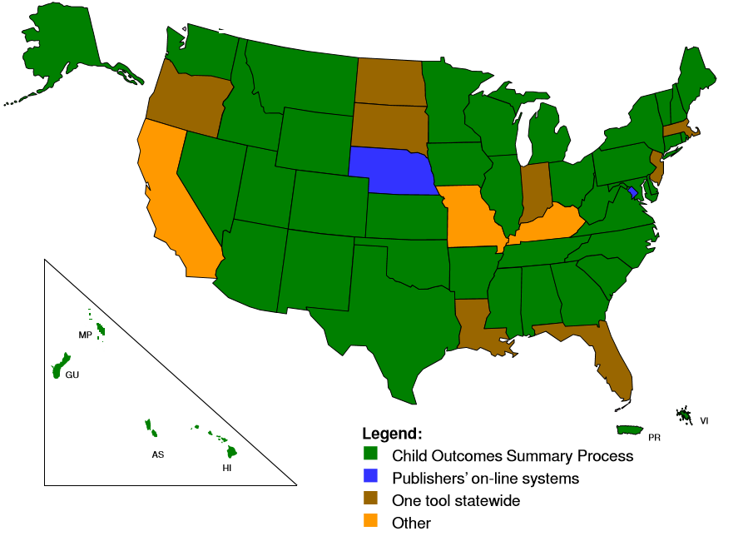
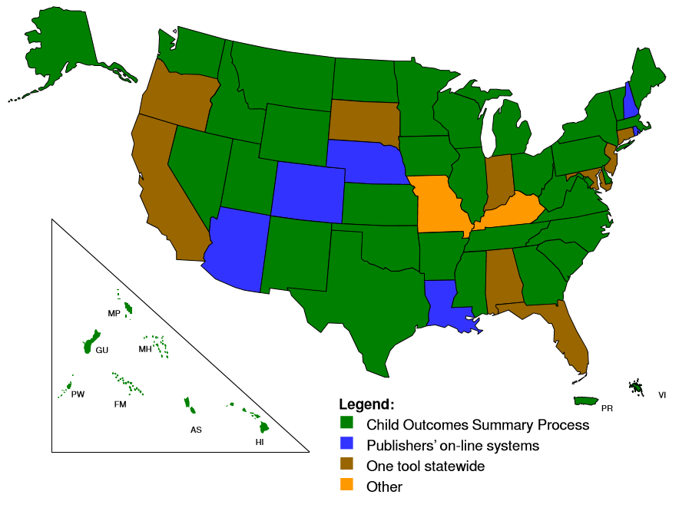
State Approaches to Child Outcomes Measurement (Sept. 2015)
Part C
619
Most states use the COS process for reporting child outcomes data.

Slide 6
More About the COS Process
Provides a method for integrating multiple sources of information about a child’s functioning in the three outcome areas, including different assessment tools.
Was developed by the Early Childhood Outcomes (ECO) Center in 2005.
The ECO Center/ECTA Center initially developed a variety of training materials for providers on how to implement the COS process, but…
Many different people around the country have been providing training,
Practitioners completing the COS process have received different amounts of training, and…
That training has been of different levels of quality.
Problem: Variability in the quality of child outcomes data obtained from using the COS process.

Slide 7
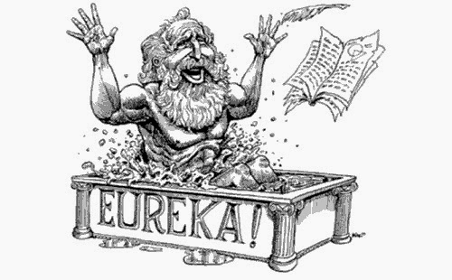
Solution
Provide consistency in the quality of COS process training through the:
COS Online Module
COS-Competency Check (COS-CC)
COS-Team Collaboration (COS-TC) Toolkit
Source: Google image search

Slide 8
COS Online Module

Slide 9
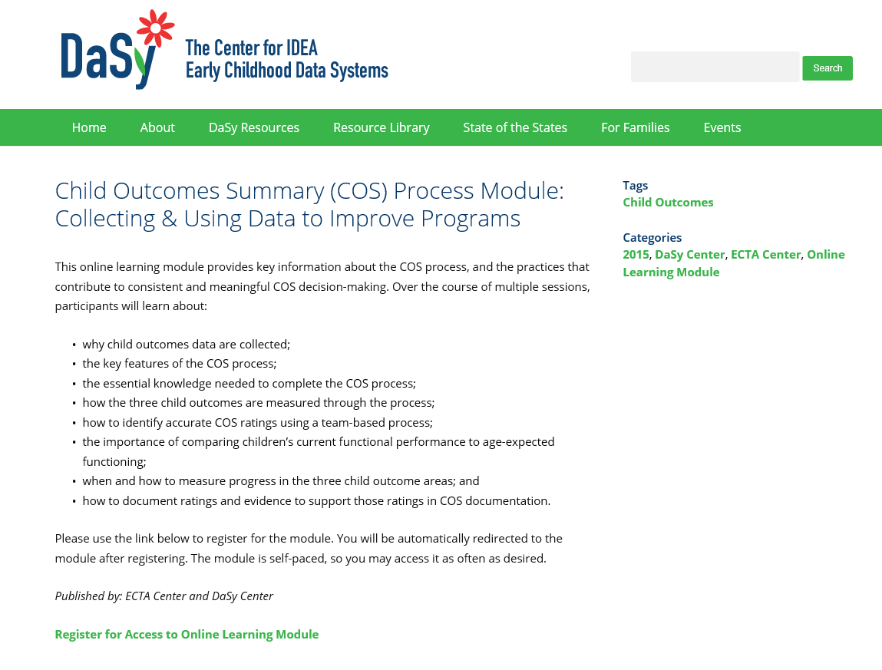
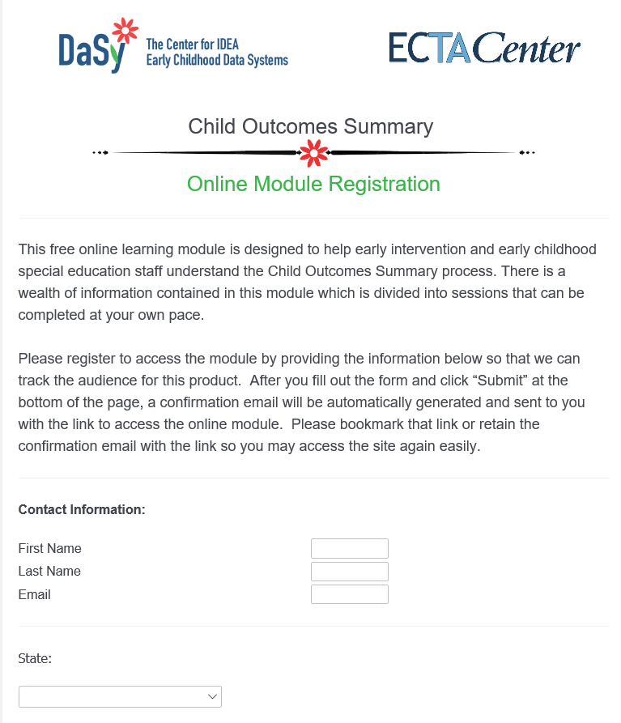
Accessing the Module

Slide 10
Target Audiences & Intended Outcome
Target Audiences:
Early intervention and early childhood special education staff (e.g., therapists, Service Coordinators)
State and local administrators/supervisors
National, state, and local technical assistance providers
Intended Outcome:
State Part C and 619 staff will be better able to improve the knowledge and skills of practitioners who use the COS process to collect child outcomes data, which also will lead to improved child outcomes data quality.

Slide 11
Content Overview
Over the course of 8 sessions, users are provided with key information about the COS process and the practices that contribute to consistent and meaningful COS decision-making.
Session 1: Introduction - So What's This All About?
Session 2: Overview of the COS Process
Session 3: Completing the COS Process
Session 4: The 7-Point Scale
Session 5: More Information About Determining a Rating
Session 6: Good Teaming, Good Decisions
Session 7: Documenting the COS Rating (late Aug.)
Session 8: Measuring Progress (Sept.)
Bonus Grab-n-Go Presentation: OSEP Reporting (Oct.)

Slide 12
What’s involved in a session?
PDQuest©
Time commitment/session: 30-45 minutes

Slide 13
Module Usage: We Built It…and They Came!
Source: Google image search

Slide 14
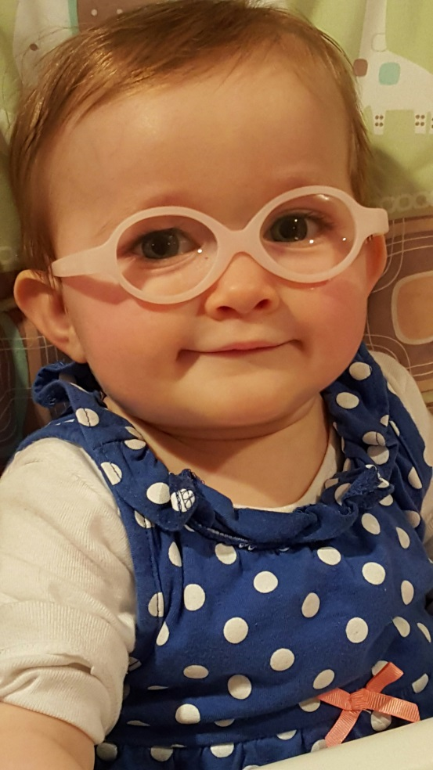
Examples of State Uses
PD for new staff or as required refresher training
Using session content as a foundation to develop state-specific PD content
Writing COS Module into SSIP improvement strategies
Other ways you are using it in your state?

Slide 15
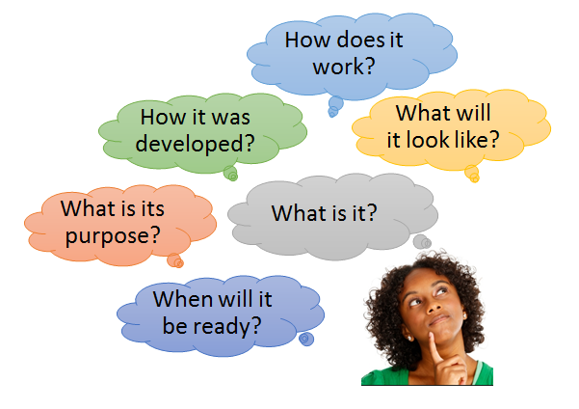
COS Competency Check (COS-CC)

Slide 16
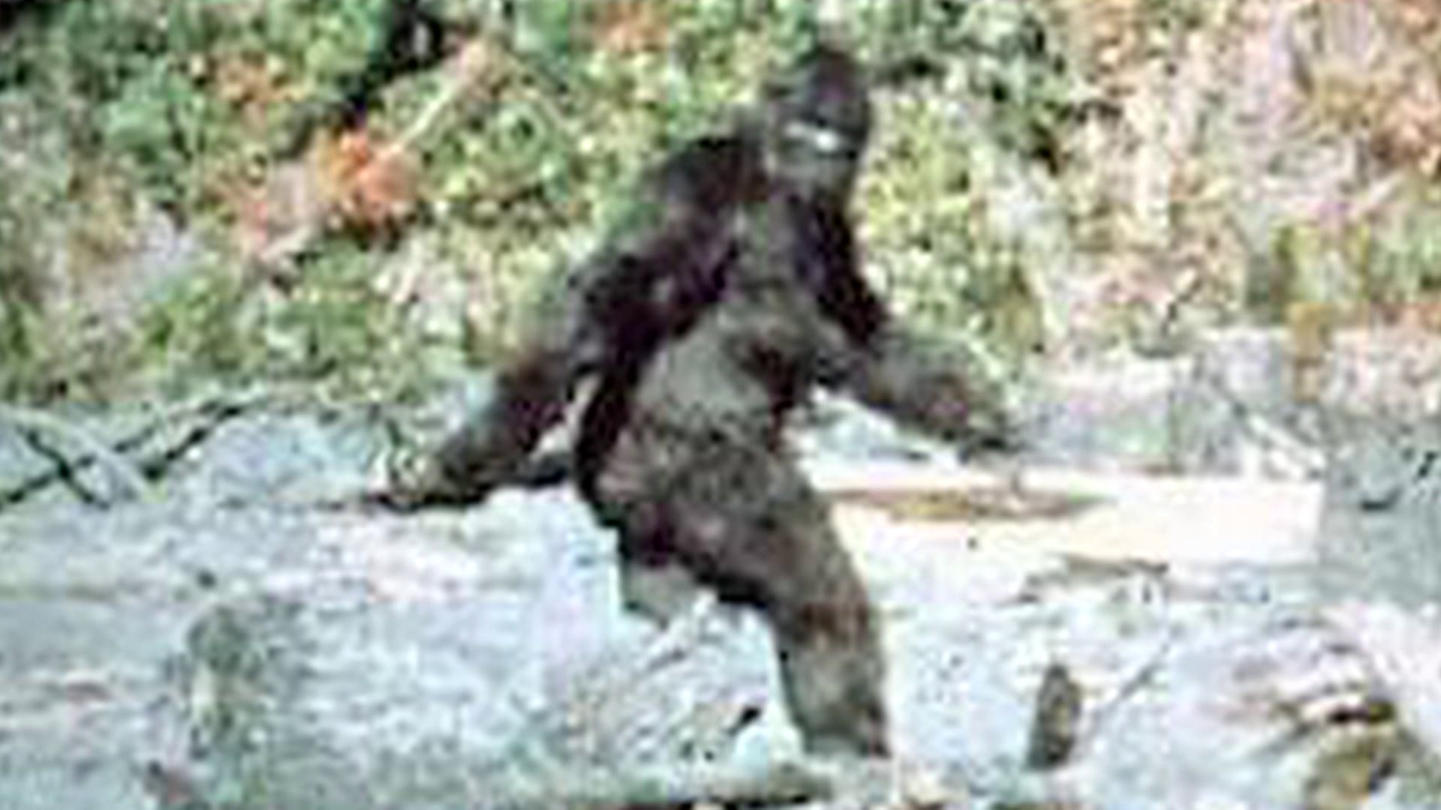
The Big Foot of COS PD Tools
Source: Google image search
Does it really exist? Some have seen it, but will we ever ALL see it?

Slide 17
What is the COS-CC and what is its purpose?
It is an assessment tool designed to:
Provide states with a way to verify that practitioners have key competencies needed to participate in the COS process, namely an understanding of:
Why we measure child outcomes
The content of the 3 outcomes
Functionality
Anchoring skills in age expectations
The 7-point rating scale
Help states identify professional development needs and tailor individualized support to staff.

Slide 18
What the COS-CC is Not
It is not a training tool.
It does not assess everything that a practitioner needs to know to participate in the COS process.
Does not assess observation skills or collaborative teaming skills.
It is not a certification.
Source: Google image search

Slide 19
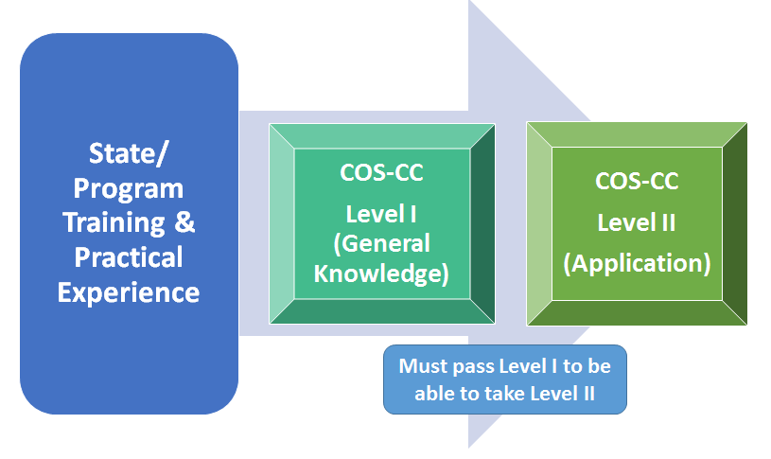
How does it work?

Slide 20
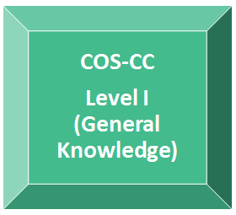
Level I
Assesses general knowledge of:
Why we measure child outcomes
The content of the 3 outcomes
Functionality
Anchoring skills in age expectations
The 7-point rating scale

Slide 21
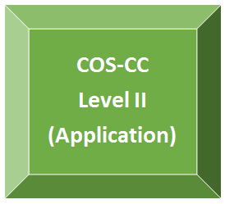
Level II
Assesses ability to apply general knowledge associated with key competencies to:
Short scenarios
Case studies (with videos)

Slide 22
How was the assessment developed?
IRB exemption obtained
Iterative process involving:
Content development by DaSy/ECTA workgroup
Content validation by national experts
Piloting of items with EI and ECSE practitioners
Source: Google image search

Slide 23
What will it look like?
An online assessment with backend monitoring and reporting capabilities for local and state administrators
DaSy, in partnership with JHU CTE, is building the online assessment data system.
Source: Google image search

Slide 24
Passing the COS-CC
To pass the COS-CC, users must pass both Level I and Level II.
Downloadable documentation of passing will be provided (e.g., a certificate).
Scores/results will be saved in the system until the user’s account is removed by an administrator.
What happens if a user isn’t able to pass it?

Slide 25
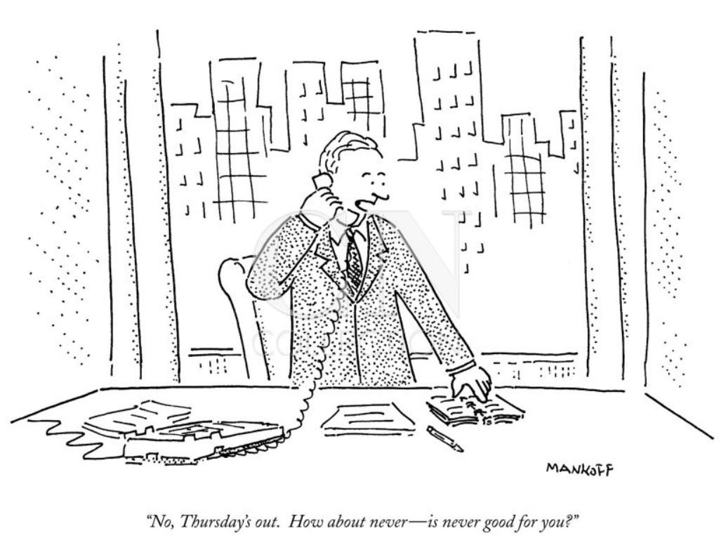
WHEN will it be ready?
Cartoon source: The New Yorker, 5/3/93

Slide 26
COS Team Collaboration (COS-TC) Toolkit

Slide 27
Components of the COS-TC
Quality Practices Checklists
Descriptions and Examples
Video Clips
Herman Family Scenario

Slide 28
Checklists
Planning for the COS
Explaining the COS to Families
Understanding Child Functioning
Building Consensus for High Quality COS Ratings
Interactive Practices

Slide 29
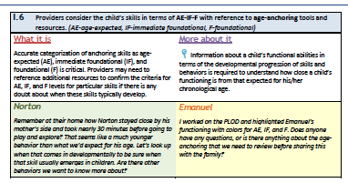
Descriptions and Examples

Slide 30
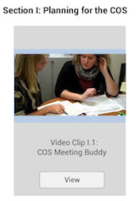
Video Clips
Meant to focus on a specific section of the checklist
Real life examples of team practices and rating opportunities
Interactive examples

Slide 31
Herman Family Scenario: Facilitator’s Guide
Presents examples of challenging situations, such as:
Communicating difficult information to families
Determining ways to engage families when they have limited time or availability
Finding ways to fully understand children’s functional abilities beyond conventional testing alone
Provides practitioners with opportunities for problem solving and identifying effective strategies that could be used in their work.

Slide 32
State Experiences with Supporting a COS PD Program
Source: Google image search

Slide 33
Arizona Part C: Increasing Data Quality

Slide 34
Arizona Part C (cont.): Use of the DaSy/ECTA COS Module
All EIP team members attend
Review of the EIP’s current COS data
Review of how team members are using the data for program improvement
Discussion between sessions of the module on how to improve collaboration and practices
Module will be utilized for on-boarding of new team members

Slide 35
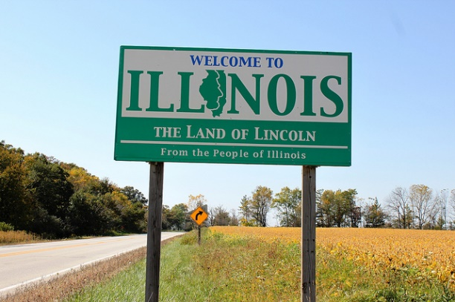
Illinois Part C
Source: Google image search
Have used a variety of approaches to supporting the COS process over time
Face-to-face statewide training for Service Coordinators
General online module for interventionists
Worked with Early Childhood Technical Assistance Center (formerly Early Childhood Outcomes Center) on statewide face-to-face training
Developed individual modules around each outcome area
Have embedded child and family outcomes in Systems Overview and in some other system offerings
Continue to offer face-to-face trainings focused on problem-solving and practice

Slide 36
Illinois Part C (cont.)
Using DaSy/ECTA COS online module and its contents in a few ways
Some content has been embedded in Service Coordinator online training
Module will be available for access for IL EI credit for professionals
Module may be used as prerequisites for face-to-face trainings
Planning to use COS-TC for SSIP work
Developing policies and procedures
Face to face professional development opportunities
Evaluation efforts

Slide 37
Illinois Part C (cont.)
http://www.cvent.com/d/5vqjqw

Slide 38
Questions or comments?

Slide 39
Contact Information
Maureen Casey: mcasey@azdes.gov
Chelsea Guillen: cguillen@illinois.edu
Kathi Gillaspy: kathi.gillaspy@unc.edu
Amy Nicholas: amy.nicholas@unc.edu
Kellen Reid: kellen.reid@unc.edu
Cathy Smyth: cathysmyth@yahoo.com

Slide 40
Find Us, Like Us, Follow Us!
Visit the DaSy website at: http://dasycenter.org/
Like us on Facebook: https://www.facebook.com/dasycenter
Follow us on Twitter: @DaSyCenter
Visit the ECTA website at: http://ectacenter.org/
Like us on Facebook: https://www.facebook.com/ECTA-Center-304774389667984/
Follow us on Twitter: @ECTACenter

Slide 41
The contents of this presentation were developed under grants from the U.S. Department of Education, #H373Z120002 (Project Officers: Meredith Miceli and Richelle Davis) and #H326P120002 (Project Officer: Julia Martin Eile). However, contents of the presentation do not necessarily represent the policy of the U.S. Department of Education, and you should not assume endorsement by the Federal Government.

