Slide 1
Data Sharing: Federal TA Efforts, What We Know & What We Need to Know
2013 IDEA Leadership Conference
July 29, 2013

Slide 2
Overview of TA Investments
Privacy Technical Assistance Center (PTAC)
Center for the Individuals with Disabilities Education Act (IDEA) Early Childhood Data Systems (DaSy Center)
Early Childhood Technical Assistance Center (ECTA)
Notes:
Birth to 21 vs. EC
Scope of each one related to privacy

Slide 3
Presenters
Moderator - Sharon Walsh, DaSy
Baron Rodriguez, PTAC
Jennifer Tschantz, DaSy
Evelyn Shaw, ECTA

Slide 4
Purposes and Agenda
Provide overview of Federal TA investments and plans for coordination of those efforts
Review of available resources, plans for TA and where to send questions
Identification of privacy and data sharing issues and questions

Slide 5
Other Data Sharing Session
TITLE: Who’s On First? – Confidentiality, Records, and Data Sharing under IDEA Part C and FERPA
When: Wednesday July 31, 2013
10:00–11:15
Speakers: Kala Surprenant, OGC
Frank Miller, OSEP
Dale King, Family Policy
Compliance Office

Slide 6
Thoughts for Discussion
?
What challenges do states face related to data sharing and privacy?
What solutions and resources have you found helpful?
What areas would be helpful to focus on for collaborative TA?
What issues need clarification?

Slide 7
Overview – PTAC Coordination @ ED
“One Stop” resource center for all privacy & security questions.
Regional meetings, customized webinars, and on-site presentations
Technical Assistance (TA) site visits
Help desk
Web resources

Slide 8
Web Resources
Web Resources
Issue briefs, and white papers
Training Videos
Security checklists
Frequently Asked Questions
(FAQs)
Webinars, presentations, and training materials

Slide 9
Overview – PTAC Coordination @ ED
Privacy Technical Assistance Center (PTAC)
Privacy Advisory Committee (PAC) – Cross section of all ED offices to provide uniform guidance across all ED offices in the areas of privacy and security.
Office of General Council, Family Policy Compliance Office (FPCO)
FERPA Working Group (FWG) – FPCO, Chief Privacy Officer, Office of Management.

Slide 10
PTAC TA Helpdesk & Site Visits

Slide 11
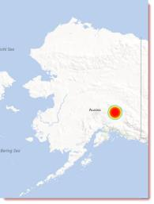
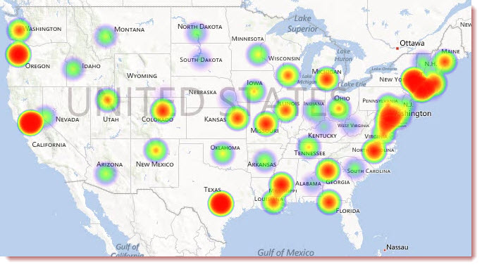
PTAC TA Number of Requests
Red indicates greater number of TA requests
Locations are set to State capitals for privacy reasons

Slide 12
ED/PTAC Resources Available
Case Studies
H.S. Feedback Report
Head Start Program
FPCO Enforcement of FERPA
PTAC Technical Assistance
Data Sharing
Data Sharing Agreement Checklist
Guidance for Reasonable Methods
Data Security
Data Security Checklist
Data Governance Checklist
Cloud Computing
Identity Authentication Best Practices
Data Breach Response Checklist

Slide 13
Additional ED/PTAC Resources:
Disclosure Avoidance FAQs
Identification of Data Types & Uses
De-identified Data Case Study
FERPA 101 professional training video
FERPA 201 (Data Sharing) professional training video
FERPA 301 (Postsecondary) professional training video

Slide 14
PTAC in 2013 Upcoming Publications & Videos
Publications
Reverse transfer (FAQ)
Data sharing with Labor agencies (case study)
Data destruction & recordkeeping (issue brief)
Contracting for IT Services in Education
FERPA Exceptions (FAQ)
FERPA Exceptions (flowchart by data type)
Video Trainings
FERPA for parents & eligible students

Slide 15
Contact Information
Family Policy Compliance Office
Telephone: (202) 260-3887
Email: FERPA@ed.gov
FAX: (202) 260-9001
Website: www.ed.gov/fpco
Privacy Technical Assistance Center
Telephone: (855) 249-3072
Email: privacyTA@ed.gov
FAX: (855) 249-3073
Website: http://ptac.ed.gov

Slide 16
Overview of the DaSy Center
DaSy’s Role as it Relates to Data Privacy, Data Confidentiality, and Data Sharing

Slide 17
What is DaSy?
A new 5-year Center funded by OSEP to assist states with improving Part C and Part B preschool data by:
Building better data systems
Coordinating data systems across early childhood programs
Building longitudinal data systems
Building the capacity of states to use data

Slide 18
Center’s Goals
Provide national leadership and coordination around EC data systems
Generate new knowledge and useful products regarding building coordinated EC data systems and including EC in statewide longitudinal data systems
Design and implement a continuum of technical assistance strategies to improve state capacity to collect, analyze, and report high quality data
Notes:
KD: Collect information from states about current and planned data systems for Part C and Part B Preschool including links to other data systems
Develop a framework for Early Childhood Data Systems
Develop documents and resources (e.g., best practices, lessons learned) to support the use of the framework to improve data systems
TA &D: Use framework to provide intensive TA to 10 states (phase in, years 2 and 3)
Promote critical data system requirements
Develop national TA network
Provide a continuum of general TA and dissemination activities
Maintain a website
Prepare and disseminate reports, documents, and other materials
Support states in developing data systems to address APR performance and compliance indicators

Slide 19
The Time is Right
Recognition of the:
The importance of early childhood
Need for good data
Need for coordinated early childhood data systems
Need for longitudinal data systems
Resources for:
Building coordinated EC systems (RTT-ELC)
Building state data systems (SLDS, CEDS, PTAC, RTT-ELC)
State and local programs are increasingly aware of the importance of having good data.

Slide 20
Where DaSy fits
More powerful and higher quality data about programs, personnel, services, and children and families
Policy makers, state agency staff, local program staff, and others use data to improve programs
Improve the quality of Part C and Part B Preschool services and supports
Improve outcomes for children and families
Improved capacity in states to meet IDEA reporting requirements and ask and answer policy and programmatic questions
Better data systems
as a tool
to improved programs

Slide 21
Who are we?
SRI International
Frank Porter Graham (FPG) Child Development Institute
Applied Engineering Management (AEM)
Westat
Center for Technology in Education (CTE) at Johns Hopkins University (JHU)
Cadre of national experts

Slide 22
Some Key Collaborations
OSEP Early Childhood Technical Assistance (ECTA) Center
OSEP Early Childhood Personnel Center (ECPC)
Support team for the State Longitudinal Data System (SLDS) grants
Common Education Data Standards (CEDS)
Early Learning Challenge (ELC)TA Consortium
Privacy Technical Assistance Center (PTAC)
Center on Enhancing Early Learning Outcomes (CEELO)
Early Childhood Data Collaborative (ECDC)

Slide 23
DaSy Confidential Workgroup
Members
Sharon Walsh
Baron Rodriguez
Haidee Bernstein
Missy Cochenhour
Robin Nelson

Slide 24
DaSy Confidentiality Workgroup - Purpose
Develop resources to assist State Part C and 619 coordinators/programs to address data confidentiality, data sharing, and data privacy questions and issues as they build and use early childhood data systems.

Slide 25
DaSy Confidentiality Workgroup Goals
Identify State Part C and 619 questions/issues around data confidentiality, sharing, and privacy.
Collaborate with PTAC and other TA Centers to develop and disseminate useful resources for states.
Facilitate getting answers to specific and general questions from States (Part C and 619)
Provide professional development opportunities (often through collaboration) for states, particularly for Part C and 619 folks.

Slide 26
DaSy Confidential Workgroup-Current Activities
PD for workgroup members
Identifying state questions/Issues
Reviewing and analyzing existing resources
Supporting C/619 participation in Aug 1st EC Data Privacy Meeting hosted by PTAC/SLDS
Identify HIPPA resources and expertise

Slide 27
DaSy Confidential Workgroup-Future Activities
Identify and disseminate existing relevant and useful resources
Develop “new” resources and products
Tweak and repackage relevant PTAC documents specifically for Part C and 619 audiences
Develop an ongoing FAQ document
Hosting webinars /topical meetings
PTAC 101 webinar - Monday 8/19 2 – 3 PM ET
Data confidentiality, data privacy, data sharing sessions at the National Meeting
Community of Practice?
Continuing to coordinate our work with other TA Centers and federal partners

Slide 28
How to request help from DaSy
Email any DaSy staffer
Email to dasycenter@sri.com
Call DaSy Center at 650-859-3881

Slide 29
Much more to come….
http://dasycenter.org/

Slide 30
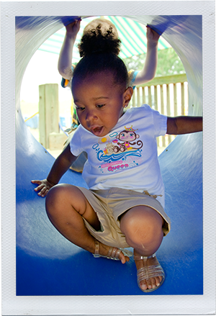
EARLY CHILDHOOD TECHNICAL ASSISTANCE CENTER
Leadership Meeting
July 29, 2013

Slide 31
Who is ECTA?
National Early Childhood TA Center
Early Childhood Technical Assistance Center (ECTA)
Center for Early Literacy Learning
Technical Assistance Center on Social Emotional Intervention
Early Childhood Outcomes Center

Slide 32
Center Activities
Responsive TA, web site and products
Development of “systems framework” with partner states
Intensive TA on systems framework
Support the revision of the DEC Recommended Practices
Defining essential features of implementation components
Intensive TA on Recommended Practices
Intensive TA on Outcomes Measurement Systems
Support C and 619 involvement in cross EC and 0- 3rd grade initiatives

Slide 33
Frank Porter Graham Child Development Institute, UNC
Pacer Center
Puckett Institute
SRI International
University of Colorado, Denver
University of South Florida
Walsh Taylor Associates

Slide 34
NECTAC TA on Confidentiality/Procedural Safeguards/CAPTA
Publications
Coordinated Sessions at OSEP national meetings on family rights, procedural safeguards, CAPTA
Webinars on Vulnerable Populations on
Listserv compilations on CAPTA MOUs, policies, procedures, and referrals

Slide 35
Overarching Purpose
To improve services
systems and assist states
in scaling up and sustaining
effective services and
research-based interventions
to improve outcomes for infants,
toddlers and preschoolers with
disabilities and their families

Slide 36
Integrated ECTA Initiatives
What does a state need to put into place in order to encourage, support, require local implementation of effective practices?
How can we best support states’ success in identifying, implementing, scaling up, and sustaining effective practices.
Implementation of Effective Practices
and
Positive Outcomes for Young Children with Disabilities and their Families
System Framework: Components and quality indicators of an effective system
DEC Recommended Practices: Effective practices for supporting children and families
Implementation Process: The science of implementation and sustainability
+
+
=
Notes:
Barbara
1. Systems Framework answer the question: What does a state need to put into place in order to encourage, support, require local implementation of effective practices?
2. The DEC Recommended Practices work (which is being worked on concurrently by the DEC Commission) will identify effective practices for supporting children and families. So these will be primarily the practitioner interactions with families and children.
3. OUR WORK: relates to implementation processes, and what we know from implementation science about what it takes to be successful in implementing, scaling up, and sustaining effective practices.
So, it’s our premise that it’s the integration of these 3 areas of ECTA work that IN TOTALITY that supports the box on the far right – the implementation of effective practices and the subsequent positive outcomes for children and families.
Pause for questions, reactions?

Slide 37
ECTA Intensive TA for Selected States
Outcome Measurement Systems
Building Effective Systems (System Framework)
Implementing selected Recommended Practices

Slide 38
Focused Topics for TA
TA
Governance
Monitoring and Accountability (including Procedural Safeguards)
IFSP Process, Service Coordination, Natural Environments
TA
Transition Practices
Personnel Development
Funding/Finance
Data System
Quality Standards
Child and Family Outcomes Measurement
Service Models
TA
IEP Process
Inclusion
Child Find Systems
Family Practices
Child Assessment
Implementation Process
TA

Slide 39
Thoughts for Discussion
What challenges do states face related to data sharing and privacy?
What solutions and resources have you found helpful?
What areas would be helpful to focus on for collaborative TA?
What issues need clarification?

