Slide 1
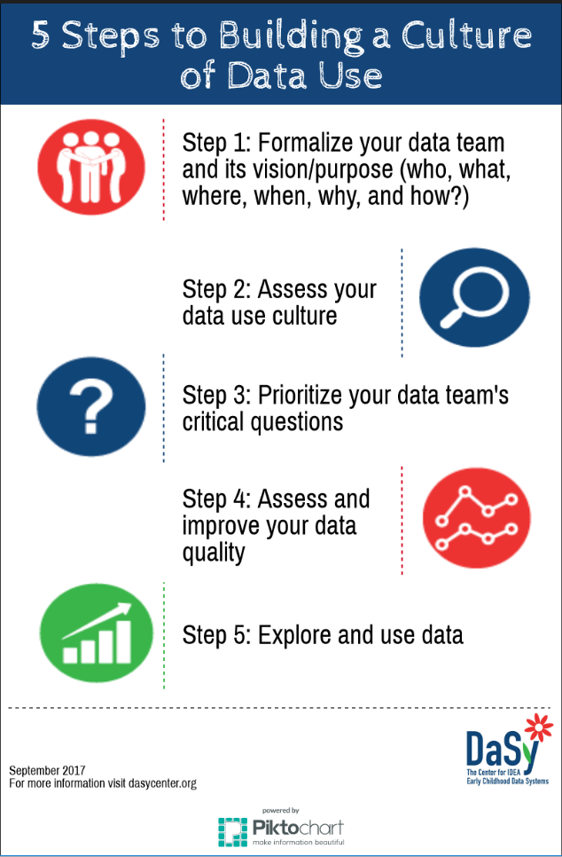
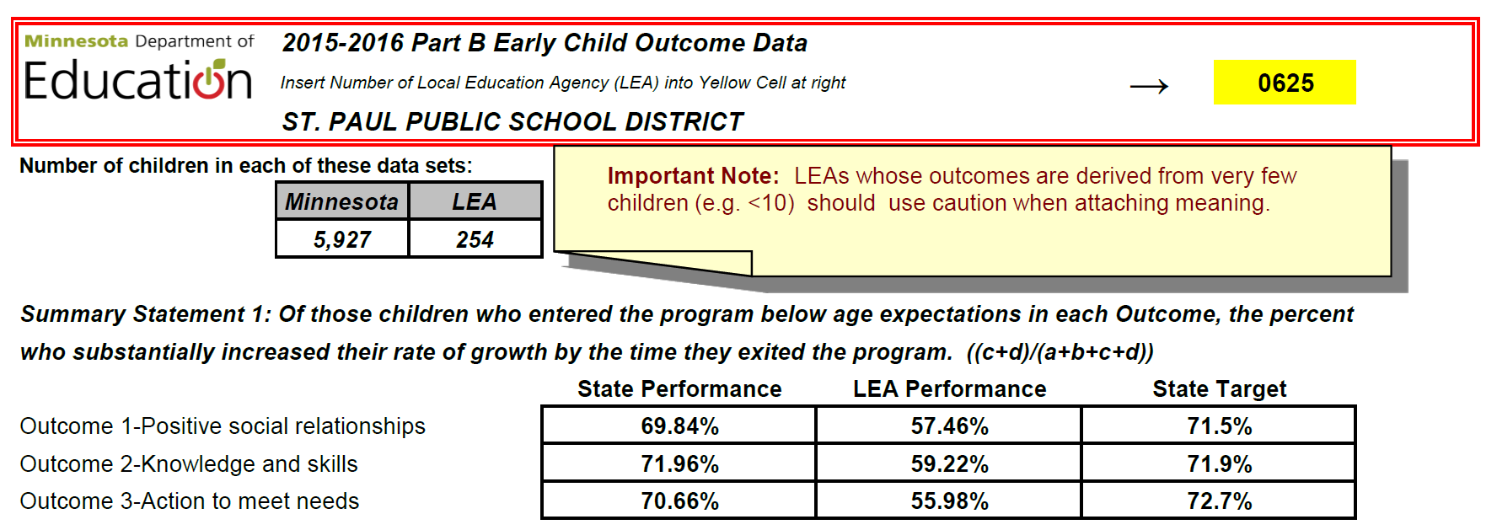
Making Informed Decisions: Leveraging Local Data Use for Program Improvement
Tony Ruggiero, Abby Schachner, & Denise Mauzy
Division for Early Childhood's 33rd Annual International Conference on Young Children with Special Needs and Their Families
Portland, Oregon | October 2017
Overview
Five Steps to Building a Culture of Data Use
Effective use of early intervention (EI) and early childhood special education (ECSE) data is fundamental to achieving positive outcomes for children with disabilities and families.
Professionals need data to make informed decisions that support positive outcomes.
For effectiveness, data should be embedded in the culture of EI and ECSE.
Data teams help ensure that data are used to inform decisions about program operations, accountability, and improvement.
Step 3:
Know what questions can help you understand how programs and policies support children’s progress. Data teams can:
contribute to identifying critical questions and
prioritize critical questions based on the data team’s purpose and availability of high-quality data.
Examples of Critical Questions
1.D.1. What are the outcomes for children and families participating in early intervention/early childhood special education (EI/ECSE)? .
1.B.6. What is the relationship between the IDEA service setting and child outcomes?
1.B.4. What characteristics of services are related to better outcomes for children and families?
Data Teams and Building a Data Use Culture
A data team is a group of professionals and stakeholders who work together to use data to plan and make decisions about programs and services.
Effective data teams help EI/ECSE programs build a culture of data use.
Step 4:
Use high-quality data to make program and policy decisions. Ensure high-quality data through the use of:
data system enhancements such as built-in edit checks to prevent errors at data entry;
documented data cleaning process that involves the state and local EI or ECSE programs; and
professional development to understand the data collection process.
DEC Recommended Practices
This poster addresses DEC Recommended Practices:
(L9) Leaders develop and implement an evidence-based professional development system or approach that provides practitioners a variety of supports to ensure they have the knowledge and skills needed to implement the DEC Recommended Practices.
(L12) Leaders collaborate with stakeholders to collect and use data for program management and continuous program improvement and to examine the effectiveness of services and supports in improving child and family outcomes. Source: https://divisionearlychildhood.egnyte.com/dl/tgv6GUXhVo
Step 1:
Ensure that you have a foundation in place to support effective data use.
Take time to ensure that all group members agree on the team’s purpose.
Work with team members on a common vision.
Include members such as individual service providers/teachers, State Education Agency or Local Education Agency coordinators and data managers, and families.
Step 5:
Examine and explore data over time by factors such as race, geography, age of child, disability category, etc. Consider that:
all data team members provide a unique perspective to analyzing the data;
members with an interest in the data can contribute to the “drill down” of the data or assist with analyses; and
answering critical questions and interpreting data should be a team activity and should not be the responsibility or reflect the perspective of just one person.
Resources
Step 2:
For more information about critical questions go to http://dasycenter.org/resources/critical-questions/
For more resources on communicating data see http://dasycenter.org/data-visualization-toolkit-tools-tips-for-presenting-data-effectively/
For more guidance on conducting data analysis for program improvement go to: http://dasycenter.org/planning-conducting-and-documenting-data-analysis-for-program-improvement
These and more additional resources can be accessed through the DaSy Center website: http://dasycenter.org
Assess your data culture strengths and challenges in using data to support informed decision-making. Data should:
be embedded in the culture of EI and ECSE;
be used to make informed decisions that support positive outcomes for children with disabilities and their families; and
be promoted by data teams to ensure that data are used to inform decisions about program operations, accountability, and program improvement.
For more information, please contact: Abby.Schachner@sri.com
Stay connected with DaSy: http://dasycenter.org
Follow us on Twitter: @DaSyCenter

