Slide 1




What is the problem?
Broad Data and Infrastructure Analysis
October 2013
Kathy Hebbeler
Christina Kasprzak
Cornelia Taylor

Slide 2
Theory of Action
Data Analysis
In-depth Analysis Related to Focus Area
Infrastructure Assessment
In-depth Analysis Related to Focus Area
Focus for Improvement
Data Analysis
Broad Analysis
Infrastructure Assessment
Broad Analysis

Slide 3

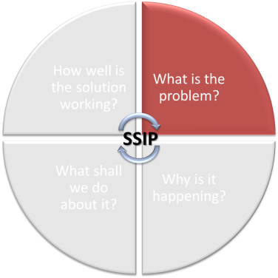
Data Analysis
3

Slide 4

Evidence
Inference
Action
4

Slide 5

Evidence refers to the numbers, such as
  “45% of children in category b”
The numbers are not debatable
5
Notes:
60% of children are in SS1
20% of children had an entry rating of 7
Just the facts

Slide 6
Inference
How do you interpret the #s?
What can you conclude from the #s?
Does evidence mean good news? Bad news? News we can’t interpret?
To reach an inference, sometimes we analyze data in other ways (ask for more evidence)
6
Notes:
What’s critical is how we interpret the numbers --- putting meaning on the data.
What does the data tell you? What can you conclude?
Is it something you’re not sure what it means?

Slide 7
Inference
Inference is debatable -- even reasonable people can reach different conclusions
Stakeholders can help with putting meaning on the numbers
Early on, the inference may be more a question of the quality of the data
7
Notes:
It’s important to realize that inference is debatable– different people can reach different conclusions. That’s why stakeholders (such as the program administrators, staff, beneficiaries) can help with putting meaning on the numbers.
You don’t want to start making conclusions or decisions about the quality of your program until you feel the data are accurate.

Slide 8
Action
Given the inference from the numbers, what should be done?
Recommendations or action steps
Action can be debatable – and often is
Another role for stakeholders
Again, early on the action might have to do with improving the quality of the data
8
Notes:
So, after you’ve decided what the data mean, you can think about what actions need to be taken. This too can be debatable and may be another place where stakeholders can help.

Slide 9

Data Quality: What if you don’t trust the data?
Notes:
Catch 22 – you don’t want to use the data until it’s high quality, but it can’t become high quality until you use it.

Slide 10

Data Quality
Not the focus of the SSIP
But must be addressed in the SSIP
  Describe data quality issues identified through
  Describe data quality efforts

Slide 11
Data Quality
How have you identified child outcomes data quality issues?
  Pattern checking analysis
  Data system checks
  Data quality reviews (e.g. record reviews, COS reviews)
  Survey with local programs
  Other?

Slide 12
Data Quality
What efforts are you making to improve child outcomes data quality?
  Pattern checking analysis and follow up
  Guidance materials development and dissemination
  Training and supervision of relevant staff
  Data system checks and follow up
  Data quality review process and follow up
  Data review with local programs
  Other?

Slide 13
Data Quality
Resources on assuring the quality of your child outcomes data http://ectacenter.org/eco/pages/quality_assurance.asp

Slide 14
Data Quality
How have you identified family indicator data quality issues?
  Calculation of response rates
  Analysis for representativeness of the data
  Other?

Slide 15
Data Quality
What efforts are you making to improve family indicator data quality?
  Strategies to improve overall response rates
  Strategies to increase responses from certain subgroups of families
  Other?

Slide 16
Data Quality
Resources on assuring the quality of your family indicator data can be found on http://ectacenter.org/eco/pages/tools.asp#AdditionalResources

Slide 17
Getting Started: Broad Data Analysis

Slide 18
What is the problem?
Governance
Funding/ Finance
Personnel/ Workforce (PD&TA)
Data System
Monitoring and Accountability
Quality Standards
result
Implementation
of effective practices
Improved outcomes for children and families
Notes:
Looking at the system and its relationship with implementing effective practices and outcomes for children and families
Starting places (rust box – if you already know what you want to focus on as far as effective practices); (orange box – if you don’t already know what you want to focus on)
Back into the system from either place.
Different ways of coming at this process.

Slide 19
Starting with a question (or two..)
All analyses are driven by questions
Several ways to word the same question
Some ways are more “precise” than others
Questions come from different sources
Different versions of the same question are necessary and appropriate for different audiences.
Notes:
You’re really starting with a question – that is critical for focusing your analysis. You can’t really just start with data.

Slide 20
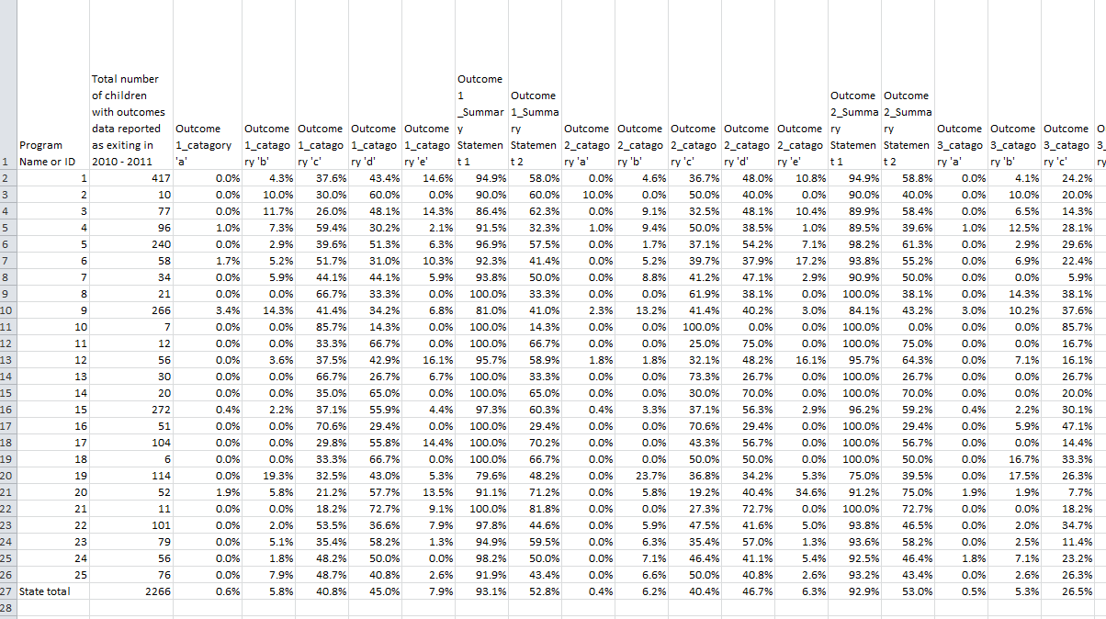
Notes:
Excel file to show that you can’t just start with the data – have to start with question(s)
There’s tons of data and an infinite number of ways to look at it. How will you prioritize your process? By defining questions.

Slide 21
Do you have a Starting Point?
Starting with an issue and connecting to outcomes, practices/services, and systems
Starting with effective practices and connecting forwards to child and family outcomes and backwards to systems
What’s the evidence? Does it substantiate your issue? Testing hypotheses?
Notes:
If you start with an issue or practice, you need to connect to the outcomes. For overall ‘effective practices’ you are connecting in theory.
Sense of who has decided what they’re doing? How many people already have an idea of what they’ll be working on for the SSIP?
What are they focusing on?
You are either reviewing data to support focus area OR reviewing to identify focus area.
Starting point is really one or more questions (hypotheses)

Slide 22
Starting Points
Starting with an issue and connecting to outcomes, practices/services, and systems
  E.g. low income children have lower outcomes than other children
  Is your hypotheses substantiated by the data?
  What other data do you have about the issue that substantiates your hypotheses that this is a critical issue for your state? (e.g. monitoring visits, complaints data, etc., TA requests)
Notes:
Reviewing data to support focus area OR reviewing to identify focus area.
Your hypothesis IS the issue. So, if you think you have an issue with supporting children with social emotional issues, your hypothesis is that children with social emotional issues have lower outcomes data. Now you have to run some data analysis to substantiate your hypothesis.

Slide 23
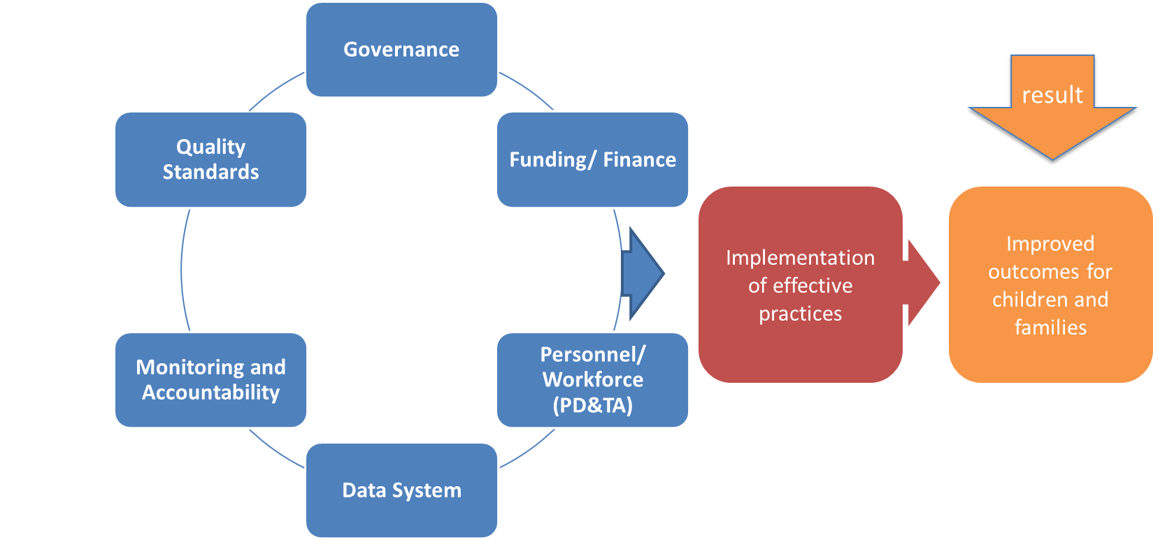
Do you have a Starting Point?
If not ...
Starting with child and family outcomes data and working backwards to practices/services and systems

Slide 24
Broad Data Analyses
Analysis of child outcomes data
By summary statement
State data compared to national data
Local data comparisons across the state
State trend data
Analysis of family indicator data
State data compared to national data
Local data comparisons across the state
State trend data
Notes:
Begin with a reasonable/doable set of basic analyses as a basic starting place
You’re using these data to either: (a) substantiate your issue/test your hypothesis or (b) identify an issue

Slide 25
Identifying a General Focus for Improvement
Stakeholder Review of Broad Data Analyses
What are the overall outcomes data tell us?
  How is the state performing?
    Compared to national averages?
    Compared to what we expect?
    Which outcomes have the lowest performance data?
  How are local programs performing?
    Compared to the state average?
    Compared to one another? Which programs have the lowest performance data?
Notes:
If you’re identifying an issue

Slide 26

Identifying a General Focus for Improvement
What will be your general focus area?
  Low performing areas?
  One or more of the 3 child outcomes?
  One or more of the 3 family indicators?

Slide 27
Activity
Looking at Data
Notes:
Activity – Mock stakeholder process –
Data charts
Make the data story lead to 2-3 local programs with lower performance than other programs (could be one or more outcome areas)

Slide 28

Broad Infrastructure Assessment
Notes:
Context, landscape, broad look at your system strengths and challenges, features.
What is the current capacity of the system?

Slide 29
Theory of Action
Theory of Action
Data Analysis
In-depth Analysis Related to Focus Area
Data Analysis
In-depth Analysis Related to Focus Area
Infrastructure Assessment
In-depth Analysis Related to Focus Area
Infrastructure Assessment
In-depth Analysis Related to Focus Area
Focus for Improvement
Data Analysis
Broad Analysis
Infrastructure Assessment
Broad Analysis

Slide 30
Infrastructure Assessment
A description of how the State analyzed the capacity of its current system to support improvement and build capacity in LEA's and local programs to implement, scale up, and sustain evidence-based practices to improve results for children and youth with disabilities, and the results of this analysis.
  State system components include: governance, fiscal, quality standards, professional development, technical assistance, data, and accountability.
Notes:
”

Slide 31
Infrastructure Assessment
  The description must include the strengths of the system, how components of the system are coordinated, and areas for improvement within and across components of the system.
  The description must also include an analysis of initiatives in the State, including initiatives in general education and other areas beyond special education, which can have an impact on children and youth with disabilities.
  The State must include in the description how decisions are made within the State system and the representatives (e.g., agencies, positions, individuals) that must be involved in planning for systematic improvements in the State system.

Slide 32
Broad Infrastructure Assessment
Description of different system components
  What are the strengths of each component?
  What are the challenges in each component?
  How is the system coordinated across components?
What are the big initiatives currently underway that impact young children with disabilities in the state?
How are decisions made in the State system and who are the decision-makers and representatives?
Notes:
Discussion?

Slide 33

Narrowing the focus through more in-depth analysis

Slide 34
Considerations for Selecting a Priority Issue
Will make a difference in results for children and/or families
Leadership in the state supports efforts to address the issue
State is committed to making changes in the issue, in terms of values, resources, and staff time
Activities already planned by the state will be enhanced
Key stakeholders understand the issue, its scope, significance, and urgency for the state
The issue is feasible/doable
The issue is defined and circumscribed well enough to be addressed in 1-3 years
Notes:
Narrowing your area of focus once you’ve got a broad issue or area to start with.

Slide 35
Narrowing the Focus
Stakeholder process
What additional questions does the data raise?
What are your hypotheses about why the data are ...
  Lower than expected?
  Lower than national averages?
  Lower in some local programs?
Notes:
Narrowing your area of focus once you’ve got a broad issue or area to start with.

Slide 36
Narrowing the Focus
How might your hypotheses help you narrow your area of focus?
What types of programmatic and policy questions will help guide you to narrow your focus?
Notes:
Let’s say at this point you’re only sure you want to focus on districts X, Y and Z. Or you know you want to focus on outcome A (social emotional). How do you narrow the focus?

Slide 37

Analyzing Child Outcomes Data for Program Improvement
Quick reference tool
Consider key issues, questions, and approaches for analyzing and interpreting child outcomes data.
http://www.ectacenter.org/~pdfs/eco/AnalyzingChildOutcomesData-GuidanceTable.pdf
Notes:
This guidance document is a tool to help identify key issues, questions, and approaches for analyzing and interpreting data on outcomes for young children with disabilities. The tool outlines a series of steps related to defining analysis questions, clarifying expectations, analyzing data, testing inferences, and conducting data-based program improvement planning. It is best used in combination with other resources or as a point of reference for a group working with technical assistance providers or others who have experience analyzing and interpreting data. States will benefit from using the tool as a guide and individualizing specific content based on the data they have available and the specific issues that are priority interests or focal areas for program improvement.

Slide 38


Steps in the Process
Defining Analysis Questions
Step 1. Target your effort. What are your crucial policy and programmatic questions?
Step 2. Identify what is already known about the question and what other information is important to find out. What is already known about the question?
Clarifying Expectations
Step 3. Describe expected relationships with child outcomes.
Step 4. What analysis will provide information about the relationships of the question content and child outcomes? Do you have the necessary data for that?
Step 5. Provide more detail about what you expect to see. With that analysis, how would data showing the expected relationships look?
Notes:
The guidance table presents some key questions to consider at important points in the process of using data for program
improvement. They are intended to support group discussion and decision-making and to serve as examples of the types
of questions to be considered. In most cases, the process of using data is an iterative one, proceeding in a series of steps
that sometimes inform earlier steps. The steps
Question: Where is the idea of ‘what data do you have’ or ‘what is realistic given the data’?

Slide 39


Steps in the Process
Analyzing Data
Step 6. Run the analysis and format the data for review.
Testing Inferences
Step 7. Describe the results. Begin to interpret the results. Stakeholders offer inferences based on the data.
Step 8. Conduct follow-up analysis. Format the data for review.
Step 9. Describe and interpret the new results as in step 7. Repeat cycle as needed.
Data-Based Program Improvement Planning
Step 10. Discuss/plan appropriate actions based on the inference(s).
Step 11. Implement and evaluate impact of the action plan. Revisit crucial questions in Step 1.

Slide 40
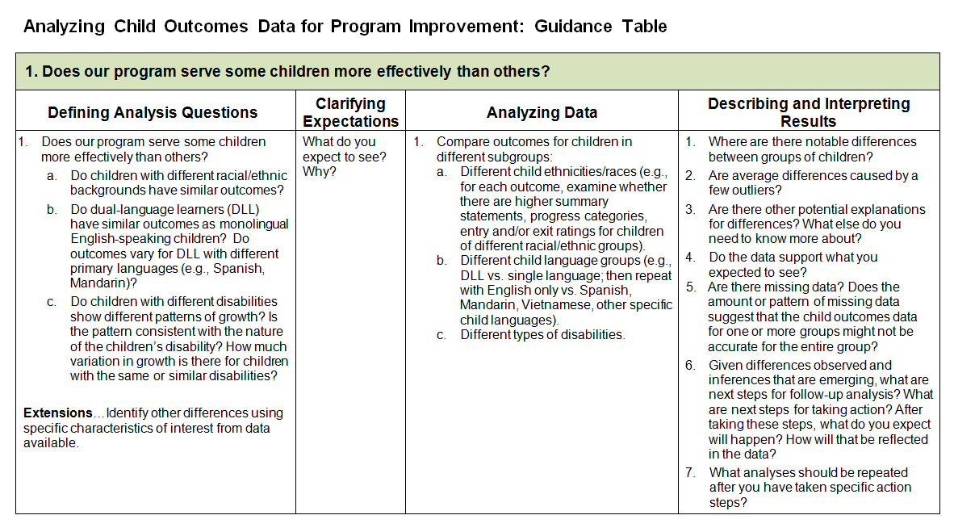
Guidance Table
Notes:
Analyzing Child Outcomes Data for Program Improvement: Guidance Table

Slide 41
Defining Analysis Questions
What are your crucial policy and programmatic questions?
Example:
1. Does our program serve some children more effectively than others?
  Do children with different racial/ethnic backgrounds have similar outcomes?

Slide 42

Starting with a question (or two..)
All analyses are driven by questions
Several ways to word the same question
Some ways are more “precise” than others
Questions come from different sources
Different versions of the same question are necessary and appropriate for different audiences.

Slide 43
Question sources
Internal – State administrators, staff
External –
The governor, the legislature
Advocates
Families of children with disabilities
General public
OSEP
External sources may not have a clear sense of what they want to know

Slide 44
Sample basic questions
Who is being served?
What services are provided?
How much services is provided?
Which professionals provide services?
What is the quality of the services provided?
What outcomes do children achieve?

Slide 45
Sample questions that cut across components
How do outcomes relate to services?
Who receives which services?
Who receives the most services?
Which services are high quality?
Which children receive high cost services?

Slide 46
Making comparisons
How do outcomes for 2008 compare to outcomes for 2009?
In which districts are children experiencing the best outcomes?
Which children have the best outcomes?
How do children who receive speech therapy compare to those who do not?

Slide 47
Making comparisons
Disability groups
Region/school district
Program type
Household income
Age
Length of time in program
Comparing Group 1 to Group 2 to Group 3, etc.

Slide 48
Question precision
A research question is completely precise when the data elements and the analyses have been specified.
Are programs serving young children with disabilities effective?
(question 1)

Slide 49
Question precision
Of the children who exited the program between July 1, 2008 and June 30, 2009 and had been in program at least 6 months and were not typically developing in outcome 1, what percentage gained at least one score point between entry and exit score on outcome 1?
(question 2)

Slide 50

Finding the right level of precision
Who is the audience?
What is the purpose?
Different levels of precision for different purposes
BUT THEY CAN BE VERSIONS OF THE SAME QUESTION

Slide 51
Activity
Forming Good Data Analysis Questions
Notes:
Review criteria, have examples for the participants to review and talk about why they are good/not good

Slide 52
Clarifying Expectations
What do you expect to see?
Do you expect children with racial/ethnic backgrounds will have similar outcomes? Why? Why not?

Slide 53
Analyzing Data
Compare outcomes for children in different subgroups:
    a. Different child ethnicities/races (e.g. for each outcome examine if there are higher summary statements, progress categories, entry and/or exit ratings for children of different racial/ethnic groups).

Slide 54
Talking with Your Analyst

Slide 55
Elements
Who is to be included in the analysis?
Exit between July 1, 2011 and June 30, 2012
In program at least 6 months (exit date minus entry
date)
Not typically developing at entry (hmm….)
What about them?
Entry score outcome 1
Exit score outcome 1
Do we need to manipulate the data?
Gain = Exit score minus entry score

Slide 56
Variables/Data Elements
ID
Year of Birth
Date of entry
Score on Outcome 2 at entry
Gender

Slide 57
Many options…
How do exit scores compare to entry scores?
– Compare average score at entry and exit
– Compare two frequency distributions of scores
– Compare % who were rated typical
Need to decide what you want
May need to be able to communicate it to someone else.

Slide 58
Variables/Data Elements
What data elements do you need to answer your questions?
Do you need to compute variables to answer your question?
– Time in program?
– Age at entry?

Slide 59
Outcome 1: Summary Statements by Child’s Race/Ethnicity

Slide 60
Outcome 1: Progress Categories by Child’s Race/Ethnicity

Slide 61
Describing and Interpreting Results
Stakeholder process
Is the evidence what you expected?
What is the inference or interpretation?
What might be the action?
Notes:
Provide more detail about some of the specific kinds of questions to get you started looking at these three.

Slide 62

Activity
Analyzing data for program improvement
Notes:
Switch to an Activity – the focus would be on low performing programs
A little bit of qualitative data about the low performing data – low performing on all indicators, qualitatively you know about turnover or dispute resolution, qualitatively the demographics (rural/urban, military base, autism center).
Low performing programs (e.g. major urban areas)
Connected to poverty and/or race

Slide 63
Challenges with Numbers Based on Small Ns
E.G. a program with 5 exiters
2009-10 4 of 5 exit at age expectations SS2 = 80%
2010-11 2 of 5 exit at age expectations SS2 = 40%
2011-12 3 of 5 exit at age expectations SS2 = 60%
In this example a difference of 1 child changes the summary statement by 20 percentage points
How do we interpret the differences from year to year?
Notes:
From the longer handout of patterns, we will investigate a few of the expected patterns today.

Slide 64

A range masquerading as a number
When you compute a percentage or an average, there is a range of likely values around the percent or average.
The more children used to compute the percent or average, the more narrow this range of likely values is.
47%
(27 – 67%)

Slide 65

This is explicitly described in polling
The poll was conducted for CNN by ORC International, with 841 adults nationwide questioned by telephone. The survey's overall sampling error is plus or minus 3.5 percentage points.

Slide 66
Why do you care?
Issues with ...
Comparison of actual to target
Comparisons across local programs
Comparisons over time

Slide 67
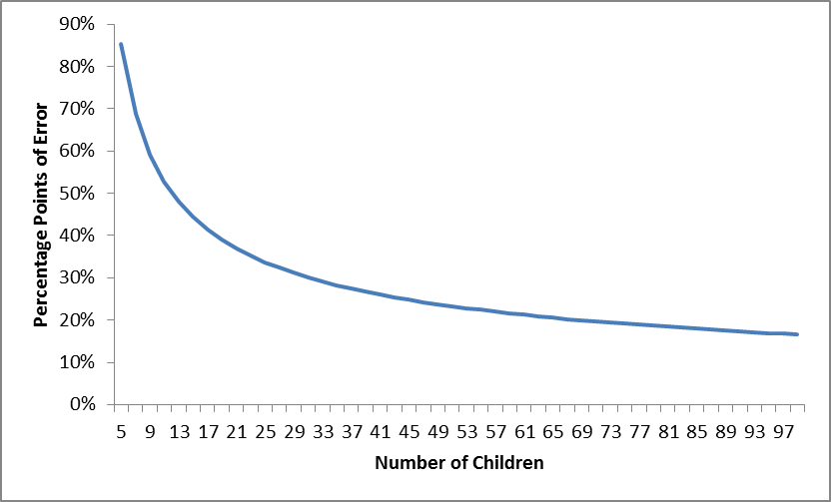
Amount of error by N size
(2 – 100, Statistic Value 53%)

Slide 68
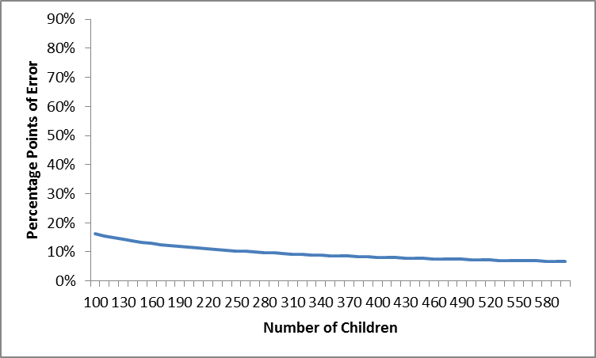
Amount of error by N size
(100 – 600; Statistic Value 53%)

Slide 69
What to do about it?
Determine other ways to measure the effectiveness of the programs
  Qualitative summary of the progress made by children including detail about child and family characteristics
  Use a different subset
    Sum across multiple years
    Look at all children receiving services not just those exiting
If possible, limit across program comparison to programs with at least 30 children.

Slide 70
Considerations for Selecting a Priority Issue
Will make a difference in results for children and/or families
Leadership in the state supports efforts to address the issue
State is committed to making changes in the issue, in terms of values, resources, and staff time
Activities already planned by the state will be enhanced
Key stakeholders understand the issue, its scope, significance, and urgency for the state
The issue is feasible/doable
The issue is defined and circumscribed well enough to be addressed in 1-3 years
Notes:
Narrowing your area of focus once you’ve got a broad issue or area to start with.

Slide 71

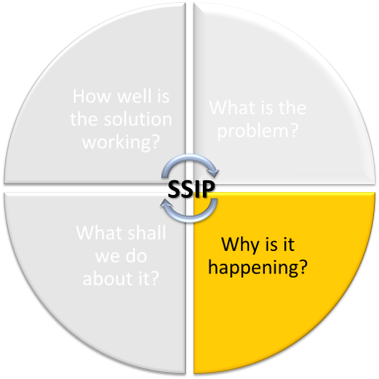
in-depth analysis in the focus area

Slide 72
Root Cause Analysis
Digging into the local issues and challenges
Asking questions about barriers at different levels

Slide 73


Local Contributing Factor Tools
http://ectacenter.org/~docs/eco/ECO-C3-B7-LCFT.docx
http://ectacenter.org/~docs/topics/gensup/14-ContributingFactor-Results_Final_28Mar12.doc
Notes:
Draft Tool for C-3/B-7, and final tool for C-2, C-4, C-5, and C-6
Designed to:
Assist EI programs/LEAs in collecting valid and reliable data to determine contributing factors impacting performance on State Performance Plan (SPP) results indicators resulting in meaningful improvement plans

Slide 74
Purpose
Provide ideas for types of questions a team would consider in identifying factors impacting performance

Slide 75

Process
Used by teams including:
  Parents
  Providers/teachers
  Administrators
  Other stakeholders

Slide 76

Data Sources
Qualitative Data
  Interviews
  Focus groups
Quantitative Data
  Outcomes data
  Compliance data
  Policies and procedures
  Child records

Slide 77

Question Categories
System/
Infrastructure
Practitioner/
Practices
Policies/ procedures
Competencies of staff
Funding
Implementation of effective practices
Training/TA
Time
Supervision
Resources
Data
Supports
Personnel
Notes:
Some questions are designed to determine adequacy of agency management and oversight while others are geared for gathering information from service coordinators, teachers and providers and about actual practices. Data collected from this investigation should be used to identify contributing factors that relate to program infrastructure, policies and procedures, funding, training and technical assistance, supervision, data, personnel and provider practices

Slide 78

Child Outcomes Tool
Sections:
Quality data: questions related to collecting and reporting quality outcomes data
Performance: questions related to improving performance related to outcomes
Notes:
These next few slides are specific to the ‘child outcomes’ LCFT, but we have for both child and family.

Slide 79
Data Quality Questions, e.g.
Do we have comprehensive written policies and procedures describing the data collection and transmission approach?
Do we have a process for ensuring the completeness and accuracy of the data?
Do we have procedures in place to inform stakeholders, including families, about tall aspects of the outcomes measurement system?
Do our practitioners have the competencies needed for measuring outcomes?
Do those who are entering the data have the competencies and resources needed for entering and transmitting the data?
Do our supervisors oversee and ensure the quality of the outcomes measurement process?

Slide 80
Performance Questions, e.g.
Do we have a process for ensuring IFSP/IEP services and supports are high quality and aligned with individual child and family needs and priorities?
Do we have a process for supporting practitioners and tracking that they are implementing effective practices?
Do we have adequate numbers of qualified personnel?
Does our monitoring and supervision adequately look at the program performance?
Do practitioners understand the mission, values and beliefs of the program?
Do practitioners know what competencies are expected in their position?
Do practitioners have the knowledge and skills related to implementing effective practices?
Do practitioners attitudes reflect the values of the program?
Do practitioners have adequate time and resources and support from local leadership?

Slide 81
Activity
Root cause analysis with local contributing factors tool
Notes:
Only the child outcomes LCFT will be copied and in their hands

Slide 82
In-depth Infrastructure Analysis on focus area

Slide 83
Infrastructure Analysis
A description of how the State analyzed the capacity of its current system to support improvement and build capacity in LEA's and local programs to implement, scale up, and sustain evidence-based practices to improve results for children and youth with disabilities, and the results of this analysis.
  State system components include: governance, fiscal, quality standards, professional development, data, technical assistance, and accountability.
Notes:
”

Slide 84
Infrastructure Analysis
  The description must include the strengths of the system, how components of the system are coordinated, and areas for improvement within and across components of the system.
  The description must also include an analysis of initiatives in the State, including initiatives in general education and other areas beyond special education, which can have an impact on children and youth with disabilities.
  The State must include in the description how decisions are made within the State system and the representatives (e.g., agencies, positions, individuals) that must be involved in planning for systematic improvements in the State system.

Slide 85
Theory of Action
Data Analysis
In-depth Analysis Related to Primary Concern Area
Infrastructure Assessment
In-depth Analysis Related to Primary Concern Area
Focus for Improvement
Data Analysis
Broad Analysis
Infrastructure Assessment
Broad Analysis

Slide 86
Focused Infrastructure Analysis
E.g. Using a tool like the Local Contributing Factors Tool
Specific to the focus area:
  Description of different system components
  What are the initiatives currently underway
  How are decisions made and who are the decision-makers and representatives

Slide 87

ECTA System Framework

Slide 88


ECTA Systems Framework

Slide 89
System Framework: Purpose and Audience
Purpose: to guide states in evaluating their current Part C/619 system, identifying areas for improvement, and providing direction on how to develop a more effective, efficient Part C and Section 619 system that requires, supports, and encourages implementation of effective practices.
Audience: the key audience is state Part C and state Section 619 coordinators and staff, with acknowledgement that other key staff and leadership in a state will need to be involved.

Slide 90
Iterative Validation Process
Review of the existing literature
Discussions with partner states about what’s working or not working in their states (related to various components); what it means to be ‘quality’
Draft of components, subcomponents, quality indicators and elements of quality
Review of drafts and input from: partner states, TWG, ECTA staff, others
Revisions to drafts based on input
Re-send revised drafts and have partner states ‘test’ through application
Revisions to drafts again
Send more broadly to get input
Literature
State Examples
Draft
Review/Input
Revise
State Testing
Revise
Broader Input
Notes:
Generally speaking, we will be engaging in an iterative validation process that will include state partners as well as this technical work group. This means that we will work collaboratively with the state folks and with this group to draft ideas, review and edit those ideas (over and over so that each iteration is an improvement on the last), and then (when ready) we will share more refined ideas in a broader sense to more folks in the field for additional refinement.
We recently identified our 6 partner states – DE, ID, MN, NJ, PA & WV. They applied to be a partner states, so these are the final six selected and they represent some diversity across demographics (like size of state, and region of the country) as well as diversity in some state systems aspects (such as Lead Agency for Part C and eligibility criteria).
Our Technical Work Group – you all – are a second key group that we’ll be working with throughout the iterative process. You were selected because of your expertise in knowing the Part C and Section 619 programs and/or your general expertise around quality systems and systems building. So we have some diversity within this group –some folks having more research experience, some more TA and consulting; we have diversity with some folks who know Part C and/or Section 619 particularly well, others who understand the general early childhood and systems building.

Slide 91
System Impact Results
What does a state need to put into place in order to encourage, support, require local implementation of effective practices?
Governance
Funding/ Finance
Personnel/ Workforce (PD&TA)
Data System
Monitoring and Accountability
Quality Standards
result
Implementation
of effective practices
Improved outcomes for children and families
Align/Collaborate Across EC

Slide 92
Draft Components
Considered in all components
Cross cutting themes
Governance: Vision, mission, setting policy direction, infrastructure, Leadership, decision-making structures, public engagement and communication, etc.
Engaging stakeholders, including famiies
Establishing/revising policies
Promoting collaboration
Using data for improvement
Communicating effectively
Family Leadership & Support
Coordinating/Integrating across EC
Finance: Securing adequate funding, allocation of resources, establishing systems of payment, etc.
Quality Standards: Program standards that support effective practices, ELGs, ELSs
Monitoring and Accountability: Monitoring and accountability for outcomes, quality measurement systems, continuous improvement, systems evaluation
Workforce development: professional development, personnel standards, competencies, licensure, credentialing, TA systems, etc.
Data System: System for collecting, analyzing and using data for decision-making, coordinated data for accountability and decision-making, linked data

Slide 93
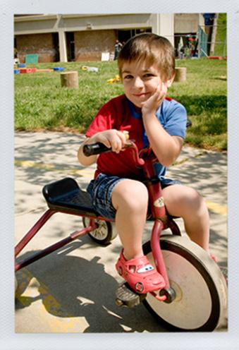
System Framework
Products:
  components and subcomponents of an effective service delivery system (e.g. funding/finance, personnel and TA, governance structure)
  quality indicators scaled to measure the extent to which a component is in place and of high quality
  corresponding self-assessment for states to self-assess (and plan for improvement)
  with resources related to the components of the system framework

Slide 94
System Framework
Each Component (e.g. Workforce) will include defined:
  Subcomponents (e.g. personnel standards)
    Quality indicators (e.g. state has articulated personnel standards...)
      Element of quality
      Element of quality
      Element of quality
        (self-assessment rating scale on the extent to which the quality indicator is in place)
    National resources and state examples
Notes:
So ultimately, we would have each component, followed by subcomponents, quality indicators, elements of quality (that can be scaled for measurement), and corresponding resources.
So if we play this out, we might have personnel development as a component, personnel standards as a subcomponent, a quality indicator that might say something like ... ‘the state has articulated personnel standards for early intervention and preschool providers’, and evidence of implementation might be things like... the state has written personnel standards describing the core competencies for early intervention and preschool special education personnel, the compentencies are aligned with effective practices, ...

Slide 95
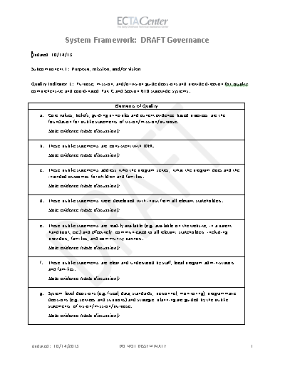
Governance SubComponent
Subcomponents (based on literature and consensus to-date):
Purpose, mission, and/or vision
Legal Foundations
Administrative Structures
Leadership and Performance Management

Slide 96

Finance Subcomponents
Subcomponents (based on literature and consensus to-date):
Fiscal Data
Strategic Finance Planning Process/ Forecasting
Procurement
Resource Allocation, Use of Funds and Disbursement
Monitoring and Accountability

Slide 97

Framework Uses
Complete comprehensive self-assessment of system for overall program improvement (not directly related to SSIP)
Guide broad or specific infrastructure analysis (e.g., what information that should be considered) for SSIP process

Slide 98

Alignment
ECTA System Framework
SSIP
Governance
Governance
Finance
Finance
Monitoring and Accountability
Accountability
Quality Standards
Quality Standards
Workforce Development
TA
Professional Development
Data Systems
Data

Slide 99
Infrastructure Analysis
Determine current system capacity to:
  Support improvement
  Build capacity in EIS programs and providers to implement, scale up, and sustain evidence-based practices to improve results
Notes:
Reminder of SSIP requirements

Slide 100
SSIP Infrastructure Analysis
Identify:
  System strengths
  How components are coordinated
  Areas for improvement within and across components
  Alignment and impact of current state initiatives
  How decisions are made
  Representatives needed to plan system improvement
Notes:
Reminder of SSIP requirements

Slide 101

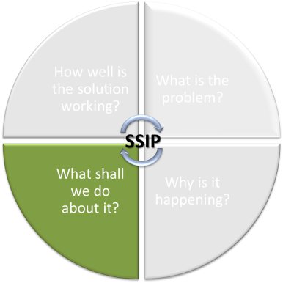
Theory of Action

Slide 102
Theory of Action
Based on the data analysis and infrastructure analysis, the State must describe the general improvement strategies that will need to be carried out and the outcomes that will need to be met to achieve the State-identified, measurable improvement in results for children and youth with disabilities.
  The State must include in the description the changes in the State system, LEA's and local programs, and school and provider practices that must occur to achieve the State-identified, measurable improvement in results for children and youth with disabilities.
  States should consider developing a logic model that shows the relationship between the activities and the outcomes that the State expects to achieve over a multi-year period.

Slide 103
What is a Theory of Action?
Series of if-then statements that explain the strategies and assumptions behind the change you are planning to make
Reveals the strategic thinking behind the change you seek to produce
Your hypotheses about how a combination of activities will lead to the desired results

Slide 104
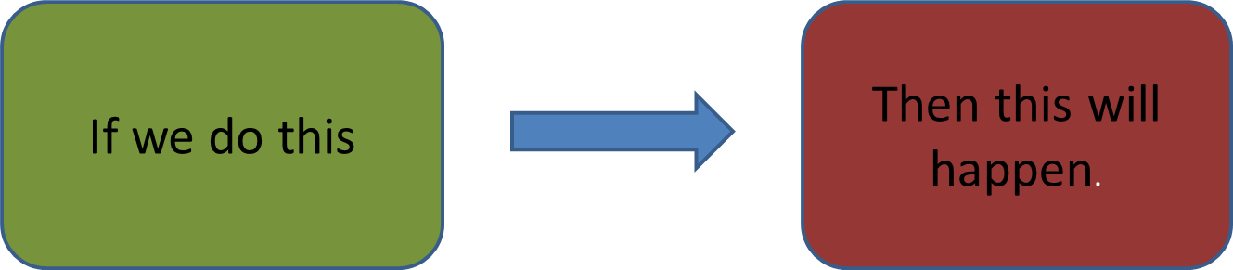
Theory of Action
Theory of Action is based on your:
  Data analysis
  Assumptions about systems change
  ‘Vision of the solution’
Theory of Action is also the basis for your plan of activities

Slide 105
Theory of Action
Improvement Strategy
If we implement a statewide initiative that focuses on implementing the Pyramid Mode
Then children will improve functioning in positive social and emotional outcomes
Build capacity of local programs implement initiative
Includes changes in state system

Slide 106
Who should develop it?
Defined team of leaders
  With the authority
  With the perspectives
  With the data
Stakeholder input
  From different levels of the system (perspectives)
  Participated in the review and interpretation of the data, identification of issues and challenges, and setting of priorities
Notes:
Here we could ask states who they plan to involve as stakeholders?

Slide 107
Developing the Theory of Action
Working backwards from the desired result
Using data gathered
What result are you trying to accomplish?
  Improved outcomes for children and families
  Improved outcomes for children in program/ district A
  Improved outcomes for a subgroup of children
  Others?

Slide 108
Governance
Funding/ Finance
Personnel/ Workforce (PD&TA)
Data System
Monitoring and Accountability
Quality Standards
result
Implementation
of effective practices
Improved outcomes for children and families

Slide 109
What do we know about how practices need to look in order to achieve the outcomes?
Governance
Funding/ Finance
Personnel/ Workforce (PD&TA)
Data System
Monitoring and Accountability
Quality Standards
result
Implementation
of effective practices
Improved outcomes for children and families

Slide 110
What do we know about how the system needs to look in order to support the practices?
Governance
Funding/ Finance
Personnel/ Workforce (PD&TA)
Data System
Monitoring and Accountability
Quality Standards
result
Implementation
of effective practices
Improved outcomes for children and families

Slide 111
Practices/Practitioners
What do we know about how practices need to look in order to achieve the outcomes?
  What do practitioners need to know?
  What do practitioners need to do?
  What are the data telling us about what practitioners currently know/do not know, are/are not doing?

Slide 112
Direct Support
What kinds of direct support for effective practices (e.g., training, TA, coaching) is needed to support practitioners to ensure they understand and can implement the practices?
  What content do practitioners need to know?
  When/how should practitioners be able to access that direct support?
  What are the data telling us about what direct support is currently happening/not happening?

Slide 113
Local Program/District Supports
What kinds of supports are needed at the local agency/district level?
  What policies or procedures are needed?
  What fiscal supports are needed?
  What expectations and supervision are needed?
  What types of monitoring is needed?
  What are the data telling us about what is currently happening/not happening at the local/district level?

Slide 114
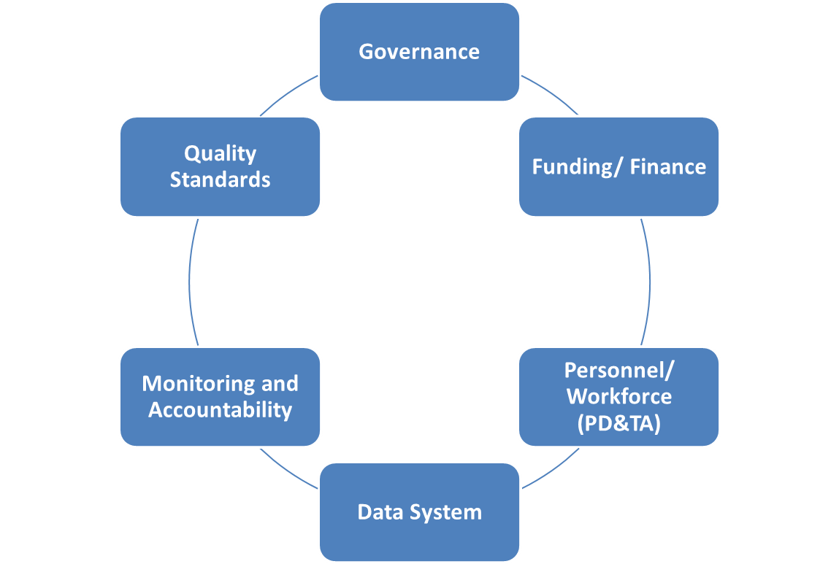
State Level Supports
What kinds of supports are needed at the state agency level?
  Governance
  Finance
  Monitoring/Accountability:
  Workforce/PD/TA
  Quality standards
  Data systems
What are the data telling us about what is currently happening/not happening at the state level?

Slide 115
State System:
Implementation of effective state systems that support effective practices
What specific state system supports are needed to encourage/ require practices?
Local System:
Implementation of effective local systems that support effective practices
What specific local system supports are needed to encourage/ require practices?
Direct Support:
Implementation of direct support for effective practices (e.g., training, TA, coaching and other supports)
What specific direct support is needed to give practitioners the skills to implement effective practices?
Practices:
Implementation of effective practices by teachers and providers
What specific practices need to occur to accomplish the specific outcomes?
Result:
Improved outcomes for children and families
What specific outcomes or population is the focus?
Notes:
Potential activity: Could we ask state teams to do some kind of SWOT analysis of each of these components of their own system? This would be something they could take home with them or this might be a better activity when we are discussing infrastructure analysis. Just thinking out loud. ☺

Slide 116
State System and Local Systems:
Practices:
Result:
level
Statewide and local analysis by variables
State system infrastructure analysis and local contributing factors
What data do we have on practices?
What do the data tell us about c/f outcomes?
Data Analysis
Notes:
I wonder if slide 22 and 23 go better when talking about theory of action? Perhaps, we should move these to be with the theory of action (before the evaluation section)?. We could also discuss this as a tool for states. Maybe we could give out a blank one of these and do an activity using this form?

Slide 117
State System and Local Systems:
Practices:
Result:
level
Statewide and local analysis by variables
State system infrastructure analysis and local contributing factors
What data do we have on practices?
What do the data tell us about c/f outcomes?
Data Analysis
If the state system did L, M, N to support local systems and practitioners
If the local system/district did E, F, G to support practitioners
If state and local systems provide direct support for effective practices e.g. training, TA, coaching and other supports on A, B, C and X, Y Z
If practitioners know A, B, C and do X, Y, Z
Then the child/family outcomes will improve
Theory of Action
Notes:
I wonder if slide 22 and 23 go better when talking about theory of action? Perhaps, we should move these to be with the theory of action (before the evaluation section)?. We could also discuss this as a tool for states. Maybe we could give out a blank one of these and do an activity using this form?

Slide 118
Activity
Developing a Theory of Action

Slide 119
State System and Local Systems:
Practices:
Result:
level
Statewide and local analysis by variables
State system infrastructure analysis and local contributing factors
What data do we have on practices?
What do the data tell us about c/f outcomes?
Data Analysis
If the state system did J, K, L to local systems and practitioners
If the local system/district did G, H, I to support practitioners
If we provide direct supports for effective practices e.g. training, TA, coaching on A, B, C and D, E, F
If practitioners know A, B, C and do D, E, F
Focused desired result for children and/or families
Theory of Action
Activities to be implemented to ensure state system supports local systems and implementation of desired practices
Activities to be implemented to ensure local systems support practitioners
Activities to be implemented to ensure effective training, TA, coaching and other supports related to desired practices
Activities to be implemented to ensure practitioners have relevant knowledge and implement aligned practices
Focused desired result for children and/or families
Plan of Action
Notes:
I wonder if slide 22 and 23 go better when talking about theory of action? Perhaps, we should move these to be with the theory of action (before the evaluation section)?. We could also discuss this as a tool for states. Maybe we could give out a blank one of these and do an activity using this form?

Slide 120

Action Plan
Logic model might be a good way to present the plan
Specific activities at the different levels of the system
Responsibilities
Timelines
Resources
Evaluation

Slide 121
Activity
Developing potential activities

Slide 122
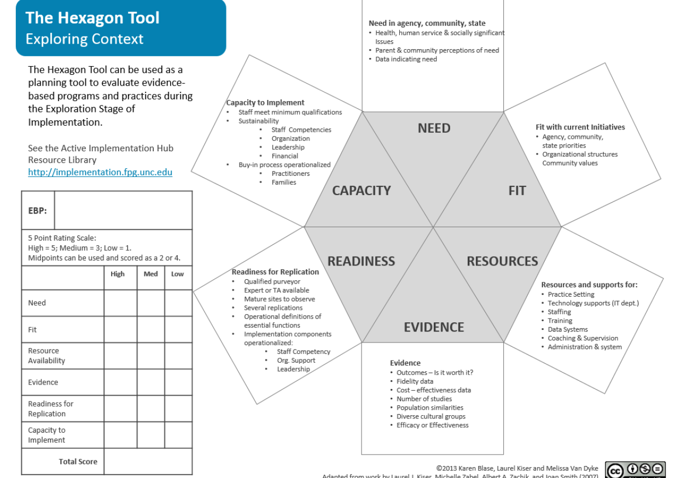

Slide 123

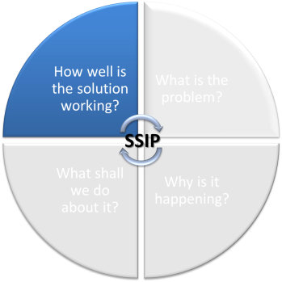
Evaluation

Slide 124
Evaluating the Implementation
Built into the plan from the beginning
Based on data that informed the plan development
Formative and summative
Benchmarks to show progress

Slide 125
For Each Activity...
Did the activity occur?
  If not, why not?
  What do we need to do next?
Did it accomplish it’s intended outcomes?
  If not, why not?
  What else do we need to do before we move to the next activity?

Slide 126
Evidence of Progress
Two types of evidences
Activities accomplished and intended outcomes of each activity achieved (to show progress along the way)
Changes in the bottom line data for children and families (movement in the baseline data)

Slide 127
Data at Different Levels
What kinds of data do you need (have) at different levels?
Child/family outcome data
Overall outcomes
Specific to the more narrow result focus

Slide 128
Data at Different Levels
What kinds of data do you need (have) at different levels?
Practice/Service data, e.g.
Supervisor observation
Monitoring data
Self assessment data
IFSP/IEP and service data
Fidelity data (data about practitioners implementing a practice as intended)

Slide 129
Data at Different Levels
What kinds of data do you need (have) at different levels?
Training and TA data, e.g.
Participation records
Quality
Intended outcomes
Use of knowledge/skills (implementation)

Slide 130
Data at Different Levels
What kinds of data do you need (have) at different levels?
System level evidence, e.g.
Policies, procedures, agreements
Fiscal supports
Training calendars, standards

Slide 131
State System and Local Systems:
Practices:
Result:
level
If the state system did J, K, L to local systems and practitioners
If the local system/district did G, H, I to support practitioners
If we provide direct supports for effective practices e.g. training, TA, coaching on A, B, C and D, E, F
If practitioners know A, B, C and do D, E, F
Focused desired result for children and/or families
Theory of Action
Activities to be implemented to ensure state system supports local systems and implementation of desired practices
Activities to be implemented to ensure local systems support practitioners
Activities to be implemented to ensure effective training, TA, coaching and other supports related to desired practices
Activities to be implemented to ensure practitioners have relevant knowledge and implement aligned practices
Focused desired result for children and/or families
Plan of Action
Did the activity occur? Did the activity accomplished its intended outcome(s)? If not, why not?
Do practitioners implement the practices with fidelity (i.e. as intended)?
Did outcomes improve?
Evaluation

Slide 132
Activity
Developing evaluation strategies

