Slide 1
The Importance of Personnel Data
Donna Spiker
Co-Director, DaSy Center
OSEP 2016 Virtual leadership Conference
February 2016

Slide 2

Having data can help you answer critical questions…..
Asking the right questions can support the state agency to effectively:
  administer the program
  meet accountability requirements for EI and ECSE
  improve results for children and families through an examination of program features

Slide 3
Having the right types of data helps you to answer critical questions about….
Types and characteristics of personnel
  Demographic characteristics (age, gender, race/ethnicity)
  Training and professional development received
Relationships between personnel data and:
  Characteristics of children served
  Outcomes of children served
  Types of evidence-based practices used
  Types of training and professional development received

Slide 4
Having personnel data can help you answer critical questions about …..
The characteristics of early intervention and early childhood special education practitioners
  What are the demographic characteristics of EI and ECSE practitioners (e.g., age, ender, race/ethnicity)?
  What are the levels of education and years of experience of EI and ECSE practitioners?
  How many EI and ECSE practitioners have specific types of credentials or licenses (e.g, EI specialist, preschool, special education, licensed therapist)?
  What is the turnover rate among EI and ECSE practitioners (by year, by professional role, by local program)?

Slide 5
Having personnel data can help you answer critical questions about…..
Ongoing professional development (PD) of EI and ECSE practitioners
  What PD activities do EI and ECSE providers and teachers participate in during employment?
  How much PD (e.g., hours, CEU units) do EI and ECSE providers and teachers receive over a given period of time (e.g., in a year, over a 5-year period) by role or profession?
  How much of specific types of PD (e.g., on evidence-based practices) do EI and ECSE providers and teachers receive over a given period of time (e.g., in a year, over a 5-year period) by role or profession?

Slide 6
Having key data elements allows you to track trends over time….
Year to year changes in personnel data such as:
  What is the turnover rate among EI and ECSE practitioners over time?
  Are more personnel receiving training about evidence-based practices over time?
  Are more personnel implementing evidence-based practices over time?
  Are more children being served by well-trained personnel?
  Are more children with well-trained personnel experiencing better outcomes?

Slide 7

Having the ability to link data elements allows you to answer critical questions…
Linking child and family data to personnel data can help answer questions like:
  Are some types of children more likely to receive services from well-trained personnel?
  Do children who receive services from highly-qualified personnel have better outcomes?
Linking across different datasets requires the use of unique child and personnel identifiers

Slide 8
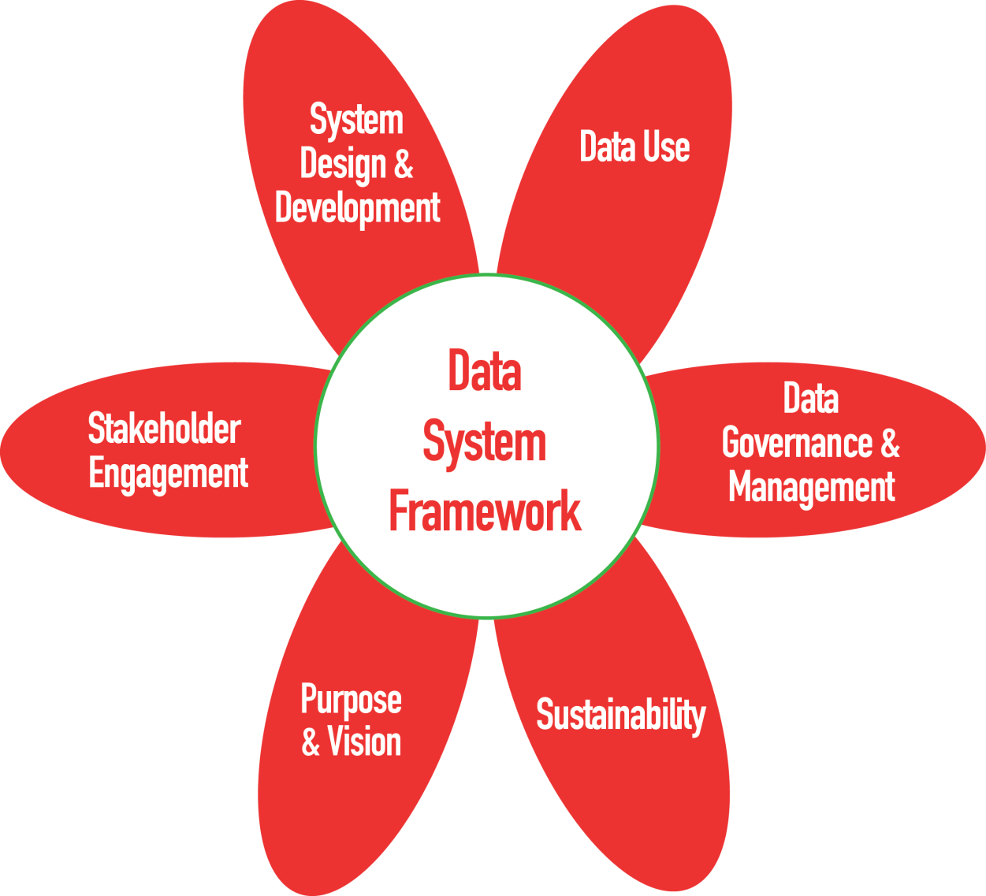
DaSy System Framework

Slide 9
The DaSy Center has TA specialists who can help you with your personnel data….
We can help state staff to:
  think about some of the personnel questions they would like to be able to answer with their data systems
  take stock of where their data systems are relative to being able to provide the data to answer important questions
  begin to plan for how to improve the power of their data systems

Slide 10
You can find useful resources on the DaSy Center web site….
Visit the DaSy website at:
http://dasycenter.org/
Like us on Facebook:
https://www.facebook.com/dasycenter
Follow us on Twitter:
@DaSyCenter

Slide 11

The contents of this presentation were developed under a grant from the U.S. Department of Education, # H373Z120002. However, those contents do not necessarily represent the policy of the U.S. Department of Education, and you should not assume endorsement by the Federal Government. Project Officers, Meredith Miceli and Richelle Davis.
Notes:
Instructions to presenters: This slide is to be included as the last slide in your deck but you are not expected to show it to the audience. Please be sure to delete these instructions from this slide’s notes page in your presentation.

