Slide 1
Using Data to Reduce Suspension and Expulsion of Young Children
Donna Spiker Co-Director, DaSy Center
OSEP 2016 Virtual leadership Conference February 2016

Slide 2
Having data can help you answer critical questions…..
Are certain programs suspending or expelling more children?
Are children of different backgrounds more likely to be suspended or expelled?
What are the outcomes for children that are included in high-quality programs?
Are strategies that reduce suspension and expulsion rates being successfully implemented?

Slide 3
Having the right types of data are important to answer critical questions….
Types of programs
Program quality data (e.g., QRIS ratings)
Strategies or practices used to support inclusion
Child and family demographic characteristics
Child and family outcomes data

Slide 4
Having key data elements allows you to track trends over time….
Year to year changes in settings where children receive services:
Are more children being suspended and expelled over time?
Year to year changes in program quality:
Are more children receiving services in high-quality programs?
Are there more high-quality programs available?
Are more appropriate strategies to support inclusion being implemented?

Slide 5
Having the ability to link data elements allows you to answer critical questions…
Linking child and family data to program and personnel data can help answer questions like:
Are some types of children more likely to be suspended or expelled?
Are some types of children more likely to receive services from highly-qualified personnel?
Linking across different datasets requires the use of a unique child identifier

Slide 6
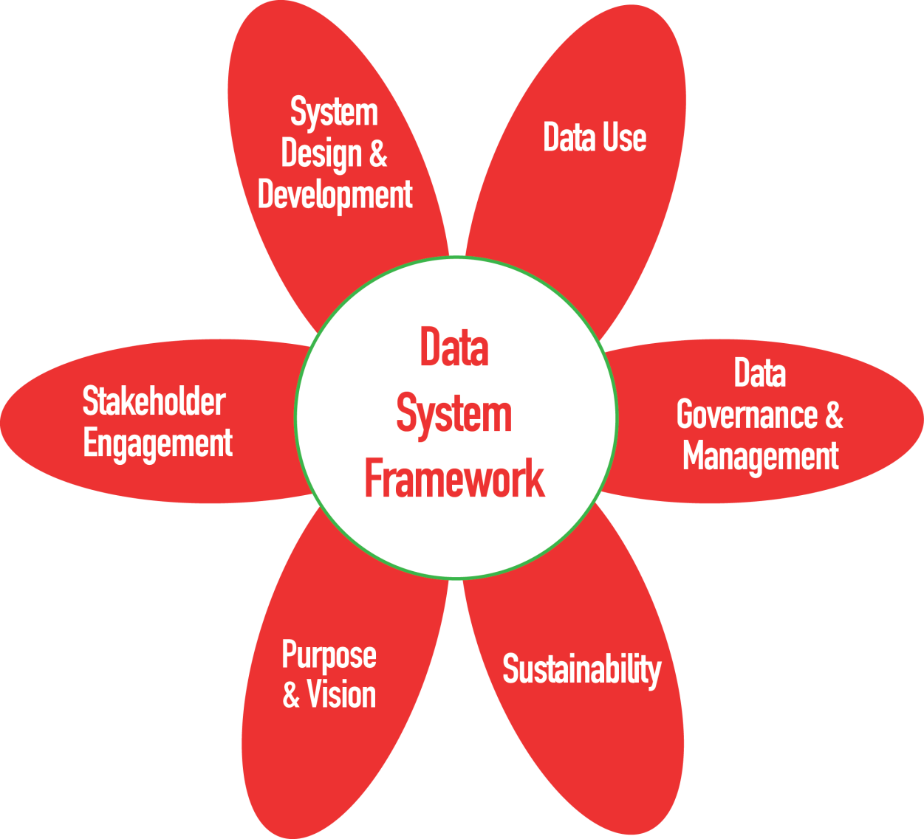
DaSy Data System Framework
A tool to help states think about the quality of their state data system
Indicators of quality to help state build more powerful data systems so you can answer critical questions

Slide 7
The DaSy Center has TA specialists who can help you….
Visit the DaSy website at: http://dasycenter.org/
Like us on Facebook: https://www.facebook.com/dasycenter
Follow us on Twitter: @DaSyCenter

Slide 8
The contents of this presentation were developed under a grant from the U.S. Department of Education, # H373Z120002. However, those contents do not necessarily represent the policy of the U.S. Department of Education, and you should not assume endorsement by the Federal Government. Project Officers, Meredith Miceli and Richelle Davis.
Notes:
Instructions to presenters: This slide is to be included as the last slide in your deck but you are not expected to show it to the audience. Please be sure to delete these instructions from this slide’s notes page in your presentation.

