Slide 1
Does Your Data System Answer Your Critical Questions?
Abby Winer, DaSy Center at SRI International
Grace Kelley, DaSy Center at SRI International
Brendan Ibe, GA Dept. of Health
STATS-DC
July 10, 2015

Slide 2

Welcome
Who’s in the room?
  Who are you affiliated with?
    State
    University/researchers
    Technical assistance
    Vendors/IT
    Other?
  What areas do you work in?
    General education
    Postsecondary
    Special education
    Early childhood

Slide 3
Session Outline
Overview of the DaSy Center
Discuss what are critical questions and how they can be used
Learn about how Georgia identified their critical questions and what they have learned
Notes:
Today we will discuss the critical questions a high-quality data system must be able to answer and the important questions it should be able to answer through integration into an ECIDS or SLDS in order to improve outcomes for children and youth in the state, including those with disabilities.
We will share examples from a state, GA, of how they were able to analyze data to answer their critical questions.

Slide 4
The Center for IDEA Early Childhood Data Systems (DaSy)
A 5-year Center funded by ED’s Office of Special Education Programs (OSEP) to assist states with improving IDEA Part C early intervention and Part B section 619 preschool special education data by:
  Building better data systems
  Coordinating data systems across early childhood programs
  Connecting to longitudinal data systems
  Building the capacity of states to use data
Center Co-Directors: Kathy Hebbeler, Donna Spiker
Notes:
What is DaSy?

Slide 5
DaSy Center’s Goals
Provide national leadership and coordination around IDEA EC data systems
Generate new knowledge and useful products for IDEA Part C and Part B preschool state agencies regarding building integrated EC data systems with linkages to statewide longitudinal data systems
Design and implement a continuum of technical assistance strategies to improve state capacity to collect, analyze, report, and use high quality IDEA EC data

Slide 6
DaSy Activities
Knowledge Development
  Collect information about state IDEA EC data systems
  Develop a framework for state IDEA EC data systems
TA and Dissemination
  Provide a continuum of TA and dissemination activities
  Provide intensive TA to 10 states
Leadership and Coordination
  Communicate and collaborate with relevant projects
  Support communities of practice

Slide 7
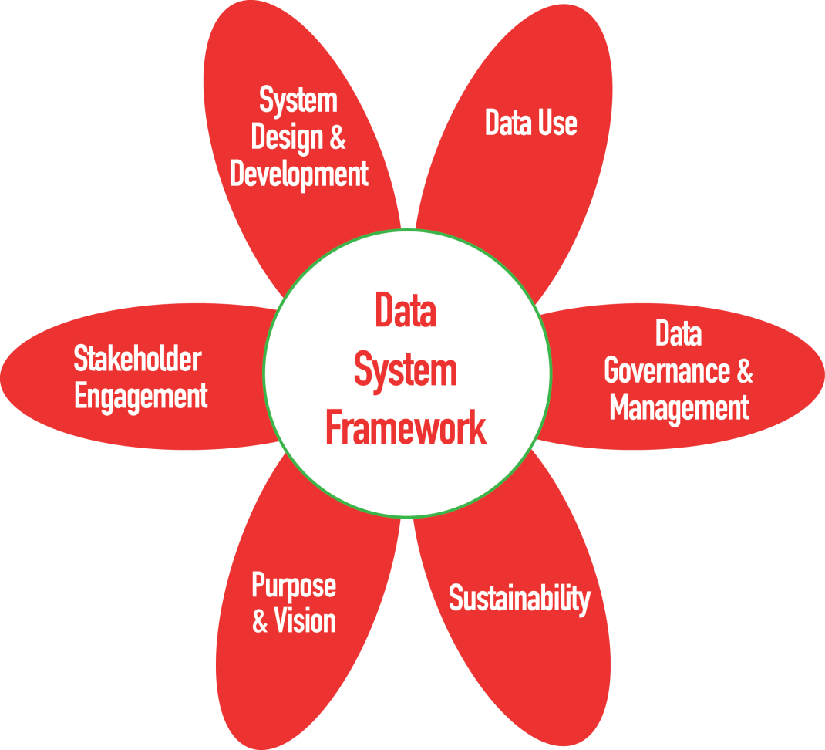
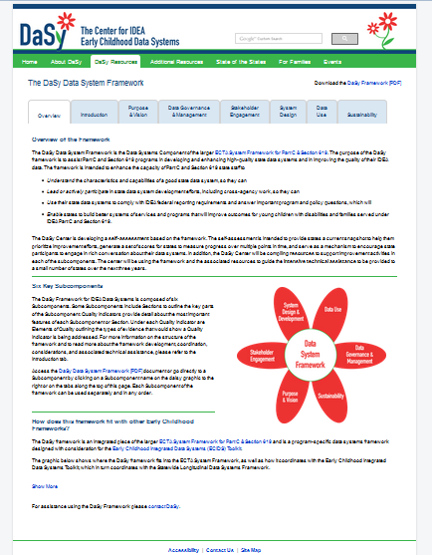
Six Sub-Components of the DaSy Data System Framework
http://dasycenter.org/resources/dasy-framework/
Notes:
Overview – DaSy components. The The DaSy Data System Framework is actually a part of the Data Systems Component of the larger ECTA System Framework for Part C & Section 619.

Slide 8

Linking to EI and ECSE
Does your state currently or plan to include early intervention or preschool special education data in your ECIDS or SLDS?

Slide 9
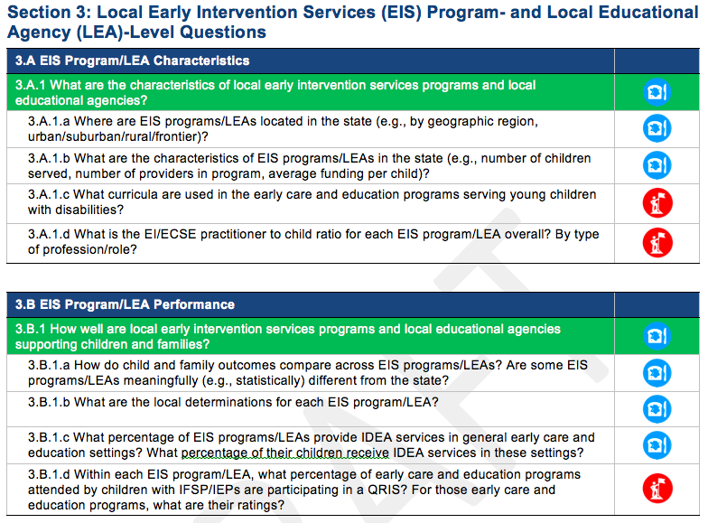
Can Your Data System Answer Your Critical Questions?
3 sections of questions:
  Child- and family-level
  Practitioner-level
  Local Early Intervention Services (EIS) program/Local educational agency (LEA)-level
Broad & specific example questions
Essential & aspirational questions
Notes:
What is a high-quality system? One characteristic of a high-quality state data system is that it is able to provide the information needed to address important questions. But what are those questions? What questions should data users, such as program directors, advocates, and policy-makers, be asking about early intervention and early childhood special education? The Center for Early Childhood IDEA Data Systems (DaSy) compiled a set of Critical Questions that a powerful state data system should be able to answer. The answers to these questions serve various functions including: supporting the state agency in effectively administering the program, and meeting accountability requirements for early intervention and early childhood special education, and improving results for children and families through an examination of program features.
The questions are grouped into three sections, which align with the suggested data elements in the DaSy Data System Framework System Design Subcomponent (see SD4). Each section has a set of broad questions, with each broad question followed by more specific example questions.
The broad questions represent critical global questions for state monitoring, evaluation, and program improvement efforts in early intervention and early childhood special education.
The specific example questions illustrate more detailed approaches that will allow the state to address the issues raised in the overall broad questions.
The critical questions include both essential questions, denoted by the [bread and butter] symbol and aspirational questions, denoted by the [mountain climber] symbol.
Essential questions are those that a comprehensive, well-functioning state data system should be able to answer.
Aspirational questions, although valuable to ask and answer, are more complex and require more information or more linkages to other data systems than would be expected even with a good system. For both the essential and aspirational questions, there is no expectation that the data has to be in one system to answer the question. The only expectation is that the state can access the data and link data if necessary to answer the question – wherever that data might reside.
Many state data systems do not currently have all of the data elements to be able to answer even all of the essential questions. The purpose of the document is to help states think about some of the questions they would like to be able to answer with their data system, take stock of where their data systems are with regard to being able to provide the data to answer these important questions, and begin to plan for how to improve the power of their data systems.

Slide 10

Critical Questions You May Have…
To what extent are children with Individual Family Service Plans/ Individualized Education Plans (IFSP/IEPs) attending general early care and education programs? 1.B.1
  What percent of children enrolled in EI/ECSE are served in general early care and education programs* (e.g., Early Head Start, Head Start, home visiting, child care, state Pre-K)? How does this compare to the overall population of children birth-5 in the state?
Notes:
What questions can you answer as you link data across EI/ECSE, early childhood and K-12?
Broad questions and example sub-questions – how you break that down and operationalize to be able to analyze data to answer it

Slide 11

Critical Questions You May Have…
What are the long-term outcomes of children who participate in early intervention/early childhood special education (EI/ECSE)? 1.C.3
  What percent of children who exit EI/ECSE at age expectations do not have an IEP in K-12 (e.g., in kindergarten, in third grade, in grade 12, at graduation, ever)?
  What percentage of children with IFSP/IEPs are spending time in high-quality early care and education settings?
Notes:
What questions can you answer as you link data across EI/ECSE, early childhood and K-12?
Broad questions and example sub-questions – how you break that down and operationalize to be able to analyze data to answer it

Slide 12
Critical Questions You May Have…
What are the characteristics of the practitioners working with children with IFSP/IEPs in general early care and education? 2.A.1
  What are the levels of education and years of experience of the general early care and education practitioners working with children with IFSP/IEPs?
What is the cost of providing early intervention/early childhood special education services to children and families? 3.C.1
  What is the average cost per child for EI/ECSE services statewide? For each EIS program/LEA?

Slide 13
How Critical Questions Can Guide Your Work
Critical questions can…
  Be a tool to plan enhancements to a data system
  Help organize analyses to inform program operations, program improvement, and policy and accountability
Notes:
When developing or examining your data system, just as you would approach a research design or study, you begin with your key questions in mind

Slide 14
How to use this document as a tool to plan enhancements to a data system
Identify the questions in this document that are a priority for the state/locality.
Identify which of these questions can and cannot be answered with the current data system.
Prioritize the questions that currently cannot be answered.
Review your data system and data elements to identify what additional data or enhancements to the data system would be needed to be able to answer these questions.
Develop a plan to begin to collect the necessary data elements or to make the necessary enhancements to your data system.
Notes:
Can help you advocate and justify why you need to gather certain data

Slide 15
How to use this document to organize analyses
Identify the questions in this document that are a priority for the state/locality.
Identify which of these questions your state can answer with your data system and which questions currently cannot be answered.
Develop an analysis plan to answer the priority questions that can be answered with your current data system.
Analyze the data.
Apply the results of the analysis to answer your priority questions – and improve services for children and families.
Notes:
To identify gaps/needs
Or to prioritize data needed
Identifying your critical questions – whether from this document or developing your own, can also be used to organize analyses to inform program operations, program improvement, and policy

Slide 16
Stay Tuned!
Developing analysis templates for each of the critical questions that will
  identify the data elements needed
  provide suggested analyses, and
  give examples of tables or graphs for displaying the data.
Notes:
Next steps for the DaSy critical questions will be to develop analysis template for each of the critical questions…
Stay tuned for how to work with data to answer each of the critical questions!

Slide 17
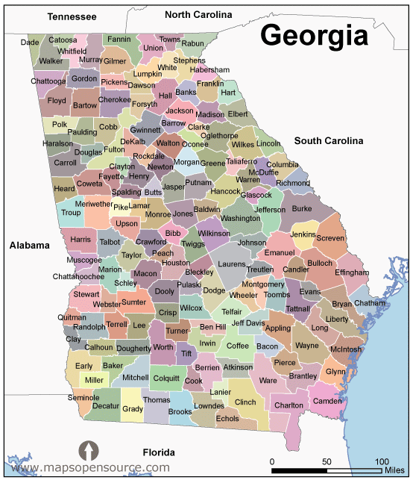
Georgia Early Intervention
Babies Can’t Wait

Slide 18
Identifying Critical Questions - Fiscal
How many children does the state serve in EI/ECSE? (1.1.1a)
What are the characteristics of children and families served in EI/ECSE? (1.a.1.b.)
What percentage of children in EI/ECSE are enrolled in public insurance, other public services? (1.b.2.a,b)
What major funding streams and allocations support children participating in EI/ECSE ? (3.c.1.)
How have the characteristics of children and families enrolled in EI/ECSE changed over time? (1.A.1.c)
Notes:
As part of a fiscal initiative GA was asked to provide data on number or children served, demographics of children and families in the state and receiving services, and funding sources

Slide 19
Identifying Critical Questions- SSIP
What age do children enter the program?
How long do children participate in EI/ECSE – average length of time/% in program less than six months? (1.B.2.d)
What is the relationship between child outcomes and length of time in services? (1.B.4.a)
What is the status of young children in Georgia and the external factors influencing child health in the state?

Slide 20
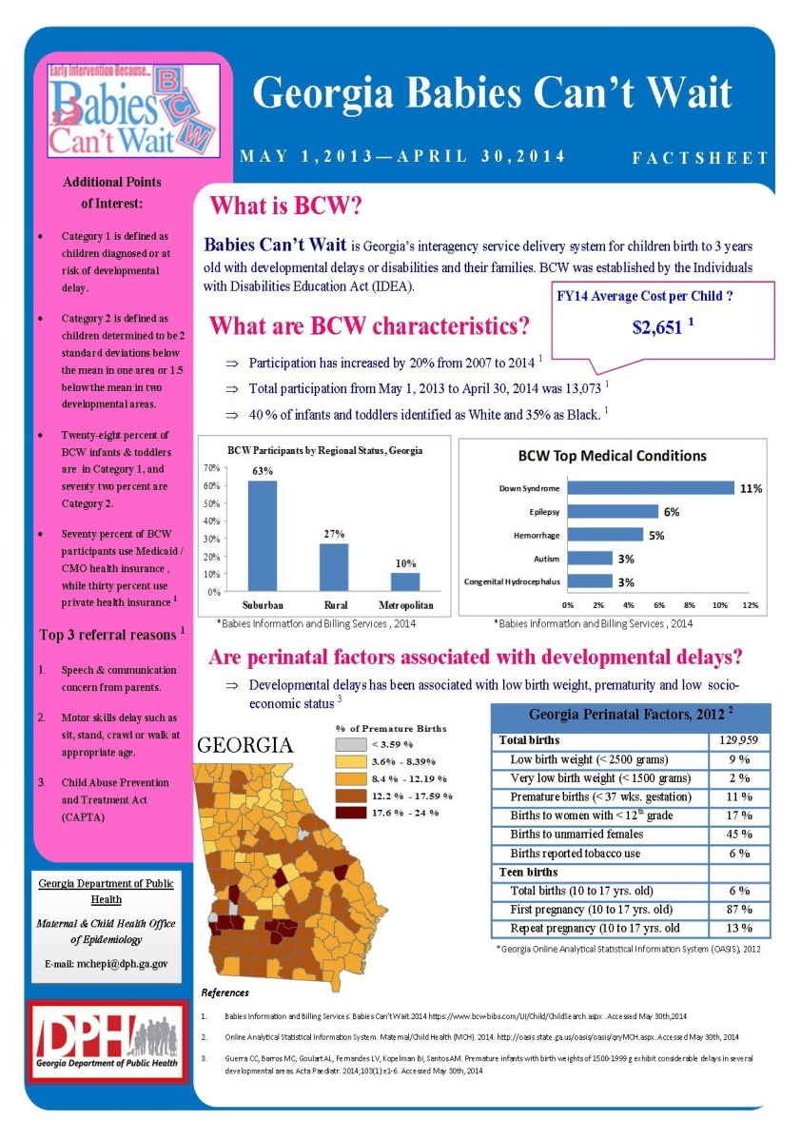
Initial answers to the critical question
Enrollment into EI increased 20% from 2007-2014.
In FY14, cost per child was $2,651
¾ have suspected developmental delay with communication as leading concern and ¼ have medical conditions with Down Syndrome as top condition
Georgia ranks poorly nationally in perinatal factors and poverty rate, with counties in the southern part of the state worst affected.
Notes:
We produced this fact sheet for health district and aggregated for the state. It showed that 20% increase from 2007-2014, average cost per child $2651
Fact sheet included BCW characteristics, top referral reasons and perinatal factors. Sorted data by geography, race, medical condition….

Slide 21
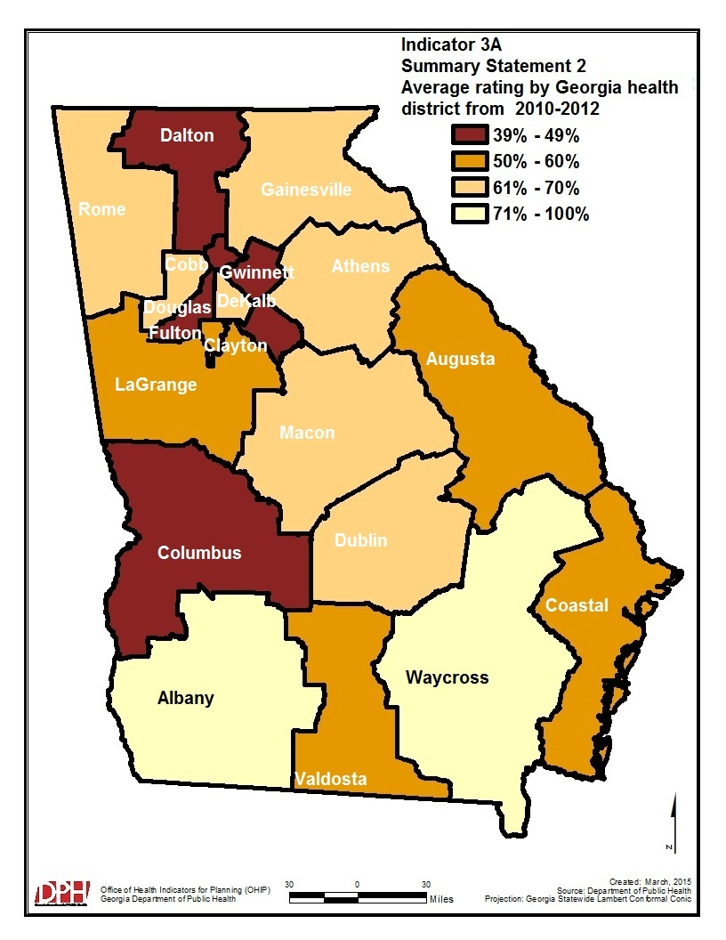
Follow up answers to the critical question
Analysis of data revealed that that although majority of children enroll with concern in the area of communication
These children typically do better on exit outcomes than children with concerns related to social-emotional skills
Notes:
5-Year trend analysis of Georgia APR Part-C indicators which revealed Indicator 3 (Child Outcomes) had the least improvement. Further analysis showed that although most children enter the program with a primary concern related to communication, they made adequate progress. However those children who entered with a concern related to social emotional skills did not make the same progress.
Low performing health districts on child outcomes indicator 3A from 2010-2012 were identified. Some of which matched the areas with worse perinatal outcomes.
Laid over this: Poverty, RTT, perinatal outcomes
What made the difference was having a variety of partners at the table that asked those critical questions

Slide 22
Ultimate Critical Question
What can be done to alleviate these factors and who are our potential partners ?
How do we improve the outcomes of the children and families we serve?

Slide 23
What do we do about it?
Georgia SSIP stakeholders voted to adopt a State identified Measurable Result (SiMR) “ Increase the percentage of infants and toddlers who are nearer or meet age expectation for positive social-emotional skills including social relationships”
Further more, the EPI group were mandated to research and evaluate the association of family/maternal characteristics and age of child at enrollment to improved exit child outcome
Notes:
The stakeholders requested additional information be compiled to identify the potential characteristics, and the correlation between age of enrollment and outcomes at end of program ~

Slide 24
Preliminary Results Show...
This box plot shows improvement in exit score rating over the entry score rating by age categories in the Socio-emotional subcategory of Child outcomes.
Specifically, children enrolled between 0-6 months of age had significantly improved socio-emotional exit score compared to other age categories.
0-6 >6-12 >12-18 >18-24 >24
Age of enrollment in months
Notes:
This chart is directly related to social relationships …..
We are now linking our Part-C data with vital records data to extract maternal demographic characteristics such as income, educational level, age, as well as our APR indicator 2 data (settings) for where the children were receiving EI services (daycare center or Home), and the eligibility category of the children into EI in GA (Babies Can’t Wait). To know if children in one eligibility category improved more than others in another category.
This chart demonstrates that early enrollment in the program correlates to better outcomes for children. The best outcomes were for those children who enrolled at 0-6 months and stayed in the programs

Slide 25
Lessons learned
Our critical questions has helped to shed light as to where the needs are most desperate in our state.
It has helped our stakeholders to prioritize resources and partner with other initiatives to get the best bang for the buck.
Linking the various data elements has highlighted the crucial importance of certain data elements which will now be included in future our APR data.
Process was successful because it was a combined effort between programmatic and data/analytic staff
Notes:
We are now working to link our data to vital records to get Mothers age, education level, geographic area and income to tailor interventions to the risk factors,.
Overall this helps the discussion about factors ( environmental, family or geography) that may impact child outcomes in the program, and how this aligns withs interventions of BCW. Children enrolled in the BCW program improved regardless of geography, family etc. if enrolled in the program at an earlier date

Slide 26
Discussion
What are the some of the critical questions you have considered in your work?
  How did you develop those questions?
  What was the result (e.g., identifying additional data needed, prioritizing analyses, informing policy)?

Slide 27

Additional Questions?

Slide 28
How to Stay In Touch
Visit the DaSy website at:
http://dasycenter.org/
Like us on Facebook:
https://www.facebook.com/dasycenter
Follow us on Twitter:
@DaSyCenter
Email us:
  Abby.winer@sri.com
  Grace.kelley@sri.com
  Brendan.Ibe@dph.ga.gov

Slide 29


The contents of this presentation were developed under a grant from the U.S. Department of Education, # H373Z120002. However, those contents do not necessarily represent the policy of the U.S. Department of Education, and you should not assume endorsement by the Federal Government. Project Officers, Meredith Miceli and Richelle Davis.

