Slide 1
Kindergarten Entry Assessment (KEA): Getting It Right For All Children
2015 Leadership Conference
“All In: Achieving Results Together”
Kathleen Hebbeler, SRI International
Early Childhood Technical Assistance Center (ECTA)
Center for IDEA Early Childhood Data System (DaSy)
Notes:
I am going to talk with you today about Kindergarten Entry Assessment but I want to start with some basic information about early childhood to show why KEAs have become so important. Hopefully, you have noticed that the first five years of life are receiving a lot of attention in media and from policy makers lately. There is a good reason for this. Let’s look at some numbers to see why.

Slide 2
Notes:
One number is 700. 700 neural connections being formed every second in the first three years of life. That is why your Part C and 619 programs are so important. Very important things are happening in the young child’s brain.
Source: http://developingchild.harvard.edu/resources/multimedia/interactive_features/five-numbers/

Slide 3
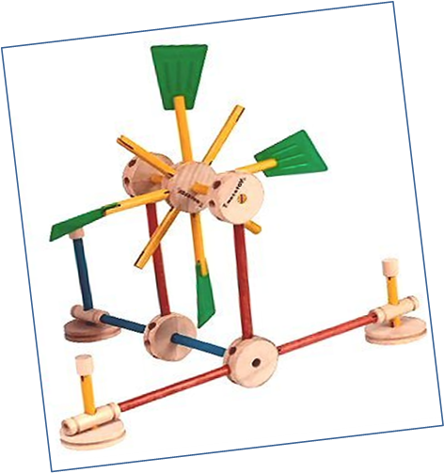
Experience shapes the architecture of the developing brain
Notes:
Early experiences shape the developing brain. Stimulating, rich, warm, responsive and nurturing experiences with the child’s caregivers leads to more complex structures in the brain. On the other hand, poverty and stressful life events are associated with a reduction in brain volume.

Slide 4
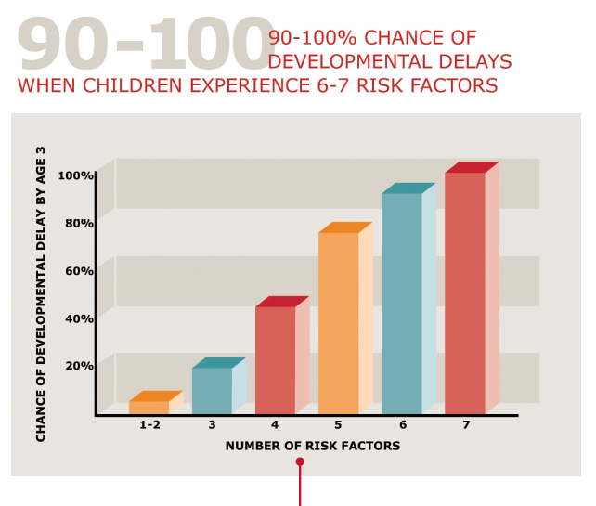
Poverty
Caregiver mental illness
Single parent
Low maternal education
Child maltreatment
Notes:
Here’s another number. The chance of a child experiencing a developmental delay increases by 90-100% when the child experiences 6 or more risk factors such as poverty, low maternal education, and having only one parent.
Source: http://developingchild.harvard.edu/resources/multimedia/interactive_features/five-numbers/

Slide 5
Differences at Kindergarten Entry
Notes:
Data from a national study show that children from lower income families are already substantially behind their more advantaged classmates when they start kindergarten. (And these children often attend school with some of the least experienced teachers which is why the gap gets worse rather than better as children get older)
Source: Lee, V. E., & Burkam, D. T. (2002). Inequality at the starting gate: Social background differences in achievement as children begin school. Washington, DC: Economic Policy Institute.

Slide 6
Kindergarten Outcomes:
Former EI Participants’ Receipt of Special Education and Disability Status
Notes:
The good news is that the young brain that is so vulnerable is also pliable which is why high quality interventions and preschools in early childhood can make a real difference. For example, a national study found that 46% of former Part C early intervention recipients did not have IEPs in kindergarten. And equally important, these children were performing like their typically developing peers.
High quality early childhood programs can make a difference – that is the good news. The bad news is that only 55 percent of the nation’s 3 and 4 year olds attend preschool and the percentage attending high quality preschools is considerably smaller than that. The US’s 55% compares to 94% for Italy, 91% for New Zealand, and 63% for Mexico.
Source: http://www.sri.com/work/publications/national-early-intervention-longitudinal-study-neils-final-report

Slide 7
Early childhood matters
Some children have good experiences in the first five years; some do not
And so we ask: what does development and learning look like when children enter kindergarten?

Slide 8
KEA Fundamentals
Assessment administered at the start of kindergarten
Multiple purposes, e.g.,
Inform instruction
Produce a picture of state’s children at entry to kindergarten
NOT to be used to keep a child out of kindergarten or for high stakes decisions.

Slide 9
Many states are adopting KEAs
26 states plus DC currently require a KEA
Differences across states:
Required by statute
Sample or state wide
Multiple domains vs. literacy or literacy and math
One time at K Entry or ongoing (e.g., K-3)
One tool statewide, approved list, local decision
Commercial product vs. developed by state
Results reported statewide vs. not at all
Notes:
Source: http://ecs.force.com/mbdata/mbquestRT?rep=Kq1407

Slide 10
Race to the Top Early Learning Challenge Grants (RTT-ELC)
Administered in the first few months of school
Covers all essential domains of school readiness
Used to close readiness gap, to inform instruction in the early grades, to notify parents about children’s status
Not used to prevent entry to kindergarten
Notes:
The U.S. Department of Education has been a strong supporter of KEAs. There were incentives built in to the Race to the Top Early Learning Challenge Grants for KEA implementation

Slide 11
RTT-ELC Domains of School Readiness
Language and literacy development
Cognition and general knowledge, including early mathematics and early scientific development
Approaches to learning
Physical well being and motor development, including adaptive skills
Social and emotional development

Slide 12
Race to the Top Early Learning Challenge Grants
KEA Status by 2015:
Pilot Testing | GA, MA, MN, NM, RI
Phasing in Implementation | CO, DE, IL, MI, NJ, PA, WA
Statewide Implementation | CA, KY, MD, NC, OH, OR, VT, WI

Slide 13
Enhanced Assessment Grants
Enhance existing KEA
Measure the essential domains of development
Produce data that can
Guide individual instruction
Be reported to stakeholders including families, teachers, administrators, early learning providers, and policy-makers
Be included in state’s SLDS
MD-OH Consortium
CT, IN, MA, MI, NV
NC Consortium
AZ, DC, IA, IN, OH, OR, ME, ND, RI, SC
TX

Slide 14
States working on KEA thru Enhanced Assessment Grants
MD-OH Consortium | CT, IN, MA, MI, NV, MD, OH
NC Consortium | AZ, DE, DC, IA, OR, ME, NC, ND, RI, SC
Texas | TX

Slide 15
Assessing Young Children with Disabilities
Critical issue in early childhood assessment:
What is a valid and feasible method for learning what a child knows and can do
in multiple domains
at entry to kindergarten?
Notes:
Young children are difficult to assess. How a state answers that question has direct implications for getting valid information for kindergarten children with disabilities

Slide 16
Notes:
This is not the way we assess young children.

Slide 17
Two* Approaches in Early Childhood
Observation-based Assessment
Infer child’s knowledge/behavior based on what child does/says in daily classroom activities
Criteria specified
Teacher collects data
Direct Assessment
Infer child’s knowledge/behavior based on responses to set of scripted tasks
Administered 1-on-1
Teacher collects data
*Plus hybrid of the two.
Notes:
Both require teachers to be trained. There is more professional development required with observation-based assessment because the teacher has to know what to look for and know how to interpret the child’s behavior. The observation based assessment at kindergarten entry in some states

Slide 18
For young children with disabilities
The more structured or formalized the assessment…
the more there is a need for adaptations and accommodations
the higher the likelihood that some children cannot be assessed
By definition, observation-based assessments provide multiple opportunities for a child to demonstrate competence (UDL).

Slide 19
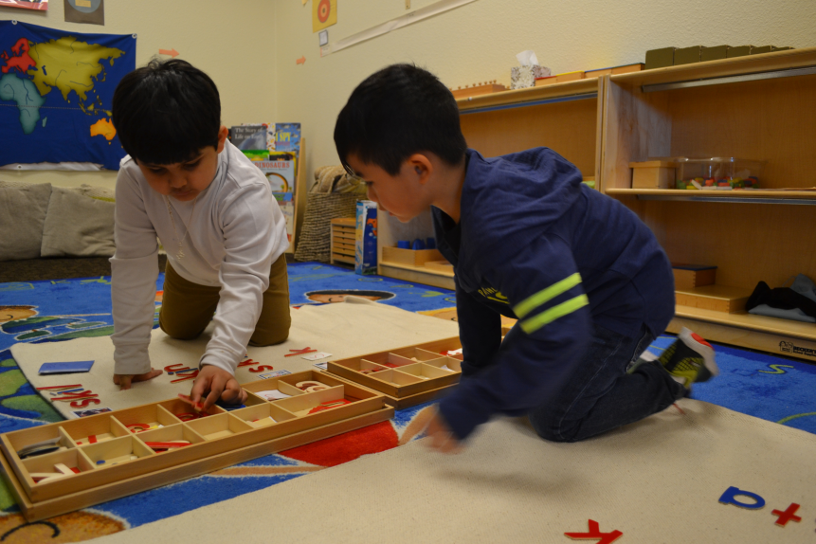
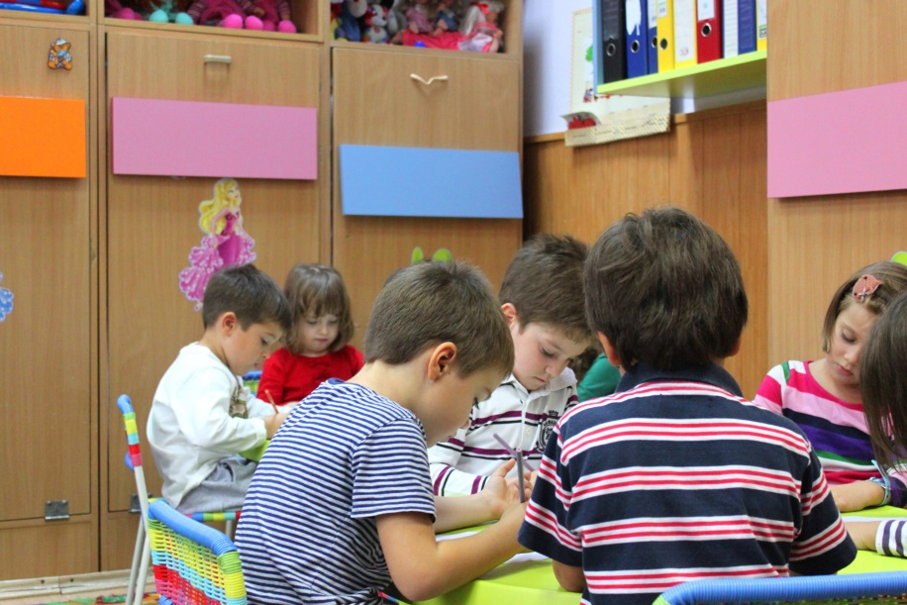
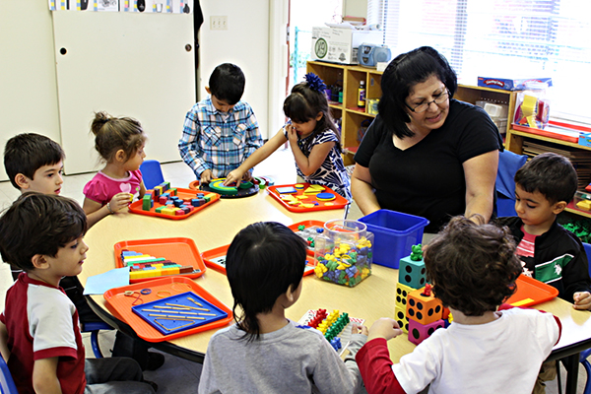
Observation-based assessment requires a developmentally appropriate kindergarten
© Lenutaidi | Dreamstime.com - Preschoolers To Kindergarten Photo
Notes:
Observation-based assessment requires a developmentally appropriate classroom. That means the classroom looks like the pictures on the right where children are active and engaged with each other and with the materials in the classroom and not like the picture on the left where children are spending much of the day doing worksheets. Unfortunately, what we hear around the country is that kindergarten classrooms used to be developmentally appropriate but are not anymore. This is a big problem for appropriate assessment because there is not much to observe in the classroom on the right. It also is a huge problem for the children in these classrooms because this is not the way young children learn best.

Slide 20
Conclusions
KEAs are trending!
Lots of variation in purpose and implementation across the states
Still resolving the significant measurement issues related to the valid assessment of young children, especially children with disabilities

Slide 21
Conclusions
In your state:
Make sure kindergarteners with disabilities are included in the KEA
Get the disaggregated data for children with IEPs

