Slide 1
Emerging Issues in Using Preschool and Kindergarten Assessment to Improve Learning
2015 Leadership Conference
“All In: Achieving Results Together”
Kathleen Hebbeler, DaSy/ECTA/IDC at SRI International
Dee Gethman, Iowa Department of Education
Sophia Hubbell, Ohio Department of Education

Slide 2
Assessment: Been There, Now What?
2015 Leadership Conference
“All In: Achieving Results Together”
Kathleen Hebbeler
DaSy/ECTA/IDC at SRI International

Slide 3
What is assessment?
“Assessment is the process of gathering information to make decisions. “
Source: DEC Recommended Practices in Early Intervention/Early Childhood Special Education

Slide 4
Different Tools, Different Purpose Different Information
Type | Purpose | Defining feature(s) | Example
Developmental screening | Identify need for follow re: possible delay or disability | Quick, scored as pass-Fail | Ages and Stages
Norm referenced | Determine eligibility | Provides standard deviation, % delay | BDI, Bayley, Vineland
General outcome measures | Identify need for additional or specialized instruction/ follow up | Quick, designed for repeated administration | IGDIs, DIEBELS
Criterion-referenced, curriculum-based, formative assessment | Inform instruction | Lots of detail; designed for repeated administration | AEPS, Carolina, HELP, GOLD, Work Sampling

Slide 5
And a few more purposes..
Accountability
K-12: Summative
EI/ECSE - Child outcomes measurement for APR
Benchmarking (Status of a population)
National Heath Interview (not an assessment)
APR child outcomes measurement serves this purpose
We repurpose existing assessment tools for these purposes

Slide 6
Some Assessment Challenges
Eligibility tools do not provide information for instructional planning
How consistently are practitioners using any systematic assessment for instructional planning and tracking progress?
Validity of the data when tools are repurposed

Slide 7
DEC Recommended Practices
11 Assessment practices that convey characteristics of good assessment for children with disabilities, e.g.
Use strategies appropriate for the child (i.e., that accommodate the child’s sensory, physical, communication, and other characteristics )
Use a variety of methods (e.g, observation and interviews)
Gather assessment information from multiple sources, (including the child’s family)
Obtain information about the child’s skills in daily activities, routines, and environments

Slide 8
New Developments
Acceptance/Recognition of the need for ongoing assessment in early childhood
Formative Assessment
Policy makers discovered early childhood
Investments in preschool
Concerns about school achievement (esp. gaps)
KEA

Slide 9
Ongoing Assessment to Inform Instruction
Not a new concept in ECSE
Was resistance about assessment in general EC
Fueled in part by inappropriate assessment and use of results
Now part of developmentally appropriate practice
NAEYC & NAECS/SDE. (2003). Early childhood curriculum, assessment and program evaluation.

Slide 10
Formative Assessment: What is it?
A process used by teachers and students during instruction that provides feedback to adjust ongoing teaching and learning to help students improve their achievement of intended instructional outcomes.
American Educational Research Association,
The American Psychological Association (APA), and
The National Council on Measurement in Education (NCME), 2014 &
Council of Chief State School Officers (CCSSO), 2006
Notes:
New name but not a new concept in ECSE. Formative assessment is gaining ground in K-12. It has a strong evidence base that shows using formative assessment leads to improved learning.

Slide 11
Kindergarten Entry Assessment*
Promoted by US Depts of Ed and HHS
Included in Race to the Top- Early Learning Challenge Grants
Enhanced Assessment Grants (EAGs)
26 States plus DC require a KEA
States vary on purpose
Inform instruction, benchmarking, etc.
*AKA Kindergarten Readiness Assessment (KRA), etc.

Slide 12
Kindergarten Entry Assessment
Misconceptions about what it is and is not
Design challenges
Administer quickly vs. comprehensiveness
Implementation challenges
Professional development, union opposition; media coverage

Slide 13
Formative Assessment and KEA Issues for Children with Disabilities
Know very little about inclusion of children with disabilities in FA or KEA efforts
Inclusion – are the tools being used in regular EC classroom appropriate for all children with disabilities?
Design – were the tools developed to be used with children with disabilities?

Slide 14
Questions
What is the current landscape in your state with regard to Preschool and Kindergarten (i.e., KEA and, if applicable K-3) Assessment?
What is the connection between your state’s preschool or kindergarten standards and current or planned assessments?
What issues have you encountered regarding assessing children with disabilities, including those with severe disabilities, with these assessments? How have you addressed these issues?

Slide 15
Questions (continued)
How are these data being used? or what are you state’s plans for how these data are to be used?
Use of the preschool data?
Use of the KEA, K-3 data?
How are assessment data used (or not) to support the transition of children from one setting to another (e.g., preschool to kindergarten)?

Slide 16
Questions (Concluded)
What are some of the challenges your state encountered in developing or selecting new assessments? How did you address these challenges?
What are some of the challenges your state encountered (or anticipates) in implementing new assessments? How did you (or plan to) address these challenges?

Slide 17
What is Happening in Iowa
2015 Leadership Conference
“All In: Achieving Results Together”
Dee Gethman
Iowa Department of Education

Slide 18
Iowa DE Requires Preschool Program Standards
Iowa’s Quality Preschool Program Standards: Assessment of Child Progress
Use appropriate assessment methods and tools for the intended purposes
Assess strengths, progress and areas of learning needing additional supports
Utilize data to inform decisions about instruction, interventions and approaches for teaching;
Inclusive of families

Slide 19
Iowa’s Legal Requirements
Preschool (PK)
Kindergarten – Third Grade
Administer TS GOLD Assessment System (online) (2013)
Every child enrolled in district preschool at least once per year
Utilize systemic, ongoing assessment (2007)
Assess children’s development and progress
Inform instruction
Align to Iowa Early Learning Standards
Kindergarten
K Literacy Assessment (2005)
Every child before 10/1
Kindergarten – Third Grade
Early Literacy Implementation (2014)
Provide DE approved, Universal Screening in reading, every child
Progress Monitor in reading, based on substantial deficiency
Provide Intensive Instruction

Slide 20
Iowa’s Guidance
Preschool (PK)
Kindergarten – Third Grade…
Utilize Comprehensive Assessment System
Implement TS GOLD Assessment as a formative assessment to:
Reflect on children’s progress
Adjust instruction for groups and individual children
Review growth on curriculum-based objectives from fall, winter, spring
Administer Universal Screening to identify literacy skills
Individual Growth and Developmental Indicators (IGDIs)
Build/Select high quality assessments aligned with Iowa Core
Develop comprehensive assessment system, include Kdgn Entry Assessment
K-3 Formative Assessment Consortium
Utilize formative assessment process for teaching and learning

Slide 21
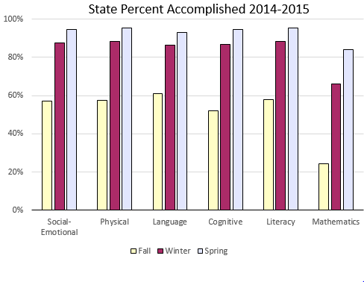
Iowa Example: GOLD

Slide 22
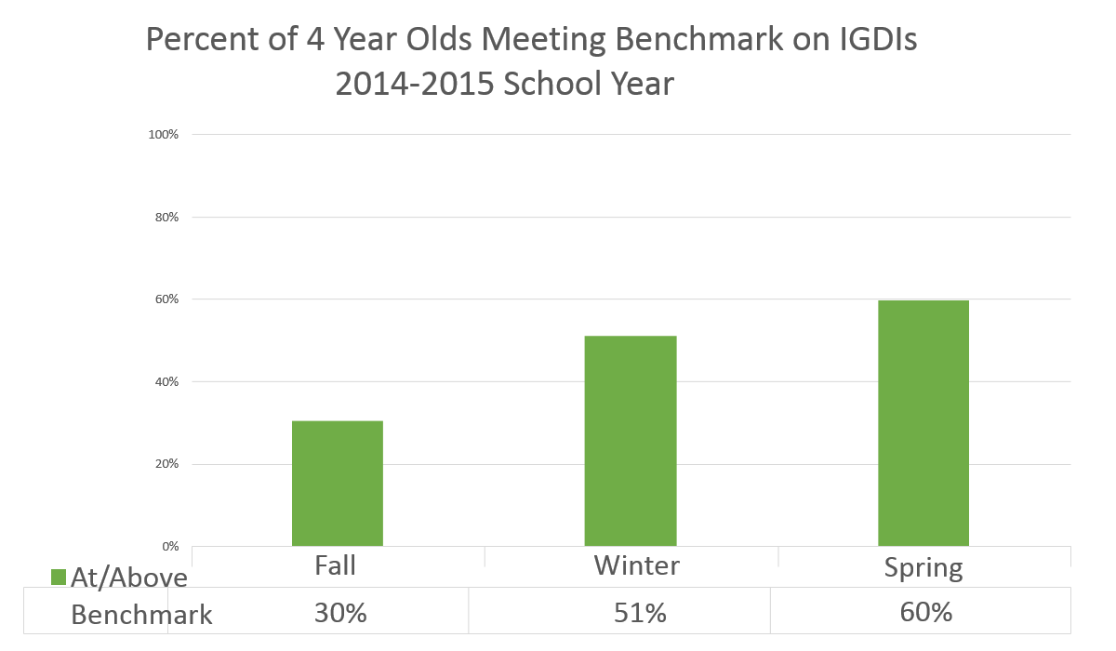
Iowa’s Example: IGDIs

Slide 23
Iowa’s Continuous Improvement Process
Healthy Indicators: Data Analysis and Use
Assessment and Data-Based Decision Making (2015-2016)
Universal Instruction (2015-2016)
Targeted and Intensive Instruction
Leadership
Infrastructure

Slide 24
Iowa’s Guidance: Transition PK - K
GOLD Data Reports (Curriculum-Based)
Widely Held Expectations
Readiness
IGDIs Spring Benchmark Data (Universal Screener)
Initial instructional planning in K
Iowa Early Learning Standards and Iowa Core alignment to understand learning expectations
Working Collaboratively So…Every child enters Kindergarten ready to learn

Slide 25
Moving Forward in Iowa
K-3 Formative Assessment Enhancement Pilot
Comprehensive Assessment System for PK – 3
Alignment of Assessment Requirements and Guidance
Integrate Data Sources at state and local level

Slide 26
Early Childhood Assessment in Ohio
2015 Leadership Conference
“All In: Achieving Results Together”
Sophie Hubbell
Ohio Department of Education

Slide 27
Ready for Kindergarten
Ohio’s Early Childhood Comprehensive Assessment System
Notes:
Maryland and Ohio decided to collaborate to develop a new assessment system as part of our RTT-ELC applications. Both states were lucky to have received the awards and we each bring a strong background to the collaboration. Ohio has implemented its KRAL for 7 years now (a direct assessment only focusing on literacy) while MD has implemented its modified Work Sampling System for over 10 years (a primarily observational assessment that was comprehensive focusing on all domains of readiness). Both states wanted to incorporate both direct and observational measures and ensure the new assessments were aligned with their new expanded standards for young children and aligned to the CCSS.

Slide 28
Purpose
Support children’s development and academic achievement to improve educational outcomes
Measure the progress of children in all areas of school readiness

Slide 29
Assessments
Kindergarten Readiness Assessment
Early Learning Assessment
4-36 Months
36-72 Months
Expanded Progressions
Notes:
ELCG, Ready For Kindergarten is the Brand Name for the Comprehensive Assessment System that Ohio as adopted for Children in the Early Years
The Kindergarten Readiness which is implemented at the beginning of Kindergarten to assess the learning and development of children
Early Learning Assessment which is currently developed for children ages 3-5 and will soon include an infant and toddler assessment (2016)

Slide 30
Scope
ONE Comprehensive Assessment System with built-in accommodations for ALL students
All essential domains of school readiness
Aligned to state and national standards
Notes:
Alignments
Birth to K Entry Standards
Head Start Early Learning Framework
K-12 Standards
Standards for English Language Learners
Early Child Outcomes IDEA reporting
Ohio and Maryland reviewed their respective Birth to Kindergarten Entry standards and created an aligned set of standards.
Early Learning assessments (birth to 72 months) will be aligned to the Office of Special Education Programs federal requirements to measure the 3 categories of child outcomes:
1. Positive social-emotional skills (including social relationships);
2. Acquisition and use of knowledge and skills (including early language/communication [and early literacy]); and
3. Use of appropriate behaviors to meet their needs.

Slide 31
Assessment Domains
Social Foundations
Language and Literacy
Mathematics
Science
Social Studies
Physical Well-Being and Motor Development
Fine Arts (Early Learning Assessment only)
Notes:
Research consistently shows a predictive relationship between school readiness and later school success. (Specifically, literacy, numeracy, and social foundations (approaches toward learning, emotion regulation, and executive functioning) have been found to be predictive of school readiness and later school success.
OELDS Domains EC-CAS Domains
Social Emotional Development + Approaches toward Learning + some cognitive (executive functioning) = Social Foundations (SF)
Cognitive Development and General Knowledge (including Math, Science and Social Studies) = Mathematics (MA) + Science (SC) + Social Studies (SS)
Language and Literacy Development = Language and Literacy (LL)
Physical Well-Being and Motor Development = Physical Development (PD)

Slide 32
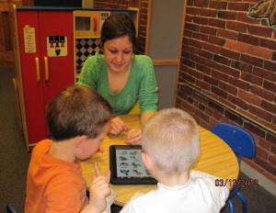
Technology
Assessment materials and scoring
Data capture and reporting
Customized reports for teachers, families and schools
Professional development
Some items available for students online
Notes:
There are 3 technology components – 2 for teachers and one for students:
the ORS – Online Reporting System is where teachers access assessment items, enter student scores, and run student and class reports. It is also where administrators can run building or district level reports. Different report types will be available for teachers, parents, and administrators.
The ELC – Electronic Learning Community– is where teachers go to access professional development resources including the 100% online version of the kindergarten readiness assessment training.

Slide 33
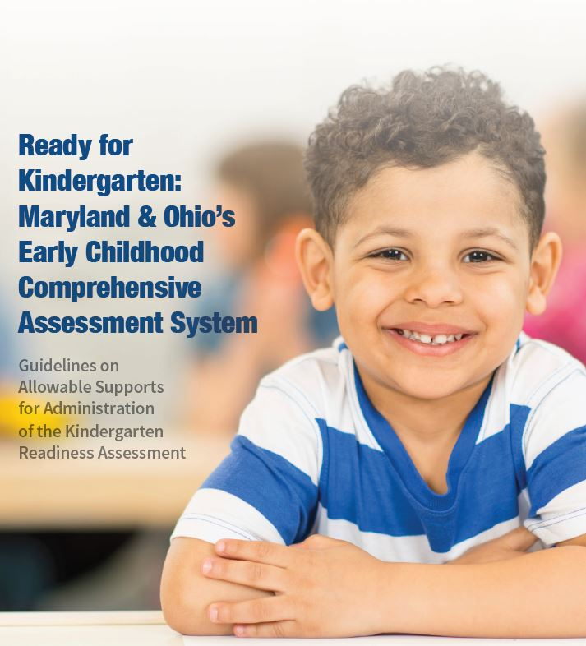
Children with Disabilities

Slide 34
Assessment Data Use
Kindergarten
Third Grade Reading Guarantee
Child outcome measure of prior care
Preschool
Required source of data for ECO process
Measure child progress in TQIRS rated programs
Notes:
Teachers will be able to
Track children’s learning trajectories (milestones, progress
Individualize learning opportunities and plan for intervention
Ensure that children are on the path for kindergarten readiness
Gather data to inform the IDEA required Early Childhood Outcomes

