Slide 1
Exploring the Role of Part C and Section 619 Participation in Designing and Using Linked/Integrated Early Childhood Data
March 11, 2015

Slide 2

Welcome, the DaSy team is happy to work with you today…
Missy Cochenour
Kathi Gillaspy
Grace Kelley
Denise Mauzy
Amy Nicholas
Jeff Sellers
Sharon Walsh

Slide 3
What to expect…
Day 1:
  IDEA meeting with DaSy TA team focused on tools and resources related to the larger ECIDS conversation
  ECIDS staff at the SLDS Best Practices conference (Hyatt)
Day 2: (Move to the Hyatt- 4 minute walk)
  DaSy TA team co-host with the ECIDS/SLDS TA team
  IDEA and ECIDS state staff across the nation will work together on integrated data issues
Reflection leading to next steps, including follow-up call and TA
Electronic evaluation

Slide 4
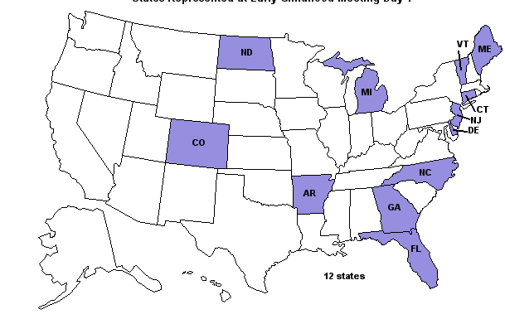

Slide 5
Who Is Participating Tomorrow?
ECIDS
IDEA Part C & Part B/619
Both ECIDS and IDEA

Slide 6






Review Today’s Agenda and Outcomes

Slide 7

What you told us…
(n=18)

Slide 8
“I understand and can articulate the advantages/value of linked and/or integrated data.”
As part of a pre-meeting questionnaire, state participants were asked their level of agreement with this statement. This slide contained the results.

Slide 9
“I understand which linked and/or integrated data can be used (from other programs/agencies) to answer critical questions related to C and 619, ultimately supporting SSIP and other program improvement efforts”.
As part of a pre-meeting questionnaire, state participants were asked their level of agreement with this statement. This slide contained the results.

Slide 10
“I understand the governance and technical considerations for Part C and 619 data systems when planning to link and/or integrate data.”
As part of a pre-meeting questionnaire, state participants were asked their level of agreement with this statement. This slide contained the results.

Slide 11
“Please rate your level of familiarity with Early Childhood Integrated Data Systems (ECIDS) efforts in your state.”
As part of a pre-meeting questionnaire, state participants were asked their level of agreement with this statement. This slide contained the results.

Slide 12
Getting to know you…
Find meeting participant that you don’t know well
Sit with them for 5 minutes
Each of you record about your partner
  Name, state, role
  Share 1 or 2 of each of the following
    Current activity, strength/assets, or success related to linking and/or integrating data
    Biggest challenge in their state related to linking and/or integrating data
Introduce your partner to the large group (1 minute)

Slide 13

Terms, Resources, & Tools

Slide 14
Key Terminology for the Next Two Days
Data/Information Sharing
Data Integration
Data Linkages
Data System
Early Childhood Integrated Data System
ECIDS Tool Kit
Interoperability
Stakeholders

Slide 15
Resources/Tools: DaSy Framework and ECIDS Toolkit

Slide 16
Broad Definition of “Data System”
Data System refers to the hardware, software, and other applications that enable Part C and Section 619 programs to collect data about children, families, workforce, and/or program characteristics (e.g., program quality), as well as the analysis, reporting, and data use practices associated with those data.

Slide 17
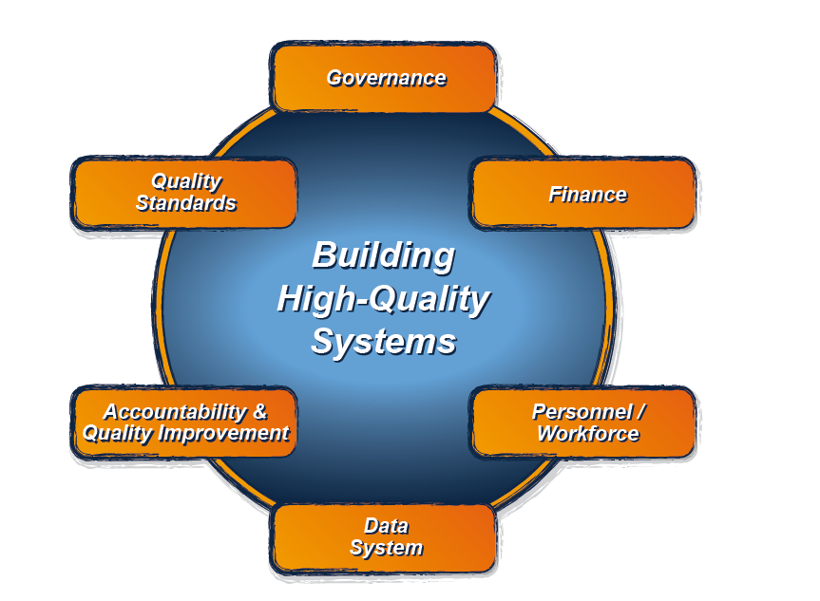
The DaSy Data System Framework:
What is it?
It is the Data System component of the larger ECTA System Framework for Part C & Section 619.
For more information about the ECTA System Framework, visit: http://ectacenter.org/sysframe/

Slide 18

Purpose of the DaSy Data System Framework
Assist Part C and Section 619 state staff in developing and enhancing high-quality state data systems and in improving the quality of their IDEA data.
http://dasycenter.org/framework/index.html

Slide 19
The DaSy Framework Addresses Three Major Uses of Data
Accountability
  Federal and state reporting
Program Improvement
  Identifying strengths and weaknesses, improving results
Program Operations
  Day-to-day management and operation of program activities

Slide 20
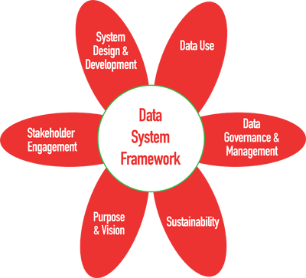
Six Subcomponents of the DaSy Framework

Slide 21
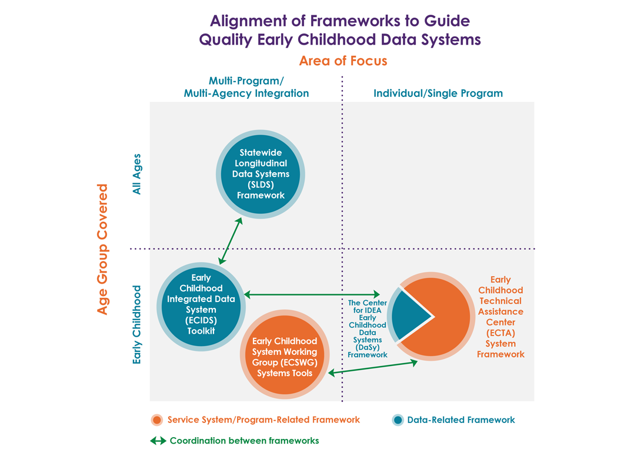

Slide 22
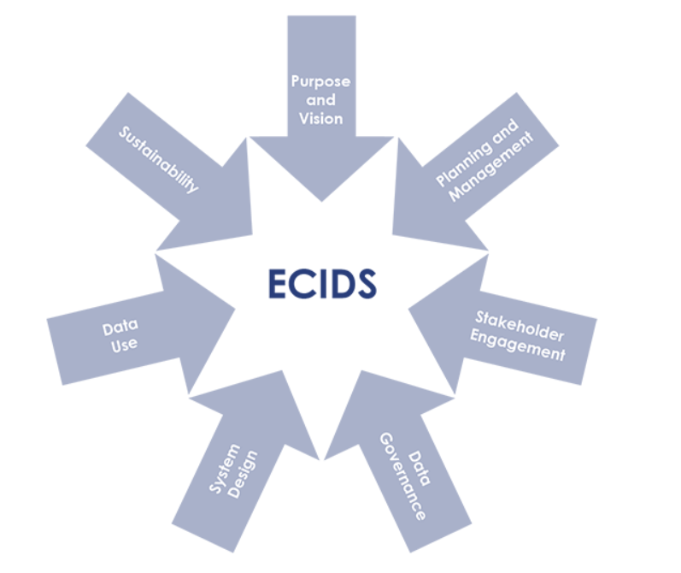
The ECIDS Toolkit
https://slds.grads360.org/#program/ecids-toolkit

Slide 23
A Stakeholder Engagement Example
DaSy Framework
  Indicator 4a. Part C/619 state staff understand their role as stakeholders in the integrated data system initiative.
ECIDS Toolkit
  Key Indicator 2c: Early childhood stakeholders are able to articulate their roles in informing and achieving the intended outcomes of the ECIDS.

Slide 24
A Purpose and Vision Example
DaSy Framework
  Purpose and Vision Indicator 2c. The purpose and vision of the data system address accountability, program improvement, and program operations, including the state’s key program and policy questions.
ECIDS Toolkit
  Purpose and Vision Key Indicator 1D- The Early Childhood Executive Leadership has documented the guiding questions or critical policy questions intended to frame the functions of the ECIDS.

Slide 25

Table Talk
How do you see these tools complementing one another?
What questions do you have about how the tools relate to one another and can be used to support your work?
What are the implications for when you return back to your respective states?

Slide 26

Exploring Linked and Integrated Data

Slide 27

Intro Reflection and Planning Tool
Focus Area
Key Considerations
Ideas or Actions You Would Like to Pursue
Support Required and From Whom

Slide 28
Share
Link
Integrate

Slide 29
Data/Information Sharing
Information sharing describes the exchange of data between various organizations, people and technologies.
  http://www.techopedia.com/definition/24839/information-sharing
Can occur in many forms for Part C and 619
  Paper report
  Electronic file
  Others
Note: Transition data is an example of required data sharing

Slide 30
Data Linkage
DaSy-The process of joining or connecting records in one data set/system with those in another data set/system. Records can be linked through a common identifier in both data sets or by some other method.

Slide 31
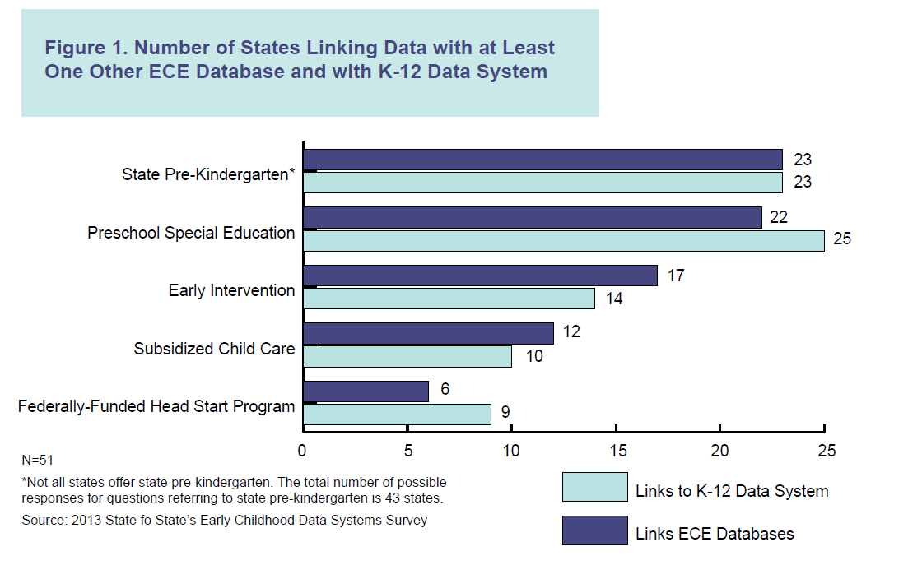
Early Childhood Data Collaborative- Linking Head Start Data with State Early Care and Education Coordinated Data Systems- March 2015

Slide 32
Data Integration
SLDS-Data integration is the combination of technical and business processes used to combine data from disparate sources into meaningful and valuable information. A complete data integration solution encompasses discovery, cleansing, monitoring, transforming and delivery of data from a variety of sources.
  Source: www.ibm.com/software/data/integration/

Slide 33
What does integrating data mean?
Resolution of
  data definitions from multiple sources
  data element code sets from multiple sources
Distinguishing the subtle differences in data from multiple sources
Goal: To spend more time on what the data say than reconciling the various meanings
Example: Gender codes “M/F” in Source A vs. “male/female” in Source B vs. “1=male/2=female” in Source C

Slide 34
DaSy Framework & Your Responses
Quality Indicator PV2e
The purpose and vision of the Part C/619 state data system include integrating information from early childhood programs and agencies as well as participation in the broader State Longitudinal Data System (SLDS) efforts.
This slide contained state responses on their status for this element of quality.
Notes:
Quality Indicator PV2: The purpose and vision include the Part C/619 state program’s intents and goals for the data system. (Page 10 of your Framework)

Slide 35
Why integrate data?
Unduplicated count of children
Broader application for the data
A complete picture of child/student, workforce, and program
Identify influences outside program or agency
Recognize program or policy effects over time
For more information, check out What is an ECIDS?
http://nces.ed.gov/programs/slds/pdf/WhatisanECIDS.pdf

Slide 36

Align
Align
Align
Align

Slide 37

Large Group Discussion
What are examples of benefits for Part C and/or 619 to link/integrate data?

Slide 38
Impact of Selection of Integrated Data Model
3 Potential Models
Centralized
Federated
Hybrid
Within C/619
Between C/619
ECIDS
SLDS

Slide 39
Key Features of Centralized Models
Central database
Match data once, use many times
Ability to integrate data
Stability and testability
Data more readily available for use in reports, BI, dashboards, etc.

Slide 40
Single Agency Example
a state Department of Education-supported online Individualized Education Program (IEP) system
all local districts can access the system for data on their students, transfer students between districts, and perform transactional data collection functions associated with each student
system is hosted by the Department on a cloud server rather than each local district hosting on individual servers
DaSy: Types of Data Systems http://dasycenter.org/resources/papers/types_data_systems.html

Slide 41




EC Centralized ECIDS
Presentation Layer:
Reports, Data Marts, Datasets
Metadata
EC Data System
Student Identities
INTEGRATION
MATCHING
Child
Care
Head Start
State
PreK
Early Intervention – Part B
Early Intervention – Part C
Home
Visiting
Other
Data
K12
Data

Slide 42
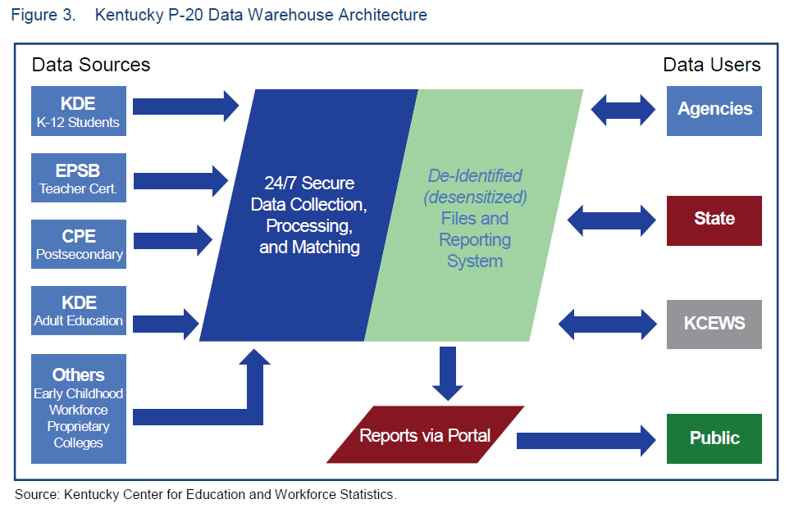
An SLDS Example

Slide 43
Key Features of Federated Models
No central database to support
Accommodates a culture of data sharing sensitivity
Can be implemented more quickly
Matched dataset does not persist
Limited to producing datasets for research/analysis

Slide 44


EC Federated ECIDS
Metadata
Presentation Layer:
Research Datasets
Matched dataset is cached, then removed once data are delivered to requester.
Home
Visiting
MATCHING
Child
Care
Other
Data
Early Intervention – Part B
Early Intervention – Part C
State PreK
Head Start

Slide 45
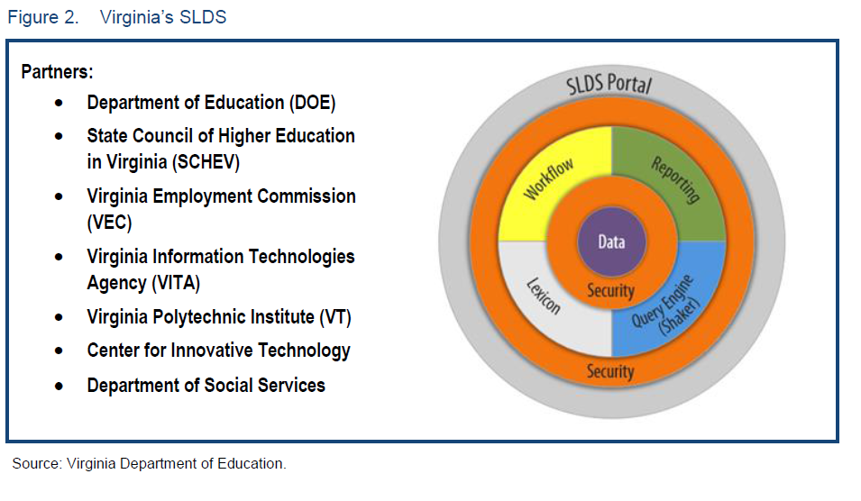

Slide 46
Key Features of Hybrid Models
PII-matchable data linkages maintained
    Biggest process bottleneck
Can produce results more quickly
Matched dataset does not persist
Similar functionality as federated model

Slide 47
EC Hybrid ECIDS
Metadata
Presentation Layer:
Research Datasets
Matched dataset is cached, then removed once data are delivered to requester.
Student Identities
Home
Visiting
MATCHING – Linkages Persist
Child
Care
Other
Data
Early Intervention – Part B
Early Intervention – Part C
State PreK
Head Start

Slide 48


Slide 49
Common Misconceptions
You lose control of your data
Your data must be perfect before you can begin to integrate it with other data
Integrating data allows you to go in and “play” in the data to see what you can find
You no longer have to analyze your own data
If the lawyers review and approve your consents and MOUs, you are compliant with FERPA, HIPAA, and IDEA
Others?

Slide 50

Reflections

Slide 51

Break
Please return by 10:45

Slide 52

Governance and Technical Considerations for Part C and 619 Data Systems When Planning to Integrate Data

Slide 53
Integrated Data Governance Principles
Agency-wide approach to managing information, from collection through use
All programs that collect/use data are represented
Program area ownership of information
  It’s NOT an IT initiative
Clear, distinct roles for and relationships among program areas, IT, and leadership
Each data element has one owner
Common processes, definitions, and business rules across programs
Data governance coordinator

Slide 54
DaSy Framework & Your Responses
Quality Indicator DG2e
Data governance policies address Part C/619 representation on other data governance structures and describe the extent of their decision-making authority as it relates to Part C/619 state data.
This slide contained state responses on their status for this element of quality.
Notes:
Quality Indicator DG2: The state ensures data governance and management roles and responsibilities clearly establish decision-making authority and accountability. (page 12)

Slide 55
DaSy Framework & Your Responses
Quality Indicator DU2c
Part C/619 state staff or representatives develop documentation of the specifications (e.g., data elements, restrictions related to data elements, querying parameters, report criteria) to answer specific questions, and is updated as needed.
This slide contained state responses on their status for this element of quality.
Notes:
Quality Indicator DU2:. Part C/619 state staff or reps conduct data analysis activities and implement procedures to ensure the integrity of the data. (page 36)

Slide 56

Technical Considerations

Slide 57
DaSy Framework & Your Responses
Quality Indicator DG4g
Data governance policies require that any internal or external program or agency maintaining and/or using state Part C/619 data adhere to applicable data quality policies and procedures.
This slide contained state responses on their status for this element of quality.
Notes:
Quality Indicator DG4: Data governance policies require the development and implementation of procedures to ensure the quality and integrity of data collected from state/local programs and agencies. (page 14)

Slide 58
DaSy Framework & Your Responses
Quality Indicator DG4h
Data governance policies require that supporting documentation is available to ensure interoperability when transferring state Part C/619 data to other programs or agencies (e.g., data dictionaries, data validation checks).
This slide contained state responses on their status for this element of quality.
Notes:
Quality Indicator DG4: Data governance policies require the development and implementation of procedures to ensure the quality and integrity of data collected from state/local programs and agencies. (page 14)

Slide 59
DaSy Framework & Your Responses
Quality Indicator DG6g
Data governance security policies require that all internal or external entity or agency maintaining or using state Part C/619 data adhere to all applicable security policies and procedures.
This slide contained state responses on their status for this element of quality.
Notes:
Quality Indicator DG6: Data governance policies require the development and implementation of procedures to ensure the security of the data from breach or loss. (page 16)

Slide 60
DaSy Framework & Your Responses
Quality Indicator SDD4q
The Part C/619 state data system has interoperability that allows for linking Part C or 619 data to other statewide longitudinal and early childhood data systems.
This slide contained state responses on their status for this element of quality.
Notes:
Quality Indicator SD4: The Part C/619 state data system has the capacity to support accountability, program improvement, and program operations, and should contain the following data elements and features.*
*Unless otherwise noted, the data elements listed in this quality indicator are recommended for inclusion in data systems for both Part C and 619 programs. It is not necessary for all of the data elements to be in one data system as long as the necessary linkages are in place. For example, budgeted and expended funds for each local program/district may be obtained by linking to a separate agency financial system. (page 30)

Slide 61
Where do you start?
Determine what must be delivered to provide added value. These are your “requirements.”
Products, systems, software, and processes are the ways how to deliver, satisfy, or meet the requirements whats.

Slide 62
Why are requirements important?
Until we have a detailed understanding of the business processes and interfaces, we will continue to be challenged in defining the right solutions.
Without understanding the “why” and “what,” sometimes we fix what’s not broken.
Other times in solving one problem others are created.

Slide 63
What functionality is needed for those requirements?
What functionality is needed to conduct the types of data analysis you want to conduct for your program?
Data analytic functionality can range from simple on-screen predefined (or “canned”) reports to rich business intelligence capabilities.
How will decisions for data element inclusions be determined?

Slide 64
When are these considerations made?
Early
Review often
As (not if) changes are suggested, be ready to discuss/negotiate impact of changes.
Be realistic with both time and budget

Slide 65
How these decisions are made…
Interviewing subject matter experts and relating needs
Organizing complex information into understandable subject areas
"Translating" technical language into business language and vice versa
Ensuring stakeholder involvement at all levels of decision-making
Drafting clear and concise written documentation for users and technicians
Working successfully with multidisciplinary teams

Slide 66
Desired outcome(s) should…
Begin with end in mind.
Describe what you are trying to achieve by engaging stakeholders, including results and impacts.
Answer, “What specifically are you trying to achieve?”
Be more specific than the “purpose,” and should be the initial step in the stakeholder engagement process.
Keep stakeholders focused on the outcome(s) throughout the engagement process.

Slide 67
Benefits of good planning
Good requirements gathering provides a firm foundation from which to work.
Customers need to know what is being developed and that it will satisfy their needs.
Developers need to know what to develop and testers what to test.
A quality requirements document can provide all of these things.

Slide 68

Hitting the Target

Slide 69

Reflections

Slide 70

Lunch!
Please be back here no later than 1:15 pm.

Slide 71

Critical Questions

Slide 72
DaSy Framework & Your Responses
Quality Indicator PV2c
The purpose and vision of the data system address accountability, program improvement, and program operations, including the state’s key program and policy questions.
This slide contained state responses on their status for this element of quality.
Notes:
PV2-The purpose and vision include the Part C/619 state program’s intents and goals for the data system. (page 10)

Slide 73
DaSy Framework & Your Responses
Quality Indicator DU1c
When planning documents, products, resources, and timelines, Part C/619 state staff consider accountability and program improvement questions that drive data analysis and use.
This slide contained state responses on their status for this element of quality.
Notes:
Quality Indicator DU1:Part C/619 state staff plan for data analysis, product development, and dissemination to address the needs of the state agency and other users. (page 36)

Slide 74
DaSy Framework & Your Responses
Quality Indicator DU2a
Part C/619 state staff or representatives analyze data to address accountability and program improvement needs, including providing timely information for federal and state reporting requirements.
This slide contained state responses on their status for this element of quality.
Notes:
Quality Indicator DU2: Part C/619 state staff or representatives conduct data analysis activities and implement procedures to ensure the integrity of the data. (page 36)

Slide 75
DaSy Framework & Your Responses
Quality Indicator DU2b
Part C/619 state staff prioritize and respond to various types of data requests, including for data that are readily available and queried regularly, data that require additional staff time to query, and data exports for external users.
This slide contained state responses on their status for this element of quality.
Notes:
Quality Indicator DU2: Part C/619 state staff or representatives conduct data analysis activities and implement procedures to ensure the integrity of the data. (page 36)

Slide 76
Let’s Think About Critical Questions
DaSy is developing a set of Critical Questions that can be considered by states.
Will be available soon
Document contains questions on:
  Child and Family Level
  Practitioner level
  Local EIS and LEA Program level
For today, we have selected 10 of these questions that involve data linkages and integration.

Slide 77
Stickers, Stickers, and More Stickers Activity
Large group discussion
  Review posted questions
  Add any critical questions that are missing (group consensus)
Individual activity
  Using your stickers, select your highest priority questions
  You may use multiple stickers on a question
Large group discussion
  Review trends
  Self select for additional work on priority question

Slide 78
10 Critical Questions Identified by DaSy
What percent of children enrolled in EI/ECSE are served in general early care and education programs (e.g., Early Head Start, Head Start, home visiting, child care, state Pre-K)? (Indicator B6-A) How does this compare to the overall population of children birth-5 in the state?
What percent of children with IFSP/IEPs are spending time in high quality early care and education settings?

Slide 79
Critical Questions
What percent of children in EI/ECSE are enrolled in public insurance, such as Medicaid and/or CHIP?
What percent of children or families in EI/ECSE are receiving other public services (e.g., CAPTA, WIC, foster care, CSHCN, CPS, SSI)?
What percent of children who receive EI services continue on to ECSE?

Slide 80
Critical Questions
What is the relationship between child outcomes and characteristics of the general early care and education settings in which children with IFSP/IEPs spend time (e.g., child to caregiver ratio, type/variety of settings, curricula, staff experience, and quality)?
What percent of children who exit EI/ECSE at age expectations do not have an IEP in K-12 (e.g., in kindergarten, in third grade, in grade 12, at graduation, ever)?

Slide 81
Critical Questions
What are the characteristics of children who exit EI/ECSE at age expectations and without an IEP but who subsequently receive an IEP later in K-12? How do they differ from EI/ECSE recipients who do not receive special education services later in K-12?
What percent of children who have received EI/ECSE are achieving at grade level later in K-12 (e.g., at grade 3; grade 6; etc.)?
What percent of children who exit EI/ECSE at age expectations achieve at grade level later in K-12? What percent of their classmates are achieving at grade level?

Slide 82
Mapping the Elements
Use the worksheet in your packet
  Write the questions at the top of the worksheet
Identify
  elements needed to answer the question
  if data are available
  which agency has the data
  whether any conversations about data sharing have occurred

Slide 83
Report Out
What did you discover?
Which state(s) can potentially answer this question?
  For those who cannot, what is the largest barrier?

Slide 84

Reflections

Slide 85
What is an ECIDS?
Why Does it Matter to Me?

Slide 86
What Is an ECIDS?
Collects, integrates, maintains, stores, and reports
information
Early childhood programs across multiple agencies
within a state that serve children and families from
birth to age eight
From the SLDS brief: An Early Childhood Integrated Data System

Slide 87
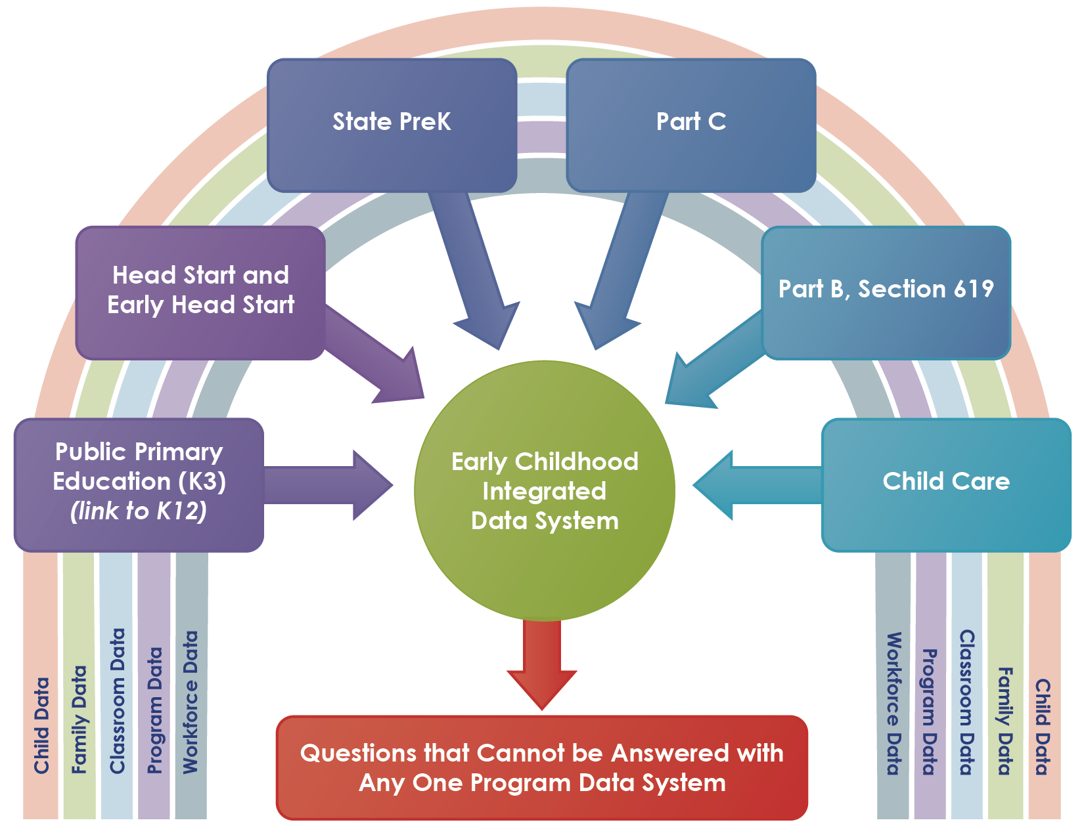
ECIDS
From the SLDS brief: An Early Childhood Integrated Data System

Slide 88
Exploring the Potential…
ECIDS efforts are still in planning and initial implementation stages in many states.
  Demonstrations tomorrow focused on how data are being used
Discussion on multiple fronts about how to potentially include program-level and quality data in ECIDS
  QRIS
  Head Start
  Part C/619

Slide 89
Key Themes: Head Start Participation in ECIDS
Similar to Head Start, Part C and 619 will have to address…
Record matching
Formal data sharing agreements
Developing tools for secure data linkages
Inclusion in state governance bodies
Addressing concerns about how data are used
Transparency of privacy protection and security practices and policies
Early Childhood Data Collaborative- Linking Head Start Data with State Early Care and Education Coordinated Data Systems- March 2015
http://www.childtrends.org/wp-content/uploads/2015/03/ecdc-head-start-brief.pdf

Slide 90
3 Approaches to ECIDS
Centralized
Federated
Hybrid

Slide 91
What model is being planned or implemented in your state ECIDS?

Slide 92
Break
Please be back at 3:00 p.m.

Slide 93
Maximizing Part C and Section 619 Participation in Integrated Data and ECIDS Efforts

Slide 94
DaSy Framework & Your Responses
Quality Indicator SE4a
Part C/619 state staff understand their role as stakeholders in the integrated data system initiative.
This slide contained state responses on their status for this element of quality.
Notes:
Quality Indicator SE4: Part C/619 state staff are engaged as stakeholders in integrated data system initiatives, such as C/619 integrated data system, ECIDS, SLDS. (page 21)

Slide 95
DaSy Framework & Your Responses
Quality Indicator SE4b
Part C/619 state staff participate as active stakeholders in the (integrated data system) initiative in a variety of ways.
This slide contained state responses on their status for this element of quality.
Notes:
Quality Indicator SE4: Part C/619 state staff are engaged as stakeholders in integrated data system initiatives, such as C/619 integrated data system, ECIDS, SLDS. (page 21)

Slide 96

Are you…
Trying to get to the table?
At the table but still figuring out your role?
Actively participating it the table activities?

Slide 97
Stakeholder Engagement Process
Stage 1:
Inform
Stage 2:
Prepare
Stage 3:
Act
Reflect

Slide 98

Stage 1: Inform
Beginning Your Involvement
In this stage, you need to:
    Find out who is involved in the work
    Develop an understanding of what is to be accomplished
    Identify the benefits to children and families in your program
    Gather and process introductory information about the initiative’s leadership
Integrated Data System Initiatives

Slide 99
Benefits of a High-Quality Integrated Data System to Part C/619
Stage 1:
Inform
An integrated data system will enable you to:
      Analyze data and answer critical questions about child and family outcomes, such as:
          How well do children enrolled in Part C/619 do when they enter kindergarten? Beyond kindergarten (e.g., 3rd grade, 5th grade, etc.)?
          Is later school performance related to the length of time children were enrolled in the Part C/619 program or age of referral?
      Examine the long-term benefits of specific services provided
      Develop data-informed program improvement activities

Slide 100
Exploring Your Program’s Needs and Interests
Stage 1:
Inform
What questions do I have that I cannot answer with my own system?
What do I want others to know about my program that an integrated system could support?
What data do we need to include in the new system to ensure we are able to answer the questions that we want/need to answer?
Are there program requirements related to data security and access?
How will my program’s involvement in the initiative be sustained?
What opportunities will I be given to participate in future enhancements to the system?

Slide 101
Stage 2: Prepare
Stage 2: Prepare
Understand the context in which the integrated data system work is occurring.
        Develop a deeper understanding of the scope of the work
        Identify how Part C and Part B 619 fit into the work
          What Part C/619 data should be included in the system?
          What data from other programs/agencies need to be included for Part C/619 to be able to answer their critical questions?
        Clarify expectations for your engagement (both your own expectations and those of the initiative’s leadership)

Slide 102
Enhancing Your Engagement
Purposeful Planning
Stage 2:
Prepare
Active engagement requires purposeful planning.
    Identify specific outcomes you hope to achieve as a stakeholder in an initiative (e.g., access to K-12 data for longitudinal analyses)
    Understand how the information gained improves child and family outcomes
    Continue to strengthen your data systems literacy skills

Slide 103
Create a Message Map
Big Idea
Supporting Sub-points
Factual Support

Slide 104
Grouping for Message Map Activity
“Please rate your level of familiarity with Early Childhood Integrated Data Systems (ECIDS) efforts in your state.”
GROUP 1: “I am familiar with ECIDS and am engaged in this work in my state.”
GROUP 2: “I am familiar with ECIDS efforts but am not engaged in this work in my state.”
GROUP 3: “I am not familiar with ECIDS nor am I engaged with this work in my state.”

Slide 105
Stage 3: Act
Stage 3: Act
Develop and strengthen relationships with leaders and other stakeholders.
    Discuss roles/responsibilities
    Respond to requests for input/involvement
    Be an active member of the stakeholder group through information gathering
        Ask questions and advocate for your program!
        Make meaningful contributions to the development of the data system
Integrated Data System Initiatives

Slide 106
Enhancing Your Engagement
Information Gathering
Stage 3:
Act
    Getting the answers you need to advocate for Part C/619.
    For example:
    Where is Part C/619 in the state’s priority timeline for including our data in the system? Will our data be included now or years down the road?
    What will Part C/619 be able to do with the data in the system? What questions will be able to answer?
    Requires an understanding of what data are going into the system.
    Who (what agency/program) will own and maintain the data once the system is completed?

Slide 107

Reflect
Reflect
    Assess progress toward targeted outcomes.
        Is the work moving in the direction I had hoped/expected?
    Examine your roles and contributions.
        Am I playing an active role in moving the work forward?
    Reflect on the content of the group’s discussions.
        Am I getting the information I need from leadership to make informed contributions to discussions?

Slide 108
Putting it All Together
Actively seek and gather information needed to make informed contributions
Strengthen relationships with leaders and other stakeholders
Build your knowledge and capacity to function effectively as a stakeholder through communication, cooperation, and collaboration
Seek support when needed--the DaSy Center is here to help!

Slide 109

Putting it All Together with the ECIDS Demonstrations

Slide 110
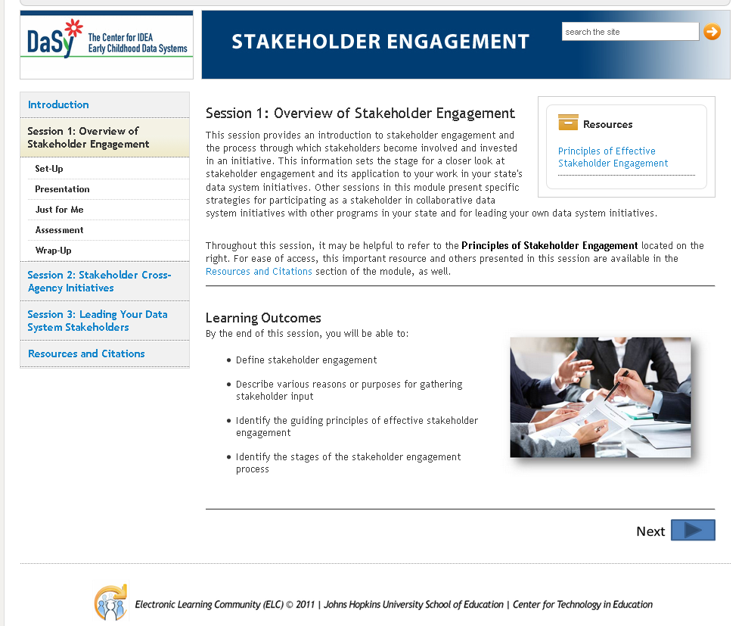
http://www.dasycenter.org/resources/modules.html

Slide 111

Reflections

Slide 112
Next Steps and TA Needs
Review the ideas/action items from the 4 major topics
  As an individual OR
  As part of a state grouping
Record your top 2 or 3 next actions to pursue
  Idea
  First action step
  Person(s) involved
  Timeframe
Be sure to include any TA that you need

Slide 113

Today’s Evaluation & Tomorrow’s Meeting
Evaluation will be emailed to you today
Tomorrow’s meeting starts at 8:30 am
  Located in Hyatt Regency Bethesda
  1 Bethesda Metro Center

Slide 114



The contents of this presentation were developed under a grant from the U.S. Department of Education, #H373Z120002. However, those contents do not necessarily represent the policy of the U.S. Department of Education, and you should not assume endorsement by the Federal Government. Project Officers, Meredith Miceli and Richelle Davis.

