Slide 1
ECTA/DaSy System Framework Self-Assessment
June 18, 2015

Slide 2
Outcomes for this Webinar
Participants will…
Understand the potential uses of the Framework Self-Assessment
Learn how to use the self-assessment to evaluate various components of their Part C or Section 619 state system
Learn how to use the self-assessment as the basis for improvement planning

Slide 3

What we will cover today
Overview of the self-assessment
Guidance on use of the self-assessment
Demonstration of the self assessment

Slide 4

Poll Questions

Slide 5
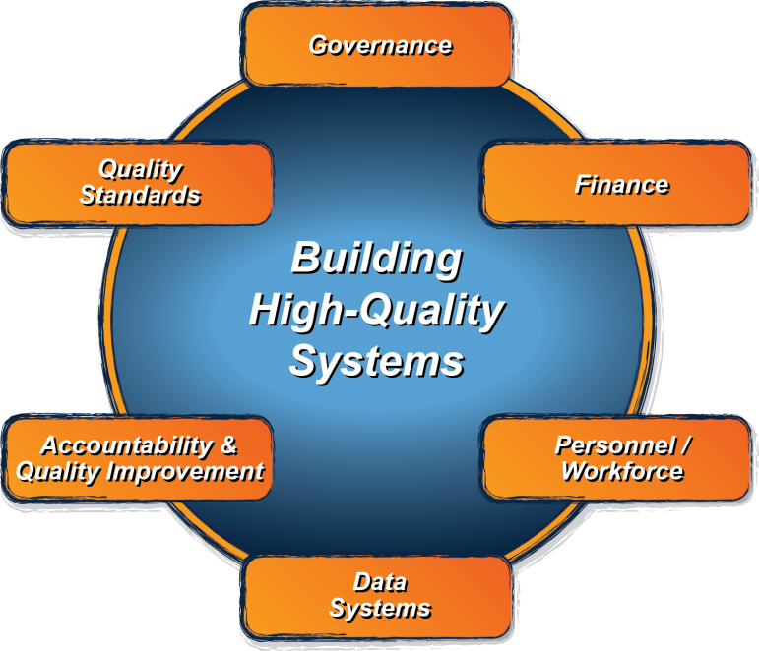
The ECTA/DaSy System Framework: What is it?
Good outcomes for children with disabilities and their families
Implementation of Effective Practices

Slide 6
Framework Components
ECTA System
Data System Subcomponents
Governance – GV
Finance – FN
Personnel/Workforce – PN
Account & Qual. Imp. – AC
Quality Standards – QS
Data System – DS
Purpose and Vision – PV
Data Governance/Mgmt. – DG
Stakeholder Engagement – SE
System Design/Develop. – SD
Sustainability – SU

Slide 7
ECTA/DaSy Self-Assessment: Purpose
Provides a structure for state Part C and Section 619 programs to evaluate their systems
Identifies relative strengths and weaknesses in the system so state can identify and address areas for improvement

Slide 8
Features of Self-Assessment
Use for ECTA and DaSy System Frameworks
Provides a current status ‘snap shot’ to help prioritize improvement efforts
Ability to measure progress over multiple points in time
Shared structure
  Same scale for rating Elements of Quality, 1 to 4
  Same scale for scoring Quality Indicators, 1 to 7
Built in Excel

Slide 9
Element Rating Scale
Element Rating | Implementation of Element
1 | No - element not in place and not planning to work on it at this time
2 | No - element not in place but planning to work on it or getting started
3 | Yes - element partially implemented
4 | Yes - element fully implemented

Slide 10
Quality Indicator Rating Scale
QI Rating | Description of Rating
1 | None of the elements is yet planned or in place.
2 | Most of the elements are not yet planned or in place.
3 | Some elements are in place; a few may be fully implemented.
4 | At least half of the elements are in place; a few may be fully implemented.
5 | At least half of the elements are in place; some are fully implemented.
6 | At least half of the elements are fully implemented; the rest are partially implemented.
7 | All elements are fully implemented.

Slide 11
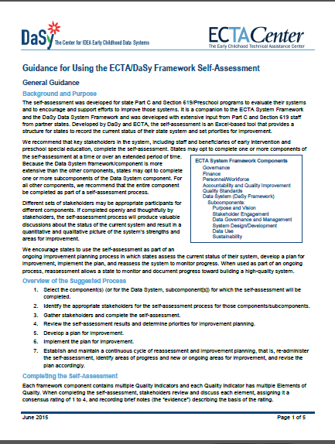
Tip: Download, print, and read the guidance document.

Slide 12
Guidance
Flexibility to complete one or many components (or data system subcomponents)
Suggested process
  Identify and involve stakeholders
  Discussion → Rate elements and document the evidence
  Review results and determine priorities for improvement planning
First step in action planning for system improvement
Detailed instructions in guidance and Excel document

Slide 13
Top Ten Reasons to Use the
Self-Assessment
10. Provides a mechanism for getting stakeholders involved in discussion of state system
9. Generate rich discussion on aspects of system
8. Rate elements of quality for various system components
7. Get automatically calculated QI ratings – no math!
6. Handy-dandy place to document the rich discussion on specific strengths and areas needing improvement

Slide 14
Top Ten Reasons to Use the
Self-Assessment
5. Get cool graph of QI ratings across components (and data subcomponents)
4. Get current snapshot
3. Designate priorities for system improvement
2. Measure progress in infrastructure development by looking at change over multiple points in time – SSIP!
1. Better systems lead to improved outcomes for children and families

Slide 15

On to the Tool . . .

Slide 16
ECTA and DaSy can help ….
Phone, email, on-site technical assistance on one or more components/subcomponents
Help with planning for the process or facilitating the use of the self-assessment
Identification of resources
Support the development and/or implementation of an improvement plan
Contact your ECTA or DaSy state liaison or any of the ECTA or DaSy staff

Slide 17

Partner States
ECTA
DaSy
Delaware
Idaho
Minnesota
New Jersey
Pennsylvania
West Virginia
Alaska
Arkansas
Connecticut
Georgia
Idaho
Massachusetts
Pennsylvania

Slide 18

Questions

Slide 19

The contents of this tool and guidance were developed under grants from the U.S. Department of Education, #H326P120002 and #H373Z120002. However, those contents do not necessarily represent the policy of the U.S. Department of Education, and you should not assume endorsement by the Federal Government.
Project Officers: Meredith Miceli, Richelle Davis, and Julia Martin Eile.

