Slide 1
DaSy Data System Framework: A Tool for Building High-Quality State Part C and Section 619 Data Systems
Kellen Reid (DaSy)
Kathy Hebbeler (DaSy)
Lisa Balivet (AK Part C Data Manager)
Jan Stevenson (GA 619 Coordinator)
Robin Nelson (DaSy)
Elaine Mulligan (DaSy)
February 19, 2015

Slide 2
Outcomes for this Webinar
Participants will…
Be able to identify the key components of a high-quality Part C and Section 619 data system.
Understand some of the potential uses of the framework to improve their Part C and/or 619 data systems and improve the quality and use of their IDEA data.
Gain an initial understanding of the Framework self-assessment tool and other resources developed by DaSy to support states’ use of the tool.

Slide 3

What we will cover today
Overview of the framework (Kathy Hebbeler)
Uses of the framework (Lisa Balivet, Jan Stevenson)
Introduction to the self assessment (Robin Nelson)
Resources to support the framework (Elaine Mulligan)

Slide 4
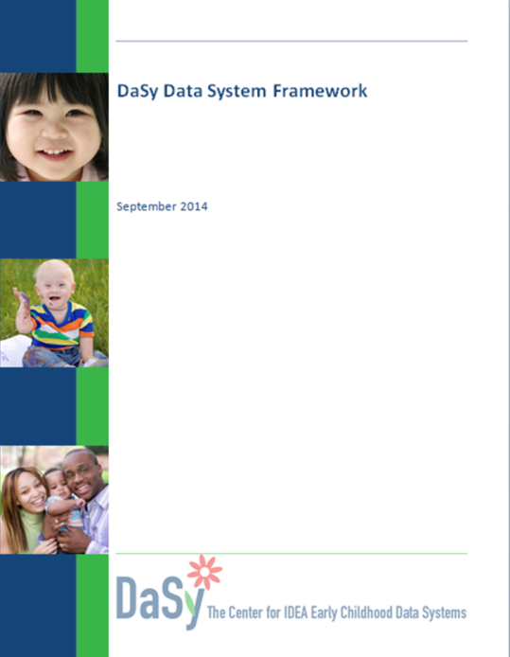
Contributors to the DaSy Framework
Notes:
The framework was developed through a year long process that included lots of input from seven partner states and reviews by external reviewers. We want to thank each of them for their input. The final product is so much better because of their contribution.

Slide 5
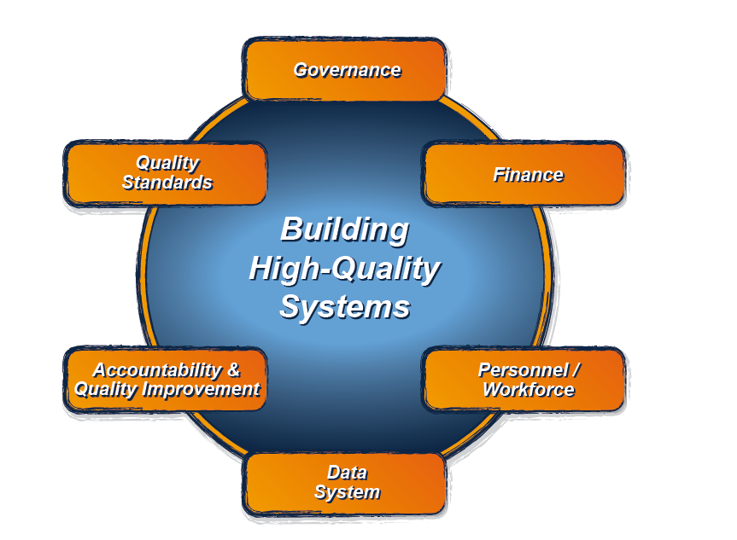
The DaSy Data System Framework: What is it?
It is the Data System component of the larger ECTA System Framework for Part C & Section 619.
For more information about the ECTA System Framework, visit: http://ectacenter.org/sysframe/

Slide 6

Purpose of the DaSy Data System Framework
Assist Part C and Section 619 state staff in developing and enhancing high-quality state data systems and in improving the quality of their IDEA data.

Slide 7
Broad Definition of “Data System”
Data System refers to the hardware, software, and other applications that enable Part C and Section 619 programs to collect data about children, families, workforce, and/or program characteristics (e.g., program quality), as well as the analysis, reporting, and data use practices associated with those data.
Notes:
KATHY: Data system is conceptualized broadly in the DaSy framework. It refers to the hardware, software, and other applications that enable Part C and Section 619 programs to collect data about children, families, workforce, and/or program characteristics (e.g., program quality), as well as the analysis, reporting, and data use practices associated with those data.

Slide 8
The DaSy Framework Addresses Three Major Uses of Data
Accountability
  Federal and state reporting
Program Improvement
  Identifying strengths and weaknesses, improving results
Program Operations
  Day-to-day management and operation of program activities
Notes:
KATHY: Data system can and should be doing all of these things for you.
program operations/functions such as billing, timeline tracking, web-based IFSPs and IEPs
Management of the state program as well as local programs/districts

Slide 9
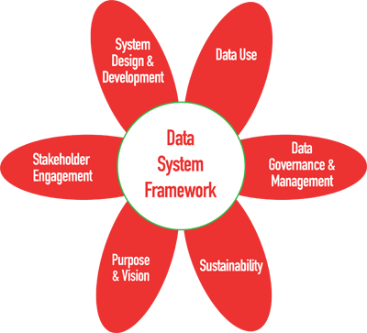
Six Subcomponents of the DaSy Framework
Notes:
The data system framework consists of 6 sub-components. I want to give you a few minutes to study them. There will be a quiz coming later.

Slide 10

Structure and vocabulary
Sub-component (6)
  Section
    Quality Indicator
      Elements of quality

Slide 11
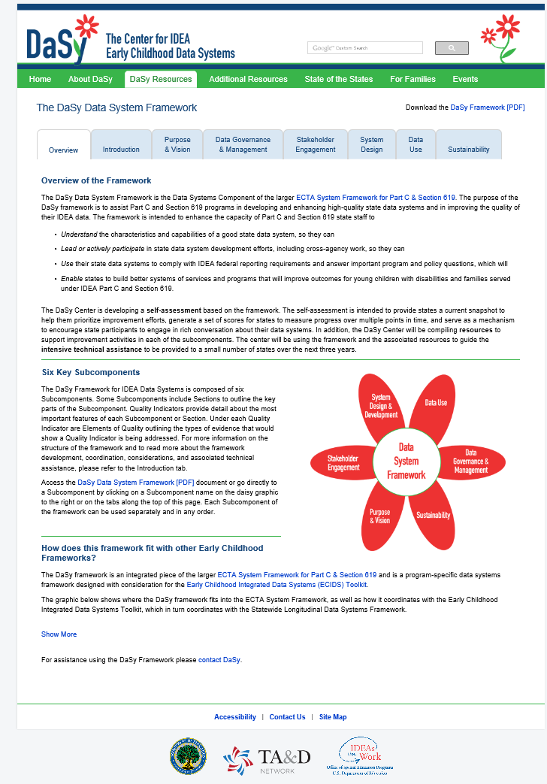
http://dasycenter.org/framework/index.html
For bound printed copies, send an email to:
dasycenter@sri.com
Notes:
You can go to the DaSy web site and interact with the contents of the framework in all sorts of interesting ways. Click on any of those petals and you will be taken to a page on that sub-component. Hopefully, some of you still have the bound copies we distributed at the conference in New Orleans. If you didn’t get one or you would like more printed copies of the framework, send us an email.

Slide 12
Look inside
Notes:
So let’s take a look inside the print version of the framework. We are going to look inside.

Slide 13
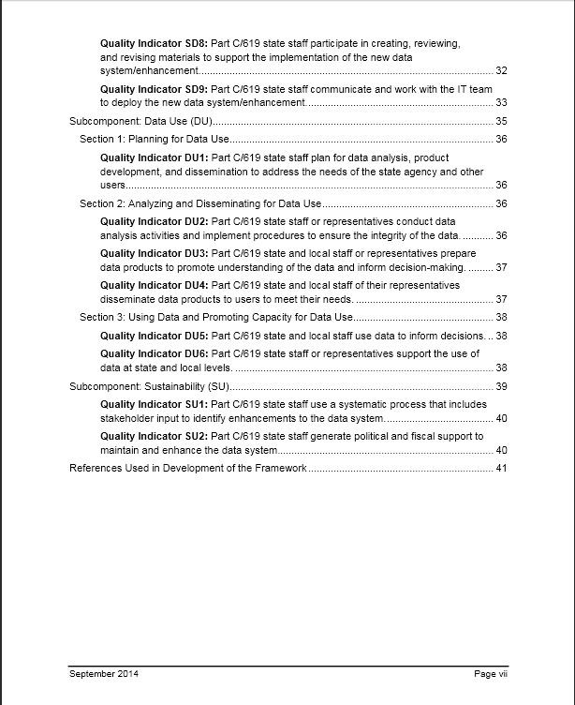
Notes:
You will find a table of contents that lists all of the quality indicators in each of the 6 sub-components.

Slide 14
Quality Indicator DU3: Part C/619 state and local staff or representatives prepare data products to promote understanding of the data and inform decision-making….37
Notes:
Let’s look at one quality indicators. This one is the 3rd quality indicator in Data Use – that’s DU for short.

Slide 15

Quality Indicator DU3: Part C/619 state and local staff or representatives prepare data products to promote understanding of the data and inform decision-making.
Notes:
So you are saying to yourself exactly what does it mean for Part C/619 state and local staff or representatives to prepare data products to promote understanding of data and to inform decision-making. Well, we are glad you asked that question.

Slide 16
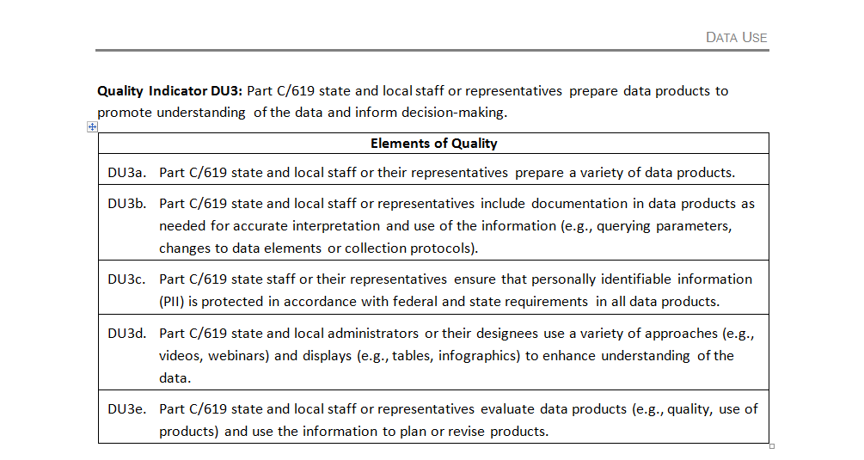
Notes:
Because the answer is back in the Data Use section of the document. When you turn to the Data Use section of the framework, you will find DU3 along with its elements of quality. Elements like DU3a. and DU3c and DU3d. So do you want to take a look at how your state is doing with data use? So that is what it means to do a quality job of preparing data products. Do you want to know more about data use? Look at all of the DU quality indicators. Look at the elements. Browse through the framework and see what a quality data system looks like.

Slide 17



Now, let’s hear from our state partners!
Lisa Balivet Alaska’s Part C Data Manager
Jan Stevenson Georgia’s Part B 619 Coordinator
Notes:
The “interview” portion of the webinar: Jan and Lisa displayed through their webcams in a pod with the presentation slides. Kathy facilitates questions—presenting one question, having both Jan and Lisa answer, and then moving to the next question.

Slide 18
1. Why did you apply to support the development of the DaSy Data System Framework?

Slide 19
2. What do you see as the potential or actual benefits of the Framework and how do you see it being used?

Slide 20
3. How has participating in the Framework development process helped you think about your program’s involvement in cross-agency data system initiatives?

Slide 21
4. How would you envision DaSy being able to help support your data system improvement?

Slide 22

* Self Assessment
* Resources

Slide 23
Overall Features of Self-Assessment
Includes ECTA System Framework & DaSy Framework
Provides states a current status ‘snap shot’ to help prioritize improvement efforts
Shared structure
  Same scale for rating Elements of Quality, 1 to 4
  Same scale for scoring Quality Indicators, 1 to 7
  Document the evidence
Built in Excel
Notes:
Shared structure: Components, sub-components, elements, indicators
Rating Elements of Quality
4-point rating scale to reflect the extent to which each element is fully in place or implemented
1 = No, element not in place and not planning to work on it at this time
2 = No, element not in place but planning to work on it or getting started
3= Yes, element partially implemented
4 = Yes, element fully implemented
“Rating” Quality Indicators
7-point Rating for Quality Indicators: To reflect the extent to which the quality indicator is fully in place/ implemented
1 = None of the elements are yet in process
2 = A few of the elements are in process . . .
3 4 5
6 = Most of the elements are fully implemented, the rest are in process
7 = All elements are fully implemented

Slide 24
Assumptions for Use
Emphasis on “self”
Flexibility to complete one or many components
Involvement of stakeholders
Encourages rich conversations about the system
First step in action planning for system improvement
Strongly recommend use of Excel tool
Notes:
Rating the elements of quality and documenting the evidence → Encourages participants to engage in rich conversations about the system.

Slide 25
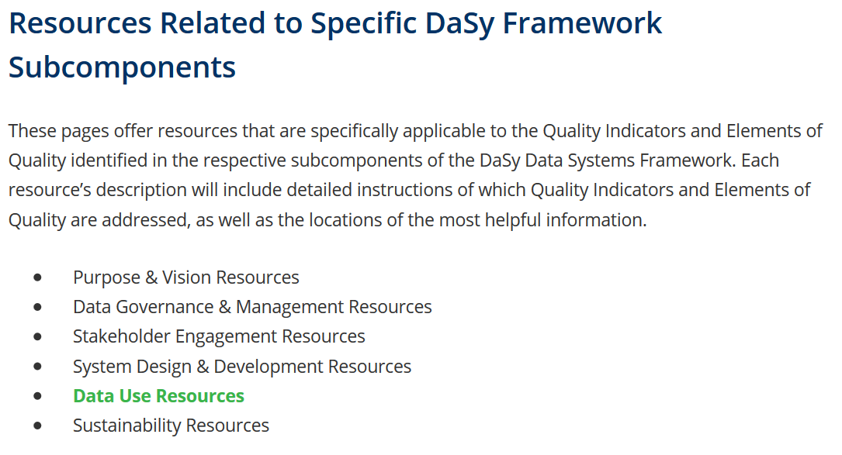
Resource Collections to support Framework use
New pages will offer resources specifically applicable to the QIs and Elements of Quality of the DaSy Framework.
Notes:
Each resource collection can be accessed from the resource subcomponent page or from the larger Framework Related Resources page. These are still in development; the screens shown here are preliminary views of the collection results for the Data Use subcomponent.

Slide 26
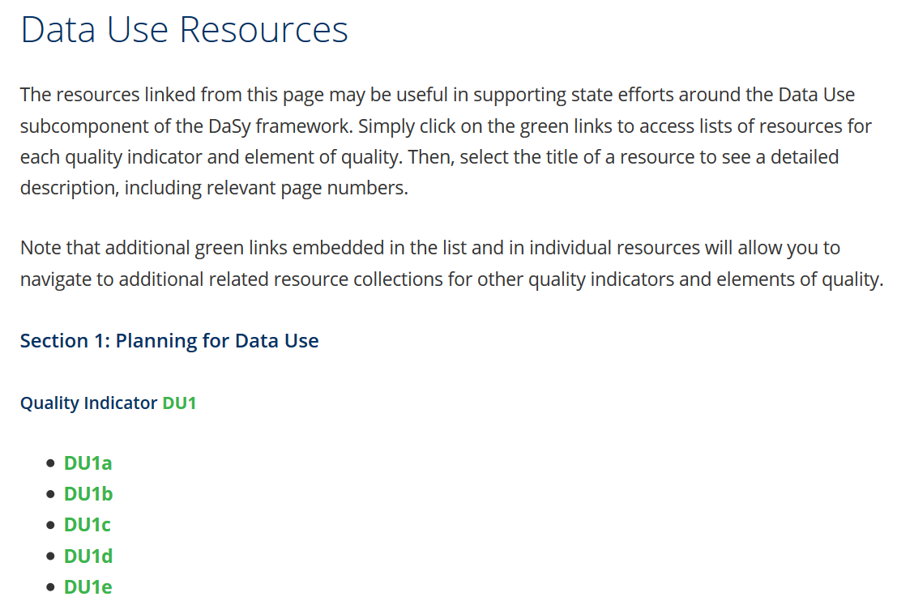
Resource Collections to support Framework use
Simply click on the green links to access lists of resources for each quality indicator and element of quality.
Notes:
There will be separate resource pages for each Framework subcomponent (Purpose & Vision, Data Governance & Management, System Design & Development, Data Use, Stakeholder Engagement, and Sustainability). On each subcomponent resource page, green “hot links” are included for each Quality Indicator and Element of Quality.

Slide 27
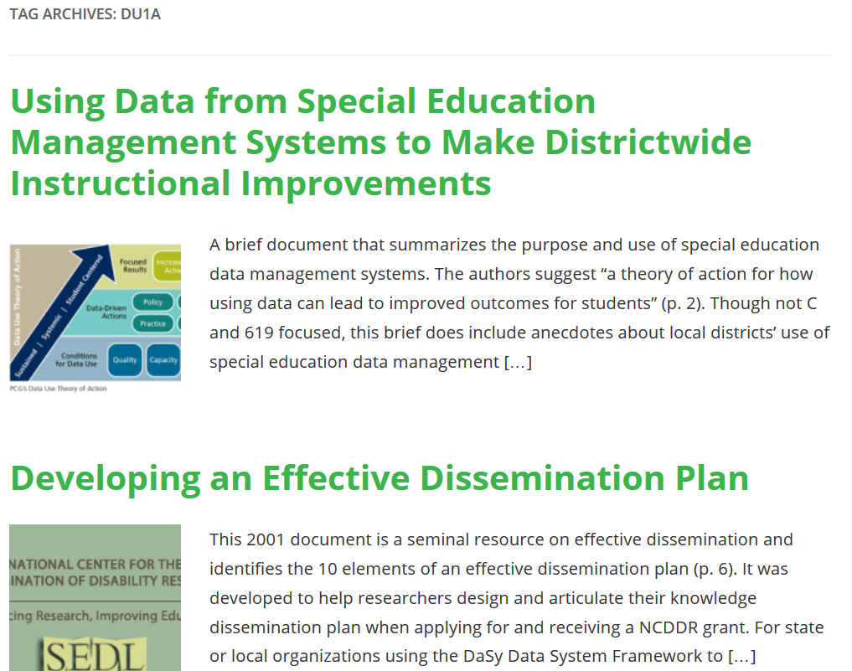
Resource Collections to support Framework use
Then, select the title of a resource to see a detailed description, including relevant page numbers.
Notes:
The collection display page will show an image related to the resource and an abbreviated description of its content.

Slide 28
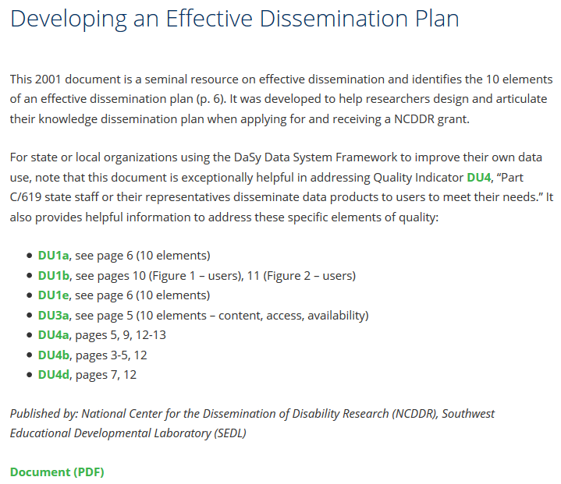
Resource Collections to support Framework use
Each resource’s full description will include which QIs & Elements of Quality are addressed, as well as the locations of the most helpful information.
Notes:
The resource itself is linked at the bottom of the item (Document). Clicking the link will open the resource in a new tab, and the item will stay open in the original tab so the user can reference the page numbers to navigate to relevant content.
Note that additional green links embedded in the list and in individual resources will allow you to navigate to additional related resource collections for other quality indicators and elements of quality.

Slide 29

Participant Poll
Notes:
You are caught up on everything. What aspect of your data system would you like to start working on improving tomorrow?
Purpose and vision (articulated mission, usage, and goals of data system)
Data governance and management (establish responsibility for data, data quality, data integrity; oversee operations)
Stakeholder engagement (gather input from stakeholders at every level)
System design and development (functional and technical requirements; development/enhancement of data system)
Data use (ongoing use of data for accountability, program improvement, program operations)
Sustainability (capacity to support data system over time)

Slide 30
DaSy can help….
Facilitate use of the self assessment for 1 or more sub-components
Phone, email, on site technical assistance on 1 or more sub-components
Identification of resources
Supporting the development and implementation of an action plan to address issues identified through the self-assessment
Contact your DaSy state liaison or any of the DaSy staff
listed on our web site.
Notes:
KATHY: (notes; 5 minutes)

Slide 31

Questions
Notes:
(10 minutes)

Slide 32



The contents of this presentation were developed under a grant from the U.S. Department of Education, #H373Z120002. However, those contents do not necessarily represent the policy of the U.S. Department of Education, and you should not assume endorsement by the Federal Government. Project Officers, Meredith Miceli and Richelle Davis.

