Slide 1
Why Should EI/ECSE Participate in Early Childhood Integrated Data Systems (ECIDs)?
Missy Cochenour (DaSy Center, SLDS State Support Team)
Amy Nicholas (DaSy Center)
Valerie Bakken (Part B Section 619 Coordinator, ND)
Alice Ridgeway (Part C Data Manager, CT)
Jill Singer (Part C Coordinator, NC)
DEC’s 31st Annual International Conference
October 8, 2015
Atlanta, GA

Slide 2
Introductions
The DaSy Center is a national technical assistance (TA) center funded by the U.S. Office of Special Education Programs (OSEP). DaSy works with states to support IDEA early intervention and early childhood special education state programs in the development or enhancement of coordinated early childhood longitudinal data systems.
The Statewide Longitudinal Data Systems (SLDS) Grant Program and its partners offer a wide and growing range of support to help state education agencies in the design, development, and use of longitudinal data systems, including ECIDSs. States can request TA from the State Support Team on a specific issue as they strive to meet project objectives.

Slide 3
Session Objectives
Gain an understanding of:
Why states are developing Early Childhood Integrated Data Systems (ECIDSs) and how the work is being funded;
The progress being made with the inclusion of early intervention (EI; Part C) and early childhood special education (ECSE; Part B 619) data in those systems; and
The benefits EI/ECSE can experience by participating in cross-agency integrated data system initiatives.
Learn about tools/resources for EI and ECSE leaders and their stakeholders to support participation in conversations about cross-agency data systems.

Slide 4
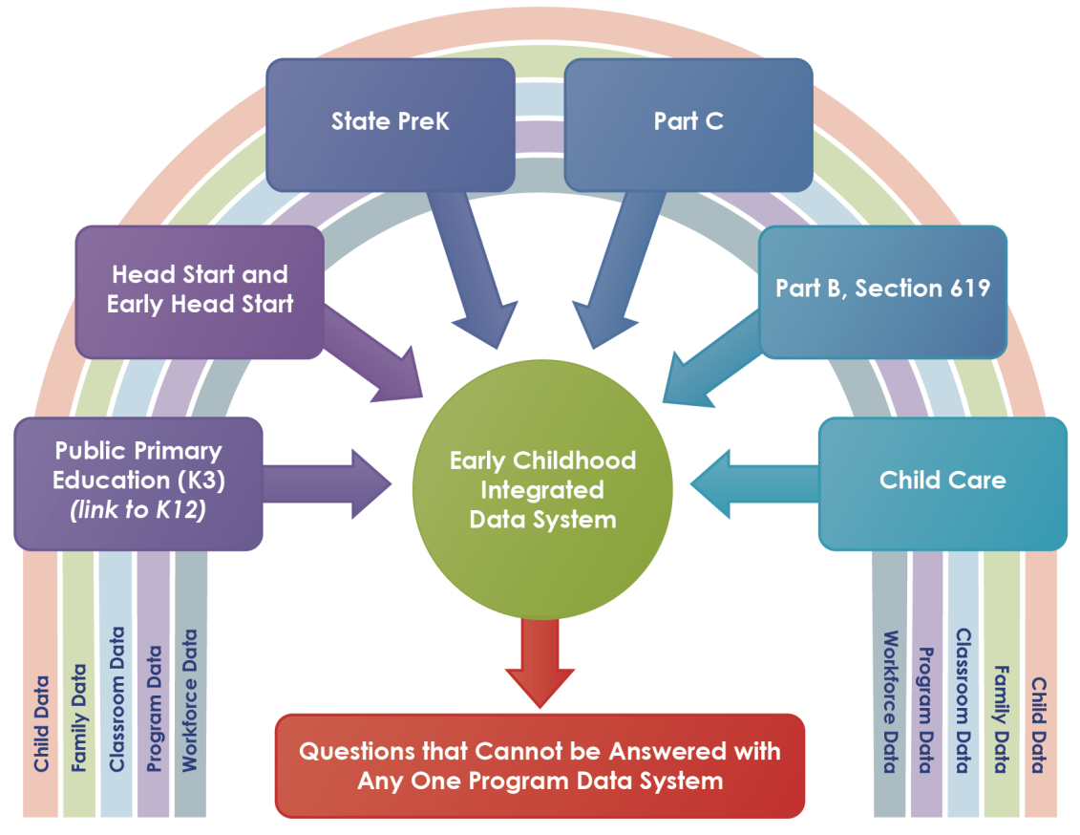
What is an ECIDS?
Collects, integrates, maintains, stores, and reports information from early childhood programs
Includes data from multiple agencies/programs within a state that serve children and families from birth to age 8, such as data on:
Individual children
Children’s families
Classrooms/sites
Workforce
(Source: What is an ECIDS?, NCES, 2014)

Slide 5
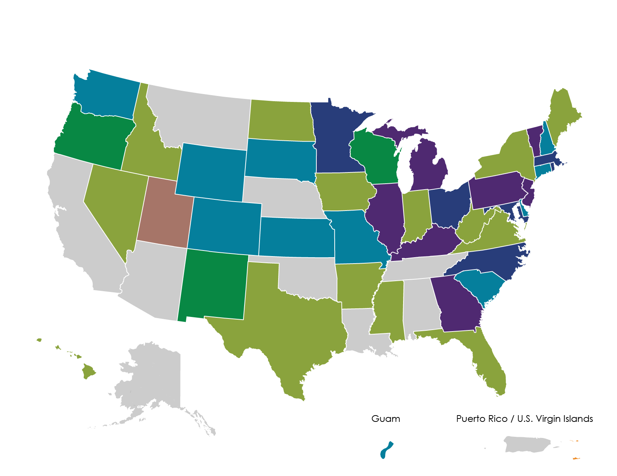
Funding ECIDS Initiatives
RTT-ELC States ECIDS – Round 1
RTT-ELC States ECIDS – Round 2
RTT-ELC States ECIDS – Round 3
States Using SLDS for ECIDS –
EC Specific (U.S. Virgin Islands)
States Using SLDS Grant to Include EC in P-20
States Using Internal Resources for ECIDS
ECCS Grant Toward ECIDS (Utah)
States Not Working Toward an ECIDS

Slide 6
Why Develop an ECIDS?
To answer questions that cannot be answered using single-program data
Can your EI/ECSE program answer the following questions?
What is happening to the children you serve after they leave your program?
In what other programs are your children/families participating that may contribute to the outcomes they experience?
To enhance cross-agency/program collaboration
How well is your EI/ECSE program collaborating with other programs to provide seamless, coordinated comprehensive services to children and families?

Slide 7
Progress with Including EI/ECSE
Eight states are working on developing partnerships to integrate EI/ECSE data in their ECIDSs.
DaSy ECIDS Learning Community (LC)
Objectives:
EI/ECSE representatives will identify data needed from their state ECIDS to meet program goals, including SPP/APR and SSIP activities.
State ECIDS Teams will identify the data from EI/ECSE needed to meet their identified goals.
Cross-state LC teams will discuss issues related to match/mismatch between EI/ECSE data needs and ECIDS purpose and use in states.
State ECIDS Teams, including Part EI/ECSE, will develop solutions to address those challenges.

Slide 8
EI/ECSE Participation in ECIDSs: Key Considerations
EI/ECSE programs participating in an ECIDS need to consider:
How records will be matched
Data sharing/linkage agreements
Security of data sharing/linkages
Representation on ECIDS governance body
Stakeholder concerns about how data are used
Transparency of privacy protection and security practices/policies
Source: Early Childhood Data Collaborative- Linking Head Start Data with State Early Care and Education Coordinated Data Systems- March 2015
http://www.childtrends.org/wp-content/uploads/2015/03/ecdc-head-start-brief.pdf

Slide 9
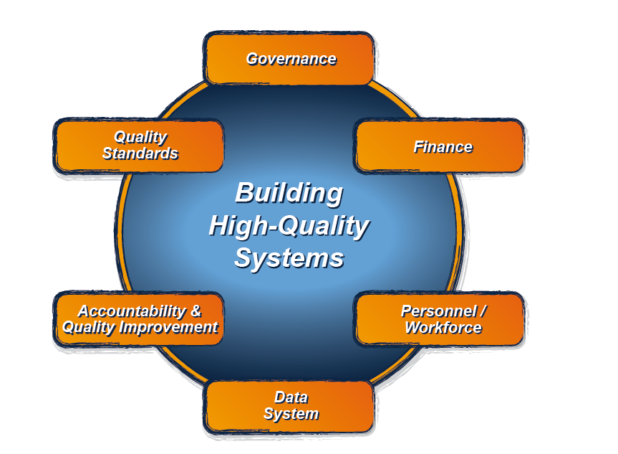
The DaSy Data System Framework: What is it and how is it used?
It is the Data System component of the larger ECTA System Framework for Part C & Section 619.
It is a tool designed to assist Part C and Section 619 state staff in developing and enhancing high-quality state data systems and in improving the quality of their IDEA data.
For more information about the ECTA System Framework, visit: http://ectacenter.org/sysframe/

Slide 10
Six Subcomponents of the DaSy Framework
For more information about the DaSy Data System Framework, visit: http://dasycenter.org/framework/index.html

Slide 11
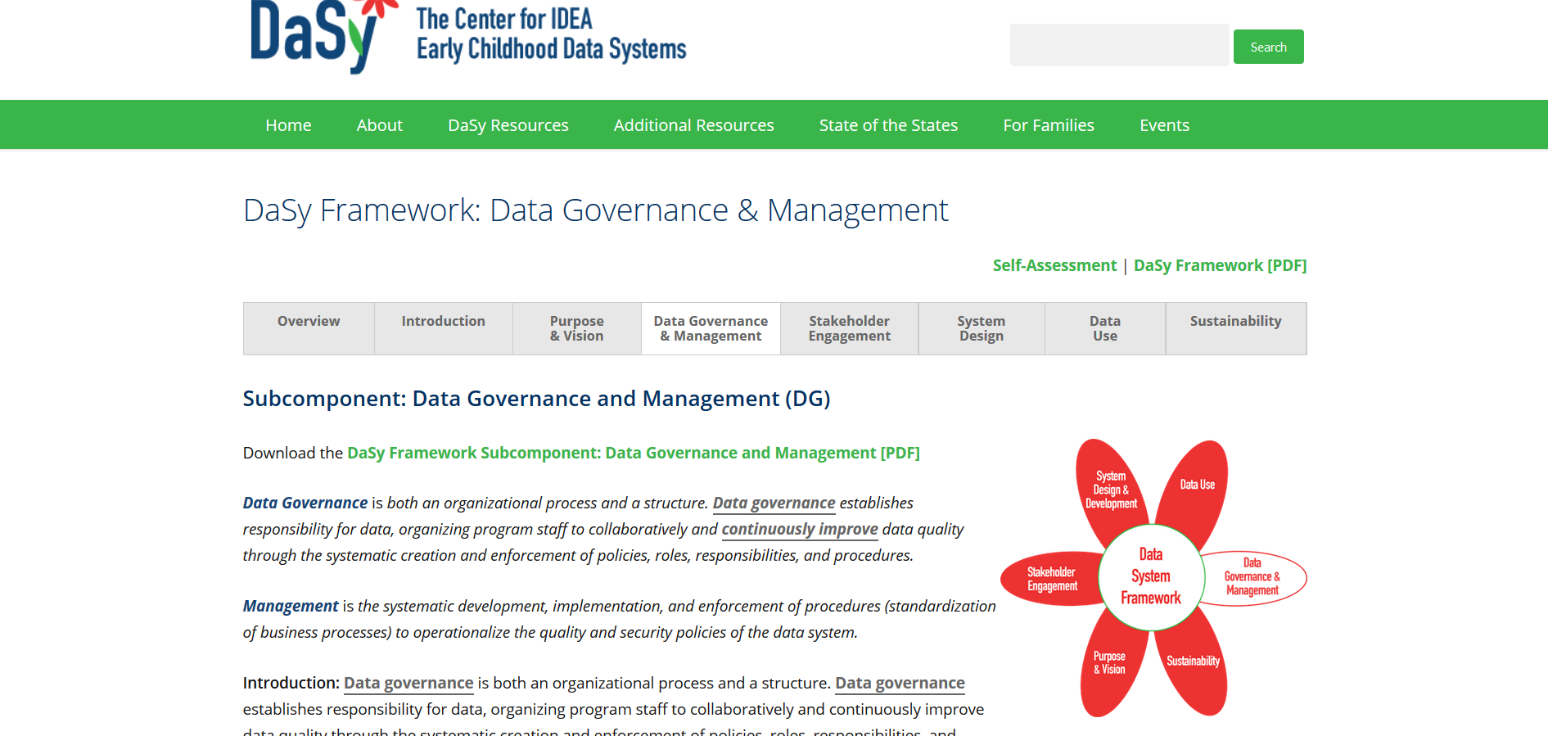
DaSy Framework: http://dasycenter.org/resources/dasy-framework/
Part C/619 involvement
in ECIDS initiatives is
addressed in every
subcomponent
of the Framework!

Slide 12
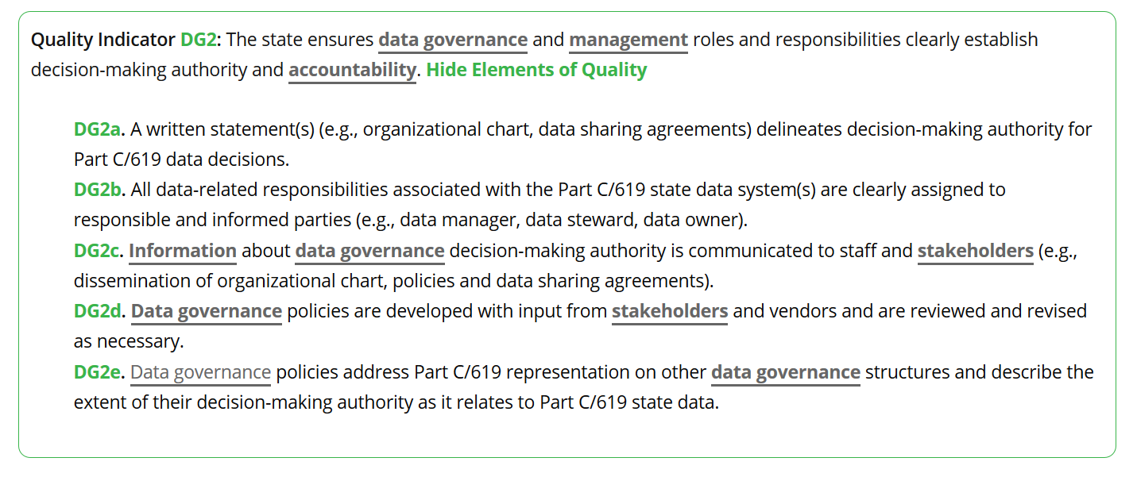
For example: Data Governance & Management (DG2e)

Slide 13
Built-in Glossary

Slide 14
A State’s Story: Exploring the Power of an ECIDS
What are the benefits EI/ECSE can experience from participation?
For example, what questions can EI/ECSE answer using data from the ECIDS and how can answers to those questions lead to improved outcomes for children and families?
What advice, experience, or recommendations would you offer to other EI/ECSE leaders who are interested in becoming involved in their state ECIDS?
For example, where to begin, what to prepare for, challenges to avoid, using the DaSy Framework

Slide 15
EI/ECSE Stakeholder Think Abouts
Benefits
Critical questions
Needed data elements
Data stewardship
Timeline
Technical requirements for EI/ECSE data system
Expectations for stakeholder engagement
Involvement in enhancements

Slide 16
Tools to Support EI/ECSE Stakeholder Participation in ECIDS Initiatives
DaSy Framework
ECIDS Toolkit
DaSy Stakeholder Engagement Online Learning Module

Slide 17
The contents of this presentation were developed under a grant from the U.S. Department of Education, #H373Z120002. However, those contents do not necessarily represent the policy of the U.S. Department of Education, and you should not assume endorsement by the Federal Government. Project Officers, Meredith Miceli and Richelle Davis.

