Slide 1
State of the States Related to Systemic Improvement
Council for Exceptional Children (CEC)
Division of Early Childhood (DEC)
October, 2015
Kristin Reedy, NCSI
Christina Kasprzak, ECTA
Cornelia Taylor, NCSI/ECTA

Slide 2
Objectives
Provide a national snapshot of state SSIPs
Engage in dialogue with participants regarding what needs to happen to improve outcomes for young children with disabilities
Provide an opportunity to inform and encourage the broader involvement of the early childhood community in and connection to state SSIP efforts

Slide 3
Outcomes
Knowledge of state focus areas and plans related to the State Systemic Improvement Plan (SSIP)
Opportunity to provide perspectives on state and local improvement efforts
Discussion of how broader participation of the early childhood community in state SSIP efforts can help leverage the impact of early childhood initiatives in the states
Exploration of barriers that stand in the way of systemic change
Identification of strategies to overcome barriers and improve outcomes for children and families

Slide 4


Participating with Poll Everywhere
How to vote via the web or text messaging
From any browser
From a text message
Pollev.com/(DASY)
22333
DASY your response

Slide 5
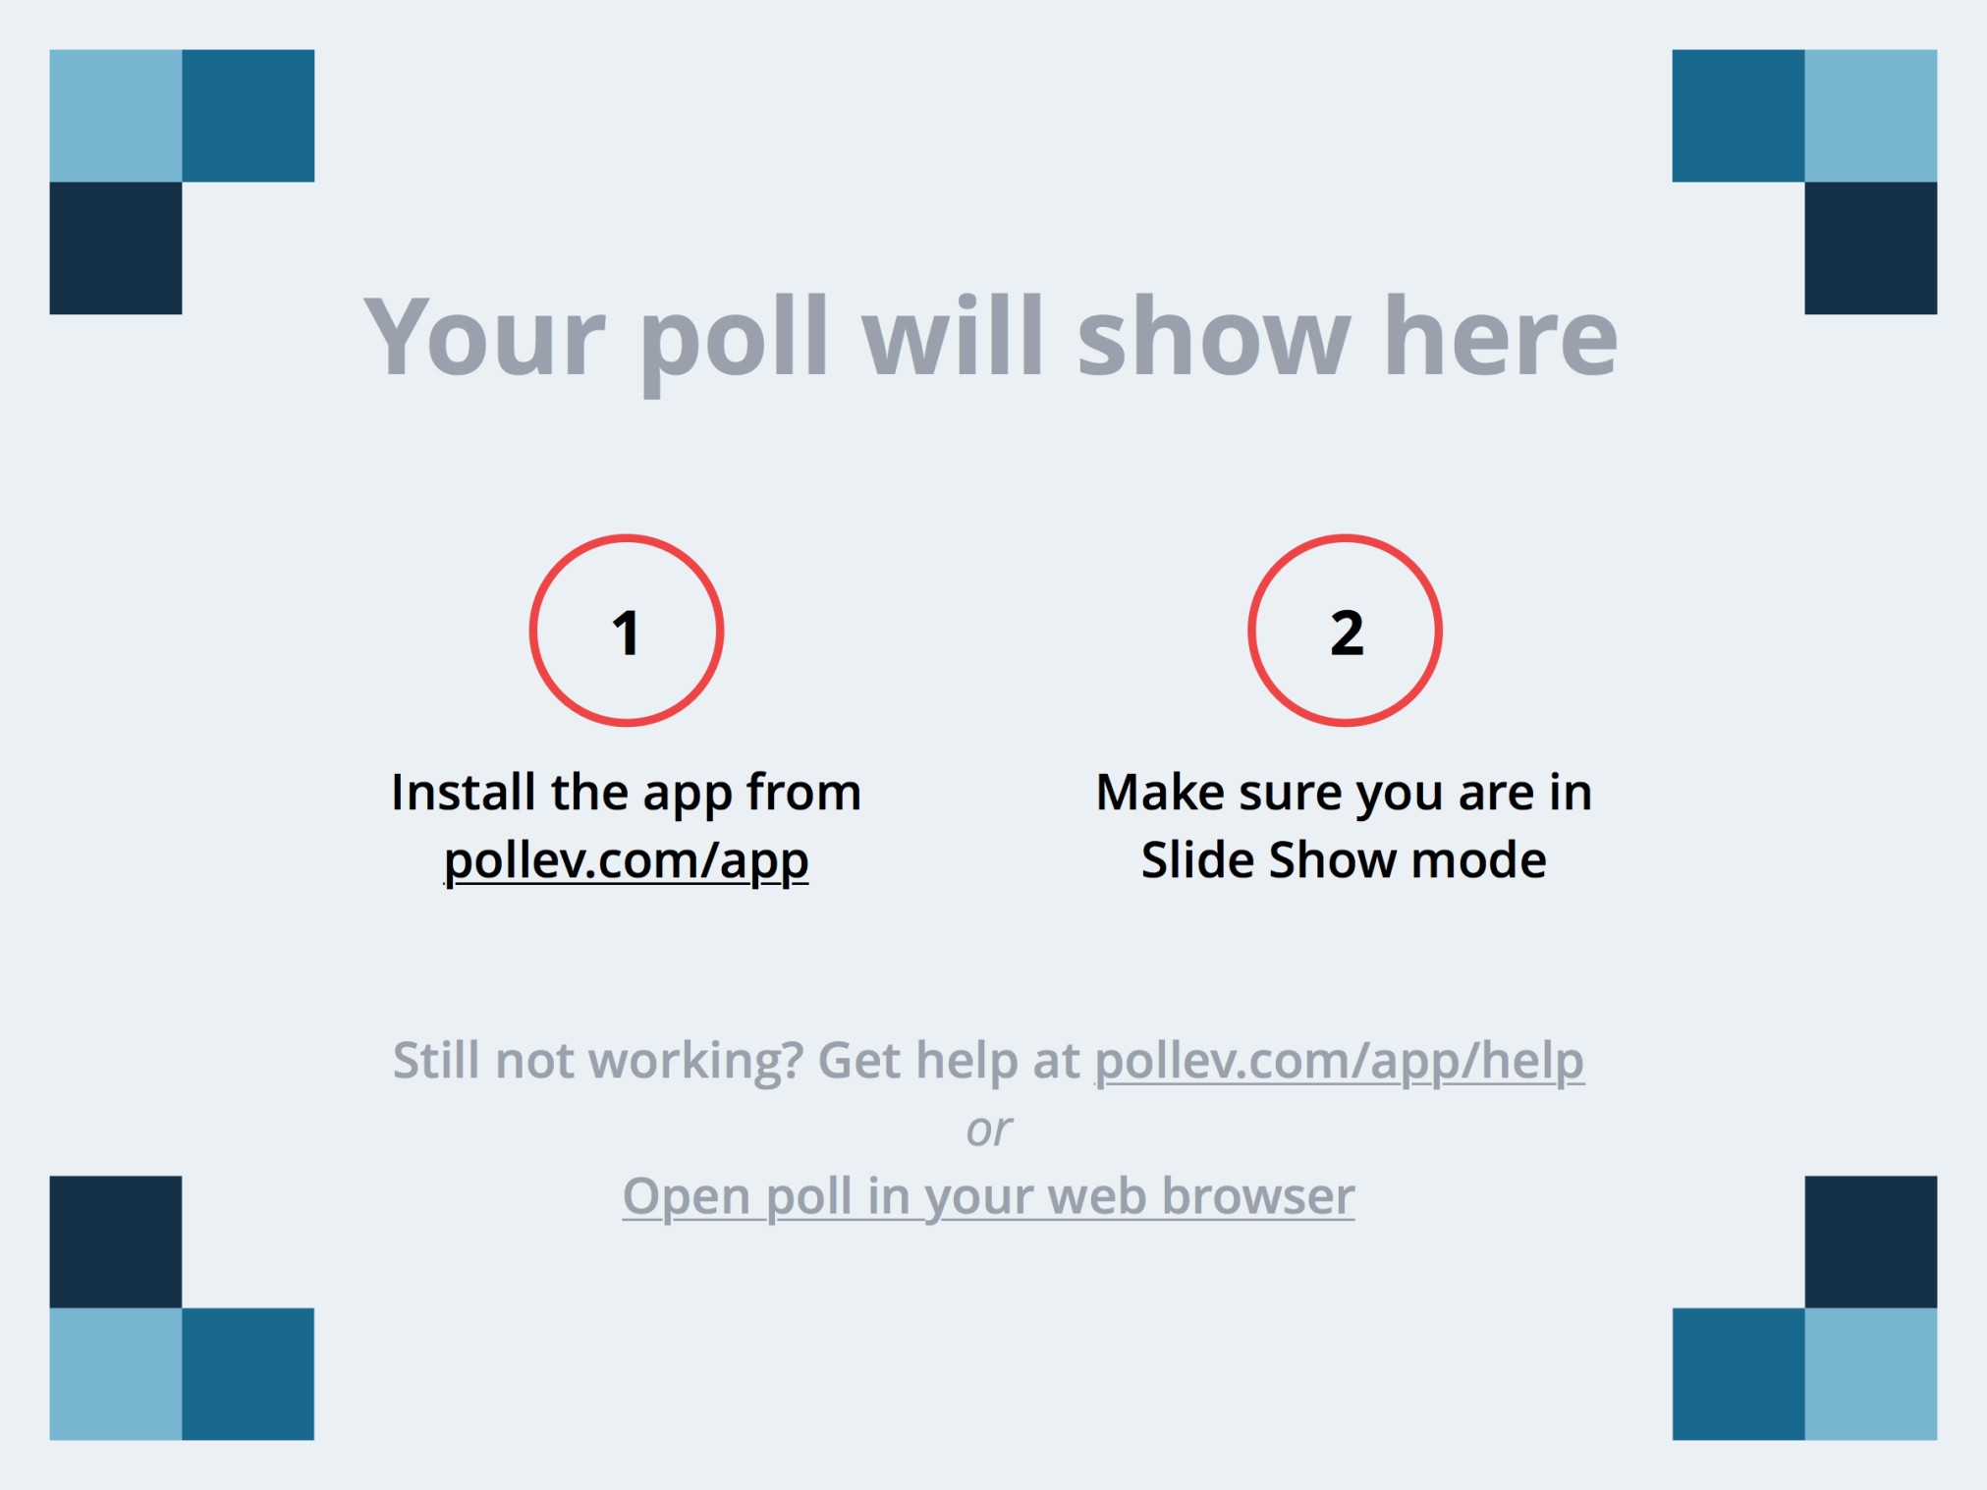
Notes:
How many cups of coffee did you have this morning?
https://www.polleverywhere.com/multiple_choice_polls/g3ZDSGd0H1tn2ec

Slide 6
Notes:
What best describes your professional role?
https://www.polleverywhere.com/multiple_choice_polls/5X2bm59HZshgJa3

Slide 7
Notes:
Where do you live?
https://www.polleverywhere.com/multiple_choice_polls/iPcLD7lDUzeji6N

Slide 8
Notes:
How have you been involved in the development of your state's SSIP (State Systemic Improvement Plan)?
https://www.polleverywhere.com/multiple_choice_polls/B6KMQlbhRTHsMnT

Slide 9
Opening Discussion
If you had an infusion of additional resources, where would you focus those resources to improve your system, services, and ultimately outcomes for children and families?

Slide 10

Background
Results Driven Accountability:
Achieving the Vision of Successful Outcomes for All Children with Disabilities
Notes:
RDA is a policy initiative announced by the US Office of Special Education Programs (OSEP) in the Spring 2012.
OSEP is committed to improving educational and early intervention results for America’s infants, toddlers, children and youth with disabilities.

Slide 11
RDA – Shifting the Balance
OSEP has revised its accountability system to shift the balance from a system focused primarily on compliance to one that puts more emphasis on results.
Notes:
For many years, OSEP’s accountability system emphasized the procedural compliance provisions of the IDEA over student learning outcomes. This new direction emphasized a more balanced approach in order to effectively impact educational results.

Slide 12
Why now?
“For too long we’ve been a compliance-driven bureaucracy when it comes to educating students with disabilities.”
“We have to expect the very best from our students – and tell the truth about student performance – so that we can give all students the supports and services they need. The best way to do that is by focusing on results.”
(U.S. Secretary of Education Arne Duncan)
Notes:
Make the connection between early intervention and long terms outcomes, e.g., graduation.
As we know, the positive outcomes of graduation from high school with a general education diploma and post-school outcomes of higher education, employment and independent living are predicated on early childhood outcomes. That’s one of the reason the early intervention and early childhood special education are so important.

Slide 13



Poor Outcomes for too Many
Students With Disabilities
Low academic achievement
Above average dropout rates
Higher than average arrest rates
For more information:
Sanford et al., 2011; NAEP, 2013;
Planty et al., 2008, Aud et al., 2012
Notes:
For too long, these are the national trends that we have seen: poor outcomes for too many children with disabilities.
This isn’t true for all SWD. But for too many SWD, this is what happens.
Add efficacy of early childhood info (next slide plus?) – KEA
Insert NIELS information about the long term impacts of EI – Maybe plug the importance of SLDS and ECIDS to help states make case for the impact of EI and ECSE on these longer term outcomes; Economic report on early childhood that came out of the white house related to early childhood assessment
Students with disabilities have poorer outcomes in terms of postsecondary education and employment.
Academic achievement: Intensive intervention is a highly relevant and timely topic considering the continuing underachievement of students with disabilities, as reflected in the National Assessment of Educational Progress (NAEP). In 2013, 18% of 4th graders with disabilities performed at or above the “Proficient” level in mathematics, compared to 45% of their non-disabled peers (data retrieved from http://nationsreportcard.gov/reading_math_2013/#/student-groups). Patterns are similar in 4th grade reading (11% of students with disabilities and 38% of students without disabilities), 8th grade math (8% and 39%, respectively), and 8th grade reading (9% and 40%, respectively).
Dropout rates: There are differences in how “dropout” was defined in these sources: The Condition of Education 2012 (Aud et al., 2012) and The Condition of Education 2008 (Planty et al., 2008). 2006 were the latest available data broken out for SWDs. In general, students with disabilities have a much higher dropout rate (26.2%, compared to a 7% status dropout rate for all students in 2010). Students in the Emotional Disturbance category had the highest dropout rate of all disability categories (44.9%), followed by Learning Disabilities (25.1%).
Arrest rates: Twenty-three percent of young adults with disabilities have been arrested at least once, almost twice the rate for youth in the general population (12 percent; p < .001). Rates for arrest and parole are highest among students identified as having Emotional Disturbance (49.4 percent). (Sanford et al., 2011)

Slide 14
Why RDA?
30 year focus on compliance improved compliance
States are not seeing improved results
  Young children are not coming to Kindergarten prepared to learn
  In many locations, a significant achievement gap exists between children with disabilities and their general education peers
  Children are dropping out of school
  Many children who do graduate with a regular education diploma are not college and career ready
  (Michael Yudin, Assistant Secretary, Office of Special Education & Rehabilitative Services)
Notes:
We have observed that a 30 year focus on procedural compliance resulted in just that: improved compliance. That’s important because compliance with IDEA requirements is one of the foundations of improved results. But we have seen that in spite of better compliance rates, we are not seeing improved outcomes or results.
Studies show that children who participate in quality early intervention and preschool programs are:
· More likely to graduate from high school
· More likely to have a job
· Less likely to have committed crimes
· More likely to attend a 4-year college
· Less likely to be a teen parent
· Less likely to use drugs
· More likely to earn higher income
· More likely to be healthy
References:
The High/Scope Perry Preschool Program http://www.highscope.org/content.asp?contentid=219
The Carolina Abecedarian Project http://abc.fpg.unc.edu/
ECTA Web site on Effectiveness of Infant and Early Childhood Programs: http://ectacenter.org/topics/effective/effective.asp
Insert:
EC Outcomes:
Pull state examples from RTT/ELC states that touch on importance of SSIP investment in EC
For over 30 years, there has been a strong focus on regulatory compliance with the IDEA and Federal regulations for early intervention and special education.
OSEP
States
Districts/Programs
As a result, compliance has improved!

Slide 15
High Quality Early Intervention
Studies show that children who participate in quality early intervention and preschool programs are:
More likely to graduate from high school
More likely to have a job
Less likely to have committed crimes
More likely to attend a 4-year college
Less likely to be a teen parent
Less likely to use drugs
More likely to earn higher income
More likely to healthy
By kindergarten, about half of those who received early intervention are no longer considered to have a disability (NEILS)
Notes:
References:
NEILS report: http://www.sri.com/work/publications/national-early-intervention-longitudinal-study-neils-final-report
NEILS findings ppt: http://www.google.com/url?sa=t&rct=j&q=&esrc=s&source=web&cd=3&cad=rja&uact=8&ved=0CDYQFjACahUKEwinrJPClsTHAhXKOT4KHfKBBE8&url=http%3A%2F%2Fwww.nectac.org%2F~ppts%2Fmeetings%2FnationalDec05%2FhebbelerKathleen023Jan17-handout.ppt&ei=o1fcVefOJ8rz-AHyg5L4BA&usg=AFQjCNG_LikxL20QMyPRr_WQoOtMM36JRg
References:
The High/Scope Perry Preschool Program http://www.highscope.org/content.asp?contentid=219
The Carolina Abecedarian Project http://abc.fpg.unc.edu/
ECTA Web site on Effectiveness of Infant and Early Childhood Programs: http://ectacenter.org/topics/effective/effective.asp

Slide 16
What is the Vision for RDA?
All components of an accountability system will be aligned in a manner that best support States in improving results for infants, toddlers, children and youth with disabilities, and their families.
Notes:
This is OSEP’s vision for what a Results-Driven Accountability system would look like. Emphasis on alignment between components: compliance and results.

Slide 17
What are the Components of RDA?
State Performance Plan/Annual Performance Report (SPP/APR) measures results and compliance and includes a State Systemic Improvement Plan (SSIP)
Determinations reflect State performance on results, as well as compliance
Differentiated monitoring and support focuses on improvement in all States, but especially low performing States
Notes:
These are the three main components of RDA.
1. The SPP/APR is an annual report on state performance for children with disabilities along a number of compliance and results indicators. States set goals and performance targets and report every February on their progress.
2. Based partly on data reported in the SPP/APR, OSEP makes annual “determinations” of each state’s status. States can be in four determinations categories: Meets Requirements, Needs Assistance, Needs, Intervention and Needs Substantial Intervention. OSEP makes the announcement of the annual determinations levels for states in June/July every summer. For many years, determinations levels were based only on compliance. Last summer, OSEP issued 2015 determinations based on both compliance and results for Part C.
3. Based on determination levels and other information, OSEP provided differentiated monitoring and support. This is true for how OSEP expects their TA Centers to work, as well. There are three levels of assistance: Universal/General TA that benefits all states, targeted TA/support for some states, and intensive intervention for a small number of low performing states.

Slide 18
State Performance Plan/ Annual Performance Report
New 6 year SPPs were due on February 1, 2015
OSEP staff reviewed Indicators 1-16 in the SPPs and provided initial input to States
A new indicator in the SPPs (Indicator C11/B17) is the State Systemic Improvement Plan (SSIP), a comprehensive, multi-year plan focused on improving results for student with disabilities which was due April 1st
Notes:
Let’s go back for a minute to the SPP/APR. OSEP has added an indicator to both the Part B and Part C SPP/APR. The new indicator and new requirement is the State Systemic Improvement Plan (SSI)).

Slide 19
Year 1— FFY 2013 Delivered by Apr 2015 | Year 2— FFY 2014 Delivered by Feb 2016 | Years 3-6— FFY 2015-18 Feb 2017- Feb 2020
Phase I Analysis | Phase II Plan | Phase III Implementation and Evaluation
Data Analysis ; Infrastructure Analysis; State-identified measureable result; Coherent Improvement Strategies; Theory of Action. | Multi-year plan addressing: Phase I Content/Updates Infrastructure Development; Support EIS Program/LEA in Implementing Evidence-Based Practices; Evaluation Plan. | Reporting on Progress including: • Phase I and Phase II Content/Updates • Progress toward short- and long-term outcomes • Revisions to the SPP and evaluation data to support decision
Notes:
The development of the State Systemic Improvement Plan comes in stages.
States submitted their Phase I SSIPs in April 2015. There were several required components to the Phase I SSIPs. ECTA in collaboration with NCSI and other TA Centers recently completed an analysis of the Phase I SSIPs and Christina will be sharing some preliminary data on what we learned from the SSIP analysis in a few minutes
Phase II of the SSIP is due in April 2016. This is where the required multi-year plan really gets fleshed out in detail. It’s three components are (1) Infrastructure development, (2) evidence-based practices, (3) and an evaluation plan.
Phase III will be a report on implementation.
So, this is the basic structure and requirements of Results Driven Accountability which includes the State Systemic Improvement Plan. Now Christina will share preliminary results of the SSIP Phase I analysis to give you a picture/snap shot of the state of the states with regard to Part C early intervention.
On this slide I think it would be helpful to orient the audience to the idea of components within Phase 1 because the content analysis is organized by components.

Slide 20
National Picture of States’ Identified Measureable Results (SIMR)
Part C State Profiles: https://osep.grads360.org/#program/idea-part-c-profiles
Part B State Profiles: https://osep.grads360.org/#program/idea-part-b-profiles
Notes:
https://osep.grads360.org/#program/idea-part-c-profiles
Part C-
https://osep.grads360.org/#communities/pdc/documents/9033
Part B-
https://osep.grads360.org/#communities/pdc/documents/9012
Main page with links to both-
https://osep.grads360.org/#program/spp-apr-resources
--

Slide 21
Child Outcomes Reported by Part C and Section 619/Preschool
Percent of infants and toddlers with IFSPs or preschoolers with IEPs who demonstrate improved:
  Positive social-emotional skills (including social relationships)
  Acquisition and use of knowledge and skills (including early language/communication, and early literacy)
  Use of appropriate behaviors to meet their needs

Slide 22
Family Outcomes Reported by Part C
Percent of families participating in Part C who report that early intervention services have helped their family:
  Know their rights
  Effectively communicate their children's needs
  Help their children develop and learn

Slide 23
Component 1 – Data Analysis
All states were required to conduct analysis of their child and/or family outcomes data to identify areas of low performance to address with improvement strategies. Three main analysis approaches were used:
Data Disaggregation
Longitudinal trend analysis
Linking to other data sources

Slide 24
Linking data across programs/agencies
Notes:
States were required to conduct data analysis on key data, including data from SPP/APR indicators, 618 data collections, and other available data as applicable, to (1) select the SIMR for Infants and Toddlers with Disabilities and their Families, and (2) identify root causes contributing to low performance. States were required to describe how data were disaggregated, if compliance data were a barrier to improvement, data quality issues, and if additional data were needed.
All states used child and/or family outcomes data as the primary data source in their analyses for selecting a SIMR. Figure 1.1 below shows the data sources the 56 reporting states accessed in addition to child and family outcomes data, including those sources outside of the Part C program/agency. Almost all states (98%) analyzed SPP/ARR data, while more than three quarters of the states (77%) accessed 618 data. Thirty-six states (64%) accessed data sources not listed in the figure below. These sources included national data, census data, risk assessment reports, data from various state departments (e.g. Mental Health, Medicaid), reports on child poverty, etc.

Slide 25
Results - Data Disaggregation
Notes:
Replaced with Figure 1.3.
Of the 54 states that disaggregated their outcomes data, 44 states (82%) found notable differences in outcomes among variables as reflected in Figure 1.3 below. Most often these differences fell into the categories of district/region/program (73%), race/ethnicity (48%), disability category (48%), and length of time in service (41%). Smaller numbers of states found differences in outcomes based upon gender, socioeconomic status, home language, provider, and “other” variables unique to individual states.

Slide 26
Root Cause Analysis
States were required to do additional analysis to identify root causes of low performance. Methods used to conduct the root cause analysis included:
Stakeholder discussion (98%)
Review of existing data (98%)
Survey (50%)
Other (20%)
Notes:
Figure 1.6 below illustrates the data collection strategies that states used for conducting the root cause analysis. Almost all, 55 (98%) of 56 reporting states, conducted a root cause analysis and used review of existing data (including data already in their data system). Similarly, 98% made use of stakeholder discussions. Half (50%) of the reporting states collected survey data. The “other” category (20%) included collecting interview data, focused data samples, and reports of local program discussions.

Slide 27
Results – Root Cause Analysis
Notes:
Replaced with Figure 1.8.
Figure 1.8 below shows the areas that the states identified as root causes related to improving the state's SIMR. This list was topped by outcome measurement (64%), primarily representing states’ concern with the methods used to collect and report outcome information, family centered practices (62%), intervention strategies (60%) and evaluation and assessment (53%).
Forty-eight (87%) of the 55 states that did a root cause analysis reviewed compliance data. Ten (21%) of these 48 states found compliance data was impacting improvement in the state's SIMR. Timeliness of services, IFSP within the 45-day timeline, and transition were mentioned most frequently as being barriers. In addition, 11 (20%) of the 56 states utilized linkages with other agencies' data systems, and 42 (75%) of the 56 states identified the need to collect additional data.

Slide 28
Part C State-Identified Measureable Result*
Child Outcome A - Positive social-emotional skills — 32
  AK, AL, AZ, CA, DE, FL, GA, HI, ID, IN, KS, LA, MA, MD, MI, MO, MT, NC, ND, NJ, NM, NV, OR, PA, RI, TX, UT, VT, WA, WI, WV, WY
Child Outcome B - Acquisition and use of knowledge and skills — 20
  AS, DC, GU, IL, LA, MA, ME, MI, MN, NE, NH, NM, OH, OK, OR, PA, PR, SD, TN, VI
Child Outcome C - Use of appropriate behaviors to meet their needs — 5
  CO, LA, NM, SC, VA
Family Outcome A - Help families know their rights – 1
  NY
Family Outcome B - Help families effectively communicate children's needs — 2
  CT, NY
Family Outcome C - Help families help child develop and learn — 4
  AR, IA, KY, NY
* States with SIMRs representing more than one outcomes are repeated
Notes:
Seven states and territories are measuring clustered SIMRS. LA, ME, MN, NM, NY, OR, PA
Note The Northern Mariana Islands are using a measurement that is not an indicator on the APR

Slide 29
Part B State-Identified Measureable Result
Graduation — 13
  AK, DC, FL, GA, MN, MT, NC, ND, NJ, PA, RMI, VA, WV
Reading/ELA — 34
  AR, AS, AZ, CNMI, CO, CT, DE, FSM, GU, HI, IA, ID, IL, IN, KS, LA, MI, MS, NE, NV, NM, NY, OH, OK, OR, Palau, SC, SD, TN, TX, VI, WA, WI, WY
Math — 7
  KY, MD, ME, PR, RI, UT, VT
Reading and Math — 2
  CA, MO
Early Childhood Outcomes — 2
  MA, NH (Social Emotional)
Post-school Outcomes — 2
  AL, BIE
Variations: Disability category; race/ethnicity; gender; grades; English learner; poverty status; subset of districts
Notes:
Breakout K-3

Slide 30
Focusing Improvement on a subset of the population
25 states are focusing their SSIP on a subset of children receiving Part C service. States are defining subsets in the following ways:
Notes:
Same as Figure 3.2
Target Populations
Thirty-one states (55%) included all Part C children in their SIMR while 25 states (45%) will focus on a subset of children. Figure 3.2 shows the subpopulations included in the 25 states.
‘Other’ includes
cohorts of service providers,
Equally divided state by population characteristics and geographically. First cohort will include 18 counties and is representative of whole state.
In program for one year
Innovation Zones
Medicaid eligibility
Subset of children in two EI providers trained in RBI

Slide 31
A Closer Look at Preschool Outcomes
Preschool SPED also has an important role in the SSIP. These programs are involved in three ways:
  Part C results include the performance of infants and toddlers and preschoolers (1 state)
  Part B SSIP focused on Preschool SPED (2 states)
  Preschool SPED as an input to the Part B results

Slide 32
Component 2 – State Identified Needs in Infrastructure Analysis

Slide 33
Infrastructure Analysis: Professional Development Needs (N=56)

Slide 34
Infrastructure Analysis: Technical Assistance Needs (N=54)

Slide 35
What EL initiative(s) did the state include in their SSIP?
Notes:
Compare to Figure 2.16 in report. The same except that we left off the “other” category.
In addition to examining the components of their state infrastructure, states looked at other early childhood initiatives as part of their infrastructure analysis. Figure 2.16 below presents the early childhood (EC) initiatives that were included in states’ SSIPs. The largest category was “other,” as reflected by 41 (73%) of the 56 states. The “other” category included a variety of local, state, and national efforts, such as infant mental health initiatives,
Early Childhood systems grants, and screening initiatives. Of the most commonly included initiatives across states, Home visiting (63%), Early Head Start (41%) and Race to the Top (36%) were most often named.

Slide 36
SIMR | Features
MN Part C/619- Infants, toddlers and preschool children with disabilities will substantially increase their rate of growth in the acquisition and use of knowledge and skills by the time they exit Part C or transition to Kindergarten. | Birth to Five Child Knowledge and Skills Statewide
AR Part C- Increase the percent of families participating in Part C who report that early intervention has helped them help their child develop and learn. | Family Outcomes Statewide
IL Part C- Indicator 3: Increase the percentage of Infants and Toddlers with disabilities who demonstrate greater than expected progress (i.e., Summary Statement 1) in the acquisition and use of knowledge and skills in our pilot areas (i.e., Aurora, East St. Louis, and Williamson) by .9% percentage points by 2018. | Child Knowledge and Skills Outcomes Part C only Targeting 3 areas
Notes:
Make sure to reference the handout with all of the state SIMRs and let them know that they can get more information at GRADS 360 on the state profiles

Slide 37
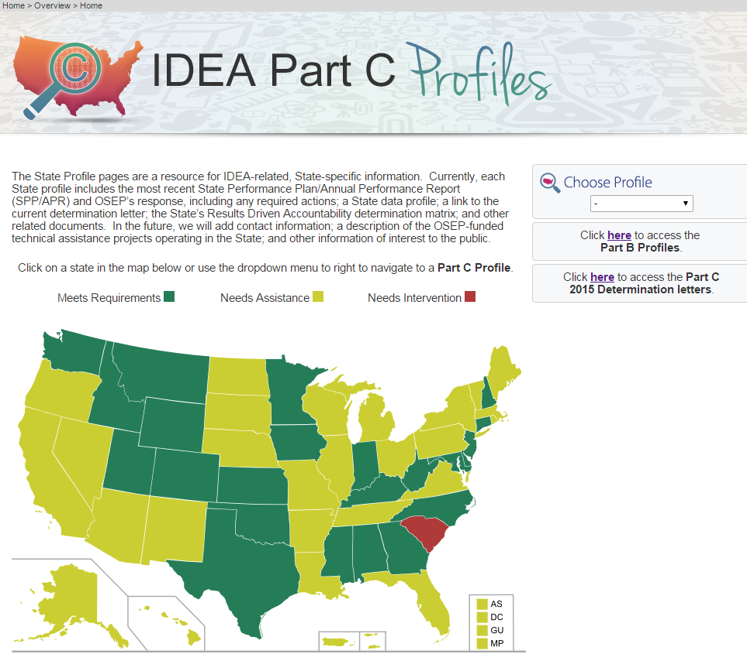
https://osep.grads360.org/#program/idea-part-c-profiles
Notes:
The SSIP and much more information about your state is available from GRADS360
GRADs 360 is where the final SSIP-C Analysis will be posted.

Slide 38
Stakeholder Involvement
Notes:
Inserted 6.1 chart.
Stakeholders, as critical participants in improving results for infants and toddlers with disabilities and their families, are required to be included in developing, implementing, evaluating, and revising the SSIP. This includes establishing a State’s targets under Indicator 11.
Figure 6.1 below presents the involvement of stakeholder types across all components of the SSIP Phase I process. All 56 (100%) reporting states involved family representatives, local providers, staff representing other state agencies and staff from other programs within the Lead Agency at some point in the process. Most states also involved representatives from EC initiatives (95%) and higher education/technical assistance staff (93%). Twenty-four (43%) states involved state legislators. Thirty-three (59%) states included “other” types of stakeholders included members of the medical community (e.g. nurses, pediatricians), advocates, local providers, and ICC members.

Slide 39
Worthy of Celebration!
Focus on Results!
Focus on Data (data-informed improvement planning)!
Focus on a systemic approach to change – integrating systems, practices and outcomes!

Slide 40
Getting Involved
How have you been involved in your state?

Slide 41
Small Group Activity
Individually review hypothetical example
Assign roles: Facilitator and Notetaker
As a group, identify improvement strategies
    Additional data
    Changes in infrastructure
    Leveraging existing initiatives
Get ready to report out

Slide 42
Share Back
What additional information or data is needed to inform the improvement planning process?
What key infrastructure changes are needed to support implementation of EBPs at the local level?
How can the state leverage the existing infrastructure to support evidence-based practices at the local level?

Slide 43
Engaging Stakeholders
Strategies to engage stakeholders
  Phase I examples
  Phase II suggestions
What perspectives do we need to have to bring this work forward, based on the improvement strategies?
How might you, in your current role, engage in this work?
Notes:
Look to see if anyone in the audience has been actively involved in their state and ask them to contribute.
Example of how a state has worked with stakeholders in Phase I and how it will be a different level of engagement in Phase II.

Slide 44
QUESTIONS?

Slide 45
Share One Take-Away…
… from this presentation and discussion with colleagues on the State of the States related to Systemic Improvement in your work on the SSIP in your state.

Slide 46
Links to 2015
SPP/APR Analysis Reports
Part C-
https://osep.grads360.org/#communities/pdc/documents/9033
Part B-
https://osep.grads360.org/#communities/pdc/documents/9012
Main page with links to both-
https://osep.grads360.org/#program/spp-apr-resources
--

Slide 47
Contact Information
Kristin Reedy, NCSI
kreedy@wested.org
Christina Kasprzak, ECTA christina.kasprzak@unc.edu
Cornelia Taylor, NCSI/ECTA cornelia.taylor@sri.com

Slide 48
THANK YOU!

