Slide 1




2015 Early Childhood Privacy and Confidentiality Workshop
February 4, 2015
Baron Rodriguez, PTAC Director Frank Miller, Deputy Director FPCO (DoED)
Joyce Popp, PTAC Support Team Sharon Walsh, DaSy Consultant Robin Nelson, DaSy Consultant Missy Cochenour, State Support Team

Slide 2
Objectives for the Day
Learn about FERPA & HIPAA implications for early childhood integrated data systems
Develop drafts of data sharing agreements with your state team
Learn why data mapping is an important aspect of ensuring privacy and confidentiality of your data
Review recent guidance on transparency and reflect/review your state’s approach to transparency of data systems.
Discuss the implications of multi-agency data breaches through individual state scenario based activities.

Slide 3
Introductions
As a state, discuss what you hope to learn today and how each of you fit into the state picture around early childhood integrated data systems, both now and in the future

Slide 4
Early Childhood Data Overview
- Missy Cochenour, SST -

Slide 5
Key Data Uses in Early Childhood
What is driving the work in Early Childhood?
  Critical policy and program questions across agencies and programs
Who are the potential users?
  Policymakers, program administrators, teachers, parents, and others
Discussion question: What does the use have to do with Privacy?

Slide 6
Key Data Uses in Early Childhood
User | Interest/Need | Example(s)
Policymakers & Legislators | Inform policy development, revision, and funding decisions | Resource allocation, program evaluation, legislative actions, etc.
Program leaders | Improve program effectiveness and efficiency | Program evaluation, resource allocation, staffing needs, community needs, program development, program planning, etc.
Educators | Inform decisions to improve local‐level learning environments | Resource allocation, staffing needs, instructional approaches, student placement, curriculum development, etc.
Researchers | Assess the impact of policies and programs on students and education entities | Research questions, program evaluation, policy evaluation, etc.
Families | Support learning and inform decisions about placement in available schools/programs/ courses | Which schools/programs to send their child to, which classes to take to be ready for college, resources available, etc.

Slide 7
Key Data Uses in Early Childhood
User | Examples from Other States
Policymakers & Legislators | Are children birth to age 5 on track to succeed when they enter school? What are the education and economic returns on early childhood investments? What are the definable characteristics of the state’s Birth‐8 workforce? Which children and families are and are not being served by which programs and services?
Program leaders | What characteristics of programs are associated with positive outcomes for which children? What characteristics of programs improve quality of services for families? Is my program effective? Are my teachers prepared to meet the needs of the families we serve?
Educators | Is my class/child development on track to succeed when they enter school? Is “this” instructional strategy working for this child?
Researchers | Does the self‐regulation of a child predict their school success in K? How effective is this program? (General program evaluation) What would the impact of increased quality standards have on the workforce?
Families | What is the best program for my child? Where are programs located? Is my child on track to be ready for school?

Slide 8
Early Childhood Education Program Definition
According to 20 USCS § 1003(8), the term “early childhood education program” means –
“(A) a Head Start program or an Early Head Start program carried out under the Head Start Act (42 U.S.C. 9831 et seq.), including a migrant or seasonal Head Start program, an Indian Head Start program, or a Head Start program or an Early Head Start program that also receives State funding;
(B) a State licensed or regulated child care program; or

Slide 9
Early Childhood Education Program Definition
a program that—
  (i) serves children from birth through age six that addresses the children's cognitive (including language, early literacy, and early mathematics), social, emotional, and physical development; and
  (ii) is –
    (I) a State pre-kindergarten program;
    (II) a program authorized under section 619 or part C of the Individuals with Disabilities Education Act [20 USCS § 1419 or §§ 1431 et seq.]; or
    (III) a program operated by a local educational agency.”

Slide 10
Privacy Considerations in Using Early Childhood Data
What legal obligation do EC educational agencies and institutions have to protect PII from students records?
Privacy of individual student records is protected under FERPA
– Other Federal, State, and local laws, such as HIPAA and IDEA, may also apply
Determine how/which information is going to flow between agencies to help assess which laws may apply
Develop data sharing agreements which ensure data is only shared for authorized purposes and adequately protected at all times

Slide 11
FERPA / IDEA
Overview
Frank Miller, Deputy Director FPCO Baron Rodriguez, PTAC Director & Robin Nelson, DaSy Consultant

Slide 12







What Is Personally Identifiable Information (PII)?
Address
Mother’s maiden name
Name
Date of birth Place of birth
Social Security Number
Names of parent or other family members

Slide 13






What is Personally Identifiable Information (PII)?
IDEA PART C 20 U.S.C. 1400 and 34 CFR Part 303 | IDEA PART B 20 U.S.C. 1400 and 34 CFR Part 300 | FERPA 20 U.S.C. 1232g and 34 CFR Part 99

Slide 14
What Else Is Personally Identifiable Information (PII)?
FERPA - 99.3 (PII)
Info. that, alone or in combination, is linkable to a specific student that would allow a reasonable person in the school community, who does not have personal knowledge of the relevant circumstances, to identify the student with reasonable certainty.
Info. requested by a person who the educational agency or institution reasonably believes knows the identity of the student to whom the education record relates.

Slide 15
What Else Is Personally Identifiable Information (PII)?
IDEA Part C - 303.32
PII definition refers to FERPA PII definition
Except-- student=child
school=EIS provider
IDEA Part B - 300.29
List of personal characteristics or other information that would make it possible to identify the child with reasonable certainty

Slide 16
What Is Directory Information?
PII that is not generally considered harmful or an invasion of privacy if disclosed
Not a student’s Social Security Number and generally not a student ID number
May include a student ID number displayed on a student ID badge
16

Slide 17





What records are covered?
IDEA PART C 20 U.S.C. 1400 and 34 CFR Part 303 | IDEA PART B 20 U.S.C. 1400 and 34 CFR Part 300 | FERPA 20 U.S.C. 1232g and 34 CFR Part 99

Slide 18
What records are covered?
IDEA Part C
Early Intervention Records
IDEA Part B Education Records
FERPA
Education Records
The type of records covered under the definition of “education records” in FERPA.
Records that are – Directly related to student; and
Maintained by an educational agency or institution or by a party acting for the agency or institution
99.3
All records regarding a child that are required to be collected, maintained, or used under Part C.
Records that are collected, maintained, or used
300.611(b)
303.403(b)

Slide 19


Who must comply?
IDEA PART C 20 U.S.C. 1400 and 34 CFR Part 303 | IDEA PART B 20 U.S.C. 1400 and 34 CFR Part 300 | FERPA 20 U.S.C. 1232g and 34 CFR Part 99

Slide 20
Who must comply?
IDEA Part C Participating agency
Any individual, agency, entity, or institution that collects, maintains, or uses personally identifiable information to implement the requirements in part C.
Includes any individual or entity that provides any part C services.
Does not include primary referral sources or public agencies or private entities that act solely as funding sources for Part C services.

Slide 21
Who must comply?
IDEA Part B Participating agency
Any agency or institution that collects, maintains, or uses personally identifiable information, or from which information is obtained under Part B.

Slide 22
Who must comply?
FERPA
Educational agency or institution
Any public or private agency or institution that provides educational services and/or instruction to students; or is authorized to direct and control public elementary or secondary, or postsecondary educational institutions; and
to which funds have been made available under any program administered by the Secretary

Slide 23



When do the confidentiality provisions apply?
IDEA PART C 20 U.S.C. 1400 and 34 CFR Part 303 | IDEA PART B 20 U.S.C. 1400 and 34 CFR Part 300 | FERPA 20 U.S.C. 1232g and 34 CFR Part 99

Slide 24
When do the confidentiality provisions apply?
IDEA Part C
When the child is referred for early intervention services...
Until the later of when the participating agency is no longer required to maintain or no longer maintains that information under applicable Federal and State laws
303.401(c)(2)

Slide 25
When do the confidentiality provisions apply?
IDEA Part B confidentiality provisions
Apply to records that are collected, maintained, or used
300.610 through 300.626

Slide 26
When do the confidentiality provisions apply?
FERPA
When the student is “in attendance at an educational agency or institution”
99.3 (Definition of student)

Slide 27


Whose records are covered?
IDEA PART C 20 U.S.C. 1400 and 34 CFR Part 303 | IDEA PART B 20 U.S.C. 1400 and 34 CFR Part 300 | FERPA 20 U.S.C. 1232g and 34 CFR Part 99

Slide 28
Whose records are covered?
IDEA Part C
Child = An individual under the age of 6 and may include an infant or toddler with a disability
303.6

Slide 29
Whose records are covered?
IDEA Part B
Child with a disability: Children determined eligible under one of 13 disability categories & needs special education and related services as a result of disability.
300.8
“Records relating to … children that are collected, maintained or used…”
300.610

Slide 30
Whose records are covered?
FERPA
Student = Any individual who is or has been in attendance at an educational agency or institution and regarding whom the agency or institution maintains education records.
99.3

Slide 31
FPCO Letter to Edmunds (2012)
“Early intervention records” is the same as “education records” for purposes of the confidentiality protections under IDEA Part C and FERPA
If early intervention records are covered under FERPA and IDEA Part C, those records are exempt as PHI under the HIPAA Privacy Rule

Slide 32
How FERPA Terms Apply to IDEA Part C
IDEA Part C, in § 303.414(b)(2), includes the following translation provisions for FERPA terms:
  Education record = Early intervention record
  Education = Early intervention
  Educational agency or institution = Participating agency
  School official = Qualified EIS personnel/Service Coordinator
  State educational authority = Lead agency
  Student = Child under IDEA Part C

Slide 33
Primary Rights of Parents under FERPA
Right to inspect and review education records (§ 99.10);
Right to seek to amend education records (§§ 99.20, 99.21, and 99.22); and
Right to consent to the disclosure of personally identifiable information from education records, except as provided by law (§§ 99.30 and 99.31).

Slide 34


Annually Notified of Rights
§ 99.7
Schools must annually notify parents of students and eligible students in attendance of their rights under FERPA.
FERPA RIGHTS

Slide 35

Right to Consent to Disclosures
Except for specific exceptions, a parent or eligible student shall provide a signed and dated written consent before a school may disclose education records.
The consent must:
specify records that may be disclosed;
state purpose of disclosure; and
identify party or class of parties to whom disclosure may be made.
§ 99.30
35

Slide 36


So, when is prior consent NOT required before disclosing PII in education records?

Slide 37
What Are the Exceptions to General Consent?
§ 99.31
To school officials with legitimate educational interests (defined in annual notification);
To schools in which a student seeks or intends to enroll;
To State and local officials pursuant to a State statute in connection with serving the student under the juvenile justice system;
To comply with a judicial order or subpoena (reasonable effort to notify parent or student at last known address);
To accrediting organizations;

Slide 38
What Are the Exceptions to General Consent?
To parents of a dependent student;
To authorized representatives of Federal, State, and local educational authorities conducting an audit, evaluation, or enforcement of education programs;
To organizations conducting studies for specific purposes on behalf of schools;
In a health or safety emergency;
To State and county social service agencies or child welfare agencies (new); and
Directory information.

Slide 39
Uninterrupted Scholars Act (USA)
New exception to the general consent rule under FERPA enacted on January 14, 2013:
Permits disclosure of PII from education records of children in foster care to: “agency caseworker or other representative” of a State or local child welfare agency (CWA) who has the right to access a student’s case plan under State or tribal law
Disclosure permitted when: the CWA is “legally responsible… for the care and protection of the student”
Provisions for tribal organizations as well

Slide 40
Additional Exception to Consent
Uninterrupted Scholars Act amended the notification requirement in FERPA’s subpoena or judicial order exception (§ 99.31(a)(9)) when the parent is a party to a court proceeding involving child abuse, neglect, or dependency and the court order is issued in the context of that court proceeding

Slide 41

The exceptions to consent are permissible, NOT required

Slide 42
What are the Recordkeeping Requirements?
An educational agency or institution must maintain a record of each request for access to and each disclosure from an education record, as well as the names of State and local educational authorities and Federal officials and agencies listed in § 99.31(a)(3) that may make further disclosures of personally identifiable information from the student’s education records without consent under
§ 99.33.

Slide 43

What are the Enforcement Provisions?
The Family Policy Compliance Office (FPCO) investigates complaints and violations under FERPA
Parents and eligible students may file timely complaints (180 days) with FPCO
If an SEA or another entity that receives Department funds violates FERPA, FPCO may bring an enforcement action against that entity
Enforcement actions include the 5-year rule as well as withholding payment, cease and desist orders, and compliance agreements

Slide 44
Guidance Documents & FERPA Regulations
Addressing Emergencies on Campus http://www2.ed.gov/policy/gen/guid/fpco/pdf/emergency-guidance.pdf
Joint FERPA-HIPAA Guidance http://www2.ed.gov/policy/gen/guid/fpco/doc/ferpa-hipaa-guidance.pdf
FERPA & Disclosures Related to Emergencies & Disasters http://www2.ed.gov/policy/gen/guid/fpco/pdf/ferpa-disaster- guidance.pdf
Balancing Student Privacy & School Safety http://www2.ed.gov/policy/gen/guid/fpco/brochures/elsec.html
Current FERPA Regulations http://www2.ed.gov/policy/gen/reg/ferpa/index.html
New Amendments to FERPA Regulations (Effective 1/3/12)
▪ http://www.gpo.gov/fdsys/pkg/FR-2011-12-02/pdf/2011-30683.pdf
New Model Notifications
LEAs:http://www2.ed.gov/policy/gen/guid/fpco/ferpa/lea-officials.html

Slide 45
HIPAA Overview

Slide 46
What is HIPAA?
Health Insurance Portability and Accountability Act of 1996
Established Certain Insurance Protections
Coverage Portability
Limited exclusions for health conditions
Prohibited discrimination based on health status
Guaranteed renewability

Slide 47
What is HIPAA?
Required Standards for the Exchange of Electronic Information
Directed the Department of Health and Human Services to:
Set standards for the content of electronic transactions and for the format of transmission
Establish “Code Sets” for use as descriptors of diagnosis and treatment
Establish “Unique Identifiers” for employers and providers
The Centers for Medicare and Medicaid Services (CMS) sets electronic standards through formal notice and comment
rule-making

Slide 48
What about HIPAA Privacy and Security?
Statute sets out a process for establishing privacy protections (SEC. 264)
HHS directed to make recommendations covering “at least”
what rights an individual has regarding his/her health information
procedures to exercise those rights
appropriate uses and disclosures for individually identifiable information

Slide 49
HIPAA Privacy and Security Protections and Requirements
HIPAA Administrative Simplification Regulations
Suite of regulations covering HIPAA provisions
▪ 45 CFR Parts 160, 162, and 164
Privacy Rule and Security Rule implemented and enforced by the Office of Civil Rights in the Department of Health and Human Services

Slide 50
HIPAA Privacy and Security Protections and Requirements
Privacy Rule - 45 CFR Part 160 and Subparts A and E of Part 164
Establishes national standards to protect individuals’ medical records/personal health information
Final Rule - August 14, 2002
  Accounting for Disclosure - provision within Privacy Rule
    Covered entities must provide, on request, account of disclosures of protected information
    Modifications proposed - May 31, 2011 - to implement HITECH Act provisions/other updates
    Final Rule still pending

Slide 51
HIPAA Privacy and Security Protections and Requirements
Security Rule - 45 CFR Part 160 and Subparts A and C of Part 164
Established national standards for the protection of electronic personal health information
Sets requirements for administrative, physical and technical safeguards
Final Rule - February 20, 2003

Slide 52
HIPAA Privacy and Security Protections and Requirements
Enforcement - 45 CFR Parts 160 and 164
Provides standards for the enforcement of all HIPAA rules
Final Rule - February 16, 2006
Breach Notification - 45 CFR 164.400-414
Requires HIPAA covered entities to provide notifications of any breach of “protected heath information”
Interim Final Rule - August 24, 2009

Slide 53
HIPAA Privacy and Security Protections and Requirements
HIPAA Omnibus Rule - 45 CFR Parts 160 and 164
Implements provisions of the Health Information Technology for Economical and Clinical Health Act (HITECH) - part of the American Recovery and Reinvestment Act of 2009
Modifies Privacy, Security and Enforcement Rules
Final Rule - January 17, 2013

Slide 54
Privacy - What Rights Are Conferred?
Notice of privacy practices
Access to records
Amend/correct records
Disclosure accounting
Restriction request
Confidential communications requirements

Slide 55
Privacy - Who Does It Apply to?
“Covered Entities”
Health Plans - in general, all group and individual plans that provide or pay for health services
Health Care Providers - any health care provider who engages in any electronic transactions covered by HIPAA standards
Healthcare Clearinghouses - generally entities that convert nonstandard information into standard format required for electronic transmission

Slide 56
Privacy - Who Does It Apply to?
“Business Associates”
Individual or organization
Performs services on behalf of a covered entity OR
Provides services to a covered entity AND
Services involve the use and/or disclosure of protected health information

Slide 57
Privacy - What’s Included?
“Protected Health Information” (PHI)
Any individually identifiable health information held or transmitted by a covered entity
Information is protected regardless of form - electronic, paper, oral

Slide 58
Privacy - What’s NOT Included?
De-identified information
Education and certain other records subject to, or defined in, the Family Educational Rights and Privacy Act, 20
U.S.C. § 1232g
JOINT GUIDANCE ON THE APPLICABILITY OF FAMILY EDUCATIONAL RIGHTS AND PRIVACY ACT (FERPA) and the HEALTH INSURANCE PORTABILITY AND ACCOUNTABILITY ACT (HIPAA) TO STUDENT RECORDS

Slide 59

When Can PHI Be Used or Disclosed?
Any purpose authorized in writing by the individual
Any use “permitted” or “required” under regulation
Governing principle - “minimum necessary”

Slide 60
“Required” Uses
Disclosure to the individual or their personal representative
Disclosure to HHS for compliance investigation or enforcement action

Slide 61
“Permitted” Uses
“Use with opportunity to object”
Informal process
Does not require written permission
Individual may opt out of participation
Example: inclusion of information in a directory
Incidental Use/Disclosure
Inadvertent disclosure associated with otherwise permissible use

Slide 62
“Permitted” Uses
Public Interest and Benefit Activities
Balance between public and private benefit issues
List of 12 categories, including:
  Public Health Activities
  Judicial & Administrative Proceedings
  Victims of Abuse, Neglect or Domestic Violence
  Law Enforcement Purposes
  Research
  Serious Threat to Health or Safety

Slide 63
“Permitted” Uses
Limited Data Set
Aggregated information
Some identifiers removed
Requires a data use agreement
Agreement must specify purposes and limitations on use

Slide 64
“Authorized” Uses
Required for any other use of PHI
Authorization must be in writing
Must be specific in terms of what data and purpose of use
May authorize use by covered entity or by third party
Treatment or payment MAY NOT be conditioned on authorization
Authorization specifically required for:
  Psychotherapy notes
  Marketing

Slide 65
Breach Notification
“Wall of Shame”
Violations involving disclosure of information on 500 or more individuals
834 reported cases reported under Breach Notification (as of April 14)

Slide 66
Items of Interest
Personal Representative
Parents generally recognized as “personal representative of an un-emancipated minor”
Personal representative exercises privacy rights on behalf of minor
State law governs
Limited exceptions (where state or other law requires disclosure of information to the minor)

Slide 67
Items of Interest
Disclosure of Student Immunizations to Schools - Section 164.512(b)
Omnibus Rule of 2013
Covered entity may share proof of immunization with school
– when such proof is required for admittance of student
Written consent is required, but
Covered entity must document some form of agreement
Form of documentation not specified
Documentation need not be HIPAA compliant “authorization”

Slide 68
Security Rule
Applies to information contained in electronic records (“e- PHI”)
Includes information created, received, maintained or transmitted in electronic form
Requires administrative, technical, organizational and physical safeguards of e-PHI
Does not specify standards or measures
Requires “Risk Analysis” - on an ongoing basis - to determine what is “reasonable and appropriate”

Slide 69
Summary
IS THE INFORMATION NEEDED CONTAINED IN AN “EDUCATION RECORD”?
IS THE INFORMATION HELD BY A HIPAA “COVERED ENTITY”?
IS THE INFORMATION IN THE FORM OF “PROTECTED HEALTH INFORMATION”?

Slide 70
MC3
Transparency of Data
Systems, Current Landscape & Considerations
- Frank Miller, Deputy Director, FPCO
U.S. Department of Education

Slide 71
Why Transparency?
Rise in public discourse on data and student privacy
Rise in misinformation and confusion about the issues
State-level legislative action to restrict data collection, use, and sharing
Privacy vs. Utility Tradeoff
What’s in it for the parent’s and students?

Slide 72
Fair Information Practice Principles (FIPPs)
Collection Limitation
Data Quality
Purpose Specification
Use Limitation
Security Safeguards
Openness
Individual Participation
Accountability

Slide 73
Transparency Best Practices
Let parents know what information you’re collecting, and why you’re collecting it
Keep (and publish) a data inventory
Inform parents about your data governance and information security practices
Be open about who you share data with, and why. (Post your data sharing contracts and MOUs)
Value! Value! Value! (Explain what’s in it for the parents/children)

Slide 74
Remember:
In the absence of information, people tend to assume the worst
Just because something is legal, doesn’t mean it’s a good idea!
Be open about what you’re doing
Highlight your successes

Slide 75
Transparency Activity
- Joyce Popp, PTAC Expert & State Support Team

Slide 76


Let’s look at some state examples…
76

Slide 77

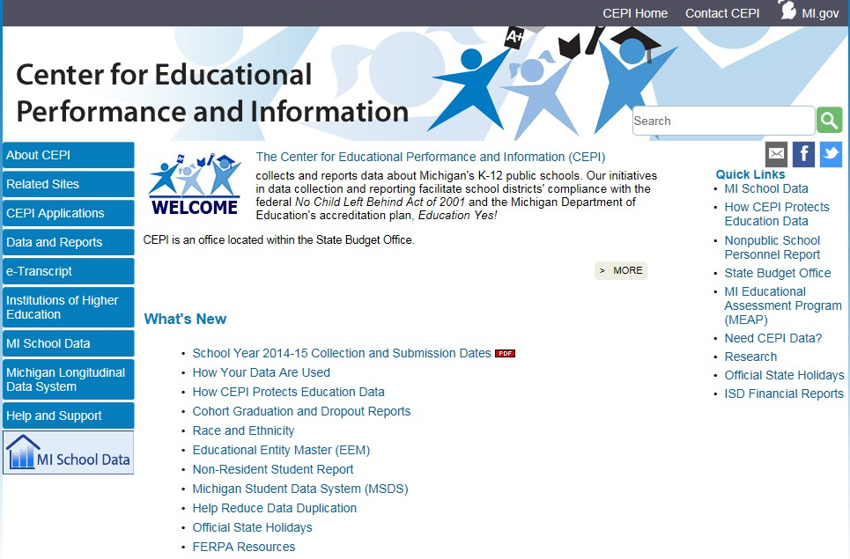
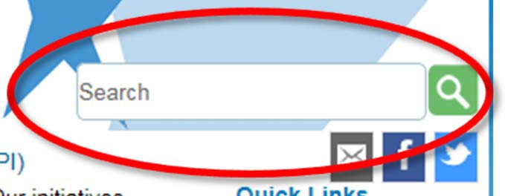
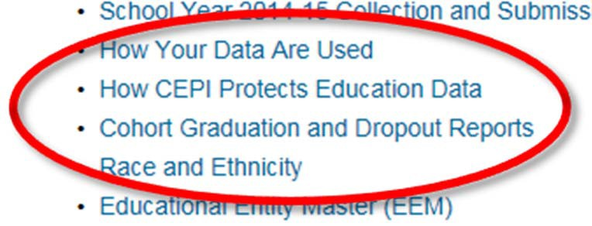
www.michigan.gov/cepi/
77

Slide 78

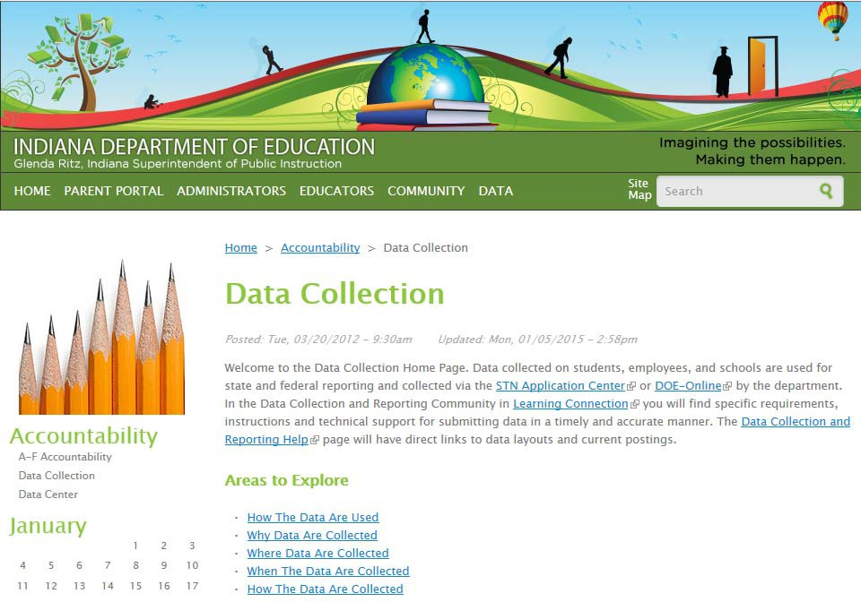
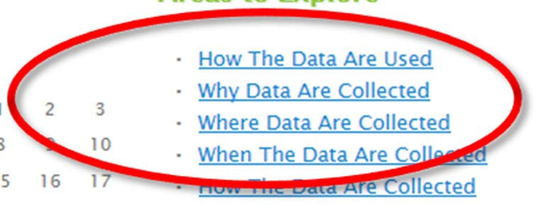
www.doe.in.gov/accountability/data-collection
78

Slide 79

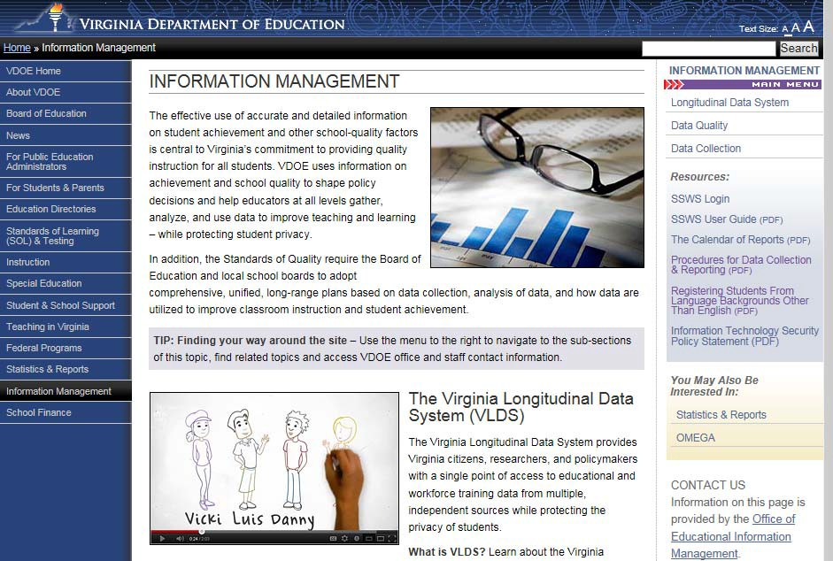
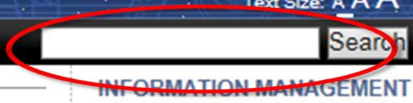
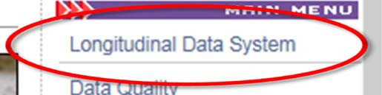
http://www.doe.virginia.gov/info_management/index.shtml
79

Slide 80

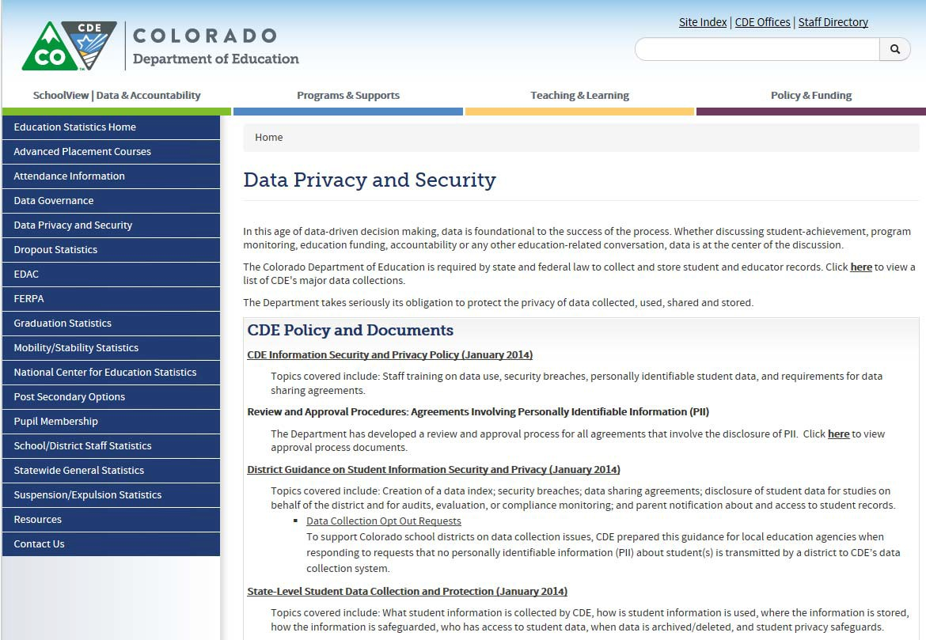
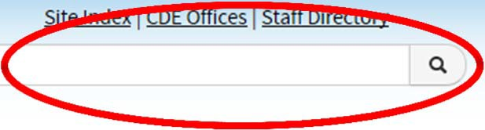
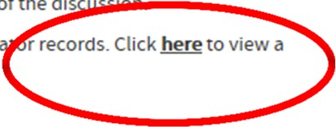
http://www.cde.state.co.us/cdereval/dataprivacyandsecurity
8
0

Slide 81
Team Exercise
Now you get to give it a try!
81

Slide 82
Transparency (We are all among friends!!)
Pretend you are a member of the public searching for information about data efforts in the state to your left.
  Is it easy to find the website?
  Is there information on what data is being collected and why?
  Can you find the information on data collection easily?
  Is there a “search” feature on the site?
82

Slide 83
Transparency
Can you locate information on data privacy and transparency policies?
Is the information presented in a clear, concise and consistent manner?
Is there a glossary of terms available?
Does the information address who has access to the data and for what purposes?
Contact information - Is there an email address and/or phone number if the public/parents want more information on these data systems or their rights?
83

Slide 84
Next Steps /Take Away
Reflect on the perspective of your State’s information and what qualities you want your stakeholders to associate with it.
Consider how you might be able to improve your State’s transparency.
Address what are the benefits of your data system and the information obtained.
Contemplate producing reports and FAQs to address data transparency questions/concerns.
Update information as you receive feedback and requests from stakeholders for continuous improvement.
84

Slide 85
Data Governance
& Privacy
Joyce Popp, PTAC Support Team

Slide 86
Benefits of Data Governance
–Data Governance is an organizational approach to data and information management. Benefits include:
Increased consistency and confidence in decision making
Decreased risk of compliance issues
Improved data security
Designated accountability for information quality
Minimized or elimination of re-work and/or duplicative systems/data collection

Slide 87
Data Governance Program: Scope
–Scope of a Data Governance program with focus on privacy, compliance, and security includes:
Protection of sensitive data
Vulnerability assessment and risk mitigation
Enforcement of regulatory, contractual, and architectural compliance requirements
Identification of stakeholders, decision rights, and accountabilities
Access Management

Slide 88
Data Governance Program Implementation: Key Steps
–Decision-making authority
Establish organizational structure with different levels of data governance, specific roles and responsibilities at each level
–Standard policies & procedures
Adopt and enforce a written data governance plan
–Data inventory
Conduct an inventory of all data that require protection
–Data content
Identify the purposes for which data are collected and justify the collection of sensitive data
–Data records
Specific activities related to handling data to ensure compliance with security policies
88

Slide 89
Data Governance Program Implementation: Key Steps – cont.
–Data quality
Ensure that data are accurate, relevant, timely, and complete for the purposes they are collected
–Data access
Define and assign differentiated levels of data access to individuals based on their roles and responsibilities
–Data security
Ensure the security of sensitive data by mitigating the risks of unauthorized disclosure
–Data dissemination
Ensure that data sharing and reporting activities comply with federal, state and local laws

Slide 90
Data Governance Committee Key Drivers
–Information Technology should NEVER drive data systems
Program expertise and needs drive excellent and well used data systems
–Decisions require multi-office input and senior leadership input
Data Governance Committees should include (at a minimum):
– High ranking senior executive (Deputy Director level)
– Communications/Public Information Officer
– Legal
– Chief Information Officer
– Data Director
– Research Direct
– Program Office Directors (SPED, Assessment, Title, Curriculum/Instruction, etc.)

Slide 91
Data Governance Committee’s Typical Responsibilities
–Data Requests
Setting prioritization and criteria for approval
Recommending approval
Authoring/Determining need for MOU
Reviewing cost estimates and available resources
–Data Calendar
Communicating to stakeholders (subcommittee?)
Seek input on impact of data collection/reporting dates
–Cross-agency data integration
Review duplicative collections
Ensure alignment with program rules/policies
Ensure alignment to correct source data

Slide 92
Data Governance Committee’s Typical Responsibilities
–Impact analysis of law changes on data collection/reporting
Federal and State laws
–Regular Communication to staff, stakeholders, and senior leadership on key decisions
–Agency policy/procedure around ALL data collection/reporting activities
Retention
Archive
Request
Use/Access
MOUs
Protection of Personally Identifiable data (Student, Teacher, Staff)
92

Slide 93
Q & A Panel
- Sharon Walsh, Facilitator -

Slide 94
Panelists
Kathleen Styles, U.S. Education Chief Privacy Officer
Joyce Popp, Former CIO of Idaho/PTAC-SST
Baron Rodriquez, PTAC Director
Missy Cochenour, SLDS EC Data System Lead
Robin Nelson, DaSy Consultant

Slide 95
Data Mapping Overview
- Baron Rodriguez, PTAC Director -

Slide 96

Why do we need to Map?
Understanding data flows/sources/elements helps determine which laws apply:
  Privacy Protections
  Security Requirements
  Breach Notification Requirements
  Consent Requirements
Gives you a better understanding of your data systems and assists you with internal & external communications

Slide 97
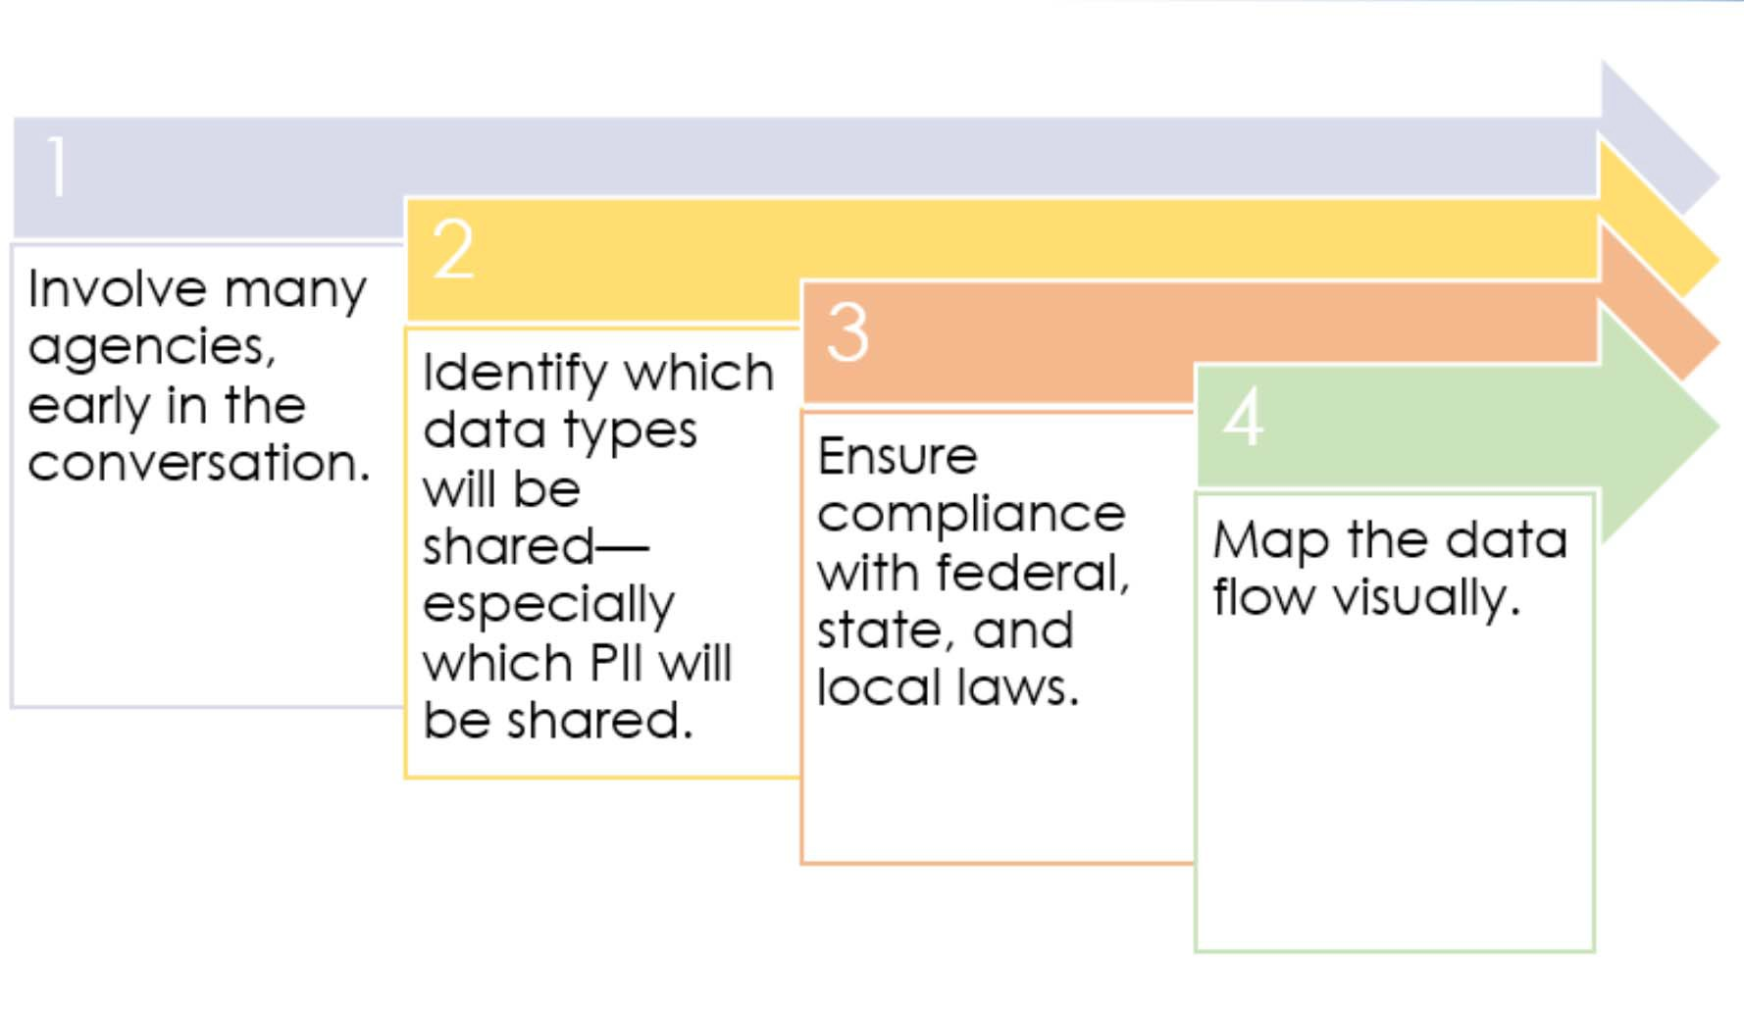
High Level Mapping Steps
97

Slide 98
Data Mapping: Key Steps
Identify the key policy questions
  Align to district, gubernatorial, legislative, executive leadership goals.
Identify data types/elements needed to answer those questions.
  Do you have multi-agency governance? Yes=Document the process; No=institute multi-agency governance
  Agencies involved?
  What level of data is needed at the input AND output level?
98

Slide 99
Data Mapping: Key Steps
Review applicable state, federal, & local laws.
  Current/pending privacy bills? Impact?
  Compliance is the bar, not the ceiling.. You may want MORE stringent controls.
Review current privacy policies in EACH agency involved with data integration.
  Alignment with applicable laws above?
  Do policies meet multi-agency governance needs of LINKED data?
99

Slide 100
Data Mapping: Key Steps
Identify the key policy questions
  Align to district, gubernatorial, legislative, executive leadership goals.
Identify data types/elements needed to answer those questions.
  Do you have multi-agency governance?
  Yes=Document the process; No=institute multi-agency governance
100

Slide 101
Mapping Process…
Map data flow in a visual format
  Where information resides (agency/system), where it will go, and what the output (aggregate, PII, de-identified) of the combined data will be?
Verify governance covers all data sets and actors
  Ownership of input data
  Ownership of LINKED data
  Accountability
  Collection
101

Slide 102
Mapping Process…
Verify data sharing agreements needed and/or in place currently
  Look at visual data flows/agencies involved to determine which laws/FERPA exception applies.
    Workforce: Definition (state) of a public official?
    Audit/Evaluation Exception: Determination of “Education Program”
    Audit/Evaluation Exception: Designating an “Authorized Representative
  Best practices for Data Sharing Agreements
102

Slide 103
Team Data Mapping Activity
- Baron Rodriguez, PTAC Director -
103

Slide 104
Team Activity:
Your turn..
Utilizing DRAFT Data Mapping Checklist, begin the process of mapping your data.
Each team will map out their systems on chart paper following the process in the checklist.
Report out in 45 minutes
104

Slide 105

Activity Report Out
Discuss your mapped systems:
  What steps were particularly challenging?
  What steps were missing from the checklist that your team had to do?
  What information was missing to adequately complete the data mapping activity?
Yes.. We knew that this couldn’t be done in 45 minutes!
105

Slide 106
MOU/Data Sharing Agreement Overview
- Baron Rodriguez, PTAC Director -

Slide 107

What Is a Data Sharing Agreement?
Can be called many different names: MOU, MOA, Contract, Written Agreement, etc.
The mandatory elements of the agreement vary slightly between the two exceptions
The data sharing checklist delineates the minimum requirements under the Studies and the Audit or Evaluation exceptions

Slide 108
Approaches to Data Sharing Agreements
Master data sharing agreement across all early childhood partners with addendums for each request based on the type of exception
No master data sharing agreement across all early childhood partners, only individual agreements for each request

Slide 109

Why Are Data Sharing Agreements Needed?
They are now required when sharing under either the Audit/Evaluation exception or Studies exception
Even under the School Official exception, it is a best practice to have an agreement in place

Slide 110
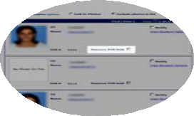
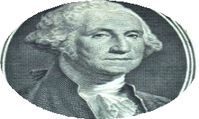
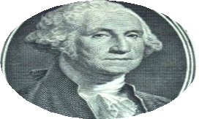



When Does FERPA Apply to EC Organizations?
Student Data
Federally funded
NOT federally funded?
Student record with PII and health data: FERPA applies.
Health‐record only. HIPPA may apply.
Not FERPA
protected. HIPAA may apply.

Slide 111

Key Points to Remember
Properly de-identified data can be shared without any FERPA considerations and should be your FIRST option as it limits the risk of unauthorized PII disclosure
In most cases, consent is the best approach for sharing PII with non-profit organizations
Directory Information is often misunderstood. Opt-out provisions do not prevent data from being shared under the Audit/Evaluation or School Official exceptions
111

Slide 112
Data Sharing = Disclosure
Remember: There is no “data sharing” or “research” clause in FERPA, rather, sharing of student PII is considered “disclosure” under FERPA and is only allowable under specific circumstances.

Slide 113

FERPA’s Audit or Evaluation Exception
A state or local educational authority may designate a third party as their “authorized representative” and then disclose PII from education records to them for the purposes of conducting an audit or evaluation of a federal or state- supported education program.

Slide 114
FERPA’s Audit or Evaluation Exception - Requirements
Disclosing entity must be a state or local educational authority
Must be for the evaluation of a federal or state- supported education program
Must use a written agreement to designate the recipient as the authorized representative
The written agreement must include a number of required elements
(see “Guidance on Reasonable Methods and Written Agreements”)

Slide 115
FERPA’s Audit or Evaluation Exception - Requirements
The recipient must:
Comply with the terms of the written agreement;
Use the PII only for the authorized purpose;
Protect the PII from further disclosure or other uses; and
Destroy the PII when no longer needed for the evaluation.

Slide 116
School Official Exception
Schools or LEAs can use the School Official exception under FERPA to disclose education records to a third party only if the outside party:
Performs a service/function for the school/district for which the educational organization would otherwise use its own employees
Is under the direct control of the organization with regard to the use/maintenance of the education records

Slide 117
School Official Exception
Uses education data in a manner consistent with the definition of the “school official with a legitimate educational interest,” specified in the school/LEA’s annual notification of rights under FERPA
Does not re-disclose or use education data for unauthorized purposes

Slide 118
Studies Exception
“For or on behalf of” schools, school districts, or postsecondary institutions
Studies must be for the purpose of
  Developing, validating, or administering predictive tests; or
  Administering student aid programs; or
  Improving instruction.
Written Agreements

Slide 119
Written Agreements: Studies Exception
Written agreements must
  Specify the purpose, scope, and duration of the study and the information to be disclosed, and
  Require the organization to
    use PII only to meet the purpose(s) of the study
    limit access to PII to those with legitimate interests
    destroy PII upon completion of the study and specify the time period in which the information must be destroyed

Slide 120

Remember: Use the Appropriate FERPA Exception
Schools/LEAs: IT contractors must meet criteria under the School Official exception discussed earlier.
SEAs: Cannot use the School Official exception; therefore, must designate IT service providers as “authorized representatives” under the Audit/Evaluation exception.

Slide 121
Audit or Evaluation
§ 99.35
Federal, State, and local officials listed under
§ 99.31(a)(3), or their authorized representative, may have access to education records only –
  in connection with an audit or evaluation of Federal or State supported education programs, or
  for the enforcement of or compliance with Federal legal requirements which relate to those programs.
The information must be:
  protected in a manner that does not permit disclosure of PII to anyone; and
  destroyed when no longer needed for the purposes listed above.

Slide 122

Who Is an Authorized Representative?
§ 99.3
Any entity or individual designated by a State or local educational authority or an agency headed by an official listed in § 99.31(a)(3) to conduct—with respect to Federal- or State-supported education programs—
any audit or evaluation, or any compliance or enforcement activity in connection with Federal legal requirements that relate to these programs

Slide 123

Studies Exception
§ 99.31
Studies conducted “for or on behalf of” schools, school districts, or postsecondary institutions
Studies must be for the purpose of
  Developing, validating, or administering predictive tests;
or
  Administering student aid programs;
or
  Improving instruction.

Slide 124

What Are Written Agreements?
Mandatory for LEA or SEA disclosing PII without consent under audit/evaluation
Mandatory for school or LEA for disclosing to outside organization under the studies exception, or for SEA redisclosing for, or on behalf of, school or LEA

Slide 125

Reasonable Methods
§ 99.35
In disclosing to a designated authorized representative under audit/evaluation exception, LEA must ensure to the greatest extent practicable that an authorized representative
  Uses PII only to carry out an audit or evaluation of education programs, or for the enforcement of or compliance with, Federal legal requirements related to these programs
  Protects the PII from further disclosures or any unauthorized use
  Destroys the PII records when no longer needed for the audit, evaluation, or
125
enforcement or compliance activity

Slide 126
Frequently Asked Questions to HHS #1
On your school’s enrollment card, there is a question asking whether the student has health insurance. If the parent answers “no,” a school staff member sends a letter home informing the parent about Medicaid and CHIP and providing a toll-free number to call to get help with an application.
DOES THIS VIOLATE FERPA?
A: This is perfectly acceptable. It raises no FERPA concerns because the school has not disclosed personally identifiable information (PII) from a student’s education records to an outside entity.

Slide 127
Frequently Asked Questions to HHS #2
On the school enrollment card, there is a question asking whether the student has health insurance. If the parent answers “no,” the nurse calls to inform the parent about Medicaid and CHIP. She asks if it is OK to share the parent’s phone number with the school social worker, who can provide application assistance.
Is a consent form needed to allow the nurse to pass the parent’s phone number to the social worker – both school employees – or is oral consent necessary?

Slide 128
Frequently Asked Questions to HHS #2
A: In this scenario, no consent is required for the school nurse to disclose PII from education records to another school official with a legitimate educational interest (i.e., the school social worker). A “legitimate educational interest” typically means that the school official needs to see the education records in order to perform their professional duties.
Remember:
Annual notification requirement – Defining WHO, WHAT, and “legitimate educational interest”

Slide 129
Frequently Asked Questions to HHS #3
On the school’s enrollment card, there is a question asking whether the student has health insurance. If the parent answers “no,” staff from a community-based organization that works with the school calls the parent to talk about the availability of Medicaid and CHIP and to offer application assistance. (FYI, the community-based organization might be a local community health center, a children’s health advocacy organization, or Boys and Girls Club.)
Can the school provide this information to the community- based organization?

Slide 130
Frequently Asked Questions to HHS #3
A: FERPA does not generally permit schools to disclose PII from students’ education records to a community-based organization without the consent of the parent or eligible student, or unless the disclosure meets one of the exceptions to the general consent requirement.
Exceptions: Directory Information (as defined)
But… Because this type of information (eligibility) is considered PII, it cannot be considered directory information and requires parental consent.

Slide 131
State MOU Development Activity
- Missy Cochenour, SST -

Slide 132
Objectives
To have your state work to establish a draft data sharing agreement needed to continue the work in your state

Slide 133
Activity Part 1: Understanding the Relationship to Structure & Privacy
The structure of your agencies and where the data currently resides impacts the way in which agreements are created and for what purpose
How the data moves is important consideration in the way the agreement is created
Considerations:
– Look at your structure across agencies and how the data flows (data mapping activity)

Slide 134
Activity Part 2: Privacy Considerations with Critical Questions
Complying with FERPA:
  Under what exception does it apply?
    List the exceptions
  Is there an MOU in place to share these data?
  Does it include the critical question and the related elements?
  Aggregate and de-identified data

Slide 135
Activity Part 3: Decide the Approach
Considering your structure, decide on the approach for sharing data
  Master data sharing agreement with addendum
  No master data sharing agreement, only individual agreement
Decide on which exception is needed based on the agreement type:
  Studies exception
  Audit or Evaluation exception

Slide 136
How to Make the Decision
Master Data Sharing Agreement
Technical sharing
Share Data
Studies Exception
Specific Use for Sharing
Audit and Eval.
Exception
Audit and Eval. Exeception
Let’s look at the checklist

Slide 137
Commonalities
All agreements should have a specified purpose for the agreement
All agreements should have the identified data that will be shared
All agreements should discuss destruction of data
All agreements should discus the consequences of not following the agreement
When using exceptions the agreement should always have information about how the data will be used (not applicable for a master data sharing agreement as this will be captured in the addendum)

Slide 138
Differences
There are more differences than commonalities as is the nature of these agreements:
Master Agreements | Studies Exception | Audit or Evaluation Exception
Focuses on the linkage and storage of data across entities Discusses where the data will reside and who owns it | Very specific purpose | Specific purpose Much more detail about the identification, use and destruction of PII

Slide 139
Activity Part 4: Instructions
Please work in your state team and your TA support to:
  For states with a draft MOU: Review your current sections and modify as needed
  For states drafting an MOU today: Create a draft that is appropriate for your state

Slide 140
Wrap-up Activity Discussion
What needs to be done with your draft when you return home?

Slide 141
Summarize
Lessons learned
Next steps for the state
Resources requested that might be helpful as you continue this conversation in your state

Slide 142
State Team Discussion
- Baron Rodriguez, PTAC Director -

Slide 143
State Team Discussion
What steps can you take to engage and inform parents and the public?

Slide 144
Wrap Up
- Baron Rodriguez, PTAC Director -

Slide 145

Resources
Checklist: Data Sharing Agreement (Apr 2012)
Guidance for Reasonable Methods and Written Agreements
Protecting Student Privacy While Using Online Educational Services
Webinar: The Intersection of FERPA and IDEA Confidentiality Provisions (Mar 2012)
Case Study #2: Head Start Program (Jan 2012)
More PTAC resources at http://ptac.ed.gov/
– Data security, privacy, disclosure avoidance, data governance, data sharing, legal references, FAQ, video trainings, webinars, and other events!

Slide 146
Questions & Answers
Thank you!!

