Slide 1
What Practitioners Need to Know about Measuring EI and ECSE Outcomes
The Center for IDEA
Early Childhood Data Systems
Kathleen Hebbeler, SRI International
Lynne Kahn, Frank Porter Graham Child Development Institute
Presented at the Division for Early Childhood Conference
St. Louis
October 2014

Slide 2
Objectives
Understand why data on child outcomes in EI and ECSE are being collected
Understand what the data tell us
Know that these data will be used to drive program improvement as part of Results Driven Accountability

Slide 3
General Background
Emerging importance of accountability in public programs over last 20 years
Not enough to have data on how many clients were served or how many hours of service were provided
In special education in particular, the emphasis shifted from getting children access to services to focusing on the outcomes being achieved.
***Accountability is about demonstrating results.***

Slide 4
Outcomes and Federal Funding
Every year the Office of Special Education Programs (OSEP) in the US Department of Education distributes federal IDEA funds to state Part C and Part B Preschool agencies. For 2014,
Part C:
Part B Preschool:
All federal agencies are required to report on the outcomes achieved by their programs.
In 2005, OSEP required states to report data on child outcomes so the agency could:
Justify the funding for Part C and Part B Preschool.
Fulfill its requirement to report data on the outcomes of Part C and Part B Preschool.

Slide 5
Ultimate Goal for EI and ECSE
“To enable young children to be active and successful participants during the early childhood years and in the future in a variety of settings – in their homes with their families, in child care, preschool or school programs, and in the community.”
Based on the ECO stakeholder process when identifying 3 functional outcomes
Entire document available at http://projects.fpg.unc.edu/~eco/assets/pdfs/ECO_Outcomes_4-13-05.pdf
Notes:
Outcomes aren’t just about accountability…
This is where we want our children (EI and ECSE children) to accomplish and so we want to be accountable for helping children/families achieve this goal…

Slide 6
Three Child Outcomes
Children have positive social-emotional skills (including social relationships)
Children acquire and use knowledge and skills (including early language/ communication [and early literacy])
Children use appropriate behaviors to meet their needs

Slide 7
Child Outcomes Step by Step
Available at:
http://projects.fpg.unc.edu/~eco/pages/videos.cfm

Slide 8
Outcomes Are Functional
Functional outcomes:
Refer to using skills to accomplish things that are meaningful to the child in the context of everyday life
Refer to an integrated series of behaviors or skills that allow the child to achieve the important everyday goals

Slide 9
Children Have Positive Social Relationships
Involves:
Relating with adults
Relating with other children
For older children, following rules related to groups or interacting with others
Includes areas like:
Attachment/separation/autonomy
Expressing emotions and feelings
Learning social rules and expectations
Social interactions and play

Slide 10
Children Acquire and Use Knowledge and Skills
Involves:
Thinking
Reasoning
Remembering
Problem solving
Using symbols and language
Understanding physical and social worlds
Includes:
Early concepts—symbols, pictures, numbers, classification, spatial relationships
Imitation
Object permanence
Expressive and receptive language and communication
Early literacy

Slide 11
Children Take Appropriate Action to Meet Their Needs
Involves:
Taking care of basic needs
Getting from place to place
Using tools (e.g., fork, toothbrush, crayon)
In older children, contributing to their own health and safety
Includes:
Integrating motor skills to complete tasks
Self-help skills (e.g., dressing, feeding, grooming, toileting, household responsibility)
Acting on the world to get what one wants

Slide 12
OSEP Reporting Categories
Percentage of children who:
a. Did not improve functioning
b. Improved functioning, but not sufficient to move nearer to functioning comparable to same-aged peers
c. Improved functioning to a level nearer to same-aged peers but did not reach it
d. Improved functioning to reach a level comparable to same-aged peers
e. Maintained functioning at a level comparable to same-aged peers
3 outcomes x 5 “measures” = 15 numbers

Slide 14
The Summary Statements
Of those children who entered or exited the program below age expectations in each outcome, the percent who substantially increased their rate of growth by the time they turned 3 [6] years of age or exited the program.
The percent of children who were functioning within age expectations in each outcome by the time they turned 3 [6] years of age or exited the program.
Notes:
States set targets on the Summary Statements

Slide 15
State Approaches to Measuring Child Outcomes – 2012-13
Approach | Part C (N=56) | Preschool (N=59)
COS 7 pt. scale | 42/56 (75%) | 37/59 (63%)
One tool statewide | 8/56 (14%) | 9/59 (15%)
Publishers’ online analysis | 1/56 (2%) | 6/59 (10%)
Other | 5/56 (9%) | 7/59 (12%)
Notes:
Fairly steady over the last several years. Only a few changes as some states re-assess their approach and change.

Slide 16
Method for Calculating National Estimates
Weighted average of states that met minimum quality criteria
Minimum Quality Criteria:
Reporting data on enough children
Part C – 28% or more of exiters
Part B Preschool – 12% or more of child count
Within expected patterns in the data
category ‘a’ not greater than 10%
category ‘e’ not greater than 65%
Notes:
An important point is that the criteria for inclusion in the national analysis is really a minimal quality criteria and not meant to be an absolute (e.g., we may raise the bar and what we are able to look at in terms of data quality at a national level is very limited).
Minimum expectations of quality at this point. Low amounts of missing data and within reasonably expected patterns for ‘a’ and ‘e’
Remember: Part C is all exiters, so we expect a higher %. 619 is of child count, so we expect a lower %. This is the national data we have to work from. Within a state, it is best to have the actual number of children exiting with at least 6 mo of service to calculate the actual % of missing data.

Slide 17
Number of States that Met Criteria for Inclusion in the National Analysis
 | 08-09 | 09-10 | 10-11 | 11-12 | 12-13
Part C | 19 | 29 | 39 | 33 | 41
Part B Preschool | 15 | 33 | 36 | 39 | 41
Notes:
Minimum expectations of quality at this point. Low amounts of missing data and within reasonably expected patterns for ‘a’ and ‘e’

Slide 18
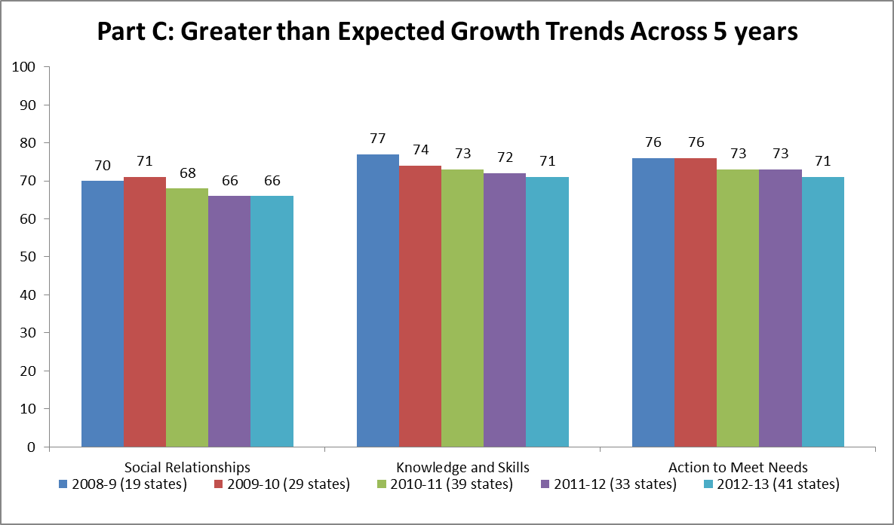

Slide 19
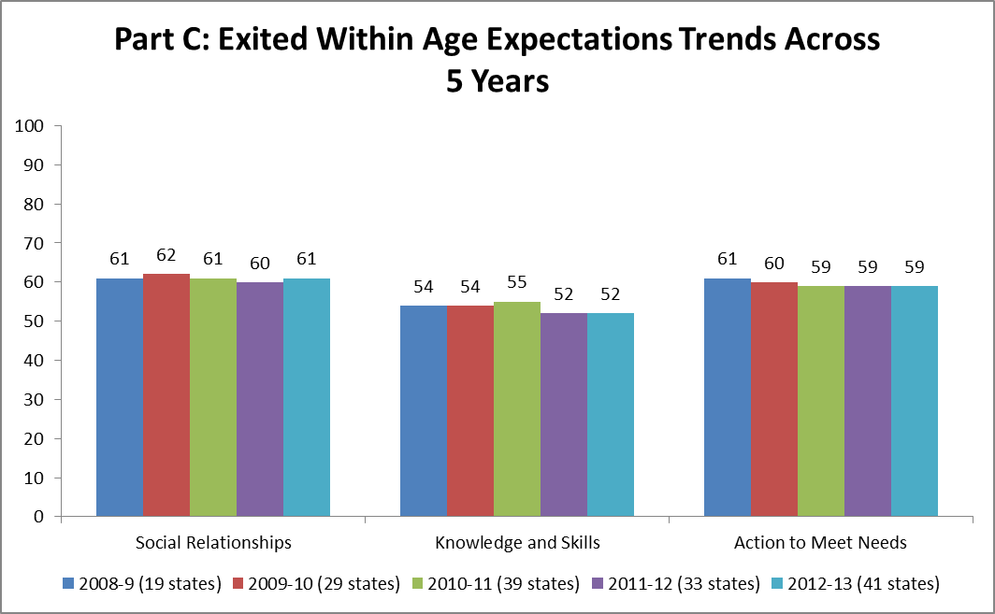

Slide 20
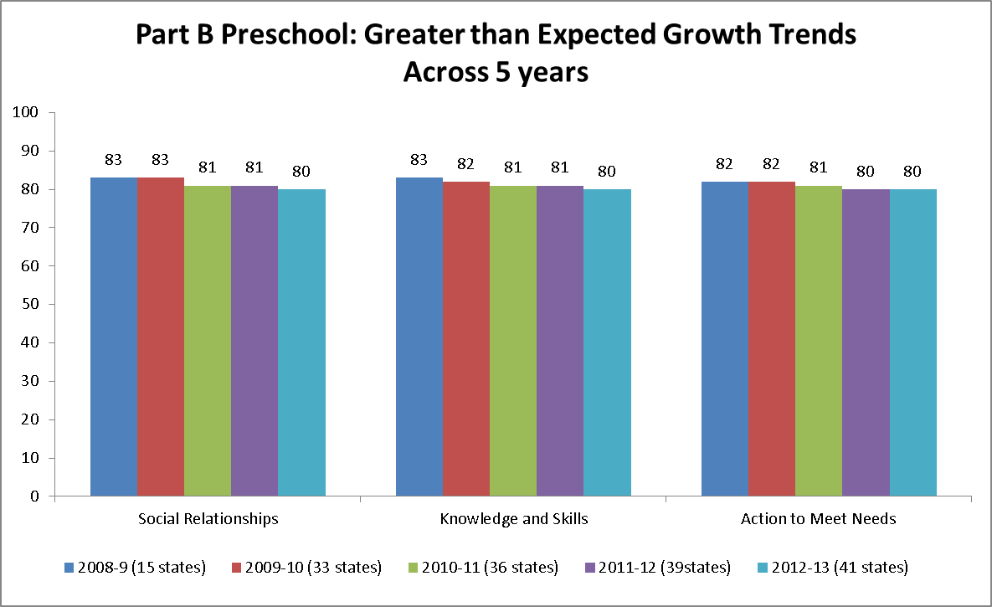

Slide 21
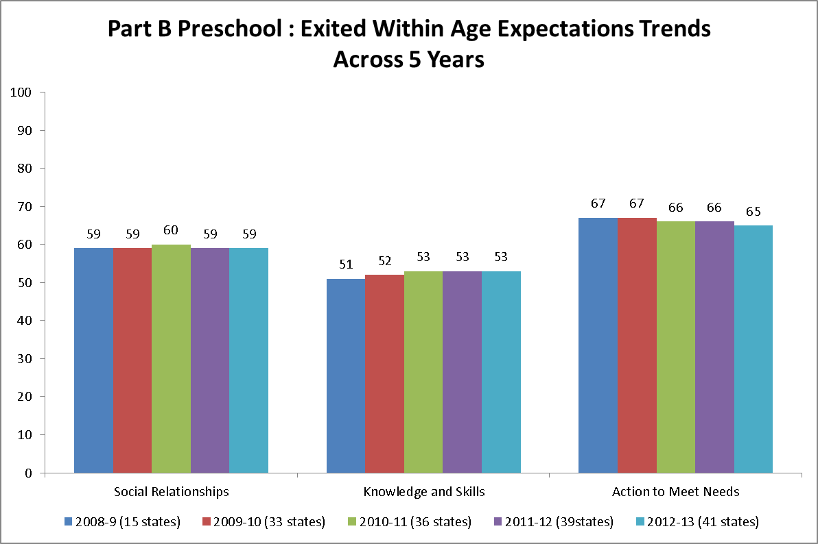
Notes:
Kathy

Slide 22
Inferences?
Given the trends over time in the state reported outcomes data, what inferences might you make?

Slide 23
What We See
Continuing to see consistency over time
Increasing number of states who meet minimum quality criteria for national analysis
Increasing number of children in the child outcomes data
Notes:
We continue to see consistency in the data over time, increasing numbers of children in the child outcomes data, and increasing number of states who meet the minimum quality criteria for inclusion in the national analysis.
Question is now: Should we raise the bar?

Slide 24
State Level Variation and Patterns

Slide 25
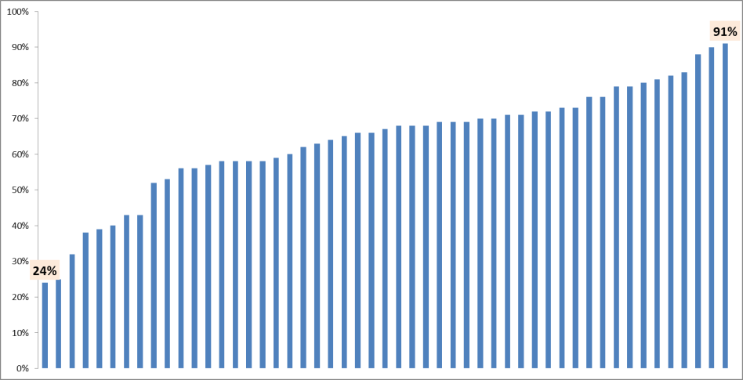
Part C: State Variation: Greater than Expected Growth
– Social Emotional, 2012-2013, All States
National: 66%

Slide 26
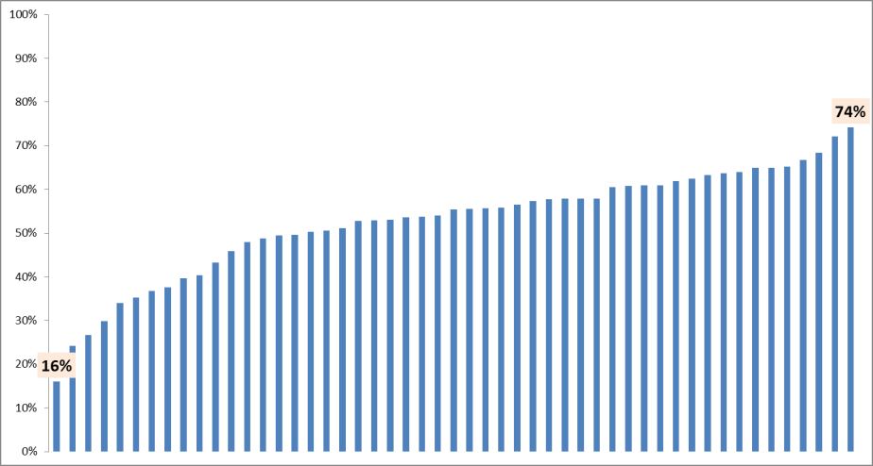
Part B Preschool: State Variation: Exited within Age Expectations – Knowledge and Skills, 2012-2013, All States
National: 53%
Notes:
Kathy

Slide 27
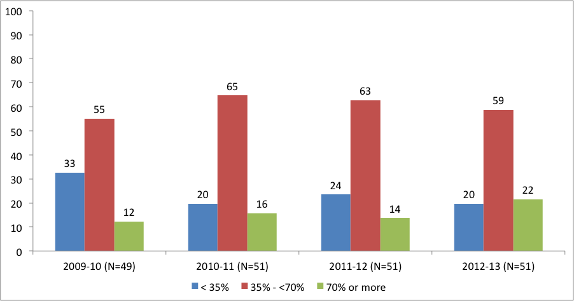
Part C: Percent of States by Completeness of Child Outcomes Data*
* Completeness = (total with outcomes data/total exiters)
14
Notes:
Kathy
Quality is not a yes or no question. Quality exists in varying degrees. The quality we look at for the national analysis is a really minimal criteria. What happens when we look at a higher criteria?
If we were to raise the bar to 35% of exiters, the majority of states would meet the higher criteria (81% of states).
Another point to make on this slide is that the percent of states that have 70% or more of exiters has almost doubled since 2009-10

Slide 28
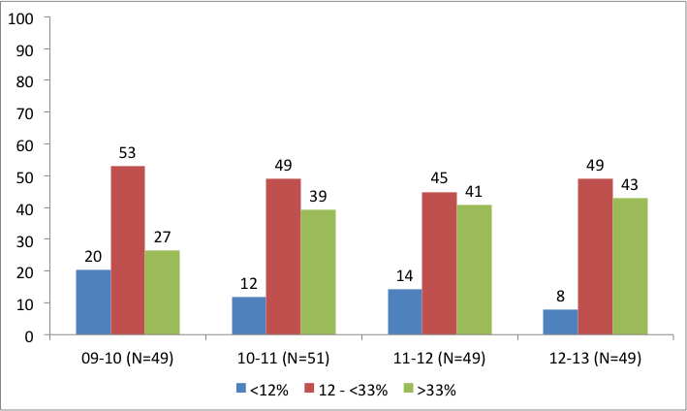
Part B Preschool: Percent of States by Completeness of Child Outcomes Data*
* Completeness = (total with outcomes data/child count)
15
Notes:
Kathy
The majority of states exceed the minimum 12% bar we had set for the national analysis (92% of states). This strongly suggests that we should consider raising the bar.

Slide 29
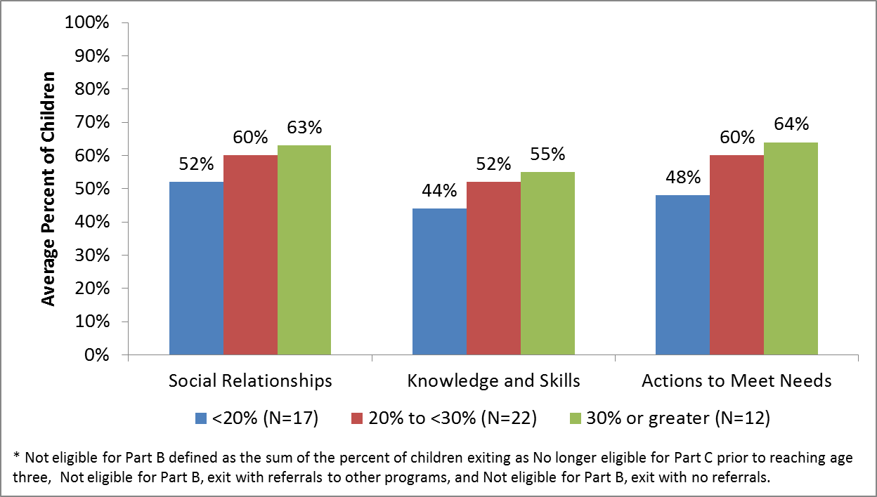
Part C: Exited within Age Expectations by State Percent of Exiters Not Eligible for Part B* 2012-13 - All States
Notes:
Kathy
Note: Not eligible for Part B is defined as the percent of children exiting who are categorized as either 1) No longer eligible for Part C prior to reaching age three (e.g., completion of IFSP prior to max age), 2) Not eligible for Part B and exit with referrals to other programs, and who are 3) Not eligible for Part B and exit with no referrals

Slide 30
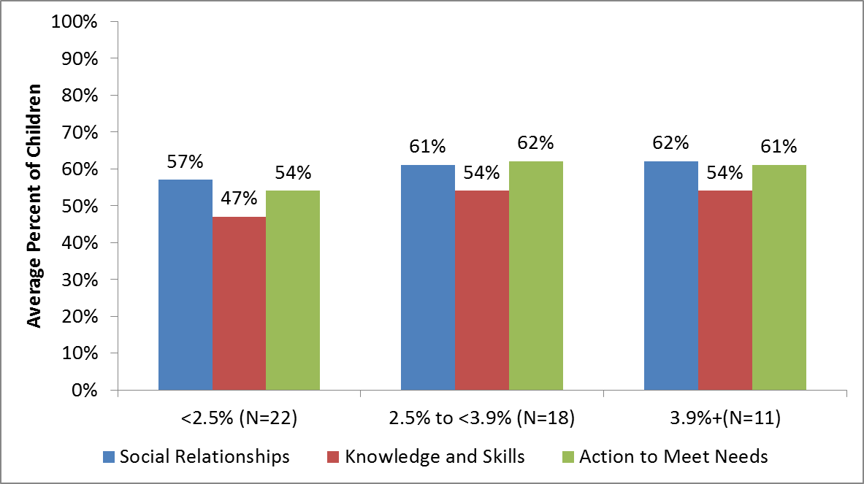
Part C: Average Percentage Who Exited within Age Expectations by State Percent Served*, 2012-13 – All States
*http://therightidea.tadnet.org/assets/2514
Notes:
Percent served is collapses into 3 groups: less than 2.5%, 2.5 to less than 3.9%, and 3.9% and greater.
As a greater proportion of children receive Part C services, the percent exiting with age expectations increases.
Note: Percent served is based on a population estimate of the number of children birth to 3 from the Census.

Slide 31
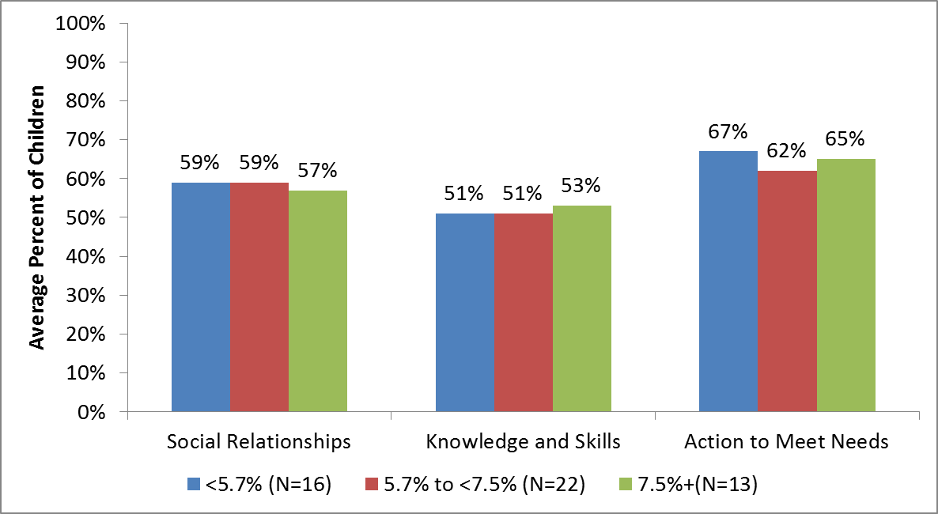
Part B Preschool: Average Percentage Who Exited within Age Expectations by State Percent Served, 2012-13, All States
Notes:
Percent served is collapses into 3 groups: less than 2.5%, 2.5 to less than 3.9%, and 3.9% and greater.
For 619, we do not see the same pattern as we do for Part C across all the outcomes. For knowledge and skills, the states serving a greater proportion of children have slightly higher percentages of children exiting within age expectations. However, this pattern is not consistent for the other 2 outcomes.

Slide 32
Inferences again?
What do you make of this data?

Slide 33
How States Are Using Outcomes Data

Slide 34
What is the SSIP?
Multi-year, achievable plan that:
Increases capacity of EIS programs/LEAs to implement, scale up, and sustain evidence-based practices
Improves outcomes for children with disabilities (and their families)
Notes:
So what is the State Systemic Improvement Plan or SSIP? The SSIP is a comprehensive, ambitious, yet achievable multiyear plan for improving results for children with disabilities. The SSIP is to be developed in Phase I and Phase II and then implemented in Phase III. Through a detailed data and infrastructure analysis, States must assess the capacity of their current infrastructure systems and their ability to enhance this infrastructure to increase the capacity of Local Education Agencies (LEAs) and Early Intervention Service (EIS) programs to implement, scale up, and sustain, evidence-based practices that will result in improved outcomes for infants, toddlers and preschoolers with disabilities. Throughout this webinar, we will provide an overview of the SSIP process.

Slide 35
Who has to develop an SSIP?
State Part C program
State Part B program
The Part B program will only need to develop one plan.
Role of Part B 619 program
619 incorporated into the Part B
619 focus for the Part B
Part C and Section 619
Coordination across 0-21

Slide 36
Year 1 - FFY 2013 Delivered by April 2015 | Year 2 - FFY 2014 Delivered by Feb 1, 2016 | Years 3-6 Delivered by Feb 1, 2017 Updated 2018, 2019, 2020
Phase I Analysis | Phase II Plan | Phase III Implementation and Evaluation
Data Analysis Analysis of State Infrastructure to Support Improvement and Build Capacity State-Identified Measurable Result(s) for Infants and Toddlers with Disabilities and their families* Selection of Coherent Improvement Strategies Theory of Action | Infrastructure Development Support for EIS Program/LEA in Implementation of Evidence-Based Practices Evaluation Plan | Results of Ongoing Evaluation Extent of Progress Revisions to the SPP
* Families are included for Part C only. Part B includes results for children with disabilities
Notes:
The proposed SSIP is to be developed in 2 phases and then implemented in a third phase that occur over the new APR reporting period of 2015-2020
Phase 1—April, 2015
Phase 2—February, 2016
Phase 3—February, 2017 through February, 2020
Data Analyses: In order to improve results, States must assess the capacity of their current infrastructure systems and their ability to enhance this infrastructure to increase the capacity of EIS programs and providers to implement, scale up, and sustain evidence-based practices that will result in improved outcomes for infants and toddlers with disabilities and their families. The data and infrastructure analysis should use multiple data sources, including SPP/APR indicators and 618 State-reported data, to identify systemic approaches that will lead to improved results for infants and toddlers with disabilities and their families across key measures: early childhood outcomes and family involvement.
Identification of the Focus for Improvement: A description of improvement strategies on which the State will focus that will lead to a measurable child-based result. The State must include in the description how the data analysis led to the identification of the area on which the State will focus. The State must demonstrate how addressing this area of focus for improvement will build the capacity of EIS programs and providers and supports to improve the identified result for infants and toddlers and their families with disabilities. (For example, the State might be working to improve the validity and representativeness of their data on early childhood outcomes and family involvement.)
Infrastructure to Support Improvement and Build Capacity: A description of how the State analyzed the capacity of its current system to support improvement and build capacity in EIS programs and providers to implement, scale up, and sustain evidence-based practices to improve results for infants and toddlers with disabilities and their families, and the results of this analysis. State system components include: governance, fiscal, quality standards, professional development, data, technical assistance, and accountability.
The description must include:
strengths of system
how components of system are coordinated
areas for improvement within and across components of the system
an analysis of initiatives in State, including initiatives in general education and other areas beyond special education, which can have an impact on children and youth with disabilities
how decisions are made within State system and representatives (e.g., agencies, positions, individuals) that must be involved in planning for systematic improvements in the State system
Theory of Action: Based on the data analysis and infrastructure analysis, the State must describe the general improvement strategies that will need to be carried out and the outcomes that will need to be met to achieve the State-identified, measurable improvement in results for infants and toddlers and their families with disabilities. The State must include in the description the changes in the State system, and EIS program and provider practices, that must occur to achieve the State-identified, measurable improvement in results for infants and toddlers with disabilities and their families. States should consider developing a logic model that shows the relationship between the activities and the outcomes that the State expects to achieve over a multi-year period.
Evaluation Plan: A description of how the State will evaluate the implementation of its SSIP. The plan must include the methods that will be used to collect and analyze data related to specific activities and outcomes of the SSIP. The description must also include how the State will use the results of the evaluation to examine the effectiveness of the implementation of the plan and the progress toward achieving intended outcomes, and make modifications to the SSIP as necessary.

Slide 37
Data Analysis - requirements
A description of how the state identified and analyzed key data to:
select the State-identified Measurable Result.
identify root causes contributing to low performance.
The description must include information about:
how the data were disaggregated by multiple variables.
if applicable, any concerns about the quality of the data and how the state will address these concerns.
If applicable, methods and timelines related to any additional data to be collected and analyzed.

Slide 38
Measurable Result - requirements
(1) May, but need not, be an SPP/APR indicator or a component of an SPP/APR indicator.
(2) Must be clearly based on the data and state infrastructure analyses.
(3) Must be a child or family level outcome in contrast to a process outcome.
(4) May be a single result or a cluster of related results.
Notes:
Reiterate that data analysis and infrastructure analysis go together!

Slide 39
What are the potential state identified measureable results (SIMRs) for early childhood?
Broad- Improved progress between entry and exit in any of the 3 functional outcomes
Or more specific- Improved results for children on the Autism spectrum in the area of social relationships
Improved results for children in the state’s lowest performing programs in the area of language and early literacy

Slide 40
Current Emphasis of State Requests for Technical Assistance
Data Quality
Increasing the number of children/families in the data
Pattern checking to identify data quality issues
Training, guidance, supervision, etc.
Using Data for Program Improvement
SSIP data analysis
Identifying trends in the data
Identifying areas of low and high performance
Identifying meaningful differences
Notes:
Data quality continues to be an area of emphasis but also emphasizing using data for program improvement– much of this work is tied to SSIP efforts

Slide 41
Your experience with your state’s SSIP?
Have you been involved in your state’s work on their SSIP?
Can you share the role you have played and your perspective as a stakeholder or planner?

Slide 42
How OSEP Will Be Using Outcomes Data

Slide 43
Results Driven Accountability (RDA)
IDEA requires OSEP to monitor state implementation of IDEA
To date, OSEP monitoring of states has focused on compliance
Timelines, signatures….
Processes.
Based on OSEP review of state provided information, states are divided into categories:
Meets requirements, Needs Improvement, Needs Intervention
.

Slide 44
Coming soon…
OSEP is moving to monitoring states on the results they are achieving for young children with disabilities and their families.
Already released a process for doing this for Part B but it does not include preschool.
Exactly how to use data on results to identify low performing states for EI is still being worked out but it is coming.
Stay tuned…..

Slide 45
Using child outcomes for accountability
What should be considered?
Data quality?
States’ outcome data compared to one another?
Individual state progress- each state compared to itself over time?

Slide 46
Questions?
36

Slide 47
Find More Resources At:
http://www.ectacenter.org/eco
Notes:
Abby

Slide 48
The contents of this presentation were developed under a grant from the U.S. Department of Education, #H373Z120002. However, those contents do not necessarily represent the policy of the U.S. Department of Education, and you should not assume endorsement by the Federal Government. Project Officers, Meredith Miceli and Richelle Davis.

