Slide 1
High Quality Child Outcomes Data in Early Childhood: More Important than Ever
Kathleen Hebbeler, SRI International
Christina Kasprzak, Frank Porter Graham Child Development Center
Lynne Kahn, Frank Porter Graham Child Development Center
OSEP Project Directors Meeting
Washington, DC
July 2014

Slide 2
Overview
Overview of the State Systemic Improvement Plan (SSIP)
The role of data in the SSIP
What we know about child outcomes data nationally
What supports do states need to use their child outcomes data effectively for program improvement?

Slide 3
What is the SSIP?
Multi-year, achievable plan that:
Increases capacity of EIS programs/LEAs to implement, scale up, and sustain evidence-based practices
Improves outcomes for children with disabilities (and their families)
Notes:
So what is the State Systemic Improvement Plan or SSIP? The SSIP is a comprehensive, ambitious, yet achievable multiyear plan for improving results for children with disabilities. The SSIP is to be developed in Phase I and Phase II and then implemented in Phase III. Through a detailed data and infrastructure analysis, States must assess the capacity of their current infrastructure systems and their ability to enhance this infrastructure to increase the capacity of Local Education Agencies (LEAs) and Early Intervention Service (EIS) programs to implement, scale up, and sustain, evidence-based practices that will result in improved outcomes for infants, toddlers and preschoolers with disabilities. Throughout this webinar, we will provide an overview of the SSIP process.

Slide 4
Who has to develop an SSIP?
State Part C program
State Part B program
The Part B program will only need to develop one plan.
Role of Part B 619 program
619 incorporated into the Part B
619 focus for the Part B
Part C and Section 619
Coordination across 0-21

Slide 5
Year 1 - FFY 2013 Delivered by April 2015 | Year 2 - FFY 2014 Delivered by Feb 1, 2016 | Years 3-6 Delivered by Feb 1, 2017 Updated 2018, 2019, 2020
Phase I Analysis | Phase II Plan | Phase III Implementation and Evaluation
Data Analysis Analysis of State Infrastructure to Support Improvement and Build Capacity State-Identified Measurable Result(s) for Infants and Toddlers with Disabilities and their families* Selection of Coherent Improvement Strategies Theory of Action | Infrastructure Development Support for EIS Program/LEA in Implementation of Evidence-Based Practices Evaluation Plan | Results of Ongoing Evaluation Extent of Progress Revisions to the SPP
* Families are included for Part C only. Part B includes results for children with disabilities
Notes:
The proposed SSIP is to be developed in 2 phases and then implemented in a third phase that occur over the new APR reporting period of 2015-2020
Phase 1—April, 2015
Phase 2—February, 2016
Phase 3—February, 2017 through February, 2020
Data Analyses: In order to improve results, States must assess the capacity of their current infrastructure systems and their ability to enhance this infrastructure to increase the capacity of EIS programs and providers to implement, scale up, and sustain evidence-based practices that will result in improved outcomes for infants and toddlers with disabilities and their families. The data and infrastructure analysis should use multiple data sources, including SPP/APR indicators and 618 State-reported data, to identify systemic approaches that will lead to improved results for infants and toddlers with disabilities and their families across key measures: early childhood outcomes and family involvement.
Identification of the Focus for Improvement: A description of improvement strategies on which the State will focus that will lead to a measurable child-based result. The State must include in the description how the data analysis led to the identification of the area on which the State will focus. The State must demonstrate how addressing this area of focus for improvement will build the capacity of EIS programs and providers and supports to improve the identified result for infants and toddlers and their families with disabilities. (For example, the State might be working to improve the validity and representativeness of their data on early childhood outcomes and family involvement.)
Infrastructure to Support Improvement and Build Capacity: A description of how the State analyzed the capacity of its current system to support improvement and build capacity in EIS programs and providers to implement, scale up, and sustain evidence-based practices to improve results for infants and toddlers with disabilities and their families, and the results of this analysis. State system components include: governance, fiscal, quality standards, professional development, data, technical assistance, and accountability.
The description must include:
strengths of system
how components of system are coordinated
areas for improvement within and across components of the system
an analysis of initiatives in State, including initiatives in general education and other areas beyond special education, which can have an impact on children and youth with disabilities
how decisions are made within State system and representatives (e.g., agencies, positions, individuals) that must be involved in planning for systematic improvements in the State system
Theory of Action: Based on the data analysis and infrastructure analysis, the State must describe the general improvement strategies that will need to be carried out and the outcomes that will need to be met to achieve the State-identified, measurable improvement in results for infants and toddlers and their families with disabilities. The State must include in the description the changes in the State system, and EIS program and provider practices, that must occur to achieve the State-identified, measurable improvement in results for infants and toddlers with disabilities and their families. States should consider developing a logic model that shows the relationship between the activities and the outcomes that the State expects to achieve over a multi-year period.
Evaluation Plan: A description of how the State will evaluate the implementation of its SSIP. The plan must include the methods that will be used to collect and analyze data related to specific activities and outcomes of the SSIP. The description must also include how the State will use the results of the evaluation to examine the effectiveness of the implementation of the plan and the progress toward achieving intended outcomes, and make modifications to the SSIP as necessary.

Slide 6
Data Analysis - requirements
A description of how the state identified and analyzed key data to:
select the State-identified Measurable Result.
identify root causes contributing to low performance.
The description must include information about:
how the data were disaggregated by multiple variables.
if applicable, any concerns about the quality of the data and how the state will address these concerns.
If applicable, methods and timelines related to any additional data to be collected and analyzed.

Slide 7
Measurable Result - requirements
(1) May, but need not, be an SPP/APR indicator or a component of an SPP/APR indicator.
(2) Must be clearly based on the data and state infrastructure analyses.
(3) Must be a child-level outcome in contrast to a process outcome.
(4) May be a single result or a cluster of related results.
Notes:
Reiterate that data analysis and infrastructure analysis go together!

Slide 8
What are the potential state identified measureable results (SIMRs) for early childhood?
All state Part C and 619 programs report on progress between entry and exit in 3 functional outcomes

Slide 9
The Three Child Outcomes
Outcome 1, Positive Social Relationships
Relating with adults, other children, and for older children, following rules related to groups like interacting with others
Outcome 2, Knowledge and skills
Thinking and reasoning, remembering, problem solving, using symbols and language, and understanding physical and social worlds
Outcome 3, Take Appropriate Actions to Meet Needs
Taking care of basic needs, getting from place to place, using tools (e.g., fork, toothbrush), and in older children, contributing to their own health and safety
Notes:
Abby

Slide 10
Much more information available
http://ectacenter.org/webinars.asp#y2014ssip

Slide 11
Q: What do states need to have in place to be able to identify a measurable result, develop and implement a plan to improve the result, and track progress?
A: Valid and reliable data on child outcomes

Slide 12
State Approaches to Measuring Child Outcomes
2012-13
Approach | Part C (N=56) | Preschool (N=59)
COS 7 pt. scale | 42/56 (75%) | 37/59 (63%)
One tool statewide | 8/56 (14%) | 9/59 (15%)
Publishers’ online analysis | 1/56 (2%) | 6/59 (10%)
Other | 5/56 (9%) | 7/59 (12%)
Notes:
Fairly steady over the last several years. Only a few changes as some states re-assess their approach and change.

Slide 13
How the National Estimates are Calculated
Identify states with the highest quality data.
Weight the data in those states by their child count to represent the nation.
Notes:
We were concerned 5 years ago when we started computing national numbers about the number of states with questionable child outcomes data and the impact of the data from those states on the national numbers.

Slide 14
Identifying States with the Highest Quality Data
Criteria for quality data:
Reporting data on enough children
Part C – 28% or more of exiters
Preschool – 12% or more of child count
Within expected patterns in the data
category ‘a’ not greater than 10%
category ‘e’ not greater than 65%
***Note: These criteria eliminate states with the lowest quality data from the analysis.***
Notes:
Minimum expectations of quality at this point. Low amounts of missing data and within reasonably expected patterns for ‘a’ and ‘e’
Remember: Part C is all exiters, so we expect a higher %. 619 is of child count, so we expect a lower %. This is the national data we have to work from. Within a state, it is best to have the actual number of children exiting with at least 6 mo of service to calculate the actual % of missing data.

Slide 15
Number of States that Met Criteria for Inclusion in the National Analysis
 | 08-09 | 09-10 | 10-11 | 11-12 | 12-13
Part C | 19 | 29 | 39 | 33 | 41
Preschool | 15 | 33 | 36 | 39 | 41
Notes:
Minimum expectations of quality at this point. Low amounts of missing data and within reasonably expected patterns for ‘a’ and ‘e’

Slide 16
Part C – Reason States were Excluded from Analyses
Reason Part C state was excluded | 2010-11 | 2011-12 | 2012-13
State is sampling | 3 | 2 | 1
No outcomes data reported | 0 | 0 | 0
Reported outcomes data on less than 28% of reported exiters | 3 | 6 | 4
Had at least one outcome with category a greater than 10% or category e greater than 65% | 4 | 5 | 3
Reported outcomes data on less than 28% of reported exiters AND Had at least one outcome with category a greater than 10% or category e greater than 65% | 1 | 4 | 2
Questionable data quality based on review of SPP/APR and knowledge gained through TA | 1 | 0 | 0
States included in the analysis | 39 | 33 | 41

Slide 17
Part B Preschool – Reason States were Excluded from Analyses
Reason Part B state was excluded | 2010-11 | 2011-12 | 2012-13
State is sampling | 4 | 2 | 3
No progress category data reported | 1 | 2 | 1
No outcomes data reported | 1 | 0 | 0
Reported outcomes data on less than 12% of child count | 2 | 4 | 1
Had at least one outcome with category a greater than 10% or category e greater than 65% | 4 | 3 | 4
Reported outcomes data on less than 12% of child count AND Had at least one outcome with category a greater than 10% or category e greater than 65% | 0 | 0 | 0
Questionable data quality based on review of SPP/APR and knowledge gained through TA | 2 | 0 | 0
No child count data available | 1 | 0
States included in the analysis | 36 | 39 | 41*
* 1 state was excluded because it did not report child count data

Slide 18
For more information about what states are collecting and reporting on child outcomes, see
http://ectacenter.org/eco/pages/fed_req.asp

Slide 19
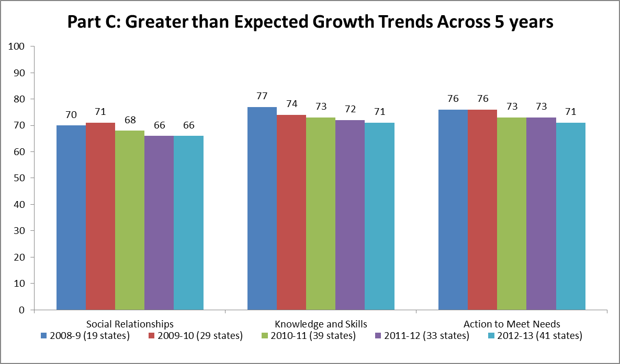

Slide 20
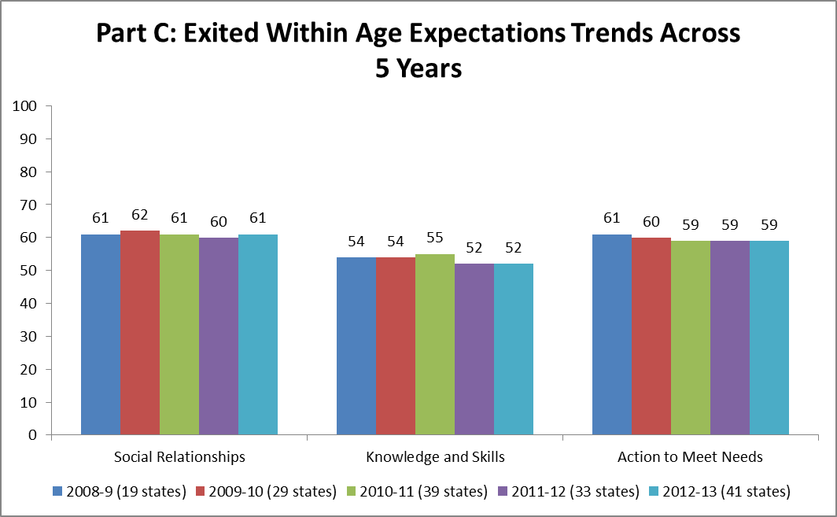

Slide 21
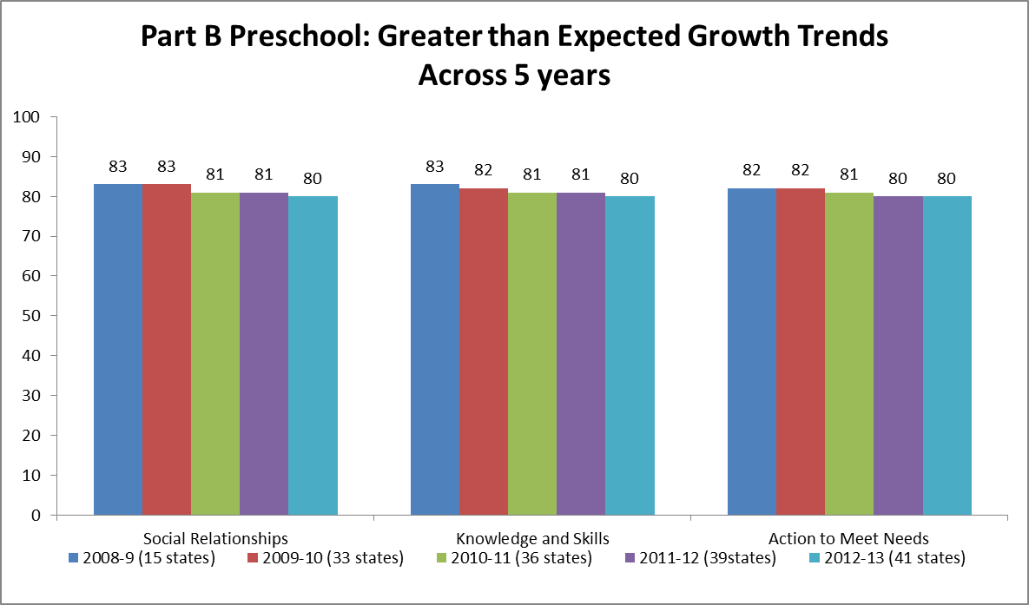

Slide 22
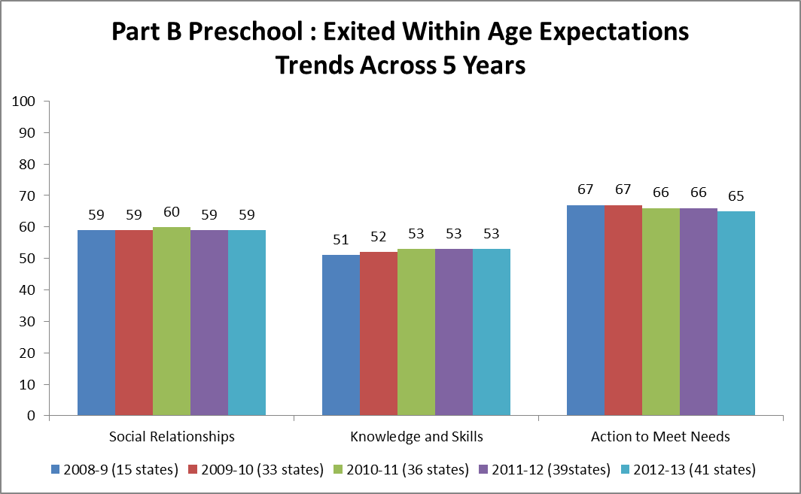

Slide 23
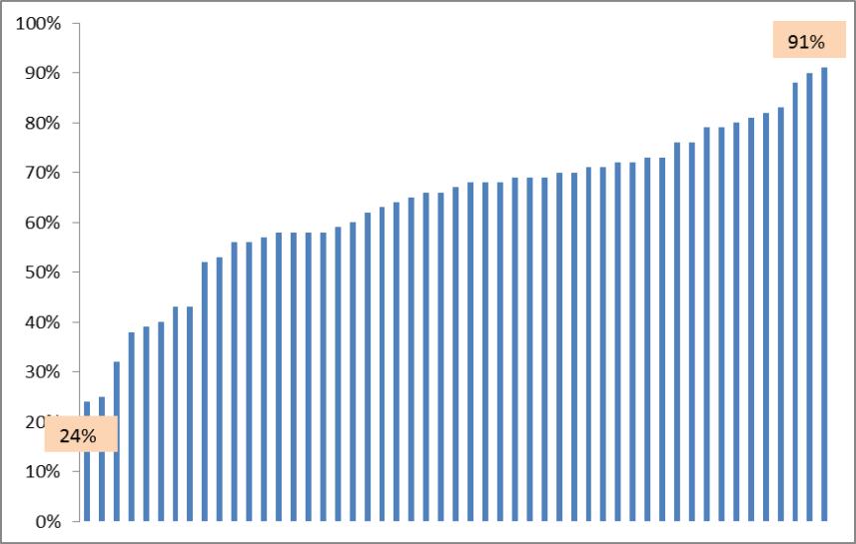
Part C State Variation: Greater than Expected Growth
– Social Relationships, 2012-13
National: 69%

Slide 24
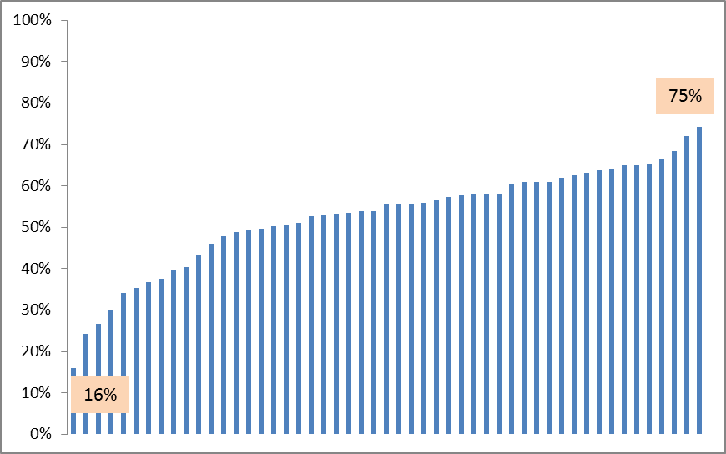
Part B Preschool State Variation: Exited within Age Expectation - Knowledge and Skills, 2012-13
National estimate: 52%

Slide 25
Questions to consider
What would a “model state” that could effectively use child outcomes data to drive program improvement look like? What features or capacities would the state have?
What are the current challenges faced by states in using their child outcomes data to develop and monitor an improvement plan?
How can technical assistance providers and higher education help states address these challenges.

