Slide 1
ECIDS and DaSy: Frameworks for Building Better Data Systems
July 31, 2014
2014 NCES STATS-DC Data Conference
Concurrent Session IV: 9-10 am

Slide 2
Today’s Presenters
Colleen Murphy, Parent Support Programs Manager, Utah Department of Health, Bureau of Child Development
Jaci Holmes, Federal State Legislative Liaison, Maine Department of Education
Kathy Hebbeler, Project Co-Director, DaSy
Missy Cochenour, SLDS State Support Team/DaSy/CEDS

Slide 3
Session Objectives
Share overview of ECIDS Toolkit and DaSy framework
Discuss how these frameworks can help you use your data through current state examples
Present implications for integrating early childhood program data into P-20+ State Longitudinal Data Systems (SLDS)

Slide 4
Overview:
The ECIDS Toolkit

Slide 5
ECIDS Toolkit – Purpose
Provide a method for states to assess progress in developing and ECIDS
Enhance the capacity of states working to integrate data across early childhood to understand the key pieces of an ECIDS and how it connects with the other states integrated data system efforts so they can lead or actively participate.
Provide resources and state examples to help build better systems of services and programs that will improve outcomes for young children and families.
Offer practical suggestions for each step in the overall process of integrating EC data and connecting it to an SLDS.

Slide 6
Purpose of Revision
Update content based on information learned over the last two years
― Terms change (E.g. EC LDS → ECIDS)
Expand the focus beyond planning to planning and beyond
― Drop the “planning” in “Planning Guide”
Add criteria to the self-assessment tool
Update resources and to PDC for state reference.
States can continue to learn from each other across states as they work on the guide.

Slide 7
What is the ECIDS Toolkit?
The ECIDS Toolkit includes:
Self-Assessment
Guide (the narrative)
These documents are being revised in response to states’ requests to update the information.

Slide 8
The ECIDS Toolkit
Self-Assessment Tool | Guide
Introduction to the self-assessment | Introduction to the guide
Definition of key indicators and elements of quality | Glossary of terms
Each component will have:
 | Definition of terms for that component
Purpose of the component | Purpose for the component
Key indicators | Content Subsections (aligned to key indicators)
Elements of quality | Resources

Slide 9
ECIDS Toolkit – Intended Uses
Intended Users:
ECIDS Leads, Core Teams, Early Childhood Executive Leadership, P-20W+ Partners
Intended Uses:
Determine progress made around ECIDS and alignment to P-20W+
Understand the key pieces of an ECIDS and how it connects with the other states integrated data system efforts
Allow states to determine their strengths and areas of needed improvement
TA Goals
Resource allocation in states
Facilitate State discussions
Share lessons learned from other states

Slide 10
ECIDS Toolkit Release!

Slide 11
Live Demo
https://slds.grads360.org/#program/ecids-toolkit

Slide 12
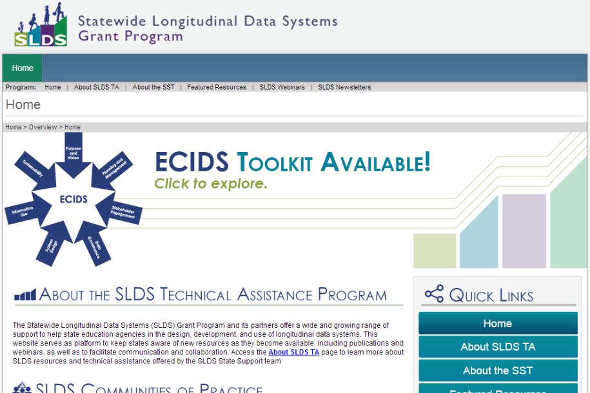
Main SLDS Page

Slide 13
ECIDS Toolkit Home Page (1 of 2)

Slide 14
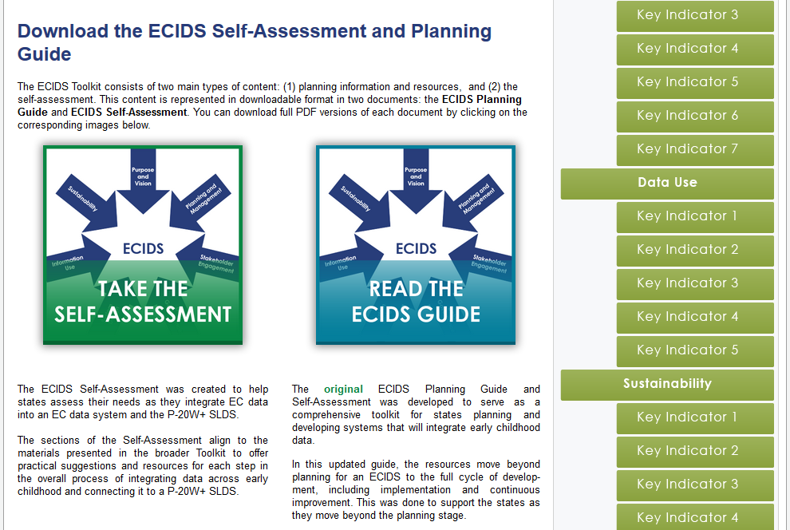
ECIDS Toolkit Home Page (2 of 2)

Slide 15
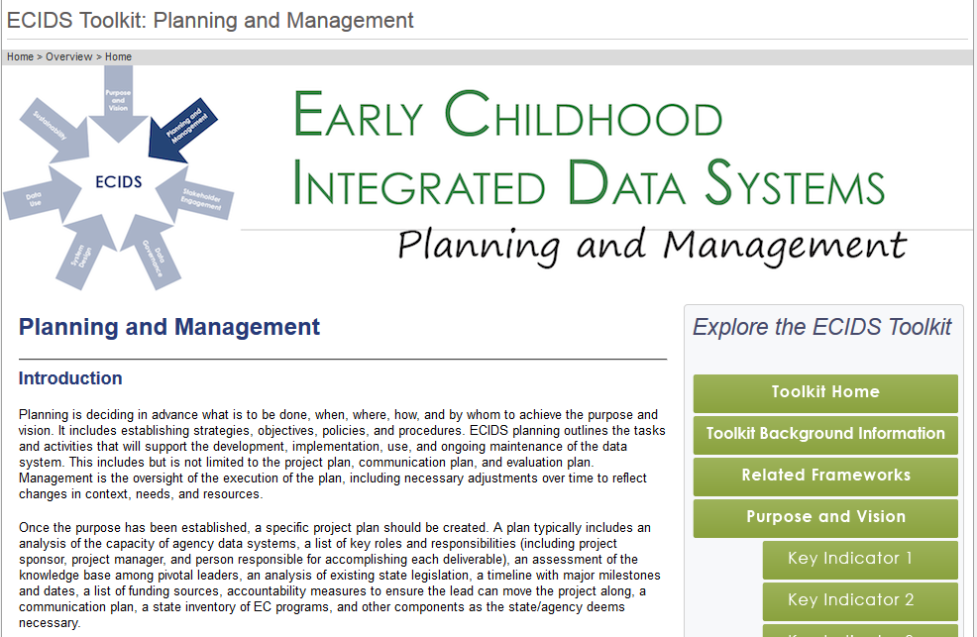
Component Page (1 of 2)

Slide 16
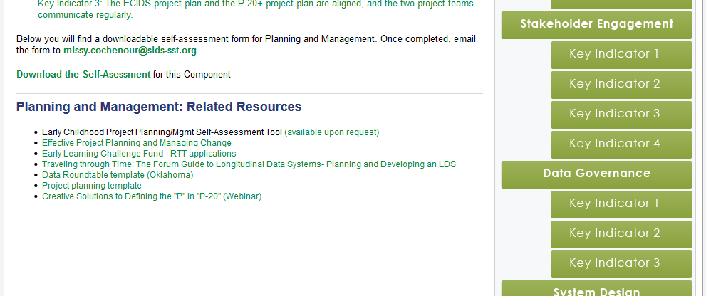
Component Page (2 of 2)

Slide 17
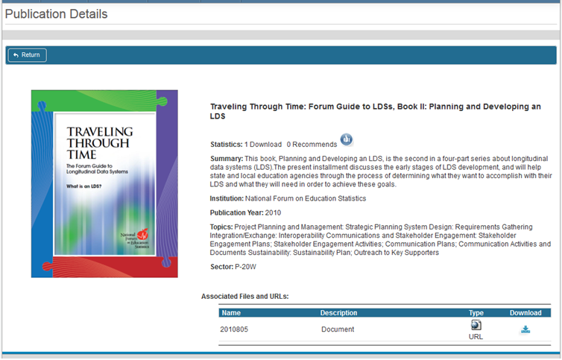
Resources Link to PDC

Slide 18
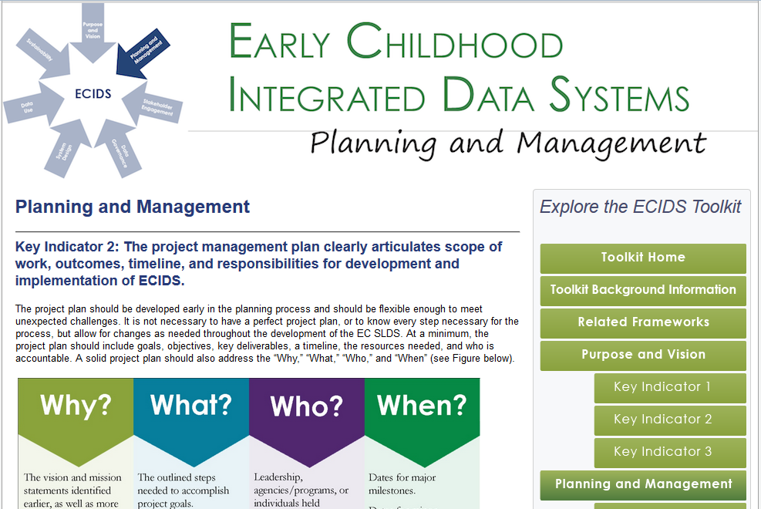
Key Indicator Page (1 of 2)

Slide 19
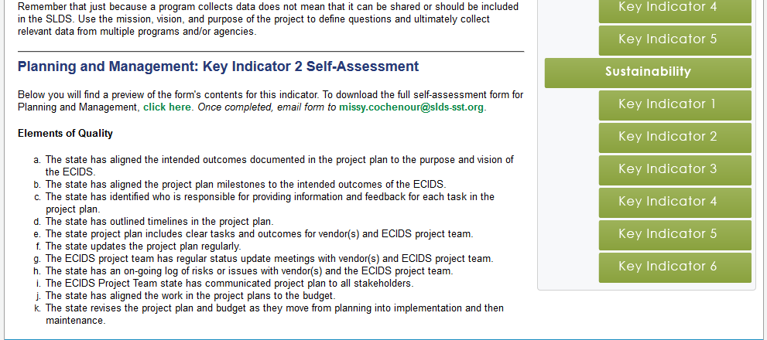
Key Indicator Page (2 of 2)

Slide 20
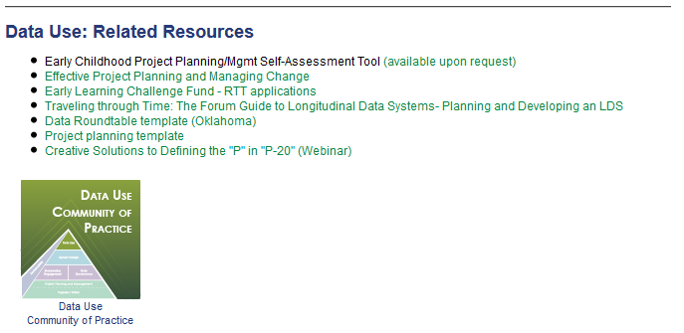
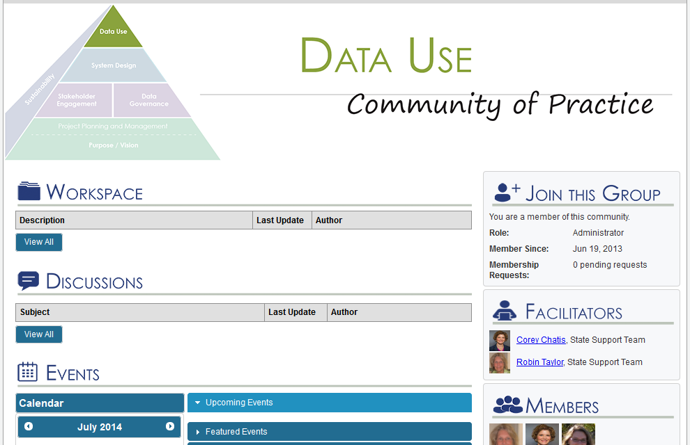
Connection to COPs

Slide 21
Overview:
The DaSy Framework

Slide 22
Purpose of the DaSy Framework
To enhance the capacity of Part C and Part B 619 staff to
Understand the characteristics and capabilities of a good data system, so they can…
Lead or actively participate in state data system’s development efforts, including cross agency work, so they can…
Use their data system(s) to address IDEA reporting requirements and to answer important program and policy questions, which will…
Allow states to build better systems of services and programs that will improve outcomes for young children with disabilities and families.

Slide 23
The DaSy Framework
Introduction
Self-Assessment, with scoring rubric
Components, each of which will have:
Notes and assumptions
Quality indicators
Elements of quality
Glossary of terms
Component
Quality/Key Indicator
Elements of Quality

Slide 24
The DaSy Framework will…
Provide a common language for DaSy and other TA providers to use in discussing Part C and 619 data systems with states.
Provide an organizing structure for categorizing resources and state examples related to Part C and 619 data systems (to be developed).
Serve as the organizing structure for a self assessment (to be developed).

Slide 25
Coming Soon!
Watch for release in Fall 2015

Slide 26
Collaborative Development

Slide 27
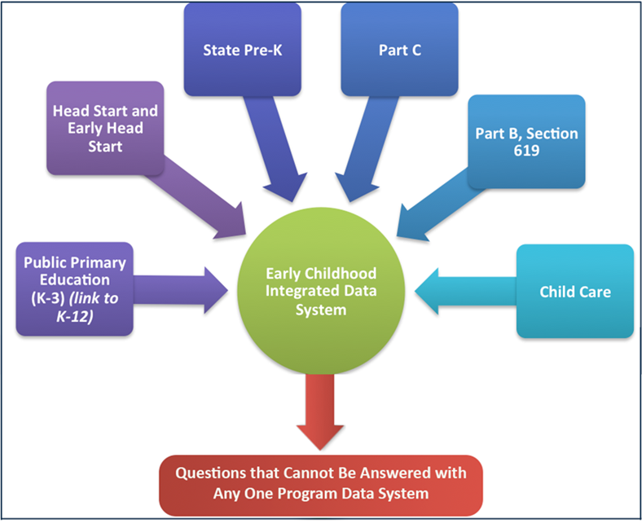
Why do we have both?
Critical factors for success are different for program data systems vs. integrated data systems
Audience varies
DaSY: Part C and 619 (program focused)
ECIDS: State teams working to integrate early childhood data (multiple programs and/or agencies)
Keep it from being too overwhelming to be together

Slide 28
Relationships

Slide 29
Comparison of Components
ECIDS | DaSy
Purpose and Vision | Purpose and Vision
Planning and Management
Stakeholder Engagement | Stakeholder Engagement
Data Governance | Data Governance and Management
System Design | System Design/Development
Data Use | Data Use
Sustainability | Sustainability

Slide 30
State Partners
ECIDS (ECIDS Lead and IT Staff) | DaSy (Part C and B 619 Staff)
Kansas | Alaska
Maine | Arkansas
Minnesota | Connecticut
Missouri | Georgia
North Carolina | Idaho
Utah | Massachusetts
Washington | Pennsylvania

Slide 31
External Reviewers
ECIDS | DaSy
Elliot Regenstein, Ounce of Prevention | Elliot Regenstein, Ounce of Prevention
Albert Wat, NGA | Albert Wat, NGA
Carlise King, ECDC | Carlise King, ECDC
Maria Taylor, National Registry Alliance | Andy Gomm, New Mexico Part C
Kathryn Tout, INQUIRE | Mary Corey, Missouri Special Education
Michelle Thomas, RTT-ELC | Lisa Backer, Minnesota Early Childhood Special Education
Fran Majestic, OHS | Colleen Murphy, Utah Early Childhood
Christina Kasprzak, ECTA | Chris Robin Payne, Rhode Island Part C

Slide 32
Alignment with P-20W+
State Examples
Maine: Connection with P-20W was critical to examine the long term impact of early childhood on later child outcomes. We have examined the third grade assessment scores of children who were in public preschool programs. They show a 6-8% increase in proficiency scores form their peers who did not participate.
Utah: To quote Aristotle, "The whole is greater than the sum of its parts". Through this work I have learned many ways to make my data system more efficient and more inclusive while gaining experience from "lessons learned". It has also helped to guide the timeline of my work. I have been able to collaborate with experts, save time, and this collaboration has given credibility to the work in Utah.

Slide 33
Brief Discussion
What did you see that you like?
What enhancements would you like to see in future developments?

Slide 34
So What?
How can these frameworks help you use your data?

Slide 35
In Maine these tools have…
Helped to develop an interdepartmental governance structure w/two specific tiers
Helped to develop an interdepartmental governance policy and manual to clearly articulate roles and responsibilities
Verified the manner of data integration of our early childhood programs
Lead to strategic discussions about sustainability
Helped to more clearly articulate our conceptual and presentation frameworks for communication

Slide 36
In Utah these tools have…
Helped to establish where to start
Used to assist in determining where are we going
Prevented scope/vision creep
Allowed Utah to individualize our data system

Slide 37
Brief Discussion
How might this guide be helpful to you in your work?

Slide 38
What are the implications for integrating early childhood program data into P-20W+ State Longitudinal Data Systems (SLDS)?

Slide 39
Alignment with P-20W+
The challenge
There are different roles for those that may lead the ECIDS but then be part of the P-20W+
The solution
Within each component there is an indicator that discusses P-20W+ alignment
They address the appropriate role of the EC team in the development of the P-20W+
Implications
Program, Integrated data, and P-20W+ should be coordinated to maximize benefits and leverage resources

Slide 40
Alignment with P-20W+
State Examples
Maine: This is important because it allows examination of the multiple influences that impact student outcomes, and supports the development of public policy.
Utah: The Early Childhood Integrated Data System is not located with the SLDS system. It has been imperative to keep the larger vision in view as we have both developed our system. This guide has helped delineate the different roles and responsibilities which helps our two systems to compliment each other.

Slide 41
Brief Discussion
How might this guide be helpful to people in sectors outside of early childhood?
Educate
Advocate
Others?

Slide 42
Resources
ECIDS Toolkit Link:
https://slds.grads360.org/#program/ecids-toolkit
DaSy Link:
http://dasycenter.org/

Slide 43
Contact Information
Colleen Murphy, cmurphy@utah.gov
Jaci Holmes, Jaci.Holmes@maine.gov
Kathy Hebbeler, kathleen.hebbeler@sri.com
Missy Cochenour, missy.cochenour@aemcorp.com
Lauren Wise, lauren.wise@aemcorp.com

Slide 44
Thank you!

