Slide 1
Benefits and Challenges of Integrating Data in Early Childhood:
The Case of Early Intervention and Early Childhood Special Education
Linda Goodman, Connecticut
Kathleen Hebbeler, SRI International
Abby Winer, SRI International
Meredith Miceli, Office of Special Education Programs
STATS-DC July 30, 2014

Slide 2
What we will cover
The potential of integrated data systems for answering important questions
The challenges associated with integrating data
Status of early childhood special education state programs’ ability to link data across systems
Examples from Connecticut

Slide 3
The Center for IDEA Early Childhood Data Systems (DaSy)
A 5-year Center funded by ED’s Office of Special Education Programs (OSEP) to assist states with improving IDEA Part C early intervention and Part B preschool data by:
Building better data systems
Coordinating data systems across early childhood programs
Connecting to longitudinal data systems
Building the capacity of states to use data
Reference the DaSy Handout for more information.

Slide 4
Understanding Part C (Early Intervention- EI) and Part B Preschool (Early Childhood Special Education - ECSE)
EI = Birth to age 3; ECSE – 3 to 5
Services to children with disabilities
EI: natural environment; building capacity of caregivers to promote the child’s development
ECSE: with same age peers; services provided in other programs (e.g., Head Start, child care, state Pre-K)
Other programs are critically important to how well these children will do.

Slide 5
Who are the children?
Mostly developmental delays, communication delays.
Delays in young children are transitory.
Some children do catch up developmentally and no longer need service.
Other children are not eligible but are very close. What happens to them?
Analyses need to be focused on the children and what happens to them under various scenarios.

Slide 7
A small sample of critical questions...
Which children with IEPs are served in state Pre-K?
What is the quality of programs attended by 4 year olds with IEPs ?
What is the extent of turnover among early care and education providers working with young children with disabilities?
How many early intervention participants have IEPs as 4 year olds? In kindergarten? In 3rd grade?
What happens to children who are found not eligible?

Slide 8
High quality state data systems can provide valid and reliable information for…
Accountability
Are state programs improving outcomes?
Program improvement
What are strengths and weaknesses and how can the state improve effectiveness?
Knowledge development
What constitutes an effective program?
What are effective practices?

Slide 9
Status of States
Online needs assessment developed by DaSy workgroup
Sent to IDEA Part C (Early Intervention) and Part B 619 (Early Childhood Special Education) coordinators
Completed with data managers and others identified by coordinators
Asked about status of data systems

Slide 10
Who were the respondents?
Sent to all states and jurisdictions
Report of the information collected focuses on information reported by 50 states, DC, and Puerto Rico
We had an excellent response rate:
For Part C 94% (n = 49)
For 619 96% (n = 50)
Notes:
We focused the report on the 50 states, DC and Puerto Rico since they are included in IDEA data tables for how child count is reported.

Slide 11
Only about one-third of states have linked data across Part C and 619.
Notes:
There 12 states with Education as the lead agency for Part C, so we would expect C and 619 data to be in same system or connected.
We combined data from the two surveys, and the pie graph on this slide shows that about one-fourth disagreed about the connections.

Slide 12
There is infrequent use of common identifiers across Part C and 619.
Common identifier for C & 619
Child-level | 21%
Program-level or school-level | 12%
Workforce-level | 6%

Slide 13
Linkages with K12 education data are more common for 619 than for Part C.
Types of education data in same system or have been linked | Part C | 619
K12 special education | 41% | 87%
K12 general education | 14% | 79%
Notes:
Not surprising that more states can link for 619 as Education is typically the lead agency. This means that either data are in the same system or in different systems but linked.

Slide 14
For Part C, few states have linkages with other EC data, and for 619,almost half have linkages with state preK.
Types of other EC data | Part C | 619
State pre-K | 12% | 46%
Head Start | 6% | 22%
Early Head Start | 2% | 10%
Child care | 6% | 8%
Home visiting | 8% | 8%

Slide 15
Linkages with health data are more common for Part C than for 619.
Types of health data | Part C | 619
Medicaid/SCHIP | 42% | 12%
EHDI | 37% | 8%
Vital records | 21% | 0%
Birth defects registry | 21% | 2%
All-payer claims (insurance) | 13% | 0%
WIC/SNAP | 8% | 6%
Hospital | 6% | 2%
Behavioral health | 4% | 2%

Slide 16
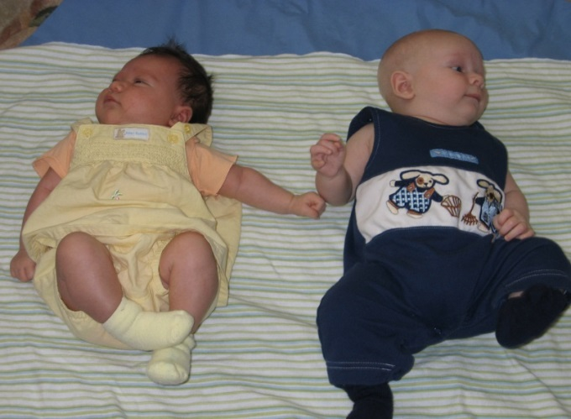
Only few states have linked Part C or 619 data to social services data.
Types of social services data | Part C | 619
Child welfare | 21% | 10%
Foster care | 12% | 8%
Temporary Assistance for Needy Families (TANF) | 10% | 14%
Homeless services | 6% | 14%

Slide 17
Challenges
Lack of common identifiers
Common language to align data elements and systems
Procedures and agreements for sharing data across departments and sectors
Concerns about confidentiality (FERPA, HIPAA)
Maintenance of linkages

Slide 18
Linking IDEA Part C and Part B Section 619 Data – Connecticut Example
How it started
Part B needed to report on FAPE at three
Part C wanted to be able to track children longitudinally at least into Kindergarten
Using a “comp ID” resulted in only an 60-65% match
The CSDE (Conn. State Dept. of Education) was using a state assigned student identifier to track students under NCLB.

Slide 19
Linking IDEA Part C and Part B Section 619 Data – Connecticut Example
The quick fix (2007)
The SASID Registry does not allow for concurrent registration
At the beginning of each month, Part C would transmit a batch file to the SASID Registry to enroll and obtain SASIDs for newly eligible children.
The same day, Part C would disenroll these children which then allowed their LEAs to enroll them as they approached age three.
Using the SASID resulted in a 100% match

Slide 20
Another Use for Linked Data: Notification to LEAs and SEA
Nightly upload to the Special Education Data Application by SASID results in four reports for LEAs about children :
Children Referred to their LEA for Evaluation
Children over age 2 ½ with no release of information to their LEA.
Children with release of information to their LEA
Children under Age 2 ½ with no release of information or referral for evaluation.

Slide 21
Oct 1 Served in Part C and Referred to Part B compared to All Children Exiting Part C at age 3 who are referred to LEAs for Evaluation during the year.
Began Assigning SASIDs

Slide 22
Served in Part C without an IEP at Kindergarten Entry

Slide 23
2007 Connecticut Births 40,579
Referred to Part C
7645
Evaluated
for Eligibility
7107
Eligible for Part C
4297
Initial IFSP Developed
4109
Services Started
3950
Exited at Age 3
2619
Exited to Part B
1954

Slide 24
2007 Connecticut Births 40,579
Referred to Part C
18.8%
Evaluated
for Eligibility
17.5%
Eligible for Part C
10.6%
Initial IFSP Developed
10.1%
Services Started
9.7%
Exited at Age 3
6.5%
Exited to Part B
4.7%

Slide 25
4297 Children Born in 2007 were Eligible for Part C
Final Exit Reasons
438
~
10.2%
636
~
14.8%
171
~
4%
373
~
8.7%
1954
~
45.5%
462
~
10.8%
264
~
6.3%
Not Elig/
IFSP
Done
Parent
Withdrew
Moved
Unavailable
Eligible for Part B
Both
Not Elig
for B
B
Unk
Try to keep these colors in your head.
Notice there is no Yellow!

Slide 26
Match Records
SASID

Slide 27
2007s “Part B Eligible” Compared to Each Total
Eligible for Part C (N=4297)
Exited at Age 3 (N=2680)
Exited to Part B
1954 (45.5%)
IEP on
10/1/10
1257 / 1537 (81.8%)
1619 / 2663 (60.1%)
IEP on 10/1/11
IEP on 10/1/12
1430 / 2975 (48.1%)

Slide 28
2007s - Parts of the Whole
Eligible for Part C (N=4297)
Part B – Special Education = Yes
October 1, 2010 (N=1537)
October 1, 2011 (N=2663)
October 1, 2012 (N=2975)

Slide 29
2007s Comparing Total “Eligible”
Eligible for Part C (N=4297)
Part B – Special Education = Yes
October 1, 2010 (N=1537)
October 1, 2011 (N=2663)
October 1, 2012 (N=2975)

Slide 30
Eligible 2007s Compared to The Census
40,579
Eligible for Part C (N=4297)
Part B – Special Education = Yes
October 1, 2010 (N=1537)
October 1, 2011 (N=2663)
October 1, 2012 (N=2975)

Slide 31
Conclusions
Integrated data systems can allow states to answer critical policy questions
Linking to other programs is an important issue to improve outcomes for young children with disabilities
Challenges exist, but are not insurmountable
Some states are making great progress linking across programs

Slide 32
For more information
Visit the DaSy website at: http://dasycenter.org/
Like us on Facebook: https://www.facebook.com/dasycenter
Follow us on Twitter: @DaSyCenter

Slide 33
The contents of this presentation were developed under a grant from the U.S. Department of Education, #H373Z120002. However, those contents do not necessarily represent the policy of the U.S. Department of Education, and you should not assume endorsement by the Federal Government. Project Officers, Meredith Miceli and Richelle Davis.

