Slide 1
What Else Would You Like Your Data Systems to Do?
August 2018 IDIO Conference
Bruce Bull, DaSy

Slide 2


The DaSy Center

Slide 3

The Perfect Data System
Notes:
Unsplash: Sai Kiran Anagani

Slide 4
Audience Roles
Data Managers
Coordinators/Directors
Vendors
Other?

Slide 5
Position Tenure in Current Position
< 1 year
1-3 years
3-5 years
5-10 years
10-15 years
15-20 years
> 20 years
Longest?
Notes:
Unsplash: rawpixel

Slide 6
Age of “Primary” Special Education Data System (since original deployment or significant enhancements)
< 2 year
2-5 years
5-10 years
> 10 years
Longest
Notes:
Unsplash: rawpixel

Slide 7
Notes:
Unsplash: Vincent Botta

Slide 8
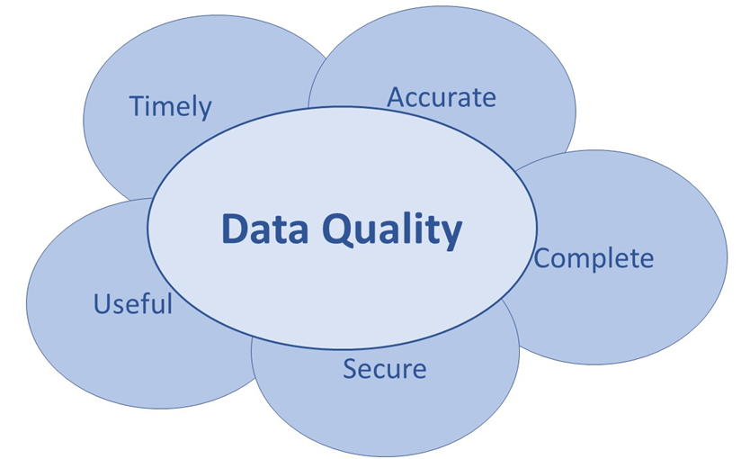
Data Quality

Slide 9
Questions
#1 What works well in your data system(s)?
#2 What would improve your data system(s)?
#3 What data system improvements (local or state) might improve early childhood for children, parents, providers, administrators?
#4 How could general supervision (SSIP, prof development, SPP/APR, monitoring, improvement planning, dispute resolution, etc.) be better supported by data systems?

Slide 10
Group Activity
3-4 Small Group Activity
  Facilitator
  Note Taker
  Reporter Outer

Slide 11
Small Group Assignments
 | Question 1 | Question 2 | Question 3 | Question 4 (time?)
Facilitator | Last birthday | Tallest | Most recent new phone | Last dentist appointment
Note Taker | Next birthday | Shortest | Last tattoo or piercing | Last new (or new to you) vehicle purchase
Reporter Outer | New year baby (on or after Jan 1st any year) | Last paid for hair experience | Next child or grandchild’s birthday | Furthest (from home) 2018 vacation destination (taken or booked to be taken)

Slide 12
Groups
Group together by:
Part C
  State-wide child level systems
  Non state-wide child level systems
619
  State-wide student level systems
  Non state-wide student level systems

Slide 13
State Staff Note
Be specific! Make sure the response passes the stranger test.

Slide 14
Vendor Note
The small group questions are designed primarily for state staff—not vendors (and not TA providers). What you hear may be informative to current and potential system solutions. But today is an opportunity to hear from states, not talk to states about what your system may or may not do.

Slide 15
Partial List of Functions Possible Within IDEA Child/Student Level Data System (Part C Focused)
Register initial referrals
Record child demographics
Repository for elig and assmnt info
Track eligibility determination
Assign Service Provider
Provide IFSP form and function
Provide for annual / modified IFSP
Record planned services
Record delivered services, initial or all
Transfer in state (program to program)
Support child transition (e.g., to 619)
Support child outcome (entry-exit) data
Close case, including exit info
Schedule service appointments
Repository for family info/contacts
Manage local agencies /vendors/service providers
  - provider registry (e.g., contact info, demographics, application, areas of service, locations served)
  - credential/certification information
  - provider calendar / scheduler
  case load information (incl serv coord)
Local agency improvement planning
Local agency application for federal funds
Parent portal

Slide 16
(Con’t) Partial List of Functions Possible Within IDEA Child/Student Level Data System (Part C Focused)
Report Capabilities
  - full data export capability
  - provider reports
  - manager reports
  - service coordinator reports
  - 618 reports
  - APR indicator reports
  - child outcome reports
  - ad hoc report capability (end users can build and design custom reports)
  - dispute resolution (mediation, complaints, due process tracking and reporting)
  - family outcome report (if system supports family survey collection/ - administration)
  - local agency compliance indicator reports
  - correction of non-compliance reports
System Administration Management (lead agency ability)
  - roles x access/permissions
  - email manager
  - notification/tickler system
  - resource repository
  - protocol builder (allows system administrator to create new collection within system, e.g., for data system evaluation, conference evaluation for those that attended.)
Linking capabilities (e.g., child data with provider data, Part C with EHDI)
Edit check and validation procedures
Ability to track transactions by user

Slide 17
Question #1
#1 What works well in your data system(s)?

Slide 18
Group Activity #2
Report Out
Address question #2
New small group roles

Slide 19
Coming soon to education data . . .
Higher quality data
More data
More data efficiency
More integrated data / connected data systems
More use of big data and AI to personalize learning
More data security risks
More data governance
Faster data systems development life cycle (SDLC)
More and more and more . . .

Slide 20
Coming soon to a job near you . . .
Big (and bigger) data
Business Intelligent (BI) software
Predictive Analysis
Artificial Intelligence (AI)
Internet of Things/people (IOT)
Increased data governance
Evolving data security
Smarter data systems
Increased data linking
Mobile data solutions
Voice activated: data analysis, visualization
Faster data turnarounds
Shorter attention spans
More and more . . .

Slide 21
Question #2
#2 What would improve your data system(s)?
(Make this one about
specifically about yours. ☺)

Slide 22
Group Activity #3
Report Out
Address question #3
New small group roles

Slide 23
Question #3
#3 What data system improvements (local or state) might improve early childhood for children, parents, providers, administrators?

Slide 24
Group Activity #4
Report Out
Address question #4
Next?

Slide 25
Question #4
#4 How could general supervision (SSIP, professional development, SPP/APR, monitoring, improvement planning, dispute resolution, etc.) be better supported by data systems?

Slide 26
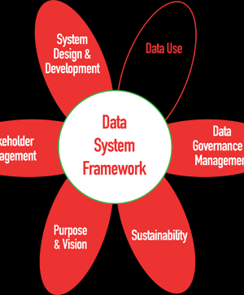
DaSy Tools
#1 Resource

Slide 27
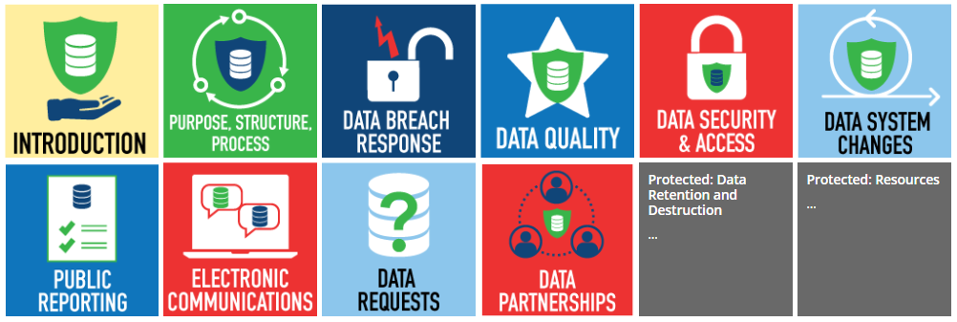
DaSy Tools
Data Governance and Management Toolkit

Slide 28
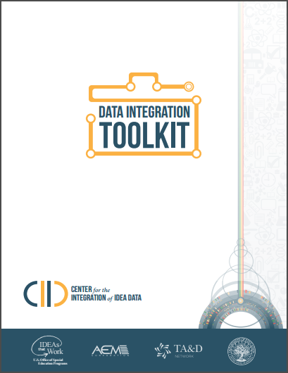
More Tools
The Unofficial Guide to the Why and How of State Early Childhood Data Systems (The Ounce of Prevention Fund)
New Toolkit! Including IFSP Information in Your Part C Data System
CIID Data Integration Toolkit
Work with TA providers.

Slide 30
Contact DaSy
Visit the DaSy website at:
http://dasycenter.org/
Like us on Facebook:
https://www.facebook.com/dasycenter
Follow us on Twitter:
@DaSyCenter

Slide 31

Thank you
The contents of this tool and guidance were developed under grants from the U.S. Department of Education, #H373Z120002 and #H326P170001. However, those contents do not necessarily represent the policy of the U.S. Department of Education, and you should not assume endorsement by the Federal Government. Project Officers: Meredith Miceli, Richelle Davis, and Julia Martin Eile.

