Slide 1
Suspension and Expulsion in the Early Years: Using Data to Inform Continuous Improvement for Children with Disabilities
Yvonne Greene, Arkansas
Jenny May, South Carolina
Tony Ruggiero, DaSy
Rebecca Valenchis, AEM
2018 Improving Data, Improving Outcomes Conference
August 2018

Slide 2
Session Agenda
Overview and Objectives
Welcome and Introductions
Defining Suspension and Expulsion
States on Stage: Arkansas and South Carolina
Suspending and Expelling Children with Disabilities
Closing and Wrap-Up

Slide 3
Session Objectives
Define suspension and expulsion in early childhood
Examine sample scenarios to determine whether practices are examples of suspension and/or expulsion
Compare and contrast current policies addressing suspension and expulsion
Support improvements in data practices and use based on information learned

Slide 4
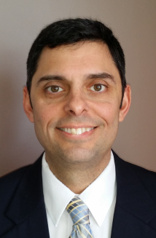
Meet the Team
Rebecca Valenchis
Tony Ruggiero
Yvonne Greene
Jenny May

Slide 5
Meet the Audience
What is your primary role?

Slide 6
Defining Suspension and Expulsion in Early Childhood

Slide 7
Show What You Know
What do you KNOW about suspension and expulsion? | What do you WONDER about suspension and expulsion? | What did you LEARN about suspension and expulsion?
I already know… | I want to know… | A-ha! Now, I know…

Slide 8
Suspension and Expulsion in the Early Years
Schachner, A., Belodoff, K., Chen, W-B., Kutaka, T., Fikes, A., Ensign, K., Chow, K., Nguyen, J., & Hardy, J. (2016). Preventing Suspensions and Expulsions in Early Childhood Settings: An Administrator’s Guide to Supporting All Children’s Success. SRI International: Menlo Park, CA. Accessed from http://preventexpulsion.org

Slide 9
Definitions: Suspension and Expulsion
In-School Suspension: Practices that involve removing or excluding the child from the classroom
Out-of-School Suspension: Practices that involve temporarily removing the child from the program
Expulsion: Permanent removal or dismissal from the program
Soft-Expulsion: Practices that leave the family with little choice but to withdraw their child from the program
Schachner, A., Belodoff, K., Chen, W-B., Kutaka, T., Fikes, A., Ensign, K., Chow, K., Nguyen, J., & Hardy, J. (2016). Preventing Suspensions and Expulsions in Early Childhood Settings: An Administrator’s Guide to Supporting All Children’s Success. SRI International: Menlo Park, CA. Accessed from http://preventexpulsion.org

Slide 10
Transition Trivia

Slide 11
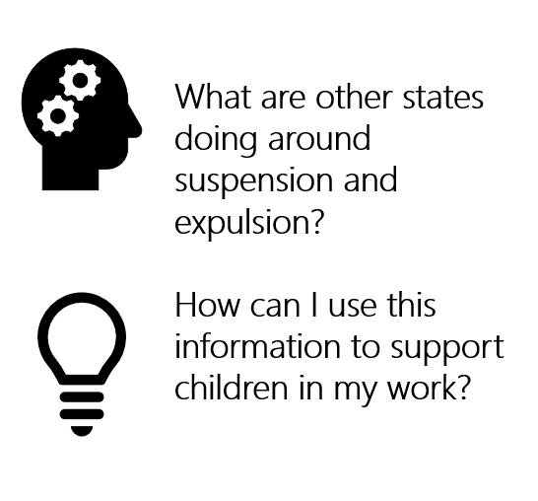
States on Stage

Slide 12
South Carolina: Data
Severe limitations to existing data
Semantics
Self report
No consistent requirement for reporting
Infrastructure to support the field when reporting illustrates a problem
Policy inhibits accurate data collection

Slide 13
South Carolina: Data
Opportunities for improvement
Rebuilding our baseline
Sample new semantics for self reporting
Secondary data check/triangulate responses
BIR (Behavior Incident Reporting) new structure
Pyramid statewide implementation
Pyramid programmatic implementation data collection
Qualitative focus groups by sector*

Slide 14
South Carolina: Policy
Head Start
CERDEP
Early Childhood Special Education
SIMR
Private Early Childhood Education Environments

Slide 15
South Carolina: BUILD
Preventing preschool suspension and expulsion cohorts 1 and 2
Data and self reflection/evaluation
Notes:
BUILD inspired looking in a robust way on this topic

Slide 16
South Carolina: Supporting the Field

Slide 17
South Carolina: Proposals & Cross-Sector Collaboration
Early Learning Standards
Embed social emotional development and behavior and expectations
Infant Early Childhood Mental Health
Pyramid Master Cadre
Coaching
Behavioral Health help desk!

Slide 18
Arkansas: 2015 Beginnings

Slide 19
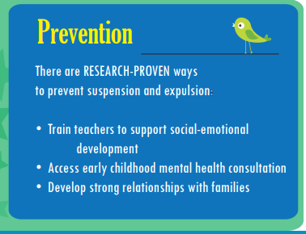
Arkansas: Infographic
https://humanservices.arkansas.gov/images/uploads/dccece/Expulsion%20Infographic%20Draft_2-25.pdf

Slide 20
Arkansas: Behavior Help
https://www.behaviorhelponline.org/

Slide 21
Arkansas: Behavior Help
https://www.behaviorhelponline.org/

Slide 22
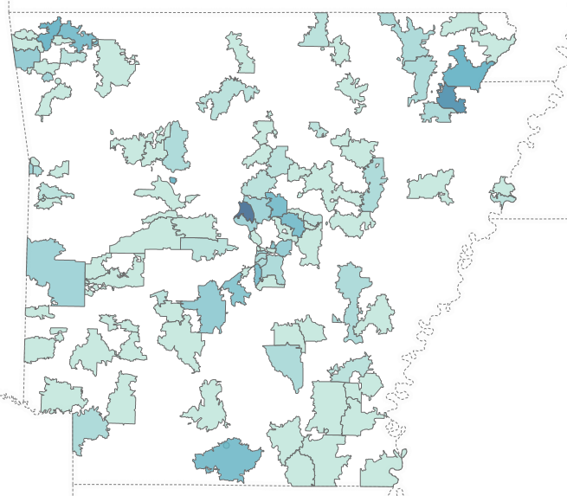
Arkansas: Behavior Help
2016-2017
264 Children
173 Centers
50 Counties

Slide 23
Arkansas: Behavior Help Referrals
2016-2017
10% of the children are currently in foster care.
82% of the children are male.
Race
61% of the children are Caucasian.
28% of the children are African American.
7% of the children are Bi-Racial/Other.
5% of the children are Hispanic.

Slide 24
Arkansas: Behavior Help Referrals

Slide 25
Arkansas: Behavior Help Case Closure

Slide 26
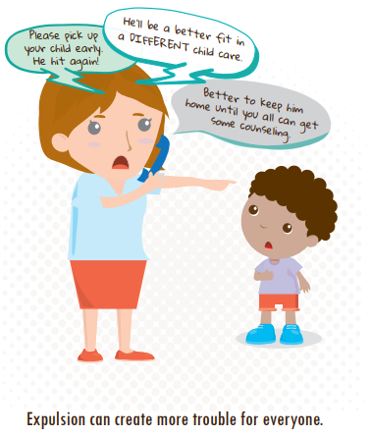
Arkansas: Pre-Training Provider Practices
57% Called Parent (in the past month)
43% Suspended or Expelled
9% Expelled

Slide 27
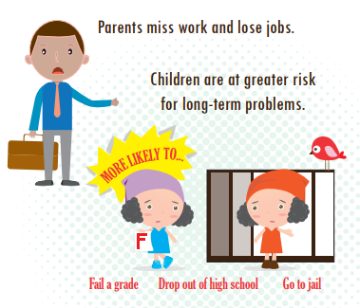
Arkansas: Behavior Help Survey Results
83% Learned New Strategies
84% Made Changes that Improved the Classroom
69% Saw a Difference in Behavior

Slide 28
Arkansas: Behavior Help Survey Results
89% Recommend Behavior Help
I would describe my partnership with the BehaviorHelp team as rewarding and educational. My coach helped me with ideas for the classroom, ways to communicate with my parents, and she showed me some techniques I used personally. I would recommend the Behavior Help team to any of my colleagues.

Slide 29
Arkansas: Behavior Help Survey Results
86% Would Use Behavior Help Again
[BehaviorHelp Staff] was very passionate about helping me find ways to help the child. I could tell she took my request very seriously and was continuously trying to think of ways to help me. She was very sincere in helping me to be a better teacher in the classroom for the child.

Slide 30
Arkansas: Behavior Help Specialists & TA

Slide 31
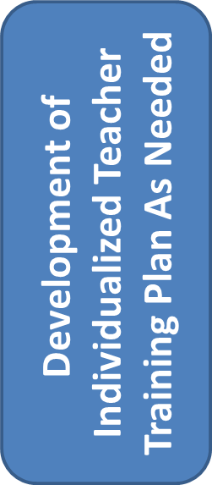
Arkansas: Behavior Help
Tier 3: Behavior frequent and extreme and/or identified trauma history or multi-system involvement;
Early Childhood Mental Health Consultation
Tier 2: Behavior described as more serious and/or teacher frustration is high;
Short term TA by team of experts in developmentally appropriate practice and/or social-emotional supports
Tier 1: Concerns described sound developmentally normal and frustration is not excessively high;
DCCECE Specialists share information and resources
Provider/Parent complete online form and interview with DCCECE staff

Slide 32
Arkansas: Training
Training began in the fall of 2015
Target audience state Prek (to pilot process)
Community awareness meetings for CCDF providers
Spring 2016
Official kickoff of new No-suspension policy
Regional training events across state
Summer 2016
State Prek directors and providers
Headstart providers
Early Childhood Special Education Behavior Specialist
Ongoing
How to provide supports need for children

Slide 33
Arkansas: Dimensions of Expulsion

Slide 34
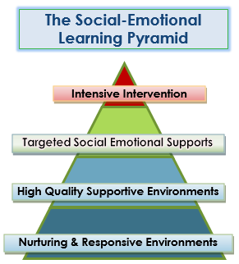
Arkansas: The Pyramid Model
Most problem behaviors can be addressed by looking at adult behaviors:
Building positive relationships
Putting preventive classroom strategies in place
Specifically teaching children social and emotional skills
Increasing positive behavior supports for children who need more help

Slide 35
Arkansas: Accessing Behavior Help
Online Documents/Handouts located at: http://humanservices.arkansas.gov/dccece/Pages/ChildCareAssistance.aspx

Slide 36
Arkansas: The Good News!
We CAN support children and help teachers manage challenging behaviors
We CAN prevent suspension and expulsion

Slide 37
Transition Trivia

Slide 38
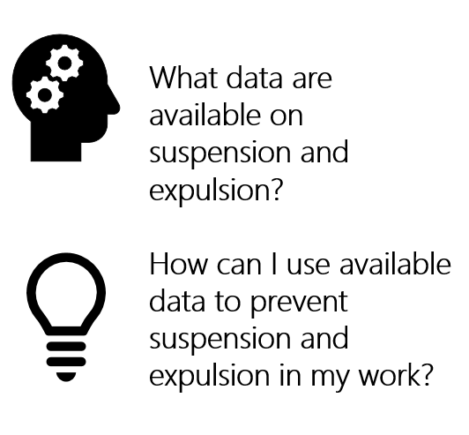
Suspending and Expelling Children with Disabilities

Slide 39
Examples of Suspension and Expulsion
Darius | Anya
Sofia | Ian
In-School Suspension
Out-of-School Suspension
Expulsion
Soft-Expulsion

Slide 40
Definitions: Suspension and Expulsion
In-School Suspension: Practices that involve removing or excluding the child from the classroom
Out-of-School Suspension: Practices that involve temporarily removing the child from the program
Expulsion: Permanent removal or dismissal from the program
Soft-Expulsion: Practices that leave the family with little choice but to withdraw their child from the program
Schachner, A., Belodoff, K., Chen, W-B., Kutaka, T., Fikes, A., Ensign, K., Chow, K., Nguyen, J., & Hardy, J. (2016). Preventing Suspensions and Expulsions in Early Childhood Settings: An Administrator’s Guide to Supporting All Children’s Success. SRI International: Menlo Park, CA. Accessed from http://preventexpulsion.org

Slide 41
What can currently available data tell us?
Children with disabilities are more than twice as likely to receive an out-of-school suspension than children without disabilities at the K-12 level
(Civil Rights Data Collection, 2014)

Slide 42
What can currently available data tell us?
2.7 million children received an out-of-school suspension; Children with disabilities represented 26 percent of this total at the K-12 level
(Civil Rights Data Collection, 2015-2016)

Slide 43
What can currently available data tell us?
120,700 children received an expulsion; Children with disabilities represented 24 percent of this total at the K-12 level
(Civil Rights Data Collection, 2015-2016)

Slide 44
Data Dilemma: A Closer Look at CRDC Data
 | Suspensions 2015-2016 | Expulsions 2015-2016
Total | 2,700,000 | 120,700
Percentage of Enrollment | 12% | 12%
Percentage Suspended or Expelled | 26% | 24%

Slide 45
What can we do?

Slide 46
Transition Trivia

Slide 47
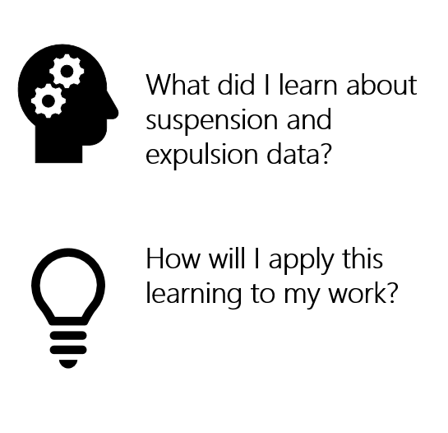
Closing and Wrap-Up

Slide 48
Show What You Know
What do you KNOW about suspension and expulsion? | What do you WONDER about suspension and expulsion? | What did you LEARN about suspension and expulsion?
I already know… | I want to know… | A-ha! Now, I know…

Slide 49
For More Information
Visit the DaSy website at: http://dasycenter.org/
Like us on Facebook: https://www.facebook.com/dasycenter
Follow us on Twitter: @DaSyCenter

Slide 50
Stay in Touch!
Rebecca Valenchis: Rebecca.Valenchis@aemcorp.com
Tony Ruggiero: Robert.Ruggiero@aemcorp.com
Jenny May: jmay@ed.sc.gov
Yvonne Greene: Yvonne.Greene@arkansas.gov

Slide 51
Thank You
The contents of this presentation were developed under a grant from the U.S. Department of Education, # H373Z120002. However, those contents do not necessarily represent the policy of the U.S. Department of Education, and you should not assume endorsement by the Federal Government. Project Officers, Meredith Miceli and Richelle Davis.

