Slide 1
Where to Start: Planning for a New Data System or System Enhancement
Robin Nelson, DaSy Center
Amy Nicholas, DaSy & ECTA Centers
Noah Feldman, MA Part C
Susan Franck, WA Part C
Improving Data, Improving Outcomes Conference
Arlington, VA
August 2018

Slide 2
Session Overview
This session is intended to identify key considerations for states before working through the action phases of developing or enhancing a Part C or Part B 619 data system.
We will describe data system features that states are using to improve the IFSP and IEP processes, facilitate date entry/workflow, and strengthen communication and collaboration.
State presenters will share experiences and learnings from managing their data system development projects.

Slide 3
Typical Barriers and Pitfalls
Lack of shared vision
Needs of stakeholders not aligned with vision and scope
Insufficient project/contract management
Taking shortcuts in development and deployment processes
Architecture unsuitable for scale/scope/context
Notes:
Resistance

Slide 4
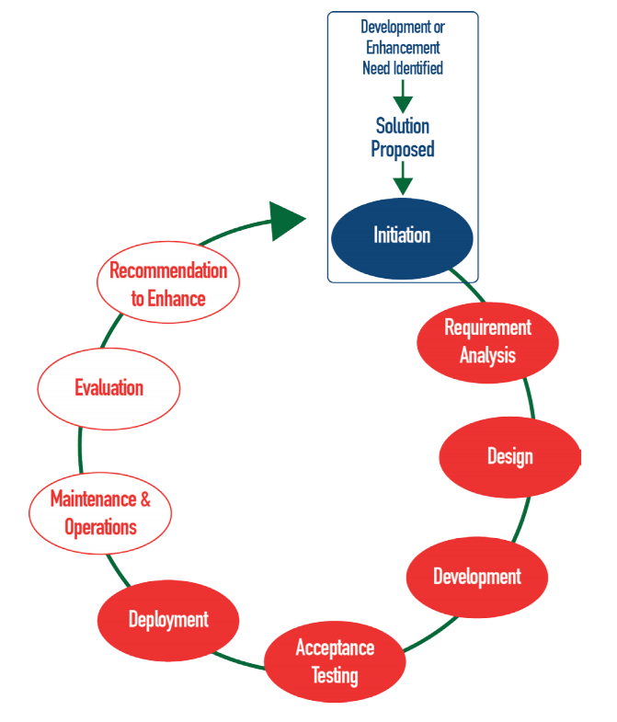
Phases of System Development Life Cycle

Slide 5
Where Are You?
Early stages of considering something
Planning new system
Developing new system
Planning enhancement
Developing enhancement

Slide 6
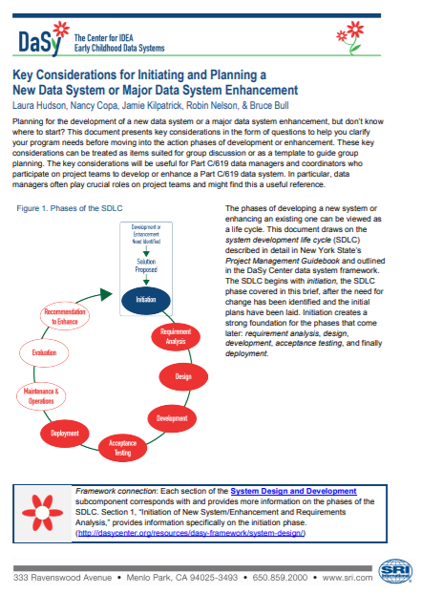
Key Considerations for Initiating and Planning a New Data System or Major Data System Enhancement
Available as standard pdf
and
fillable worksheet

Slide 7
Big Picture Issues
Vision
Outcomes
Scope
Communication
Identify and engage stakeholders
Develop strategies
Management of
Development
Implementation
Risk

Slide 8
Form Your Team
Governance
Management
Development
Deployment
Operations

Slide 9
Project Team
Project Sponsor
Project Manager
Business Analyst
Data Manager
Developer / DBA
Others???

Slide 10
Find the Right Solution
In-house
Internal agency
Procurement
Competitive RFP
Off-the-shelf
Options for
Development
Hosting
External agency
Contract
Sole source
Custom build
Operations
Maintenance

Slide 11
Financial Considerations
Potential development costs
Potential budget allocation
Potential funding sources
Potential cost savings
Long-term costs: support, maintenance

Slide 12
Software Development Approaches
Waterfall
Agile
Conception
Conception
Initiation
Initiation
Analysis
Analysis
Design
Design
Build
Build
Testing
Testing
Deployment
Deployment
Notes:
://www.seguetech.com/waterfall-vs-agile-methodology/

Slide 13


State Experiences with Data System Projects

Slide 14
Washington Early Supports for Infants and Toddlers (ESIT)
Data management system (DMS) background
  Microsoft Silverlight application
  Databased structure was built for one workflow for service coordination
  Reports were built for reporting, not monitoring or measuring progress
Data system enhancement project
  Research

Slide 15
Define what your system needs to do
Describe business processes
Identify and re-examine workflows
Define requirements
  Functional/business
  Nonfunctional/technical
  IT staff turnover
  Implemented Agile
  Developed a communication plan

Slide 16
Washington ESIT DMS
Current System
Built around the
service coordinator
System has many “hard stops” which disrupts work flow
New System
Built around the child
Limit the number of “hard stops” to ease work flow
Limited administrative functions
Add administrative functions
Data collection by geographic service areas
Data collection by early intervention programs

Slide 17
Washington ESIT DMS (cont.)
Current System
New System
Multiple logins
Single login
Reports include monitoring progress
Reports limited to reporting results
Records planned services
Records actual service delivery

Slide 18
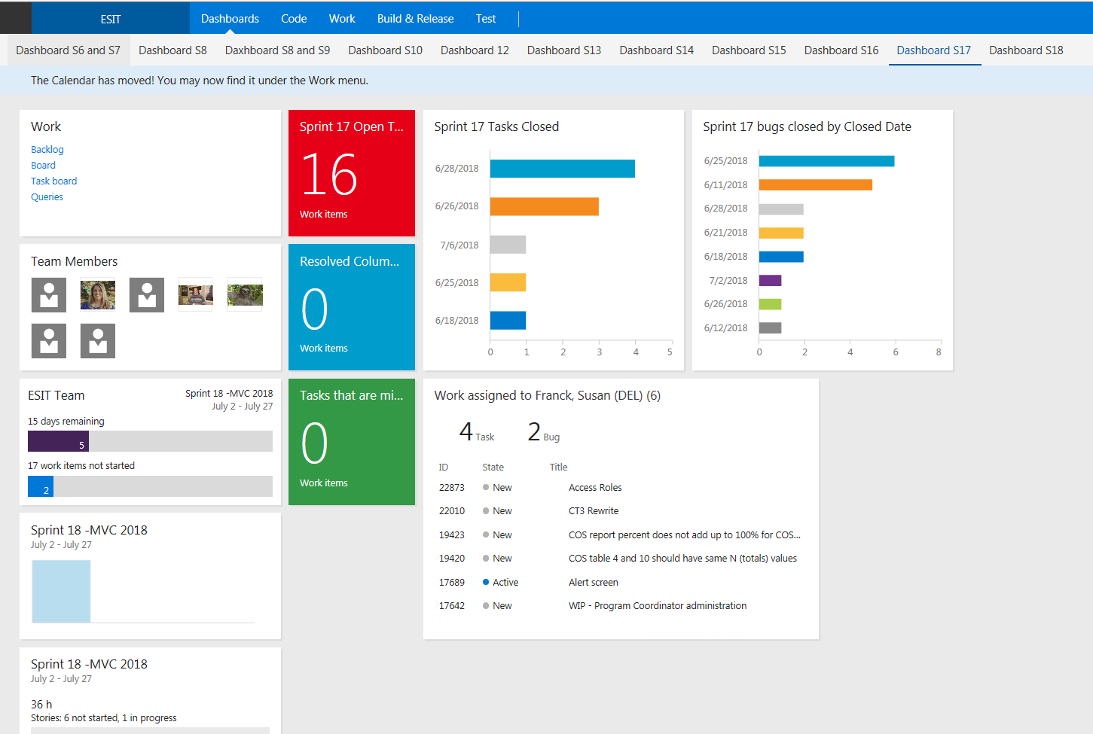
Team Foundation Server (TFS)

Slide 19
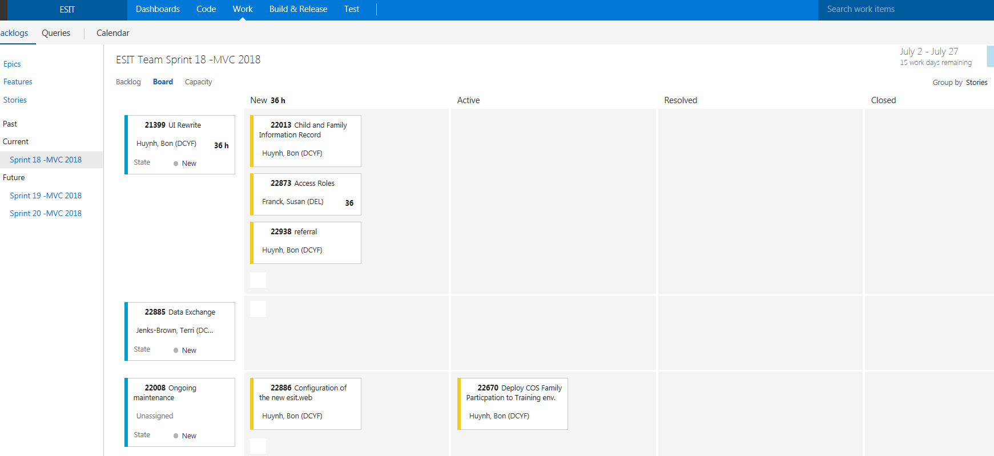
TFS (cont.)

Slide 20
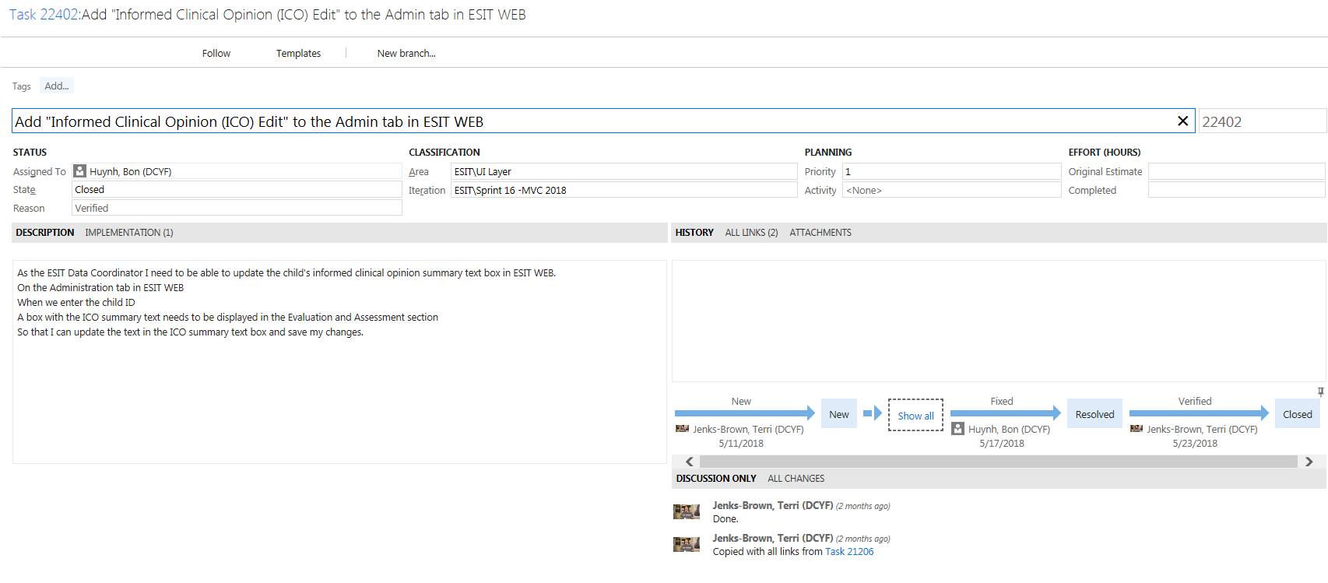
TFS (cont.)

Slide 21
Massachusetts Early Intervention
Developing: New web-based client and fiscal system
  Full Client record
  EMR upload capability
  Full Reimbursement and payment processing
Replacing: EI Information System (EIIS) and Fiscal System
  20+ years old systems
  Access database and SQL

Slide 22

Massachusetts: Current EI Data Processes
Local Program Data Collection Process
DPH Databases:
EIIS Referral Form
Local Client Database
Redundant data entry
Human error
EIIS Evaluation Form
Local EIIS
EIIS IFSP Form
Multiple steps for data transmission
Local Billing System
EIIS
EIIS Discharge Form
TVP Website
Manual Data Verification
Waiver
(Request for Reimbursement
Separate databases that are not connected
Client Record, Progress notes, IFSP
Additional processes for data needs
Waiver
Database
DPH Claims System
TSS
Third Party Payor
Certification Tracking Form
Email form
Payor System
Claim Support documentation
Personnel
Database
Email documents
Source: DPH EI Analysis & Provider Interviews

Slide 23
Massachusetts: Future EI Data Processes
Local Program Data Collection Process
DPH Databases:
Option 1
Enrollment Data
Clinical Data
DPH Client System
EI Personnel Data
Local Billing System
DPH Claims System
Third Party Payor
Payor System

Slide 24
Massachusetts: EMR Integration Becoming Reality
New EIIS as primary software
EI DPH will develop extract for EMR upload
50% of EI agencies currently own EMR
EMR as primary software (EIIS secondary)
EI DPH will develop integration function for upload to EIIS
EI agencies will develop extract for EIIS upload

Slide 25
Massachusetts: Future EI Data Processes
Local Program Data Collection Process
DPH Databases:
Option 2
Enrollment Data
Local Client Database (EMR)
Clinical Data
DPH Client System
EI Personnel Data
Local Billing System
DPH Claims System
Third Party Payor
Payor System

Slide 26
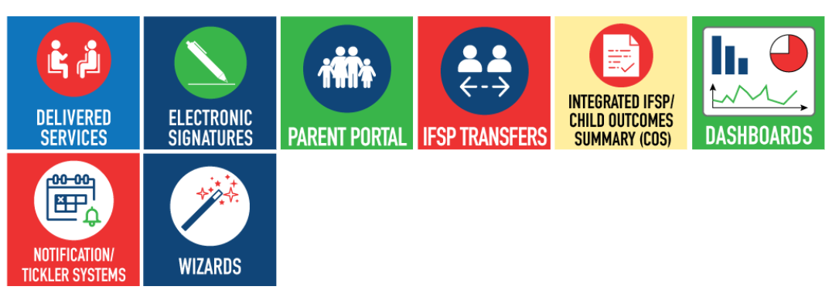
Data System Features

Slide 27
Deciding on Features
States can benefit from exploring features other states are using to collect and facilitate the reporting and use of data, including IFSP and IEP data.
For each feature, specific business requirements are needed to communicate and document (in writing) all potential uses to meet program needs.
  Developing and Sharing Your Business Requirements to Build a Better Data System

Slide 28
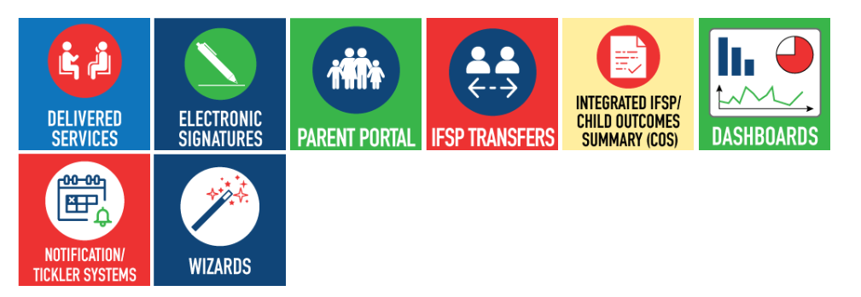
DaSy Center Toolkit
Including IFSP Information in Your Part C Data System: Selected Features and Related Functionality

Slide 29
What You’ll Find for Each Feature
Connections to the DaSy Data System Framework;
Potential data elements needed to develop various aspects of the feature;
A list of functionality options that could be used to implement the feature;
Key design considerations;
State examples,* and
Related technical assistance resources.

Slide 30

Group Sharing & Discussion

Slide 31
We Want to Hear from You
Have you used the DaSy IFSP Toolkit? If so, please share how/why.
What other features would you like to see in the IFSP Toolkit?
Describe any interesting things you’re done or are planning to with your data system, e.g., a new feature or functionality.

Slide 32
Related DaSy Resources
Key Considerations for Initiating and Planning a New Data System or Major Data System Enhancement
  Standard PDF and fillable worksheet
IFSP Toolkit - Including IFSP Information in Your Part C Data System
DaSy Framework: System Design
Developing and Sharing Your Business Requirements to Build a Better Data System
Building a Better Data System: What are Process and Data Models?

Slide 33
Find Us Online
Visit the DaSy website at:
http://dasycenter.org/
Like us on Facebook:
https://www.facebook.com/dasycenter
Follow us on Twitter:
@DaSyCenter

Slide 34

Thank You
The contents of this presentation were developed under a grant from the U.S. Department of Education, # H373Z120002. However, those contents do not necessarily represent the policy of the U.S. Department of Education, and you should not assume endorsement by the Federal Government. Project Officers, Meredith Miceli and Richelle Davis.

