Slide 1
Introducing the Child Find Self-Assessment
Brenda Wilkins & Jennifer Barrett-Zitkus, OSEP
Evelyn Shaw, ECTA
Margaret Gillis & Kathryn Morrison, DaSy
Improving Data, Improving Outcomes Conference
August 14, 2018

Slide 2
Welcome!
Who is in the room?
Notecards for questions and comments

Slide 3
Agenda
National snapshot
Introduction to the Child Find Self-Assessment
TA Resources

Slide 4
Focusing on Child Find: National Snapshot, Challenges, and Opportunities

Slide 5
National Snapshot: 618 Child Count Data FFY 2016-2017 Toddlers
US and outlying territories: 372,896 total number infants and toddlers with IFSPs *
Birth to one % = 1.24
One to two % = 2.88
Two to Three % = 5.22
Birth to three % = 3.12
*cumulative count is approximately 2 times higher than the point in time child count data
Notes:
Evelyn

Slide 6
Percentage of population, birth through 2 years

Slide 7
National Snapshot: Child Find Special Populations
Child Maltreatment (Children’s Bureau, 2018; Child Maltreatment, 2016)
  Over 1/4 of victims (28.5%) under age three; children less than one year have the highest victimization rate (24.8 per 1,000 children)
  Voluntary reporting on CAPTA referrals to Part C (National Child Abuse and Neglect Data System or NCANDS) evolving (# of states, additional field)
Neonatal Abstinence Syndrome (NAS)/Prenatal Opioid Exposure
  CNS irritability, digestive tract dysfunction, inability to maintain core body temperature; more likely to be born low birth weight (LBW), increase in short-term (high infant mortality rate) and long-term complications
  NAS has increased signiﬁcantly over time (Lynch et al 2018)
Zika infection during pregnancy (Wheller, Anne C, 2018)
  Microcephaly and other severe brain defects (not always evident at birth but can appear later); other birth defects (e.g. eye defects, hearing loss, and impaired growth)

Slide 8
Child Maltreatment – 2015* and 2016**
National – States Reporting Both Figures | 2015 (n = 22) | 2016 (n = 23)
Victims Who Were Eligible for Referral to Part C Agencies | 37,520 | 35,433
Victims Who Were Referred to Part C Agencies | 24,564 | 23,731
Percent of Victims Who Were Referred to Part C Agencies | 65.5 Range 18.2-100% | 67.0 Range 17.3-100%
*U.S. Department of Health & Human Services, Administration for Children and Families, Administration on Children, Youth and Families, Children’s Bureau. (2017). Child Maltreatment 2015. Available from http://www.acf.hhs.gov/programs/cb/research-data-technology/statistics-research/child-maltreatment.
**U.S. Department of Health & Human Services, Administration for Children and Families, Administration on Children, Youth and Families, Children’s Bureau. (2018). Child maltreatment 2016. Available from
https://www.acf.hhs.gov/cb/research-data-technology/statistics-research/child-maltreatment.

Slide 9

National Coordination and Collaboration

Slide 10
OSEP and OSEP-Funded TA Centers
OSEP
Collaboration on Child Find Self-Assessment (OSEP Monitoring and State Improvement Planning) – highlighted in this session
Developmental Screening and Disabilities Workgroup (OSEP Research to Practice participation)
OSEP-Funded TA Centers
Child Find Workgroup – cross center (DaSy, ECTA)
Tools and resources highlighted in this session
IDEA Data Center Peer Learning Group

Slide 11

IDC Peer Learning Groups
Part C Peer Learning Groups (PLGs)
Timeliness of Service Delivery (Indicator C1) and Timeliness of the Individualized Family Service Plan (IFSP) (Indicator C7)
Child Find for ages birth to 1 (Indicator C5), and Child Find for ages birth to 3 (Indicator C6)

Slide 12
Developmental Screening and Disabilities Workgroup
“. . .facilitate intentional collaboration across this multidimensional area and promote consistency of understanding and messaging across all the National Centers that are jointly funded by the Office of Head Start and the Office of Child Care and collaboration with other national partners (i.e. Learn the Signs Act Early, and OSEP/OSEP funded TA Centers)”
Objectives include:
Improve practice/response/knowledge around developmental screening
Improve coordination between multiple early childhood and disability partners including early intervention
Identify existing materials and gaps that TA materials could fill

Slide 13
Division for Early Childhood (DEC) Collaboration
DEC Protection & Well-Being Special Interest Group
Webinars March 2018 (DEC, ECTA, Center for Youth with Multi-System Involvement at Westat and American Institutes for Research)
Presentation at DEC and on-going planning for future events
DEC Draft Potential Position Statement on Low Birth Weight (LBW), Prematurity, and Early Intervention
Draft potential statement that is under review
Presentations at IDIO and DEC conferences

Slide 14
Opportunities to Strengthen Child Find
Develop systems to better track and improve earlier identification
Close gaps in integrating Part C early identification systems within states and local communities
Reduce gaps in tracking children from concerns to referral, evaluation, and services
Combine developmental monitoring and screening systems to increase earlier identification (more targeted and appropriate referrals) and receipt of early intervention services
(Barger, Rice & Simmons, 2016; Barger et al, 2018)

Slide 15


Child Find System
Coordination with referral sources
Clear and rigorous definition of eligibility
High quality data systems
Evaluation and appropriate identification
Public awareness

Slide 16
Child Find Self-Assessment (CFSA)
Voluntary self-assessment tool to support Part C programs
Collaborative effort with ECTA, IDC and DaSy

Slide 17
Why Focus on Child Find?

Slide 18



Child Find Special Populations
Children who have been maltreated
Children with opioid or other substance exposure
Children exposed to Zika infection
¹
¹ Designed by Icon Pond from Flaticon

Slide 19
How is the CFSA Organized?
Statutory requirements specific to Part C
  Highlights the specific requirements all States must have for a Comprehensive Child Find System.
Child Find Best Practices.
  Evaluates and tracks how a State identifies and implements child find best practices.
  Assist States in identifying evidence-based practices to support their Child Find efforts.
  Child Find special populations.
Technical Assistance and Resources.
  Provides an overview of OSEP funded resources and technical assistance centers that are committed to improving State early intervention and early childhood special education service systems

Slide 20
Section I
Fillable PDF
Highlights requirements
Includes:
  Referral procedures
  Timeline
  Screening procedures (optional)

Slide 21
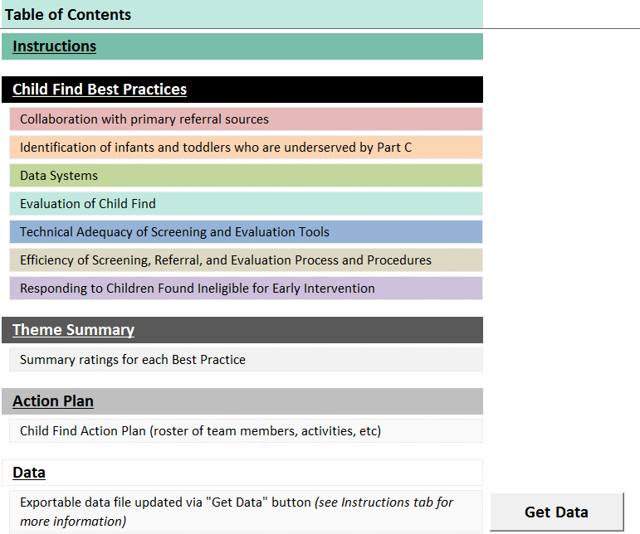
Section II Table of Contents

Slide 22
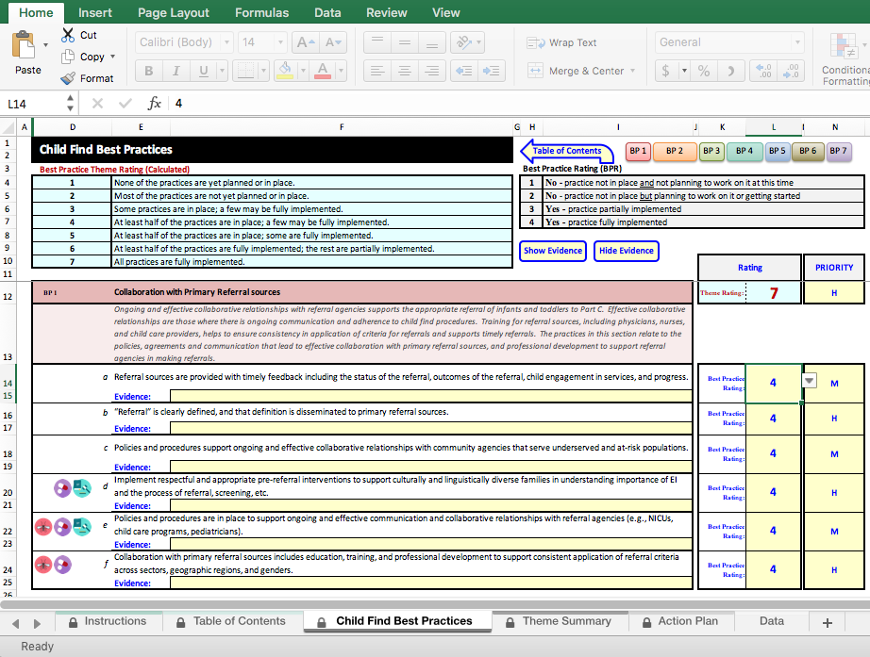
Section II
Notes:
Kathryn
An excel tool
3rd tab is Child Find Best Practices
Note, we are still gathering feedback, so this may change some.
We would like to get your feedback on this section of the tool in particular, so please write down any comments you have on your notecards for us as we walk through the tool.
This is where the real action is; where states rate the best practices
Includes 7 BP “themes”:
Collaboration with primary referral sources
Identification of infants and toddlers who are underserved by Part C
Data systems
Evaluation of child find
Technical adequacy of screening and evaluation tools
Efficiency of screening, referral, and evaluation process and procedures
Responding to children found ineligible for early intervention
All on one worksheet; can use buttons at top to navigate to a particular theme
Each theme includes several best practices; states enter their rating for each BP (1-4) in this column; rating scale at top right

Slide 23

Section II – Best Practice Ratings
No, practice not in place and not planning to work on it at this time
No, practice not in place but planning to work on it or getting started
Yes, practice partially implemented
Yes, practice fully implemented

Slide 24
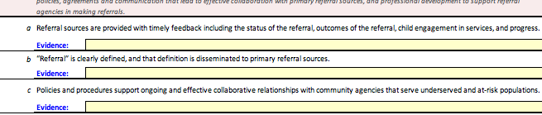
Section II - Evidence
Spaces to provide evidence for each best practice (yellow spaces)

Slide 25
Section II – Theme Ratings
None of the practices are yet planned or in place.
Most of the practices are not yet planned or in place.
Some practices are in place; a few may be fully implemented.
At least half of the practices are in place; a few may be fully implemented.
At least half of the practices are in place; some are fully implemented.
At least half of the practices are fully implemented; the rest are partially implemented.
All practices are fully implemented.

Slide 26
Section II

Slide 27
Section II
Notes:
Kathryn
Can rate the priority of each best practice
- High
- Medium
- Low
Can help states identify which best practice(s) they should focus on in their Child Find efforts
Overall priority level for themes is not automatically calculated

Slide 28
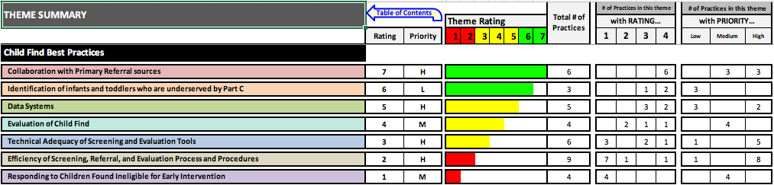
Section II – Theme Summary
Summarizes info for each theme for which all best practices rated
Cannot enter data on this sheet
Colored bars graphically depict theme ratings

Slide 29
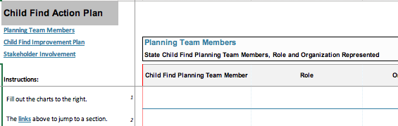
Section II – Action Plan
Space for states to use ratings and priorities to plan next steps
Includes sections for documenting:
  Members of the Child Find planning team
  Child Find improvement plan (e.g., activities, timeline)
  How stakeholders will be involved

Slide 30
Timeline to Release
Making revisions based on external review
Pilot with 3-5 states
Incorporate input from pilot
Anticipate formal release of tool at DEC Conference in October

Slide 31

Questions?

Slide 32
Activity
Best Practice Rating Scale
Color | # | Rating Description
 | 1 | No – practice not in place and not planning to work on it at this time
 | 2 | No – practice not in place but planning to work on it or getting started
 | 3 | Yes – practice partially implemented
 | 4 | Yes – practice fully implemented
Notes:
Kathryn

Slide 33

Child Find TA Resources
Child Find

Slide 34
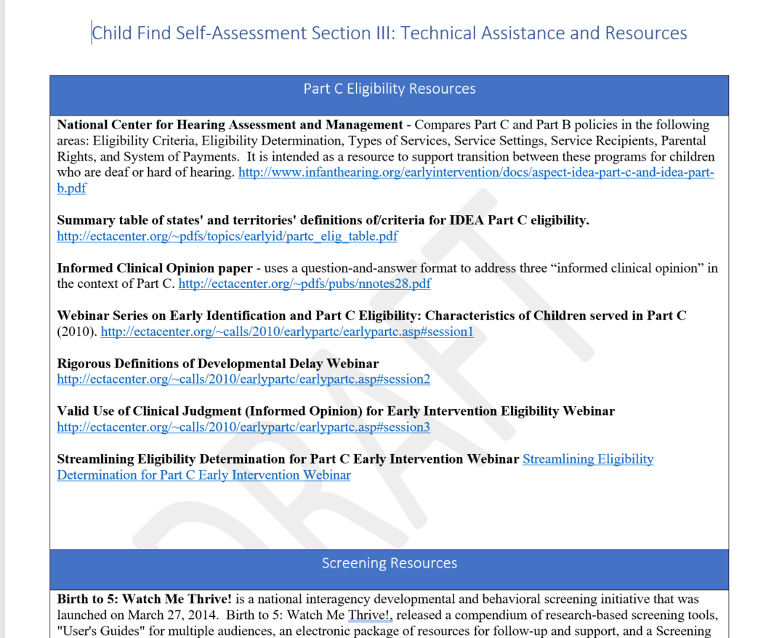
Section III

Slide 35
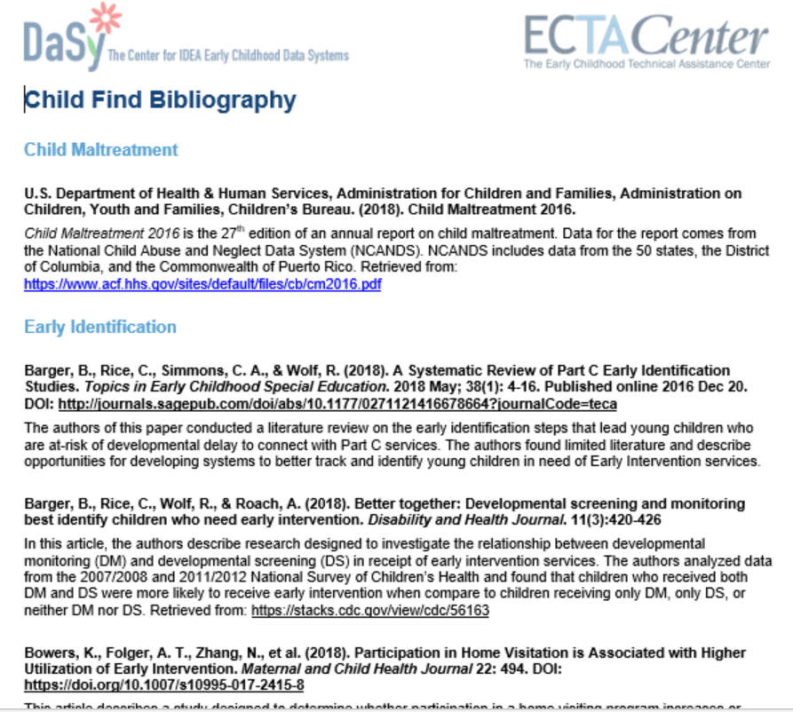
Child Find Bibliography

Slide 36
Identifying Meaningful Difference in Child Find
Excel-based calculator
Allows for comparisons related to the percentage of infants and toddlers served:
  State percentage compared to state target
  Local program percentage compared to state target
  year-to-year comparisons of the state percentages
Computes confidence intervals to determine whether the difference is large enough to be considered meaningful (i.e., statistically significant)
https://dasycenter.org/identify-meaningful-differences-in-child-find/

Slide 37
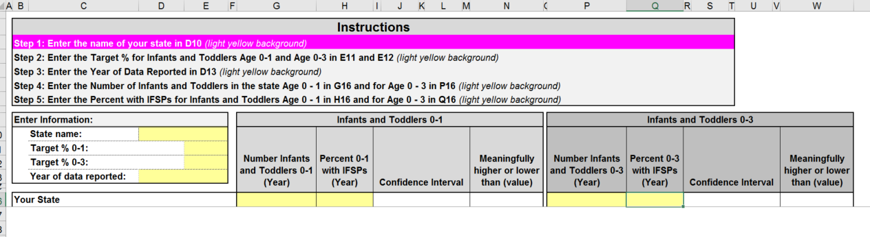
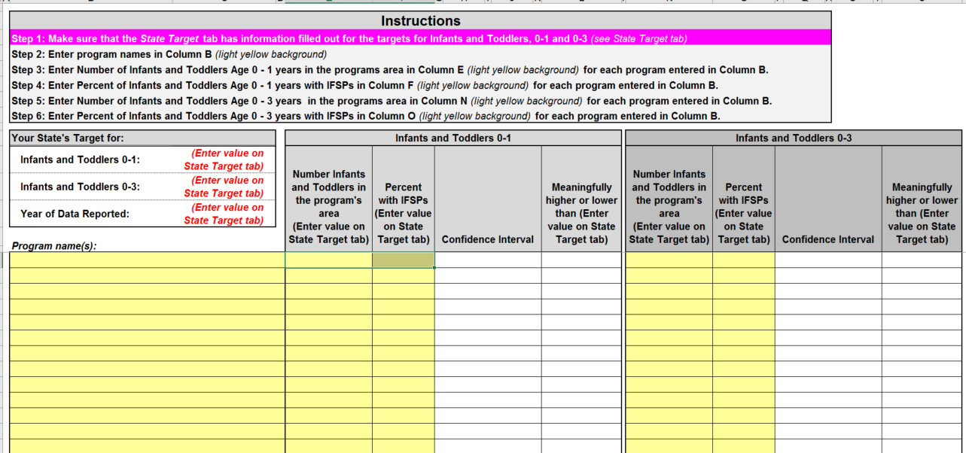
Screenshot of Calculator

Slide 38
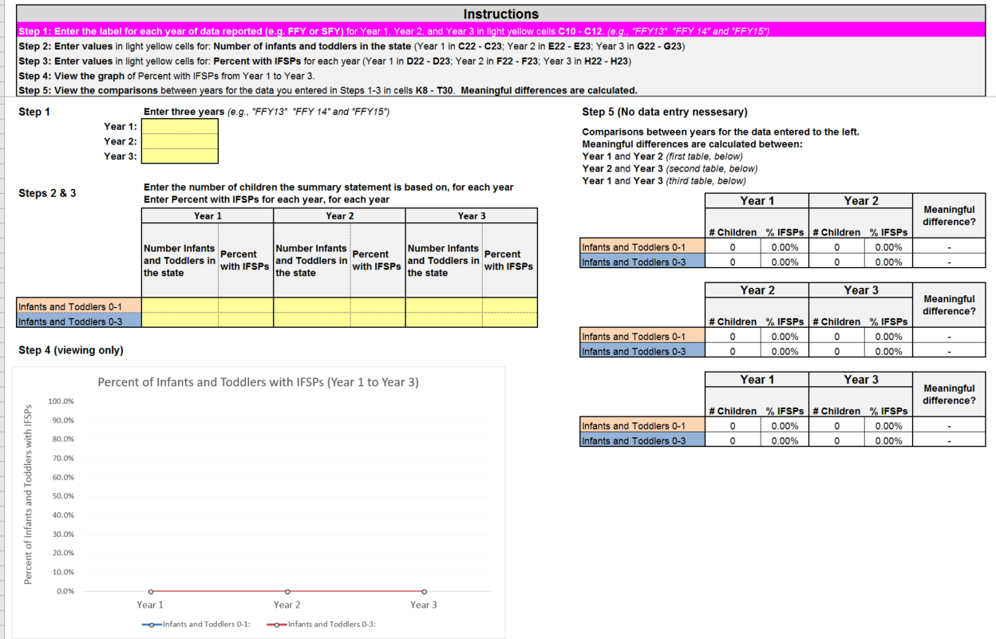
Screenshot of Calculator (continued)

Slide 39
Child Find Data Special Collection
Collection of Federal, TA center, and other resources relevant to collection and analysis of child find data
Coming soon!

Slide 40
Child Find Funnel Diagram Tool
Coming soon!
Excel-based tool
Allows states or local programs to enter data on children in each step of the referral and enrollment process for a referral cohort
Displays a funnel diagram to visually examine where children are dropping out of the process
Can be used to examine opportunities to improve the efficiency of child find efforts

Slide 41
Update (2018) State and Jurisdictional Definitions Infants and Toddlers with Disabilities Under IDEA Part C

Slide 42
Supports for Child Find
618 Data Pre-Submission Edit Check Tools
IDC developed the 618 Data Pre-submission Edit Check Tools for assisting states prepare their Part C data submissions. States can use the tools to identify potential edit check errors or errors in subtotals or totals prior to submitting the data to OSEP.
Back to Basics on Part C Child Find

Slide 43
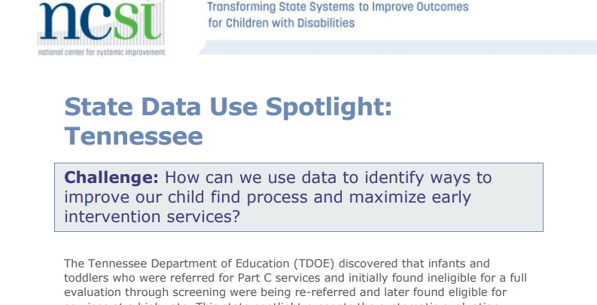
State Data Use Spotlight: Tennessee

Slide 44
Large Group Discussion
What other resources do States need?
What do you need to advocate for additional resources in your State?

Slide 45
Wrap up
Thank you!
If you are interested in participating in the pilot of the Child Find Self-Assessment, please fill out the interest form.
Please complete the evaluation for this session.

Slide 46
Resources
Visit the DaSy website at:
http://dasycenter.org/
Follow DaSy on Twitter:
@DaSyCenter
Visit the ECTA website at:
http://ectacenter.org/
Follow ECTA on Twitter:
@ECTACenter

Slide 47

Thank you
The contents of this tool and guidance were developed under grants from the U.S. Department of Education, #H373Z120002 and #H326P170001. However, those contents do not necessarily represent the policy of the U.S. Department of Education, and you should not assume endorsement by the Federal Government. Project Officers: Meredith Miceli, Richelle Davis, and Julia Martin Eile.

