Slide 1
Data Governance Demystified: Concepts to Reality
Session presented at:
Improving Data, Improving Outcomes Conference, September 2014

Slide 2
Session Presenters/Facilitators
Christy Cronheim, Idaho Department of Health and Welfare
Rick Harris, Idaho Department of Health and Welfare
Maria Synodi, Connecticut Department of Education
DaSy Facilitators- Bruce Bull, Sharon Walsh, and Denise Mauzy

Slide 3

In this session, we will..
Provide an overview of the Governance and Management Subcomponent
Facilitate discussions about
  Topics in the subcomponent
  State panelists’ perspectives
  Group discussion and report out
Discuss ways to use this subcomponent in your state
3

Slide 4
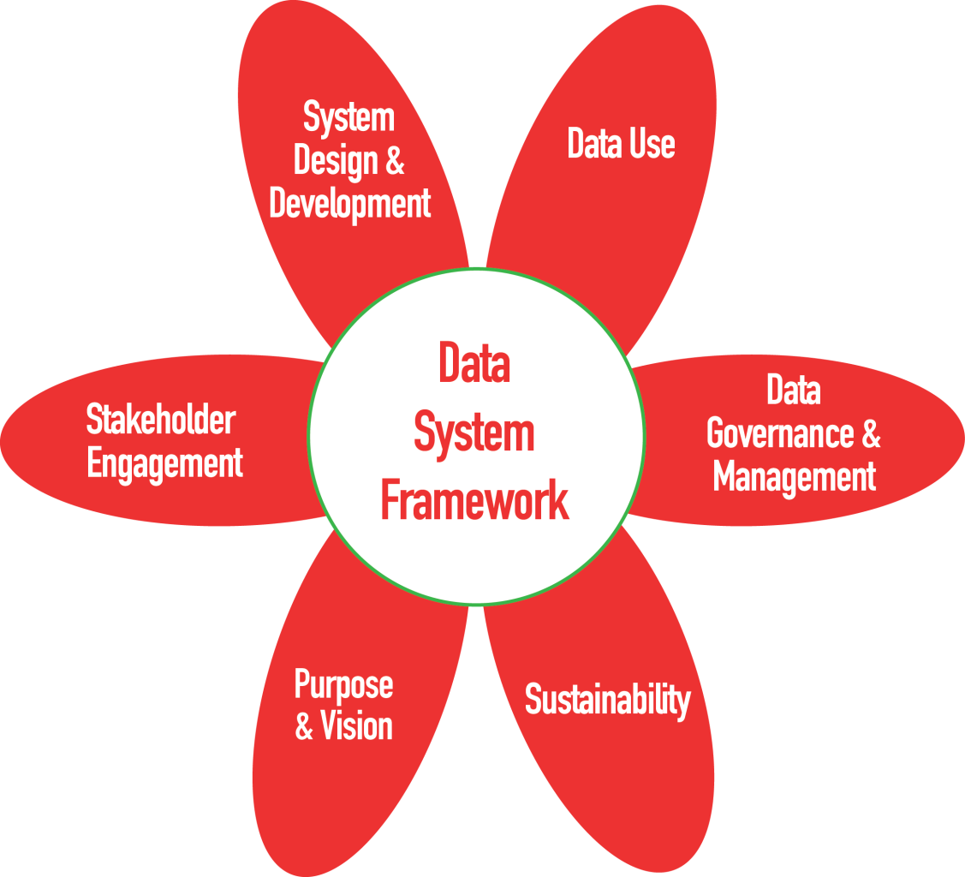
DaSy Framework Subcomponents

Slide 5
Governance and Management
Quality and Integrity
QI = 2
E = 14
Security and Access
QI = 3
E = 22
Authority and Accountability
QI = 3
E = 14

Slide 6
Introduction to Data Governance and Management Subcomponent
Data governance is both an organizational process and a structure.
  establishes responsibility for data
  organizes program staff to collaboratively and continuously improve data quality through the systematic creation and enforcement of policies, roles, responsibilities, and procedures
Management is the systematic development, implementation, and enforcement of procedures to operationalize the quality and security policies of the data system.

Slide 7
Notes and Assumptions
Data governance exists whether formal or informal.
Informal data governance is associated with significant risks.
Formal data governance has significant benefits.
Data governance structures and policies are not static.

Slide 8
Notes and Assumptions (cont’d)
Managing the state data system requires responding to the evolving structures and policies and implementing the associated procedures.
Part C/619 state staff or their representatives should be actively engaged in the governance of their data system.

Slide 9
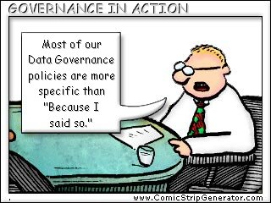
Authority and Accountability

Slide 10
Authority and Accountability Focuses On…
Identification of data governance structure
Identifying decision-making authority and accountability
Authorizing staff or representatives to implement policies and manage the data system

Slide 11
Connecticut:
Existing Data Governance Context
Data Linkages
Data Collection Guides & Trainings
Technical Assistance
Stakeholder Involvement
Governance Body
Notes:
Data Collection Guides & Trainings: 619 program and data staff contribute to writing, reviewing of guides and trainings
Technical Assistance: from 619 program and 619 data staff with collaboration and decision-making occurring between the program and data staff/unit
Stakeholders: Input that informs the data system comes from both 619 program and data staff at the state and local level
Governance: Agency Data Governance Body

Slide 12
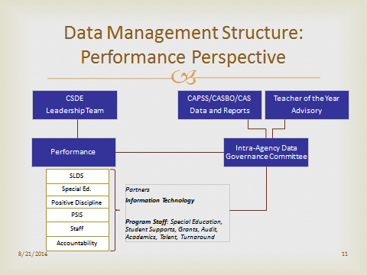
Connecticut Data Governance Structure

Slide 13
Data Governance: Informal and Formal Systems
Multiple Layers of Data Governance
  Formal Data Governance Committee
  Some Decision-Making Regarding Data (e.g., security, access and use) at Other Levels
  Some Policies & Procedures: Program & Data Staff Provide Input
Security and Access to 619 Data
  At Different Levels: Both Program and Data Staff
  Heavy Reliance on FERPA for security & protection of PII
  Training and TA: Provision of & Access to Internal and External Training on Data Submission, Access, Security, Protection, Use
  Addressing Data and Data Linkage Requests
  Memorandum of Agreements (MOAs)

Slide 14
Connecticut: 619 Governance Strengths & Challenges
Daily/weekly interface & collaboration between 619 and data staff is informal and formal (e.g., no written policies & procedures)
  618 Data
  SPP and APR
  Data Requests: within and outside of agency
  Data Linkages: within and outside of agency
Authority & Accountability: review of data collection, draft analysis, edit checks, decision-making, data exchanges, program implications/policy implications
Quality & Integrity: training, TA, quality assurance, data reliability and validity, 619 manager reviews data changes, edits, edit checks, other
Challenge: No formal policies for decision-making and at what level

Slide 15
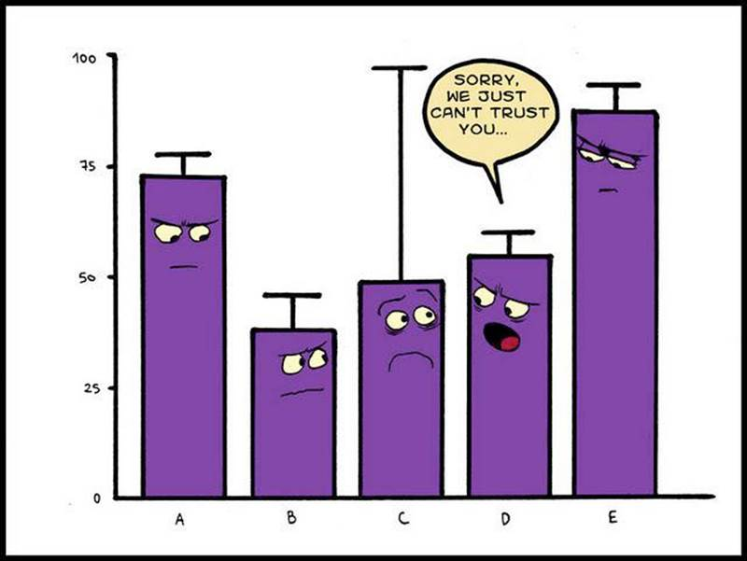
Quality and Integrity
Need graphic or cartoon here

Slide 16
Quality and Integrity Focuses On…
Policies that require implementation of procedures to ensure validity, reliability, accuracy, consistency, and intended use of data
Implementation of training and monitoring procedures to ensure consistent application of data quality and integrity policies and procedures

Slide 17
Quality and Integrity, Idaho Part C
One major goal of our latest data system was to improve the ability to obtain accurate and reliable data
Updates to system design are made as necessary to continue improving the quality and integrity of data
Crystal Report templates are created to help state and local management identify missing and incorrect data

Slide 18
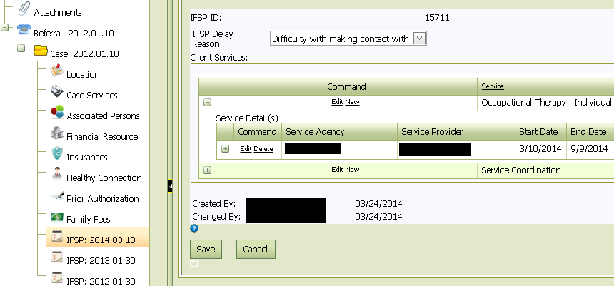
Quality and Integrity, Idaho Part C
Quality and Integrity improved with new system design

Slide 19
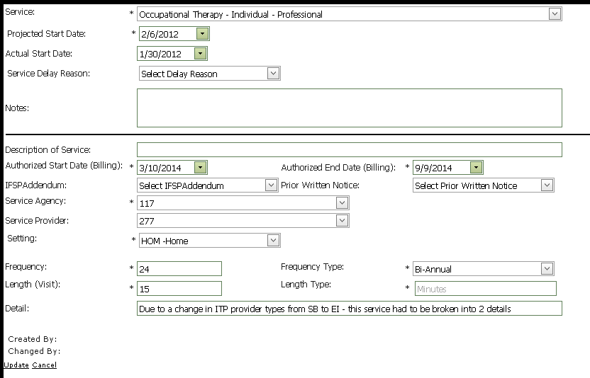
Quality and Integrity, Idaho Part C
Original design led to staff incorrectly changing Projected and Actual Start Dates

Slide 20
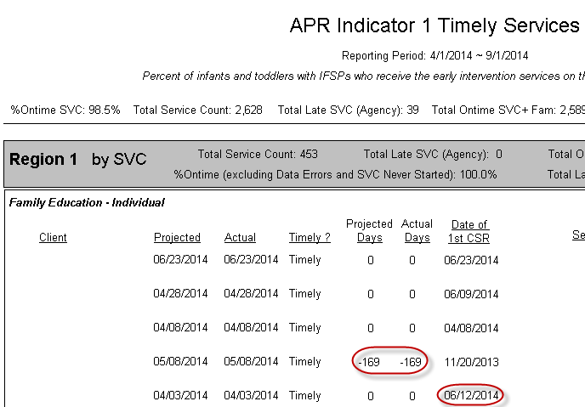
Quality and Integrity, Idaho Part C

Slide 21
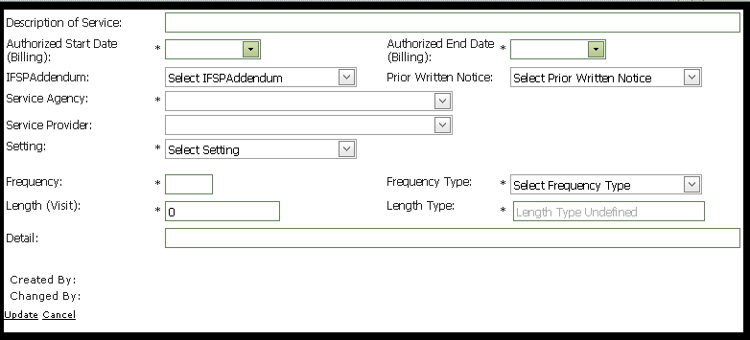
Quality and Integrity, Idaho Part C
New design change will improve timely service data

Slide 22
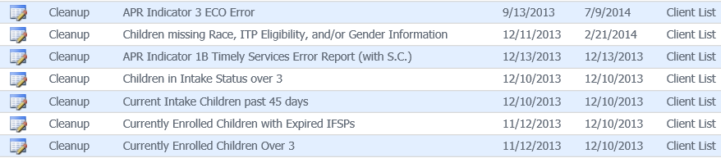
Quality and Integrity, Idaho Part C
Crystal Report Templates that help identify missing and inaccurate data

Slide 23
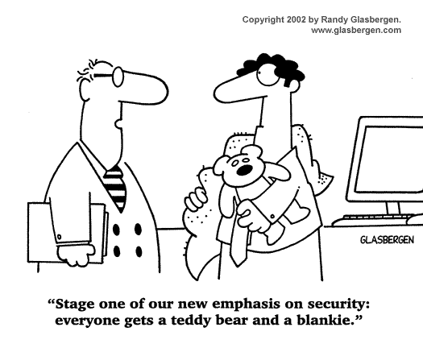
Security and Access

Slide 24
Security vs Access: What’s the Difference?
Security-is your data safe?
Access is allowing those with a need get (only) what they need

Slide 25
Security (Governance)
Polices that support
  People (e.g., training)
  Technical safeguards
  Data sharing

Slide 26
Access (Governance)
Polices that support
  People (e.g., training)
  Systems (applications support appropriate user access)

Slide 27
Management of Security and Access
Practices that support
  Communication (inform, train)
  Monitoring (people, systems)
  Revision as needed

Slide 28
Security and Access, Idaho Part C
All Staff and Contractors must adhere to HIPPA and FERPA when dealing with personally identifiable information in Idaho’s Part C data system
Firewall, Virus, and backup protection
New login standards
  Password must be changed every 90 days
  Auto logoff after 15 minutes of activity
  Standards updated as necessary
When staff or contractors are no longer employed their system access is inactivated.
  Crystal Report that will show inactivity periods of our users

Slide 29
Security and Access, Idaho Part C

Slide 30
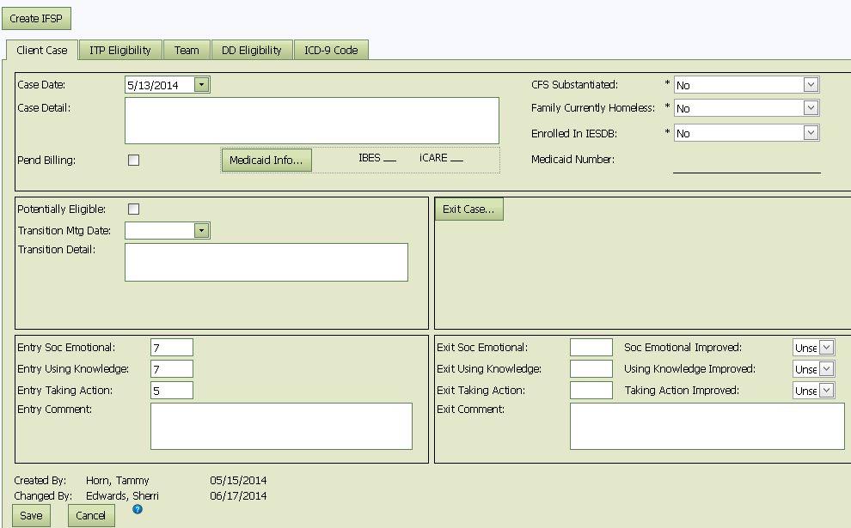
Security and Access, Idaho Part C

Slide 31
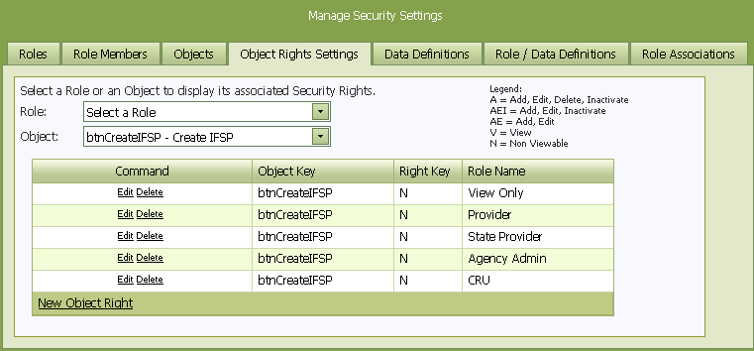
Security and Access, Idaho Part C

Slide 32

Small Group Discussions
Your table has been assigned one of the Quality Indicators to discuss
Review the elements in your
assigned Quality Indicator
Discuss the strengths and
possible challenges of your
state in meeting the elements of quality in your assigned Quality Indicator

Slide 33

Group Report Out
What were some highlights of the discussion at your table?
Were there similar strengths identified?
Were there similar challenges identified?
Which elements of quality received the most discussion?
Were there any surprises in your discussion?

Slide 34

Ways Governance and Management Subcomponent Can Be Used by States
State staff can use the self assessment (coming soon!) to see where the state is with different aspects of data use
The self assessment ratings can be used to identify priority areas for improvements in Data Governance and Management.
The state can use the self-identified priorities to advocate for resources needed for better data use practices.

Slide 35
Connecticut Data Governance
Connecticut’s Next Steps
Connecticut is a DaSy partner state
Focus of Connecticut: Reviewing Data Governance Framework & Components [619 in context of B]
Used the Data Governance Framework in a Survey Monkey to all members of the agency Data Governance Committee
Plan to use the results of survey to prioritize focus of 619 data in the context of the Data Governance Committee and decision-making with regard to 619 data
Result is to formalize policy and decision-making with the 619 program and data staff

Slide 36
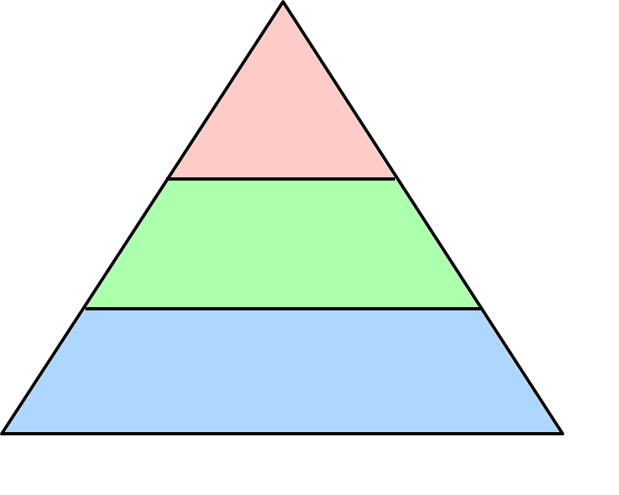

Connecticut: Data Governance Framework for Future Discussion
Executive
Level 3 Decision-Making: Commissioner
Agency Chiefs
Legislature
Data Governance Committee
Level 2 Decision-Making: Adding, Discontinuing, Indicators, Elements, Collections
CAPSS
CASBO
CAS
Data & Program Experts, Other
IT, Data and Program Staff
Level 1 Decision-Making: Validation, Quality Assurance, Training and TA, Edit Checks
LEAs and Other Stakeholders

Slide 37
Idaho Data Governance
Idaho’s Next Steps
Idaho is also a DaSy Partner state
Idaho Part C will use this framework to prioritize any areas that need improvement for data governance.
Document clearly, our data governance policies and standards
Create training materials on how to Manage Security settings
Stay involved with our Department’s current project to align data governance standards for all of Health and Welfare

Slide 38
Large Group Discussion
What are your thoughts on how the Data Governance and Management component can be used in your state?

Slide 39
DaSy Resources
Visit the DaSy website at:
http://dasycenter.org/
Like us on Facebook:
https://www.facebook.com/dasycenter
Follow us on Twitter:
@DaSyCenter

Slide 40



The contents of this presentation were developed under a grant from the U.S. Department of Education, #H373Z120002. However, those contents do not necessarily represent the policy of the U.S. Department of Education, and you should not assume endorsement by the Federal Government. Project Officers, Meredith Miceli and Richelle Davis.

