Slide 1
Privacy Collaboration! The Latest Resources from DaSy, PTAC, and IDC
Baron Rodriguez (PTAC)
Jeff Sellers (IDC)
Jennifer Tschantz (DaSy)
Improve Data, Improving Outcomes Conference
September 2014

Slide 2
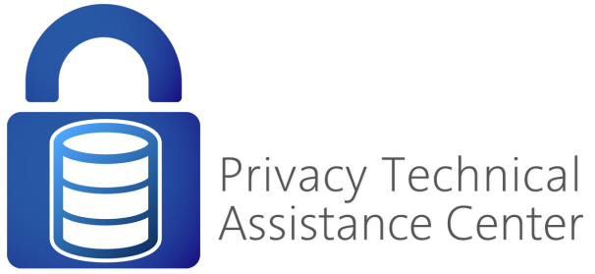
Session Objectives / Agenda
Provide an overview of U.S. Department of Education Technical Assistance (TA) investments related to data privacy
Summarize the coordination across these TA Centers
Highlight new data privacy resources
Share plans for upcoming resources
Gather input on data privacy, confidentiality, security issues and questions to help shape future resources and coordination efforts

Slide 3
ED-funded TA Centers Related to Data Privacy

Slide 4
Federal TA Investments related to Data Privacy
Privacy Technical Assistance Center (PTAC)
Center for the Individuals with Disabilities Education Act (IDEA) Early Childhood Data Systems (DaSy Center)
IDEA Data Center (IDC)

Slide 5
Overview – PTAC @ ED
“One Stop” resource center for all privacy & security questions.
Regional meetings, customized webinars, and on-site presentations
Technical Assistance (TA) site visits
Help desk
Web resources

Slide 6
Web Resources
Web Resources
Issue briefs, and white papers
Training Videos
Security checklists
Frequently Asked Questions
(FAQs)
Webinars, presentations, and training materials

Slide 7
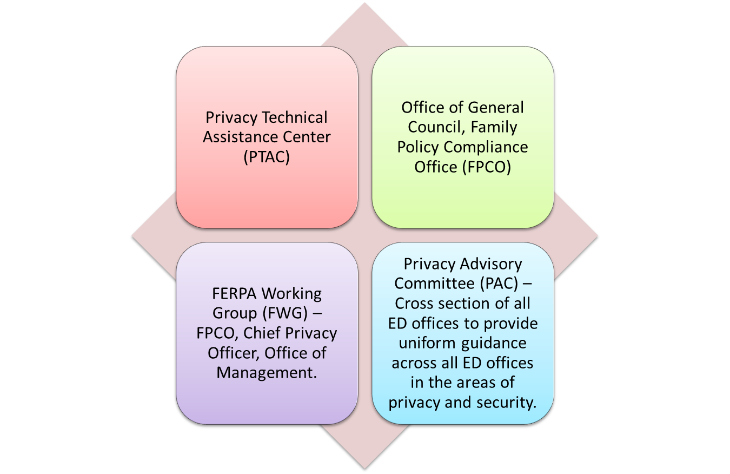
How are PTAC guidance documents/advice vetted at U.S. ED?

Slide 8
Process for your questions to our TA Centers
Request received by FPCO/PTAC/DaSy/IDC
Reviewed by FERPA Working Group [FWG]
Routed for review by best possible expert at ED/TA Centers
FWG=PTAC, OGC, FPCO, CPO, OSERS

Slide 9
DaSy Confidentiality Workgroup - Purpose
Develop resources to assist State Part C and 619 coordinators/programs to address data confidentiality, data sharing, and data privacy questions and issues as they build and use early childhood data systems.

Slide 10
DaSy Confidentiality Workgroup Members
Sharon Walsh
Robin Nelson
Baron Rodriguez
Haidee Bernstein
Danielle Crain
Ann Agnew
Sara Thayer
Jennifer Tschantz
Codie Kane

Slide 11
DaSy Confidentiality Workgroup Goals
Identify State Part C and 619 questions/issues around data confidentiality, sharing, and privacy.
Collaborate with PTAC and other TA Centers to develop and disseminate useful resources for states.
Facilitate getting answers to specific and general questions from States (Part C and 619)
Provide professional development opportunities (often through collaboration) for states, particularly for Part C and 619 folks.

Slide 12
DaSy Confidentiality Workgroup-Activities
Identify state questions and issues
Hosting webinars /topical meetings
Identify and disseminate existing relevant and useful resources
Respond to TA requests
Develop new resources and products
Notes:
Jennifer to update

Slide 13
IDC Confidentiality Workgroup
Kick-off a couple of months ago
Reviewing current resources and materials
Just getting started

Slide 14
Primary Purposes
Define how IDC TA will contribute to the privacy and confidentiality concerns of states.
Coordinate and collaborate with other TA partners, e.g. DaSy, PTAC on state TA needs for IDEA Part C and Part B.
As needed, design and deliver capacity building opportunities for internal IDC staff.
Workgroup members provide TA as a resource for state liaisons to consult and/or engage for privacy and confidentiality issues.

Slide 15
IDC Confidentiality Workgroup Members
Ross Lemke
Jeff Sellers
Danielle Crain
Beth Harrison
Holly Cavender-Wood
Karen Moran Finello
Terry Long
Dave Phillips

Slide 16
Short-term
Provide Professional Development to IDC Staff
Leverage materials that have already been produced
Identify resources and point staff to them

Slide 17
Long-term
Compile experience and lessons learned from IDC staff PD
Develop resources focused on IDC context
Coordination with DaSy & PTAC

Slide 18
IDC-DaSy-PTAC Collaboration
Cross Center staffing:
Baron is both PTAC and DaSy
Ross is both PTAC and IDC
Danielle is on Confidentiality Workgroups for both IDC and DaSy
Monthly check-ins with workgroup facilitators
On-going communication

Slide 19
IDC-DaSy-PTAC Collaboration
Sharing responses to State questions / issues (consistency)
Coordinating the response to individual State questions/issues
Coordinating and sharing the development of new Center-specific resources
Developing joint resources and hosting joint “events”

Slide 20
IDC-DaSy-PTAC Collaboration
If your state has a data privacy related question which TA center do you call?
Any one of our TA Centers!
We will coordinate the response and make sure the most knowledgeable staff respond and/or send it on to the FERPA working group at ED if needed
Notes:
-States can ask questions of IDC or DaSy state Liaison or go directly to a member of one of the confidentiality workgroups or PTAC.

Slide 21
IDC-DaSy-PTAC Collaboration
Thoughts, comments, suggestions on our collaborative efforts?

Slide 22
New Data Privacy Resources

Slide 23
Helpful Resource 1: Transparency
Why it matters to you: Parents want to know what data you are collecting and why you need it. More privacy advocates are raising public alarm bells regarding collection of young children’s data.
What does it address? Best practices as it relates to working with parents and the public regarding child data.
Where can I find it? http://ptac.ed.gov/document/Transparency-Guidance

Slide 24
Helpful Resource 2: FERPA/IDEA Crosswalk
Why it matters to you: This document will help you understand the differences between definitions, protections, and requirements around IDEA Part B & Part C and FERPA.
What does it address? It is intended to help differentiate the statutes and provide comparisons for the shared definitions.
Where can I find it? http://ptac.ed.gov/document/ferpaidea-cross-walk

Slide 25
Helpful Resource 3: FERPA Exceptions Summary
Why it matters to you: The various exceptions to FERPA can be confusing and difficult to keep track of. This gives you a simple two page or large single page “at-a-glance” view of FERPA exceptions.
What does it address? It is intended be a handy visual aid to help look at what FERPA exception applies to the data sharing work you are trying to do.
Where can I find it? http://ptac.ed.gov/document/ferpa-exceptions-summary

Slide 26
Helpful Resource 4: Data Destruction Best Practices
Why it matters to you: Given the large volume of child data collected by providers, it is important to understand responsibilities and best practices in destruction of data no longer needed.
What does it address? It details the life cycle of data and discusses legal requirements of destruction of data destruction under FERPA as well as examples of methods for properly destroying data.
Where can I find it? http://ptac.ed.gov/document/best-practices-data-destruction

Slide 27
Helpful Resource 5: Protecting Student Privacy While Using Online Educational Services
Why it matters to you: If you use personal devices with applications and/or vendors this applies to you.
What does it address? It provides guidance regarding the Department’s expectations for privacy while working with vendors and or “click-wrap” applications.
Where can I find it? http://ptac.ed.gov/sites/default/files/Student%20Privacy%20and%20Online%20Educational%20Services%20%28February%202014%29.pdf

Slide 28
Helpful Resource 6: Disclosure Avoidance FAQ – Adaptation
Why it matters to you: These Q & A relate to aggregate reporting of child data and the requirements/best practices surrounding that data. This latest version has been adapted specifically for Part C & Part B 619.
What does it address? The document provides suggestions on how to ensure that confidentiality requirements are met, including compliance with FERPA.
Where can I find it? http://dasycenter.org/resources/papers.html

Slide 29
Helpful Resource 7: Data De- identification Glossary - Adapted
Why it matters to you: Data de-identification is important to ensure the confidentiality rights of children and families served under IDEA C & 619.
What does it address? The document reviews data de-identification terminology, concepts and approaches and provides general best practice strategies to protect against data disclosures.
Where can I find it? http://dasycenter.org/resources/papers.html

Slide 30
Helpful Resource #8: DaSy’s new Data Privacy and Confidentiality Webpage
Why it matters to you: This webpage includes the data privacy resources IDEA Part C and Part B 619 folks are most interested in.
What does it address? The page includes resources from ED, (FERPA & IDEA regulations, memos, and policy letters) and resources from ED-funded TA Centers on topics such as data sharing, data security & access, and data governance.
Where can I find it? http://dasycenter.org/other_resources/topics/privacy.html

Slide 31
Upcoming Resources

Slide 32
Upcoming PTAC Resources
Contract Terms of Service
Best practices as it relates to contract terms you should have with vendors.
Acceptable Use Policy
Best practices as it relates to what your staff should sign in regard to use of technology
Mapping Data Flows
Provides direction on the process for determining which laws apply to integrated/connected data.

Slide 33
Upcoming DaSy-PTAC Resources
Data Sharing Agreement Checklist (PTAC adaptation)
Data Privacy FAQ - General
HIPAA FAQ
Webinars
FERPA 101 for Part C and 619 (PTAC adaptation)
Intersection of Confidentiality Provisions of FERPA & IDEA Part B & C (PTAC adaptation)
Disclosure Avoidance and Limiting Access to PII for Part C & 619

Slide 34
Possible DaSy-PTAC-IDC Workshop
Based on 2 previous regional workshops focused on Early Childhood and data privacy/security/sharing
Bring together 5-8 state teams consisting of key early childhood state staff (including Part C and 619 folks)
Discuss . . .

Slide 35
Additional Discussion & Input

Slide 36
Thoughts for Discussion
What challenges do states face related to data sharing and privacy?
What solutions and resources have you found helpful?
What areas would be helpful to focus on for collaborative TA?
What issues need clarification?

Slide 38
Contact Information
Telephone: (650) 859-3881
Email: dasycenter@sri.com
Website: http://dasycenter.org
Telephone: (855) 249-3072
Email: privacyTA@ed.gov
Website: http://ptac.ed.gov
Telephone: (888) 819-7024
Email: ideadata@westat.com
Website: https://www.ideadata.org/

Slide 39
The contents of this presentation were developed under a grant from the U.S. Department of Education, #H373Z120002. However, those contents do not necessarily represent the policy of the U.S. Department of Education, and you should not assume endorsement by the Federal Government. Project Officers, Meredith Miceli and Richelle Davis.

