Slide 1
Digging into “Data Use” Using the DaSy Framework Subcomponent
Improving Data, Improving Outcomes Conference, September 2014

Slide 2

Session Presenters/Facilitators
Jim Coyle, Pennsylvania Office of Child Development and Early Learning
Jan Stevenson, Georgia Department of Education
Denise Mauzy, DaSy
Donna Spiker, DaSy
2

Slide 3

In This Session, We Will..
Provide an overview of the Data Use Subcomponent
Facilitate discussions about
  Topics in the subcomponent
  State panelists’ perspectives
  Group discussion and report out
Discuss ways to use this subcomponent in your state
3

Slide 4
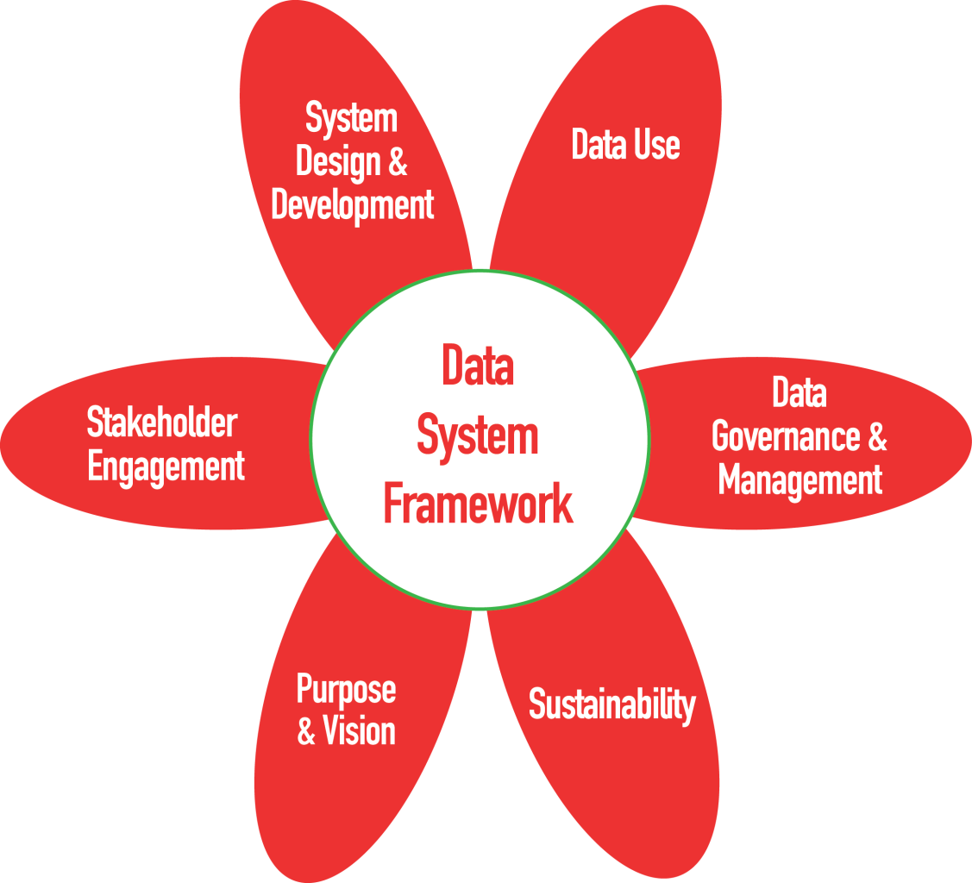
DaSy Framework Subcomponents

Slide 5
Data Use
Sections = 3
(QI = 6, E = 28)
Analyzing and Disseminating for Data Use
QI = 3
E = 13
Using Data and Promoting Capacity for Data Use
QI = 2
E = 9
Planning for Data Use
QI = 1
E = 6

Slide 6
Introduction to Data Use Subcomponent: The Power of Data
Effective use of Part C/619 data is fundamental to the achievement of positive outcomes for children and families.
To support the achievement of positive outcomes, Part C/619 state staff need the knowledge and skills to formulate critical questions about the services provided in the state and the outcomes experienced, and use their data to answer these questions.
The purpose of the Data Use subcomponent is to assist state leaders in facilitating ongoing use of quality Part C/619 data for program accountability, program improvement, and program operations at state and local levels.

Slide 7
Notes and Assumptions
The goal is effective widespread use of Part C and 619 data for program goals/evaluation/outcomes/results at all levels of the system.
Data use elements include both minimum and aspirational data use practices.
Data use reflects the
  Ongoing and cyclical nature of planning
  Analysis/preparation/delivery/dissemination of data and data products
  User supports to assist staff to access, understand, and use data

Slide 8
Notes and Assumptions (cont’d)
Acknowledges that users can be very broad and addresses users who are external (e.g., legislature, public) and internal at both the state and the local level
Assumes that all data use will comply with data governance policies and requirements and with careful attention to the protection of personally identifiable information.
Addresses procedures related to ensuring data quality during the analysis processes, while recognizing that data quality is embedded throughout the entire DaSy framework
Acknowledges that Part C and 619 should work collaboratively in data use

Slide 9
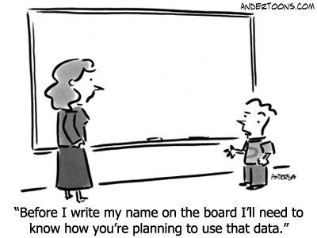
Planning for Data Use

Slide 10
Planning for Data Use Focuses On…
The planning that should occur related to
  Data analysis
  Development of data products
  Dissemination or data products
Addressing users’ needs, intended messages, and expectations for use

Slide 11
Our Discussion Questions: Planning for Data Use
Do you know enough about your users needs to plan effectively? (DU1b)
How do you plan for dissemination of data and data products? (DU1e)
  How do you review and revise dissemination plans? (DU1f)

Slide 12
State Perspective: Pennsylvania
Understanding and engaging our users:
  Stakeholders who consume the data
  Early interventionists who both create and consume data
Robust, comprehensive data system
  Serves local and state needs
  Central to the early intervention process
  Yields child, program and state level information
Data sharing
  Within early intervention
  The broader community

Slide 13
State Perspective: Georgia
Do you know enough about your users needs to plan effectively? (DU1b)
  We engage our stakeholders (state and local) to assess their needs.
  We analyze reported data to assist us in determining needs of users.
How do you plan for dissemination of data and data products? (DU1e)
  Various GaDOE Staff (Data manager, director, 619, CIO, communication, etc…)
  Ways we disseminate: piloting, public reporting, webinars, documents, public announcements, etc.

Slide 14

Large Group Discussion: Planning for Data Use
Do you know enough about your users needs to plan effectively? (DU1b)
How do you plan for dissemination of data and data products? (DU1e)
  How do you review and revise dissemination plans? (DU1f)

Slide 15

Analyzing and Disseminating for
Data Use

Slide 16
Analyzing and Disseminating for Data Use Focuses On…..
Analyzing data, including procedures to ensure integrity of the data
Preparing products to promote understanding and inform decision making
Disseminating data products to a variety of audiences to meet their needs

Slide 17
Our Small Group Discussion Questions
How is your state doing in analyzing and disseminating data to maximize its use?
  Analyzing data and ensuring integrity of data (DU2)
  Preparing products to promote understanding and inform decision making (DU3)
  Disseminating data products to a variety of users (DU4)

Slide 18
State Perspective: Pennsylvania
Embedding data analysis in verification and other activities to insure compliance with state and federal requirements. (DU2a)
Responding to data requests appropriately
  Routine needs from within early intervention community
  Reports for general stakeholder information
  Internal requests to examine trends and issues (DU2b)

Slide 19
State Perspective: Georgia
Preparing products to promote understanding and inform decision making (DU3) APR Indicator B6 (Preschool L.R.E.)
Positives:
  Environment Guideline Document
  Environment Calculator
  Environment Decision Making Flowchart
Growth Opportunities via the Framework:
  Build Capacity in LEA
  Help LEA to establish usage guidelines for system improvement
  Help LEA to examine quality of data for usage

Slide 20
Small Group Discussion Questions
How is your state doing in analyzing and disseminating data to maximize its use?
  Analyzing data and ensuring integrity of data (DU2)
  Preparing products to promote understanding and inform decision making (DU3)
  Disseminating data products to a variety of users (DU4)

Slide 21

Report Out → Two Highlights

Slide 22
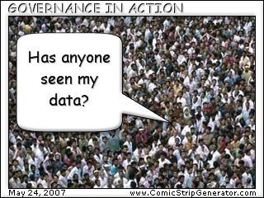
Using Data and Promoting Capacity for Data Use

Slide 23

Using Data and Promoting Capacity for Data Use Focuses On ….
Using data to inform decisions
Supporting regular use of data at state and local levels

Slide 24

Our Small Group Discussion Questions
How is your state doing in using data at the state level for making decisions/improving programs? (DU5)
What about at the local level? (DU5)

Slide 25
State Perspective: Pennsylvania
Variety of ways to engage PA data (DU3a):
  Child or early interventionist level
  Reports available through the system at local and state level
  Dashboards
  Annual reports
Documentation of source and nature of data
  Data governance
  Transparency in data products
  Use of terminology

Slide 26
State Perspective: Georgia
OSEP Indicator B7 (Preschool Outcomes)
  TA to LEA
  Professional Development (Statewide)
  State Projects/Grants
Framework
State
  Who are the users and what are their needs
Local
  Use of data for program improvement/student performance

Slide 27
Small Group Discussion
How is your state doing in using data at the state level for making decisions/improving programs? (DU5)
What about at the local level? (DU5)

Slide 28
Report Out → Two Highlights

Slide 29

Ways Data Use Subcomponent Can Be Used By States
State staff can use the self assessment to see where the state is with different aspects of data use (coming soon!).
The self assessment ratings can be used to identify priority areas for improvements in data use and monitor changes over time.
The state can use the self-identified priorities to advocate for resources needed for better data use practices.

Slide 30

DaSy Center Website
Visit the DaSy website at:
http://dasycenter.org/
Like us on Facebook:
https://www.facebook.com/dasycenter
Follow us on Twitter:
@DaSyCenter

Slide 31



The contents of this presentation were developed under a grant from the U.S. Department of Education, #H373Z120002. However, those contents do not necessarily represent the policy of the U.S. Department of Education, and you should not assume endorsement by the Federal Government. Project Officers, Meredith Miceli and Richelle Davis.

