Slide 1



Data, Now What?
Skills for Analyzing and Interpreting Data
Abby Winer
Christina Kasprzak
Kathleen Hebbeler
Division for Early Childhood Annual Conference
October 2014

Slide 2
Desired Outcomes
Opportunity to practice forming good data analysis questions
Opportunity to examine and discuss different ways of analyzing aggregate data for program improvement
Opportunity to discuss and interpret data to drive program improvement
  Program characteristics
  Child characteristics

Slide 3
Child Outcomes
States are required to report on the percent of infants and toddlers with Individualized Family Service Plans (IFSPs) or preschool children with Individualized Education Plans (IEPs) who demonstrate improved:
  Positive social-emotional skills (including social relationships);
  Acquisition and use of knowledge and skills (including early language/communication [and early literacy]); and
  Use of appropriate behaviors to meet their needs.

Slide 4
Progress Categories
Percentage of children who:
  did not improve functioning.
  improved functioning but not sufficient to move nearer to functioning comparable to same aged peers.
  improved functioning to a level nearer to same aged peers but did not reach it.
  improved functioning to reach a level comparable to same aged peers.
  maintained functioning at a level comparable to same aged peers.

Slide 5
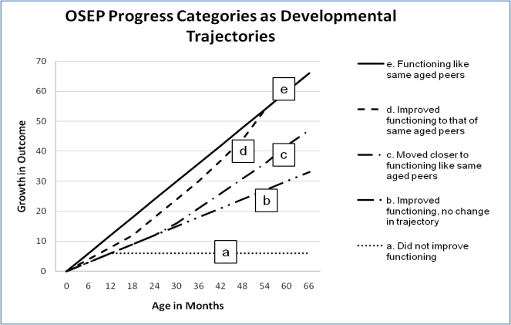
Notes:
Developmental science has provided information about the skills children master at different ages. Knowing what is expected for each age allows us to identify children who are developing too slowly. Children who are substantially behind their peers are described as having a developmental delay. The solid line on this graph (line e) illustrates typical development. All the other lines represent some kind of delay in the early years.
If Angela is 12 months old with the skills of a 6 month old, without intervention it is likely that she will continue to grow at the same rate, and have the skills of 9 month old at 18 months of age. We provide intervention services because Angela is acquiring skills at about half the rate she should be and will continue to fall farther behind. This pattern of growth is illustrated in the b line in the graph. The purpose of intervening is to improve the child’s rate of skill acquisition. The c and d lines illustrate children whose growth was greater than expected because their growth rate with intervention was greater than their growth rate before intervention.
The percentages of children showing greater than expected growth and exiting within age expectations are computed from these five percentages.

Slide 6
Summary Statements
For OSEP states are required to report on two summary statements for each of the three child outcomes:
  Summary Statement 1 : Of those children who entered the program below age expectations in each Outcome, the percent who substantially increased their rate of growth by the time they exited the program.
(c+d)/(a+b+c+d)
  Summary Statement 2 : The percent of children who were functioning within age expectations in each Outcome by the time they exited the program.
(d+e)/(a+b+c+d+e)
Notes:
The progress categories are then used to compute two summary statements that state’s report annually to OSEP to summarize the results for children receiving EI or ECSE services in their state who exited in that fiscal year

Slide 7
Value of Child Outcomes Data
Federal government is driving force behind child outcomes data collection
But there are many reasons to collect and use the child outcomes data:
  Examine program effectiveness
  Use data for program improvement
  Ultimately, to better serve children and families
Notes:
Although the federal government is the driving forces behind the movement to collect child outcomes data, it is not the only reason to collect and use it
Data on outcomes are important for state and local purposes as well including:
- To examine program effectiveness
- to improve programs by identifying strengths and weaknesses and decide where to allocate support resources such as TA and training
And ultimately, to better serve children and families and fulfill the vision of early intervention programs:

Slide 8

Evidence
Inference
Action
8

Slide 9

Evidence
Evidence refers to the numbers, such as
  “45% of children in category b”
The numbers are not debatable
9

Slide 10
Inference
How do you interpret the #s?
What can you conclude from the #s?
Does evidence mean good news? Bad news? News we can’t interpret?
To reach an inference, sometimes we analyze data in other ways (ask for more evidence)
10

Slide 11

Inference
Inference is debatable -- even reasonable people can reach different conclusions
Stakeholders can help with putting meaning on the numbers
Early on, the inference may be more a question of the quality of the data
11

Slide 12
Action
Given the inference from the numbers, what should be done?
Recommendations or action steps
Action can be debatable – and often is
Another role for stakeholders
Again, early on the action might have to do with improving the quality of the data
12

Slide 13
Topic 1: Forming Good Questions

Slide 14

Starting with a question (or two..)
All analyses are driven by questions
Questions come from different sources
Different versions of the same question are necessary and appropriate for different audiences.
What are your crucial policy and programmatic questions?

Slide 15
Defining Data Analysis Questions
What are your crucial policy and programmatic questions?
Example:
1. Does our program/district serve some children more effectively than others?
  Do children with different racial/ethnic backgrounds have similar outcomes?

Slide 16
Question sources
Internal – State administrators, staff
External –
The governor, the legislature
Advocates
Families of children with disabilities
General public
OSEP
External sources may not have a clear sense of what they want to know

Slide 17
Sample basic questions
Who is being served?
What services are provided?
How much services is provided?
Which professionals provide services?
What is the quality of the services provided?
What outcomes do children achieve?

Slide 18
Sample questions that cut across components
How do outcomes relate to services?
Who receives which services?
Who receives the most services?
Which services are high quality?
Which children receive high cost services?

Slide 19
Making comparisons
How do outcomes for 2013 compare to outcomes for 2014?
In which districts are children experiencing the best outcomes?
Which children have the best outcomes?
How do children who receive speech therapy compare to those who do not?

Slide 20
Making comparisons
Disability groups
Region/school district
Program type
Family income
Age
Length of time in program
Comparing Group 1 to Group 2 to Group 3, etc.

Slide 21
Question precision
A research question is completely precise when the data elements and the analyses have been specified.
Are programs serving young children with disabilities effective?
(question 1)

Slide 22
Question precision
Of the children who exited the program between July 1, 2012 and June 30, 2013 and had been in program at least 6 months and were not typically developing in outcome 1, what percentage gained at least one score point between entry and exit score on outcome 1?
(question 2)

Slide 23

Finding the right level of precision
Who is the audience?
What is the purpose?
Different levels of precision for different purposes
BUT THEY CAN BE VERSIONS OF THE SAME QUESTION

Slide 24
Activity 1, Part I & II
Starting with a Question
I: Forming Good Data Analysis Questions
II: Generating Questions

Slide 25
Topic 2: Looking at Data

Slide 26
Different “Levels” of Looking at Data
Individual data
  Individual child
  Individual classroom
  Individual program/district
Aggregate data
  Combining data across individual children, classrooms or districts
  Summary statistics/values

Slide 27
Why do we need to look at aggregate data?
Volume of data and information available is not easy to make conclusions
Aggregating helps to make comparisons
  What kind of characteristics for children or programs are actually linked with better outcomes?
  How do we group information about children or programs in order to make comparisons?

Slide 28
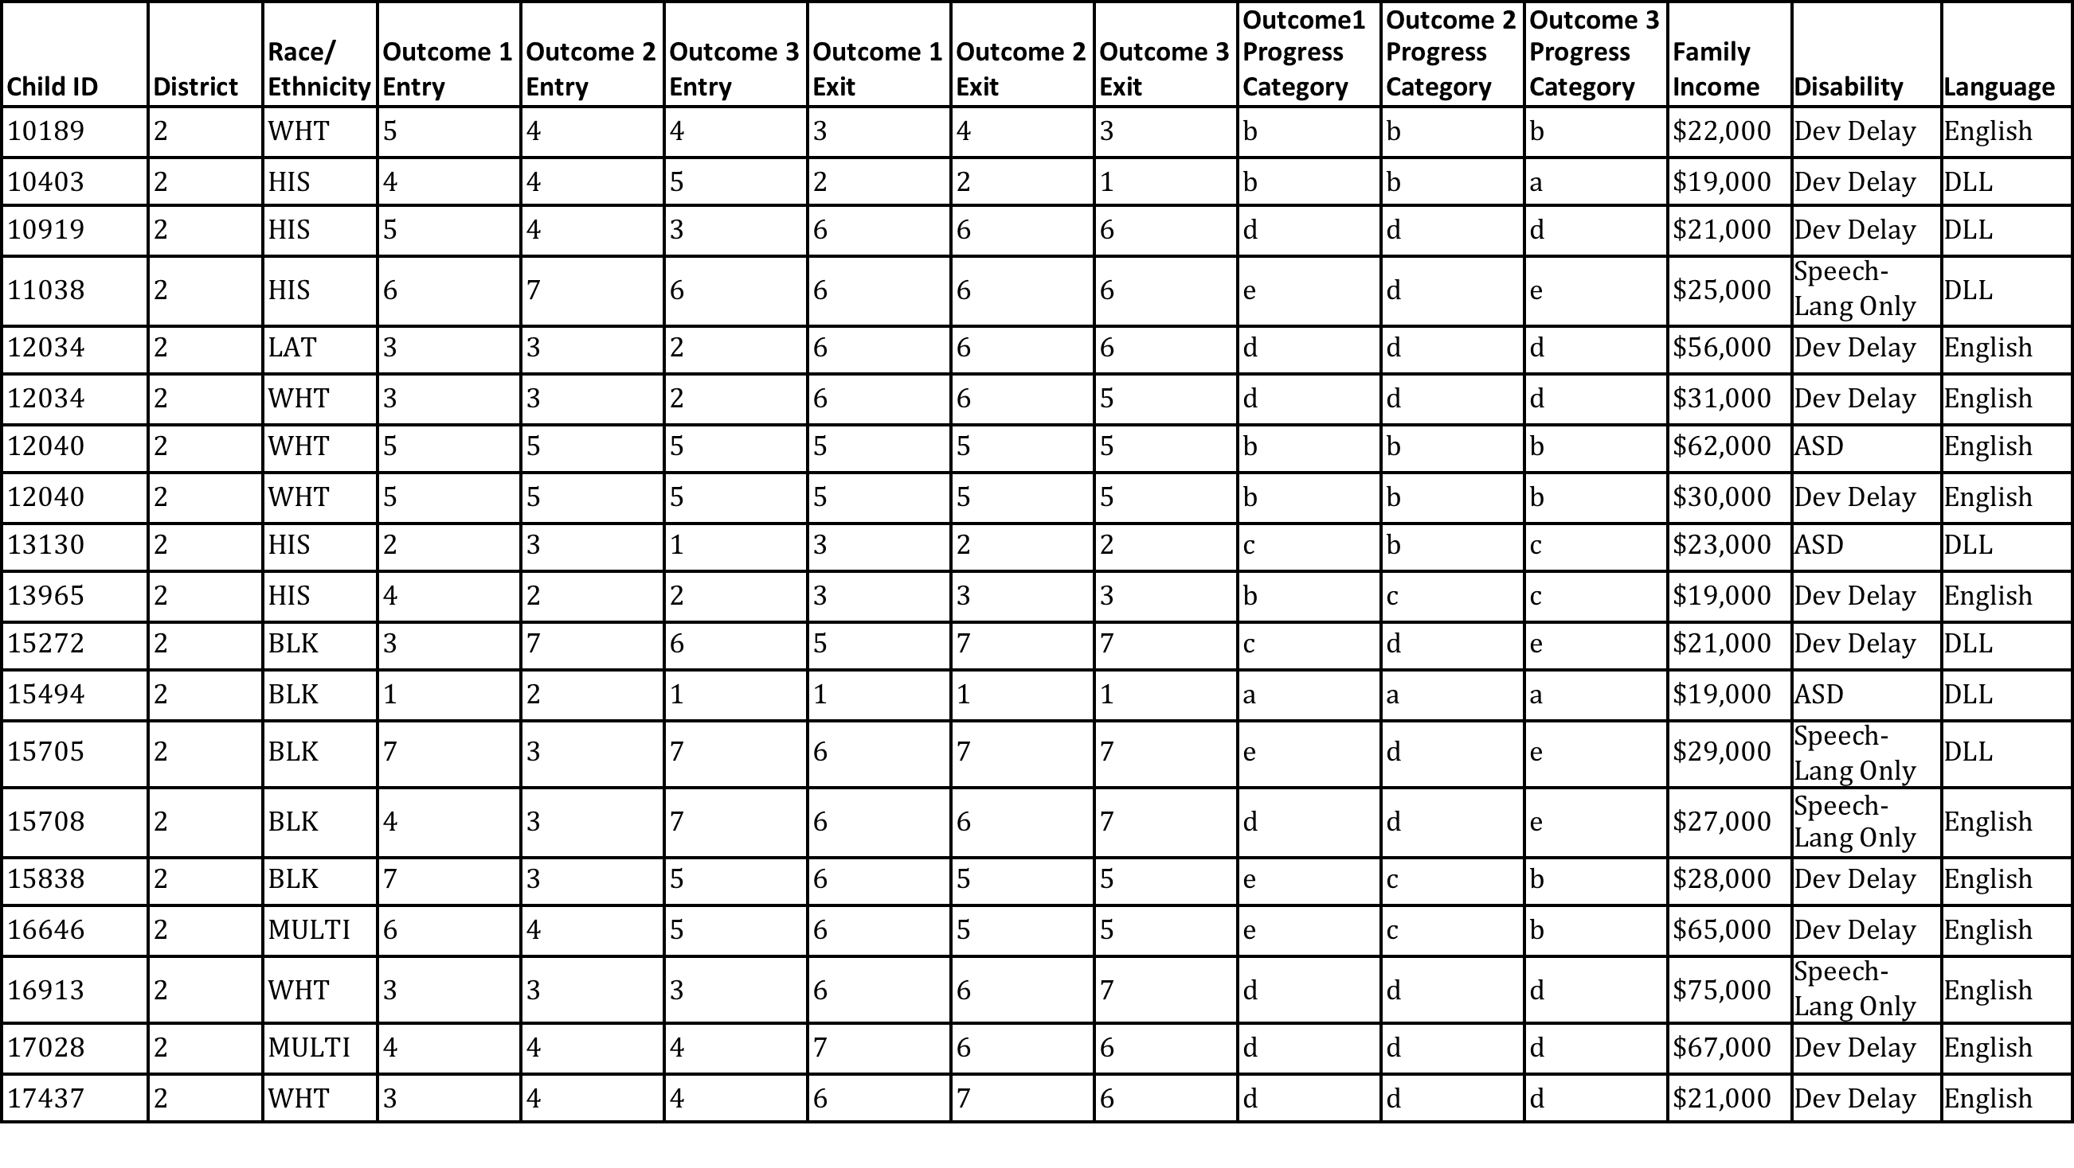
Individual Child Outcomes Data for District 2

Slide 29

Activity – 2
Looking at Data

Slide 30
Comparing District Characteristics

Slide 31
Which Districts Have Better Outcomes?
What do we mean by “which”?
  Subgroups!
What subgroups to consider?
  What factors differ across some districts
  How are districts different from one another?

Slide 32
Linking Different Pieces of Information
What information do you have available about district characteristics?
  Is it already captured in a data system or report?
  Is it collected systematically?
  What about qualitative information?

Slide 33
Activity – 3
Comparing District Characteristics

Slide 34
Comparing Child/Family Characteristics

Slide 35
Planning for Follow-up Analyses
Analysis planning
  Asking a question – what else do you want to know?
  Generating hypotheses
  Identifying data sources, including comparisons (what groups to compare, how to put together groups)

Slide 36
Which Children Have Better Outcomes than Others?
What do we mean by “which”?
  Subgroups!
What subgroups to consider?
  What factors differ for children within or across classrooms/districts/regions?
  How are children/families different from one another?

Slide 37
Linking Different Pieces of Information
What information do you have available about child/family characteristics?
  Is it already captured in a data system or report?
  Is it collected systematically?
  What about qualitative information?

Slide 38
Activity – 4
Comparing Child/Family Characteristics

Slide 39
Sharing Your Results
Communicate your analysis in a way that is appropriate for your audience
    Who are you communicating with?
    What is the key information that they need to know?
    When do they need the information?
    What other types of information do they need to help them understand the data?
Think about the different ways you want to visualize present the data

Slide 40

Thank You!
45

