Slide 1
Preventing Data Analysis Paralysis: Strategic Data Analysis Using Data Analysis Plans
Jean Shimer and Patti Fougere, MA Part C
Karen Walker, WA Part C
Karie Taylor, AZ Part C
Abby Winer, DaSy, ECTA
Tony Ruggiero, DaSy, IDC
2014 Improving Data, Improving Outcomes Conference
September 9, 2014

Slide 2
Data Analysis & Technical Assistance
Needs Assessment Survey (2013) conducted by DaSy found that:
For a majority of states, data use (e.g., analyzing data and using data for program improvement) is the most frequent priority area for Part C and Part B 619
More than half of Part C and Part B 619 programs want TA in this area
Derrington, T., Spiker, D., Hebbeler, K., & Diefendorf, M. (2013). IDEA Part C and Part B 619 state data systems: Current status and future priorities. Menlo Park, CA: SRI International.

Slide 3
Session Goals
Provide overview of SSIP
Inform participants of the data analysis plan
Describe the purpose and content of the data analysis plan
Learn from states how they are using the data analysis plan to guide their SSIP work

Slide 4
State Systemic Improvement Plan
What is the SSIP?
Multi-year, achievable plan that:
Increases capacity of EIS programs/LEAs to implement, scale up, and sustain evidence-based practices
Improves outcomes for children with disabilities (and their families)

Slide 5
Why SSIP? Why Now?
For over 30 years, there has been a strong focus on regulatory compliance based on the IDEA and Federal regulations for early intervention and special education
OSEP
States
Districts/Programs
As a result, compliance has improved!

Slide 6
Why SSIP? Why Now?

Slide 7
Why SSIP? Why Now?
Despite this focus on compliance, states are not seeing improved results for children and youth with disabilities:
Young children are not coming to Kindergarten prepared to learn
In many locations, a significant achievement gap exists between students with disabilities and their general education peers
Students are dropping out of school
Many students who do graduate with a regular education diploma are not college and career ready
Michael Yudin,
Assistant Secretary for Special Education and Rehabilitative Services

Slide 8
Phase I – Starting Point
Potentially starting with:
An issue
An initiative
Child or Family Outcomes Data
Notes:
There three SSIP phases but for this presentation focused on Phase I.

Slide 9
Phase I – Data Analysis
Analyze key data (SPP/APR, 618, other data) including:
Review of disaggregated data
Identification of data quality issues
Identification of how data quality issues will be addressed
Identification of compliance issues that are barriers

Slide 10
Phase I – Infrastructure Analysis
Determine current system capacity to:
Support improvement
Build capacity in LEAs/EIS programs and providers to implement, scale up, and sustain evidence-based practices to improve results

Slide 11
Phase I – Focus for Improvement/Measureable Results
Select focus for improvement
“What identified area, which when implemented or resolved, has the potential to generate the highest leverage for improving outcomes/results for children with disabilities?”

Slide 12
Where to Begin?

Slide 13
Data Analysis for the SSIP
Broad data analysis
Examine exiting data across potential SiMRs
Consider results along with infrastructure analysis to determine results to focus on
In-depth analysis
Plan additional analyses to limit the breadth of the SSIP data analysis efforts and drill down into relevant findings from broad analysis

Slide 14
Questions to Think Through
Does the state have concerns about data quality that limit the state’s ability to interpret the data?
What factors might be related to performance on the child or family outcome?
Child, family, provider, program?
Where are there changes over time in the identified factors that might be related to state performance?

Slide 15
Questions to Think Through
What data are available in the state data system to answer questions about any of the hypothesized relationships?
What information is already known about the identified factors?
Would additional information about the factors potentially identify root causes that could be addressed?
What are you hypotheses about what is driving differences?

Slide 16
Summarize Findings
The questions/problem statements addressed,
Hypotheses about questions/problem statements,
Analysis and results generated to address the question/problem statement
Possible root causes that suggested by the analysis
For additional ideas, see http://ectacenter.org/eco/assets/pdfs/AnalyzingChildOutcomesData-GuidanceTable.pdf

Slide 17
Essential Elements of a Data Analysis Plan
Purpose of the analysis
Description of the general topic of analysis
Details for the analysis that specify:
What – topic to be analyzed
Why – hypotheses or rationale
How – specific variables, types and order of analyses
Documentation of decisions and findings

Slide 18
State Examples

Slide 19
Early Support for
Infants and Toddlers
Washington State Systemic Improvement Data Plan (SSIP)
Karen Walker
Program Administrator
September 8, 2014

Slide 20
Background and Need for a Plan
Washington’s Early Intervention System
The Early Support Program’s data and case management system (DMS) is the single most important unifying structure in our system
289 Service Coordinators
2044 DMS users
DMS training is available

Slide 21
Background and Need for a Plan
Washington’s DMS Data
Child-level data is accessible
Some data reports are “canned” (Compliance Report)
Any DMS data element can be aggregated into an ad hoc data report
35 COS data report templates
Issue – deciding on the data to be taken from the system can be overwhelming

Slide 22
Planning the Data Path
Introduced Results Driven Accountability to our SICC in October 2013 and then at each subsequent meetings
Started planning by asking for help from WRRC and ECTA staff
January 2014 convened a two-day SSIP planning meeting with WRRC , DaSy and ECTA staff at the state office (Anne Lucas, Megan Vinh, Cornelia Taylor)

Slide 23
Initial SSIP Planning Focus
Reviewed national progress data
Considered how our child outcome data compared to national data
Considered how our child outcome data compared to other states with similar eligibility criteria

Slide 24
Initial SSIP Planning Focus
Considered how child outcome data differed across the three outcome areas
Social emotional skills/social relationships
Acquisition of knowledge and skills
Taking actions to meet needs

Slide 25
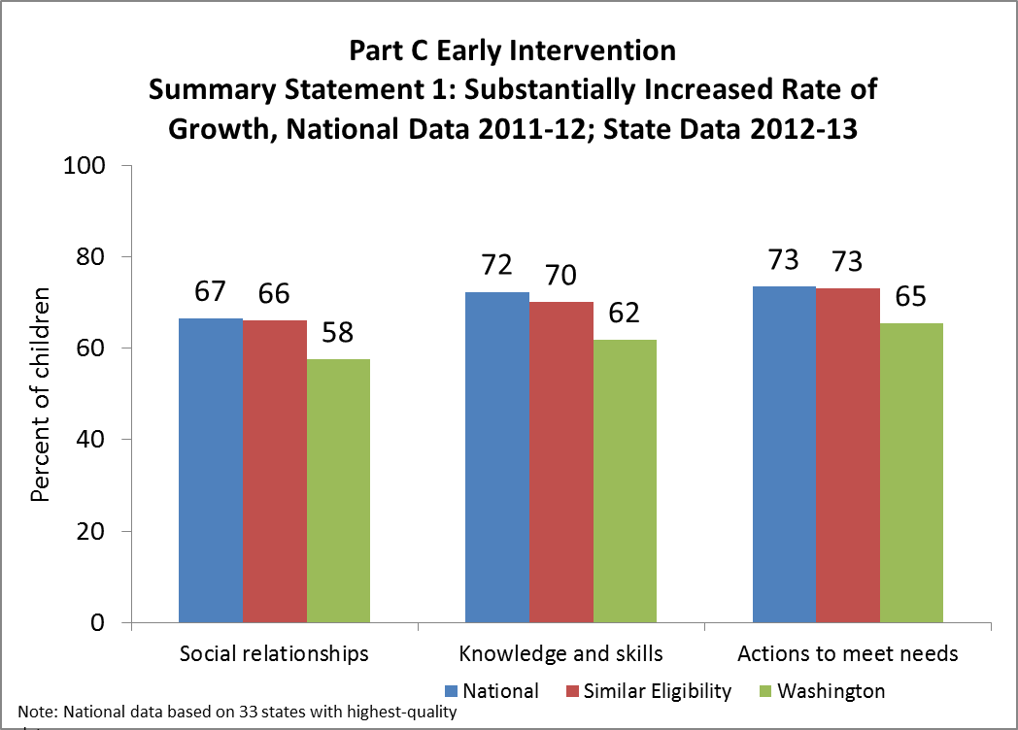

Slide 26
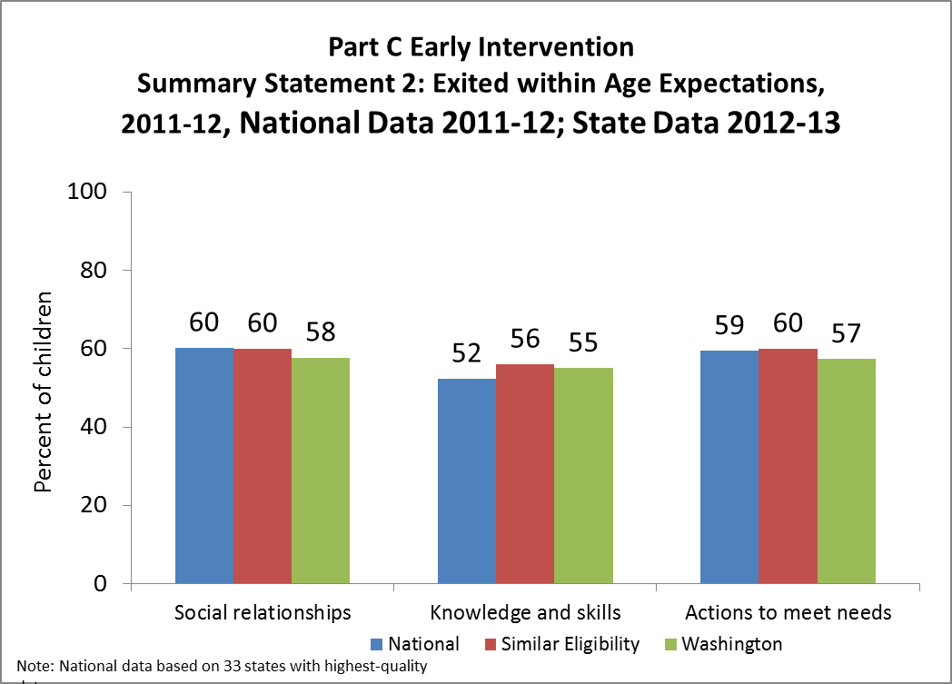

Slide 27
Local Program Comparison
Considered performance across programs – looking for low and high performing programs
Discussed why we would expect some programs to be lower performing or higher performing
When there were no clear reasons for lower performance, we determined more program data would be needed

Slide 28
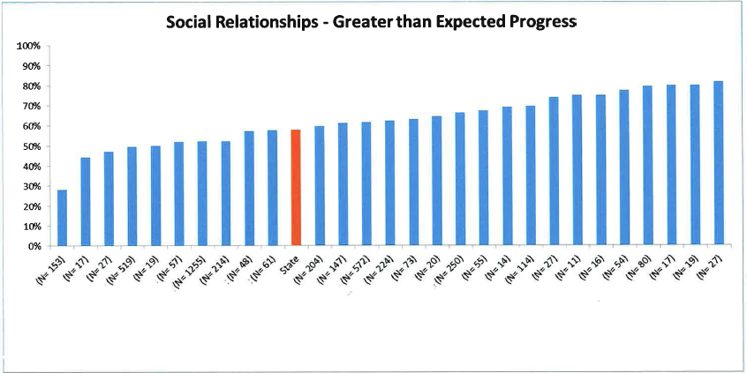

Slide 29
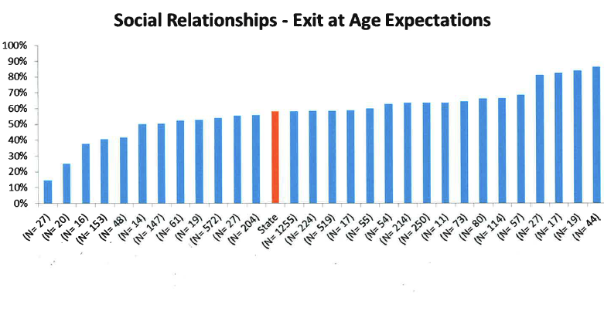

Slide 30
Data Quality Questions
Summary Statement 1
Are positive social-emotional skills/social relationships low because children are rated too high at entry
If children are rated too high at entry, is this particularly pronounced in younger children

Slide 31
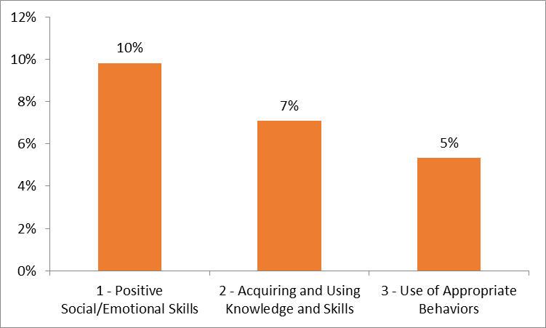
Percent of children that entered with a rating of 6 or 7 (at or above age expectations) and exited with a rating of 5 or below (below age expectations)

Slide 32
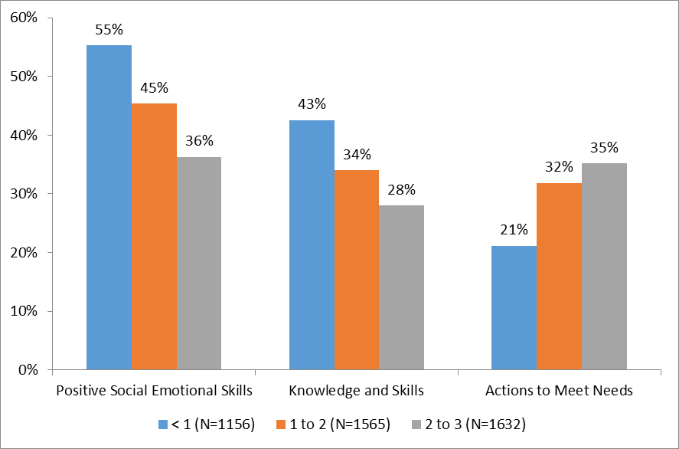
Percent of children rated as at or above age expectations (6 or 7) at entry by age of entry

Slide 33
Data Analysis Plan
January through April Leadership Team broad data analysis focused primarily on child outcome data
May stakeholder meetings were convened
Reviewed data and discussed two possible State Identified Measureable Result (SiMR)
SiMR Decision – positive social-emotional skills and relationships
Infrastructure and State Initiative Gallery Walk

Slide 34
Data Analysis Plan
Developed possible hypotheses that are assisting us in reviewing and better understanding the data
Developed questions that are helping us to probe the hypotheses – attempting to establish the root cause for the presenting data
Infrastructure and initiative data was reviewed again with a social-emotional lens (identifying leverages and hindrances both direct and indirect)

Slide 35
Data Analysis Plan
Where we are now –
Will be asking a few high/low performing programs to respond to the hypotheses questions and then will synthesize results (hoping to confirm or reject each hypothesis)
Randomly select IFSPs to analyze if social-emotional evaluation, assessment and outcome data are included and compile results

Slide 36
Data Analysis Plan
Where we are now –
Work on refining focus area (consider subgroup)
Expand Leadership Team to include social-emotional development experts
Continue to communicate with SICC and SSIP Stakeholder groups
Kids' Potential, Our Purpose

Slide 37
Data Analysis Plan
Where we are now –
Develop Logic Model/Theory of Action with Action Steps that will guide SiMR improvement strategies
Identify how improvement strategies will address the root cause(s) for performance issues
Kids' Potential, Our Purpose

Slide 38
Massachusetts Using a Data Analysis Plan September 9, 2014
Patti Fougere, MA Part C, Asst. EI Director
Jean Shimer, MA Part C, Data Manager

Slide 39
Lessons Learned
Get help
Access TA to help narrow the scope & keep you on track
Use analysis tools developed for this purpose
Stakeholders
Present simplified data to your stakeholders
Schedule regular state team conference calls
Data stuff
Your hypothesis should be stated prior to drill down analysis
Identify areas of data not to be analyzed & why
Document data quality issues
Identify additional data needs
Include challenges & outstanding questions

Slide 40
Data Analysis Plan: Definition
Program director: all activities for Phase I
Data manager: document that outlines everything learned about the data
Other state team members: anything that brings you to a decision on a focus area & provides root causes to low child outcome results

Slide 41
Data Analysis Plan
Understand your background: Stakeholder Involvement
Started early on in the process – October 2013 EI Program Director Session
ECO Stakeholders – already existing stakeholder group advising state on improving approach to measuring child & family outcomes
State Leadership Team
Interagency Coordinating Council

Slide 42
Data Analysis Plan
Understand your background
Current initiatives & practices
DaSy pilot
SASID project
Let’s Participate project

Slide 43
Data Analysis Plan
Document your Infrastructure Analysis
SWOT Analysis (Strengths/Weaknesses/Opportunities/Threats)
MA modified the SWOT tool to increase the focus on integrating existing initiatives:
What aspects of the MA EIP current initiatives make it unique?
How does the MA EIP system leverage its resources (fiscal, material, personnel, etc.) to build capacity at the local system level?
What are challenges with regard to the MA EIP ability to support local systems in efforts to implement sustainable new initiatives?

Slide 44
MA SWOT Analysis

Slide 45
Data Analysis Plan
State your Focus Area (child outcome)
State focus area: children not exhibiting improved social-emotional skills to reach a level nearer or comparable to same-aged peers
Rationale for selection of state focus area

Slide 46
Data Analysis Plan
Data Analysis documentation
Individual data areas
Hypothesis
Data analysis (include graphs, charts, tables)
Notes
Additional data needed
Data quality considerations

Slide 47
Data Analysis Plan
Looked at the usual data areas:
National/State Comparisons
Individual Program Analysis
Poverty Level Analysis
Family Outcomes Analysis
Race & Gender Analysis
Age at enrollment
Intensity of Services
Length of time in enrolled
Eligibility type analysis

Slide 48
Data Analysis Plan
Used graphs

Slide 49
Data Analysis Plan
Applied TA tools to identify meaningful differences between the state average & sub populations
 | Outcome 1 Summary Statement 1 |  |  |  | Outcome 1 Summary Statement 2
 | White Males N | White Males % | State Confidence Interval |  | White Males % | State Confidence Interval
Males by Race and Ethnicity | 1378 | 56.12% | ± 2.2% |  | 76.05% | ± 1.89%
 | # Kids | SS1 % | Confidence Interval | Meaningful Difference from State? | SS2 % | Confidence Interval | Meaningful Difference from State?
Am Ind/Alas Native | 4 | 0.00% | ± 20.17% | Yes | 75.00% | ± 29.29% | No
Asian | 85 | 53.85% | ± 8.76% | No | 60.00% | ± 8.61% | Yes
Black | 188 | 54.55% | ± 5.94% | No | 61.70% | ± 5.8% | Yes
Hispanic | 447 | 50.00% | ± 3.88% | Yes | 61.74% | ± 3.77% | Yes
Multi-Race | 69 | 62.16% | ± 9.44% | No | 72.46% | ± 8.72% | No
Pacific Isl./Nat. Haw | 1 | 0.00% | ± 36.5% | Yes | 100.00% | ± 36.5% | Yes

Slide 50
Data Analysis Plan
Developed a hypothesis
Evaluation tool is not sensitive enough to provide an accurate measure of a child’s social emotional functioning and therefore additional information from a supplemental tool may be needed to identify concerns and develop appropriate IFSP outcomes that will impact the child’s development
If this were happening (i.e. more training, mentoring, coaching) with children living in poverty, this would have an impact on improved social emotional outcome

Slide 51
Data Analysis Plan
Identified need for additional program data
Who: 3 low & 3 high performing programs on SS1
Initial analysis: profile each program with existing data
Compare with our preliminary state averages
What: Program/clinical practices
How: Survey

Slide 52
Data Analysis Plan
Next Steps
Identification of Evidence-Based practice
Hypothesis
Outstanding questions from Stakeholders
Potential areas of evidence-based practices
Improvement strategies/Action plan

Slide 53
Arizona Early Intervention Program Where Every Family Has A Team
AzEIP
September 8, 2014

Slide 54
A Decade of Change
Spring of 2013 Final Phase of AzEIP Redesign
Implementation:
Contracts
Data System
Child and Family Assessment
Policies and Procedures
AzEIP Fidelity Checklist

Slide 55
The AzEIP Process – BEFORE
Referral
DES/AzEIP Contractor
Screening, evaluation, and AzEIP eligibility determination; coordination with DDD or ASDB
Assessment and Individualized Family Service Plan (IFSP)
Within 45 days of referral
ASDB
DDD
DES/AzEIP Contractor

Slide 56
Five Separate Electronic Data Bases
AzEIP ACTS-4
DDD Focus
ASDB ECFE
Data from these three systems was put into a merged database and then data was pulled for Integrated Monitoring Activities
Child Outcomes Data
Family Outcomes Data

Slide 58
Team-Based Early Intervention Services

Slide 59
The AzEIP Team-Based Processes
Referral
DES/AzEIP Team-Based Early Intervention
Screening, evaluation, and AzEIP eligibility determination; coordination with DDD or ASDB
Assessment and Individualized Family Service Plan (IFSP) Within 45 days of referral
IFSP Implementation
ASDB
DDD

Slide 60
AzEIP Team Based Early Intervention Services Contracts
Administered by DES/AzEIP
Serve all AzEIP eligible children, including DDD and ASDB
ASDB and DDD provide SC to children eligible for ASDB and/or DDD
ASDB provides vision and hearing experts on each team and provides vision and hearing services

Slide 61
Building on the Mission and Key Principles
AzEIP Policies and Procedures
Scope of Work
Fidelity Checklist
Continuous Quality Improvement

Slide 62
Benefits of TBEIS
Promotes integrated approach
Dynamic, responsive, flexible team support for families
Individualized team decision-making by the IFSP team
Team caseload, instead of individual caseloads – more efficient use of personnel

Slide 63
Implemented Statewide TBEIS Contracts March 2013
Transitioned nearly 4,000 children from existing contracts to new AzEIP TBEIS

Slide 64
I-TEAMS Data System

Slide 65
April 2013 – I-TEAMS
New web-based application: I-TEAMS
Single comprehensive data system for all AzEIP eligible children, including DDD, ASDB,
Existing data in 4 of the existing data systems as of March 15, 2013 migrated into ITEAMS

Slide 66
Child Related Information
Referral Information
Child Demographics
Eligibility decision and reason
IFSP information
Assign and Change Team members for a child
Service Delivery information
Transfer/Exit Child information
Entry/Exit Indicator Summary
Insurance Information

Slide 67
Organization and Contract Related Information
Contract Information
Liability Insurance
Personnel
EIN numbers
Central Registry Status
Licensure
Professional Registry
Invoices

Slide 68
Analyzing Arizona Data

Slide 69
Planning for Data Analysis
Shared child outcomes data quality profile FFY 2011-12 with ICC as part of broad data analysis
Comparison to national
Trends over time
At the state level, no clear patterns to select one child outcome over another were evident

Slide 70
State Trends, Greater Than Expected Growth

Slide 71
State Trends, Exiting within Age Expectations

Slide 72
Planning for Data Analysis
Decided to dig a little deeper to disaggregate data and look at by program and other child/family characteristics
Given transition in data system, limited access to data
Transition in staff also limited capacity for data analysis
Contacted ECTA and DaSy for support

Slide 73
Developing a Plan
Discussed data analysis questions, priorities, data available, and timeline
Developed data analysis plan
Identified state team members to learn about data analysis and help lead process
Those members worked with TA providers to analyze and review data
Shared data back with larger group to discuss hypotheses and results

Slide 74
Data Analysis Plan
Identified 3 main questions and expectations to begin in-depth data analysis
Question 1: Are there differences in our child outcomes data by county?
Expectation: To identify low and high performing programs.
Question 2: Are there differences by program/service type?
Expectation: Kids part of team-based may experience more positive outcomes because looking at development more holistically and natural learning environments.
Question 3: Are there differences in our child outcomes by race and ethnicity?
Expectations: Did not necessarily have clear expectations about race/ethnicity—would like to document differences.

Slide 75
Child Outcomes By Program/Service Type, Social Emotional

Slide 76
Child Outcomes By Program/Service Type, Knowledge and Skills

Slide 77
Child Outcomes By Program/Service Type, Action to Meet Needs

Slide 78
Child Outcomes Ratings Change between Entry and Exit By Program/Service Type, Social Emotional

Slide 79
Child Outcomes Ratings Change between Entry and Exit By Program/Service Type, Knowledge and Skills

Slide 80
Child Outcomes Ratings Change between Entry and Exit By Program/Service Type, Action to Meet Needs

Slide 81
Planning for the Future

Slide 82
Stakeholder Analysis
Broad Stakeholder Analysis in May
Reviewed Child Outcomes Data with ICC in August
Smaller data analysis subgroup in September
Identify potential SiMR based on data and infrastructure analysis
Discuss ICC and Stakeholder in November

Slide 83
The Future
Evaluate the impact of implementing team-based early intervention services
Result in increasing parents/caregivers confidence and competence in supporting their child’s development within everyday routines and activities
Result in better child outcomes for all children regardless of eligibility/funding source

Slide 84
Discussion
Questions and reactions?
Who has started working on SSIP?
What are you analyzing or what would you like to analyze?
What hypotheses have you developed?
Does your process involve a stakeholder group and if so, who is on it?

Slide 85
Activity
At your tables, consider how you might plan for analyses to answer the question:
Do child outcomes differ for children experiencing adversity or economic stress?
What data do you have available to address this question in your state?
What would your hypotheses or expectations be for the results of the analyses based on your experiences and knowledge of your state?

Slide 86
Share Back
Do child outcomes differ for children experiencing adversity or economic stress?
What data did you come with to address this question?
What would your hypotheses or expectations be of the results?

Slide 87
For more information
Visit the DaSy website at: http://dasycenter.org/
Like us on Facebook: https://www.facebook.com/dasycenter
Follow us on Twitter: @DaSyCenter

Slide 88
The contents of this presentation were developed under a grant from the U.S. Department of Education, #H373Z120002. However, those contents do not necessarily represent the policy of the U.S. Department of Education, and you should not assume endorsement by the Federal Government. Project Officers, Meredith Miceli and Richelle Davis.

