Slide 1
Questions, Data, and Reports: Connecting the Data Dots Using the DaSy Framework System Design and Development Subcomponent
  Taletha Derrington and Kathleen Hebbeler
  SRI International
Improving Data, Improving Outcomes Conference
New Orleans, LA  September 10, 2014

Slide 2
Workshop Overview
Ground rules
Sections – presentation, small group practice, & large group discussions
  Question wording for different audiences
  Question wording for data analysts
  Determining if your data system can answer your questions using data dictionaries
  Reporting the data

Slide 3
Workshop Overview
Intended outcomes
  Understand the need for wording questions differently for different audiences
  Know how to develop detailed questions for analysis
  Know how to identify the variables needed to answer questions
  Know how to use a data dictionary to identify needed data elements and values
  Understand the difference between data elements and values
  Know how to develop a table shell

Slide 4

Question Wording …
…is important and requires focused thought
The same question should be presented /
phrased differently for different audiences

Slide 5
Question Wording
Categorizing questions can be a useful first step in understanding what the question is about.
Critical Question | Outcomes | Environment / Setting | Service Provider / Teacher | Services | Children / Families | Financial Data | Other
1. What are the characteristics of practitioners/teachers working in early intervention (EI) and early childhood special education (ECSE)?

Slide 6
Question Wording
Critical Question | Outcomes | Environment / Setting | Service Provider / Teacher | Services | Children / Families | Financial Data | Other
2. What services produce the best outcomes for children?

Slide 7
Question Wording
Critical Question | Outcomes | Environment / Setting | Service Provider / Teacher | Services | Children / Families | Financial Data | Other
3. What are the long-term outcomes of children who participate in EI and/or ECSE?

Slide 8
Question Wording
Critical Question | Outcomes | Environment / Setting | Service Provider / Teacher | Services | Children / Families | Financial Data | Other
4. Do children in inclusive settings have better social emotional outcomes than children in non-inclusive settings?

Slide 9


Question Wording –
Small Groups
How prepared is the EI/ECSE workforce to provide effective services and education for all children?
What is the relationship between the amount of services planned vs. received?
How do child and family outcomes differ by child and family characteristics?
What are the disability categories, race/ethnicities, dual-language learner (DLL) status, age, and socioeconomic status (SES) of children in inclusive vs. non-inclusive settings?
Write your own

Slide 10
Question Wording - Discussion
Critical Question | Outcomes | Environment / Setting | Service Provider / Teacher | Services | Children / Families | Financial Data | Other
5. How prepared is the EI/ECSE workforce to provide effective services and education for all children?

Slide 11
Question Wording - Discussion
Critical Question | Outcomes | Environment / Setting | Service Provider / Teacher | Services | Children / Families | Financial Data | Other
6. What is the relationship between the amounts of services planned vs. received?
✓

Slide 12
Question Wording - Discussion
Critical Question | Outcomes | Environment / Setting | Service Provider / Teacher | Services | Children / Families | Financial Data | Other
7. How do child and family outcomes differ by child and family characteristics?

Slide 13
Question Wording - Discussion
Critical Question | Outcomes | Environment / Setting | Service Provider / Teacher | Services | Children / Families | Financial Data | Other
8. What are the disability categories, race/ethnicities, DLL status, age, and SES of children in inclusive vs. non-inclusive settings?

Slide 14
Question Wording
Policymakers
  What do policymakers need to know?
  What will get their attention?
Data Analysts
  What do data analysts need to know?
  What wording will help them understand what you need?

Slide 15
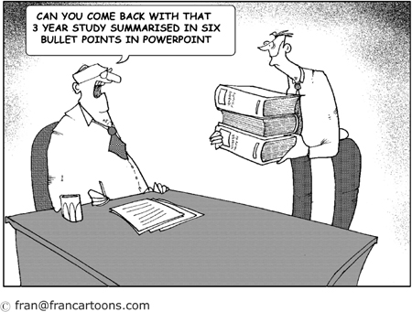
Question Wording for Policymakers
Policymakers
  Do not want a lot of detail
  Care about money and taxpayers
  Want educational programs to deliver optimal outcomes
  Are most concerned with the big picture

Slide 16
Question Wording for Policymakers
3. What are the long-term outcomes of children who participate in EI and/or ECSE?
  Does participation in EI reduce the need for special education in elementary school?
  Does participation in ECSE save taxpayers money?
  Would providing EI services to children at risk save state K-12 special education dollars?
  What percentage children who participated in ECSE are proficient in reading by 3rd grade?

Slide 17
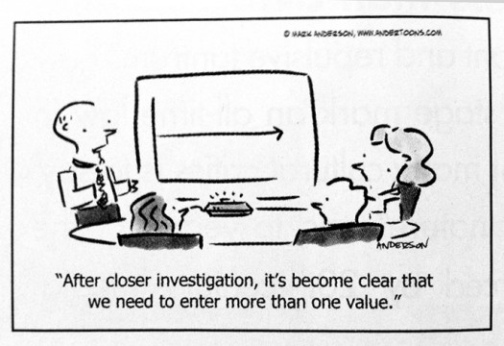
Wording Questions for Data Analysts
Data Analysts
  Need to be able to identify the needed data elements (a.k.a. variables / field names)
  Need to know who and what to include
  Need details
These are steps in “deconstructing” a question for data analyst

Slide 18
Wording Questions for Data Analysts
2. What services produce the best outcomes for children?
  What question categories are included in this question?

Slide 19
Wording Questions for Data Analysts
2. What services produce the best outcomes for children?
  What about services do you want to know?

Slide 20
Question Wording for Data Analysts
2. What services produce the best outcomes for children?
  What outcomes do you want to study?

Slide 21
Question Wording for Data Analysts
2. What services produce the best outcomes for children?
  What population do you want to study?
  What years do you want to include in the analysis?

Slide 22
Question Wording for Data Analysts
2. What services produce the best outcomes for children?
  What was the total number of hours of speech/language therapy received by children who exited between July 1, 2012 and June 30, 2013 with OSEP Progress categories d & e compared to those in categories a, b, & c in Knowledge and Skills?

Slide 23
Question Wording for Data Analysts
2. What services produce the best outcomes for children?
  What was the average number of weeks of intensive behavioral support services received by children who showed greater than expected growth in positive social relationships exiting between July 1, 2009 to June 30, 2013?
  How does this compare to the average number of weeks of intensive behavioral support services received by children who did not show greater than expected growth in positive social relationships exiting between July 1, 2009 to June 30, 2013?

Slide 24
Question Wording for Data Analysts – A Mad Lib to Identify Data Elements
2. What services produce the best outcomes for children?
What was the average number of weeks of intensive behavioral support services
[deconstruct “services”]
received by children who showed greater than expected growth in positive social relationships
[deconstruct “produce the best outcomes”]
exiting between July 1, 2009 to June 30, 2013?
[define population and years to include to deconstruct “for children”]

Slide 25
Question Wording for Data Analysts
Who and what do you want to know about?
  Children
  Families
  Outcomes
  Services
  Practitioners
  Programs
  …
What specifically do you want to know?
  Which “who”?
  Which “what”?
The WHO and WHAT are defined by ELEMENTS in a data system

Slide 26

Question Wording for Data Analysts – Small Groups
1. What are the characteristics of practitioners/teachers working in early intervention and early childhood special education?
7. How do child and family outcomes differ by child and family characteristics?
Pick one of your own.

Slide 27

Can your Data System Answer the Question?
Identifying data elements by digging into data dictionaries

Slide 28
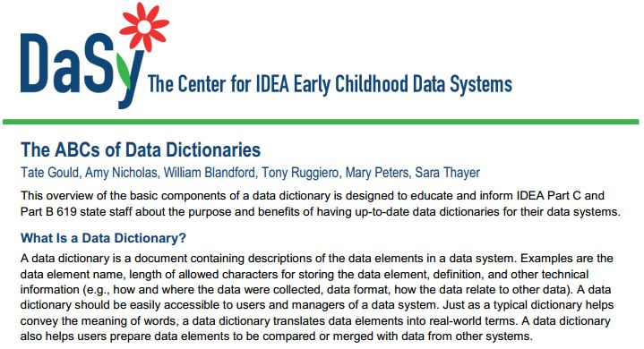
Identifying Data Elements Using Data Dictionaries
http://dasycenter.org/downloads/DaSy_papers/DSL_BriefABCsDataDictionaries.pdf

Slide 29
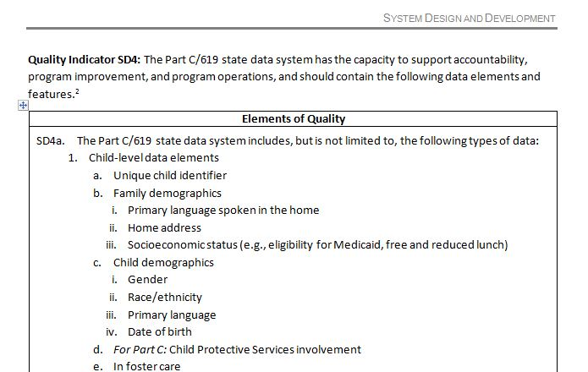
DaSy System Design and Development Framework Subcomponent, Quality Indicator 4

Slide 30
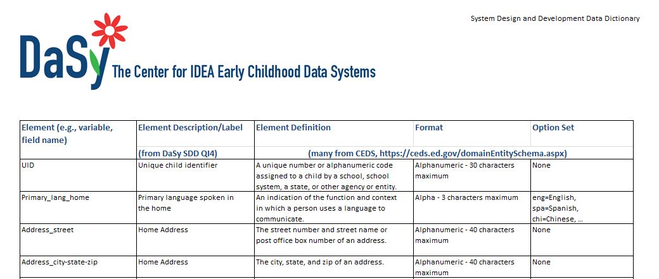
Identifying Data Elements Using Data Dictionaries
CEDS for data dictionary information (https://ceds.ed.gov/domainEntitySchema.aspx)

Slide 31
Question Wording for Data Analysts – A Mad Lib to Identify Data Elements
9. What is the average intensity of EI/ECSE services, and how does it vary by child and family characteristics?
What is the average total number of hours of
[deconstruct “intensity”]
speech/language therapy,
[deconstruct “EI/ECSE services”]
and how does it vary by family SES
[deconstruct “child and family characteristics”]
for children exiting between July 1, 2009 to June 30, 2013?
[define population and years to include to deconstruct]

Slide 32
Identifying Data Elements and Values
Data Needed | Element (Field Name)
What is the average total number of hours of
speech/language therapy,
and how does it vary by family SES
for children exiting between 7/1/09-6/30/13?

Slide 33
Identifying Data Elements and Values
Data Needed | Element (Field Name)
What is the average total number of hours of | Svcs_Rcvd_Min_NonInclus Svcs_Rcvd_Min_Inclus
speech/language therapy, | Svc_Rcvd_Type
and how does it vary by family SES | SES_Medicaid
for children exiting between 7/1/09-6/30/13? | Exit_Date

Slide 34
Identifying Data Elements and Values
Data Needed | Element (Field Name) | Values Needed
Children exiting between 7/1/09-6/30/13 | Exit_Date | 6/30/09 < (value) < 7/1/13
Speech/language therapy | Svc_Rcvd_Type | 15
Total number of hours | Svcs_Rcvd_Min_NonInclus Svcs_Rcvd_Min_Inclus | All; sum non-inclusive + inclusive; divide by 60 to get hours
Family SES | SES_Medicaid | All

Slide 35

Identifying Data Elements and Values
– Small Groups
For question 7, focusing on child outcomes, use your data dictionary (or the data dictionary created using DaSy’s System Design and Development quality indicator 4) to:
  Identify the elements (field names) needed to answer the question (are they there?)
  Identify values (i.e., variable codes) that will be used in the analysis.

Slide 36
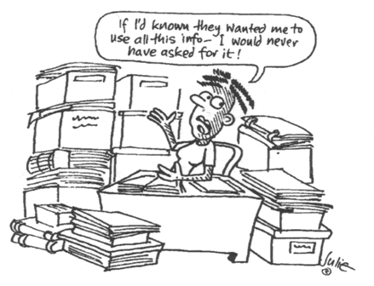
Identifying Data Elements and Values – Discussion

Slide 37
Reports – Table Shells
9. What is the average intensity of EI/ECSE services, and how does it vary by child and family characteristics?
What is the average number of hours of
[deconstruct “intensity”]
speech/language therapy,
[deconstruct “EI/ECSE services”]
and how does it vary by family SES
[deconstruct “child and family characteristics”]
for children exiting between July 1, 2009 to June 30, 2013?
[define population and years to include to deconstruct]

Slide 38
Reports – Table Shells
Table shells help analysts know what (report) you want
Family SES | Average Total No. Hrs. SLP services for children served 7/1/09-6/30/13
Medicaid-eligible
Not Medicaid-eligible

Slide 39
Reports – Table Shells
Disaggregating variables What you are reporting on
Child and Family Characteristics | Child Outcome 1 (Socioemotional) Summary Statement 1 (Greater than Expected Growth)

Slide 40

Reports – Small Groups

Slide 41
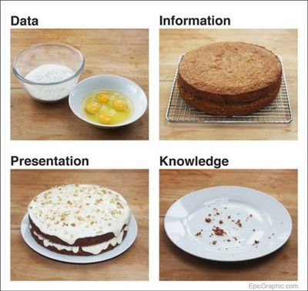
Reports – Group Discussion

Slide 42

Workshop Evaluation Discussion

Slide 43
Connect with DaSy
Visit the DaSy website at:
http://dasycenter.org/
Like us on Facebook:
https://www.facebook.com/dasycenter
Follow us on Twitter:
@DaSyCenter
Taletha Derrington, taletha.derrington@sri.com
Kathy Hebbeler, kathleen.hebbeler@sri.com

Slide 44



The contents of this presentation were developed under a grant from the U.S. Department of Education, #H373Z120002. However, those contents do not necessarily represent the policy of the U.S. Department of Education, and you should not assume endorsement by the Federal Government. Project Officers, Meredith Miceli and Richelle Davis.

