Slide 1
IDEA Part C and Part B 619 Data Systems: More Findings from the DaSy Center Needs Assessment Donna Spiker DaSy Center @ SRI International
Improving Data, Improving Outcomes Conference
Washington, DC
September 2013

Slide 2
What we will cover……
DaSy Center needs assessment conducted with all states and territories
Additional information not covered in plenary session:
Data governance
Procedures for checking data
Data access and use
Discuss your reactions to the findings

Slide 3
Brief reminder about purposes, methods, respondents….
To inform the DaSy Center’s work, the Center collected information about the:
Current status of Part C and Part B 619 state data systems,
Priorities for improvement, and
Areas where the states would like TA.
Online survey completed by Part C and Part B 619 coordinators, with data managers and other state staff
Report focuses on information from 50 states, DC, Puerto Rico
Response rate was 94% for C and 96% for 619

Slide 4
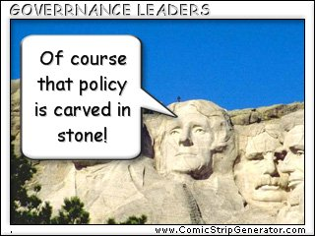
Data governance: What is it and why is it important?
Defined as entities that establish policy and procedures for the overall management of the availability, usability, integrity, quality, and security of the data
Having good data governance helps states have confidence that data are accurate and trustworthy and then they can be used for decisionmaking

Slide 5
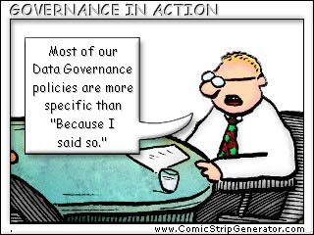
Many states have a data governance body that includes 619, but not one that includes Part C.
69% of states have no data governance body that includes Part C.
72% of states have a data governance body for 619.
35% include Part C
37% include other EC programs
62% include K12 special education
52% include K12 general education

Slide 6
Question
What do you think about the information on data governance?

Slide 7
Checking data quality: Why is it important?
To effectively manage data, states need to have processes and procedures to check and verify that the data are accurate, complete, and internally consistent.
To ensure and check that data are trustworthy:
in their collection
entry into the data system
consistency with other data in the data system.

Slide 8
For both Part C and 619, states use many tools and procedures to check their data.
 | Part C | 619
Audits built into data system | 98% | 92%
User manual | 83% | 90%
Verification visits | 81% | 71%
Annual or regular trainings | 69% | 79%
Data dictionary | 65% | 69%

Slide 9
Question
What supports are needed for states to check data for its quality?

Slide 10
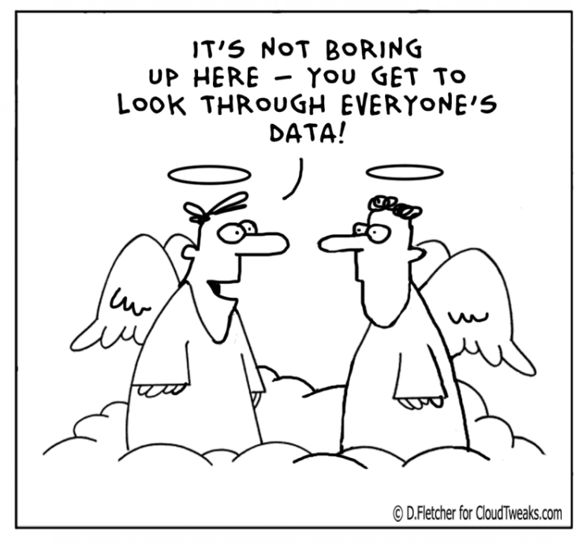
Access to and use of data: Why is it important?
The ultimate goals of collecting data and having good state data systems is to have available high-quality information that can be used for different purposes.
Access is important because using data to inform decisionmaking at any level (state to local program to teacher or service provider) requires access to information.

Slide 11
For both Part C and 619, access to child data is most common for state staff and least common for teachers and service providers.
Personnel with access | Aggregate data |  | Individual data
 | Part C | 619 | Part C | 619
Part C and 619 coordinators | 96% | 77% | 94% | 83%
Regional lead or district/LEA | 77% | 73% | 67% | 75%
School/program | 58% | 64% | 62% | 67%
Teachers/service provider | 42% | 44% | 56% | 52%

Slide 12
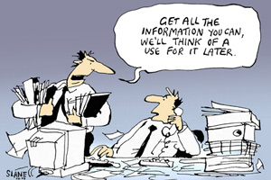
For both Part C and 619, states use their data for a variety of purposes.
Uses for data | Part C | 619
Checking/reviewing data quality | 94% | 89%
Planning for program improvement | 89% | 89%
Monitoring program improvement | 87% | 65%
Identifying professional development and TA needs | 75% | 79%
Reporting to the public, governor and the legislature | 85% | 79%

Slide 13
Questions
What do you think about the more limited access to data at the teacher and service provider levels?
Is it surprising that only 77% of the Part B 619 coordinators have access to aggregate-level child data?

Slide 14
What is interesting about the information on linkages?
These can be linkages:
Within Part C and within 619
Across Part C and 619
With K12 education
With other early childhood program, social services, health data
Notes:
And some states do not need to talk about linkages because the data are already in the same data system (e.g., When education is the lead for part C; 12 states)

Slide 15
Only about one-third of states have linked data across Part C and 619.
Notes:
Remember that there are 12 states with Education as the lead agency for Part C, so we would expect C and 619 data to be in same system or connected.
We combined data from the two surveys, and about one-fourth disagreed about the connections.

Slide 16
There is infrequent use of common identifiers across Part C and 619.
Common identifier for C and 619
Child-level | 21%
Program-level or school-level | 12%
Workforce-level | 6%

Slide 17
Linkages with K12 education data are more common for 619 than for Part C.
Types of education data in same system or have been linked | Part C | 619
K12 special education | 41% | 87%
K12 general education | 14% | 79%

Slide 18
Few states have linkages with other EC data for Part C, and almost half have linkages with state preK for 619.
Types of other EC data | Part C | 619
State pre-K | 12% | 46%
Head Start | 6% | 22%
Early Head Start | 2% | 10%
Child care | 6% | 8%
Home visiting | 8% | 8%

Slide 19
Linkages with health data are more common for Part C than for 619.
Types of health data | Part C | 619
Medicaid/SCHIP | 42% | 12%
EHDI | 37% | 8%
Vital records | 21% | 0%
Birth defects registry | 21% | 2%
All-payer claims (insurance) | 13% | 0%
WIC/SNAP | 8% | 6%
Hospital | 6% | 2%
Behavioral health | 4% | 2%
Notes:
connections between c and health are strong in many states; health is lead agency in many states (N = )
Highest with Medicaid (42%); and newborn hearing screening (EDHI- Early Hearing Detection & Intervention Program)

Slide 20
Very few states have linked Part C or 619 data to social services data.
Types of social services data | Part C | 619
Child welfare | 21% | 10%
Foster care | 12% | 8%
Temporary Assistance for Needy Families (TANF) | 10% | 14%
Homeless services | 6% | 14%

Slide 21
Questions
What is interesting about the information on linkages?
Which of the linkages are most important to you and why?
What are the challenges states face in creating these linkages?

Slide 22
What do you think about the limited availability of program-level data in state data systems?
Data system | Part C | 619
Child-level | 94% | 96%
Program-level | 29% | 40%
Workforce: EI providers | 65% | ----
Workforce: special education teachers | ---- | 83%
Workforce: related service providers | ---- | 71%
Workforce: general education teachers | ---- | 71%

Slide 23
Questions
To get copy of report:
www.dasycenter.com

