Slide 1
IDEA Part C and Part B 619 Data Systems: Current Status and Future Priorities Donna Spiker DaSy Center @ SRI International
Improving Data, Improving Outcomes Conference
Washington, DC
September 2013

Slide 2
What we will cover
DaSy Center needs assessment conducted with all states and territories
Purposes, methods, response rates
Highlights of findings
Next steps

Slide 3
What were the purposes of the needs assessment?
What we are funded to do:
Support developing or enhancing Part C and 619 data systems
Assist Part C/619 participation in integrated EC data systems
Assist Part C/619 participation in state longitudinal data systems
What we wanted to know to guide our TA:
Current status of Part C and 619 state data systems,
Priorities for improving data systems
Areas where states would like TA

Slide 4
What methods were used?
Online needs assessment developed by DaSy workgroup
Coordinated with ITCA and ECDC surveys
Sent to Part C and 619 coordinators
Completed with data managers and others identified by coordinators

Slide 5
What kinds of questions were asked?
Status of Part C and 619 data systems:
Data systems and data elements
Linkages between different state data systems
Data system administration and use of data
Note: Slightly different versions for Part C and 619
based on program differences

Slide 6
Who were the respondents?
Sent to all states and jurisdictions
Report focuses on information reported by 50 states, DC, and Puerto Rico
Notes:
We focused the report on the 50 states, DC and Puerto Rico since they are included in IDEA data tables for how child count is reported.
But we do have information for other jurisdictions.
Need to address why territories not included in the report…Be clear on what response rate based on 52 (the report numbers) way child count data is reported…..

Slide 7
What were the response rates?
We had an excellent response rate:
For Part C 94% (n= 49)
For 619 96% (n= 50)
Thanks to you all!
Notes:
Thanks to everyone who completed the surveys.
response rate based on 52 (the report numbers)

Slide 8
State data systems and data elements: Why is this important?
Data allows states to understand the characteristics of the:
Populations served
Settings and services received and their quality
Personnel providing services

Slide 9
Focus of questions and terminology
Different kinds of state level data systems
For example:
Workforce data about providers may be in multiple state databases.
School enrollment data may be in a program database.
Clarity of terminology is important
What do we mean by program or program-level data?
In EC, program typically means a center where children go.
We used a broad definition.
Notes:
For C: Program = administrative entity which receives referrals, provides evaluation services, provides service coordination, and/or provides direct services to children and families.
For 619: Classroom/Program = specific location where the child receives preschool special education services through Part B 619, including child care, Head Start, Title 1, etc.
Characteristics of programs:
a. Program structure (one or more of the following: licensing status, program setting, program type, class data such as class size, teacher name or ID, staff ratio by age group, etc.)
b. Programming (e.g., curriculum)
c. Whether program/class also serves children who do not have IEPs
d. Program quality (one or more of the following: ECERS-R, CLASS, QRIS rating, PAS, accreditation status, etc.)*
*ECERS-R = Early Childhood Environmental Rating Scale-Revised
CLASS = Classroom Assessment Scoring System
QRIS = Quality Rating and Improvement System
PAS = Program Administration Scale

Slide 10
Most states have data systems with child-level and workforce data, but fewer have program-level data systems.
 | Part C | 619
Child-level | 94% | 96%
Program-level | 29% | 40%
Workforce: EI providers | 65% | ----
Workforce: special education teachers | ---- | 83%
Workforce: related service providers | ---- | 71%
Workforce: general education teachers | ---- | 71%
Notes:
the percents are the percent of states responding (and
for child-level – there are no Nos, only missing
There is a lot more detail and information in the report.

Slide 11
Most states have a variety of data elements in their child-level data systems.
Some common data elements | Part C | 619
Child demographics | 94% | 96%
Disability category | 77% | 96%
Eligibility status | 98% | 90%
Child outcomes | 83% | 90%
Service setting | 89% | 87%
ID for program or school | 89% | 81%
Reason for exiting program | 98% | 79%
Notes:
Go through quickly

Slide 12
Less than half of states have Part C or 619 program-level data systems.
Only 29% of states have Part C program-level data systems.
Only 41% of states have 619 program-level data systems.
37% have data on program structure (e.g., agency, service model).
33% have information on whether program includes children without disabilities
Notes:
Program = administrative entity which receives referrals, provides evaluation services, provides service coordination, and/or provides direct services to children and families.
program-level data means…data on such things as:
a. Program structure (e.g., service model, number of regular and contracted staff, and/or administrative/host agency, etc.)
b. Any measure of the quality of settings in which children receive services (one or more of the following: ITERS, QRIS rating, PAS, accreditation status, etc.)*
c. Program costs
*ITERS = Infant Toddler Environmental Rating Scale
QRIS = Quality Rating and Improvement System
PAS = Program Administration Scale

Slide 13
States vary in the kinds of workforce data they have in state data systems.
Workforce data element | Part C | 619 special ed teachers | 619 related services personnel | 619 regular ed teachers
Demographics | 29% | 67% | 58% | 64%
Employment data | 54% | 77% | 60% | 67%
Education | 46% | 75% | 58% | 64%
Licenses/certifications | 56% | 83% | 69% | 71%
Professional development | 39% | 29% | 29% | 23%
Wages | 10% | 46% | 42% | 46%
Notes:
These are what we asked about:
a. Demographics (one or more of the following: race/ethnicity, age, language, gender, etc.)
b. Employment information (one or more of the following: employing agency/school, position title, years of experience, start date, etc.)
c. Education (one or more of the following: degree, field of study, etc.)
d. Licenses/certifications
e. Professional development completed (in-service or other training)
f. Wages

Slide 14
Linkages: What is it?
Linking refers to the process of joining or connecting records about one individual or entity in one data system or dataset with those in another data system or dataset using a common identifier or other method
These can be linkages:
Within Part C and within 619
Across Part C and 619
With K12 education
With other early childhood program,
social services, health data
Notes:
And some states do not need to talk about linkages because the data are already in the same data system (e.g., When education is the lead for part C; 12 states)

Slide 15
Linkages: Why is this important?
States can answer programmatic and policy questions about:
Children’s outcomes from EI and ECSE participation, e.g.:
Do former EI recipients require special education in kindergarten?
How are ECSE graduates doing in third grade?
Factors associated with good child outcomes, e.g.:
What workforce and program factors, such as personnel qualifications and program quality, have a substantial impact on child outcomes?
Do children served in inclusive programs have better outcomes?

Slide 16
In many states, child data elements are in the same system or have been linked.
Child data in same data system or have been linked | Part C | 619
Child data | 87% | 62%
Notes:
BUT note that for about 1/3 of states for 619, child data cannot be linked
Less so for workforce data, and even less so for program-level data
Remember that many states do not have state-level data systems containing program-level data (65% for C; 56% for 619).
Program data linked
C = 20%
619= 22%
Workforce data linked
C = 45%
619 = 58%

Slide 17
A minority of states can link data elements across data systems within Part C and within 619.
Linkages across data systems | Part C | 619
Child and program/school data | 19% | 31%
Child to classroom | ---- | 19%
Child and workforce data | 40% | 31%
Workforce and program/school data | 17% | 17%

Slide 18
Only about one-third of states have linked data across Part C and 619.
Notes:
Remember that there are 12 states with Education as the lead agency for Part C, so we would expect C and 619 data to be in same system or connected.
We combined data from the two surveys, and about one-fourth disagreed about the connections.

Slide 19
There is infrequent use of common identifiers across Part C and 619.
Common identifier for C & 619
Child-level | 21%
Program-level or school-level | 12%
Workforce-level | 6%

Slide 20
Linkages with K12 education data are more common for 619 than for Part C.
Types of education data in same system or have been linked | Part C | 619
K12 special education | 41% | 87%
K12 general education | 14% | 79%

Slide 21
For Part C, few states have linkages with other EC data, and for 619,almost half have linkages with state preK.
Types of other EC data | Part C | 619
State pre-K | 12% | 46%
Head Start | 6% | 22%
Early Head Start | 2% | 10%
Child care | 6% | 8%
Home visiting | 8% | 8%

Slide 22
Linkages with health data are more common for Part C than for 619.
Types of health data | Part C | 619
Medicaid/SCHIP | 42% | 12%
EHDI | 37% | 8%
Vital records | 21% | 0%
Birth defects registry | 21% | 2%
All-payer claims (insurance) | 13% | 0%
WIC/SNAP | 8% | 6%
Hospital | 6% | 2%
Behavioral health | 4% | 2%
Notes:
connections between c and health are strong in many states; health is lead agency in many states (N = )
Highest with Medicaid (42%); and newborn hearing screening (EDHI- Early Hearing Detection & Intervention Program)

Slide 23
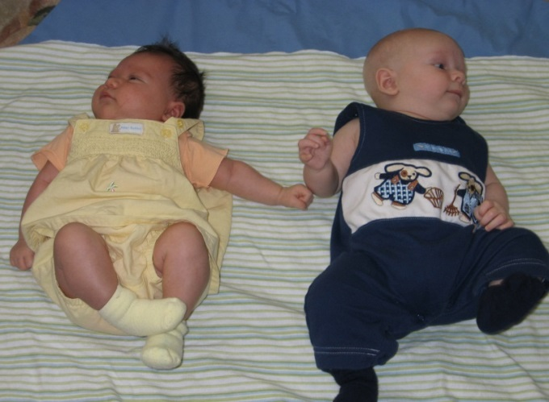
Only few states have linked Part C or 619 data to social services data.
Types of social services data | Part C | 619
Child welfare | 21% | 10%
Foster care | 12% | 8%
Temporary Assistance for Needy Families (TANF) | 10% | 14%
Homeless services | 6% | 14%

Slide 24
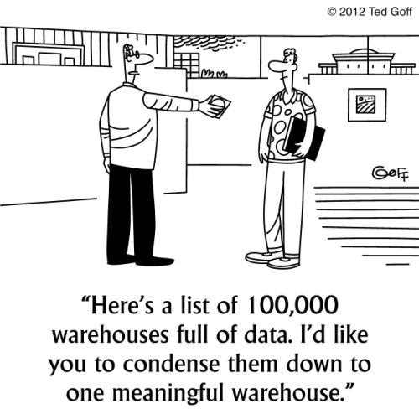
States identified many areas as priorities for future data system development and interest in receiving TA.
Notes:
Survey asked about 4 major areas and multiple topics within each topic (25 topics):
Data elements (7)
Linkages (5)
Administration and use of data (6)
Technical aspects of data systems (7)

Slide 25
Priority areas for TA
Area of state priority | Part C | 619
Child and family outcomes | 67% | 63%
Linkages between and across different types of data elements | 58% | 56%
Data use (e.g., analysis, use of program improvement) | 54% | 52%
Data sharing permissions and/or privacy issues | 67% | 48%
APR indicators/618 data | 48% | 63%
Including Part C/619 in broader state data system planning | 52% | 48%
Data quality, verification, audit systems | 50% | 46%
Linkages with social services or health data | 50% | 46%

Slide 26
Some take away messages…..
Challenge for Part B 619 programs to make full use of the child-level data elements:
not all these data elements reside in the same data system or have ever been linked for more than one-third of states.
Only 8% of the states face this challenge for Part C .
States were less likely to report having data systems with workforce data, and even fewer have program-level data.

Slide 27
More take away messages…..
Many commonalities between Part C and Part B 619 found for priority topics for future TA.
Some of the most common topics included:
child and family outcomes,
linkages between and across different types of data elements, and
using data.
We selected these priorities as major themes of this conference.

Slide 28
Next steps
Needs assessment report on DaSy web site on Monday, September 16
Coordinators and data managers may get a copy of your survey results at registration desk.
DaSy Center staff will be using findings to develop TA plans for the next year.

Slide 29
Questions
www.dasycenter.com

