Slide 1
Essentials of Data Operations
Jim Campbell, Missy Cochenour,
Baron Rodriguez
AEM Corporation
September 15th
3:00-4:45
Notes:
Issues to resolve before presentation
Multi-agency slide – The text in the boxes could be structured better to make it jump out. Maybe less words or bulleted or key words bolded/colored? (maybe the same for privacy considerations slide)

Slide 2
Overview of Session
Essential steps
Privacy considerations
Interoperability of systems
Why this matters for Early Childhood
Notes:
Birth to 21 vs. EC
Scope of each one related to privacy

Slide 3
Part C and 619 Examples
Have you ever been told you cannot see a child’s record that is in your special education program/services but enrolled in an inclusive classroom because it is in a different “system”?
Have you ever looked at your APR data and known exactly where the data quality issue came from?
Has someone use the word interoperable about your Part C and 619 systems and you knew exactly what they meant?
These are data operation questions!

Slide 4
State Examples
Notes:
Discussion:
Oregon: Inventory process, stakeholder engagement, LEA/provider involvement in collection/quality reviews, program staff for source system identification/quality & derived data assumptions.
MN: Mature data governance for k12/postsec, determined the need to develop separate DG structure for EC stakeholders.

Slide 5
Overview of Key Steps
Data quality: Ensure that data are accurate, relevant, timely, and complete for the purposes they are collected
Data access: Define and assign differentiated levels of data access to individuals based on their roles and responsibilities
Data security: Ensure the security of sensitive data by mitigating the risks of unauthorized disclosure
Data dissemination: Ensure that data sharing and reporting activities comply with federal, state, and local laws

Slide 6
Multi-Agency Considerations
Conduct analysis of legal challenges on data collection/reporting (Federal & State)
Regular communications to staff, stakeholders, and senior leadership on key decisions
Cross-agency data integration considerations:
Review duplicative collections
Ensure alignment with program rules/policies
Ensure alignment to correct source data
Information technology should never drive solutions. Program staff are essential to successful data system implementations.

Slide 7
Privacy Considerations
?
Where does the data reside as a result of your inventory?
What federal, state, and local laws apply to data sets?
What data sharing agreements need to be in place? Requirements?
What data will need to be shared AND how will the data flow?

Slide 8
What Is Interoperability?
“ability of a system to work with or use the parts or equipment of another system”
Merriam-Webster Dictionary, www.m-w.com

Slide 9
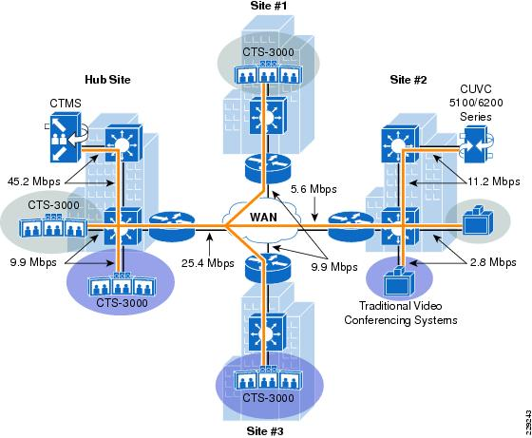
What Is Interoperability?
Cisco TelePresence Interoperability Diagram, www.cisco.com

Slide 10

What Is Interoperability?

Slide 11

What Is Interoperability?

Slide 12

What Is Interoperability?

Slide 13
Interoperability Is…

Slide 14
Interoperability Is…
Core

Slide 15
Interoperability Is…
Source
Core

Slide 16
Interoperability Is…
Source
Aligned
Core

Slide 17
Interoperability Is…
Source
Aligned
Core

Slide 18
Principles of Interoperability
Source
Aligned
Core
Principle #1
You must have an DEFINED CORE

Slide 19
Principles of Interoperability
Source
Aligned
Core
SOURCE
Principle #2
You must have an ENGAGED

Slide 20
Principles of Interoperability
Source
Aligned
Core
Principle #3
ALIGNED
Sources must be FULLY

Slide 21
So why does this matter for Early Childhood Special Education?
As early childhood begins to share data with other programs (transition data between Part C and 619, related services, increased access, K-12, etc.):
There are privacy matters to be aware of, including FERPA and HIPPA
Data quality will impact how well the data can be used and shared- ensure appropriate measures are taken to validate and check data throughout the process
  one child, many programs but something simple like different dates of birth can be a challenge
Sharing data can be an operation challenge for program people- connect with someone that understands the technical aspects of sharing data

Slide 22
Activity: Walking the line?
The facilitator will ask a series of questions in which you need to select one side of the line.

Slide 23

How to request help from DaSy
Email any DaSy staffer
Email to dasycenter@sri.com
Call DaSy Center at 650-859-3881

