Slide 1
The Early Childhood Workforce Data Landscape
Carlise King, ECDC
Mary Beth Bruder, ECPC/DaSy
Denise Mauzy, DaSy

Slide 2
Session Goals
Discuss importance of workforce data collection nationally
Review standards and tools that support states’ efforts
Provide information about workforce data collection nationally

Slide 3
Building Adult Capabilities to improve child outcomes: a theory of change
http://youtu.be/urU-a_FsS5Y
Notes:
The video does not have a download option. The link for youtube is included. Do either of you have a hotspot we could use that day? I really like the video to help set the tone.

Slide 4
A Comprehensive Early Childhood Framework
Nurturing relationships, safe environments, and enriching experiences that foster learning and development
Comprehensive services that promote children’s physical, developmental, and mental health
Early Care
and Education
Resources, experiences, and relationships that strengthen families, engage them as leaders, and enhance their capacity to support children’s well being
Family
Leadership and Support
Health
Early Identification, assessment and appropriate services for children with special health care needs, disabilities, or developmental delays
Special Needs/
Early
Intervention
Source: Adapted from Early Childhood Systems Working Group, National Governor’s Association, 2006.

Slide 5
Why Focus on Workforce Data?
How prepared is the early care and education workforce to provide effective education and care for all children?
What policies and investments lead to a skilled and stable early care and education workforce?

Slide 6
Who is Our Workforce?
Head Start
State Preschool
Early Intervention
Preschool Special Education
Subsidized Child Care
Non-Subsidized Child Care
Workforce Categories
Assistant teachers
Administrators
Family-based professionals
Non-teaching professional staff
Non-teaching support staff
Teachers

Slide 7
Early Childhood Workforce Data: What We Know and What We Need To Do in Part C and 619
Presented by: Mary Beth Bruder, PhD, Director University of Connecticut A.J. Pappanikou Center for Excellence in Developmental Disabilities Education, Research, and Service 263 Farmington Avenue, MC6222 Farmington, CT 06030 Phone: (860) 679-1500 Fax: (860) 679-1571 E-mail: bruder@nso1.uchc.edu Website: www.uconnucedd.org

Slide 8
Vision: Effective Early Childhood Models
All Children are Learning
All Personnel Have the Competencies to Insure Learning Occurs in School, Home and Communities

Slide 9
Why an EC CSPD is important
More EC leaders and practitioners working with children and families receiving IDEA services have the requisite knowledge and skills.
States have high quality CSPD (i.e., multiple state level supports for a competent EC work force)
Improved effectiveness of EI, ECSE, and EC services and supports
Improved outcomes for children and families
Note: ECPC will focus on the blue box. The working assumption is that the blue box will produce the green boxes. Large scale change in these areas will occur after the 5 years of the Center.
How improved CSPD
leads to
improved outcomes

Slide 10
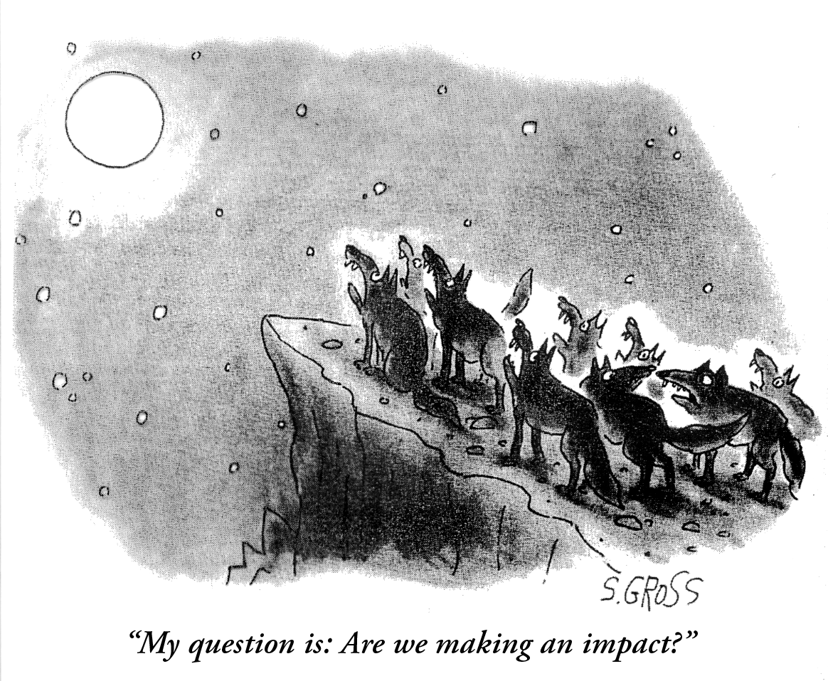

Slide 11
Infants and young children with disabilities and their families make the best overall progress when all interventions are consistent across disciplines (special education, related services and early childhood) and settings (early care and education programs, community programs and the home).

Slide 12
Professionals In Early Childhood Intervention
Physician
Psychologist
Social Worker
Educator (EC;SPED;)
Speech Language Pathologist
Audiologist
Nurse
Nutritionist
Occupational Therapist
Physical Therapist

Slide 13
A common core of measurable competency based and authentic personnel preparation standards (standards) is necessary for the preparation of competent personnel who will serve infants, toddlers and preschool children with disabilities and their families using evidenced based recommended practices across settings and environments.

Slide 14
DEC Early Childhood Special Education/Early Intervention Personnel Standards (Birth to Eight)
Initial Special Education Professionals
Special Education Early Childhood Specialists
Foundations
Development and Characteristics of Learners
Individual Learning Differences
Instructional Strategies
Learning Environments/Social Interactions
Language
Instructional Planning
Assessment
Professional and Ethical Practice
Collaboration
Leadership and Policy
Program Development and Organization
Research and Inquiry
Individual and Program Evaluation
Professional Development and Ethical Practice
Collaboration

Slide 15
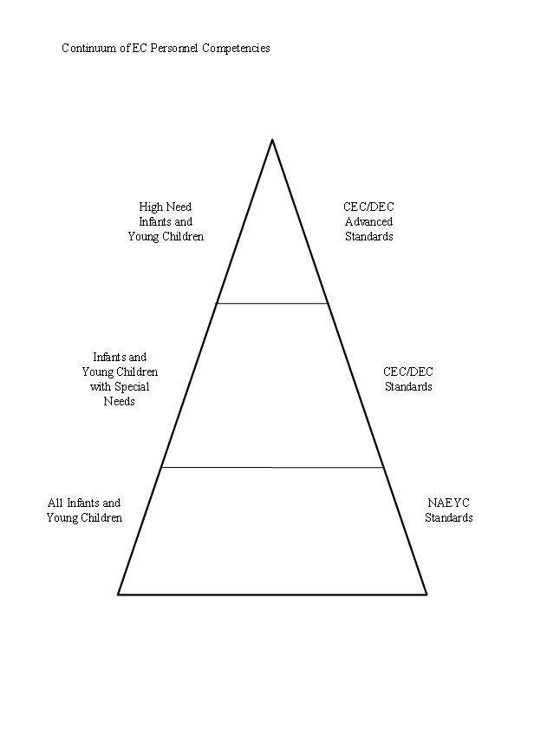

Slide 16
LRE
Least Restrictive Environment ( 1975): To the maximum extent appropriate, children with disabilities, including children in public or private institutions or other care facilities, are educated with children who are not disabled, and special classes, separate schooling, or other removal of children with disabilities from the regular educational environment occurs only when the nature or severity of the disability of a child is such that education in regular classes with the use of supplementary aids and services cannot be achieved satisfactorily.

Slide 17
Natural Environments (1986)
To the maximum extent appropriate to the needs of the child, early intervention services must be provided in natural environments, including the home and community settings in which children without disabilities participate
Natural environments are settings that are natural or normal for the child’s age peers who have no disability

Slide 18
Personnel Preparation: What we Know and What we Need to Know
Mary Beth Bruder, Ph.D. Vicki Stayton, Ph.D.
University of Connecticut Western Kentucky University

Slide 19
The Center’s Projects
Study I: The National Landscape of Early Intervention and Early Childhood Special Education
Study II: The Higher Education Survey for Early Intervention and Early Childhood Special Education
Study III: The Analysis of Federally Funded Doctoral Programs in Early Childhood Special Education
Study IV: The Impact of Credentials on Early Intervention Personnel Preparation
Study V: Analysis of State Licensure/Certification Requirements for Early Childhood Special Educators

Slide 20
The Center’s Projects
Study VI: Training and Technical Assistance Survey of Part C & 619 Coordinators
Study VII: Confidence and Competence of 619/Part C Service Providers
Study VIII: Alignment of ECSE Higher Education Curricula with National Personnel Standards
Study IX: Parent Perceptions of Confidence and Competence of 619/Part C Service Providers
Study X: Case Studies Highlighting States from Study VI on Training and TA

Slide 21
Overall Recommendation: Use IDEA to Structure an EC CSPD
Multiple Audiences
Needs Assessment
Preservice
Inservice
Technical Assistance
Personnel Standards
Evaluation

Slide 22
A comprehensive system of personal development for the early childhood workforce who serve infants, toddlers and preschool children with disabilities and their families is a necessary and integral quality indicator of an early childhood service system

Slide 23
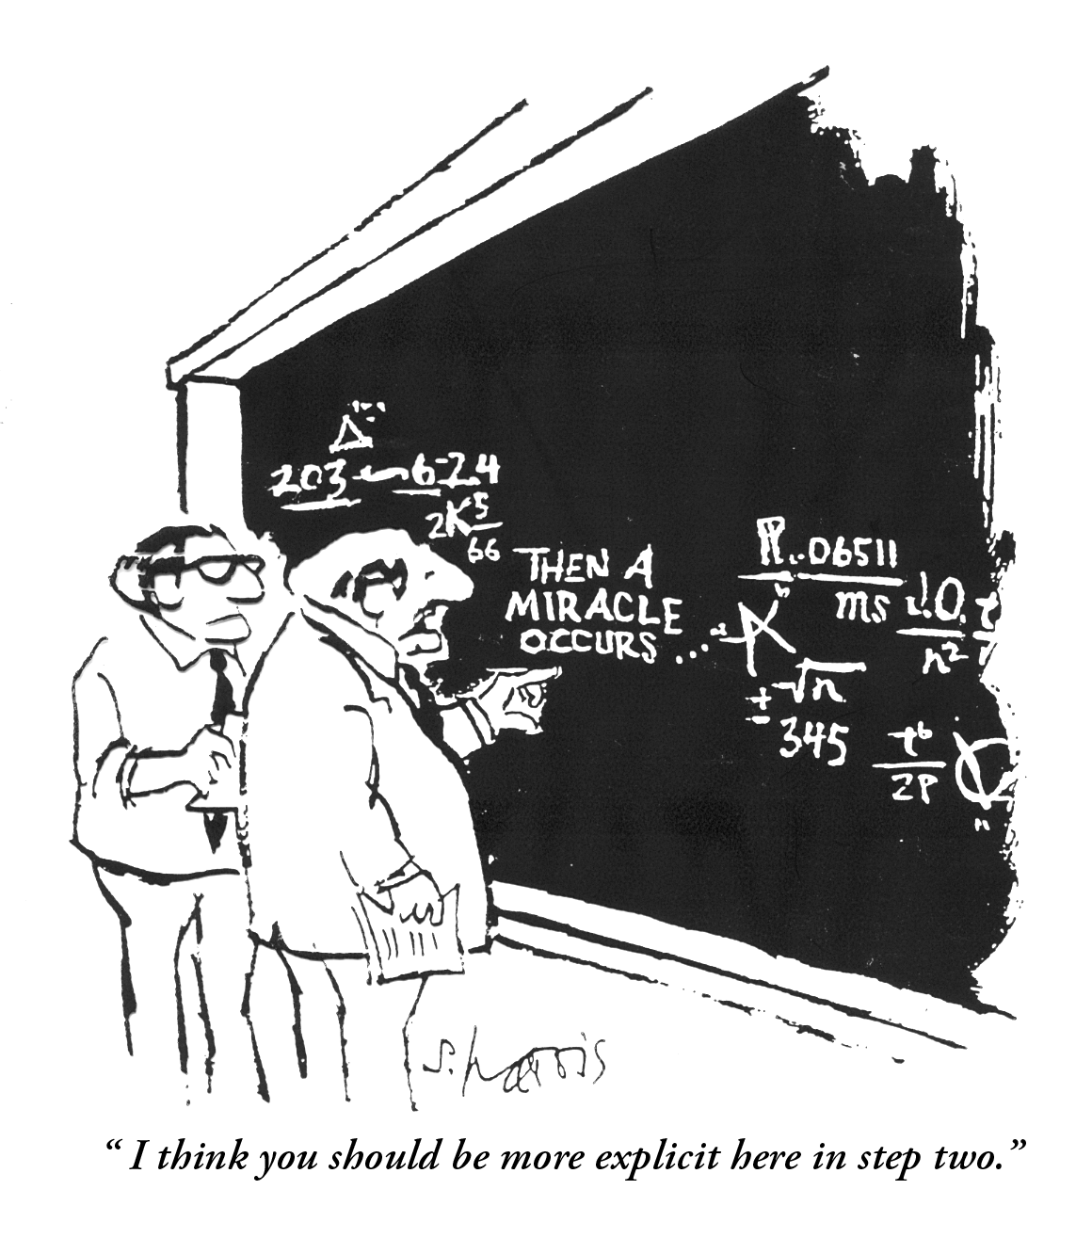

Slide 25
The Early Childhood Personnel Center (ECPC) will serve as a national resource to State Education Agencies (SEA), Lead Part C agencies, other early care and education agencies, Institutes of Higher Education (IHE), and other entities responsible for professional development of personnel providing early childhood intervention to infants, toddlers, and preschool children with disabilities and their families.

Slide 26
Center Framework
Knowledge Generation
Technical Assistance and Dissemination
Leadership and Collaboration
Personnel Policy
and Standards
Evidenced Based
Practice
Technology
Application
Model Development
Implementation Science
Outcomes and Accountability
State Agency and Certification Personnel
IHE Faculty
And Other
Trainers
Program
Admin-
and Service
Providers
Families
Graduate
Students

Slide 27
HOW??
Implementation Science
Regional Collaborations
National Partners
Management and Accountability

Slide 28
Director
Mary Beth Bruder (UConn)
Co-Director
Geroge Sugai (UConn)
Internal Evaluation Team
Mary Louise Hemmeter (Vanderbilt)
Jeannette McCollum (U of Illinois)
Vicki Stayton (Western Kentucky University)
External Evaluator
Evergreen
Coordinator
Ann Mickelson (UConn)
Project Consultants/Contractors
Pip Campbell (Jefferson University)
Division of Early Childhood
Claudia Dozier (KU- ABS/BCBA)
Larry Edelman
University of CT Regional Associate Director
Mary Beth Bruder
FL State University
Regional Associate Directors
Juliann Woods
Mary Frances Hanline
University of KS
Regional Associate Directors
Eva Horn
David Lindeman
University of OR
Regional Associate Director
Jane Squires
University of OR
Regional Associate Director
Jane Squires
Post .Doc Ching-I Chan
Gabriela Freyre Calish
Post Doc Emily Lakey
Cindy Vail
Post Doc Stephanie Parks
Post Doc Lois Pribble
Regional Advisory Board
Regional Advisory Board
Regional Advisory Board
Regional Advisory Board
Partner Organizations and Project Advisory Board
AUCD
CEC
ECTA
HECSE
ITCA
NAECS-SDE
NAEYC
NASDSE
NASDTEC
CCSSO
Part B/619 Consortia
NHSA
NRCP

Slide 29
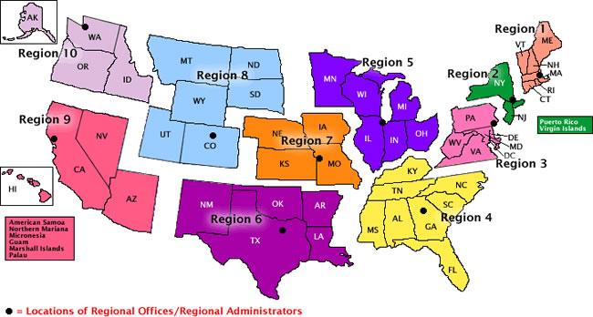

Slide 30
Regional Center | Region | States
University of Connecticut | 1 | Connecticut, Maine, Massachusetts, New Hampshire, Rhode Island, Vermont
University of Connecticut | 2 | New Jersey, New York, Puerto Rico, Virgin Islands
University of Connecticut | 3 | Delaware, Washington DC, Maryland, Pennsylvania, Virginia, West Virginia
Florida State University | 4 | Alabama, Florida, Georgia, Kentucky, Mississippi, North Carolina, South Carolina, Tennessee
Florida State University | 5 | Illinois, Indiana, Michigan, Minnesota, Ohio, Wisconsin, (Iowa)
University of Kansas | 6 | Arkansas, Louisiana, New Mexico, Oklahoma, Texas
University of Kansas | 7 | Iowa, Kansas, Missouri, Nebraska, (Iowa to FSU)
University of Kansas | 8 | Colorado, Montana, North Dakota, South Dakota, Utah, Wyoming
University of Oregon University of Hawaii | 9 | Arizona, California, Nevada Hawaii, Guam, American Samoa, Marianna, Marshal Palou, Micronesia
University of Oregon | 10 | Alaska, Idaho, Oregon, Washington

Slide 31
ADMINISTRATION AND MANAGEMENT
Data Collection and Analyses of Personnel
Policies;
Literature Reviews,
Syntheses and Papers
Review of DEC Personnel Practices, Standards;
Refine Standards across Disciplines
General TA through Meetings, Webinars, Product Development and Dissemination
Targeted TA and Dissemination to Specific Populations on Personnel Procedures,
Policies and Practices
Intensive TA to 8 States to Develop, Implement and Sustain a Model CSPD in EC for Infants and Young Children with
Disabilities
Leadership through
Collaborations;
Training Institute for C/619 Coordinators;
Training on Scaling
up CSPD’s
EVALUATION AND CONTINUOUS IMPROVEMENT

Slide 32
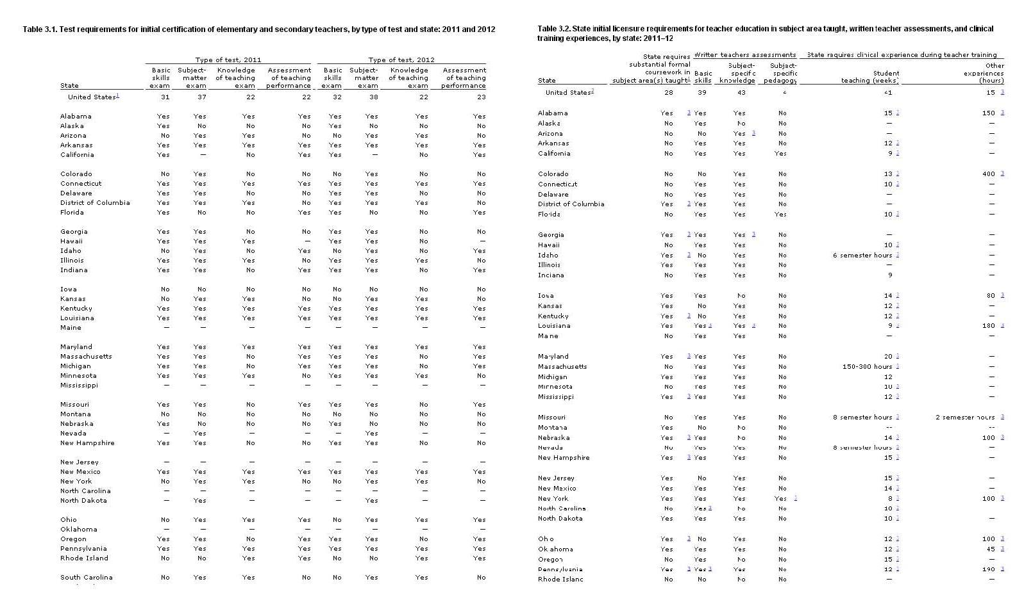
NASDSE

Slide 33
State Personnel Standard: Credential/Licensure/Certification Data
STATE __(A)_____ DISCIPLINE (B)
Name of Credential/
Licensure/Certification/Endorsement for discipline (e.g., to
allow candidate to work with 0-5 year olds with disabilities in
this discipline) by number and description (e.g. PreK – 3rd
grade; birth though grade 12) (C)
1. Which State Department Issues and oversees it (D) 2. Type (E)
3. Age (F)

Slide 34
Standard Requirements
a. Educational Requirements
i. Degree
A. Level ( Associates, Bachelors, Masters, Doctoral) (G)
B. List of approved programs in IHE or link to list (H)
ii. Curricular/Coursework requirements( y/n) (I)
Details (J)
iii. Clinical/Practicum Requirements (y/n ) (K)
Details (L)
iv. Post-graduation Requirements (y/n) (M)
details (N)
b. Exam Requirements (national ( EG Praxis) and/or state (y/n) (O)
i. Specifics (P)

Slide 35
c. Additional/Different requirements to work with infants and toddlers( y/n) (Q)
Details (R)
d. Additional /Different requirements to work within public school settings (y/n) (S)
Details (T)
e. Additional/Different requirements to work with special populations (y/n) (U)
i. Details (V)
5. Alternative Route Requirements( y/n) (V)
Experience/ coursework/exam (W)
6. Provisional and/or temporary Credential /Licensure/Certification (y/n) (X)
b. Experience/coursework/exam (Y)
7. Reciprocity with other states(y/n) (Z)
a. Details (AA)

Slide 36
Category (by order in the data table) | Definition
Discipline* | The licensure/certification/endorsement category which may include several types and paths in separate entries.
State Department Granting Licensure/Certification | The state department that is responsible to setting requirements and granting the license/certificate( usually education or health).
Name of License/Certificate | The EXACT title or name associated with the licensure /certification on the state webpages.
Type of Licensure/Certification** | The licensure/certification /endorsement
Age Range | The age population the license/certificate/endorsement holder will be able to work with.
Minimum Education Level | Minimum degree level required to receive a license/certificate.

Slide 37
Category (by order in the data table) | Definition
Additional Requirements for Working in Early Intervention (Birth to Three) | The EXTRA requirements and parameters (e.g., specific coursework, training, and experiences) for the license/certificate holder to work with infants and toddlers with special needs (under Part C of the Individuals with Disabilities Education Act)This is not standard requirement
Additional Requirements for Working in Preschools/School Districts (Three to Five) | The EXTRA requirements and parameters (e.g., specific coursework, training, and experiences) for the license/certificate holder to work with preschoolers with special needs (under Part B 619 of the Individuals with Disabilities Education Act)This is not a standard requirement
The National Organization(s) Referenced | If Yes Name of the national organization that its licensure/certification requirements/standards were referenced by the state as basis for state-level requirements/standards.

Slide 38
Category (by order in the data table) | Definition
State-Level Requirements/Standards | If yes Relates to standards used to base licensure on that are UNIQUE to and are DEVELOPED BY THE STATE – requirements that are above and beyond national standards or in place of national standards.
Specific Curriculum/Coursework Requirements | Specific curriculum/training topics, coursework or number of credits required in preparation programs leading to licensure eligibility.
Specific Field or Clinical Work Requirements | Specific number of field/clinical hours or other parameters (i.e., work with specific population) required by the state in preparation programs.
Licensure/Certification Exam | The national-level or state-level exam required to pass to obtain the license/certificate.
Competency Referenced by the Licensure/Certification Requirements | National-level or State-level competencies (e.g., knowledge and skills demonstrated by the licensee) that the state licensure/certificate requirements are based on.

Slide 39
Category (by order in the data table) | Definition
Specific Post-Academic Field or Clinical Work Requirements (Including Provisional/Temporary License Issued to Interns) | For field or clinical work requirements that are part of the TYPICAL licensure/certification preparation path. The temporary permit or provisional license granted to allow interns to practice while waiting for exam results or fulfilling post-graduate clinical fellowships is under this category.
Alternative Routes for Licensure/Certification (Including Emergency/Temporary License Issued to Professionals) | Other paths that lead to the license/certificate rather than completing the traditional preparation program. The temporary/emergency license issued due to shortage areas or special circumstances is under this category.
# of IHEs Offering Programs Leading to Licensure/Certification | The number of higher education programs preparing folks for the license/certificate through TRADITIONAL and ALTERNATIVE paths.

Slide 40
Category (by order in the data table) | Definition
Requirements for Licensure/Certification Reciprocity with Other States | The requirements for an individual who is previously licensed in another state but wants to become licensed in the state of interest. Initial licensure that allows candidates to qualify for licensure in states other than where they complete their preparation through interstate agreements.
State-Level Licensure Web Links | State-level web links that provide critical information about the license/certificate
Additional Information | Other important information that does not fit in the above categories.

Slide 41
*Discipline for data collection:
Early Childhood Special Education (ECSE)
Early Childhood Education (ECE) – does not include Head Start and Child Care information.
Occupational Therapist (OT)
Physical Therapist (PT)
Speech Language Pathologist (SLP)
Audiologist
Registered Nurse

Slide 42
** Type of licensure/certification applied:
1. Licensure/Certification
2. Licensure/Certification (SPECIFIC) with Endorsement
3. Endorsement (Added to various licenses)
4. Unified/Blended License/certificate [e.g., EC/ECSE]
5. Dual Certification (IF TWO DISTINCT Certifications are REQUIRED AT STATE LEVEL)
6. Other (e.g., advanced training not leading to licensure or endorsement)
7. Social Worker
8. Family Therapist
9. Clinical Psychologist
10. School Psychologist
11. Vision Specialist – focus on teaching license/certificate
12. Deaf and Hard of Hearing Specialist – focus on teaching license/certificate

Slide 43
Two Sample States
Disciplines(n=11):
Psychologist
Vision Specialists
ECE (Regular Educator)
ECSE (Special Educator)
Social Worker
Occupational Therapist
Physical Therapist
Speech Language Pathologist
Audiologist
Family Therapist
Registered Nurse

Slide 44
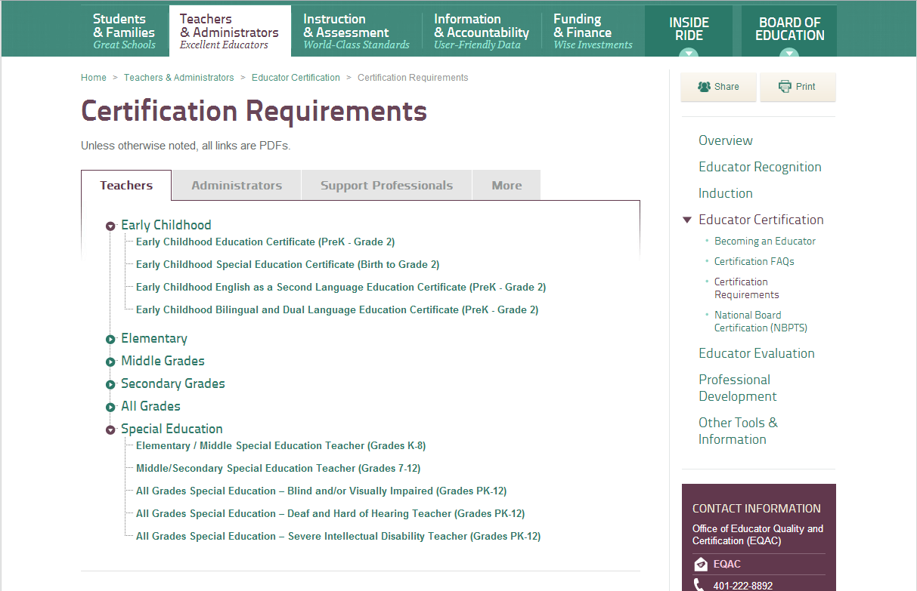

Slide 45
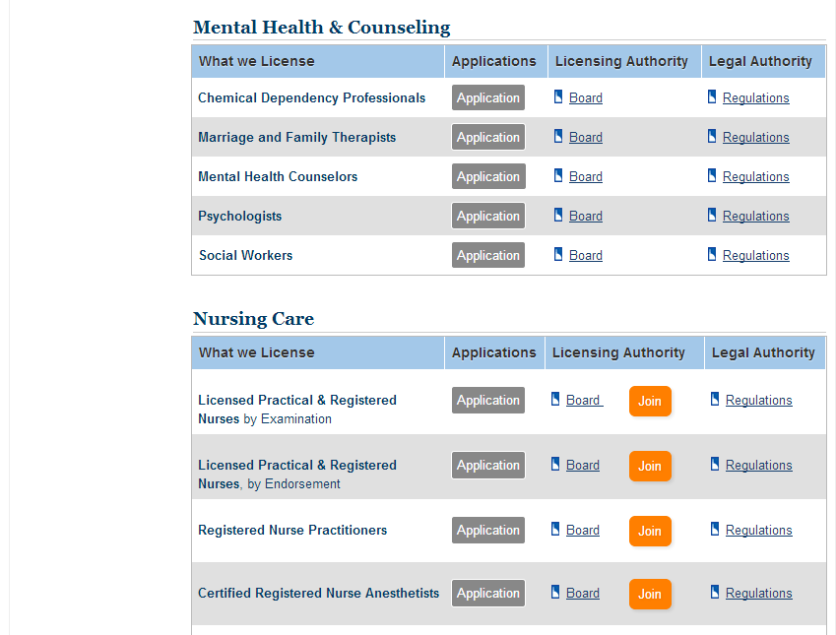

Slide 46
Age Range and Degree Level Requirements
Age range:
Minimum degree :
4 distinct age ranges
3yrs to 12th grade (n=3)
3yrs to 2nd grade (n=1)
Birth to 2nd grade (n=1)
Birth to death (n=6)
3 distinct age ranges
3 yrs to 12th grade (n=2)
3 yrs to 5 yrs (n=1)
Birth to death (n=8)
Bachelor Degree (n=4)
Masters Degree (n=4)
Doctoral Degree (n=3)
Bachelors Degree (n=3)
Masters Degree (n=4)
Doctoral Degree (n=2)
Associate Degree (n=1)
Unclear (n=1)

Slide 47
Taking a look at two specific disciplines…
Selected two disciplines:
ECSE – considered to be most complex
OT = considered to one of the least complex

Slide 48
ECSE & OT across 30 states…Age Ranges
ECSE = 15 age ranges
3yrs to 12th grade (n=4)
3 yrs to 5 yrs (n=1)
3yrs to 3rd grade (n=3)
3yrs to 2nd grade, (n=1)
Birth to K (n=3)
Birth to 3 years (n=9)
Birth to 2nd grade (n=2)
Birth to 3rd grade (n=5)
Birth to 4th grade(n=1)
Birth to 5 yrs (n=5)
Birth to 6 yrs (n=1)
Birth to 7 yrs (n=1)
Birth to 8 yrs (n=2)
K-12th grade (n=1)
Birth to 12th grade (n=3)
OT= One age range
Birth to death

Slide 49
ECSE & OT across 30 states… Type of Licensure:
ECSE - FIVE types
OT – TWO types
Licensure/Certification (n=13)
Licensure/Certification plus endorsement (n=18)
Endorsement (n=4)
Dual certification required (n=1)
Blended or Unified Licensure (n=4)
Non-Licensure (n=1)
Unclear (n=2)
Licensure/Certification(n=28)
Licensure/Certification plus endorsement (n=3)

Slide 50
ECSE & OT across 30 states… Alternative route to licensure?
ECSE:
OT:
Alternative route exists in 97% (n= 45)
Alternative route exists in 1% of states (n=31)

Slide 51
ECSE & OT across 30 states… Minimum degree level required:
ECSE =
OT =
Masters (n=2)
Bachelors (n=39)
High School Diploma (n=1)
Did not specify (n=1)
Unknown (n=1)
Masters (n=24)
Bachelors (n=6)
Completion of nationally accredited program (n=1)
Notes:
High school = North Carolina for 0-3

Slide 52
ECSE & OT across 30 states…
Licensure dependent on exam?
Reciprocity with other states?
ECSE
84% (n=44)
OT
100% (n= 31)
ECSE
68% (n=44)
OT
84% (n=31)

Slide 53
National Assessment of CSPD Components
Ongoing needs assessment
Appropriate licensing and certification
IHE programs to provide pre-service training
Ongoing, systematic and effective in-service opportunities
A data system for personnel
Evaluation
TA availability
Dissemination

Slide 54
States Reporting CSPD Components
( Data Collection is Not Completed)
 | Ongoing Needs Assessment | Appropriate Licensing and Certification | IHE programs to provide pre-service training | Ongoing, Systematic and Effective PD in-service opportunities | Evaluation | A Data System for Personnel | TA Availability | Dissemination
Part B/619 Grand Total (count/ percent) (N=24) | 10 (41.7%) | 19 (79.2%) | 21 (87.5%) | 17 (70.8%) | 11 (45.8%) | 12 (50%) | 18 (75%) | 16 (66.7%)
Part C Grand Total (count/ percent) (N=28) | 15 (53.6%) | 21 (75%) | 18 (64.3%) | 18 (64.3%) | 8 (28.6%) | 12 (42.9%) | 20 (71.4%) | 19 (67.9%)

Slide 55
Next Steps:
DaSy

Slide 56
Workforce Data Systems: Data Elements for Part C

Slide 57
Workforce Data Systems: Data Elements for Part B 619 Special Education Preschool Teachers

Slide 58
Related Services Personnel

Slide 59
General Education Teachers

Slide 60
Linkages Part C

Slide 61
Linkages Part B

Slide 62
Unique Identifiers Across C/619
Only 17% of Part C coordinators reported that there are common unique child identifiers used by both Part C and Part B 619 data systems, while 31% of Part B 619 coordinators reported having common unique child identifiers across the two data systems (Figure 10).
Few Part C and Part B 619 coordinators reported the use of common school or program unique identifiers across the two programs’ data systems (8% and 17% of states, respectively).

Slide 63
Next Steps:
ECPC

Slide 64
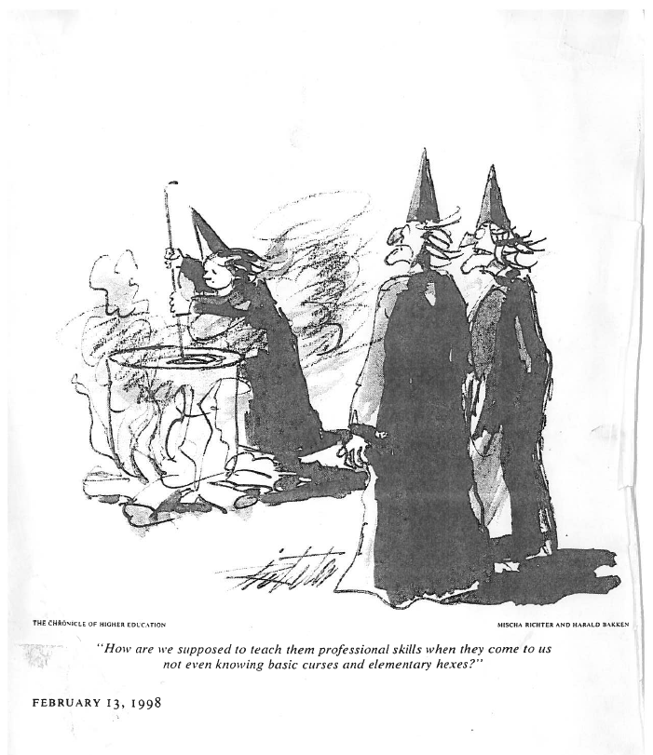

Slide 65
Web Site Information
Center Information
http://www.ecpcta.org/
Data Reports
http://www.uconnucedd.org/projects/early_childhood/publications.html

Slide 66
Early Childhood and School Age Registries: a State Workforce Data Collection Tool

Slide 67
What is a registry?
comprehensive workforce information system
collects essential data on early childhood and school age professionals
recognizes professional attainment and supports PD planning
an integral part of the infrastructure for state professional development systems
serves as a hub for data collection, reporting, and analyses

Slide 69
Primary/Typical Registry Recruitment
Practitioners/Teachers
Others
Child Care Centers
Family Child Care
Head Start
Public Pre K
Faith-based Child Care
Any program participating in a QRIS
Any professional participating in state PD activities tracked by registry
Others
Trainers
Technical Assistance Providers

Slide 70
Core Registry Data Collection Functions
User information
Workforce ID
Demographic
Employment
Verified education data
Verified training data

Slide 71
Registry as a “Hub”
Notes:
Alt text:

Slide 72
How much overlap Exists between Registry and IDEA data collection?

Slide 73
Alaska
The Alaska SEED Registry has an Early Intervention (EI) and Infant Learning Program (ILP) track on the SEED Career Ladder.
All EI/ILP professionals are required by their program to be in the Alaska SEED Registry.
Comprehensive data on Part C
No recruitment or data relationships with Part B/619 or teacher licensure

Slide 74
Illinois
Early intervention has been invited to participate in recruitment planning activities
No current targeted recruitment for early intervention or pre-school special education
Staff members who work in licensed programs are required to be in the registry
Preschool for All staff (certified and non-certified) required to join registry
Working on project involving data exchange of certified teacher data

Slide 75
Ohio
Early Intervention Service Coordinators and Supervisors are required to participate in the registry
Registry administers credentialing process
Provide information to Department of Health monthly
Teacher licensure has its own system
All Department of Education programs will be mandated to participate due to TQRIS and the ELCG
Working one-time data dump for licensure information for all teachers employed in programs participating in QRIS

Slide 76
Registry Data: Monitoring Workforce trends
2012 Workforce Dataset: A Review of Workforce Trends

Slide 77
Partnership Eligibility Review
Completion of Verification Process
Alignment with Core Data Elements for Early Childhood and School-Age Registries
Policies and Procedures Related to Data Collection Processes
9 Registries Approved
8 state, 1 regional
Participate in National Registry Alliance Workforce Dataset and other partnerships

Slide 81
Questions and Discussion
Notes:
This is where we have both moderated questions and audience questions. I think two question for our responses is probably sufficient and will help to ensure that there is sufficient time to for their questions.
Moderator Questions
What do you see as the opportunities to develop integrated workforce data systems that include the IDEA workforce?
How could the inclusion of IDEA workforce data support professional development supports in states?
What states have been successful at collecting IDEA workforce data? What was there strategies?
What are some action steps that participants can take back to their states?

