Slide 1
CEDS: Common Data Elements and Definitions for Part C and 619 Programs
Missy Cochenour, Applied Engineering Management
Haidee Bernstein, Westat
Denise Mauzy, Applied Engineering Management
Improving Data, Improving Outcomes Conference
September 15-17, 2013
Washington, DC

Slide 2
Session Description
Discuss the benefits and challenges of developing data systems across Part C and Part B/619 programs with common data elements and definitions.
Have a Hands On opportunity to explore the Align and Connect tools developed by the CEDS initiative.
Experience the power of shared data dictionaries, shared evaluation and research questions, and shared analytic strategies.
Learn a new way to answer important program and policy questions.

Slide 3
Agenda
Introduction: Missy Cochenour
Demonstration of Align: Missy Cochenour
Hands On Align session/ short break: Group work
Demonstration of Connect: Missy Cochenour
Hands On Connect Session: Group work
Notes:
Fill in who is doing what

Slide 4
CEDS OVERVIEW
?
Why is CEDS useful to you?
?
What are the Common Education Data Standards?
?
How have they been developed?
Who developed CEDS, specifically in early learning?
?

Slide 5

What are your Interests?
Are you working in your state to develop a common data vocabulary?
Are you currently using
CEDS?
Notes:
Start here

Slide 6
What is CEDS?
A vocabulary including standard definitions, option sets, and technical specifications to streamline sharing and comparing information
A national collaborative effort to develop voluntary, common data standards for a key set of education data elements
Voluntary Common Vocabulary

Slide 7
Does CEDS relate to Part C and 619?
Common Education Data Standards
Education - Sounds like it doesn’t include Head Start, Child Care, and Part C non-Education lead agencies
Standards - Sounds like it refers to benchmarks or criteria that data would have to meet
Common (mis) Conclusions:
CEDS does not include or relate to Part C and Section 619.
OR
If CEDS does include Part C and 619, it means more requirements coming down from U.S. Department of Education.

Slide 8
Why is DaSy talking about CEDS?
DaSy Goal: To develop and enhance statewide early childhood coordinated and longitudinal data systems to improve state capacity to collect, analyze, and report high quality data required under IDEA
    ALIGN: Addresses reporting high quality data by providing common data dictionaries (elements, option sets, and technical specifications)
    CONNECT: Facilitates data analysis by recommending analytic approaches (logic and formulas) to address program and policy questions as well as Federal reporting requirements (indicators)
    Enhances capacity for coordinated and longitudinal analysis by including data elements in different domains across the P-20W continuum

Slide 9

Why
CEDS in EC?

Slide 10


Same or Different File?
Maria L. Lopez
D.O.B. 3/25/2009
1010 Spruce Street
Fresno CA 93706
Mother: Inez Lopez
Father: Juan Pablo Lopez
Maria Lopez
D.O.B. 3/25/2009
939 Howard Street
Homestead, FL 33030
Mother: Inez Lopez
Father: Juan Lopez
HEAD START FILE
HEAD START FILE

Slide 11
Same or Different File
It is the same file. This migrant family moves seasonally to find work
What elements should be added to help someone determine that it is the same file?

Slide 12

Same or Different File?
J. D. Stone
123 Harper Street
West Hempstead, NY 11552
D.O.B. 9/13/2012
J. D. Stone
123 Harper Street
West Hempstead, NY 11552
D.O. B. 9/13/2012
E. I. Program Nassau County
E.I. Program Nassau County

Slide 13
Same or Different?
They are twins with different files.
What elements should be added to help someone determine that it is the same file?

Slide 14
Imagine...
A child from
Early Learning Program A also enrolls in Early Intervention Part C services that use a different education data standard.

Slide 15

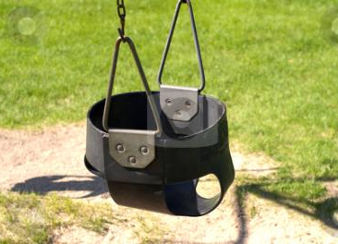
Here’s a
child:
Matthe
SmithIII
Race = Guamanian
Gender = M
Did you mean:
Matthew ?
Smith ?
Suffix = III ?
Race = NHOPI ?
Sex = M ?
Early Head Start
Early Intervention

Slide 16
CEDS Tools

Slide 17
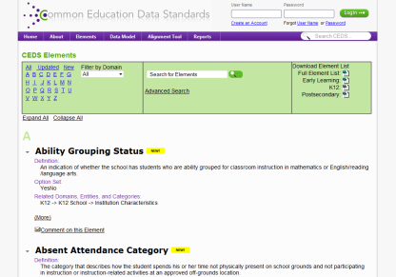
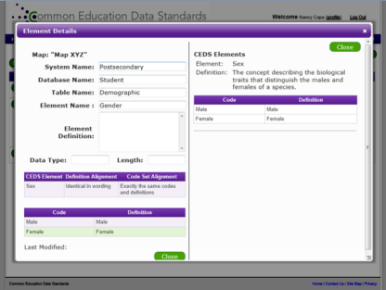
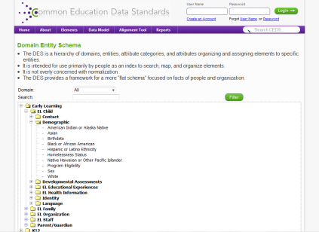
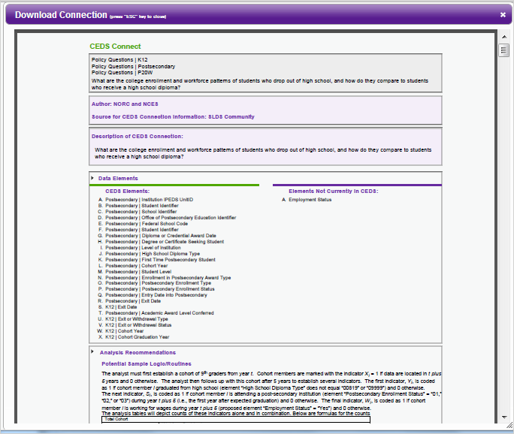
CEDS Tools
A Robust & Expanding Common, Voluntary Vocabulary drawn from existing sources
Powerful Stakeholder Tools & Models
  Connect
  Logical Data Model
  Align

Slide 18
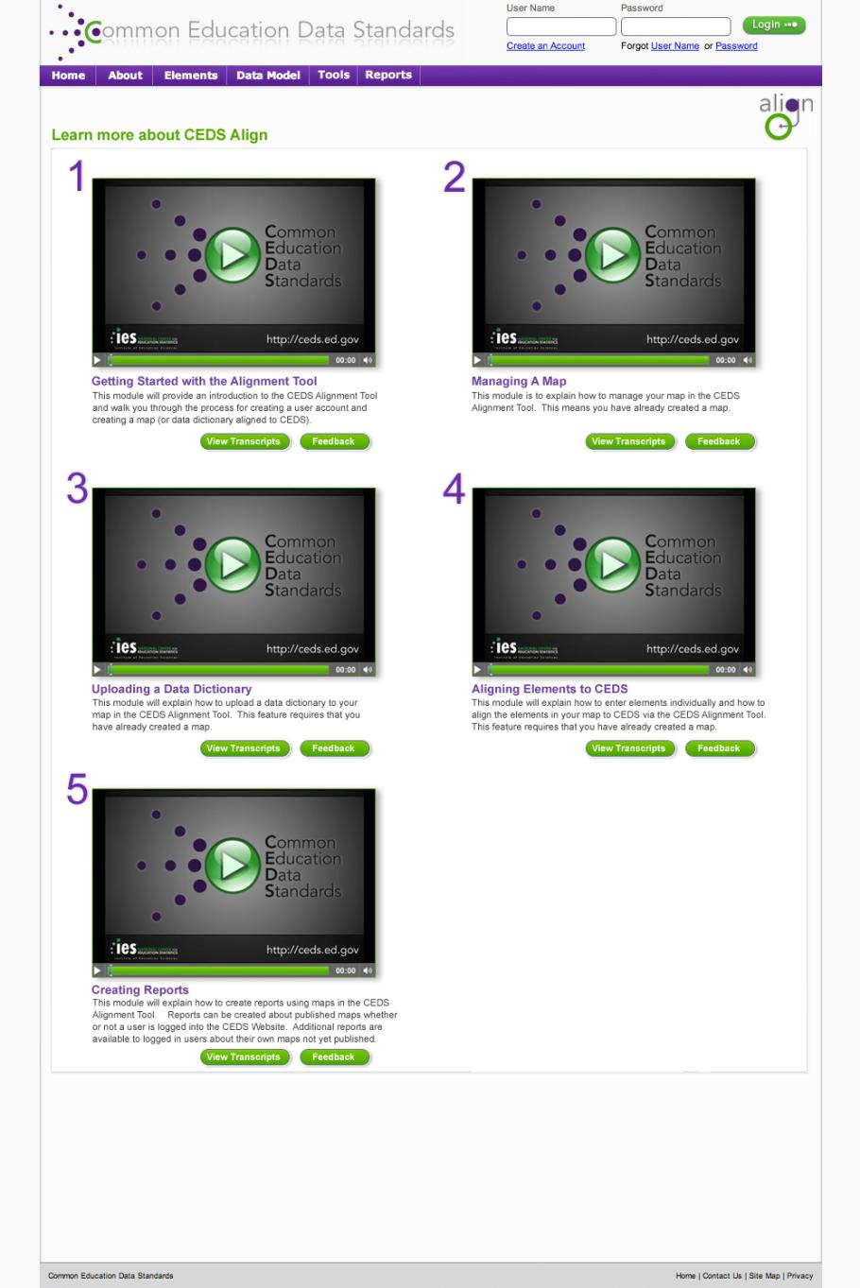

Slide 19
CEDS Anatomy: The Basics

Slide 20
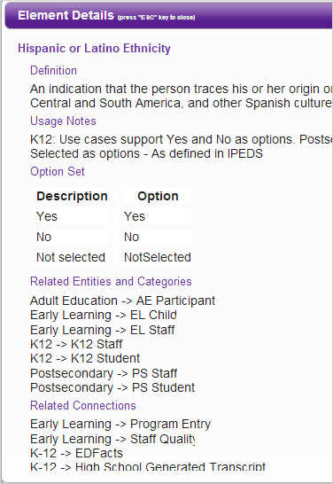

Standard Information: The Basics
Element
Definition
Hispanic
or Latino
Ethnicity
Option set
Yes
No
NotSelected
Domain
Entity
K12
K12 Student

Slide 21
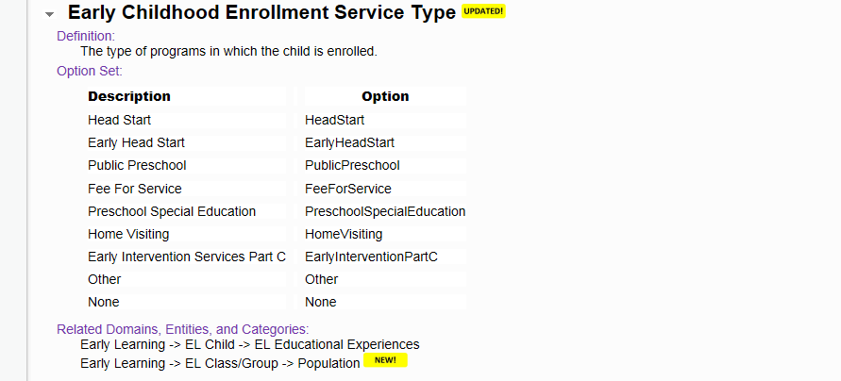
Early Childhood Enrollment Service Type

Slide 22
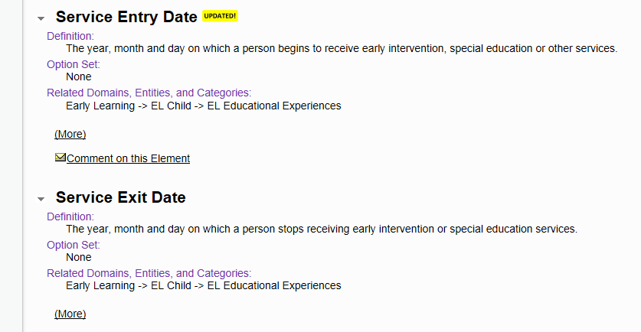
Service Entry and Exit Dates

Slide 23
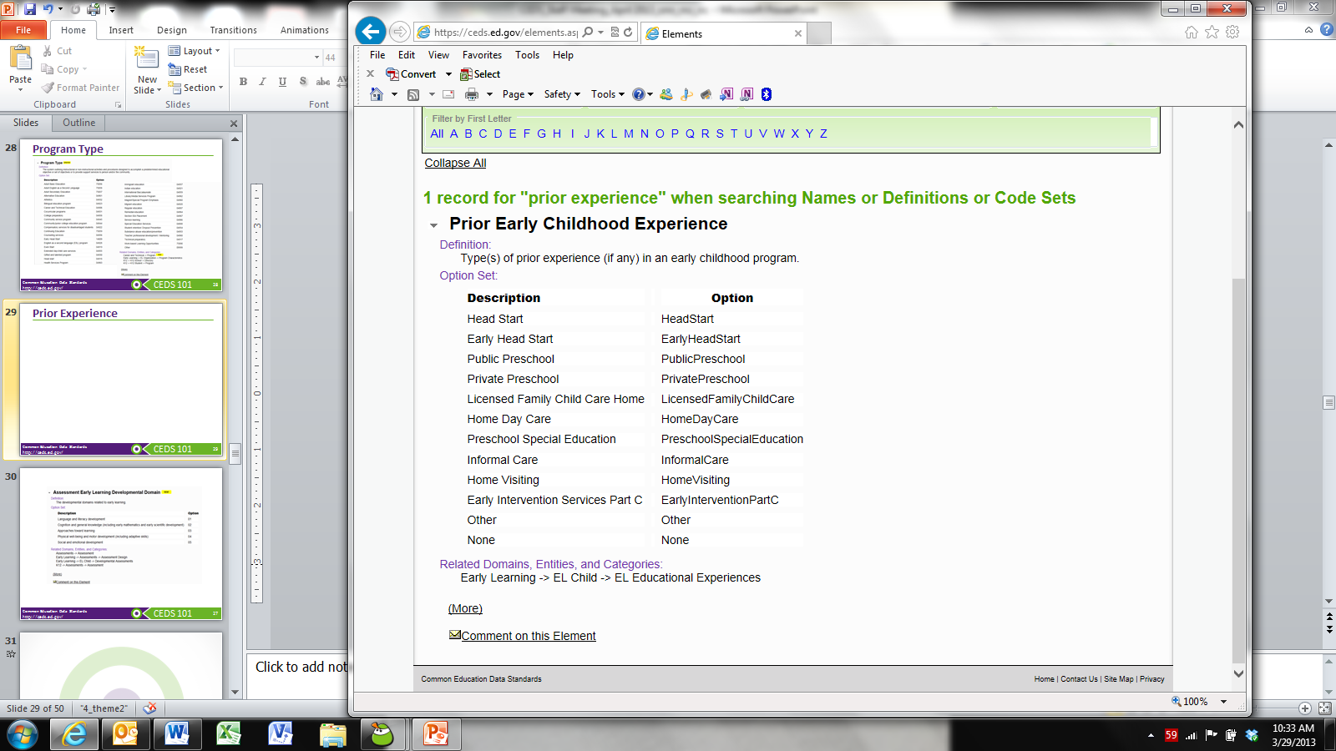
Prior Early Childhood Experience

Slide 24
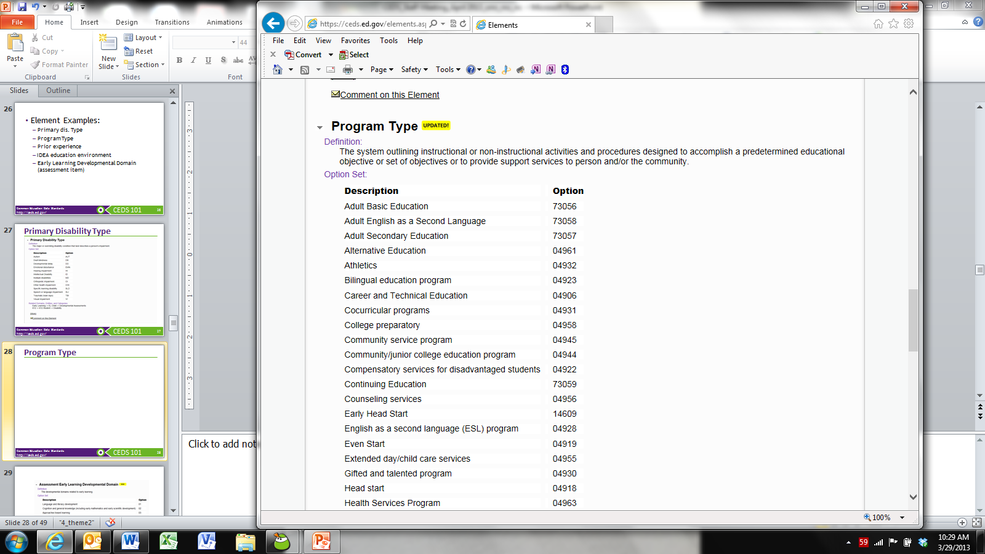
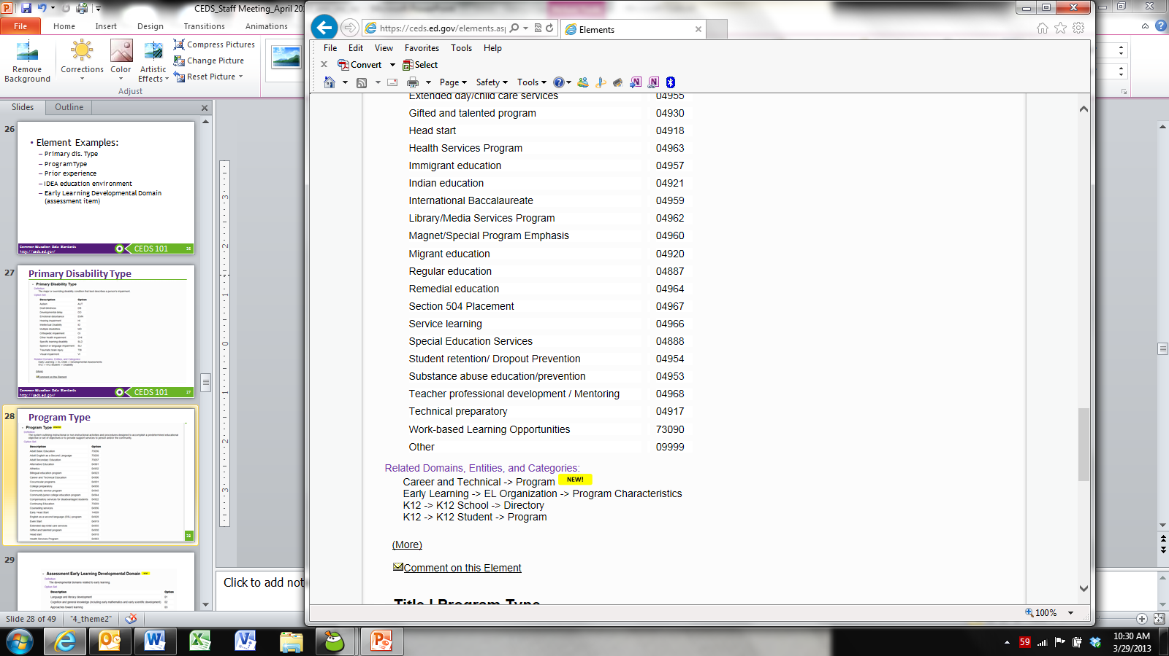
Program Type

Slide 25
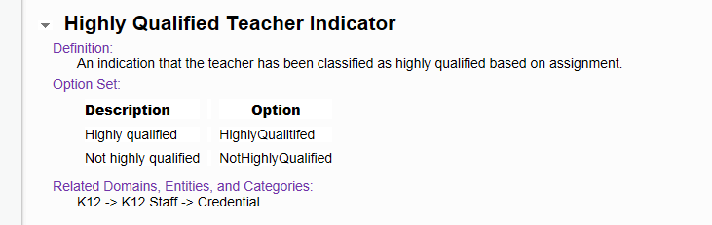
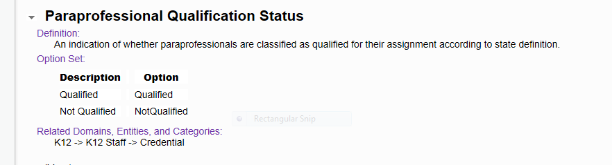
Personnel Qualification Status

Slide 26
Potential New Data Elements for Version 4
Service Description
Service Frequency
Service Intensity
Service Setting

Slide 27
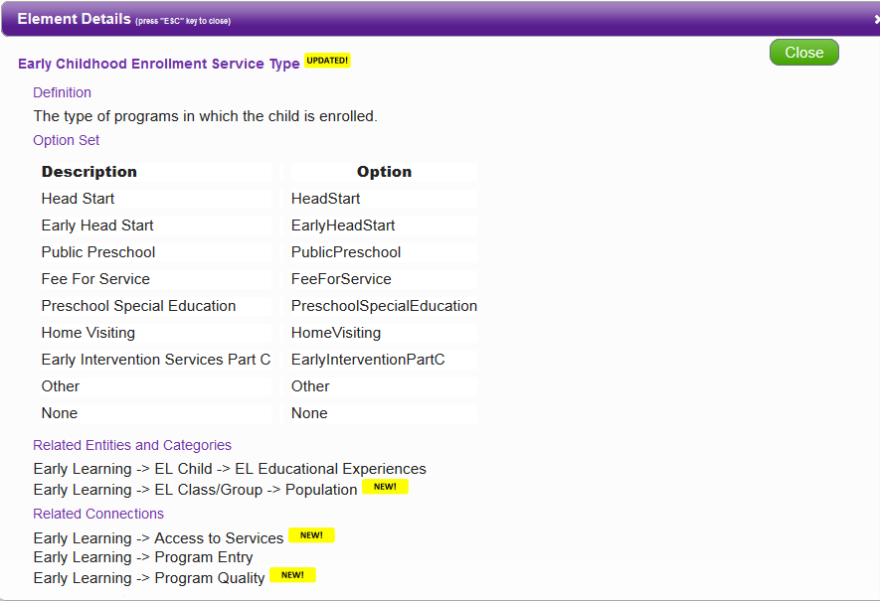
Data Element Details

Slide 28
State Example: Data Elements
Building new data system
OR
Expanding or revising existing data system
CEDS provides a “jump start”

Slide 29

Using Align

Slide 30

Align
Web-based tool that allows users to
Import or input their data dictionaries
Align their current data to CEDS
Compare their data dictionaries
Analyze their data in relation to various other CEDS-aligned efforts

Slide 31
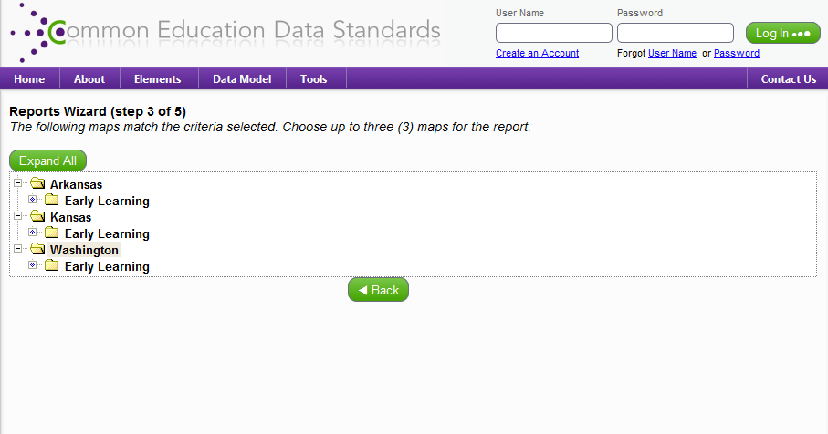
States with Early Learning Maps

Slide 32
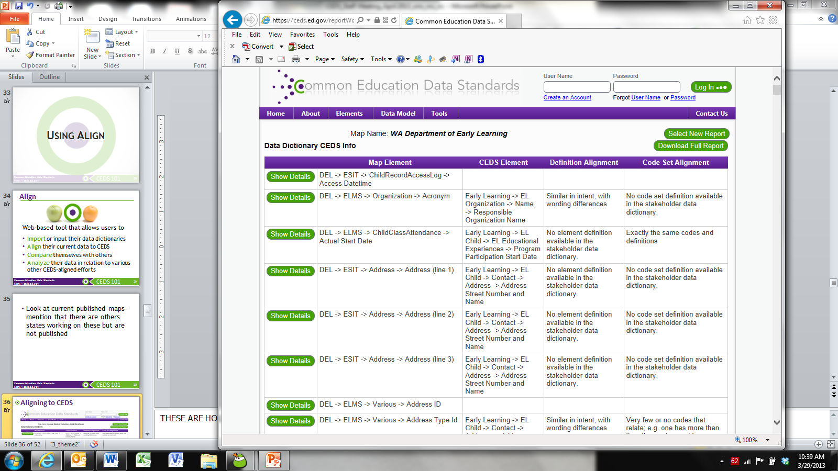
Aligning to CEDS

Slide 33
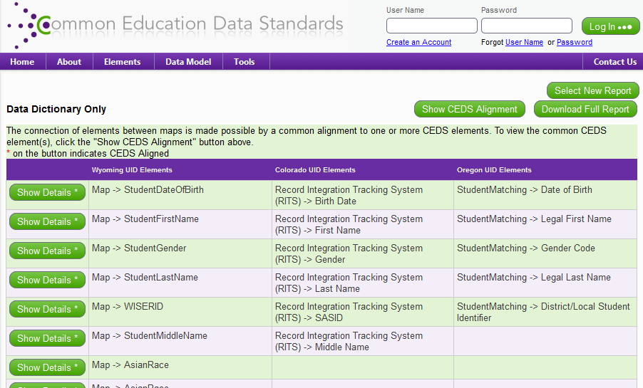
Aligning to Others

Slide 34
State Example: Align Tool
State plans to link data collected by Early Hearing Detection & Intervention (EHDI) with Part C data to guide program improvement and for CDC reporting.
Each agency can create a map using the Align tool to simplify the process of linking data sets.

Slide 35

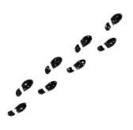
Let’s Practice Using Align
User Name:
USER1
Password:
T3sting!

Slide 36
Using CONNECT

Slide 37

Connect
Stakeholders from various types of educational organizations can use the tool to
  Answer program and policy questions
  Calculate metrics and indicators
  Address reporting requirements

Slide 38
Using CEDS to Answer Program & Policy Questions: Part C/619 Example
What percentage of children with an IFSP or IEP are currently enrolled in each early learning program setting?
To answer such a program question, you need
  Data, possibly from multiple data systems
  Data elements and their definitions
  A plan to analyze the data . . .
  You need the CEDS Connect tool.

Slide 39
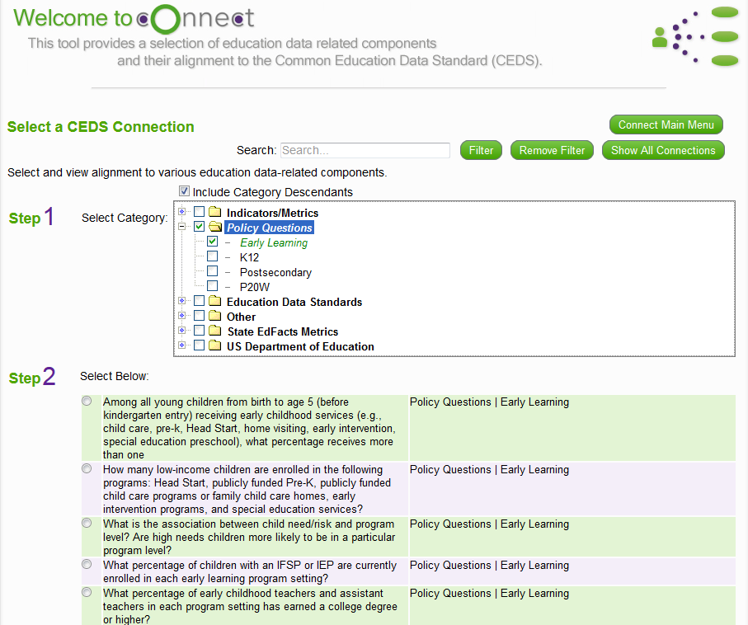
Available Connections

Slide 40
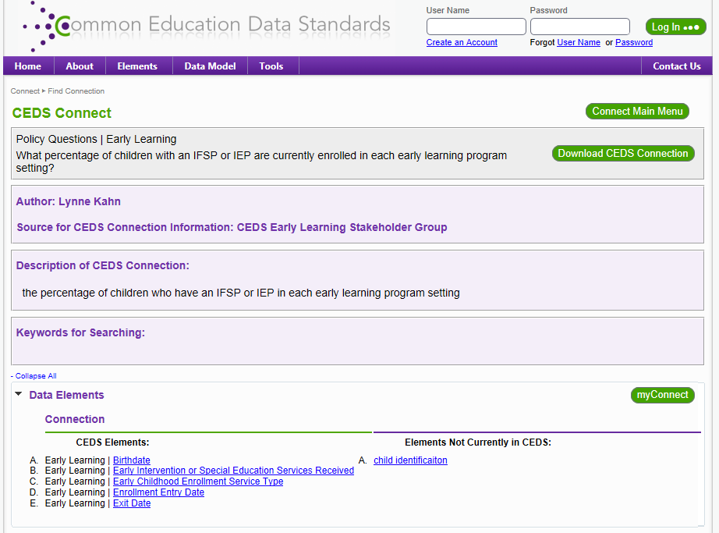
myConnect

Slide 41
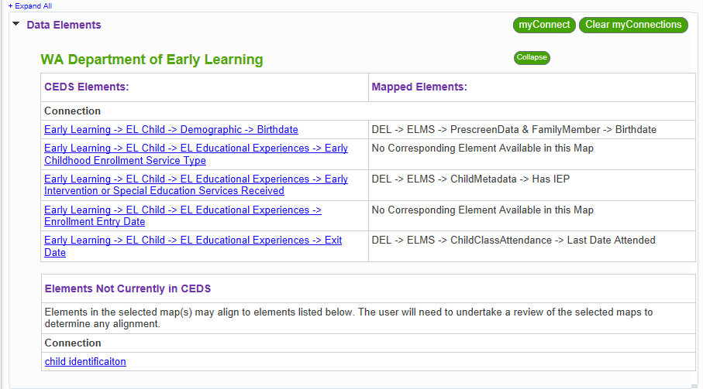
myConnect

Slide 42
State Example: Connect Tool
State serves young children under Part C and Part B/619.
State has developed a tiered quality rating and improvement system (QRIS).
Policymakers want to know if children with disabilities who participate in a highly rated program experience better outcomes. They have posed this question to the Part C and 619 Coordinators.
Where to start?

Slide 43

Let’s Practice Using Connect
User Name:
USER1
Password:
T3sting!

Slide 44
CEDS Roundtables (Tuesday at 8:00 a.m.)
Opportunity to offer an early intervention/preschool special education perspective
Topic-driven, facilitated roundtable discussions
  IFSP
  Planned and Delivered Services
  Assessment
  Transitions
  Eligibility
  Referral
Your opportunity to provide feedback and input
  Are there elements not in CEDS which might be required to support Part C or 619?
  Do you have recommendations for changes?

Slide 45

Wrap-Up
Do you better understand the benefits of CEDS?
Have you become more familiar with CEDS?
Are you ready to explore using CEDS once you return home?
What are your TA needs in relation to CEDS?

Slide 46

Engage with CEDS
http://ceds.ed.gov

