Slide 1
Why CEDS for Part C and 619: Benefits of Using Common Education Data Standards
Suzanne Raber, DaSy, SRI International
Meredith Miceli, OSEP, DaSy Project Officer
Lisa Backer, Minnesota Dept. of Education
Improving Data, Improving Outcomes Conference
September 15-17, 2013
Washington, DC

Slide 2
Opportunities to Learn about CEDS
Session | Format | When
Why CEDS for Part C and 619? | Concurrent Session (presentation & discussion) | Sunday, 3 – 4:15 pm
Making Your Data Life Easier: Using CEDS Tools | Hands-on Workshop | Monday, 9 – 12 noon
CEDS Topical Discussions | Roundtable Discussions | Tuesday, 8 – 8:45 am

Slide 3
Session Description
Discuss the benefits of developing data systems across Part C and Part B/619 programs with common data elements and definitions
Demonstrate tools developed by the CEDS initiative to share data dictionaries, evaluation and research questions, and analytic strategies
Learn new ways to answer important program and policy questions
Learn about new data elements relevant to Part C and 619 proposed in CEDS Version 4

Slide 4
Agenda
Topic | Purpose | Facilitators
CEDS Overview | Introduce CEDS | Suzanne
Program & Policy Questions | Demonstrate Connect | Suzanne & Lisa
Data Dictionaries | Demonstrate Align | Suzanne & Lisa
Data Elements | Solicit Feedback for Version 4 | Meredith & Lisa
Wrap Up: DaSy | Determine TA needs | Suzanne

Slide 5
CEDS Overview
What are the Common Education Data Standards?
How have they been developed?
Who developed CEDS, specifically in early learning?
Why is CEDS useful to you?

Slide 6
Getting to Know Our Audience
Do you know about the Common Education Data Standards (CEDS)?
Needs Assessment: About 2/3 of Part C and 619 said “Yes”
Are you currently using
CEDS tools?
Needs Assessment
Part C: 6% use CEDS tools
Part B 619: 23% use CEDS tools

Slide 7
Why CEDS? The Big Picture
Better child and family outcomes
More effective, targeted programs
Higher quality data
Data systems that can assemble & link data
Common data elements & definitions = CEDS

Slide 8
Does CEDS relate to Part C and 619?
Common Education Data Standards
Education – Also includes Head Start, Child Care, and Part C non-Education lead agencies
Standards – Here, standards refers to commonalities, not learning benchmarks or criteria that data must meet.
Resulting Common (mis) Conceptions:
CEDS does not include or relate to Part C and Section 619.
If CEDS does include Part C and 619, it means more requirements coming down from U.S. Department of Education.

Slide 9
What is CEDS?
A vocabulary including standard definitions, option sets, and technical specifications to streamline sharing and comparing information
A national collaborative effort to develop voluntary, common data standards for a key set of education data elements
Voluntary Common Vocabulary
Notes:
CEDS supports the development of a common vocabulary for P-20W. It is a collection of definitions and formats for the most commonly used P-20W education data elements but does not dictate how individual data systems collect, store, and report data. CEDS is developed each year by a group of stakeholders but is also equally shaped by those that provide feedback during this public comment period.

Slide 10
Why
CEDS in EC?
10

Slide 11
Imagine...
A child from
Early Learning Program A also enrolls in Early Intervention Part C services that use a different education data standard.

Slide 12
Here’s a
child:
Matthe
SmithIII
Race = Guamanian
Gender = M
Did you mean:
Matthew ?
Smith ?
Suffix = III ?
Race = NHOPI ?
Sex = M ?
Early Head Start
Early Intervention

Slide 13
CEDS Tools

Slide 14
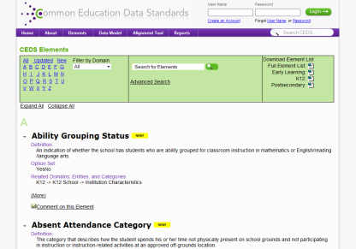
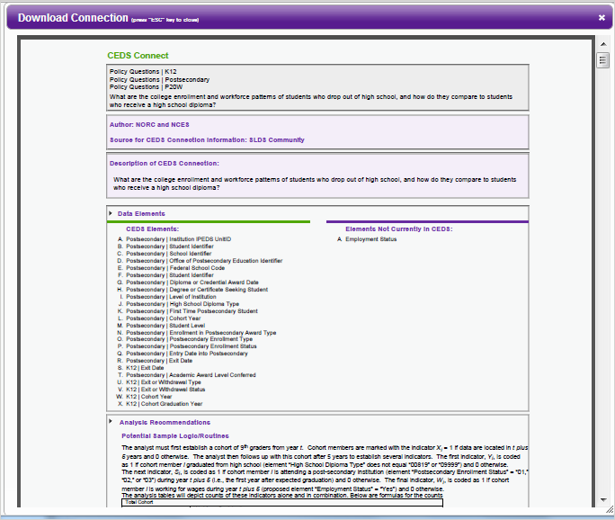
CEDS Tools
A Robust & Expanding Common, Voluntary Vocabulary drawn from existing sources
Powerful Stakeholder Tools & Models
Connect
Align
Logical Data Model

Slide 15
Using CONNECT

Slide 16
Connect
Stakeholders from various types of educational organizations can use the tool to
Answer program and policy questions
Calculate metrics and indicators
Address reporting requirements

Slide 17
CEDS for Program & Policy Questions
What percentage of children with an IFSP or IEP are currently enrolled in each early learning program setting?
To answer such a program question, you need
Data, possibly from multiple data systems
Data elements and their definitions
A plan to analyze the data . . .
You need the CEDS Connect tool.

Slide 18
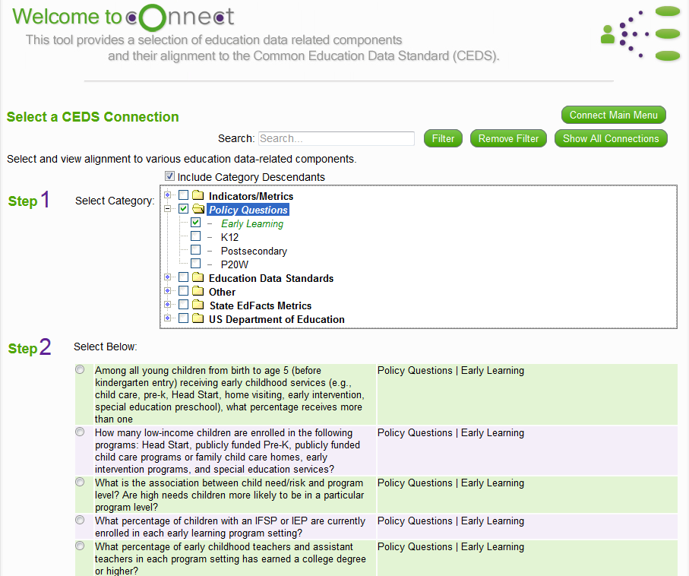
Available Connections

Slide 19
myConnect

Slide 20
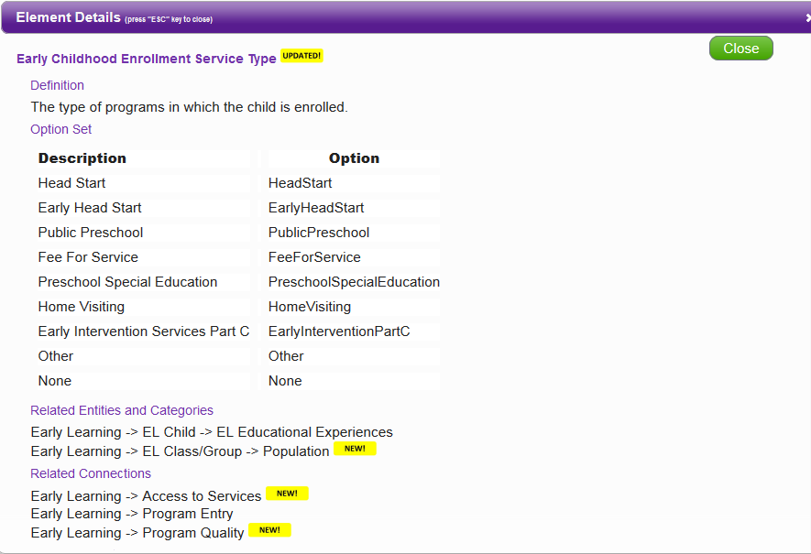
Data Element Details

Slide 21
State Example: Connect Tool
State serves young children under Part C and Part B/619.
State has developed a tiered quality rating and improvement system (QRIS).
Policymakers want to know if children with disabilities who participate in a highly rated program experience better outcomes. They have posed this question to the Part C and 619 Coordinators.
Where to start?
Notes:
Lisa

Slide 22
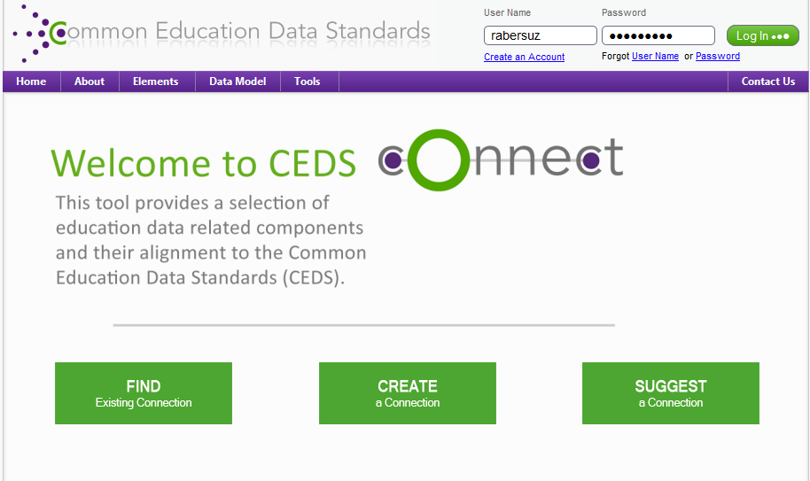
Go to CEDS Connect
Notes:
Lisa

Slide 23
Required Data Elements
Multiple elements to identify an individual child across data sets or systems
Multiple elements to identify program participation
QRIS score of provider programs
Early Childhood Enrollment Service Type
Entry/exit scores for outcomes 1-3 (available in CEDS Version 4)
Progress in outcome area at exit (available in CEDS Version 4)
Notes:
Lisa

Slide 24
Potential Analysis Recommendations
What percentage of young children who received early intervention or special education preschool and who participated in a highly rated early learning program substantially increased their rate of growth on Outcomes 1 - 3?
Determine N, the unduplicated number of children receiving EI or ECSE services.
Select those who participated in another program type.
Remove children who participated in unrated or low rated programs.
Remove children without exit ratings.
Calculate progress category (a-e) for remaining children.
Apply OSEP formula (c+d)/(a+b+c+d).
Notes:
Lisa

Slide 25
Discussion Question
How can you use the CEDS Connect tool to support Part C and 619 work in your state?
_____________________________
_____________________________
_____________________________
_____________________________
_____________________________
Notes:
Lisa

Slide 26
Using Align

Slide 27
Align
Web-based tool that allows users to
Import or input their data dictionaries
Align their current data to CEDS
Compare their data dictionaries
Analyze their data in relation to various other CEDS-aligned efforts

Slide 28
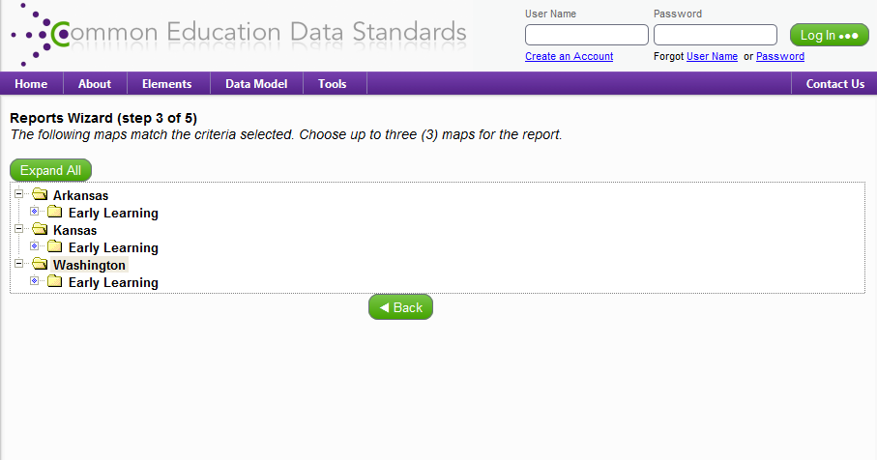
States with Early Learning Maps

Slide 29
Aligning to CEDS

Slide 30
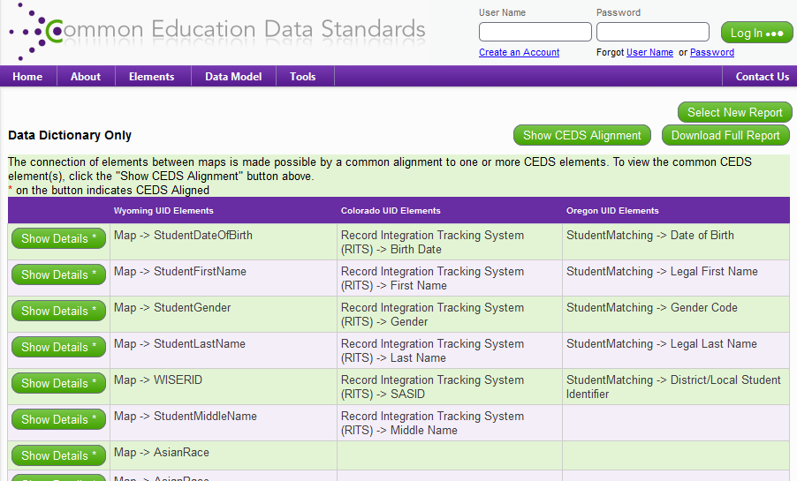
Aligning to Others

Slide 31
State Example: Align Tool
State plans to link data collected by Early Hearing Detection & Intervention (EHDI) with Part C data to guide program improvement and for CDC reporting.
Each agency can create a map using the Align tool to simplify the process of linking data sets.
Notes:
Lisa

Slide 32
Discussion Question
How can you use the CEDS Align tool to support Part C and 619 work in your state?
_____________________________
_____________________________
_____________________________
_____________________________
_____________________________
Notes:
Lisa

Slide 33
CEDS Anatomy: The Basics

Slide 34
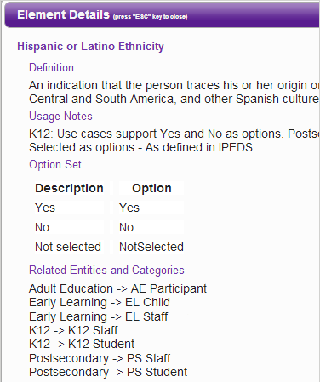
Standard Information: The Basics
Element
Definition
Hispanic
or Latino
Ethnicity
Option set
Yes
No
NotSelected
Domain
Entity
K12
K12 Student

Slide 35
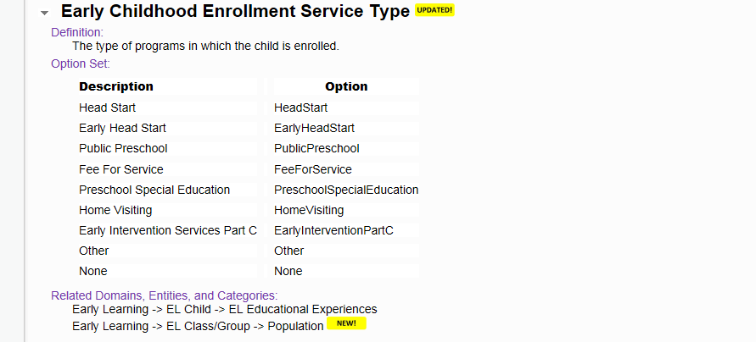
Early Childhood Enrollment Service Type

Slide 36
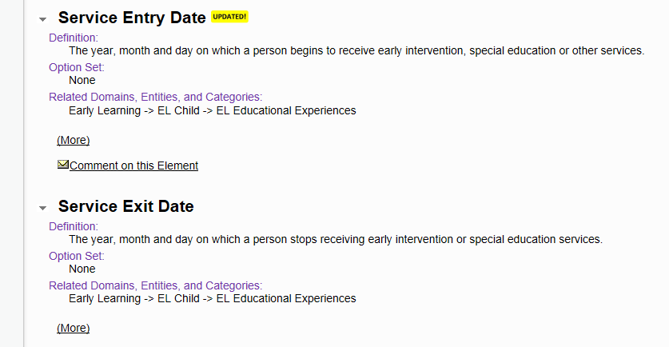
Service Entry and Exit Dates

Slide 37
Prior Early Childhood Experience

Slide 38
CEDS V4 Proposed Content Area Updates
Early Learning
K12
Postsecondary
Career and Technical Education
Workforce
Adult Education
P-20W
Notes:
The draft of the Version 4 Common Education Data Standards (CEDS) has been released for public comment. All are encouraged to review the draft standards and submit comments by September 20th via the CEDS website at: https://ceds.ed.gov/elementsCEDS.aspx. There are over 200 proposed new V4 elements, as well as some updated elements from the previous version of CEDS. The Version 4 draft spans P-20W (early learning through workforce), including additions to:
· Early Learning
· K12
· Assessment
· Postsecondary
· Career and Technical Education
· Workforce
· Adult Education
· P-20W

Slide 39
CEDS V4 Proposed Early Learning Updates
Program Quality
Assessment — “Measurement”
Staff/Professional Development
Federal Alignment to CEDS
Special emphasis on special education APR reporting
Notes:
Please note the Version 4 draft elements are accessible by the main CEDS element page (http://ceds.ed.gov/Version4Draft.aspx) or by Excel download (https://ceds.ed.gov/CEDSDownloads.aspx). The draft elements are NOT included in the data model (DES or NDS) or the CEDS Tools (Align and Connect). Once the elements have gone through the review process and been revised as final they will be included in the models and tools with the V4 release in January, 2014.
CEDS supports the development of a common vocabulary for P-20W. It is a collection of definitions and formats for the most commonly used P-20W education data elements but does not dictate how individual data systems collect, store, and report data. CEDS is developed each year by a group of stakeholders but is also equally shaped by those that provide feedback during this public comment period.

Slide 40
Part C/619 Data Element Examples (V4)
CEDS V 4 includes 106 new data elements in Early Learning domain.
Part C and 619 relevant examples
Early Learning Federal Funding Type
Early Learning Program Eligibility Status
Services Referral Outcome
Individualized Program Planned Service Type
Frequency of Service
Child Outcomes Summary Rating
Notes:
Please note the Version 4 draft elements are accessible by the main CEDS element page (http://ceds.ed.gov/Version4Draft.aspx) or by Excel download (https://ceds.ed.gov/CEDSDownloads.aspx). The draft elements are NOT included in the data model (DES or NDS) or the CEDS Tools (Align and Connect). Once the elements have gone through the review process and been revised as final they will be included in the models and tools with the V4 release in January, 2014.
CEDS supports the development of a common vocabulary for P-20W. It is a collection of definitions and formats for the most commonly used P-20W education data elements but does not dictate how individual data systems collect, store, and report data. CEDS is developed each year by a group of stakeholders but is also equally shaped by those that provide feedback during this public comment period.

Slide 41
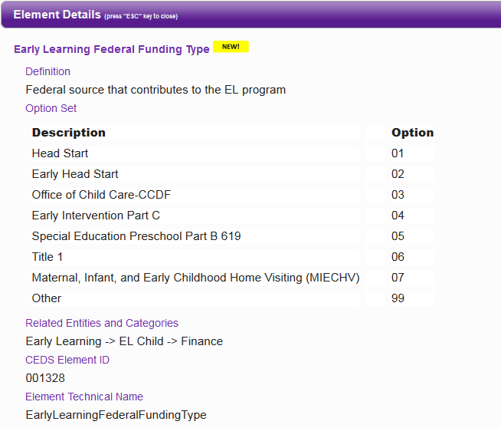
Early Learning Federal Funding Type (V4)
Notes:
Please note the Version 4 draft elements are accessible by the main CEDS element page (http://ceds.ed.gov/Version4Draft.aspx) or by Excel download (https://ceds.ed.gov/CEDSDownloads.aspx). The draft elements are NOT included in the data model (DES or NDS) or the CEDS Tools (Align and Connect). Once the elements have gone through the review process and been revised as final they will be included in the models and tools with the V4 release in January, 2014.
CEDS supports the development of a common vocabulary for P-20W. It is a collection of definitions and formats for the most commonly used P-20W education data elements but does not dictate how individual data systems collect, store, and report data. CEDS is developed each year by a group of stakeholders but is also equally shaped by those that provide feedback during this public comment period.

Slide 42
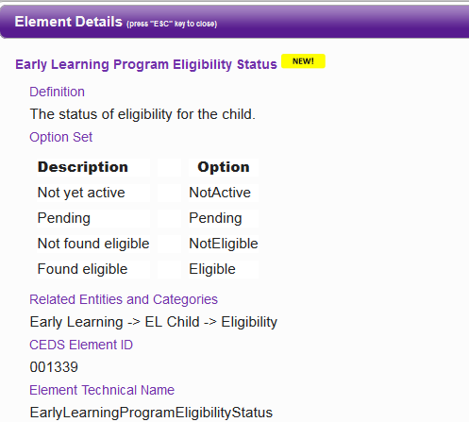
Early Learning Program Eligibility Status (V4)
Notes:
Please note the Version 4 draft elements are accessible by the main CEDS element page (http://ceds.ed.gov/Version4Draft.aspx) or by Excel download (https://ceds.ed.gov/CEDSDownloads.aspx). The draft elements are NOT included in the data model (DES or NDS) or the CEDS Tools (Align and Connect). Once the elements have gone through the review process and been revised as final they will be included in the models and tools with the V4 release in January, 2014.
CEDS supports the development of a common vocabulary for P-20W. It is a collection of definitions and formats for the most commonly used P-20W education data elements but does not dictate how individual data systems collect, store, and report data. CEDS is developed each year by a group of stakeholders but is also equally shaped by those that provide feedback during this public comment period.

Slide 43
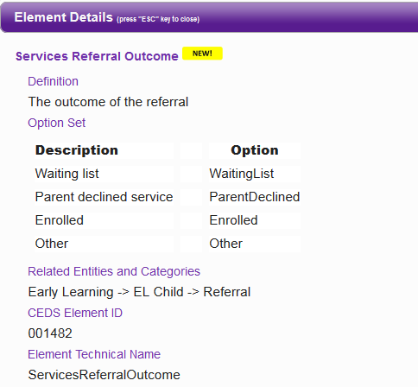
Services Referral Outcome (V4)
Notes:
Please note the Version 4 draft elements are accessible by the main CEDS element page (http://ceds.ed.gov/Version4Draft.aspx) or by Excel download (https://ceds.ed.gov/CEDSDownloads.aspx). The draft elements are NOT included in the data model (DES or NDS) or the CEDS Tools (Align and Connect). Once the elements have gone through the review process and been revised as final they will be included in the models and tools with the V4 release in January, 2014.
CEDS supports the development of a common vocabulary for P-20W. It is a collection of definitions and formats for the most commonly used P-20W education data elements but does not dictate how individual data systems collect, store, and report data. CEDS is developed each year by a group of stakeholders but is also equally shaped by those that provide feedback during this public comment period.

Slide 44
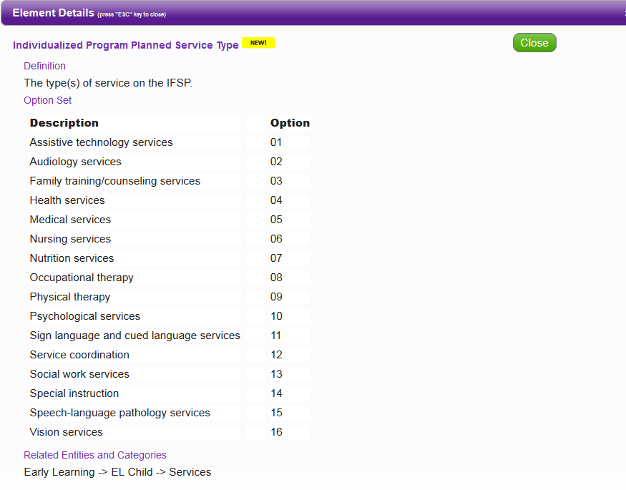
Individualized Program Planned Service Type (V4)
Notes:
Please note the Version 4 draft elements are accessible by the main CEDS element page (http://ceds.ed.gov/Version4Draft.aspx) or by Excel download (https://ceds.ed.gov/CEDSDownloads.aspx). The draft elements are NOT included in the data model (DES or NDS) or the CEDS Tools (Align and Connect). Once the elements have gone through the review process and been revised as final they will be included in the models and tools with the V4 release in January, 2014.
CEDS supports the development of a common vocabulary for P-20W. It is a collection of definitions and formats for the most commonly used P-20W education data elements but does not dictate how individual data systems collect, store, and report data. CEDS is developed each year by a group of stakeholders but is also equally shaped by those that provide feedback during this public comment period.

Slide 45
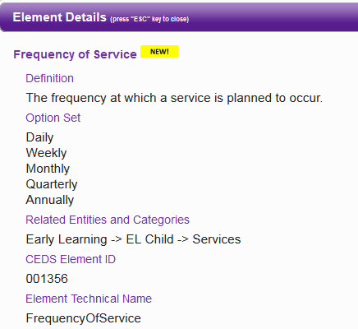
Frequency of Service (V4)
Notes:
Please note the Version 4 draft elements are accessible by the main CEDS element page (http://ceds.ed.gov/Version4Draft.aspx) or by Excel download (https://ceds.ed.gov/CEDSDownloads.aspx). The draft elements are NOT included in the data model (DES or NDS) or the CEDS Tools (Align and Connect). Once the elements have gone through the review process and been revised as final they will be included in the models and tools with the V4 release in January, 2014.
CEDS supports the development of a common vocabulary for P-20W. It is a collection of definitions and formats for the most commonly used P-20W education data elements but does not dictate how individual data systems collect, store, and report data. CEDS is developed each year by a group of stakeholders but is also equally shaped by those that provide feedback during this public comment period.

Slide 46
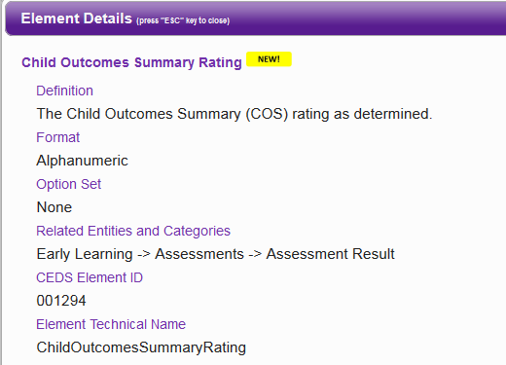
Child Outcomes Summary Rating (V4)
Notes:
Please note the Version 4 draft elements are accessible by the main CEDS element page (http://ceds.ed.gov/Version4Draft.aspx) or by Excel download (https://ceds.ed.gov/CEDSDownloads.aspx). The draft elements are NOT included in the data model (DES or NDS) or the CEDS Tools (Align and Connect). Once the elements have gone through the review process and been revised as final they will be included in the models and tools with the V4 release in January, 2014.
CEDS supports the development of a common vocabulary for P-20W. It is a collection of definitions and formats for the most commonly used P-20W education data elements but does not dictate how individual data systems collect, store, and report data. CEDS is developed each year by a group of stakeholders but is also equally shaped by those that provide feedback during this public comment period.

Slide 47
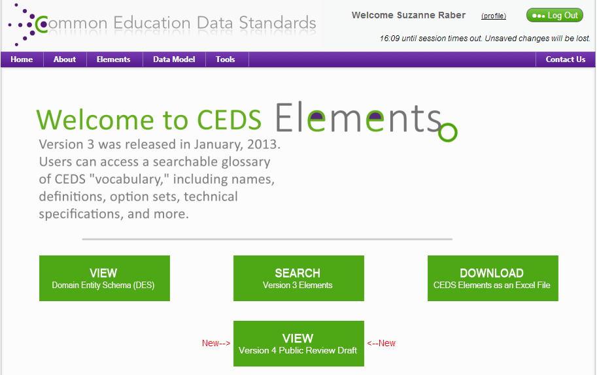
State Example: Data Elements
Building new data system
OR
Expanding/revising existing data system
CEDS provides a “jump” start.
Notes:
Lisa

Slide 48
Discussion Question
How can you use these and other proposed CEDS data elements to support Part C and 619 work in your state?
_____________________________
_____________________________
_____________________________
_____________________________
_____________________________
Notes:
Lisa

Slide 49
CEDS Roundtables (Tuesday 8:00 am)
Learn about early intervention/preschool special education data elements new to CEDS Version 4
Participate in 1 topic-driven, facilitated roundtable discussion:
IFSP  Transitions
Planned and Delivered Services  Eligibility
Assessment  Referral
Provide feedback from Part C & 619 perspective
Are the elements, definitions, etc. relevant to Part C, Part B/619?
Do you have suggestions for revisions or additional elements?

Slide 50
Wrap-Up
Do you understand the benefits of CEDS?
What is DaSy?
Why is DaSy talking about CEDS at this conference?
What are your TA needs in relation to CEDS?

Slide 51
What is DaSy?
A 5-year TA center (Dec 2012 – Nov 2017) funded by OSEP to assist states with improving Part C and Part B preschool data by:
Building better data systems
Coordinating data systems across early childhood programs
Building longitudinal data systems
Building the capacity of states to use data

Slide 52
Why is DaSy talking about CEDS?
DaSy Goal: To develop and enhance statewide early childhood coordinated and longitudinal data systems to improve state capacity to collect, analyze, and report high quality data required under IDEA
ALIGN: Addresses reporting high quality data by providing common data dictionaries (elements, option sets, and technical specifications)
CONNECT: Facilitates data analysis by recommending analytic approaches (logic and formulas) to address program and policy questions as well as Federal reporting requirements (indicators)
Enhances capacity for coordinated and longitudinal analysis by including data elements in different domains across the P-20W continuum

Slide 53
Closing Discussion Questions
What are your current
resources to support
this work?
What technical
assistance might you need to use CEDS?

Slide 54
Engage with CEDS
http://ceds.ed.gov

