Slide 1
Demystifying Data Governance
Denise Mauzy
Maria Taylor
Missy Cochenour
October 8, 2014
1:15- 2:45 pm
Notes:
MT-35 minutes overall

Slide 2
Presenters
Missy Cochenour, SLDS and DaSy
Denise Mauzy, ELC TA and DaSy
Maria Taylor, Childcare Education Institute

Slide 3
Session Objectives
Define data governance and its important
Explore data systems’ responsibilities related to:
Authority and accountability
Quality and integrity
Security and access
Discuss how effective data governance prepares registries to participate in larger state and national data system efforts like:
ECIDS
SLDS
PER
CEDS
Notes:
MT
We need to hit hard on the fact that we have to come up to speed as an Alliance. We have some good foundational pieces related to Governance but we need to review and update. Will weave PER throughout conversation.

Slide 4
Notes:
MT

Slide 5
What is Data Governance?
Notes:
MT

Slide 6
What is Data Governance?
It is both an organizational process and a structure
Establishes responsibility for data
Organizes program staff to collaboratively and continuously improve data quality through the systematic creation and enforcement of policies, roles, responsibilities, and procedures
It requires the systematic development, implementation, and enforcement of procedures to operationalize the quality and security policies of the data system.
Notes:
MT

Slide 7
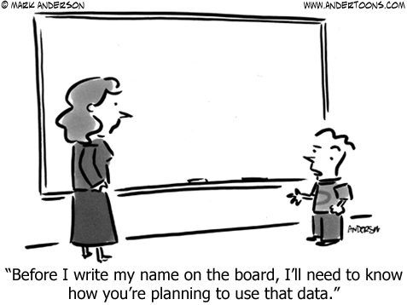
Notes:
MT

Slide 8
Why Focus on Data Governance?
Defines authority and accountability
Promotes quality and integrity
Ensures security and proper access
Data Breaches are more common
Technology continues to evolve
Privacy laws are becoming increasingly more rigid
Notes:
MT

Slide 9
Audience Poll
Been directly affected by a security breach
Had someone leave your employ who had access to secure data
Lost or had your laptop or smartphone stolen
Gotten a new work computer
Sent a report via email
Have a laptop or smartphone
Notes:
Everyone stand. Sit down if … Goal is to show that everyone is affected by governance.

Slide 10
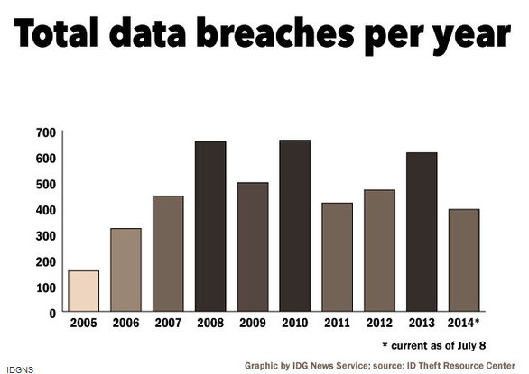
Data Breaches are on the Rise
http://www.pcworld.com/article/2453400/the-biggest-data-breaches-of-2014-so-far.html
Notes:
MT

Slide 11
Data Breaches
A staggering 43% of companies surveyed reported experiencing a data breach in the past year, up 10% over the prior year.
Retail breaches are reported at one every week or two
Experian serviced over 2,300 incidents last year
Organizations include:
Home Depot
eBay
Target
Montana Department of Health and Human Services
Many data breaches go unreported
Ponemon Institute survey was conducted in 2014 and included 567 U.S. executives, most of whom reported to company’s chief security officers.
Notes:
MT
http://www.usatoday.com/story/tech/2014/09/24/data-breach-companies-60/16106197/
http://www.pcworld.com/article/2453400/the-biggest-data-breaches-of-2014-so-far.html

Slide 12
Notes:
MT
http://www.praetorianguard.net/Blog/image.axd?picture=2013%2f11%2fChart2-Healthcare-Types-of-Incidents.jpg

Slide 13
What Causes Data Breaches?
Simple errors
St. Vincent Breast Center in Indianapolis sent 63,000 letters containing information on upcoming appointments to the wrong people
Stanford Federal Credit Union accidentally attached a file with information on 18,000 customers sent an email
Thousands of paper medical records were dumped at a public incineration site in York, Pennsylvania
Theft
Laptops, thumb drives with nothing more than login and passwords to protect the data
Poor security practices
Weak password strength
Server vulnerabilities
Ponemon Institute survey was conducted in 2014 and included 567 U.S. executives, most of whom reported to company’s chief security officers.
Notes:
MT
http://www.usatoday.com/story/tech/2014/09/24/data-breach-companies-60/16106197/
http://www.pcworld.com/article/2453400/the-biggest-data-breaches-of-2014-so-far.html

Slide 14
Legislative Trends
Twenty states enacted student-data-privacy laws during recent legislative sessions
The bulk of the new statutes focus on either:
Prohibiting the collection of certain types of data
Requiring states and school districts to improve their governance infrastructure and processes for safeguarding student information.
Landmark California law prohibits operators of online educational services from selling student data for advertising or for a non-educational purpose.
At the national level, a bill to update the main federal law protecting student privacy is currently under consideration in the United States Senate.
Notes:
MT
'Landmark' Student-Data-Privacy Law Enacted in California
By Benjamin Herold on September 30, 2014 10:10 AM
http://blogs.edweek.org/edweek/DigitalEducation/2014/09/_landmark_student-data-privacy.html?cmp=ENL-EU-NEWS2

Slide 15
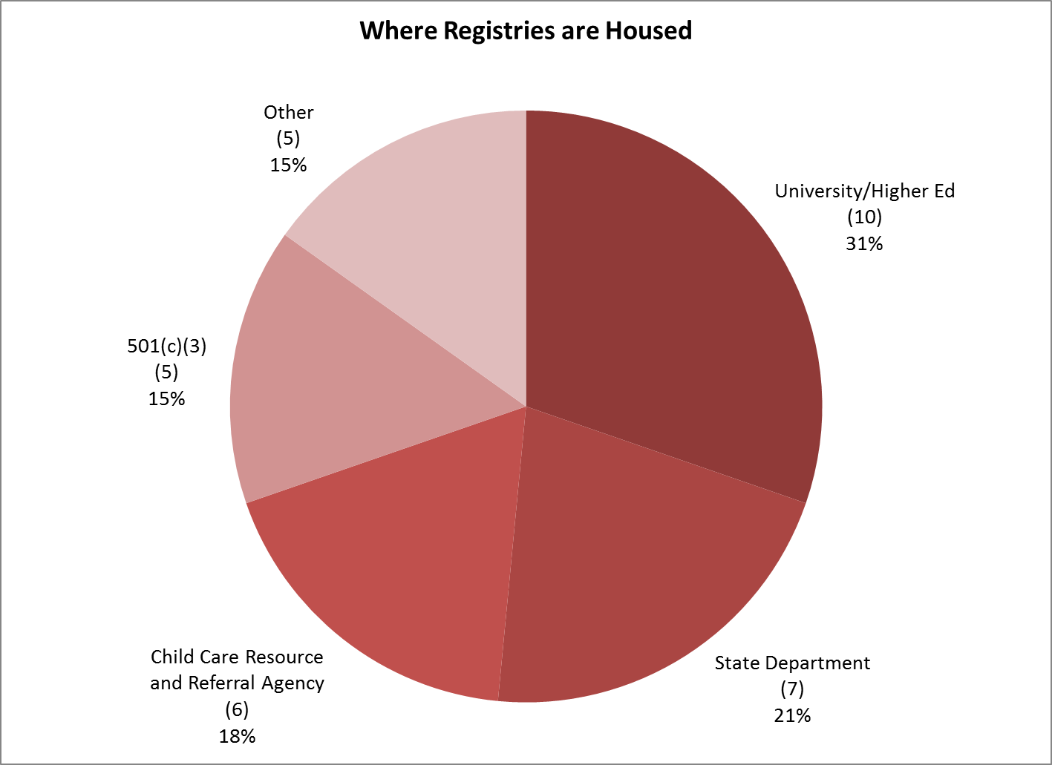
Data Governance: Impact of Where Data System is Housed
2012 National Workforce Registry Alliance State of Registries

Slide 16
Table Discussion How Does Organizational Affiliation Affect Your Governance Efforts?
Notes:
MT ends here (20 minutes total)
At your tables, share one way your organizational affiliation affects your governance efforts? For example, if your registry is housed at a University the rules for operation and governance are different than an independent not-for-profit or state agency. Ask for a couple of examples.

Slide 17
Introducing an Approach to Thinking about Program Data Governance & Assessing Your Practices Leading your own data system governance effort
Notes:
DM to start here (15 minutes presentation, 20 minutes table time)
Reference handout at this time.

Slide 18
Borrowing from the DaSy Framework
Notes:
DM

Slide 19
Important Points about Data Governance
Data governance exists whether formal or informal.
Informal data governance is associated with significant risks.
Formal data governance has significant benefits.
Data governance structures and policies are not static.
Managing the state data system requires responding to the evolving structures and policies and implementing the associated procedures.
Data system staff or their representatives should be actively engaged in the governance of their data system.
Notes:
DM

Slide 20
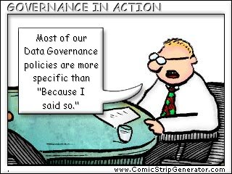
Authority and Accountability
Notes:
DM

Slide 21
Authority and Accountability Focuses On…
Identification of data governance structure
Identifying decision-making authority and accountability
Authorizing staff or representatives to implement policies and manage the data system
PER addresses issues in the policies and procedures requirements
Confidentiality Policies and Procedures
Due Process
Participant Communication
Staff Communication
Notes:
DM
-There are definite gaps in PER

Slide 22
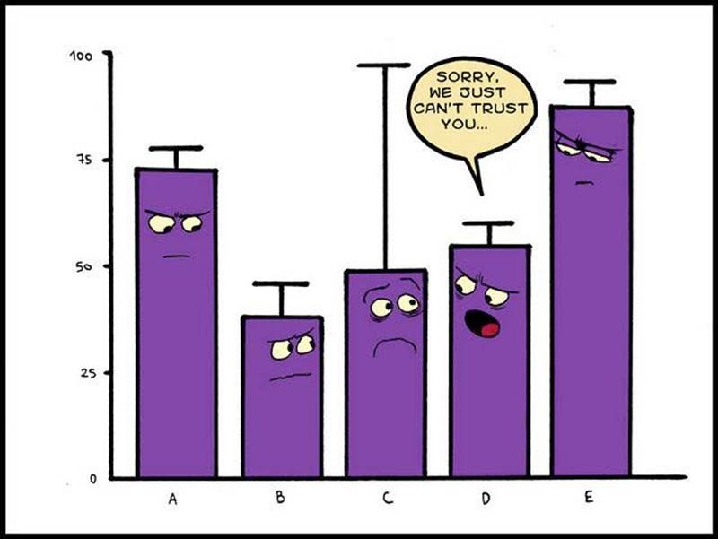
Quality and Integrity
Notes:
DM

Slide 23
Quality and Integrity Focuses On…
Policies that require implementation of procedures to ensure validity, reliability, accuracy, consistency, and intended use of data
Implementation of training and monitoring procedures to ensure consistent application of data quality and integrity policies and procedures
PER addresses issues in the policies and procedures requirements
Review
Verification
Data Entry
Data Continuity
Data Maintenance
Data Transfer
Notes:
DM

Slide 24
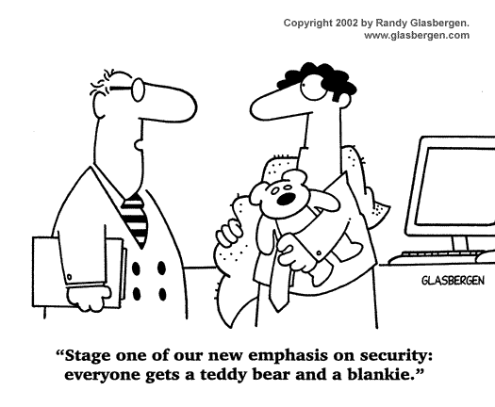
Security and Access…what’s the difference?
Notes:
DM
Security-is your data safe?
Access is allowing those with a need get (only) what they need

Slide 25
Security and Access
Policies that require the development and implementation of procedures to ensure the security of the data from breach or loss.
Policies that require the development and implementation of procedures to ensure that only authorized users gain access to the data, including reports.
PER addresses issues in the policies and procedures requirements
Data Storage
Data Transfer
Notes:
DM There are PER gaps

Slide 26
Table Discussion
At your tables, review the assigned portion of the assessment tool.
Give some examples of where data systems have made progress in a certain area?
Give some examples of challenges in these areas?
Notes:
Split the sections up by table.---Ask a couple table for a success or challenge. (15 minutes, 5 report)

Slide 27
Integrated Data Governance Being a Player in a Larger Effort
Notes:
MC to start here (20 minutes)

Slide 28
What is the Difference?
 | Registry | ECIDS
Purpose | To collect data about professionals, programs/organizations that employ them, their education attainment, professional credentialing and licensure, and professional development. | To answer program and policy questions that cannot be answered using any one data system.
Who Leads | University, R&R, Non-Profit, State Agency, Other | State Department of Education, Human Services, or Office of Early Learning
Examples of Questions | What is the highest level of education for center-based staff by role? To what extent do older professionals have more education than their younger peers? What is the average age and education level of home-based providers? | Are we preparing all of our children for kindergarten, as a whole and by subgroups? Example: What % of publically funded programs have teachers with BAs?
Notes:
MC

Slide 29
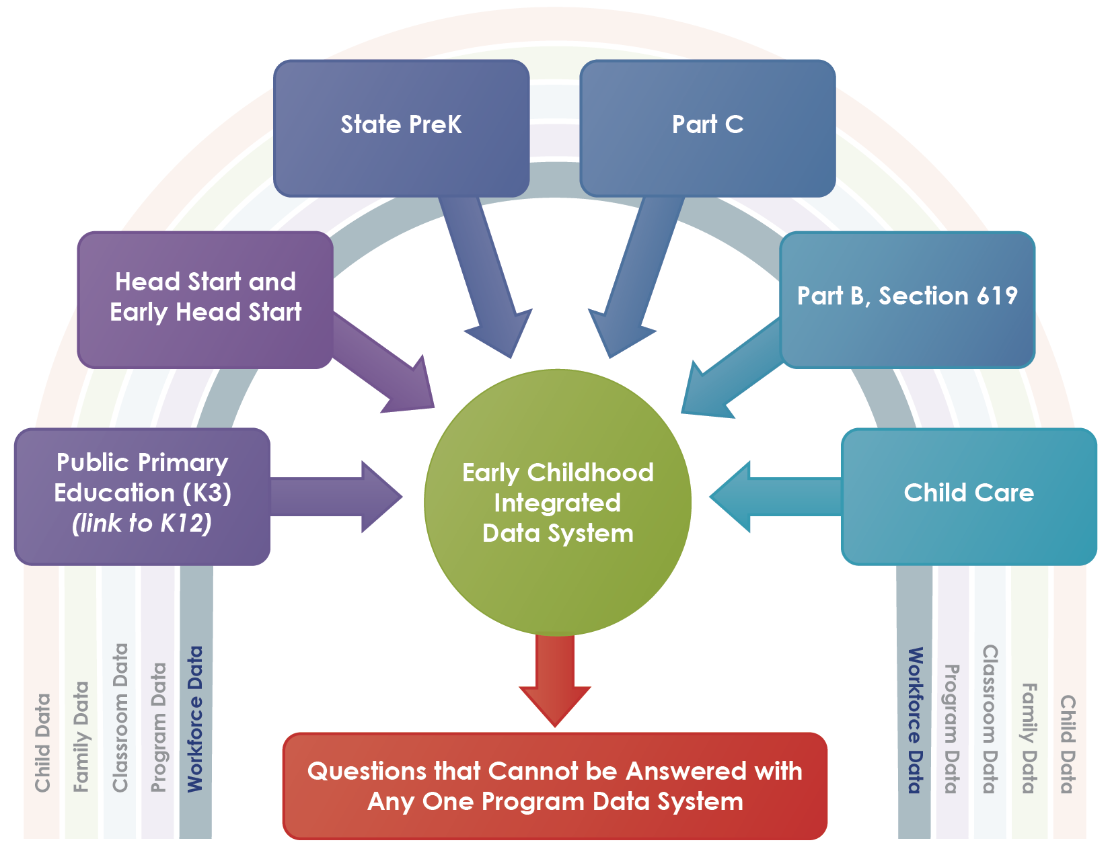
Workforce Provides An Important Piece of the ECIDS
If the workforce data is not ready to go then a state cannot have a complete picture
Notes:
MC-

Slide 30
What Does it Mean to be Ready?
Your own data system has formal governance:
Having your individual data governance in place to ensure high-quality data can be shared, security and access policies are in place, and the appropriate policies that govern the registry data exist before sharing the data with another
You are able to represent the workforce data with the integrated data effort:
Preparing your data dictionary
Knowing the quality of your data
Representing the workforce data and the nuances that surround it
Articulating what workforce data can contribute to the broader integrated data conversation
Notes:
MC-Will reference the self assessment tool and that it gives a good indication of a registry‘s readiness in terms of governance.

Slide 31
Preparing your Data Dictionary
One of the first steps in governance of an integrated data system is to understand what each data contributor has. As a part of this effort you might be asked to share your data dictionary, or in some cases use CEDS to share so others can align across the state with you.

Slide 32
Overview of ECIDS Toolkit: Data Governance
ECIDS/SLDS Integration efforts have their own self-assessment tools that help them assess the progress of these efforts
You can use these tools to:
Share with your state in case they are unaware of the resources
Understand the work of the ECIDS/SLDS and how you might be able to fit into the integration effort
Understand what questions you can ask of those leading the integration effort in your state

Slide 33
Group Questions and Comments

Slide 34
Homework for Thursday (CEDS Session)
Bring your computer
Bring your CEDS login and password
http://ceds.ed.gov/

Slide 35
Presenter Contact Information
Maria Taylor- mtaylor@cceionline.edu
Denise Mauzy- denise.mauzy@aemcorp.com
Missy Cochenour- Missy.Cochenour@aemcorp.com

