Slide 1
While you settle in…
Please sketch a visual to communicate:
In Datacopa county, 80% of children evaluated for Part C services are identified as eligible
We will discuss approaches used
later during the webinar

Slide 2
Chart with Purpose Overcoming Common Data Visualization Pitfalls to Create Effective Charts
May 3, 2017
3:00pm ET

Slide 3
Welcome and Introductions
Kerry Belodoff
Denise Mauzy

Slide 4
As a result of participating in today’s webinar, you will…
Understand common pitfalls in creating effective charts
Access resources and tools to support effective data visualization

Slide 5
What am I describing?
A curved line with every point equal distance from the center

Slide 6
What am I describing?

Slide 7
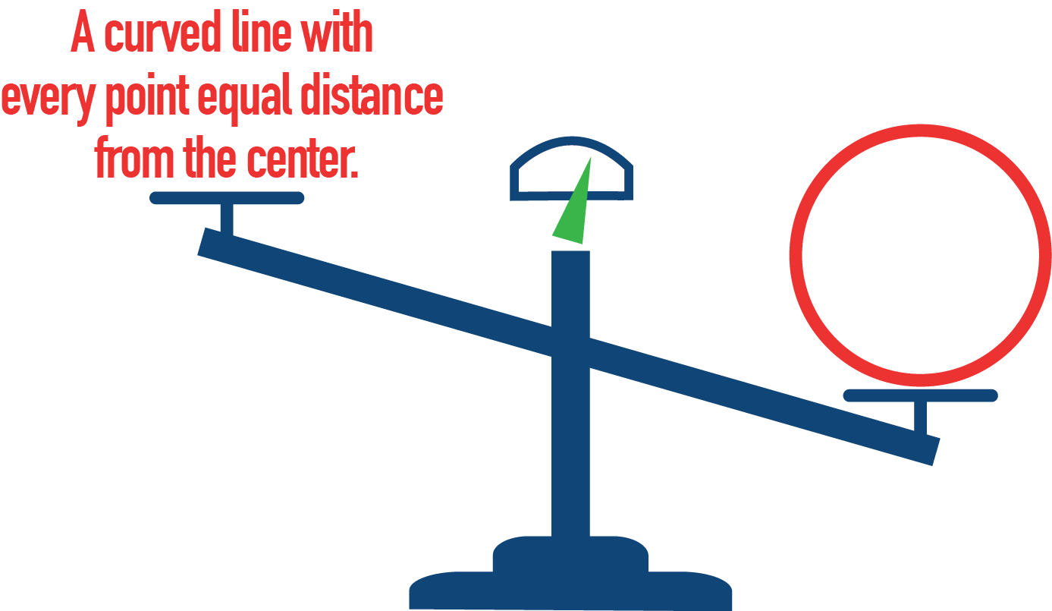
What is Data Visualization?
The representation and presentation of data or information to facilitate understanding

Slide 8
Purposes of Data Visualization
Explore and analyze patterns and relationships

Slide 9
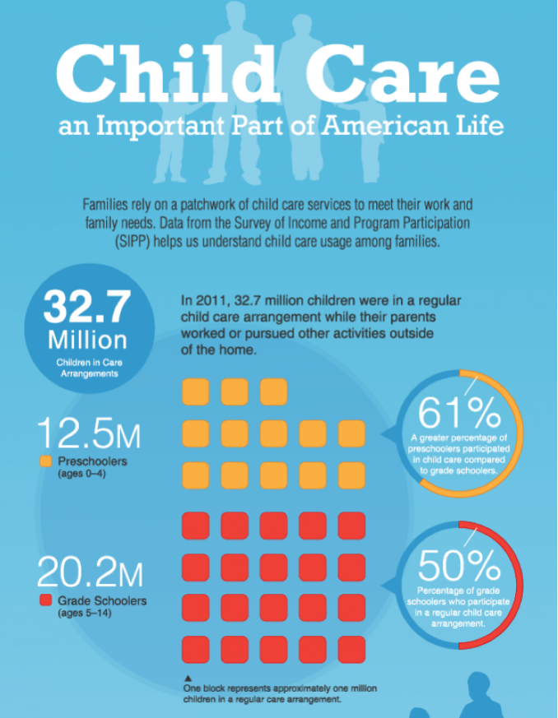
Purposes of Data Visualization
Communicate findings
Tell a data story
Use data for decision-making
Infographic from U.S. Census Bureau: https://www.census.gov/content/dam/Census/library/visualizations/2013/comm/child_care.pdf

Slide 10
What approach did you use?
In Datacopa county, 80% of children evaluated for Part C services are identified as eligible
How did you visualize this? Tell us in the chat box

Slide 11
What is Data Visualization?

Slide 12
5 Common Data Visualization Pitfalls
Not clearly articulating your message
Data overload
Misrepresenting your data
Being dull, dull, dull
Forgetting about accessibility

Slide 13
Pitfall 1: Not Clearly Articulating Your Message
Some things went up, some things stayed the same, sometimes things went down….
So, uh, what’s your point?

Slide 14
What message is being conveyed?

Slide 15
Two Potential Takeaways

Slide 16
What message is being conveyed?
Total District Employees is expanding as K-12 Enrollment is declining
FTE staff grew by 3% while enrollment dropped by 7%

Slide 17
What message is being conveyed?

Slide 18
Pitfall 2: Data Overload

Slide 19
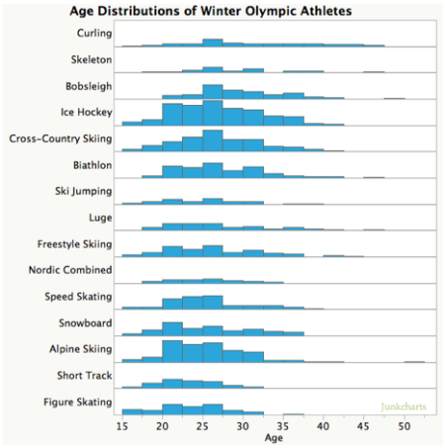
Use Small Multiples

Slide 20
Break it Down
Source: Pew Research Center via The Washington Post

Slide 21
Pitfall 3: Misrepresenting your Data

Slide 22
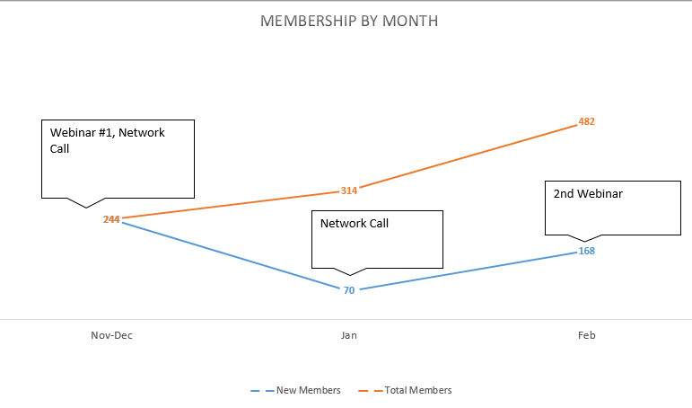

Slide 24
Pitfall 4: Dull, Dull, Dull…

Slide 25
Default is Dull

Slide 26
De-Default Your Chart

Slide 27
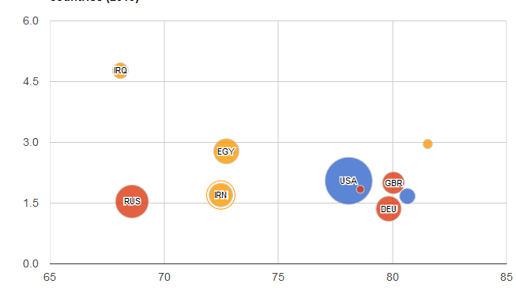
Get Interactive!

Slide 28
Pitfall 5: Forgetting About Accessibility

Slide 29
Have you ever been in a session and …
“I know you can’t see this chart, but I’ll tell you…”
The slides are printed in black and white, but the key takeaways are highlighted in color
The charts include every color of the rainbow
The presenter uses a complicated graphic that you cannot understand

Slide 30
Build in Accessibility
Visualizations are by their very nature images
Use the principles of data visualization to create your “alt text” description
Use a color contrast checker
Avoid red/green/yellow combinations
Consider how the data visualization will be presented
With your audience in mind, consider the need for multiple formats beyond “alt text”

Slide 31
DaSy-NCSI Data Visualization Toolkit
http://dasycenter.org/data-visualization-toolkit/

Slide 32
TA and Resources are Available
Visit the DaSy website at: http://dasycenter.org/
Like us on Facebook: https://www.facebook.com/dasycenter
Follow us on Twitter: @DaSyCenter
Connect with the presenters:
Kerry.Belodoff@sri.com and Denise.Mauzy@aemcorp.com

Slide 33
The contents of this presentation were developed under a grant from the U.S. Department of Education, # H373Z120002. However, those contents do not necessarily represent the policy of the U.S. Department of Education, and you should not assume endorsement by the Federal Government. Project Officers, Meredith Miceli and Richelle Davis.

