Slide 1
ECTA/DaSy System Framework Self-Assessment Comparison Tool
Robin Nelson
June 29, 2016

Slide 2
Outcomes for this Webinar
Participants will…
Increase their awareness of the Self-Assessment Comparison tool, and how it relates to the Self-Assessment tool
Understand the potential uses of the Self-Assessment Comparison tool
Learn when and how to use the Self-Assessment Comparison tool
Notes:
KATHY
ORGANIZER COMMENTS
Do we want to keep these in here?

Slide 3
What we will cover today
Brief overview of the framework and self-assessment
Purpose of the self-assessment comparison (SAC) tool
Demonstration of the SAC tool

Slide 4
Poll Questions

Slide 5
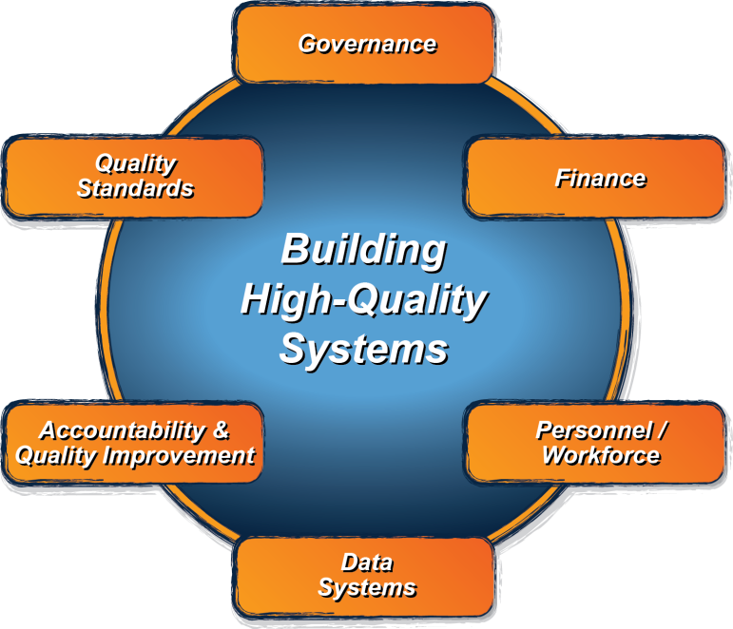
The ECTA/DaSy System Framework: What is it?
Good outcomes for children with disabilities and their families
Implementation of Effective Practices
Notes:
What does a high quality Part C/ Section 619 system look like?
Specifically, what does a state need to put into place in order to encourage/support/require local implementation of evidence-based practices that result in positive outcomes for young children with disabilities and their families?

Slide 6
Framework Components
ECTA System
Data System Subcomponents
Governance – GV
Finance – FN
Personnel/Workforce – PN
Account & Qual. Imp. – AC
Quality Standards – QS
Data System – DS
Purpose and Vision – PV
Data Governance/Mgmt. – DG
Stakeholder Engagement – SE
System Design/Develop. – SD
Data Use – DU
Sustainability – SU

Slide 7
ECTA/DaSy Self-Assessment
Use with the ECTA and DaSy System Frameworks
Provides a structure for state Part C and Section 619 programs to evaluate their systems
Provides a current ‘snap shot’
Identify relative strengths and weaknesses
Identify and prioritize areas for improvement
Built in Excel
Notes:
The self-assessment is a companion to the ECTA and DaSy frameworks.
It provides a structure to evaluate identify both areas of strength that states can build on as well as areas that need improvement.
Primary audience is state Part C and section 619 coordinators and staff, with acknowledgment that other key staff and leadership in a state will be involved.

Slide 8
Element Rating Scale
Element Rating | Implementation of Element
1 | No - element not in place and not planning to work on it at this time
2 | No - element not in place but planning to work on it or getting started
3 | Yes - element partially implemented
4 | Yes - element fully implemented

Slide 9
Quality Indicator Rating Scale
QI Rating | Description of Rating
1 | None of the elements is yet planned or in place.
2 | Most of the elements are not yet planned or in place.
3 | Some elements are in place; a few may be fully implemented.
4 | At least half of the elements are in place; a few may be fully implemented.
5 | At least half of the elements are in place; some are fully implemented.
6 | At least half of the elements are fully implemented; the rest are partially implemented.
7 | All elements are fully implemented.
Notes:
QI ratings are automatically generated from element ratings

Slide 10
Self-Assessment Comparison Tool
Allows comparisons among QIs and EQs across one or more system components or data subcomponents
Across two or three points-in-time
Can be used to evaluate the implementation of system improvement activities, e.g., infrastructure improvement for SSIP
Makes use of self-assessment data
Built in Excel
Notes:
Changes over time

Slide 11
Tip: Download, print, and read the guidance document
Notes:
Separate document with both guidance and instructions
In the tool itself, first sheet is instructions

Slide 12
On to the Tool . . .

Slide 13
ECTA and DaSy can help ….
Phone, email, on-site technical assistance on one or more components/subcomponents
Help with planning for the process or facilitating the use of the self-assessment or self-assessment comparison
Identification of resources
Support the development and/or implementation of an improvement plan
Contact your ECTA or DaSy state liaison or any of the ECTA or DaSy staff
Notes:
Next steps

Slide 14
DaSy/ECTA Framework Resources
ECTA System Framework for Part C and Section 619
http://ectacenter.org/sysframe/
Data System Framework
http://dasycenter.org/resources/dasy-framework/
Self-Assessment
http://ectacenter.org/sysframe/selfassessment.asp
http://dasycenter.org/self-assessment-for-ecta-and-dasy-frameworks/
Self-Assessment Comparison

Slide 15
Questions

Slide 16
The contents of this tool and guidance were developed under grants from the U.S. Department of Education, #H326P120002 and #H373Z120002. However, those contents do not necessarily represent the policy of the U.S. Department of Education, and you should not assume endorsement by the Federal Government. Project Officers: Meredith Miceli, Richelle Davis, and Julia Martin Eile.
Notes:
Instructions to presenters: This slide is to be included as the last slide in your deck but you are not expected to show it to the audience. Please be sure to delete these instructions from this slide’s notes page in your presentation.

