Slide 1
Introduction to Pay for Success
Janis Dubno, M.B.A., Pay for Success Fellow, U.S. Department of Education
Jennifer Tschantz, Ph.D., Early Learning Program Specialist, U.S. Department of Education, Office of Special Education Programs
Donna Spiker, Ph.D., Co-Director, DaSy Center
June 8, 2016

Slide 2
Pay for Success (PFS) Webinar Series
Developed for IDEA Early Childhood programs
Part C Early Intervention
Part B Section 619 Preschool Special Education
Goal
Build PFS knowledge and expertise
Provide a venue for discussing PFS questions, concerns and opportunities for young children with disabilities

Slide 3
Poll

Slide 4
Session Overview
What is Pay For Success (PFS)?
Benefits of PFS
PFS Partnership
PFS Lifecycle
PFS in the United States
PFS and Young Children with Disabilities
Discussion – Ideas, Concerns, Questions

Slide 5
What is Pay For Success?
Pay for Success (PFS) is:
an innovative contracting model that…
can leverage philanthropic and other private dollars to…
finance services for a target population that…
measurably improve the outcomes for the individuals and communities and, where…
government can act as the payor (spends taxpayer dollars wisely)

Slide 6
What is Pay For Success?
In a PFS financing project:
Clearly defined and measurable goals for the services are determined upfront
Private funders pay for the cost of the services
Government pays back the private funders, with a reasonable return, only if the goals are achieved
This allows the government to better partner with and leverage the resources of philanthropic and other investors to help drive evidence-based innovation and invest in what works. It can also be used to test innovative, promising interventions.

Slide 7
What Are the Benefits of Pay For Success?
Shifts funds from remediation to prevention in the context of finite resources
Shifts focus from activities to measuring and improving outcomes
Increases funding for what works - Brings private funders to education/social services sector that might not have previously participated at scale

Slide 8
What Are the Benefits of Pay For Success?
Provides for an evaluation– PFS projects include a multi-year rigorous evaluation
Increases the body of knowledge - about what works and what doesn’t (at scale) & with innovation
Relies on robust data systems –
baseline outcomes for target population;
program impact;
value of improved outcomes to government and society
Increases transparency and accountability

Slide 9
Why Engage in PFS?
Government
Improved accountability
Efficient use of limited public funds
Service Providers
Scale or expand programs to meet the need
Resources for what works
Private Funders
Impact investing
Encourage innovation and public accountability
Leverage private capital
Reduce risk
Pay for what works
Focus on improving outcomes for vulnerable populations
Funding what works

Slide 10
When Does PFS Make Sense?
Significant unmet need – at-risk families and children that experience adverse academic and life outcomes
Evidence-based or innovative interventions
Economic model or other analysis demonstrating public value to government

Slide 11
When Does PFS Make Sense?
PFS is in the early stages of development
Not every area is suitable for PFS
PFS is NOT a sliver bullet! It is one tool in the toolbox.

Slide 12
What is a Pay for Success Partnership?
Typical Partners in a Pay for Success Financing Project:
Private funders
fund the intervention (commercial, philanthropy, other).
The Intermediary - the project manager
raises capital, contracts with government, identifies service provider, identifies independent evaluator, manages the flow of funds.
Government (local, state, federal)
pays back the investor if program is successful and outcomes metrics are achieved.
Independent evaluator
measure impact and determines if outcomes have been achieved.
Service providers and programs
It’s all about the work on the ground!

Slide 13
Time Horizons
Today, investors typically have a 5-7 year time horizon. Programs and interventions that produce benefits within that time frame are best suited for PFS.
This is changing as a diverse group of private funders that are getting interested in PFS, such as foundations, high net worth individuals, social impact investors.

Slide 14
Education
Feasibility Study
Transaction Structuring
Lifecycle of a PFS Project
Implementation
Learn about PFS
Identify Community Needs / Capacity
Specify Evaluation Design
Deliver Services
Analyze Issue Area Landscape
Analyze Possible Interventions
Set Outcomes and Payment Terms
Conduct Evaluation
Explore Data
Estimate Value of Intervention
Raise Any Upfront Capital
Make Outcomes Payments?
More…
More…
More…
More…

Slide 15
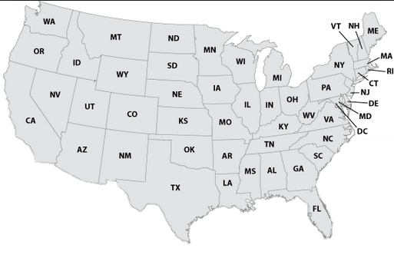
PFS Financing Projects in the U.S.
HI

Slide 16
PFS Financing Projects in the U.S.
LOCATION | FOCUS | TARGET OUTCOMES
New York City | Incarcerated Youth and Juvenile Justice | Reduction in rates of recidivism
Utah | Early Childhood Education | Reduction in need for SpEd or remedial education
New York State | Recidivism and Employment | Employment gains; Jail bed days avoided
Massachusetts | Juvenile Justice | Employment; Jail bed days avoided
Chicago | Early Childhood Education | Increase in school readiness & 3rd grade literacy; reduction in need for SpEd

Slide 17
PFS Financing Projects in the U.S.
LOCATION | FOCUS | TARGET OUTCOMES
Cuyahoga County, OH | Homelessness and Child Welfare | Reduction in out-of-home foster care placement
Massachusetts | Homelessness | Reduction in homelessness
Santa Clara County, CA | Homelessness | Reduction in homelessness with superutilizers
Denver | Homelessness | Increase housing stability and decrease jail bed days
South Carolina | Maternal and Child Health | Improve health & development of 1st time mothers and their children
Connecticut | Family Stability, Substance Abuse | Reduce substance abuse and out-of-home placements for children

Slide 18
An Example of PFS in Action – Chicago Parent Child Center

Slide 19
Expanding Chicago’s CPC through PFS
Evidenced-based high-quality preschool program
Evaluation data demonstrating positive outcomes for participants (low-income preschoolers)
Unmet need (not enough CPCs)
Strong economic model for investing in high-quality preschool

Slide 20
Investors
Investor | Seniority | Amount
Goldman Sachs Social Impact Fund | Senior | 7.5 million
Northern Trust | Senior | 5.5 million
Pritzker Foundation | Subordinate | 3.9 million
TOTAL |  | 16.9 million

Slide 21
PFS CPC Outcomes
Kindergarten readiness
Need for special education placement
Third grade literacy

Slide 22
Expanding Chicago’s CPC through PFS
An additional 2,618 low-income 4-year-olds over 4 years will participate in CPC
Safeguards in place to ensure children with disabilities are identified and receive services entitled to
Year 1 evaluation report recently released on first cohort
Results showed 59% of children met kindergarten readiness criteria.

Slide 23
Frequently Asked Questions

Slide 24
Frequently Asked Questions
Is Pay For Success an intervention?
No, it is an innovative contracting tool.
Is Pay For Success best at scaling proven programs or innovative, promising programs?
Both. Innovative, promising programs are more risky for investors but can provide government an opportunity to innovate and only pay if it works.

Slide 25
Frequently Asked Questions
Who determines the outcomes in a PFS project?
Typically the government (outcomes payor) brings the outcomes of interest to the PFS partnership. All partners discuss and agree to the outcomes.
Is this privatization?
No, most services are provided by non-profit service providers and public schools. And, government will pay for it if it works.

Slide 26
Frequently Asked Questions
Why should investors earn a return?
Typically, investors earn a modest return for taking the risk of performance and the extensive due diligence regarding the efficacy of the program or intervention.

Slide 27
PFS - Opportunities for Young Children with Disabilities
PFS projects focused on place-based systems of early childhood services
Ensure children with disabilities and the EI/ECSE supports and services are part of these conversations
PFS projects focused on expanding high-quality preschool
High Quality Preschool Programs are Inclusive! Opportunity to identify and serve children with disabilities and developmental delays earlier
Potential to expand Preschool Inclusion models - with a strong evidence-base

Slide 28
PFS - Safeguards for Children with Disabilities
Reduction in the need for later special education is an attractive “outcome” measure for EC PFS projects
Important that safeguards are in place to ensure children with disabilities are properly identified and receive special education and related services
Disability / special education community is an important stakeholder in EC PFS projects
Need to identify other outcome measures that capture the financial benefit of investing early!

Slide 29
Building Pay For Success Knowledge
Activities:
DaSy Pay For Success webpage
Webinar series
PFS Learning Community – kick-off at the Improving Data, Improving Outcomes Conference in Aug
If any interest, support handful of States to begin deep data dives

Slide 30
Proposed Webinar Topics
Input needed!
Myth busters
PFS in early childhood –examples, ideas, concerns
Discussion of potential ways PFS could be used in Part C/619
How to get started in PFS
Phases of PFS (idea conceptualization; feasibility; deal construction; implementation)
Different perspectives on PFS---funders, intermediaries, government entities

Slide 31
Contact information
Janis Dubno: Janis.Dubno@ed.gov
Jennifer Tschantz: Jennifer.Tschantz@ed.gov

Slide 32
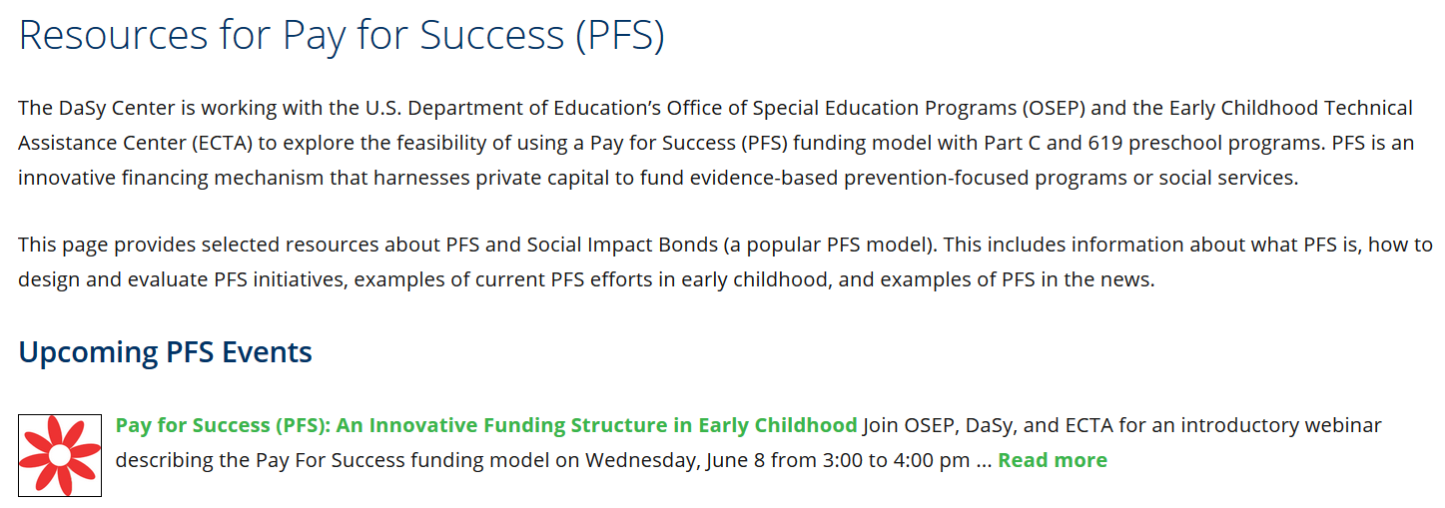
We have a new PFS page on DaSy website…
Visit the DaSy website at: http://dasycenter.org/
Like us on Facebook: https://www.facebook.com/dasycenter
Follow us on Twitter: @DaSyCenter

Slide 33
Please remember to fill out your evaluation forms

Slide 34
The contents of this tool and guidance were developed under grants from the U.S. Department of Education, #H326P120002 and #H373Z120002. However, those contents do not necessarily represent the policy of the U.S. Department of Education, and you should not assume endorsement by the Federal Government. Project Officers: Meredith Miceli, Richelle Davis, and Julia Martin Eile.

