Slide 1
Supporting Local Data Use for Program Improvement: Where are you now?
Abby Schachner
Kerry Belodoff
Tony Ruggiero
Improving Data, Improving Outcomes Conference
New Orleans, August 2016
Notes:
Abby

Slide 2
Purpose
Provide overview/refresher of local data use topical meetings
Facilitate informal sharing about activities and improvements underway to increase supports for supporting local data use
Identify desired follow-up supports
Notes:
Abby
This session is geared toward states that participated in one of the Supporting Local Data Use for Program Improvement Topical meetings, but is open to anyone interested in the bolstering data-driven decision-making at the local level. This session will facilitate informal sharing about the activities and improvements that have been made or are underway to increase supports for implementing a consistent approach and culture for local data use. Opportunities for cross-state collaboration will be identified.

Slide 3
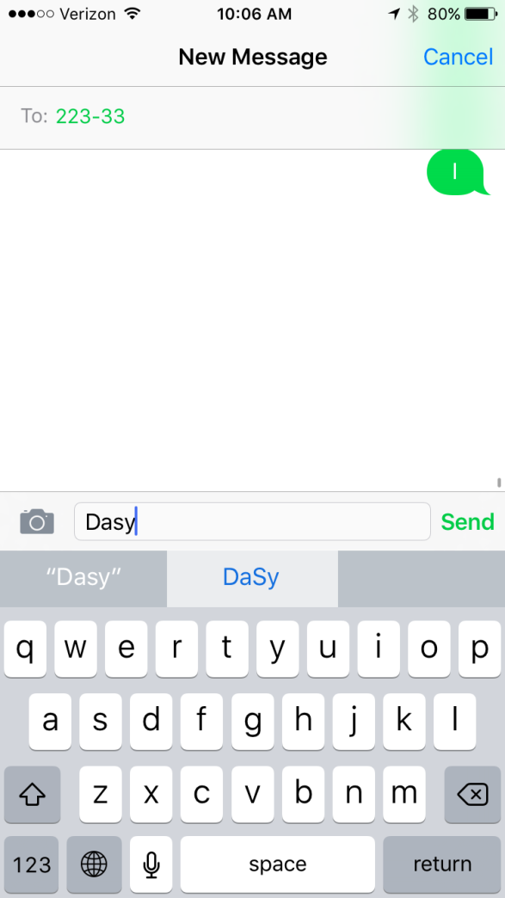
Participate in Polls
To participate in the poll:
1) Text DASY to 22333
Or
2) Log on to Pollev.com/dasy
Notes:
Abby

Slide 4
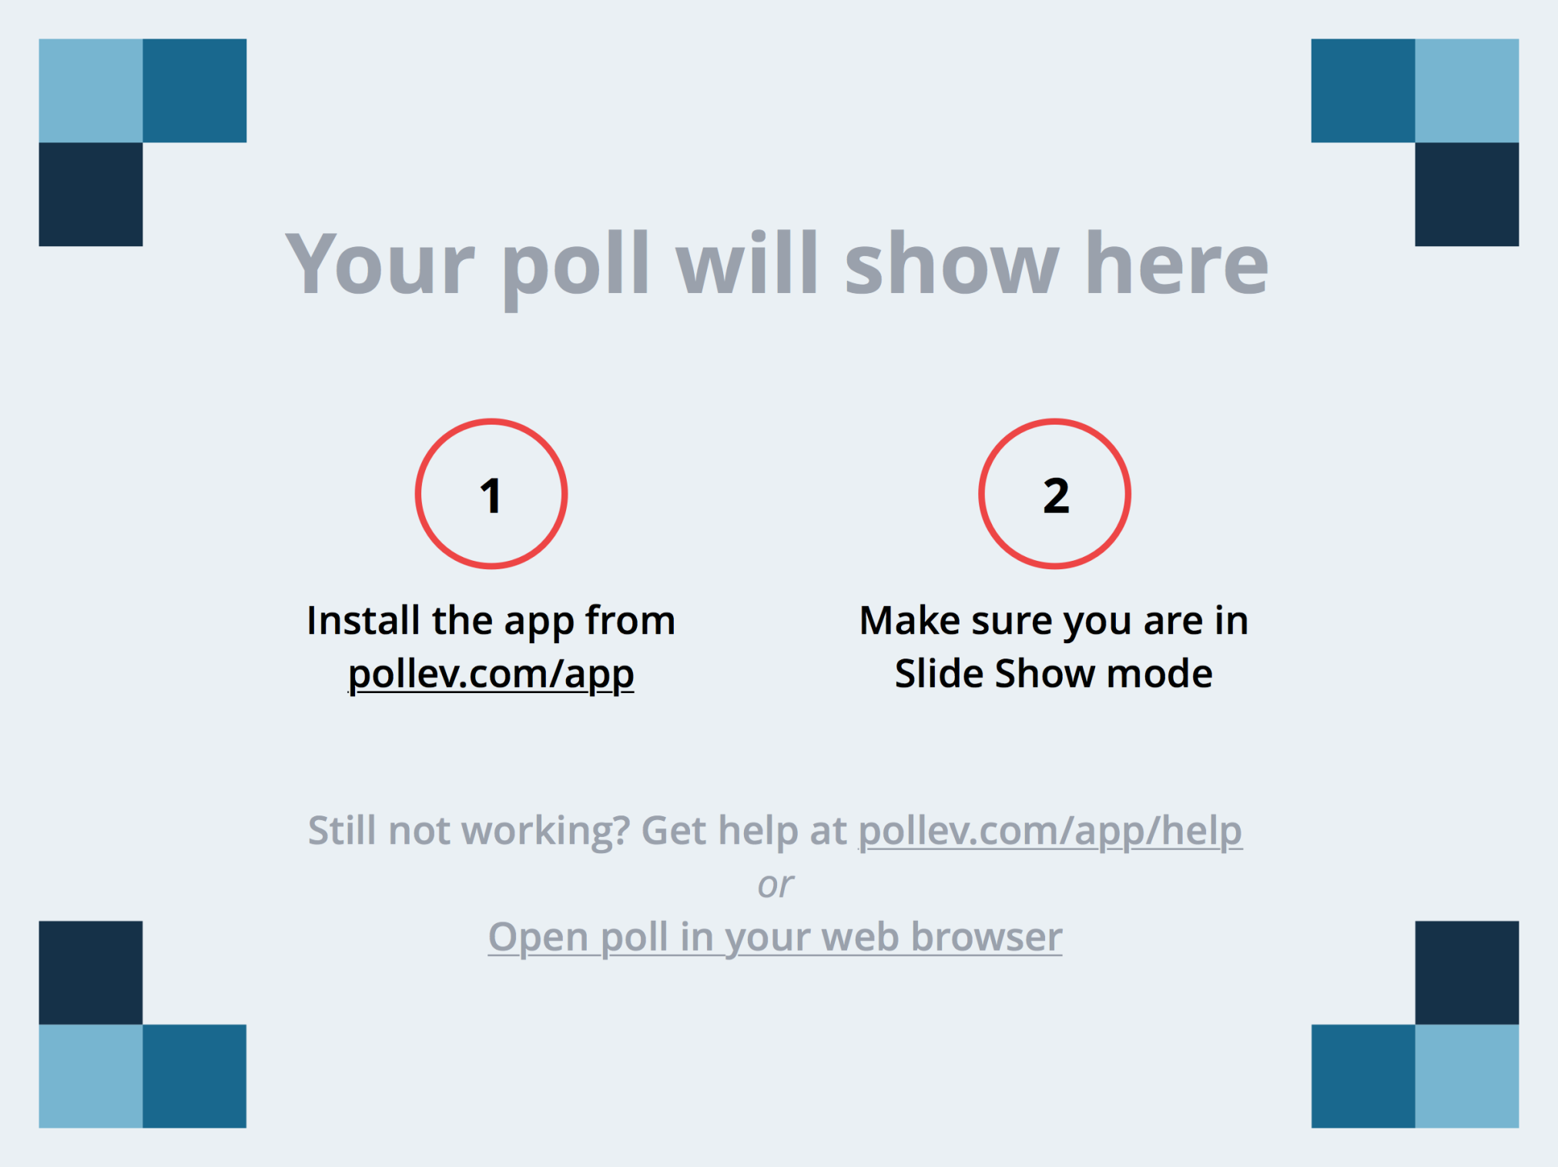
Notes:
Did you attend the Supporting Local Data Use Topical Meeting? https://www.polleverywhere.com/multiple_choice_polls/6GOO9tzo4tS1DNX

Slide 5
Supporting Local Data Use Topical Meeting
Structure
Presentations & overviews followed by hands-on activities
Facilitated state team work time
Sharing with large group, cross-state consultation
Topics
Process and approach for data-driven decision making
Creating a culture of data use
Resources and tools to support local data use and hands-on demonstration
Notes:
Abby

Slide 6
Data Use Theory of Action
Increased Child Outcomes
Data Use Theory of Action
Policy
Approach/
Model
Data-Driven
Actions
Sustained | Systematic | Child Centered
Practice
Settings
Quality
Capacity
Culture
© 2015 Public Consulting Group.
Notes:
Abby
This is a ToA we use to describe the necessary conditions for data use (on the bottom in blue) to make data driven actions (in purple) that lead to outcomes (in green).

Slide 7
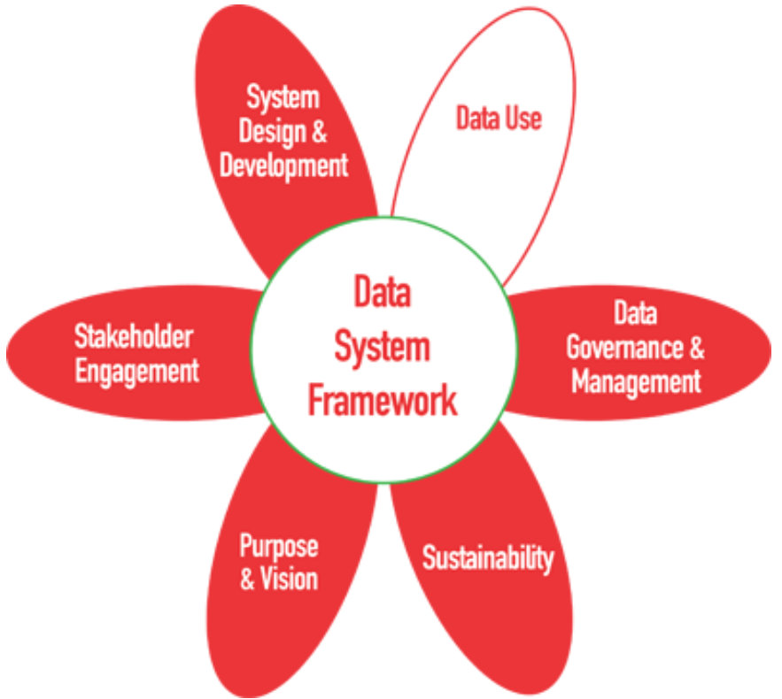
DaSy Framework for Data Use
Planning for data use
DU1. Plan for data analysis, product development, and dissemination to address the needs of the users
Analyzing and disseminating for data use
DU2. Conduct data analysis activities and implement procedures to ensure the integrity of the data
DU3. Prepare data products to promote understanding of the data and inform decision-making
DU4. Disseminate data products to users to meet their needs
Using and promoting capacity for data use
DU5. State and local staff use data to inform decisions
DU6. Support the use of data at state and local levels
http://dasycenter.org/resources/dasy-framework/data-use
Notes:
Abby
Let’s revisit the DaSy framework for data use
3 Main sections/areas and 6 indicators

Slide 8
A Data Leadership Model
Vision and Policy Management (DU1)
Create and articulate the vision for data use
Set and model expectations
Implement and uphold policies for data use in the district/region/program
Data
Management (DU2, 3)
Identify data to be collected
Manage data infrastructure and access
Design meaningful data displays
Inquiry, Analysis,
and Action (DU1, 4, 5 )
Select or develop models for inquiry and data use that will be used state-wide
Model the inquiry process publicly
Provide training and professional development to support district/regions, agencies, local administrators, local data teams, and providers/teachers in their use of data
Use data to identify professional development needs
Professional Development (DU6)
Monitor the progress of the district/region toward achieving its vision for data use
Establish the lines of communication necessary to share results and best practices
Monitoring and Communication (DU1-6)
Notes:
Abby
What matters is that people come into agreement in what the steps and the process is and what do we call those things.
For monitoring and communication, review and evaluation is the final element of each quality indicator– reviewing the effectiveness of the data displays, data use for accountability, and professional development

Slide 9
Culture:
the set of shared attitudes, values, goals, and practices that characterizes an institution or organization
http://www.merriam-webster.com/dictionary/culture
Notes:
Abby
What does it take to align attitudes, values, and goals in an organization?
How do we get people to faithfully implement practices, every time, every day?

Slide 10
Barriers to Data Use
Cultural Barriers
Technical Barriers
Political Barriers
Ingram, D. S. (2004). Accountability policies and teacher decision making: Barriers to the use of data to improve practice. Teachers College Record, 106(6), 1258–1287.
Notes:
Abby
New for those who participated in November 2015 meeting

Slide 11
Cultural Barriers
Many EI providers/teachers have developed their own personal metric for judging the effectiveness of their intervention/teaching and often this metric differs from the metrics of external parties (e.g., state accountability systems, program/district administrators, school boards).
Many EI providers/teachers and administrators base their decisions on experience, intuition, and anecdotal information (professional judgment) rather than on information that is collected systematically.
There is little agreement among stakeholders about which child outcomes are most important and what kinds of data are meaningful.
Some EI providers/teachers disassociate their own performance and that of children, which leads them to overlook useful data.
Ingram, D. S. (2004). Accountability policies and teacher decision making: Barriers to the use of data to improve practice. Teachers College Record, 106(6), 1258–1287.
Notes:
Abby

Slide 12
Technical Barriers
Data that EI providers/teachers want – about “really important outcomes” – are rarely available and are usually hard to measure.
Programs and schools rarely provide the time needed to collect and analyze data.
Ingram, D. S. (2004). Accountability policies and teacher decision making: Barriers to the use of data to improve practice. Teachers College Record, 106(6), 1258–1287.
Notes:
Abby

Slide 13
Political Barriers
Data have often been used politically, leading to mistrust of data and data avoidance.
Ingram, D. S. (2004). Accountability policies and teacher decision making: Barriers to the use of data to improve practice. Teachers College Record, 106(6), 1258–1287.
Notes:
Abby

Slide 14
How resources can help
Start with a critical question…
Identify Data Elements
CEDS Connect & Align
Clean & Prepare
Pattern Checking Tools
Explore & Analyze
Report & Share
Excel Pivot Tables
Report Templates
Data Visualization Guidance
Outlier Analysis Templates
Notes:
Kerry
Define what resources are– tools, templates, reports, techniques, guides, data products; Having these resources available and working with local staff to use them can help to build capacity for data use and promote ownership over the data.
Once you have the critical question you want to answer, there are resources that can help you in preparing, analyzing, using, and sharing your data.
The resources we are going to demo today can be created or used at the state or local level to facilitate data use. To guide your thinking, we have identified resources in four buckets. First, resources that help identify data elements needed for analysis, preparing the data through organizing or cleaning it, exploring trends, relationships, looking at subgroups, and then effectively reporting and sharing the data in user-friendly ways.

Slide 15
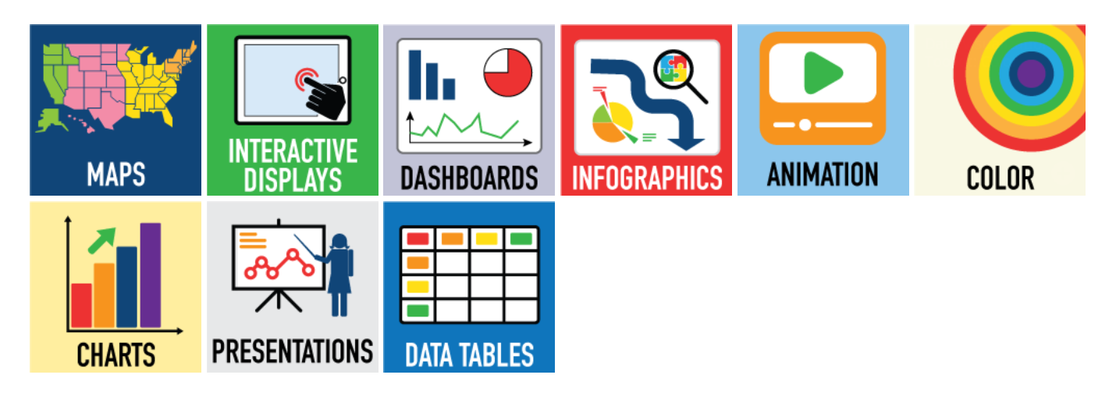
Need Data Display Templates & Ideas?
NEW! Use the DaSy-NCSI Data Visualization Toolkit
http://dasycenter.org/data-visualization-toolkit/
Notes:
Kerry
Demo Toolkit

Slide 16
Coming Soon!
Notes:
Kerry
This collection of three online learning objects, based on the content from the Supporting Local Data Use for Program Improvement topical meetings, is intended to assist State Part C/Part B 619 staff 1) gain knowledge about how to assist local program staff in building local capacity for using data for program improvement and 2) become better able to build local staff capacity for using data for program improvement by providing them with the materials, reports, and/or tools and professional development to do so and supporting their existing data use processes.
Plug for needing pilot testers

Slide 17
Discuss!
In small groups discuss:
What is your status/progress in identifying and implementing a consistent approach to data-driven decision-making?
What is your status/progress in building a culture of data use and addressing barriers?
What barriers are you breaking down? How is that going?
Additional professional development being provided around approach or culture?
Successes and lessons learned?
Notes:
Tony
Small group discussion 1 (15 min)
Share out (5 min.) – ask for volunteers from small groups to share highlights or key points
Priming VA C, PA C/619, IL 619 and MN C/619 to share

Slide 18
Discuss!
In small groups discuss:
What is your status/progress in developing or enhancing resources and tools to support:
Identifying data elements
Cleaning and preparing data
Exploring and analyzing data
Reporting and sharing data
Successes and lessons learned?
Notes:
Tony
Small group discussion 1 (15 min)
Share out (5 min.) – ask for volunteers from small groups to share highlights or key points

Slide 19
State to State Networking (Optional)
Which topics would you like to network with other states about?
Local data reports
Professional development materials and strategies
Data system functionality and capabilities
Part C and 619 linkages/partnerships in supporting data use
Another topic?
Notes:
Tony
OPTIONAL – Only if time
We have a poll everywhere set up on the next slide to get responses
Ask if there suggestions for another topic

Slide 20
Notes:
Which topics would you like to network with other states about? https://www.polleverywhere.com/multiple_choice_polls/Ru6vusB9FsYQXxz

Slide 21
Notes:
What TA supports or resources would be useful/helpful going forward? https://www.polleverywhere.com/free_text_polls/1GJixByPpeyXSvv

Slide 22
Wrap-Up
What TA supports or resources would be useful/helpful going forward?
What additional follow-up would be helpful to continue to make progress and implement ideas generated at meeting?
Volunteers for pilot testing collection of online learning objects?
Notes:
Abby

Slide 23
Resources & Tools
Know your theory of action
PCG White Paper –Theory of Action for data use culture http://www.publicconsultinggroup.com/education2/library/white_papers/EDU_Data%20Driven%20District_Practical%20Ideas_White_Paper_2013.pdf
Identify your critical questions
Critical questions for EI/ECSEhttp://dasycenter.org/critical-questions-about-early-intervention-and-early-childhood-special-education/
Identify your process for data-driven inquiry & decision-making
State Examples
Maryland TAP-IT model: http://marylandlearninglinks.org/277829
NJ SMART Ed Data System website: http://www.nj.gov/education/njsmart/
MA Dept. of Elem. & Secondary Ed. District Data Team Toolkit:http://www.mass.gov/edu/docs/ese/accountability/dart/district-data-inquiry.pdf
Notes:
Abby

Slide 24
Resources & Tools cont’d
Plan for data analysis
Guidance Table for Analyzing Child Outcomes for Program Improvement: http://ectacenter.org/eco/assets/pdfs/AnalyzingChildOutcomesData-GuidanceTable.pdf
Planning, Conducting & Documenting Data Analysis for Program Improvement: http://dasycenter.org/planning-conducting-and-documenting-data-analysis-for-program-improvement/
Notes:
Abby

Slide 25
Resources & Tools cont’d
Identify Data Elements
CEDS Connect & Align: http://www.ceds.ed.gov
Data Templates & Tools:
Outlier analysis template
Environmental settings data template
Child outcomes subgroup analysis template
Meaningful differences calculator
Explore & Analyze:
Coming soon! Excel pivot tables tutorials
Effectively Share Data:
Coming soon! Report templates
Data Visualization Toolkit: http://dasycenter.org/data-visualization-toolkit/
Notes:
Abby

Slide 26
Stay In Touch!
Email
abby.schachner@sri.com
kerry.belodoff@sri.com
robert.ruggiero@aemcorp.com
DaSy website: http://dasycenter.org/
ECTA website: http://ectacenter.org
Notes:
Abby

Slide 27
The contents of this tool and guidance were developed under grants from the U.S. Department of Education, #H326P120002 and #H373Z120002. However, those contents do not necessarily represent the policy of the U.S. Department of Education, and you should not assume endorsement by the Federal Government. Project Officers: Meredith Miceli, Richelle Davis, and Julia Martin Eile.

