Slide 1
Using Formative Assessment
To Evaluate Children’s Progress In Early Intervention and Early Childhood Special Education
Virginia Buysse, NCSI @ AIR
Alise Paillard, NCSI @ WestEd
Taletha Derrington, DaSy/NCSI @ SRI
Improving Data, Improving Outcomes
New Orleans, LA
August 15, 2016

Slide 2
Session Objectives
Identify four broad types of child assessment and the purpose of each
Describe how formative assessment can be used to monitor child progress and evaluate program improvement
Discuss current practices and key challenges that states face in using formative assessment

Slide 3

States have a growing need for high quality data to evaluate early childhood program improvement efforts

Slide 4

High quality child assessment data are a key component of program evaluation

Slide 5
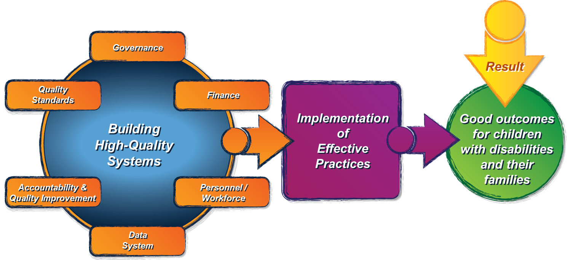
Child Assessment & the ECTA Framework
http://ectacenter.org/~pdfs/pubs/ecta-system_framework.pdf

Slide 6
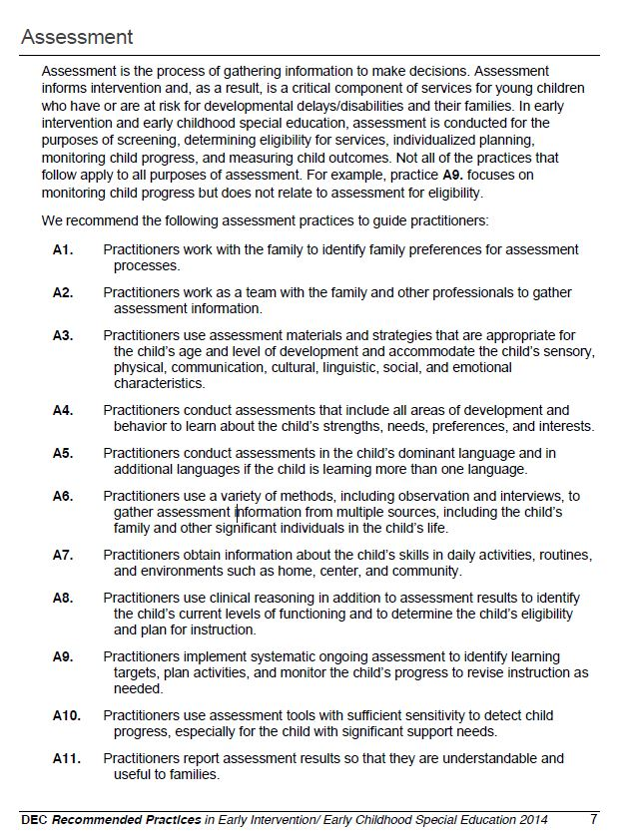
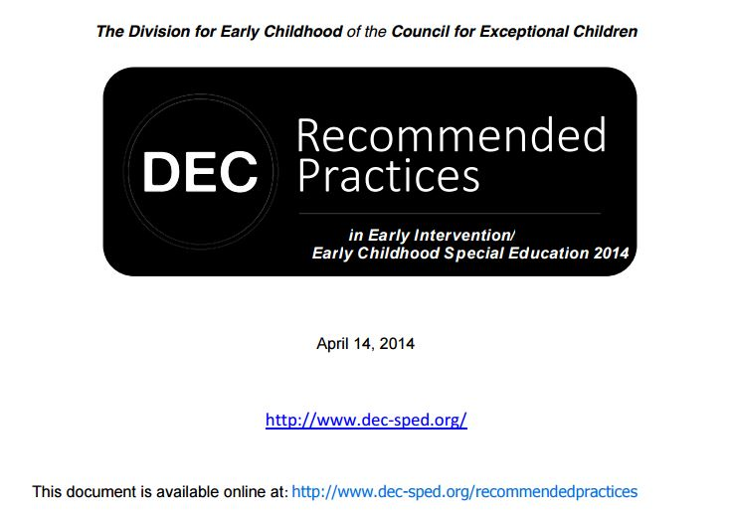
Child Assessment & DEC Recommended
Practices

Slide 7
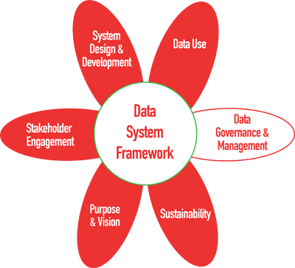
Child Assessment & the DaSy Framework
Section 2: Quality and Integrity: This section addresses policies to ensure validity, reliability, accuracy, consistency, and intended use of data. The section also focuses on the implementation of the monitoring and training procedures to ensure consistent application of data quality and integrity policies.
http://dasycenter.org/resources/dasy-framework/

Slide 8

Building Child
Assessment Systems
Across Four Broad Categories

Slide 9
Developmental Screening
Regular screening birth–8, followed by evaluation and diagnostic assessment if needed
Results communicated clearly to parents and used to make decisions about referrals and possible services
Cross-system collaboration and strategies for sharing
information
Information, resources, and PD to help early educators connect families to developmental screening services
9

Slide 10
Diagnostic Assessment
Used to identify significant concerns about children’s development
Multiple methods and sources
required, with special attention on family input
Eligibility decisions based in part on norm-referenced assessments that are age-appropriate and technically sound
Include accommodations to ensure assessments appropriately measure child’s knowledge and skills
10

Slide 11
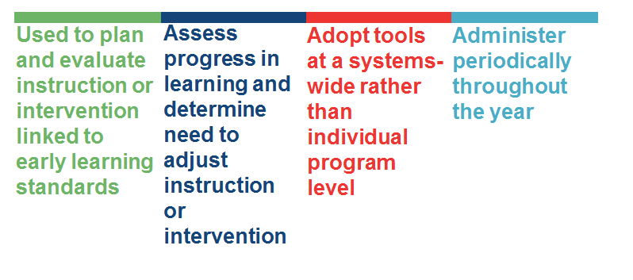
Formative Assessment
11

Slide 12
Child Outcome Assessment
Used most often to determine the effectiveness of the program
1
4
Selection of tools depends on purpose of the evaluation and child characteristics
Data aggregated at group rather than
individual child level
2
5
Used in conjunction with measures of program/classroom quality
Rely on direct assessments of child’s knowledge and skills based on structured observations and
individual assessments
3
12

Slide 13

What Challenges Do States Face in Building Statewide
Child Assessment Systems?
13

Slide 14

#1—Identifying valid, appropriate measures for young diverse learners
Infants and toddlers
Children from diverse linguistic or cultural groups
Children with learning or behavioral problems
Children with disabilities
14

Slide 15

#2—Confusion about terminology and the meaning of screening, formative assessment, and progress monitoring
15

Slide 16

#3—Confusion about which measures to use for different purposes and who should administer them
16

Slide 17

#4—Absence of professional development on how to administer and use assessments
17

Slide 18
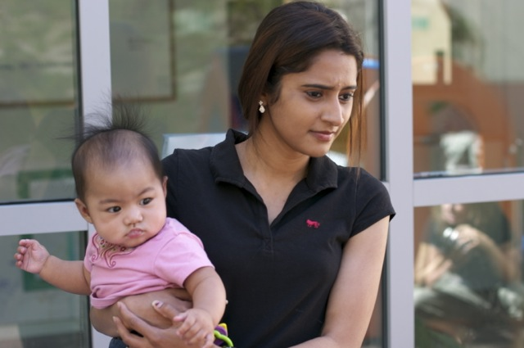
#5—Lack of guidance in how to engage families and others in assessment process
18

Slide 19

#6—Lack of time and limited capacity to administer and use formative assessment data at the individual child, program, and state levels
19

Slide 20
Explore the What and How of Formative Assessment for Monitoring the Progress of Individual Children and Groups of Children
TODAY’S PURPOSE
20

Slide 21

Expanding the traditional use of formative assessment to include program evaluation and SSIP
21

Slide 22
Formative assessment within SSIPs should…
Reflect the intended purpose
Be appropriate for use with diverse groups of children
Take into account the broader context in which the results will be used
Be adopted and used consistently across programs to provide a common metric for measuring progress in groups of children

Slide 23
Exemplar Formative Assessment Tools
Early Communicator Indicator (ECI), Juniper Gardens
Early Social Indicator (ESI), Juniper Gardens (under revision)
Preschool Early Literacy Indicators (PELI), Dynamic Measurement Group
Individual Growth and Development Indicators (IGDIs), www.myIGDIs.com
Circle Progress Monitoring System, Children’s Learning Institute

Slide 24
What child assessments are you using currently?
Which ones can be used to monitor progress?
In what areas? For what age groups?
24

Slide 25
Recommendations for States
1
Select an approach to formative assessment with input from key stakeholder groups
Early Childhood Special Ed Administrators
Early Intervention Administrators
Parents
Other ECE Representatives
Direct Service Providers / Teachers
Related Service Providers
25

Slide 26


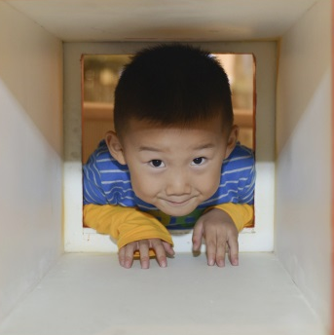
Recommendations for States
2
Support the use of formative assessment through professional development, resources, and ongoing supports
DLLs
Children with disabilities and other special needs
Children from diverse cultural and socio-economic groups
26

Slide 27





Recommendations for States
3
Create data systems for storing, managing, retrieving, analyzing, and sharing formative assessment data
27

Slide 28
Recommendations for States
4
Incorporate formative assessment into SSIPs as a way of measuring progress toward SIMRs
Parents
Teachers
Specialists
Administrators
28

Slide 29
What are your ideas about using formative assessment to monitor the progress of individual children and groups of children within SSIP?
29

Slide 30
For More Information
NCSI (http://ncsi.wested.org/ask-the-ncsi/ or http://ncsi.wested.org/)
  Contact your NCSI TA Facilitator or Cross-state Learning Collaborative Lead
  Contact Virginia Buysee (vbuysse@air.org) or Kristin Ruedel (kruedel@air.org), Lead for Data Use & Evaluation
  Follow NCSI on Twitter: @TheNCSI
DaSy (http://dasycenter.org/
  Contact your DaSy TA Liaison
  Follow DaSy on Twitter: @DaSyCenter
  Like DaSy on Facebook: https://www.facebook.com/dasycenter

Slide 31

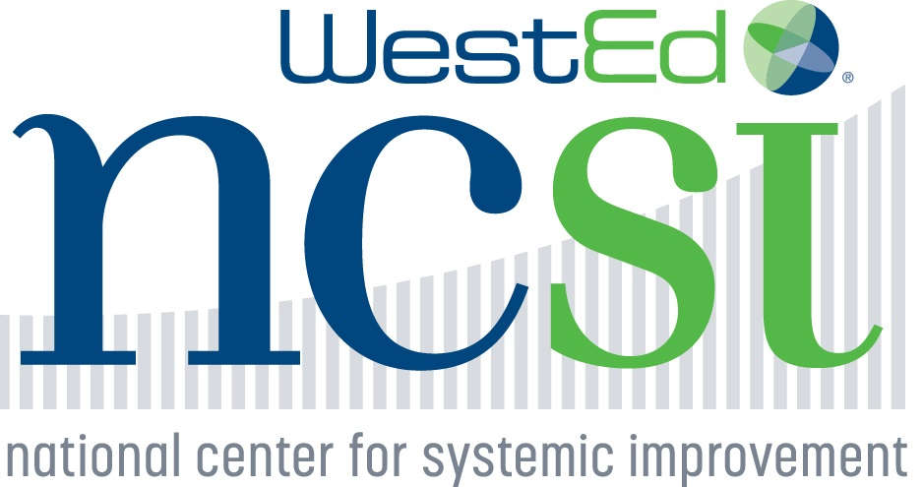




The contents of this presentation were developed under grants from the U.S. Department of Education, # H373Z120002 and H326R140006. However, those contents do not necessarily represent the policy of the U.S. Department of Education, and you should not assume endorsement by the Federal Government. DaSy Center Project Officers: Meredith Miceli and Richelle Davis. NCSI Project Officers: Perry Williams and Shedeh Hajghassemali.

