Slide 1
Is it Working? Evaluating Implementation of Evidence-Based Practices
Abby Schachner, DaSy, ECTA
Megan Vinh, ECTA, DaSy
Maureen Casey, AZ Part C (AzEIP)
Dana Romary & Ruth Chvojichek, WI Part C (WI Birthto3)
Improving Data, Improving Outcomes Conference
New Orleans, August 2016
Notes:
Abby
Introduce presenters
Who is in the room?

Slide 2
Purpose
Discuss existing resources and tools to help evaluate implementation of practices
Share concrete examples of how 2 states are working to gather information on implementation of practices
Facilitate sharing and discussion across states
Notes:
Abby
In this interactive session, participants will hear about and discuss feasible ways that states are evaluating implementation of evidence-based practices. Several concrete examples of different ways states are gathering and using data to evaluate implementation of practices will be shared such as practice profiles, coaching logs, DEC Recommended Practices Performance Checklists, fidelity measures, and state-developed tools.

Slide 3
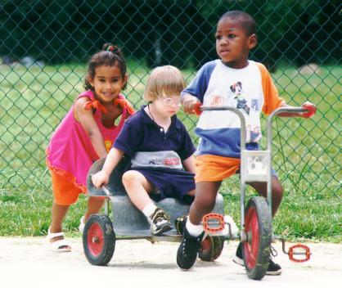
Format
Share information about measures/tools (20-30 min.)
State panel - real world examples (20-30 min.)
Large group discussion and questions (20-30 min.)
Notes:
Abby

Slide 4
Measuring Implementation
What are considerations for measuring implementation?
What are the practices we are trying to change?
Are we achieving our intended implementation changes/outcomes?
Are we making changes to those practices we are trying to change?
Are we moving along appropriately so that we can achieve our goals?
What can we do to make mid-course corrections if implementation is not going according to our plan?
Notes:
Abby

Slide 5
Different Types of Measures/Tools
Type of tool
Checklists, practice profiles, fidelity measures, logs
Source
Self-report vs. observation
Notes:
Abby
When thinking about the different type of measures and tools available or that you could adapt or develop, there are two main features to consider
The type of tool – that is the format the data will be collected in
And
The source
Who will be collecting and reporting the data? Self-report or a third party observing? (document review also possible, but less likely for measuring practices)

Slide 6
DEC Recommended Practices Checklists
May be useful for evaluating if the changes are happening to practices
Could align DEP RPs with specific interventions or practices
Could select DEC RPs to focus on with practitioners (see practice guides) and then use the performance checklists to assess implementation
Performance Checklists are intended for practitioners (and leaders where noted) to increase their understanding and use of the DEC Recommended Practices and for self-evaluation of one's use of the practices.
The Checklists are organized by DEC Recommended Practices topics:
Leadership
Assessment
Environment
Family
Instruction
Interaction
Teaming and Collaboration
Transition
Notes:
Megan
Could put into online form or survey to collect data

Slide 7
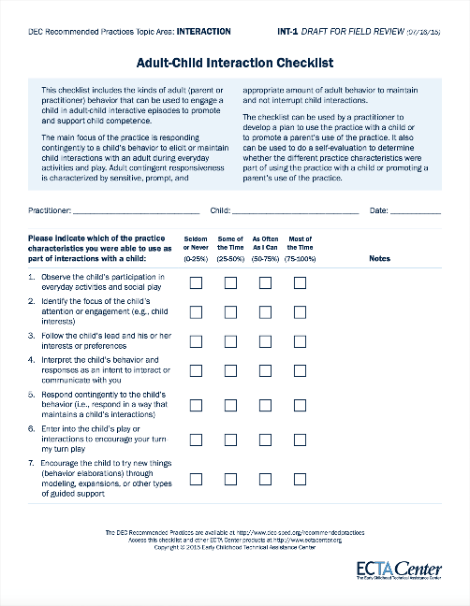
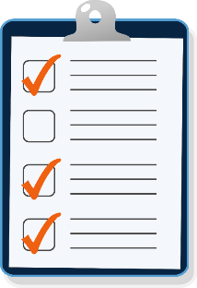
Example of a Performance Checklist
Each checklist is formatted in the same way for consistency across topic areas
Notes:
Megan
The Performance Checklists were developed following an analysis of the features and elements of the DEC RPs.
Each checklist is formatted in the same way.
They are purposely limited to one page for usability and acceptance by practitioners as “easy and quick.”
This example shows one of the 4 Interaction topic checklists, and you have samples of all 30 of the Checklists across all of the topics at your table.

Slide 8
ECTA DEC RP Practice Guides
May be useful for training, observation and coaching
Practice Guides for Practitioners
Intended primarily for practitioners working in group settings and for sharing with other practitioners in community programs (see Elements of Practice Guides).
http://ectacenter.org/decrp/type-pgpractitioner.asp
Practice Guides for Families
Intended for practitioners to share with families (see Elements of Practice Guides).
http://ectacenter.org/decrp/type-pgfamily.asp
Notes:
Megan

Slide 9
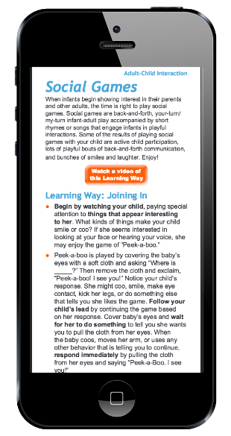
Practice Guide
Description of the Practice
Video example of the Practice
Performing the Practice
Illustrative vignette
Recognizing success
Notes:
Megan
We developed Practice Guides using the performance checklist indicators as the foundations for practice guide content.
This is an example of what a practice guide looks like.
Each practice guide is formatted in the same way and includes:
Description of the practice
Ideas for using the practice
Video examples of the practice
an Illustrative vignette, and
How to know if the practice is working.
They are designed for use on mobile devices so that the embedded videos and links to other resources are available.
There are Practice Guides for families and practitioners related to each Checklist.
[Add comments here about how practitioners can use/share Practice Guides with families.]

Slide 10
RP² Resources - Benchmarks of Quality: Program-Wide
Notes:
Megan

Slide 11
RP² - Benchmarks for Critical Elements
Leadership Team
Staff Readiness and Buy-In
Family Engagement
Program-Wide Action Plan
All Classrooms or All Home Visitors demonstrate….
Procedures for Responding to Individual Children (Classroom Tool only)
Staff Capacity Building and Support
Monitoring Implementation and Outcomes
Can be used for all RP or a focused set of RPs; Might be modified to capture other critical elements
Notes:
Megan

Slide 12
Reaching Potentials through Recommended Practices Observation Scale
Notes:
Megan

Slide 13
RP² - Observation Scale (OS) Tools
Scored by observation and interview – “ Use all the information you know”
Scaled by number of indicators and fluency/density of use
Indicators cross-walk with ECTA RP checklists
Used by coaches to:
Identify strengths and PD needs
Show change in practice implementation
Summarized across practitioners and for each practitioner
Format offers a viable exemplar for creating a tool to identify PD needs and track change in practices
Notes:
Megan

Slide 14
Practice Profiles
Practice profiles are a tool for operationalizing a strategy or practice so that it is clear what practitioners will do as they carry out the intervention or practices
Developed through systemic review, stakeholder vetting and consensus, and testing and evolving the profile
Goal of practice profiles:
Identify the intervention or practices principles that guide successful work with children and families, and
Identify the specific activities that bring these principles to life
VIDEO: https://unc-fpg-cdi.adobeconnect.com/_a992899727/ai-lesson3-p1/
Notes:
Abby

Slide 15
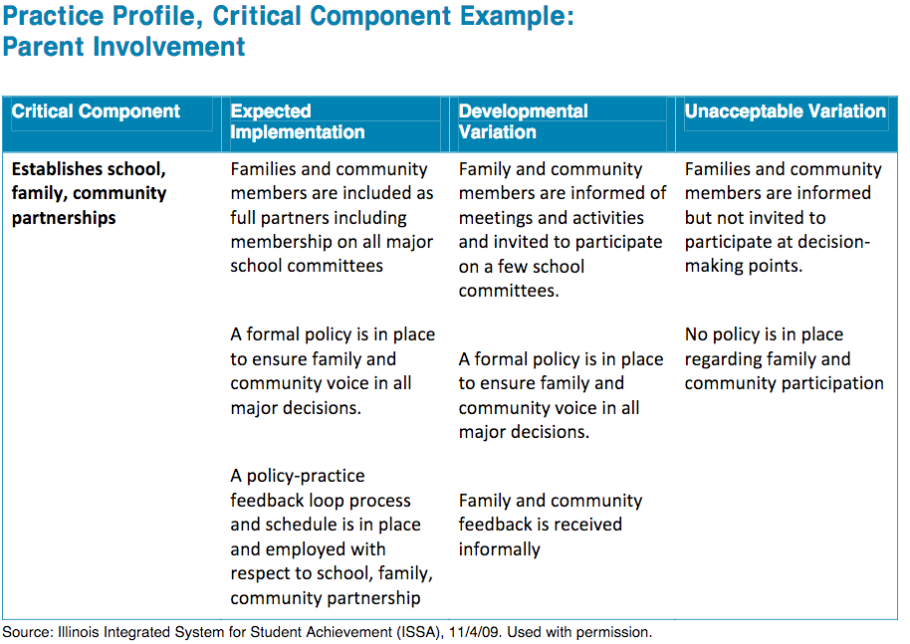
Practice Profiles (cont’d)
Provide operationalized practice model for consistent implementation of intervention or practice
Facilitate development of training protocols, coaching strategies and other assessments
Refine infrastructure and systems supports needed to be installed to facilitate consistency across practitioners
Clarify “what” is being implemented
Use to develop fidelity/implementation checklists
The AI HUB has modules and worksheets for developing practice profiles!
http://implementation.fpg.unc.edu/resources/lesson-3-practice-profiles
Notes:
Abby
Plug Post-conference workshop activity on testing out developing a practice profile

Slide 16
Fidelity Assessments
Refer to measuring the degree to which teachers or staff are able to use the intervention or practices as intended.
Ensure success is repeatable.
Three critical features of fidelity assessments are:
Context – pre-requisite conditions that need to be in place regarding setting, qualifications and preparation
Content – extent to which the required core content is used, referenced, monitored or accessed by the teacher in his or her work and/or activity
Competence – extent to which the core content and competencies are skillfully modeled, relevant feedback is provided, and sensitively reviewed
http://implementation.fpg.unc.edu/module-7/active-implementation-frameworks/fidelity-assessment-and-implementation http://implementation.fpg.unc.edu/module-7/summary
Notes:
Abby
The definition requires:
Identifying what is intended, and
Identifying the extent to which a practitioner has done that

Slide 17
Fidelity Assessments (cont’d)
Evidence-based practice models and curricula often come with already developed and validated fidelity assessments
But if not…
The AI HUB has worksheets to develop your own!
Designing a Fidelity Assessment
Developing a Fidelity Assessment
Notes:
Abby

Slide 18
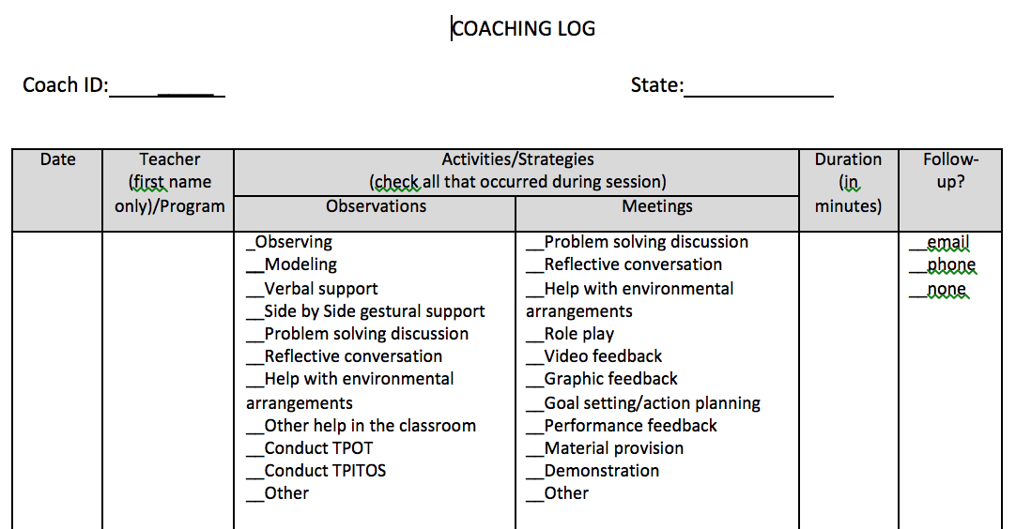
Coaching Logs
Way to keep track of coaching
Who has received coaching
Dosage: frequency and duration of coaching
Content: Topics, practices or issues covered, feedback provided, action items
Coaching Strategies used
Looking for a template?
TACSEI has editable, generic coaching log template!
And more coaching tools: http://challengingbehavior.fmhi.usf.edu/communities/coaches_main.html
Notes:
Abby
And can see if coaching being delivered as expected or aligned to desired approach and emphasis

Slide 19
State Panel
What is one example of the way you are or planning to measure practices?
What type of measure/tool are you using?
How are/did you identify or develop the measure/tool?
How is that going?
How is the measure/tool being used currently or what is your vision for how the tool might be used in the future?
What are lessons learned from the process?
Notes:
Abby
Introduce and facilitate state panel

Slide 20
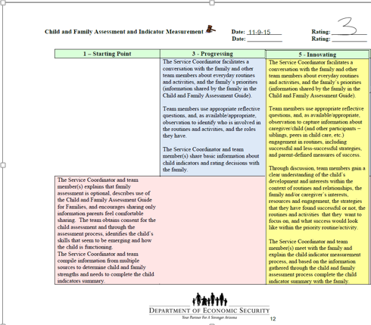
Arizona Fidelity Checklist
https://des.az.gov/sites/default/files/az_fidelity_checklist_10_07_2013.pdf
Notes:
Discuss how we have the AzEIP Fidelity Checklist and our fidelity measures for coaching, the differences we have observed between self-appraisals and observation by trained Master Coaches, and how we are collecting data on both, and then how we intend to utilize the DEC RPs to continue to ramp up fidelity/improve practices.

Slide 21
AZ: Self-Assessment vs. Observation
Self-appraisals pre- and post- training or technical assistance
Observations by trained Coaches

Slide 22
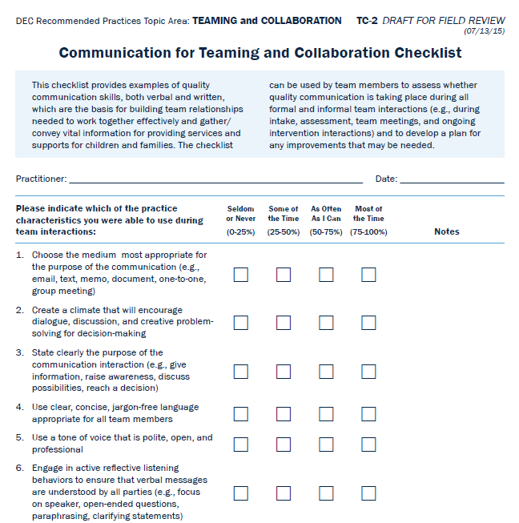
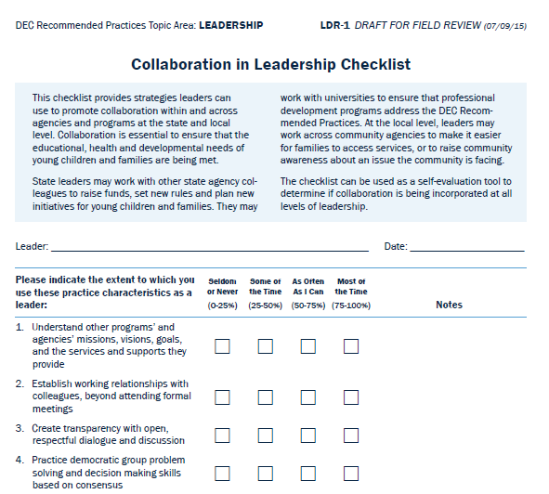
AZ: Using DEC RP Performance Checklists
Using existing checklists to support ongoing Technical Assistance and training
As well as, data collection and analysis

Slide 23
WI Birth to 3 program
Notes:
Had programs complete action plans

Slide 24
WI Birth to 3 program
Notes:
As part of the practice profile development, identified the key characteristics of the child outcomes summary process

Slide 25
WI Birth to 3 program

Slide 26
WI Birth to 3 program

Slide 27
WI Birth to 3 program

Slide 28
Discussion
Questions or reactions?
How are you currently or planning to measure and gather information about implementation of practices?
What has been rewarding and successful about the process?
What barriers are you experiencing?
Notes:
Abby

Slide 29
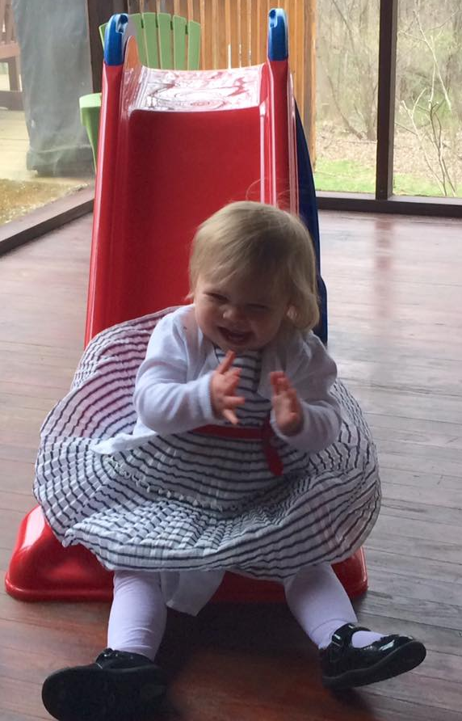
Stay In Touch!
Abby Schachner: abby.schachner@sri.com
Megan Vinh: megan.vinh@unc.edu
DaSy website: http://dasycenter.org/
Facebook: https://www.facebook.com/dasycenter
Twitter: @DaSyCenter
ECTA website: http://ectacenter.org
Facebook: https://www.facebook.com/ectacenter
Twitter: @ECTACenter
Notes:
Abby

Slide 30
The contents of this tool and guidance were developed under grants from the U.S. Department of Education, #H326P120002 and #H373Z120002. However, those contents do not necessarily represent the policy of the U.S. Department of Education, and you should not assume endorsement by the Federal Government. Project Officers: Meredith Miceli, Richelle Davis, and Julia Martin Eile.

